Slide 1





Management Module
Introduction to One Health and Drivers of disease Emergence
PowerPoint 1

Slide 2
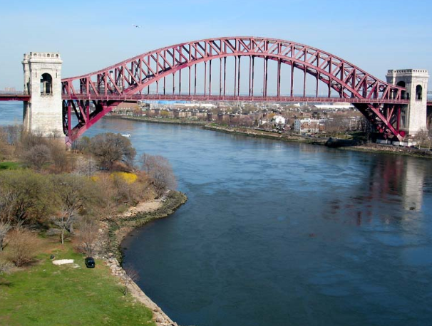
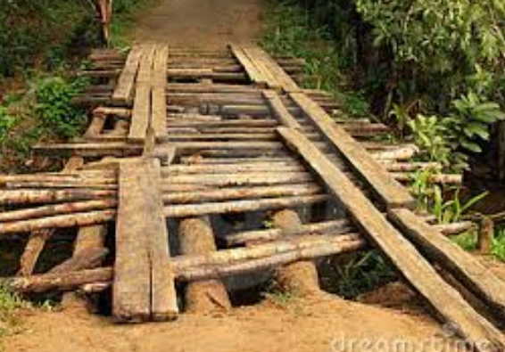
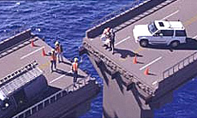

Building bridges
People understand bridges – they get you where you’re going, erase divides and create connections.

Slide 3


We need an integrated approach?

Slide 4
Emerging infectious diseases
Jones, et al Global Trends in Emerging Infectious Diseases
  On the rise – 335 (1940-2004)
  60.3% are zoonotic
    71.8% from wildlife
Wolfe et al. Origins of Major Human Infectious Diseases
  New evidence on origins of human malaria

Slide 5

Emerging Diseases
Not just humans….
Avian Influenza H5N1
  475 humans : how many birds?
BSE & Chronic Wasting Disease
Tuberculosis in wildlife reservoirs
Chytridiomycosis in amphibians
Morbillivirus in marine mammals
White-Nose Syndrome in bats

Slide 6
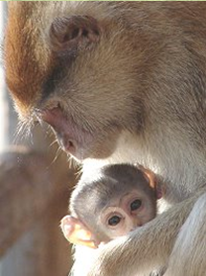
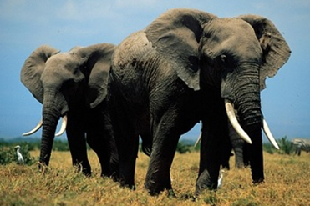
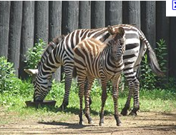
Shrinking habitats

Slide 7
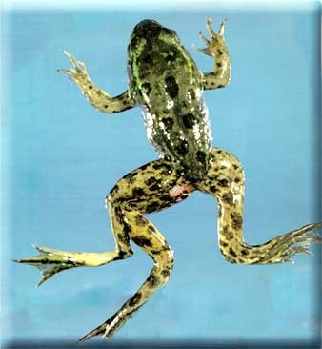
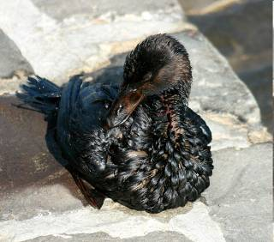
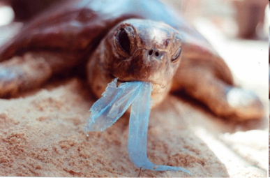
Pollution

Slide 8
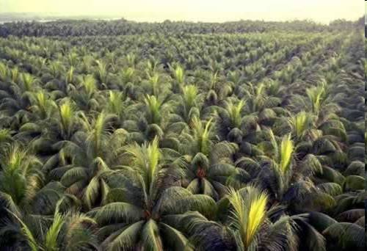
Loss of biodiversity

Slide 9
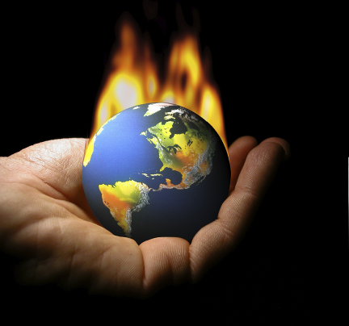
Climate change: changes in environment and Land use

Slide 10
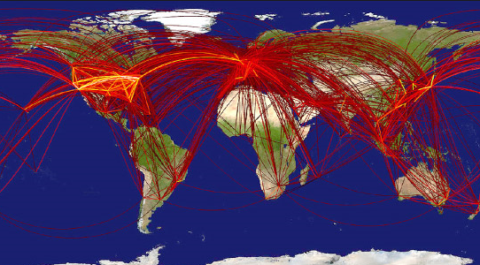
Globalization and travel

Slide 11
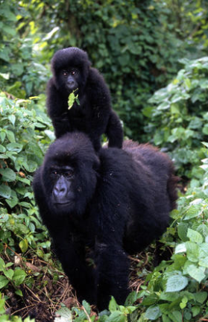
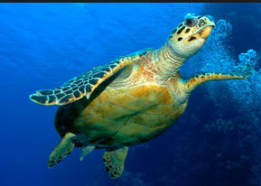
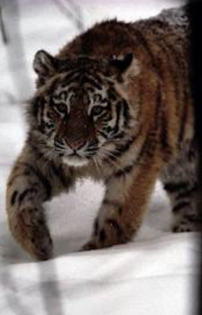

Global trade of wildlife

Slide 12
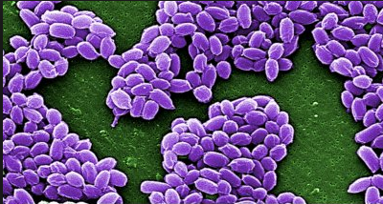
Bio-Terrorism as part of the threat

Slide 13
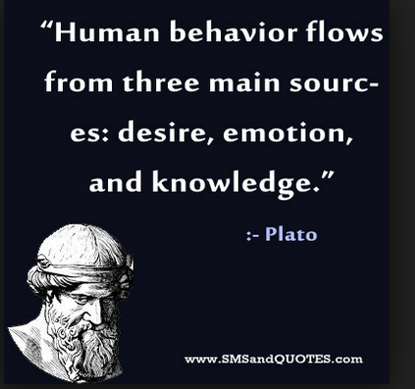
Human behavior
Sexually transmitted diseases
increased three fold when minimum
age for teenagers having sex dropped.
The development of complacent
attitudes and lack of basic knowledge
about risks have led to re-emergence of
Syphilis in the UK.
Sharing of blood contaminated
needles by drug users has led to
spread of hepatitis B and C.
Increased popularity of body piercings and tattoos provides an opportunity for the spread of blood borne viruses.

Slide 14
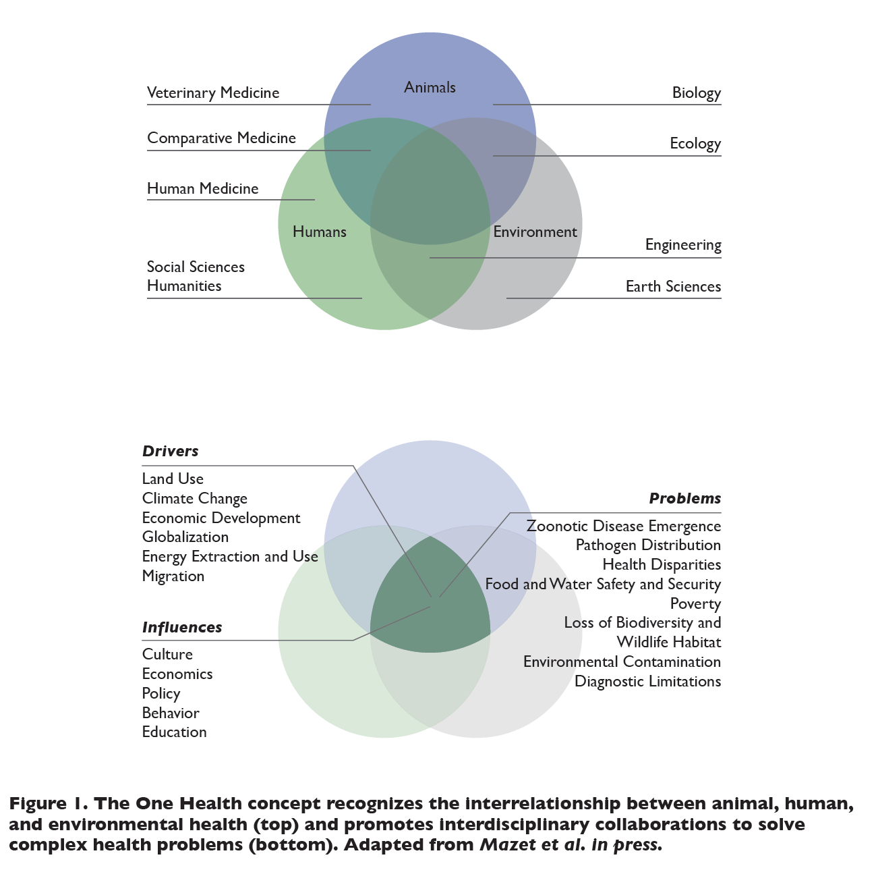

Slide 15


Why?
Prevent and Respond to disease outbreaks
Reduce risk of infectious diseases outbreak
Recognize and Identify zoonoses
ONE world: ONE health

Slide 16
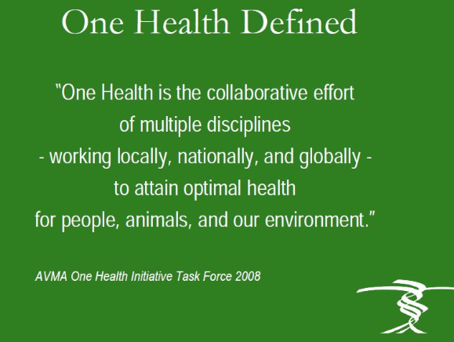

Slide 17

One Health
An interdisciplinary strategy to address health from an integrated perspective rather than a discipline-based fragmented perspective ….
Is not a discipline, it is an approach.

Slide 18
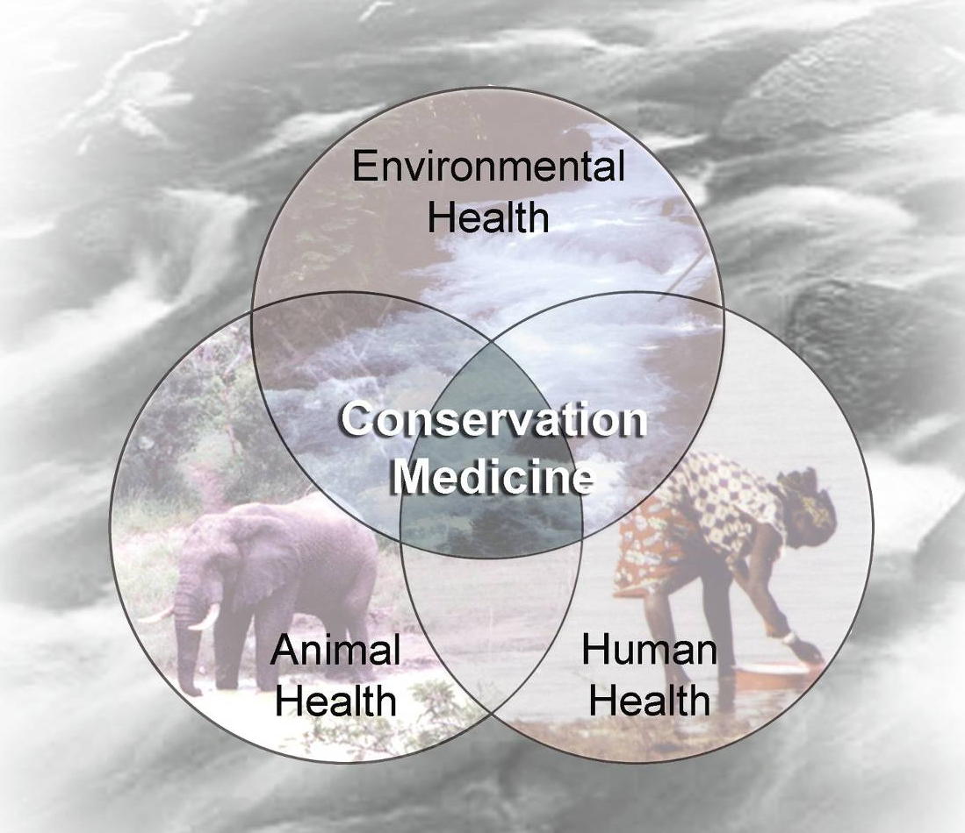
One Health

Slide 19
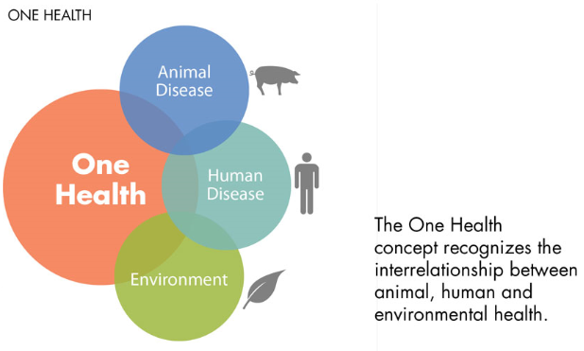


Slide 20
One Health
Human, livestock or wildlife health cannot be discussed in isolation anymore.
Public health depends on a clean environment: Hippocrates.
Objective of One Health approach is to create stronger, more efficient, integrated health systems with input from multiple stakeholders in addressing global health issues

Slide 21
Scope of One Health
Combating existing and emerging diseases and zoonosis, biomedical research and clinical medicine, conservation medicine, diagnosis, surveillance, control, response and recovery directed at natural and or intentional threats that are chemical, toxicological or radiological in nature, ethics, entomology food safety and security, global food and water systems, global trade and commerce, health of the environment and environmental conservation, implications of climate change, infectious disease ecology and integrated systems for disease detection, land use production systems and practice, mental and occupational health, public health , awareness and communication, support of biodiversity, wildlife promotion and conservation

Slide 22
Principles of One Health
Use of holistic systems approach in the management of health challenges
- Multidisciplinary and/or inter-sectoral collaboration
- Sharing of resources: technical, information, structural, human, etc.
- Promotion of transparent communication and sharing of information between stakeholders
- Cooperation between the public and private sectors
- Unified and cooperative capacity building within the health sector.

Slide 23


Major challenges
Transform systems and professions to respond more efficiently and sustainably to disease prevention and control requirements?
Work with industries currently active in locations where animal-human-environment interface is a daily reality
Enable disciplines to work together

Slide 24

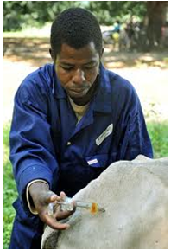
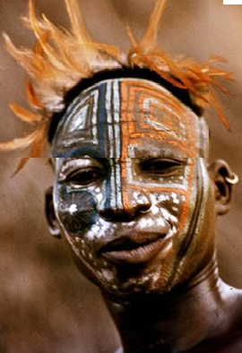
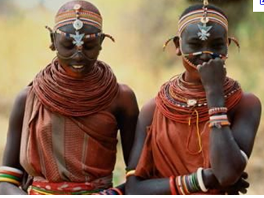

Barriers
History
Professional biases
Policies
Jurisdiction
Resources
Culture
Inertia
- Organizational
- Surveillance skills

Slide 25
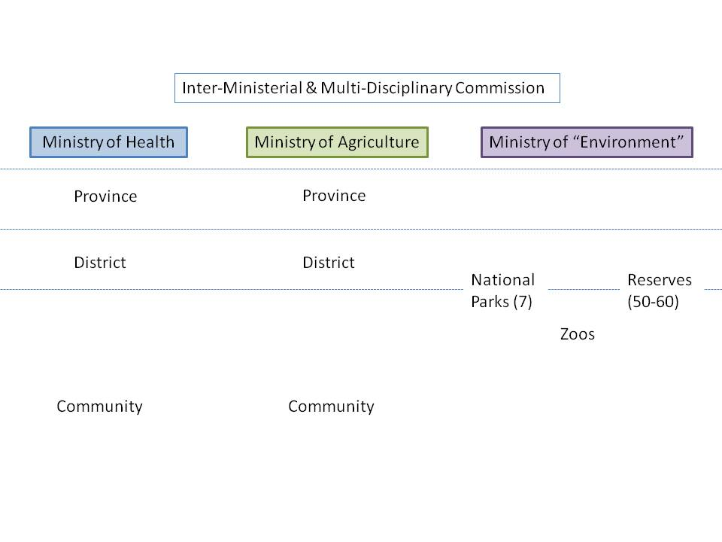
Thanks to H5N1
Management silos
One way flow of information
Limited feedback
Limited lateral flow
Notes:
“environment”

Slide 26
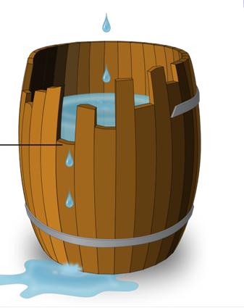
Unequal human resource capacity …
… lack of front line responders from all health professions

Slide 27
Leveling interdisciplinary understanding
Understanding limitations of own discipline
Developing a common language
Identifying gaps in past approaches to the problem

Slide 28


Each One Health professional is well-trained for their roles, mandated and appropriately equipped
Professions have improved skills to work collaboratively with each other
Health systems benefit from One Health efficiencies

Slide 29



