Slide 1
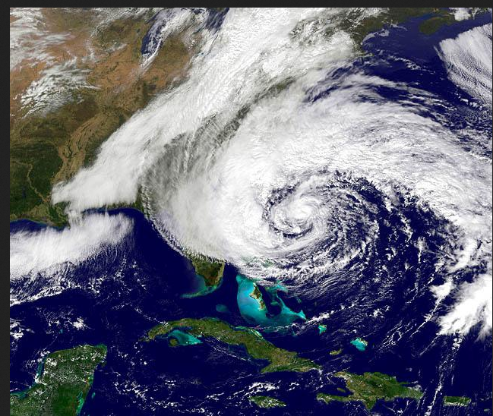
Did Climate Change Cause…?
Professor Bill Moomaw. PowerPoint No.11

Slide 2
The question, “Did climate change cause …?” is asked whenever an unusual weather event occurs
Scientists often answer
“No single event can be caused by climate change”
I, Bill Moomaw, have often given this “safe” answer:

Slide 3
Wrong question and wrong answer!
Climate change does not cause anything.
“Change” is a noun and not a verb.
Climate change is the result of changes in the climate system.

Slide 4
A better question
Did a weather event happen in a human changed climate system?
Did this type of event happen with increasing frequency?
Then it may well be a result of a changed climate!

Slide 5
To answer what changed and why, we need to understand …
What is weather?
What is climate?
What is the climate system?
What is climate change?

Slide 6
What is weather?
Weather is what we observe each day:
Instantaneous temperature and precipitation
Average annual temperature and precipitation
Variability and seasonality of temperature and precipitation
Wind velocity and storm frequency
Average and variability of humidity and drought

Slide 7
What is climate?
Climate is “the statistical description in terms of the mean and variability of relevant quantities over a period of time”.
It is measured by the 30 year average of weather metrics such as temperature and precipitation.
Source – World Meteorological Organization

Slide 8
What is the climate system?
It is a set of components that together determine the global and local climate
Sun
Atmospheric composition and its transparency to light and heat
Clouds and ability to reflect sunlight and absorb radiant heat
Land and its reflectivity
Biosphere (plants) absorption and emission of heat trapping gases
Oceans and ability to absorb heat trapping gases
Cryosphere (ice and snow) and its ability to reflect sunlight

Slide 9
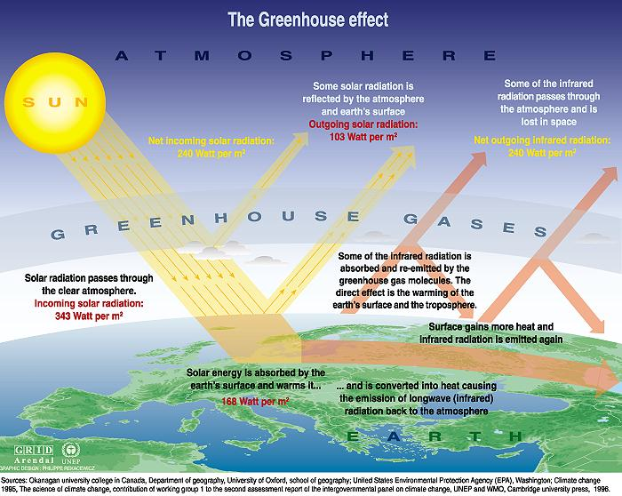

Slide 10
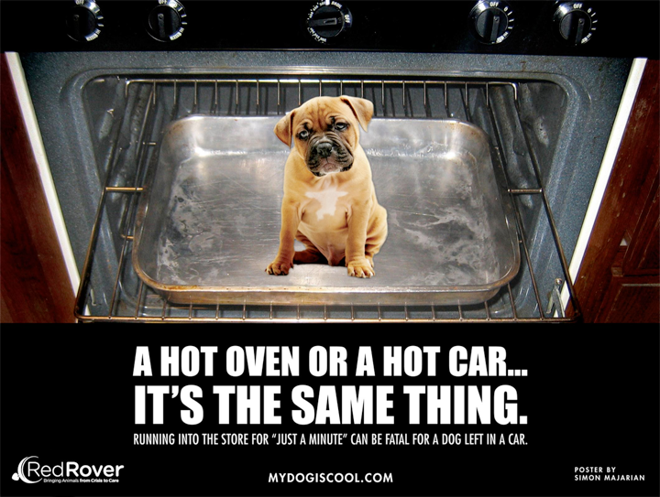
The “hot car effect”

Slide 11
Current Heat Balance of the Earth

Slide 12
Father of Climate Change Science
Notes:
Benton Hall, Oregon State University, circa 1900

Slide 13
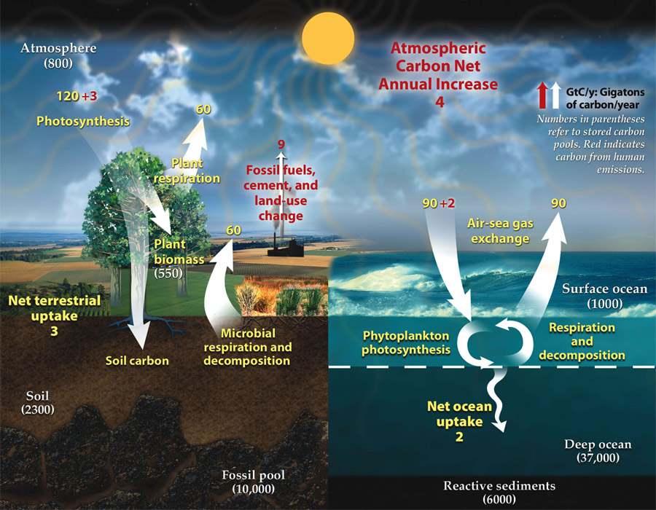

Slide 14
So let us look at changes to the climate system
The sun’s intensity has not changed much.
Human activity has altered the composition of the atmosphere a lot.
Land reflectivity has been altered by land use changes.
Deforestation and degradation of grasslands and soils has released a lot of carbon dioxide into the atmosphere.
Oceans are more acidic and the seas are warmer and rising.
Ice and snow cover have decreased allowing the Arctic to absorb more of the sun’s energy.

Slide 15
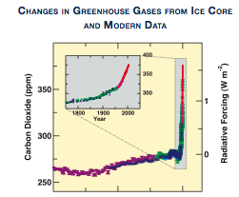
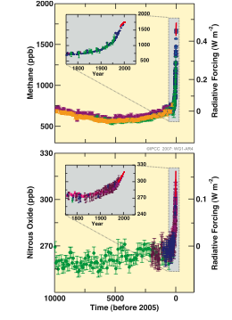
IPCC AR5 2013
Build up of Heat
Trapping Gases in
atmosphere during
Past 10,000 years

Slide 16
Did humans alter something that caused…
An increase in global temperatures?
An increase in melting of Greenland and glaciers?
An increase in sea level rise?
An increase in melting of Arctic sea ice?

Slide 17
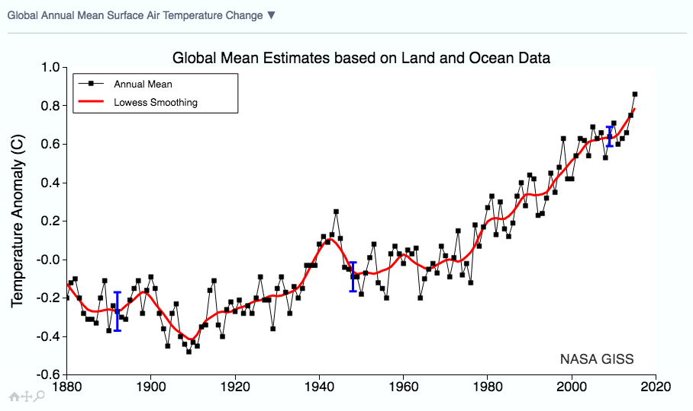

Slide 18
See the thermometer record of land and ocean temperatures since 1880
Each dot represents the global average temperature based on thousands of sites reporting in the mean of the high and low temperature of the day.
A 5 year running average is shown in red.
Note that if one uses a 30 year average temperature to define the climate, that it would be rising.
But it is a lagging indicator because one year 30 years ago counts equally with the most recent year.

Slide 19
https://www.youtube.com/watch?v=A2IxZvAW_WI

Slide 21
2015 is the warmest year on record
2015 rose above the 2014 previous record boosted by El Nino warming.
“The year 2015 was the warmest year across global land and ocean surfaces since records began in 1880.
This also marks the 39th consecutive year (since 1977) that the yearly global temperature was above average.
Including 2014, 15 of the 16 warmest years in the 136-year period of record have occurred in the 21st century. 1998 currently ranks as the fourth warmest year on record.”

Slide 22
Consecutive warmest years
2015 is the 38th consecutive year that is warmer than the average year for 20th century
Every month for the past 30 years has exceeded the average for that month in the 20th century
NOAA

Slide 23
Did humans alter something that caused…
An increase in global temperatures?
An increase in melting of Greenland and glaciers?
An increase in sea level rise?
An increase in melting of Arctic sea ice?
An increase in ocean acidification?

Slide 27
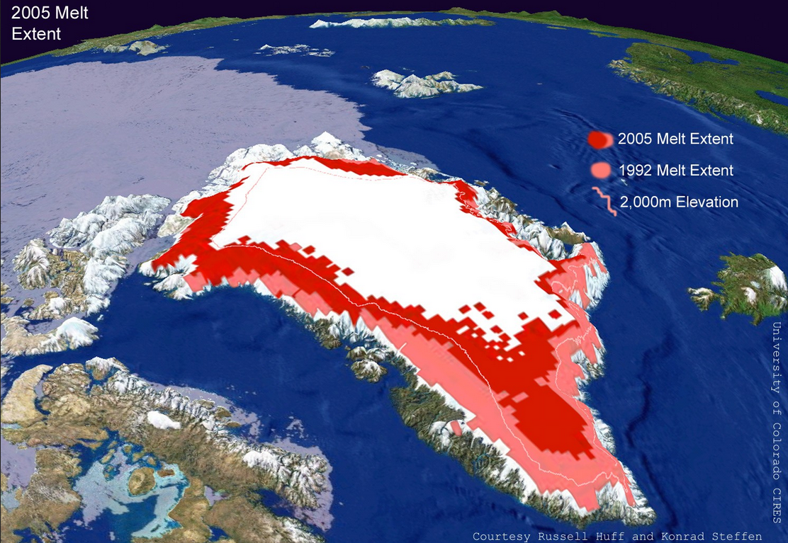

Slide 28
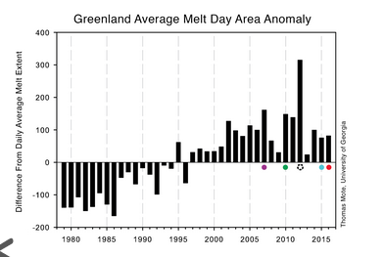
If all of Greenland melts, it will raise sea level by 7 meters or 21 feet
If all of Antarctica melts, it swill raise sea level by 60meters or 200 feet

Slide 29
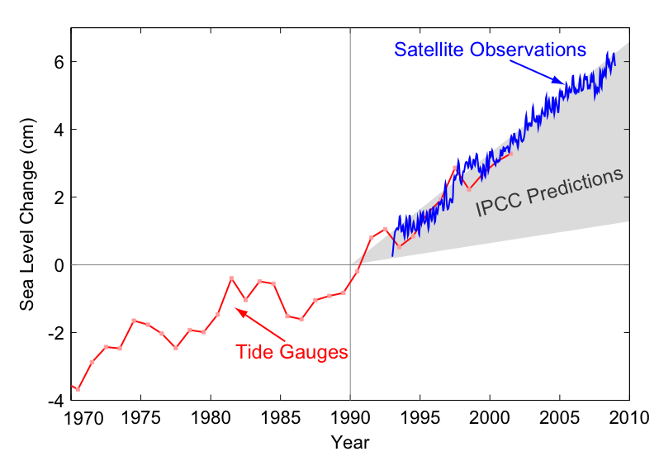
Sea-level change 1970-2010

Slide 30
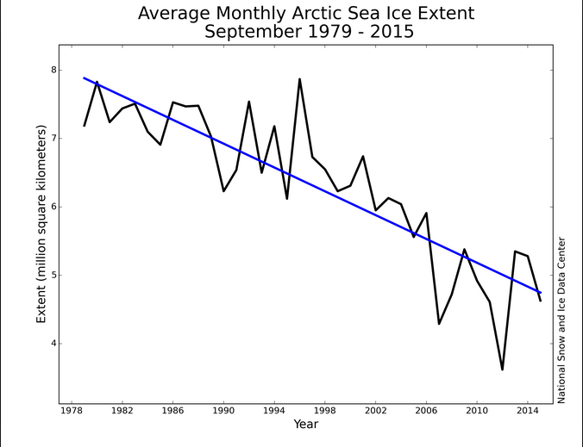
National Snow and Ice Data Center
http://nsidc.org/arcticseaicenews/2015/10/2015-melt-season-in-review/

Slide 31
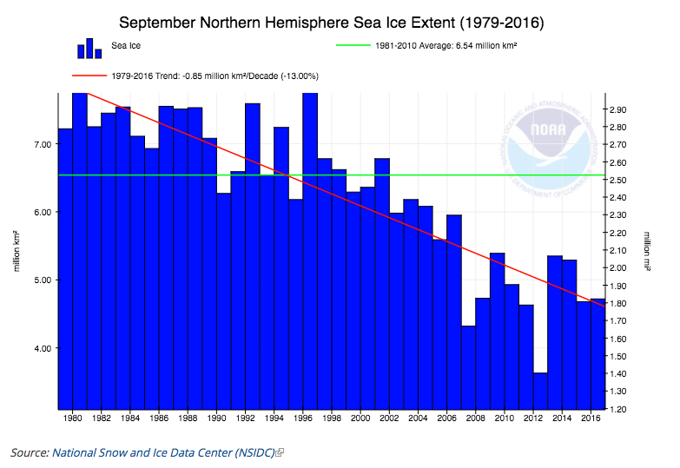

Slide 32
Adding heat trapping gases to the atmosphere increased land air and ocean temperatures.
This led to melting of Greenland and glaciers.
The two changes increased sea level.
Arctic sea ice has melted by more than half in the past 38 years.

Slide 33
Did humans alter something that caused…
Hurricane Sandy?
Typhoon Haiyan (2013) and Typhoon Hagupit (2014) in Philippines?
Four year California drought, and drought else where?
Increased wildfires?

Slide 34
Extreme weather and climate change NOAA December 23, 2016
“Without exception, all the heat-related events studied in this year’s report were found to have been made more intense or likely due to human-induced climate change, and this was discernible even for those events strongly influenced by the 2015 El Niño.” — from Explaining Extreme Events From A Climate Perspective 2015.

Slide 35
Sandy

Slide 36
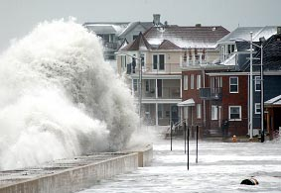
Storm activity in Massachusetts

Slide 37
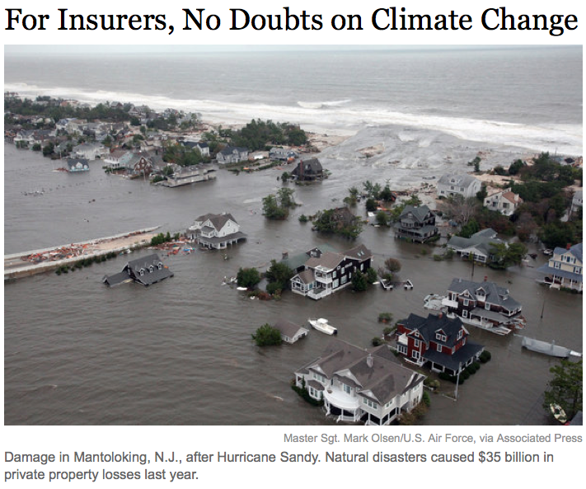

Slide 38
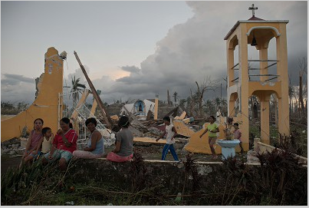
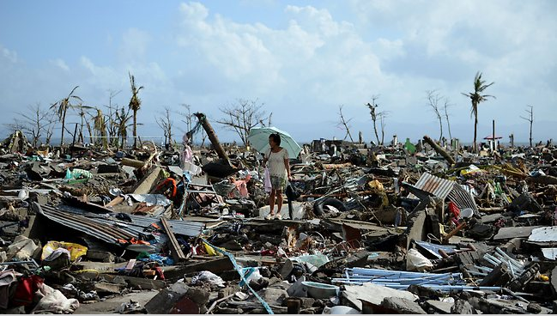
Philippines
Typhoon Haiyan 2013
Typhoon
Hagupit 2014

Slide 39
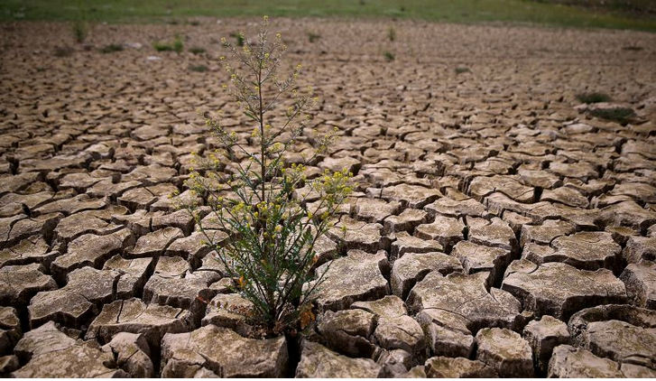

Slide 40
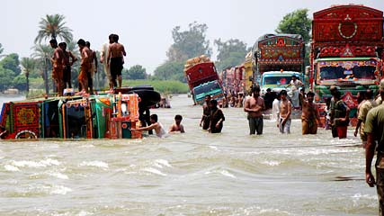
Flood in Pakistan 2010 millions affected

Slide 41
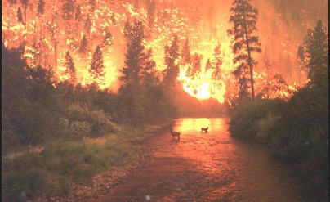
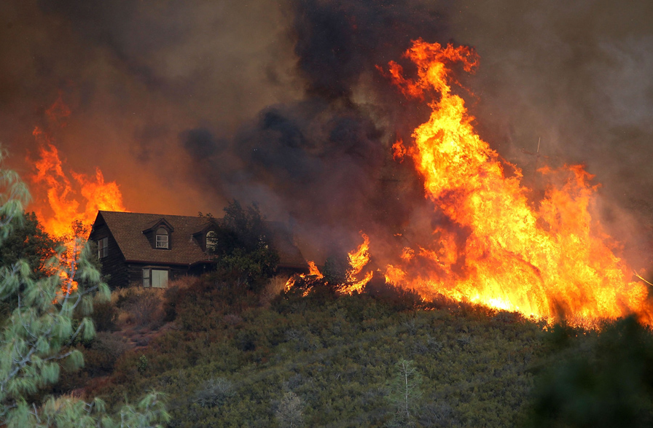
WILDFIRES IN AMERICAN WEST

Slide 42
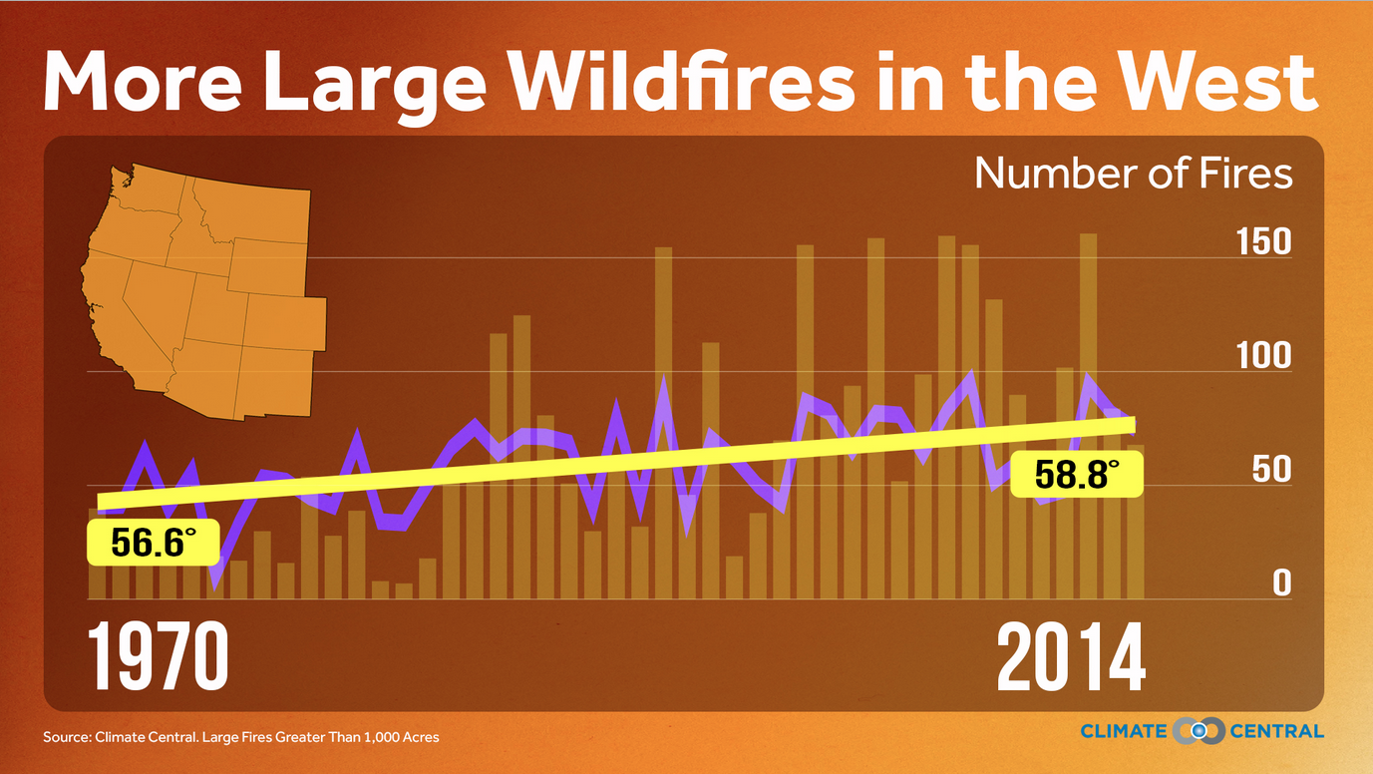

Slide 43
Other measures
Global precipitation has increased because with a warmer ocean, more water evaporates, and with a warmer atmosphere, lore water can be in the air.
The percentage of extreme precipitation events has increased.
Wet areas have become wetter, and dry areas have become drier as precipitation comes locally to areas in intense downpours.

Slide 44
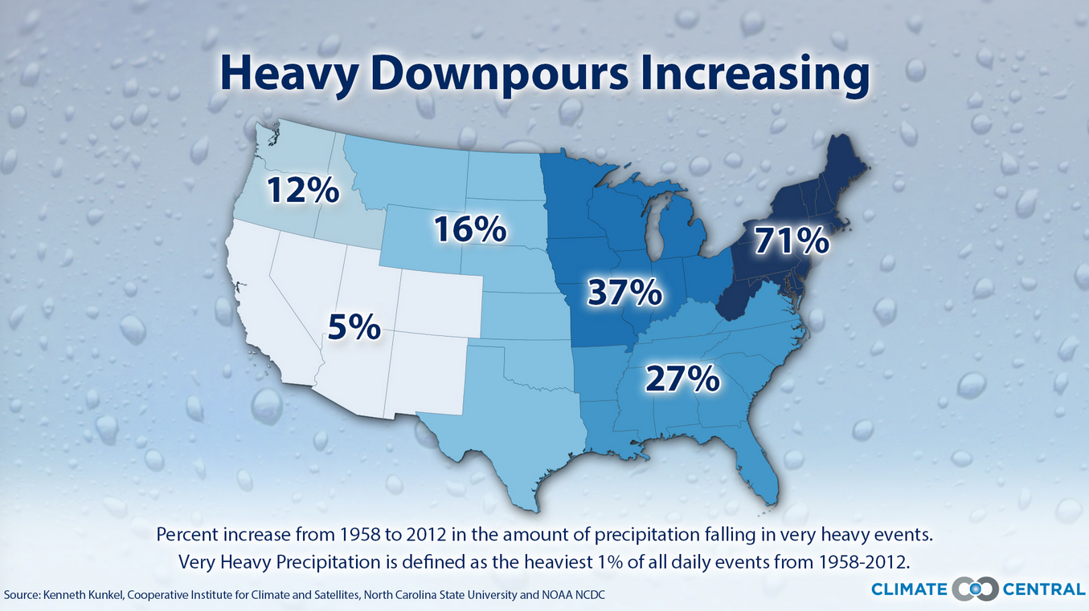

Slide 45
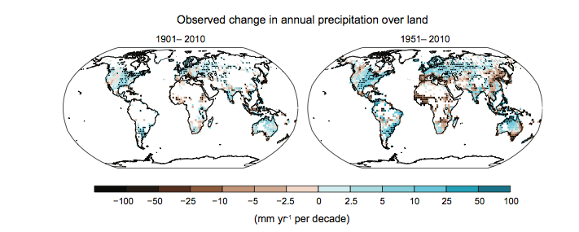
Precipitation record IPCC AR5 2013

Slide 46
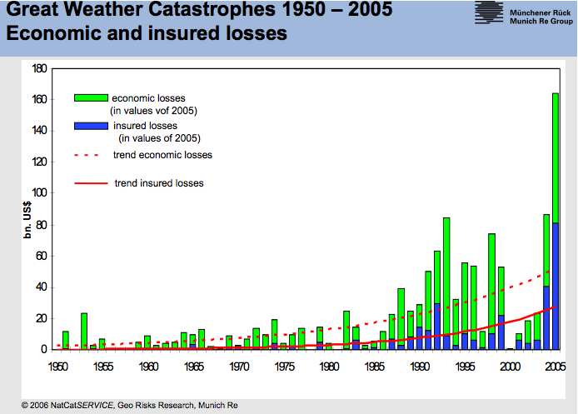

Slide 47
Asking the right question
Did the climate system change?
Did that change the climate?
Has there been a change in the frequency, intensity or type of events that lie outside the natural variability of climate?
Did human actions alter the climate system?

Slide 48
Yes, humans have changed the climate system
Many of the observed changes in the weather qualify as having occurred in a climate that has changed because the climate system has changed.
The insurance industry is convinced that extreme events have increased.
The military is convinced.
Many in the business community are convinced.
Scientists conclude that human activity has altered the climate system.

Slide 49
IPCC AR5 conclusions
“Warming of the climate system is unequivocal, and since the 1950s, many of the observed changes are unprecedented over decades to millennia. The atmosphere and ocean have warmed, the amounts of snow and ice have diminished, sea level has risen, and the concentrations of greenhouse gases have increased.”

Slide 50
IPCC AR5 conclusions
“Changes in many extreme weather and climate events have been observed since about 1950”
“Averaged over the mid-latitude land areas of the Northern Hemisphere, precipitation has increased since 1901 (medium confidence before and high confidence after 1951).”
It is extremely likely that human influence has been the dominant cause of the observed warming since the mid-20th century.

Slide 51
To summarize
Did a weather event happen in a human changed climate system?
Does this type of event happen with increasing frequency or intensity?
Is there a scientifically valid explanation that can explain the observed weather event?
Then it may well be a result of a changed climate!

