Slide 1
Ecosystem health
FACTORS THAT IMPACT THE ECOSYSTEM–powerpoint no.13

Slide 2
Ecosystem Health Factors that impact the ecosystem

Slide 3
Types of factors
Direct effects
Indirect effects

Slide 4
Direct effects on ecosystems
Changes in local land use and cover
Changes in climate
Species introduction, invasion, or removal
Over fishing
Nutrient loading from activities such as fertilizer, pest control, irrigation
Modification of rivers
Water withdrawal/dams
Pollution
Habitat loss/degradation/ fragmentation
Over hunting
Forest Fires
Tsunamis
Notes:
Facilitator can explain these or show pictures
A direct effect is anything that will cause a change – negative or positive on an ecosystem. Changes in local and regional land use that could effect ecosystems includes the conversion of forests to agriculture or urban/suburban areas. Removal of vegetation will change the hydrology of the area, the climate, and the ability of the area to weather storms.
By changing land use or constructing roads, habitats can be lost, degraded or fragmented. Many species need a minimum size of uninterrupted to survive – they either have migration corridors or they can need a certain amount of space in which to hunt. If habitat is degraded, species may be lost. As we discussed there are some species that have very specific habitat requirements. It may be that they need to have conditions that require them to be in the center of the forest.
Over fishing can upset marine ecosystems because large portions of the marine food web may be eliminated

Slide 5
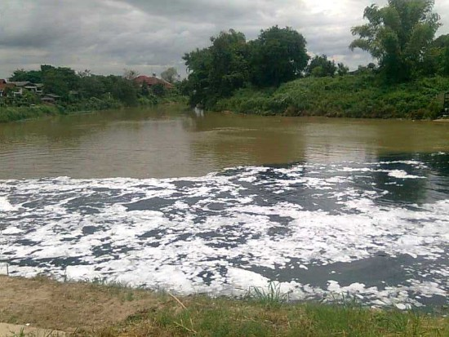
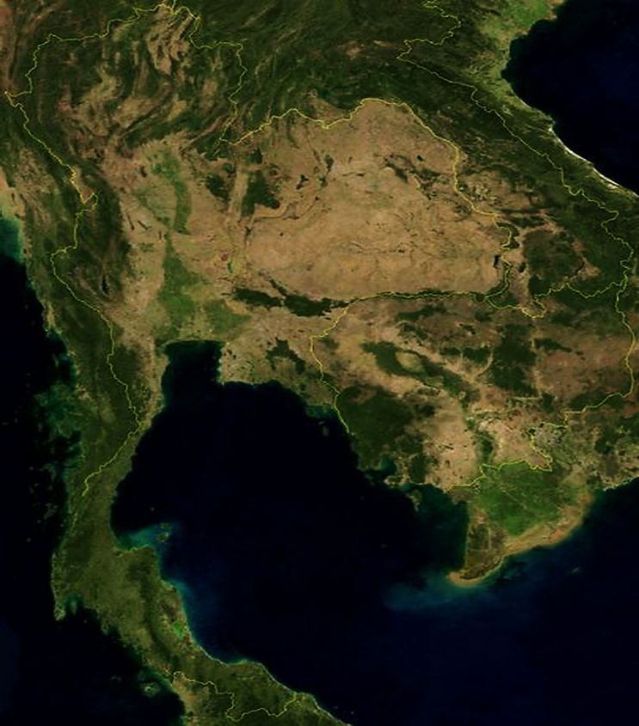
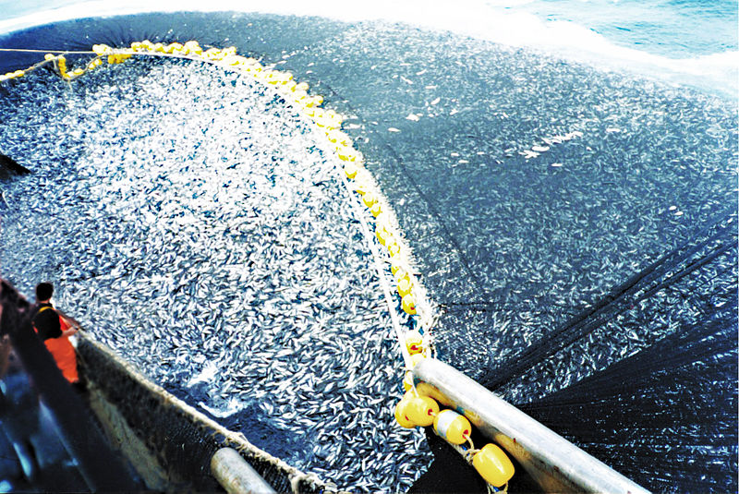
Eutrophication in Ping River at a waste water outlet in Chiang Mai, Thailand
Haze in Singapore – haze generated from forest fires
http://nongkhainewsonline.blogspot.com/2011/06/blog-post_8664.html
http://www.rid-1.com/webboard/board_view.php?forum_id=18
Overfishing
Deforestation in Thailand
Notes:
Example photos –
Haze in Singapore – haze generated from forest fires – Fisher, Max June 21, 2013. Satellite images and NASA data show vast forest fires blanketing Singapore with record pollution. Washington Post. Published: June 21 at 3:02.pm. Accessed from http://www.washingtonpost.com/blogs/worldviews/wp/2013/06/21/satellite-images-and-nasa-data-show-vast-forest-fires-blanketing-singapore-with-record-pollution/
Satellite image of deforestation in the Amazon. Wikipedia 2012. Habitat fragmentation. Accessed from http://en.wikipedia.org/wiki/Habitat_fragmentation
Eutrophication in the Potomac River at a waste water outlet in Washington, D.C. Wikipedia 2013. Eutrophication. Accessed from http://en.wikipedia.org/wiki/Eutrophication
Overfishing. Wikipedia 2013. Chilean purse seine. Accessed from http://en.wikipedia.org/wiki/File:Chilean_purse_seine.jpg

Slide 6
Indirect Effects
Indirect drivers to change in ecosystems include:
Population growth
Economic (e.g., globalization, trade, market and policy framework)
Sociopolitical (e.g., governance, institutional and legal framework)
Science and technology
Cultural and religious (e.g., beliefs, consumption)
What are some examples?
Notes:
Indirect effects are those effects that do not directly cause changes to ecosystems but can result in other activities/actions that can alter ecosystems. For example- human population increase can lead to an increase in fertilizer use to increase food production. However the increase in fertilizer if not done properly can increase the nutrient load of nitrogen and phosphorus to streams, rivers, and lakes. This can lead to eutrophication.
EXAMPLE: As income rises, diets tend to become higher in protein.

Slide 7
Human Economic Activities and Impact on Ecosystems
 | Habitat Alteration | Over-harvesting | Pollution | Introduction of Exotic Species | Climate Change
Agriculture | X |  | X | X | X
Forestry | X | X |  |  | X
Fishing | X | X |  | X
Urbanization | X |  | X | X
Manufacturing | X |  | X |  | X
Notes:
This table summarize what type of effects human economic activities can have on ecosystems. Specifically, agriculture often expands into land that was previously undisturbed or in-tact ecosystems so the habitats within that ecosystem would be altered. Agricultural runoff often contains fertilizer and pesticides. These chemicals can enter ecosystems through streams or erosion. Seeds from agricultural fields can enter ecosystems through the wind or water ways.
Discuss another mechanism that is relevant to the area.

Slide 8
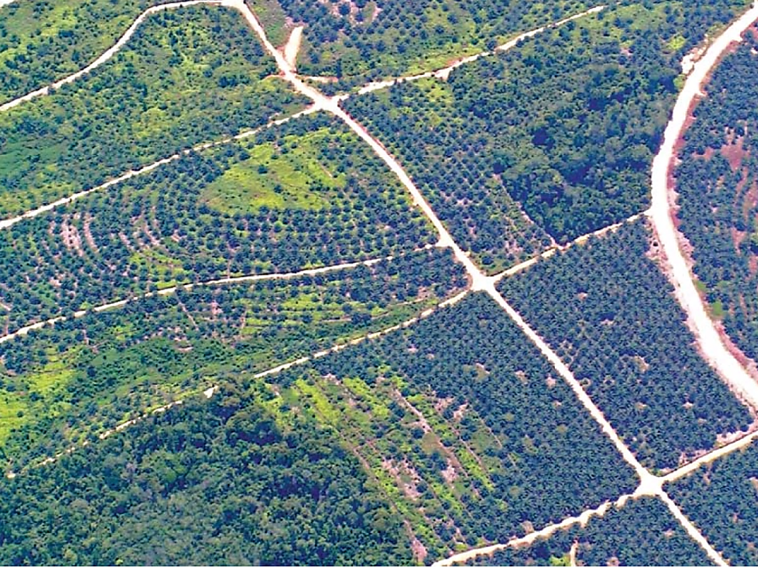
Palm Oil Plantations
Aerial view of oil palm developments in Kutai, East Kalimantan, Indonesia. (Photo:Douglas Sheil) Source: Sheil, D. et al. 2009. The impacts and opportunities of oil palm in Southeast Asia: What do we know and what do we need to know? CIFOR. Indonesia.
Notes:
Monoculture – planting a single species over a large area. Monocultures are vulnerable to predation and/or disease.
A 2005 FAO evaluation of land cover data suggests that between 1990 and 2005, 55–59 per cent of oil palm expansion in Malaysia (that is 834 000–1 109 000 ha of a total of 1 874 000 ha), and over 56 per cent of that in Indonesia (1 313 000–1 707 000 ha of a total of 3 017 000 ha) occurred at the expense of natural forest cover
In Indonesia, the majority of oil palm is established in industrial scale monoculture plantations ranging in size from 4000 to 20 000 hectares. The establishment of these plantations usually results in the near total clearing of former vegetation.
Burning is the quickest and cheapest method to clear land for plantations. This is true for ‘high volume’ forest and forests on peat soils, where the costs of removing wood with heavy machinery are high,for existing large-scale plantations, secondary vegetation or heavily logged forest, zero burning is more cost effective .
On Sumatra, oil palm plantations result in a significant reduction in biodiversity if plantations replace natural forests, secondary forests, agroforests, or even degraded forests and scrubby unplanted areas.
A 4-year study of terrestrial mammals living in and around an oil palm plantation concession in Jambi in Sumatra, Indonesia, found that oil palm monocultures are very poor habitats for most terrestrial mammal species, especially for endangered species, such as Sumatran tiger, tapirs (Tapirus spp.) and clouded leopards (Neofelis spp.). Only four mammal species (10 per cent of the number detected within the landscape) were regularly detected in the oil palm itself and none of these species had a high conservation value.
Some species, including deer, macaques and pangolins, have some tolerance for oil palm habitats and with the exception of pigs, all species showed a general preference for non-oil palm habitats—even heavily degraded natural habitats..
Birds are also affected by forest conversion to plantations resulting in a reduction in species richness of at least 60 per cent, especially affecting threatened forest-dependent birds.
Endangered species (and subspecies), such as orangutan, Sumatran elephant (Elephasmaximus sumatrensis) and Sumatran tiger, are especially threatened. During palm oil expansion, animals are often captured or killed when vegetation is cleared to make way for new plantations. Elephants are considered a risk to the oil palm plantations because they often destroy plantations and feed on the oil-rich palm nuts. Orangutans have become violent around oil palm plantations when their food source is threatened or destroyed. Tigers can also be killed if they are considered to pose a threat to plantation workers. All of these species are vulnerable to illegal wildlife poachers when forested areas are opened up to establish oil palm plantations.
Land clearing and road construction increase soil erosion in previously forested regions—especially in steeper sites. This can result in landslides. Even after trees have become established, erosion on paths and open areas can be high.
Sheil, D. et al. 2009. The impacts and opportunities of oil palm in Southeast Asia: What do we know and what do we need to know? CIFOR. Indonesia.

