Slide 1
Epidemiology Module
One Health Modules _ OHCEA
PowerPoint No. 2
The goal of the course is to provide skills to health professionals (pre-service & in-service)
in order to enable them to analyze and interpret critically information from the health system and health interventions in the community.

Slide 2
Epidemiology Module
One Health Modules
Goals
1. To know the basic terminology and concepts used in epidemiology.
2. To understand the principles of Epidemiology.
3. To understand the burden of communicable diseases.
4. To appreciate and value the principles of One Health and its application in emerging pandemics threats.
5. To appreciate and value the measures of diseases frequency.
6. To understand the scope of descriptive, analytic and participatory epidemiology.
7. To understand the importance of disease surveillance.

Slide 3
Epidemiology Module
Overview
Time/Length | Topic/Activity
30 Min | Basic Terminology and Concepts used in Epidemiology
30-45 Min | Principles of Epidemiology
60 Min | Burden of Communicable Diseases
60 Min | One Health Approach
60 Min | Measures of Diseases Frequency
60 Min | Descriptive Epidemiology
60 Min | Analytic Epidemiology
60 min | Participatory Epidemiology: Key Concepts
60 min | Diseases Surveillance: Overview

Slide 4
Goal 1: To know the basic terminology and concepts used in Epidemiology
By the end of the course, the participants should be able to:
Define epidemiology.
Explain the meaning of the epidemiologic triad.
Discuss the web of causation.

Slide 5
Introduction to Epidemiology

Slide 6
What is Epidemiology?

Slide 7
EPI DEMOS LOGOS
Upon People Study
The study of anything that happens to people

Slide 8
Fundamental axioms
Diseases (or other health events)
do not occur at random.
Diseases (or other health events)
have causal and preventive factors that can be identified.

Slide 9
Definition of epidemiology
« The study
of the distribution and determinants
of health related states or events
in specified populations
and the application of this study
to the control of health problems. »
Last, 1988

Slide 10
Epidemiology is
the study of the patterns of disease occurrence.

Slide 11
Epidemiology
identifies the risk factors.

Slide 12
Epidemiology
defines the relationship of disease to the population at risk.

Slide 13
Epidemiologic Triad
Agent
Host
Environment

Slide 14
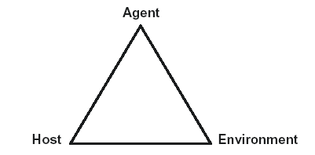
Host Factors
Physiologic
Genetic
Immunologic
Behavioral
Influence the chance for disease or its severity
Notes:
Influence the risk of exposure and host's resistance or susceptibility to infection.
Factors are biologic (age, race, sex, genetic makeup, physical state, immune status) and behaviorial (e.g. personal hygiene).

Slide 15
Agent Factors
Infectious
Toxic
Nutritional
Diseases with no agent
Necessary for disease to occur
Notes:
Factors derive from the innate properties of the agent such as morphology, size, antigenic character, growth requirements, ability to survive outside the host, spectrum of hosts, ability to produce toxins, ability to become resistant to antibiotics, ability to acquire new genetic information from plasmids, etc.

Slide 16
Environmental Factors
Physical
Biologic
Socioeconomic
Notes:
Influence existence of the agent and opportunity for exposure
Commonly divided into:
Physical (geology, climate)
Biologic (agent population density, vectors)
Socioeconomic (human population distribution, war)

Slide 17
Host, Agent, Environment

Slide 18
Factors Influencing Disease Transmission
Agent
Environment
Infectivity
Pathogenicity
Virulence
Immunogenicity
Antigenic stability
Survival
Weather
Housing
Geography
Occupational setting
Air quality
Food
Age
Sex
Genotype
Behaviour
Nutritional status
Health status
Host

Slide 19
Epidemiologic Triad-Related Concepts
Infectivity (ability to infect)
(number infected / number susceptible) x 100
Pathogenicity (ability to cause disease)
(number with clinical disease / number infected) x 100
Virulence (ability to cause death)
(number of deaths / number with disease) x 100
All are dependent on host factors

Slide 20
Story telling on Epidemiological Triad
The epidemiological triad provides a basis of understanding communicable diseases.
Taking into account that the factors that are involved in disease transmission are the agent, the host and the environment; write a story and present to your colleagues; the story should be relating the triad explaining the transmission of a disease of your choice from your community. The roles of each factor should be clearly brought out.
The story should not exceed 3 paragraphs (1/2 page)
The presentation can be supported by drawing the triad.
The presentation is expected not to last more than 15 minutes.
You will need the following resources: a flip chart; computer and projector; epidemiology course material; pen, markers

Slide 21
Health-related events
Epidemic Communicable Disease
Endemic Communicable Disease
Non-communicable Disease
Chronic Diseases
Injuries
MCH, Occupational, and Environmental Health
Health Behaviors

Slide 22
Levels of Disease
Increasing amount of disease
Pandemic
Epidemic
Endemic
Sporadic

Slide 23
Definitions
Epidemiology – Study of how disease is distributed in populations, and the factors that influence or determine this distribution
Sporadic level: Occasional cases occurring at irregular intervals
Endemic – Habitual presence of a disease within a given geographic area
Epidemic – The occurrence in a community or region of illness of similar nature, clearly in excess of normal expected rate, and derived from a common or from a propagated source
Notes:
Review definitions

Slide 24
Zoonosis, epizootic and enzootic
Zoonosis is an infection that is transmissible under natural conditions from vertebrate animals to man, e.g. rabies, plague, bovine tuberculosis…..
An epizootic is an outbreak (epidemic) of disease in an animal population, e.g. rift valley fever.
An enzootic is an endemic occurring in animals, e.g. bovine TB.

Slide 25
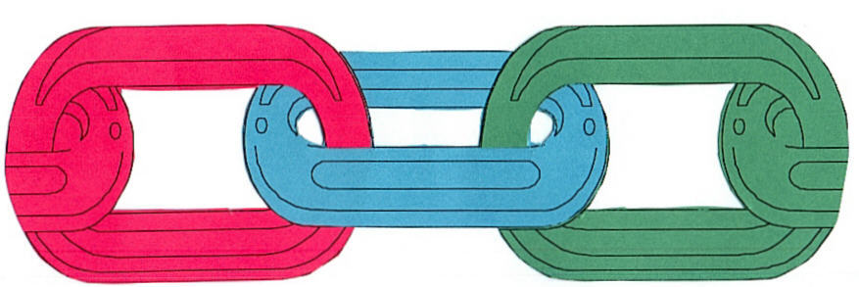
Chain of Infection
Agent
Host
Transmission
Environment

Slide 26
Dynamics of disease Transmission (Chain of Infection)
I
II
III
Source or Reservoir
Modes of transmission
Susceptible host

Slide 27
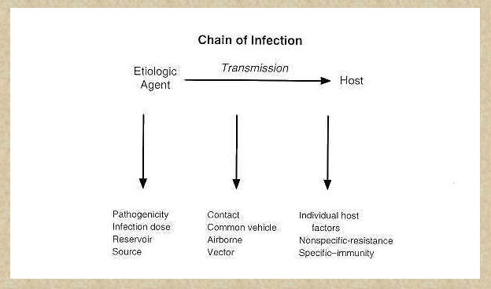

Slide 28
Factors Influencing Disease Transmission
Agent
Environment
Infectivity
Pathogenicity
Virulence
Immunogenicity
Antigenic stability
Survival
Weather
Housing
Geography
Occupational setting
Air quality
Food
Age
Sex
Genotype
Behaviour
Nutritional status
Health status
Host
(www)

Slide 29
Routes of transmission
Direct
Skin-skin
  Herpes type 1
Mucous-mucous
  STI
Across placenta
  toxoplasmosis
Through breast milk
  HIV
Sneeze-cough
  Influenza
Indirect
Food-borne
  Salmonella
Water-borne
  Hepatitis A
Vector-borne
  Malaria
Air-borne
  Chickenpox
Exposure
A relevant contact – depends on the agent
  Skin, sexual intercourse, water contact, etc
(www)

Slide 30
Exposure to Infectious Agents
No infection Clinical Sub-clinical Carrier
Death Carrier Immunity No immunity
Outcome
(www)

Slide 31
Transmission
Cases
Index – the first case identified
Primary – the case that brings the infection into a population
Secondary – infected by a primary case
Tertiary – infected by a secondary case
T
S
Susceptible
P
S
Immune
S
T
Sub-clinical
Clinical
(www)

Slide 32
Chain of Infection
Agent
Environment

Slide 33
Agents
Biologic
Chemical
Physical
Bacteria, Viruses, Parasites, Fungi
Pesticides, Drugs
Automobile, Guns

Slide 34
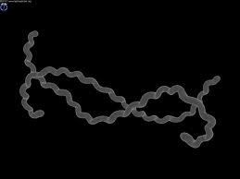
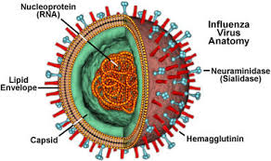
Infectious Organisms
Bacteria
Viruses
Parasites
Fungi
Prions
Leptospira interrogans
en.wikipedia.org
en.wikipedia.org
Notes:
Cover the main categories of infectious organisms and ask participants if they can think of a couple of examples of diseases caused by each. A few examples are below, if needed for discussion:
Bacteria: Leptospira interrogans (pictured), Yersinia pestis (causes plague), Borrelia burgdorferi (Lyme disease), E. coli, Salmonella, Campylobacter (all food borne)
Viruses: avian influenza (pictured), SARS, Ebola, Dengue, Japanese encephalitis, Nipah, Hendra
Parasites: malaria (protozoan), roundworms, hookworms, tapeworms (helminths), cryptosporidium (protozoan)
Fungi: Candida albicans, Aspergillus, Histoplasmosis, Cryptococcus, Pneumocystis
Prions: bovine spongiform encephalopathy (mad cow disease), Creutzfeld-Jakob disease, kuru

Slide 35
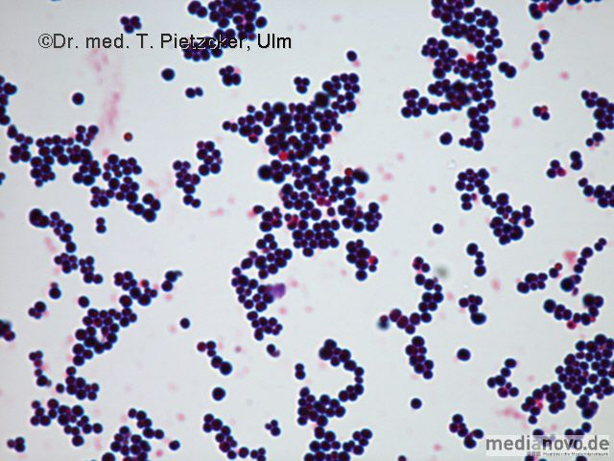
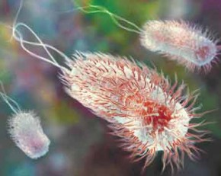
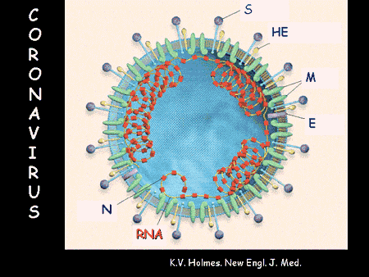
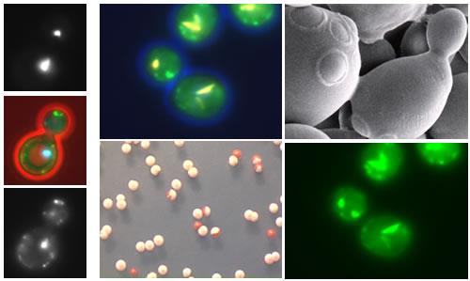
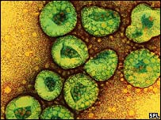
Infectious Agents
Clostridium botulinum
Enterohaemorrhagic E. coli O104

Slide 36
Chain of Infection
Transmission
Environment

Slide 37
Transmission
Method by which the infectious agent passes from a source to the host.

Slide 38
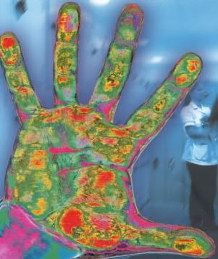
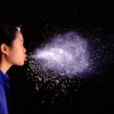
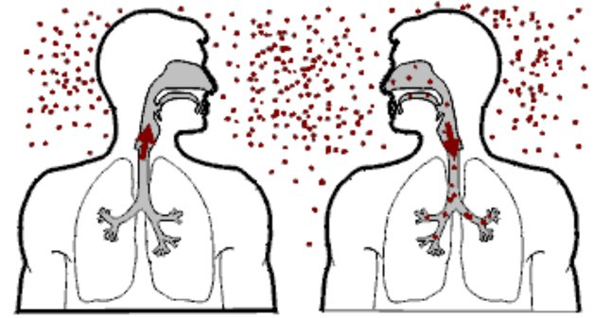

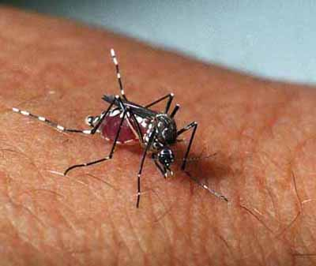

Modes of DISEASE transmission
Contact
  Direct
  Indirect
Airborne
  Droplet
  Airborne
Vector Borne
Vehicle
* Aerosolized Particles
* Aerosolized Particles from coughing or sneezing <5 microns in size containing influenza virus can be inhaled at alveolar level of lungs
Notes:
Transmission – route by which an infectious organism infects a new host
Method of transmission will influence management plan strategies
Transmission routes:
Direct contact with infected animal or human or their secretions
Indirect Contact with a contaminated surface, fomite, or other object
Contact with or consumption of contaminated food or water
Biological vector – bite of an insect such as rats, ticks, mosquitoes, or flies
Ask students for an example of a disease spread by each transmission route. One example of each is below. Note that some diseases can be spread by more than one transmission category – see if students can think of one.
Direct contact – influenza (contact with respiratory secretions of individual – breathing in particles from coughing or sneezing) – influenza could also be spread by fomites
Contaminated surface or fomite – Salmonella on contaminated food prep surface – can also be food consumption
Consumption of food or water – cholera
Biological vector - dengue

Slide 39
(II): Modes of transmission
Mode of transmission
Direct
transmission
Indirect
transmission
Direct contact
Vehicle-borne
Vector-borne:
Mechanical
biological
Droplet infection
propagative
Contact with soil
Cyclo-prop.
Air-borne
Cyclo-develop.
Inoculation into skin or mucosa
Fomite-born
Trans-placental (vertical)
Unclean hands
and fingers

Slide 40
Direct Contact Transmission
Direct contact with infected individual person or animals, or their secretions
Infectious organisms can enter via:
  Respiratory tract – inhaled particles from sneezing and coughing
  Mucous membranes – eyes, nose, reproductive, digestive tracts
  Skin – cuts, wounds, open sore, injury can facilitate entry
  Ingestion – swallowing

Slide 41

Contact with Fomite
Fomite: an inanimate object contaminated with an infectious organism
Organisms can survive on surfaces
Does not require direct contact between individuals
Examples of fomites:
  Doorknobs
  Computer keyboard
  Bedding or towels
  Needles, forceps, scissors, other
  medical equipment
  Food preparation equipment and
  serving vessels
healthline.com
Notes:
After defining what a fomite is, prompt participants to give examples of fomites that may be involved in disease transfer before listing examples.

Slide 42

Contaminated Food and Water
Food and water can become contaminated and transmit diseases when consumed
Contaminated food or water possible:
  Restaurants
  Central water supply
  Water storage containers
Often cause gastroenteritis
  Diarrhea, vomiting, nausea
  E. coli, Salmonella, Campylobacter
  Cholera, Hepatitis A
  Intestinal parasites
en.wikipedia.org

Slide 43
Chain of Infection
Host
Environment

Slide 44
Host
A person who becomes infected with an infectious agent

Slide 45
Reservoir Hosts & Transmission
Reservoir hosts with infectious agents can transmit the organism, but may not develop disease
Hosts provide a reservoir for the organism in the environment
Management is difficult if host population is large or difficult to control
Host may be required for stage(s) of an organism’s development or transmission cycle before capable of infecting another host or vector

Slide 46
Types of Reservoirs
Reservoir
Human
reservoir
Animal
reservoir
Non-living
reservoir

Slide 47
Human Reservoir
Human reservoir
Type:
Incubatory
Convalescent
Healthy
Cases
Primary case
Index case
Secondary cases
Carriers
According to spectrum of disease:
Clinical cases (mild/severe-typical/atypical)
Sub-clinical cases
Latent infection cases
Duration:
Temporary
Chronic
Portal of exit:
Urinary
Intestinal
Respiratory
Others

Slide 48
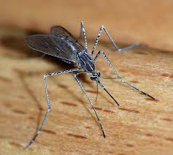
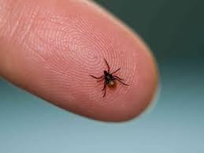
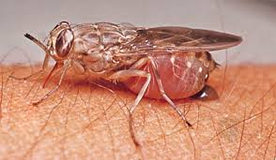
Biological Vectors - Arthropods
Vector borne diseases common worldwide
Insect provides a necessary part of disease transmission process (e.g. biting during blood meal)
www.tse-tse.com
www.cdc.gov

Slide 49
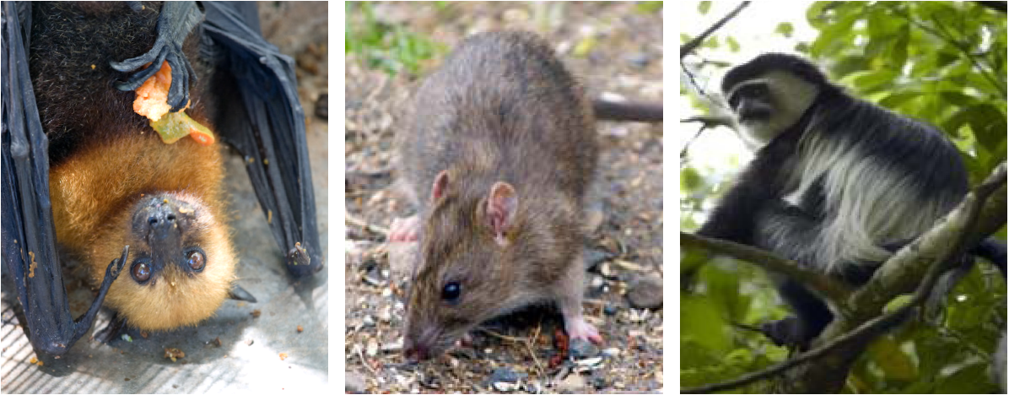
Biological Vectors - Animals

Slide 50
Environmental Factors
Population density
Nutrients
Food supply for animals
Temperature
Rainfall - Floods
Humidity
Sunlight
Radiation
Pollutants - chemical agents
Toxins
Air currents
Sound
War
Geology-soil type

Slide 51
Pathophysiology
Infectious Agent
  Virulence
  Dosage
Host
  Host Resistance
  Protective Measures
Means of Transmission
  Direct
  Indirect
Routes of Exposure
  Airborne
  Bloodborne
  Foodborne
(Fecal/Oral)

Slide 52
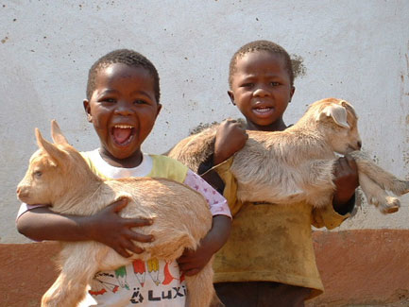
CASE STUDY: LIVELIHOODS AND DISEASE TRANSMISSION.
A CASE OF UNKNOWN DISEASE

Slide 53
Sirari is a village located in the North of Tanzania, at the border of Kenya. The estimated population is 5000. The main livelihood activity is agriculture and livestock. The climate is fairly cool and experiencing subtropical temperatures.
An NGO is assisting the community to improve livelihood, food security and income. The NGO introduced exotic breed of goats. Almost on average each household keeps 5 to 8 goats.
The community members love their goats so much that when they kid, they carry the kids, live with them in the same houses. After a while the female goats started experiencing late abortion and some died. They could not get service from vets as there are no vets in the area.
Later, some members of the family started experiencing fever-like symptoms and joint pains. The fever is on during a week, and then off the other week and keeps on alternating for at least 4 months. They bought anti malarial drugs from the local drug shop but show no improvement.
The drug shop recommended them to visit a health facility for further management. A lab test for malaria turned out to be negative. The health center referred the patients to the district hospital for further investigations…

Slide 54
Questions:
1. Who are the people affected?
2. What different stakeholders are involved?
3. What disease are you thinking about?
4. How do you link the history of the disease with the epidemiological triad?
5. What should be done differently to prevent and control their conditions?
6. What further investigations should be done at the district hospital?

Slide 55
Goal 2:To understand the principles of epidemiology
By the end of the course, the participants should be able to:
explain the principles of epidemiology.
identify and describe sources of routine morbidity and mortality.
use epidemiological methods to assess a health problem.

Slide 56
Fundamental axioms
Diseases (or other health events)
do not occur at random.
Diseases (or other health events)
have causal and preventive factors that can be identified.

Slide 57
Epidemiology helps to
Determine the magnitude and trends.
Identify the aetiology or cause of disease.
Determine the mode of transmission.
Identify risk factors or susceptibility.
Determine the role of the environment.
Evaluate the impact of the control measures.

Slide 58
Basic Epidemiologic Methods
Count cases (events)
Define involved population
Determine rates/proportions
Compare rates
Make inferences

Slide 59
Epidemiology “3 Steps”
Counting number of events or conditions in populations or subgroups of persons. (C)
Dividing the number of events by the number of persons in the population to make rates. (D)
Comparing rates from different populations to make inferences about the cause for the observed differences in rates. (C)

Slide 60
Epidemiology: Step 1 - Counting
Counting number of events or conditions in populations or subgroups of persons.
The first step in descriptive epidemiology:
  How many persons experienced a particular condition?
  Count = “numerator”.

Slide 61
Epidemiology: Step 2 - Dividing
Dividing the number of events by the number of persons in the population to make rates.
The second step in descriptive epidemiology.
  What group of persons experienced the event?
  Population group = denominator.
  Use events and population to make: proportions, rates, odds.

Slide 62
Epidemiology: Step 3 - Comparing
Comparing rates from different populations to make inferences about the cause for the observed differences in rates
  Analytic epidemiology
    Cohort (exposed vs. non-exposed)
    Case-control (sick vs. healthy)
  Comparison of rates to make rate ratios or rate differences.
  Comparison of odds to make odds ratios.
  Use ratios or differences to identify risk factors.
  Use statistical tests to determine reliability of ratios or differences.

Slide 63
Main activities of the epidemiologist
Describe an event in terms of :
  Time When?
  Place Where?
  Person Who?
Analyse the association between the event (disease, death)
and its determinants (risk factors)
Make recommendations: preventive actions, control measures

Slide 64
Generate hypotheses
Make judgments about linkages between exposure and outcome
Interpret data
Identify or correct mistakes
Interpret statistical and laboratory tests
Make decisions
Determine if an epidemic is in progress
Recommend control measures
What is the role of the Epidemiologist?
Notes:
Epidemiologists generate hypotheses, which requires making judgments about linkages between exposure and outcome.
Epidemiologists interpret the data that is collected and analyzed. They can identify or correct mistakes, and interpret the results of statistical analysis and of laboratory tests.
Epidemiologists also make decisions. Decisions can be made based upon epidemiologic and laboratory evidence to determine if an epidemic is in progress and to recommend the most appropriate control measures to contain the spread of disease.
For example, in the context of surveillance, only humans, not computers, will be familiar with the surrounding population, historical disease patterns, and existing or new reporting systems. By being familiar with ongoing surveillance trends over a number of years, epidemiologists will know whether or not a spike in a line graph is indicative of an outbreak versus the result of some external factor like enhanced reporting systems.

Slide 65

Data Sources
Notifiable diseases
Laboratories
Vital records
Registries
Surveys
Administrative data systems
Media
Other data sources
Notes:
Many different sources can be used for surveillance data. We will only discuss a few of these.

Slide 66
Goal 3:To understand the burden of communicable diseases and value the gender gaps in infectious diseases and health care access.
By the end of the course, participants should be able to:
discuss the major causes of morbidity and mortality nationally, regionally or globally.
classify infectious diseases.
debate the principles of control of communicable diseases.
define specific terms related to infectious diseases.
analyze the gender gaps in communicable diseases.

Slide 67
Definition :-Communicable disease
A communicable or infectious disease is an:
illness caused by transmission of a specific
infectious agent or its toxic products from an
infected person or animal to a susceptible
host, either directly or indirectly through an
intermediate animal host, vector or inanimate
environment (Last 1995)

Slide 68
Global epidemiology of infectious disease
Infectious diseases are the leading cause of death worldwide.
New diseases are emerging.
Old diseases are re-emerging.

Slide 69
Global epidemiology of infectious disease
Infectious diseases account for more than 25% of all deaths in the world.
Diarrhea and respiratory tract infections (RTI) account for 50% of all infectious deaths.
HIV, tuberculosis, malaria and measles are significant causes of deaths.

Slide 70
Global Burden of disease: 10 leading causes of death
Developed Countries
1. Ischaemic heart disease
2. Cerebrovascular disease
3. Lung cancer
4. Lower RTI
5. COPD
6. Colon/rectal cancer
7. Stomach cancer
8. Road Traffic accidents
9. Self inflicted injuries
10. Diabetes mellitus
Developing countries
1. Lower RTI
2. Ischaemic heart disease
3. Cerebrovascular disease
4. Diarrheal disease
5. Perinatal conditions
6. HIV
7. Tuberculosis
8. Measles
9. Malaria
10. Road Traffic accidents

Slide 71
Global Epidemiology of Infectious Disease
2,213,000
Diarrhea
TB
1,669,000
RTI
4,039,000
Malaria
1,086,000
HIV
WHO World Health Report 2000
2,673,000
Total deaths: 55,965,000
Death from infections: 14,025,000

Slide 72
Communicable Disease Burden Varies Widely Among Continents

Slide 73
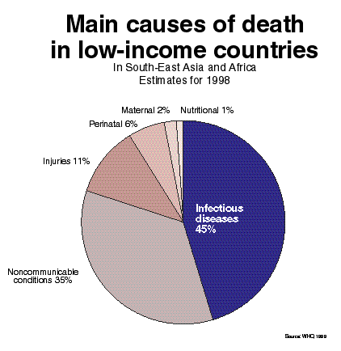

Slide 74
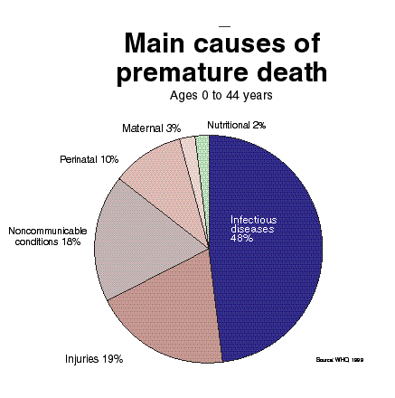

Slide 75
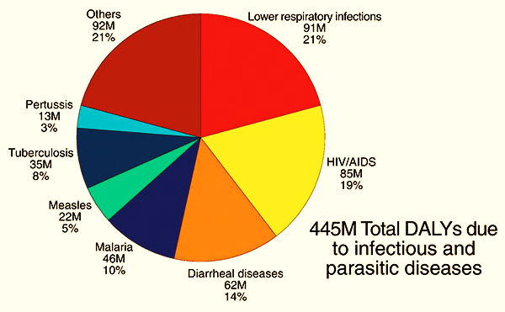
Disease Burden
60% of global mortalities due to infectious diseases
http://wwwnc.cdc.gov/eid/article/11/4/04-1167-f2.htm; http://www.smartglobalhealth.org/issues/entry/infectious-diseases
Notes:
60% of disease burden or global mortalities is due to infectious diseases which result in a total of 445 million cases per day.

Slide 76
Disease Burden (CONTINUED)
Disease | Deaths
Respiratory Infections | 3.9
Malaria | 1.3 - 3.0
HIV/AIDS | 2.5
Diarrheal Diseases | 1.8
Tuberculosis | 1.7
Neglected Tropical Diseases | 0.5
The top 6 categories of infectious diseases causing mortalities
http://wwwnc.cdc.gov http://www.smartglobalhealth.org
http://wwwnc.cdc.gov/eid/article/11/4/04-1167-f2.htm; http://www.smartglobalhealth.org/issues/entry/infectious-diseases
http://wwwnc.cdc.gov/eid/article/11/4/04-1167-f2.htm; http://www.smartglobalhealth.org/issues/entry/infectious-diseases
Notes:
Among these infectious disease, respiratory infection, malaria, HIV/AIDS, diarrheal diseases, tuberculosis and neglected tropical diseases are topmost 6 ones.

Slide 77
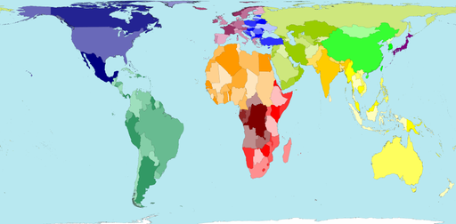
World Map According to Land Mass
Notes:
But what if we look at the world another way?

Slide 78
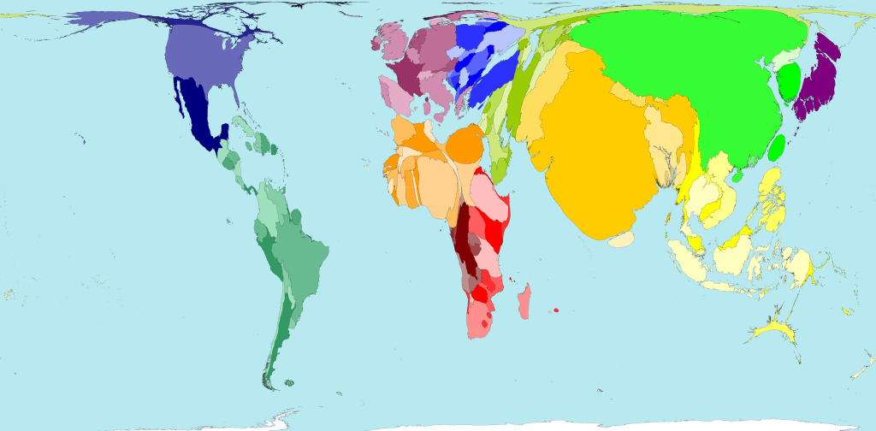
World According to Global Population
Notes:
According to the proportion of the global population

Slide 79
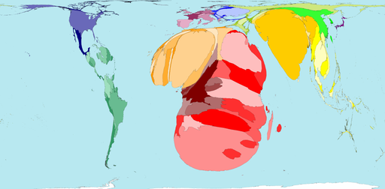
World Map Showing People With HIV
Notes:
Proportion of people living with HIV (15-49)

Slide 80
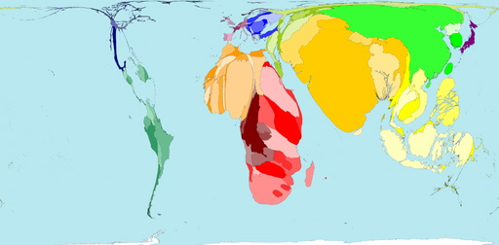
AFRICA and SOUTH ASIA’S CRISIS
TB cases
Territory size shows the proportion of
worldwide tuberculosis cases found there.
www.worldmapper.org

Slide 81
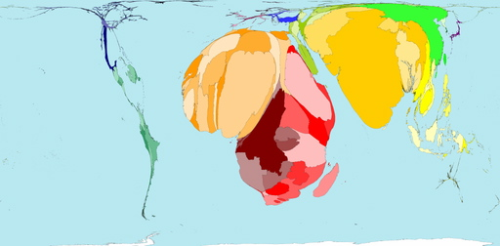
AFRICA and SOUTH ASIA’S CRISIS
Mortality 1 - 4 year olds
Territory size shows the proportion of all deaths of children aged over 1 year and under 5 years old, that occurred there in 2002.
www.worldmapper.org

Slide 82
Transmission of Infectious Diseases
How would you classify infectious diseases?

Slide 83
Classification of infectious diseases
Aetiologic
  Viral
  Bacterial
  Parasitic
  Others
Portal of entry/exit
  Respiratory
  Gastro-intestinal
  Genito-urinary
  Percutaneous

Slide 84
Classification by mode of transmission
Spread by common vehicle
  Ingestion
  Inhalation
  Inoculation
Propagation by serial transfer from host to host
  Respiratory
  Anal-oral
  Genital

Slide 85
Vocabulary
Incidence
New cases in a given time period (percent per year or per person time of observation)
Prevalence
Number of cases at a given time (percent at a given time
Attack rate
Proportion of non-immune exposed individuals who become clinically ill
Notes:
Optional slide-delete if irrelevant to your topic

Slide 86
Vocabulary
Primary case
Person who brings infection into a population
Secondary cases
Persons who are infected by the primary case (further spread is described as ‘waves’ or generations’)
Notes:
Optional slide-delete if irrelevant to your topic

Slide 87
Vocabulary
Secondary Attack Rate:
Total number of cases-initial case(s) X 100
Susceptible persons - initial case(s)
Used to estimate the spread of disease in a group
Measures the infectivity of the agent
Notes:
Optional slide-delete if irrelevant to your topic

Slide 88
Vocabulary: Transmission Probability
The probability that, given contact between an infective source and a susceptible host, successful transfer of the parasite will occur so that the susceptible host becomes infected.
Parasite
Infectious host
Susceptible host
Contact
Transmission probability depends on
Infectious host
Susceptible host
Contact definition
Parasite

Slide 89
Vocabulary
Case fatality
Proportion of infected individuals who die of the infection
Mortality rate
Proportion of the population that die yearly of the disease. (This is a product of the incidence and case fatality rate)
Notes:
Optional slide-delete if irrelevant to your topic

Slide 90
Vocabulary
Vector
Source which harbours infectious agent and transmits it to susceptible individuals
Reservoir
  Ecological niche
Zoonosis
Infections that can spread from vertebrate animals to man
Notes:
Optional slide-delete if irrelevant to your topic

Slide 91
Vocabulary
Incubation period
Time from exposure to development of disease
Infectious period
Length of time a person can transmit disease
Latent period
Period of infection without being infectious
Notes:
Optional slide-delete if irrelevant to your topic

Slide 92
Vocabulary
Epidemic
Occurrence of case of illness in excess of expectancy. An epidemic whose incidence remains stable for a long period of time is described as endemic.
Pandemic
A global outbreak

Slide 93
Vocabulary
Herd immunity
The decreased probability that a group will develop an epidemic because the proportion of immune individuals reduces the chance of contact between infected and susceptible persons.
The entire population does not have to be immunized to prevent the occurrence of an epidemic.

Slide 94
Major Transmission Routes
Insects
Animals
Vector borne
Droplet
Sexual
Blood
Skin to skin
Other
Direct
Environmental
Drop. nuclei
Dust
Airborne

Slide 95
Does a Potential Control Measure Reduce . . .
Transmission
Exposure
Infection
Disease
Death
Disability
?

Slide 96
Principles of Control
Prevent exposure
Protect susceptibles from infection
Prevent progression from infection to disease
Treat cases
  Prevent death and disability
  Prevent further transmission
Interrupt transmission
  Environmental
  Social/behavioural
  Legal

Slide 97
Gender in Communicable Diseases & Health Care System
Gender Inequalities in Health Care System
Differences in the ways in which women and men are treated by the health care system.
The various factors that can lead to inequality between the sexes, both in access to health care and also in outcomes.

Slide 98
Gender in Communicable Diseases & Health Care System
Gender Differences in Access to
Health Care
Considerable evidence of gender differences in access to health care.
In the developed countries, a wide range of studies show that most women use medical services more than men.
Women in many developing countries are denied these benefits.

Slide 99
Communicable diseases and gender-based issues
Women and men’s health concerns differ because of both biological and socio-economic factors.
  Some of the major health risks for women are directly linked to pregnancy and delivery, and many others are associated with women’s reproductive biology.
  On the socio-economic and cultural side, women and men have different roles and responsibilities in society and in the family, with consequent different lifestyles, nutrition and exposure to diseases. Gender-based differences also affect the way women and men seek care and receive treatment.

Slide 100
Gender and Communicable Diseases
In infectious diseases
Differences are a function of the interaction between biological factors and gender roles and relations.
Biological factors vary between the sexes and influence susceptibility and immunity to diseases.

Slide 101
Gender and Communicable Diseases
Gender roles and relations influence:
The degree of exposure to the relevant vectors.
The access and control of the resources needed to protect women and men.

Slide 102
Gender and Communicable Diseases
Differences between female and male prevalence and incidence rates are difficult to measure since cases in women are more likely to be undetected.

Slide 103
Gender and Communicable Diseases
Even when diseases are shared by both sexes, they may have:
different manifestations or natural histories in women and men.
differences in the severity of their consequences.

Slide 104
Gender and Communicable Diseases
For example, malaria:
biologically, women’s immunity is compromised during pregnancy making them more likely to become infected during this period.
implies differential severity of the consequences during her lifetime.

Slide 105
Gender and Communicable Diseases
Malaria during pregnancy is an important cause of maternal mortality, spontaneous abortion and stillbirths.
Particularly during pregnancy, malaria contributes significantly to the development of chronic anemia.
Biological differences between the sexes can produce different health outcomes among women and men when exposed to the same environmental hazard.

Slide 106
Gender and Communicable Diseases
How and where women and men carry out their daily activities will expose them to disease differentially:
women in seclusion
women’s more extensive clothing
domestic labor
water-related domestic work

Slide 107
Gender and Communicable Diseases
Tuberculosis (TB)
Official figures show that there are twice as many male cases of TB as female cases.
At young ages, the prevalence of infection in boys and girls is similar, but a higher prevalence has been found in men of older ages.

Slide 108
Gender and Communicable Diseases
Propensity to develop disease after infection with Mycobacterium tuberculosis may be greater among women of reproductive age than among men of the same age.

Slide 109
Gender and Communicable Diseases
Care of dependants may also increase women’s risk of contracting particular diseases.
Considerable evidence exists that indicate women are hampered in their use of health services by:
lack of transport

Slide 110
Gender and Communicable Diseases
inadequate resources
their husband’s refusal to grant permission
reluctance to expose themselves to health care providers
Gender differences in illness behaviour and in societal responses to female and male patients often cause women to come later for care

Slide 111
Gender and Communicable Diseases
HIV and AIDS and Other Sexually Transmitted Diseases (STDs)
STDs continue to be a major cause of distress, disability and sometimes death of both sexes.
HIV and AIDS in particular, is continuing to spread, killing millions of women and men in the prime of their lives.

Slide 112
Gender and Communicable Diseases
Biologically, the risk of HIV infection during unprotected vaginal intercourse is two to four times higher for women than men.
Women have a bigger surface area of mucosa exposed to their partner’s sexual secretions during intercourse.
Semen also contains a higher concentration of HIV than vaginal secretions.

Slide 113
Gender and Communicable Diseases
Semen can stay in the vagina for hours after intercourse.
Co-existing STDs increase the risk of HIV infection by three to four times (and in some cases five to six times).
Women are biologically more vulnerable.
50-80% of STDs in women have no symptoms or have symptoms that cannot easily be recognized.
are too ashamed to visit a doctor.

Slide 114
Gender and Communicable Diseases
In many societies, sex continues to be defined primarily in terms of male desire with women perceived as passive recipients.
Women may find it difficult to express their own needs.
Women may find it difficult to assert their wish for safer sex.
Women may find it difficult to negotiate for their partner’s fidelity or no sex.

Slide 115
Gender and Communicable Diseases
The combination of unequal access to care and the gender gap in medical knowledge contributes to a situation where women in both rich and poor countries have a shorter life expectancy than men after a diagnosis of AIDS.

Slide 116
Goal 4: To appreciate and value the principles of One Health and its application in emerging pandemics threats
By the end of the course, the participants should be able to:
define One Health concept.
describe how epidemiology is used by human, animal and environmental health professionals.
discuss the major factors contributing to the emergence of infectious diseases.

Slide 117
BACKGROUND
The time we live is characterized by an unprecedented increase in the emergence of new health threats in humans, animals and in the environment.
Underlying this “new dynamic” of shared risk are five key “drivers” that converge at the “human-animal-ecosystem” interface:
    Globalization
    Population growth
    Economic growth
    Food security
    Changing habitats

Slide 118
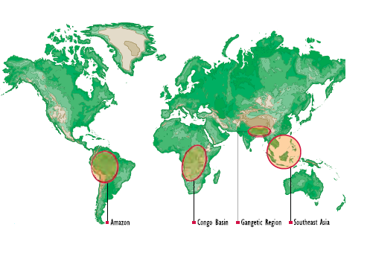
A One World Reality
No country is isolated from all others
  Wildlife, livestock, people and diseases do not respect boundaries
Countries of the world are inter-dependent
  Knowledge, goods, services
What happens in one country has impacts far beyond its borders.

Slide 119
The rising threat of zoonotic diseases
There have been about 30 new diseases in 3 decades (Jones et al, 2008)
Over 2/3 of new pathogens arise from wild-life
  SARS (Guangdong, China)
  Nipah virus, (Perak State, Malaysia)
  SIV in chimpanzees in Central Africa
  H5N1 and H1N1
Domestic animals account for 20% of new zoonoses (Jones et al, 2008) (Mostly RNA-Viruses)
Congo Basin Region is a ‘hot spot’ for new diseases

Slide 120
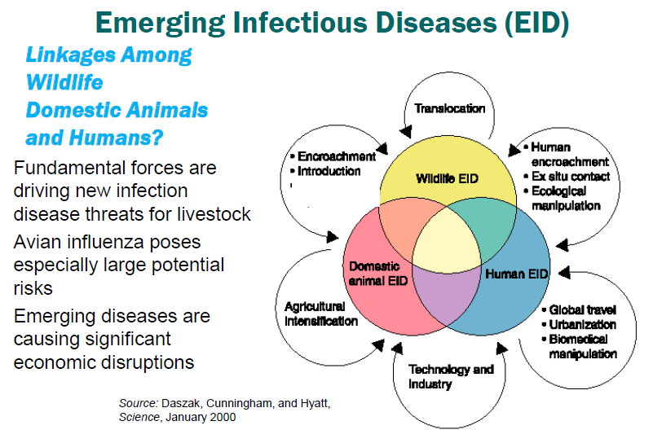

Slide 121
PARADIGM SHIFT FROM DOWNSTREAM TO UPSTREAM
Downstream approach in silos
Pathogen circulating in animals
Disease emergence
Disease impact in human population
Upstream paradigm shift using OHA
Control measures in animal population
Prevent transmission and prevent emergence
Manage diseases and infections in humans

Slide 122
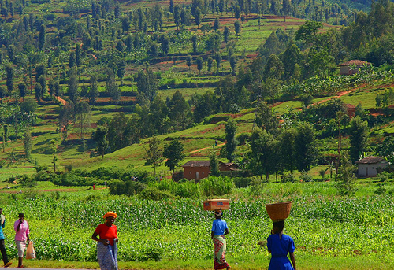

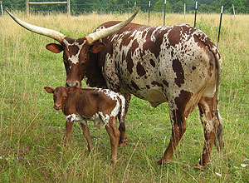
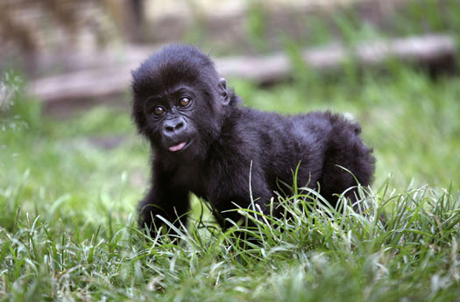
One Health
Represents an interdisciplinary strategy to address health from a holistic integrated perspective rather than a discipline-based fragmented perspective…
Is not a discipline,
rather an approach…
Wildlife, Livestock, Human Interaction

Slide 123
So what? Why change now?
Traditional disciplinary approach NOT working well enough…
Increasing public impatience with lack of progress.
Working across disciplines, sectors, cultures catalyzes creativity and innovation.

Slide 124
Why is “One Health” so difficult?
Training increasingly specialized
  Narrow and deep
Disciplinary ‘silos’ and paradigm paralysis
  Thinking constrained by education and discipline
Lack of rewards for thinking differently
  Focuses on team rather than individual
Discomfort
  Lack the skills to act in One Health manner

Slide 125
How can we describe H5N1
An animal health problem?
A public health problem?
A food security problem?
An environmental health problem?
A trade problem?
An economic problem?
A political problem?

Slide 126
What is a One Health success?
Table exercise: 10 minutes
Identify a One Health success story
Describe the range of “health” issues involved
  Public Health
  Animal Health
  Environmental Health
  Societal Health
  Economic Health
  Political Health

Slide 127
Describe how epidemiology is used by human, animal and environmental health professionals
Complex Case-study: One Health

Slide 128
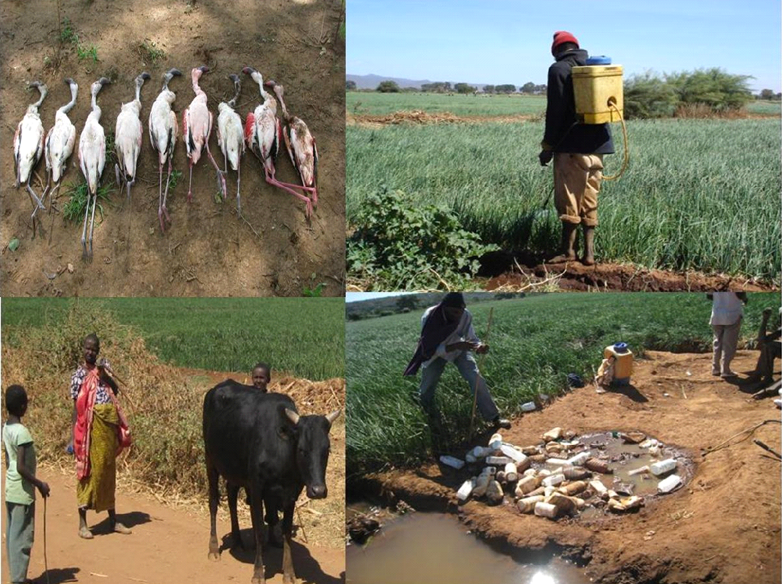

Slide 129
Background of the case
Karatu district is located in Arusha region, Tanzania and is known by its agricultural activities and people practice irrigated farming. Among the major drawback that faces the farmers are pests. As a means to overcome such problems, farmers indiscriminately use pesticides to protect their crops. This practice has been reported to be associated with many problems to the people, domestic and wild animals and the environment at large. Cases of abortions in humans and animals are quite high in the district and are associated with pesticide poisoning. Skin diseases and infertility are also rampant especially to people working in horticultural farms. Incidences of fish and aquatic bird mortalities especially Lesser flamingoes (Phoenicopterus minor) are quite high and all are linked with pesticide poisoning. For example, in 2004, up to 45 000 Lesser flamingoes died at Lake Manyara, which is being fed by rivers draining from the agricultural fields in Karatu district. Studies have shown high levels of pesticide residues in milk, beef and local chicken eggs. A case control study conducted in pregnant women who go to deliver at Mount Meru Hospital in Arusha showed that they had very high levels of pesticide residues in breast milk and abdominal fats. the newly born babies had also high levels of pesticides in muconeum and umbilical blood. Studies further showed high levels of pesticides in water collected from Lake Manyara and different rivers around irrigated farms.
Efforts have been done by the government to overcome the problem. The Tanzania Ministry of Agriculture has been conducting seminars, extension work and restricting uses of pesticides including advocating the integrated pest control systems but the problem still exist.

Slide 130
Questions
1. What is the problem?
2. Who is affected by the problem?
3. What are the sectors that can be involved in solving the problem?
4. What measures/actions can be done to safeguard the public health, animals and the environment?

Slide 131
Collaboration (shared leadership) fosters incremental change…
Engages all stakeholders
  all voices, participatory, builds trust
Strengthens partnerships
  Strategic alliances around shared interests
Builds infrastructure and capacity
  logistics, equipment, tools, people
  PLUS skills and One Health mindset to be effective

Slide 132
Discuss the major factors contributing to the emergence of infectious diseases.

Slide 133
Are infectious diseases emerging more recently than before?

Slide 134
Emerging Infections in the World since 1973
1973 Rotavirus Enteritis/Diarrhea
1976 Cryptosporidium Enteritis/Diarrhea
1977 Ebola virus VHF
1977 Legionella Legionnaire’s dz
1977 Hantaan virus VHF w/ renal flr
1977 Campylobacter Enteritis/Diarrhea
1980 HTLV-1 Lymphoma
1981 Toxin prod. S.aureus Toxic Shock Synd.
1982 E.coli 0157:H7 HUS
1982 HTLV-II Leukemia
1982 Borrelia burgdorferi Lyme disease
```````````````````````

Slide 135
1983 HIV AIDS
1983 Helicobacter pylori Peptic ulcer dz
1988 Hepatitis E Hepatitis
1989 Hepatitis C Hepatitis
1990 Guanarito virus VHF
1991 Encephalitozoon Disseminated dz
1992 Vibrio cholerae O139 Cholera
Bartonella henselae Cat scratch dz
1993 Sin Nombre virus Hanta Pulm. Synd.
1994 Sabia virus VHF

Slide 136
1994 Hendra virus Respiratory dz
1995 Hepatitis G Hepatitis
1995 H Herpesvirus-8 Kaposi sarcoma
1996 vCJD prion Variant CJD
1997 Avian influenza (H5N1) Influenza
1999 Nipah virus Encephalitis
1999 West Nile virus Encephalitis
2001 BT Bacillus anthracis Anthrax
2003 Monkeypox Pox
    SARS-CoV SARS
H5N1 Avian Influenza
2009 H1N1 Swine/avian/human Influenza

Slide 137
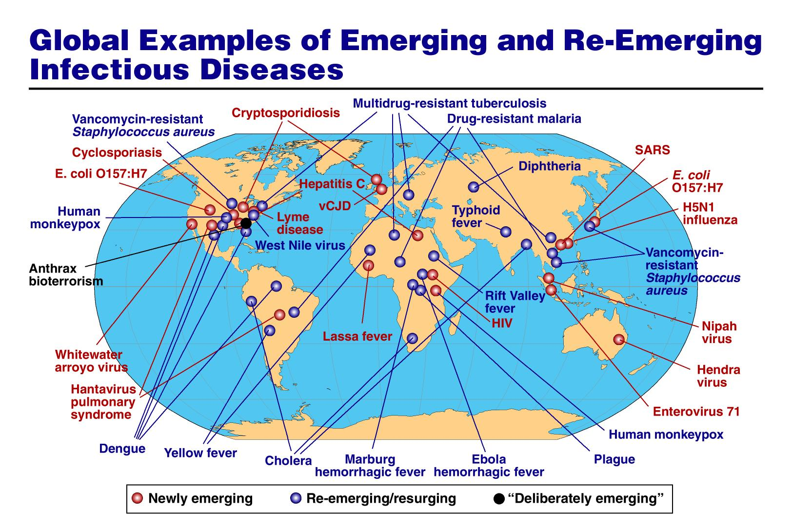
Global examples of emerging and re-emerging infectious diseases
Morens et al. 2004., Nature

Slide 138
Factors promoting zoonotic emergence
Increased human susceptibility
Poverty
Climate and ecosystem changes
Anthropogenic changes
Displaced populations (war, natural disaster)
Globalization
  Travel for work or tourism
  Food product and livestock transport (tens of millions of wild and domestic animals shipped annually)
Inadequate public health measures
Antibiotic use (contributes to antibiotic resistance)
Population size and density: allows maintenance and amplification of disease through horizontal transmission

Slide 139
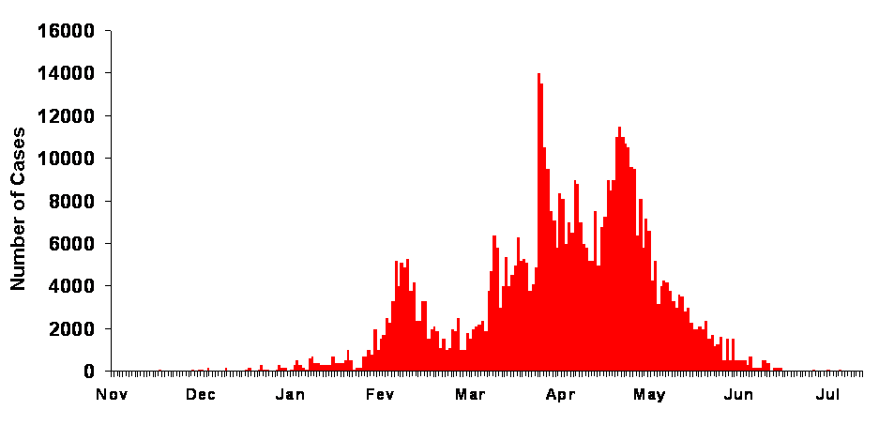
Drivers of Pandemic Risk
PANDEMIC Global spread
Global travel and trade
Globalization
Global travel: people, animals, vectors
Global trade: animal and their products
EPIDEMIC Amplification
Amplification
Urbanization
Population density
Agricultural intensification
Technology and industry
Vector distribution and densities
Transmission in health care centers
Successful A2H, V2H & H2H transmission
Human to human
transmission
Amplification
OUTBREAK Emergence
Emergence
Human encroachment
Exploitation
Translocation
Climate variability
Vector density and distribution
Ecological Pressure
Human
Ecosystem
Environment
interface

Slide 140
Goal 5:To appreciate and value the measures of disease frequency
By the end of the course, the participants should be able to:
use measures of disease frequency.
define and differentiate the measures of diseases frequency: ratios, proportions, incidence, prevalence, attack rates.

Slide 141
Measures of frequency
The basic tools to describe quantitatively the causes and patterns of disease, or any other event related to health in human populations.
For example:
  How many people are affected by a certain disease?
  What is the rate at which the disease in occurring through time?
  How does the disease burden vary by geographical region, by sex, by age, or various modes of exposure? Etc.

Slide 142
Epidemiology
Count
Divide
Compare

Slide 143
Example
To measure an event
Count
No. of new of AIDS cases
City A 58
City B 35

Slide 144
To measure an event
Count
No. new AIDS casesCases Year Population
City A 58 1990 25,000
City B 35 1989-90 7,000

Slide 145
To measure an event
Count
No. new
AIDS
cases Year Population
City A 58 1990 25,000
City B 35 1989-90 7,000
Divide
City A: 58 / 25,000 / 1 year
City B: 35 / 7,000 / 2 years

Slide 146
To measure an event
Count
No. new
AIDS
cases Year Population
City A 58 1990 25,000
City B 35 1989-90 7,000
Divide
City A: (58/25,000)/ 1 year
City B: (35/7,000)/ 2 years
Compare
City A: 232/100,000 per year
City B: 250/100,000 per year

Slide 147
Ratio
Proportion
Rate
What, who is in the denominator ? ???

Slide 148
Ratio
The quotient of 2 numbers
Numerator NOT necessarily INCLUDED in the denominator
Allows to compare quantities of different nature
= 5 / 2 = 2.5 /
1

Slide 149
Ratio- Examples
# beds per doctor
  850 beds/10 doctors
  R = 85 beds for 1 doctor
# participants per facilitator
# inhabitants per latrine
Sex ratio: Male / Female
Female / Male
Odds ratio
Rate ratio
Prevalence ratio

Slide 150
Ratio of AIDS case rates between city A and city B.
City A: 232/100,000 persons per year
City B: 250/100,000 persons per year
Q: What is the ratio of the rates for
city A compared to city B?
city B compared to city A?

Slide 151
Proportion
The quotient of 2 numbers
Numerator NECESSARILY INCLUDED
in the denominator
Quantities have to be of the same nature
Proportion always ranges between 0 and 1
Percentage = proportion x 100
2
--- = 0.5 = 50%
4

Slide 152
Proportion - Example
AIDS cases:
4000 male cases
2000 female cases
Q: What is the proportion of male cases among all cases? Female cases among all cases?

Slide 153
Example
The Proportion HIV-positive
Among 500 persons tested last week for HIV in city A, 50 were HIV‑positive: 32 men and 18 women.
Q: What is the proportion of persons who are HIV‑positive?
Q: What proportion of the HIV‑positives are male?

Slide 154
Example
Population
3500 women
6500 men
Proportion of men
= 6500 / (3500 + 6500) = 0.65 or 65 %
Male to female ratio
= 6500 / 3500 = 1.86
Female to male ratio
= 3500/6500 = 0.54

Slide 155
Rate
The quotient of 2 numbers
Speed of occurrence of an event over time
Numerator
  number EVENTS observed for a given time
Observed in 1998

Slide 156
Rate
The quotient of 2 numbers
Speed of occurrence of an event over time
Numerator
  number of EVENTS observed for a given time
Denominator
  population in which the events occur
  (population at risk)
  - includes time
Observed in 1998
2
----- = 0.02 / year
100

Slide 157
Rates
Something that may change over time
Something that is observed during some time
Measures the speed of occurrence of an event
Measures the probability to become sick by unit of time
Measures the risk of disease
Time is included in the denominator !!
However, rate is frequently used instead of ratio or proportion !!

Slide 158
Rate - Example
Mortality rate of tetanus in X country in 1995
  Tetanus deaths: 17
  Population in 1995: 58 million
  Mortality rate = 0.029/100,000/year
Rate may be expressed in any power of 10
  100, 1,000, 10,00, 100,000

Slide 159
Odds
Probability that an event will happen
Probability that an event will not happen
Won Lost Total
  ------------------------------------------------------------------------------------------------------------------------------------------------
  Rwanda Volleyball
  team 2012 14 1 15
  --------------------------------------------------------------------------------------------------------------------------------------------------
14 / 15
Odds = -------------
1 / 15
Odds of winning = 14 : 1 = 14
Odds of not winning = 1 : 14 = 0.07

Slide 160
Measures of Disease Occurence
Two types of measures :
  Prevalence
  Measures population disease status
  Incidence
  Assesses frequency of disease onset
    Cumulative incidence or incidence proportion
    Incidence density or incidence rate

Slide 161
Prevalence
Number of cases of disease at a specific time
Population at risk at that time
Proportion of a population affected by a disease
at a given time.
Expressed as a percentage
Example of bilharzia in Guadeloupe in 1979:
  Population 350,000
  Cases 96,200
  Prevalence 27.6%

Slide 162
Prevalence
Proportion of a population that is affected by disease at a given point in time.
(Point prevalence)
Prevalence in a period of time
(Period prevalence)
t1
t2
Notes:
The amount of disease in a population is constantly changing. For a stop action look at a single point in time you can use point prevalence.
If you want to know how much disease is present over a longer period of time can use period prevalence.

Slide 163
Example:
In a survey of patients in OPD clinic, 60 of 300 interviewed patients reported use of a bednet in the last 2 months before interview. The period prevalence of bednet use over last 2 months is calculated as:
Identify numerator = bednet users = 60
Identify denominator = total interviewed = 300
Calculate numerator/denominator x (100) =
60/300 x 100 = 20.0%

Slide 164
Cumulative Incidence (CI)
Number of NEW cases of disease during a period
Population at risk during this period
Incidence Proportion
Example of bilharziasis in Guadeloupe in 1979:
  Population 350,000
  New cases 1,250
  Cumulative incidence 3.6/1000 per year
  Prevalence 27.6%

Slide 165
Cumulative Incidence: Incidence proportion
CI assumes that the entire population at risk
followed up for specified time period
x
Risk
x
x
x
x
CI = 7/12 per year
= 0.58 per year
x
x disease onset
x
Month 1
Month 12

Slide 166
Example - Figure 1
Prevalence and Incidence of Disease X
July 1 August 1
Community Population 100
Notes:
Let us now do some calculations of the various epidemiologic measures we have discussed. The horizontal lines in this figure represent seven individual cases of disease X occurring last July. The date of onset of each case of illness is represented by the dot at the left of each line, while the dot at the right of each line represents the termination date of each illness, when the patient either fully recovered from his or her illness, or died of it. Thus, chronologic time is represented on a horizontal axis from left to right, and the length of the line represents the duration of each illness. Assume these seven cases occurred in a total population at risk of 100 persons.
QUESTION: What was the prevalence of disease X on July 1?
ANSWER: To calculate this we see that there were three cases on July 1, so we divide 3 by the total population, 100. This gives us a disease X prevalence rate of 3% for July 1.
QUESTION: Would this rate represent point prevalence or period prevalence? Why?
ANSWER: Point prevalence, because it represents the number of active cases of illness at a specific point in time, July 1. Someone might argue that the rate represents period prevalence for the 24-hour interval from midnight at the start of July 1st until midnight at the end of July 1st, but for simplicity we are going to assume that a single day represents a single point in time.
QUESTION: What is the prevalence on August 1?
ANSWER: Four per 100, which is the same as 4 percent, or 40 per 1,000, or 400 per 10,000, or 40,000 per million. Again, this is point prevalence.
QUESTION: What is the period prevalence for the month of July ?
ANSWER: The period prevalence rate would require you to know the number of individuals sick with disease X at any time during that month. There were 3 already sick on July 1 plus 4 new cases developed during the month) which would be a total of 7 cases. These 7 would be divided by the 100 persons in the population at risk for a period prevalence of 7% for July.
Now, imagine that this disease X is a temporary one, like diarrhea, and that one of these 7 persons who was sick in the beginning of July got well, and then got sick a second time before the end of July.
QUESTION: What would the July period prevalence be in that situation?
ANSWER: Most epidemiologists would say the period prevalence was 8%. The usual unit of epidemiologic analysis is the "case", an event of illness, and not the individual person, and thus for some diseases an individual can be a case more than once. On the contrary, HIV infection is considered a lifelong condition and one cannot revert to an uninfected state with current technology and understanding. The same is true with AIDS. Once diagnosed with AIDS, one keeps that diagnosis, even if the opportunistic condition which gave rise to the diagnosis, such as Pneumocystis pneumonia, is successfully treated.
Now let's examine the incidence of disease X in this population.
QUESTION: What would be the cumulative incidence, or the "standard" incidence rate, for the month of July?
ANSWER: Take the number of new cases, which is 4, and divide by the overall population at risk, which is 100. So the "standard" incidence rate or "cumulative incidence" would be 4 cases per 100.
QUESTION: Now, if you were calculating the incidence density, would the numerator be the same 4 cases?
ANSWER: Yes.
QUESTION: So how would you calculate the denominator for the incidence density?
ANSWER: You would sum the time "at risk" to become a new case for all individuals in the population. First, let's do this for the people who were not sick at all, and for convenience let's use units of weeks: There were 93 people (100-7) who never were sick during the entire 4 weeks, so 93 persons times 4 weeks equals 372 person-weeks.
Then we want to look at each sick person and add up the number of weeks they were not sick and thus at risk of becoming sick: The first case was sick the whole month, so it's 0 weeks at risk. We have one for 3 weeks, another for 2 weeks, another for 1 week, the next for 2 weeks, another for 1 week, and the last one for 2 weeks, which subtotals to 11 weeks, and added to the 372 weeks gives a total of 383 weeks.
So, 4 new cases among 383 person-weeks is a rate of 0.01 cases per person-week. For convenience, multiply by 100 to get 1 case per 100 person-weeks.
QUESTION: How would you convert your person-time denominator to person-years in order to have more convenient numbers to express density incidence?
ANSWER: Since there are 52 weeks/year, we divide the number of weeks 383 by 52. Which is the same as multiplying the fraction 4/383 by 52. This gives us an incidence rate of 0.54 per person-year, which converts to 54 per 100 person-years.

Slide 167
Example - Figure 1
Prevalence and Incidence of Disease X
July 1 August 1
Community Population 100
Point prevalence July 1 = 3/100 = 3%
Point prevalence August 1 = 4/100 = 4%
Period prevalence for July = 7/100 = 7%
Cumulative incidence = 4/100=4 cases per 100persons per month
Notes:
Let us now do some calculations of the various epidemiologic measures we have discussed. The horizontal lines in this figure represent seven individual cases of disease X occurring last July. The date of onset of each case of illness is represented by the dot at the left of each line, while the dot at the right of each line represents the termination date of each illness, when the patient either fully recovered from his or her illness, or died of it. Thus, chronologic time is represented on a horizontal axis from left to right, and the length of the line represents the duration of each illness. Assume these seven cases occurred in a total population at risk of 100 persons.
QUESTION: What was the prevalence of disease X on July 1?
ANSWER: To calculate this we see that there were three cases on July 1, so we divide 3 by the total population, 100. This gives us a disease X prevalence rate of 3% for July 1.
QUESTION: Would this rate represent point prevalence or period prevalence? Why?
ANSWER: Point prevalence, because it represents the number of active cases of illness at a specific point in time, July 1. Someone might argue that the rate represents period prevalence for the 24-hour interval from midnight at the start of July 1st until midnight at the end of July 1st, but for simplicity we are going to assume that a single day represents a single point in time.
QUESTION: What is the prevalence on August 1?
ANSWER: Four per 100, which is the same as 4 percent, or 40 per 1,000, or 400 per 10,000, or 40,000 per million. Again, this is point prevalence.
QUESTION: What is the period prevalence for the month of July ?
ANSWER: The period prevalence rate would require you to know the number of individuals sick with disease X at any time during that month. There were 3 already sick on July 1 plus 4 new cases developed during the month) which would be a total of 7 cases. These 7 would be divided by the 100 persons in the population at risk for a period prevalence of 7% for July.
Now, imagine that this disease X is a temporary one, like diarrhea, and that one of these 7 persons who was sick in the beginning of July got well, and then got sick a second time before the end of July.
QUESTION: What would the July period prevalence be in that situation?
ANSWER: Most epidemiologists would say the period prevalence was 8%. The usual unit of epidemiologic analysis is the "case", an event of illness, and not the individual person, and thus for some diseases an individual can be a case more than once. On the contrary, HIV infection is considered a lifelong condition and one cannot revert to an uninfected state with current technology and understanding. The same is true with AIDS. Once diagnosed with AIDS, one keeps that diagnosis, even if the opportunistic condition which gave rise to the diagnosis, such as Pneumocystis pneumonia, is successfully treated.
Now let's examine the incidence of disease X in this population.
QUESTION: What would be the cumulative incidence, or the "standard" incidence rate, for the month of July?
ANSWER: Take the number of new cases, which is 4, and divide by the overall population at risk, which is 100. So the "standard" incidence rate or "cumulative incidence" would be 4 cases per 100.
QUESTION: Now, if you were calculating the incidence density, would the numerator be the same 4 cases?
ANSWER: Yes.
QUESTION: So how would you calculate the denominator for the incidence density?
ANSWER: You would sum the time "at risk" to become a new case for all individuals in the population. First, let's do this for the people who were not sick at all, and for convenience let's use units of weeks: There were 93 people (100-7) who never were sick during the entire 4 weeks, so 93 persons times 4 weeks equals 372 person-weeks.
Then we want to look at each sick person and add up the number of weeks they were not sick and thus at risk of becoming sick: The first case was sick the whole month, so it's 0 weeks at risk. We have one for 3 weeks, another for 2 weeks, another for 1 week, the next for 2 weeks, another for 1 week, and the last one for 2 weeks, which subtotals to 11 weeks, and added to the 372 weeks gives a total of 383 weeks.
So, 4 new cases among 383 person-weeks is a rate of 0.01 cases per person-week. For convenience, multiply by 100 to get 1 case per 100 person-weeks.
QUESTION: How would you convert your person-time denominator to person-years in order to have more convenient numbers to express density incidence?
ANSWER: Since there are 52 weeks/year, we divide the number of weeks 383 by 52. Which is the same as multiplying the fraction 4/383 by 52. This gives us an incidence rate of 0.54 per person-year, which converts to 54 per 100 person-years.

Slide 168
Incidence Density
Number of NEW cases of disease during a period
Total person-time of observation
Rate
Instantaneous concept (like speed)
Denominator:
- is a measure of time
- the sum of each individual’s time at risk and free from disease

Slide 169
Incidence (density) rate
Incidence rate must take into account
number of individuals who become ill
in a population
and the time periods experienced by
members of the population
during which the events occur.

Slide 170
Person-time
100 persons years
1 person for 100 years
50 persons for two years
200 persons for 6 months
Sum of various length of time periods
cases /
person-year
/ person-month
/ person-week
/ person-day
Incidence (density) rate

Slide 171
90 91 92 93 94 95 96 97 98 99 00 Time at risk
A
B
C
D
E
6.0
6.0
10.0
8.5
5.0
x
x
Total years at risk 35.5
-- time followed
x disease onset
ID = 2 / 35.5 person- years
= 0.056 person-year

Slide 172
Example
1000 HIV negative persons were tested one year later and 50 were found HIV positive.
What is the incidence (cumulative incidence) of HIV infection?
What is the incidence density (person-time rate) of HIV infection?
Notes:
Let's do another example. Suppose we have a group of 1000 persons whom we test and find HIV-negative. A year later we test this cohort again and find that 50 are now HIV‑positive.
QUESTION: What is the incidence rate, or cumulative incidence, of seroconversion to HIV positivity?
ANSWER: The answer would be 50 cases per 1,000 population at risk, or 5% in this year.
QUESTION: Now what is the incidence density of seroconversion to HIV positivity?
ANSWER: We cannot determine incidence density in this situation, since we do not know at what time during the year the 50 HIV‑infected persons became so and thus stopped being at risk for becoming infected again.

Slide 173
Example
1000 HIV negative persons were tested one year later and 50 were found HIV positive.
What is the incidence rate (cumulative incidence) of HIV infection?
50 cases per 1000 population at risk or 5% in this year
What is the incidence density of HIV infection?
Do not know the time of infection, thus the time they stopped being at risk of becoming infected.
Notes:
Let's do another example. Suppose we have a group of 1000 persons whom we test and find HIV-negative. A year later we test this cohort again and find that 50 are now HIV‑positive.
QUESTION: What is the incidence rate, or cumulative incidence, of seroconversion to HIV positivity?
ANSWER: The answer would be 50 cases per 1,000 population at risk, or 5% in this year.
QUESTION: Now what is the incidence density of seroconversion to HIV positivity?
ANSWER: We cannot determine incidence density in this situation, since we do not know at what time during the year the 50 HIV‑infected persons became so and thus stopped being at risk for becoming infected again.

Slide 174
Estimating Incidence Density
Assume disease is acquired on the mid-point of the interval between the last disease-free visit and the first visit when disease diagnosed.
What is the incidence density of HIV infection?
Notes:
In such situations, one often assumes they all became infected on the midpoint day of the year, as that is likely to be the "average" day of infection if the members of the group became infected at random times during the year.
QUESTION: Using the mid-point assumption, what would be the incidence density of HIV infection in this cohort?
ANSWER: The numerator of the incidence density would be the 50 cases of new infection. To calculate the denominator, first take the 950 persons who did not become infected, who would contribute a total of 950 person-years to the incidence density denominator.
Next, take the HIV seroconverters, who are all assumed to have become infected on July 1. They were each at risk for half the year while they remained uninfected, so 50 persons times 1/2 year each equals 25 person-years. So the incidence density would be 50 cases per a total of 975 (950 + 25) person-years. This converts to an incidence density of .05 case per person-year, or 5.1 cases per 100 person-years.

Slide 175
Estimating Incidence Density
Assume disease is acquired on the mid-point of the interval between the last disease-free visit and the first visit when disease diagnosed.
What is the incidence density of HIV infection?
950 persons not infected = 950 person-years
50 persons at risk for ½ year = 50 x ½ = 25 person-years
50 new cases/975 person-years = .05 case per person-year, or 5.1 cases per 100 person-years
Notes:
In such situations, one often assumes they all became infected on the midpoint day of the year, as that is likely to be the "average" day of infection if the members of the group became infected at random times during the year.
QUESTION: Using the mid-point assumption, what would be the incidence density of HIV infection in this cohort?
ANSWER: The numerator of the incidence density would be the 50 cases of new infection. To calculate the denominator, first take the 950 persons who did not become infected, who would contribute a total of 950 person-years to the incidence density denominator.
Next, take the HIV seroconverters, who are all assumed to have become infected on July 1. They were each at risk for half the year while they remained uninfected, so 50 persons times 1/2 year each equals 25 person-years. So the incidence density would be 50 cases per a total of 975 (950 + 25) person-years. This converts to an incidence density of .05 case per person-year, or 5.1 cases per 100 person-years.

Slide 176
Population of City of Alpha on March 30th, 1992 = 183,000
Number of new active cases of TB occurring between January 1st and June 30th, 1992 = 26
Number of active TB cases on TB register on June 30th, 1992 = 264
The incidence rate of active cases of TB between January 1st and June 30th, 1992?
The prevalence rate of active TB as of June 30th, 1992?

Slide 177
Issues in Calculating Incidence
Define case
Denominator must represent population at risk
Notes:
The case definition must be clear. As an example, if you are looking at malaria, if one clinic uses a clinical definition such as fever and headache and another uses smear postivity you are not measuring the same thing. This is also true for prevalence.
The Denominator must represent the population at risk, or example, if you are looking at endometrial cancer what would be the denominator?

Slide 178
Comparing Incidence and Prevalence
Incidence
New cases or events over period of time
Useful studying factors causing disease, disease “risk”
Prevalence
All cases at point/period of time
Useful for measuring size of problem and planning

Slide 179
Relationship of Incidence to Prevalence
Prevalence depends on both incidence rate and duration of disease.
Because prevalence affected by factors such as migration and duration, incidence is preferred for studying etiology.
Notes:
Illnesses that you either die from quickly or recover from quickly, therefore a short duration will have a lower prevalence regardless of their incidence.
Illnesses that have a long duration due to low mortality and inability to cure will have a high prevalence even with a low incidence. Examples could include hypertension or adult onset diabetes.
Other examples; Consider putting the page 87 example on board.
Consider water example inflow is migration and incidence, outflow is death, cure, emigration.

Slide 180
Relationship between
Incidence, Prevalence and Disease Duration
Incidence
Deaths,
Cured,
Lost...
Prevalence
Duration
Adapted from Jean-Luc Grenier
Notes:
Let us discuss the relationship between prevalence and incidence, and the differences between the two measures. This beaker of water illustrates the relationship. The level of water in the beaker represents the prevalence of, say, HIV‑infected persons. This level is a function of the rate at which new infections pour into the beaker, representing incidence, as well as the rate at which water leaves the beaker, representing losses to the population due to mortality or moving out of the community.
If no deaths occurred, then the water level, representing the prevalence, would increase over time at the rate of the entry of the incoming water representing new infections. On the other hand, if there were no new cases and water stopped entering the beaker (or new cases of HIV stopped occurring), prevalence would decline as water left the beaker.
If the inflow and outflow to the beaker are balanced, even if at very high levels, then a stable level of water would occur. In such a situation, a stable prevalence rate could mask a very high incidence rate.
Since epidemiologists and public health officials are concerned about preventing new infections, incidence is generally a better measure to use to monitor how rapidly a disease is spreading. The problem with incidence, of course, is that it requires one to follow cohorts of specific individuals through time to measure new onset of disease. In most cases this is very expensive and not practical.

Slide 181
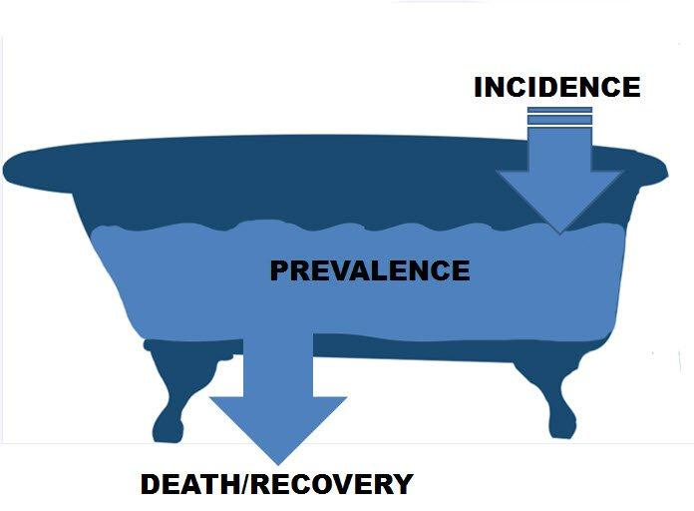
Prevalence and Incidence
Prevalence is a function of the incidence of disease and the duration of the disease
Notes:
Incidence and prevalence are related to each other. Incident cases are new cases, while prevalent cases are cases with the disease at a given point in time. Think of water in a bathtub. New cases, or incident cases, are like new water coming into the tub from the faucet. They add to the cases that are already there, or prevalent cases, which are like the water already in the tub.
Individuals who die from a disease, or who recover from a disease, fall out of the pool of prevalent cases, because they are no longer counted as having the disease. They are like water leaving the tub through the drain.
181

Slide 182
Prevalence and Incidence
= prevalent cases
Prevalence
Notes:
Let’s walk through another pictorial diagram that represents the relationship between prevalence and incidence.
Here, green smiley faces are going to be our prevalent cases. Here they are hanging out – if we were to ask who has disease at this moment, all of these smiley faces would. Let’s call this our baseline level of disease – when we look at a population, this is how many cases there are.

Slide 183
Prevalence and Incidence
= prevalent cases
New prevalence
Incidence
Old (baseline) prevalence
= incident cases
No cases die
or recover
Notes:
Now, the red faces will be our incident cases. As they develop disease, they are incident, or new, cases. The last time we looked, these smiley faces did not have disease – so they represent the incidence of disease from the last slide to this one.
Although the red smiley faces are new, they add to the cases that are already there, so the prevalence of disease in this population has just increased because of the high incidence. Note that if the incidence was low – say only one or two new red smiley faces – the prevalence would not change by much.

Slide 184
Prevalence and Incidence
= prevalent cases
= incident cases
= deaths or
recoveries
Notes:
If nobody recovered from disease, the prevalence of all kinds of diseases would be extremely high. Luckily, people and animals can recover from many (maybe even most?) diseases. When individuals recover from disease, or die from it, the prevalence decreases by that amount. When individuals no longer have a disease or health condition, they are no longer prevalent cases. In this diagram, individuals who recover are represented by the yellow smiley faces.
There is a flow that is represented by this diagram. Prevalent cases are already there. Incident cases come in and add to the prevalent cases, while deaths or recoveries decrease the amount of prevalent cases.

Slide 185
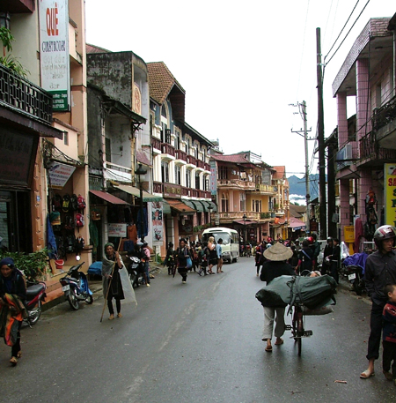
Practice Scenario
A town has a population of 3600. In 2013, 400 residents of the town are diagnosed with a disease. In 2014, 200 additional residents of the town are diagnosed with the same disease. The disease is lifelong but it is not fatal.
What is the prevalence in 2013? In 2014?
What is the incidence in 2014?
www.adventurealive.com
Notes:
Let’s walk through a practice scenario of calculating incidence and prevalence.
Say we are looking at a town with a population of 3600. In 2010, 400 residents of the town are diagnosed with a disease of interest.
In 2011, 200 additional residents of the town are diagnosed with the same disease. The disease is lifelong but it is not fatal.
How would you calculate the prevalence in 2010? In 2011?
How would you to calculate the incidence in 2011?
Note that we can calculate prevalence in both 2010 and 2011, but we can only calculate incidence in 2011. This is because we do not know how many of the cases in 2010 were NEW cases. In 2011, we can see that we have 200 new cases.
Also, the prevalence calculations will not be affected by case-patients that recover or case-patients that die. No one recovers or dies from this disease, so we do not have to consider this in the prevalence calculation. On the next slide, we will look at how to calculate these measures.

Slide 186
Practice Scenario Answers
Population: 3600
2013: 400 diagnosed with a disease
2014: 200 additional diagnosed with the disease
No death, no recovery
Prevalence (2013)
400
3600
11.1%
Prevalence (2014)
600
3600
16.7%
Incidence (2014)
?
?
?
Numerator
Denominator
Notes:
A short re-cap is at the top of this slide for your reference: we have a population of 3600, with 400 cases in 2013 and 200 more cases in 2014. To calculate the prevalence in 2013, we simply take the number of individuals with disease in 2013 (which is 400), and divide that by the total population in 2013 (which is 3600). This yields a prevalence of 11.1%.
The prevalence calculation is done in the same way in 2014, only this time we add the 200 NEW cases to the 400 OLD cases, so the numerator is 600. This gives a 2014 prevalence of 16.7%.
How would you go about calculating incidence (the final column)?

Slide 187
Practice Scenario Answers
Population: 3600
2013: 400 diagnosed with a disease
2014: 200 additional diagnosed with the disease
No death, no recovery
Prevalence (2013)
400
3600
11.1%
Numerator
Denominator
Prevalence (2014)
600
3600
16.7%
Incidence (2014)
200
3200
6.3%
Notes:
A short re-cap is at the top of this slide for your reference: we have a population of 3600, with 400 cases in 2013 and 200 more cases in 2014. To calculate the prevalence in 2013, we simply take the number of individuals with disease in 2013 (which is 400), and divide that by the total population in 2013 (which is 3600). This yields a prevalence of 11.1%.
The prevalence calculation is done in the same way in 2014, only this time we add the 200 NEW cases to the 400 OLD cases, so the numerator is 600. This gives a 2014 prevalence of 16.7%.

Slide 188
Special types of Incidence
Type | Numerator | Denominator
Morbidity rate | # cases | Population at risk
Mortality rate | # deaths | Population at risk
Case-fatality rate | # deaths from a disease | Total cases of that disease
Attack rate | # cases during “epidemic” period | Population at risk
Notes:
With both incidence and prevalence, the numerators and denominators can be altered to give specialized types of measures suitable for use in particular circumstances. Several specialized incidence rates that you will be hearing and using in epidemiology are morbidity rate, mortality rate, case-fatality rate, and attack rate.
The morbidity rate for a particular disease is the incidence of cases, that is, new cases of that disease, both non-fatal and fatal, in the population at risk during the specified period of time. In reporting morbidity rates, we often use the total population for the denominator, even if that is not really the precise population at risk. For example, we might say that the measles morbidity rate for 1993 in country X was 26 cases per 100,000 population. Technically, people who have already had measles are no longer at risk for it, but for convenience we still might use the total population in expressing a measles morbidity rate, since no one know the number of non-immune persons who might be the more specific "population at risk".
The mortality rate for a disease is the incidence of deaths in a population at risk due to that disease during a certain time period, and it is calculated similarly to the morbidity rate. A total mortality rate would reflect all causes of deaths. The population at risk is often the total population, but not always. For example, the mortality rate for prostate cancer and for breast cancer are often expressed with denominators of the populations of either men or women, respectively, since these diseases only occur in one sex or the other.
The case-fatality rate is a measure of how deadly a disease is. It is calculated from the number of deaths from a disease divided by all cases of that disease. It is really a ratio so you can also refer to the death to case ration.
Another type of incidence rate used frequently in epidemic investigations is the attack rate. The attack rate is the cumulative incidence of a disease among a particular population at risk during a specific epidemic period. For example, if all 36 students in this class attend the course picnic, and 12 of you get sick with food poisoning

Slide 189
Attack Rate
Cumulative incidence during an outbreak
  Usually expressed for the entire epidemic period, from the first to the last case
Ex: Outbreak of cholera in country X
in March 1999
  Number of cases = 490
  Population at risk = 18,600
  Attack rate = 2.6%

Slide 190
Cumulative incidence
(Attack rate)
Number of events
accumulated during a period of time
---------------------------------------------------------
Population present
at beginning of same period
These are not rates but proportions !!

Slide 191
Attack Rate
Number of new cases of a specified disease reported during an epidemic period of time
Population at risk during the same time interval
Secondary Attack Rate
Number of new cases of a specified disease among contacts of known cases
Size of contact population at risk

Slide 192
Morbidity Rates in Zimbabwe
TB: New cases reported in 1998 = 46580; Mid Year Population = 12715934
TB Incidence = 46580/12715934 x 1000 =3.7/1000
Malaria: New cases reported in 1998 = 1769420
Malaria incidence = 1769420/12715934 x 1000 = 139/1000

Slide 193
Mortality Rates
When the event under study is death rather than the occurrence of disease, we usually use the term mortality (rate) rather than cumulative incidence
Crude Death Rate (CDR)
Cause-specific Death Rate
Neonatal Mortality Rate
Perinatal Mortality Rate (PMR)
Infant Mortality Rate (IMR)
Child Mortality Rate (CMR)
Maternal Mortality Rate (MMR)

Slide 194
Crude Death Rate
The crude death rate is the mortality rate from all causes of death for the population. Numerator is all deaths.
Cause-specific Death Rate
The mortality rate from a specified cause for a population. The numerator is the number of deaths attributed to a specific cause.
The denominator for both is the size of the population at the midpoint of the time period.

Slide 195
Infant Mortality Rate
One of the most commonly used measures for comparing health services among nations.
Number of deaths among children under 1 year of age reported during a time period (usually a calendar year)
Number of live births reported during the same period
Usually expressed per 1000 live births.
Notes:
The question we are answering is “Of the children born alive, how many died before their first birthday?”
The infant mortality rate is also not technically a proper rate, since some of the infants dying this year were actually born in the previous year and are not contained in the denominator of this year's live births. We sometimes use the term index to distinguish such ratios as the maternal and infant mortality rates from true rates.
This is an important indicator as a high rate eg 120/1000 reflects poor social, economic and health conditions.
In Zimbabwe this rate, the IMR was reported to be 100-120 per 1000 live births in 1980, 84-94 in 1984, and 54 in 1988. However, the most recent report from 1999 finds the rate at 65 per 100 live births. In developed countries the rate is usually 10-20 or less.

Slide 196
Other Infant and Child Mortality Rates
Perinatal Mortality Rate:
Number of stillbirths 28 weeks or more and infant deaths under 7 days in a year
Number of live and still births 28 weeks or more in the same year
Expressed as per 1000 live and still births of 28 weeks or more
Neonatal Mortality Rate:
Number of deaths among children under 28 days of age in a year
Number of live births in the same year
Usually expressed per 1000 live births.
Notes:
There are other measures to look at the different times of infancy and childhood.
The PMR of perinatal mortality rate is a measure of the care the mother received in pregnancy (obstetric care) and the newborn baby gets immediately after birth. It can say something about the quality and accessibility of maternity services. The rate reported for Zimbabwe in 1999 was 39 deaths per 1000 pregnancies of 28 weeks or more.
The Neonatal mortality rate, tells us the probability of dying in the first month of life.

Slide 197
Other Infant and Child Mortality Rates (cont.)
Child Mortality Rate:
Number of deaths in children aged 1-4 years in a year
Number of children aged 1-4 in the same year
Under-five Mortality Rate:
Number of deaths of children under 5 years in a year
Number of live births in the same year
As the group in the numerator differs from that in the denominator for U5MR, this is actually an index rather than a rate.
Notes:
Child mortality rate is another important indicator because it measures the deaths among children over 1 year but less than 5 years. These children are at risk of malnutrition and illnesses such as diarrhea, measles, pneumonia, that may reflect economic and social conditions as well as access to health services. In Zimbabwe the CMR was calculated at 25-30 per 1000 children who had survived to age 1 year in 1990 and at nearly 40 in 1999.
The under 5 mortality takes into account the previous data and provides the probability of dying between birth and the fifth birthday. As for all the previous measures except CMR it is based on the number of live births. In Zimbabwe this was estimated to be around 75 in 1988 and this had risen to 102 per 1000 live births by the 1999 survey.

Slide 198
Maternal Mortality Rate
Number of deaths from pregnancy or childbirth in a year
Number of live births in the same year
* Actually a ratio used to measure mortality associated with pregnancy
Notes:
The maternal mortality rate is really a ratio used to measure mortality associated with pregnancy. The numerator is the number of deaths assigned to causes related to pregnancy during a given time period. The denominator is the number of live births in the same period. Because maternal mortality is much less common than infant mortality the rate is usually expressed per 10,000 or 100,000 live births.
For example, the maternal mortality rate is the number of deaths to women from causes related to pregnancy, childbirth, and the perinatal period, divided by the number of live births, times a constant of 10,000. We use the number of live births, since that is a relatively easy number to come by, whereas the true population at risk would be all pregnant women, including those who never end up giving birth. This reflects the quality of obstetric care as well as social and economic conditions for women. In the 1994 DHS this was estimated at 283 per 100,000 live births. In the 1999 DHS it was estimated at 695 per 100,000 live births. This is in contrast to less than 10 in most developed countries.

Slide 199
Death-to-Case Ratio
# of deaths of particular disease during specified period
# of new cases of the disease identified during the same period
Note: Cases in numerator may not be represented in the denominator therefore this is a ratio, but not a proportion.

Slide 200
Proportionate Mortality
Deaths due to a particular cause X 100
Deaths from all causes

Slide 201
Case Fatality Rate:
Proportion of persons with a particular condition who die from that condition.
Case fatality rate
Number of deaths due to Disease X
= -------------------------------------------------
Number of cases due to Disease X
Case fatality rate is a proportion that requires deaths in the numerator to be limited to cases in the denominator.

Slide 202
In an Asian country with a population of six million people, there were 60,000 deaths during the year ending 31 December 1997. These included 30,000 deaths occurring in 100,000 people who were sick with cholera.
Mortality rate from cholera in 1997?
Case fatality rate from cholera in 1997?

Slide 203
Goal 6: To understand the scope of Descriptive Epidemiology and Analytic Epidemiology and the Key Concepts of Participatory Epidemiology
By the end of the course, the participants should be able to:
define descriptive, analytic and participatory epidemiology.
describe categories of time, place and person.
discuss the uses of descriptive and analytical studies.
describe different types of analytic study designs.
describe the key concepts of participatory epidemiology.

Slide 204
Descriptive Epidemiology
By the end of the course, the participant should be able to:
define descriptive epidemiology
describe categories of time, place and person.
discuss the uses of descriptive studies.

Slide 205
Descriptive Epidemiology
Study of the occurrence and distribution of disease
Terms:
Time
Place
Person

Slide 206
Descriptive Epidemiology
Cases
Person
Time
Place
Who? Where? When?

Slide 207
Descriptive Studies
Sometimes called Descriptive Statistics
Generally used to describe exposure variables
Is used with all types of studies
  What, who, when, where (of health events)
Describes person, place, time, using:
  Rates
  Tables: frequency distributions
  Measures of central location and dispersion
  Graphics: graphs, charts, maps
Useful for hypothesis generation and health planning.

Slide 208
Who?/Which? Where? When? How much?
Individual (Person):
  For humans; may be characterized by age, race), sex, education, occupation, prior medical history, pre-existing disease, or other personal characteristics
  For animals; may be characterized by species/breed, prior veterinary history, pre-existing disease…
Where? (Place):
  May include information on home, workplace, school
When? (Time):
  Date/time of illness onset, or exposure to risk factors
How much? (Magnitude of problem):
  Number of cases occurring in a defined time period
Notes:
Individual, place and time are related to the Who/Which, Where, and When aspects of descriptive epidemiology.
“Individual” refers to characteristics of the case-patients or population being described. They may be characterized by age, species/breed/race, sex, education, occupation, or other personal characteristics.
The “Place” aspect may include information on where the farm, home, workplace, or school are located, such as when an outbreak occurs at one of these settings.
“Time” may be used to describe time of illness onset, or to describe when exposure to risk factors occurred.
The next few slides will walk through each of these aspects in more detail.

Slide 209
Why describing?
To get familiar with:
  the data
  the problem, its characteristics and magnitude
To determine groups at risk
To gather information for generating hypothesis on aetiology, transmission ….
To communicate the results

Slide 210
Descriptive Epidemiology
When have they been
affected
Where have they been
affected
Who has been
affected
Time
Place
Person
Animal
Ecosystem?...

Slide 211
Time
Health events present variations over time
  Annual, seasonal, daily, hourly,
  Onset of symptom
  Date of reporting
Graphical representation of data in a X, Y system:
  Magnitude of the problem
  Trends and potential evolution
  Type of transmission
  Other related events
Notes:
let us now look more closely at time
malaria, yellow fever, seasonal influenza, disease rates,
Time on x-axis

Slide 212
Time
Outbreaks/Epidemics
Epidemic curve
Cyclic, endemic or chronic phenomena
Trends
Seasonal
Secular
Notes:
Different types
Outbreaks

Slide 213
Time
Secular
Periodic
Seasonal
Epidemic

Slide 214
Secular Trend
The long-time trend of disease occurrence

Slide 215
Tetanus – by Year, United States, 1955-2000
During 2000, a total of 35 cases of tetanus were reported. The percentage of cases among persons aged 25-59 years
has increased in the last decade. Note: A tetanus vaccine was first available in 1933.
Reported Cases

Slide 216
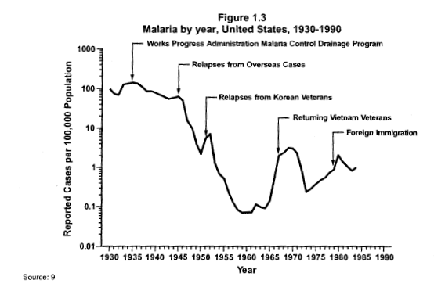
Secular (Long-term) Trends
Works Progress Administration Malaria Control Drainage Program
Relapses from overseas cases
Relapses from Korean Veterans
Returning Vietnam Veterans
Foreign Immigration
Am J Epidemiol 1990;132:S14-22
Notes:
Secular trends

Slide 217
Periodic Trend
Temporal interruption of the general trend of secular variation

Slide 218
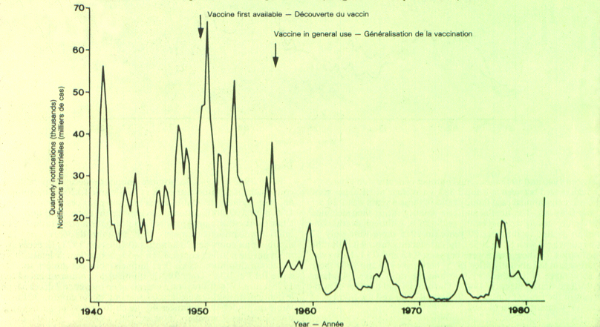
Quarterly Notifications of Whooping Cough Cases, England and Wales, 1940-1982

Slide 219
Seasonal Trend

Slide 220
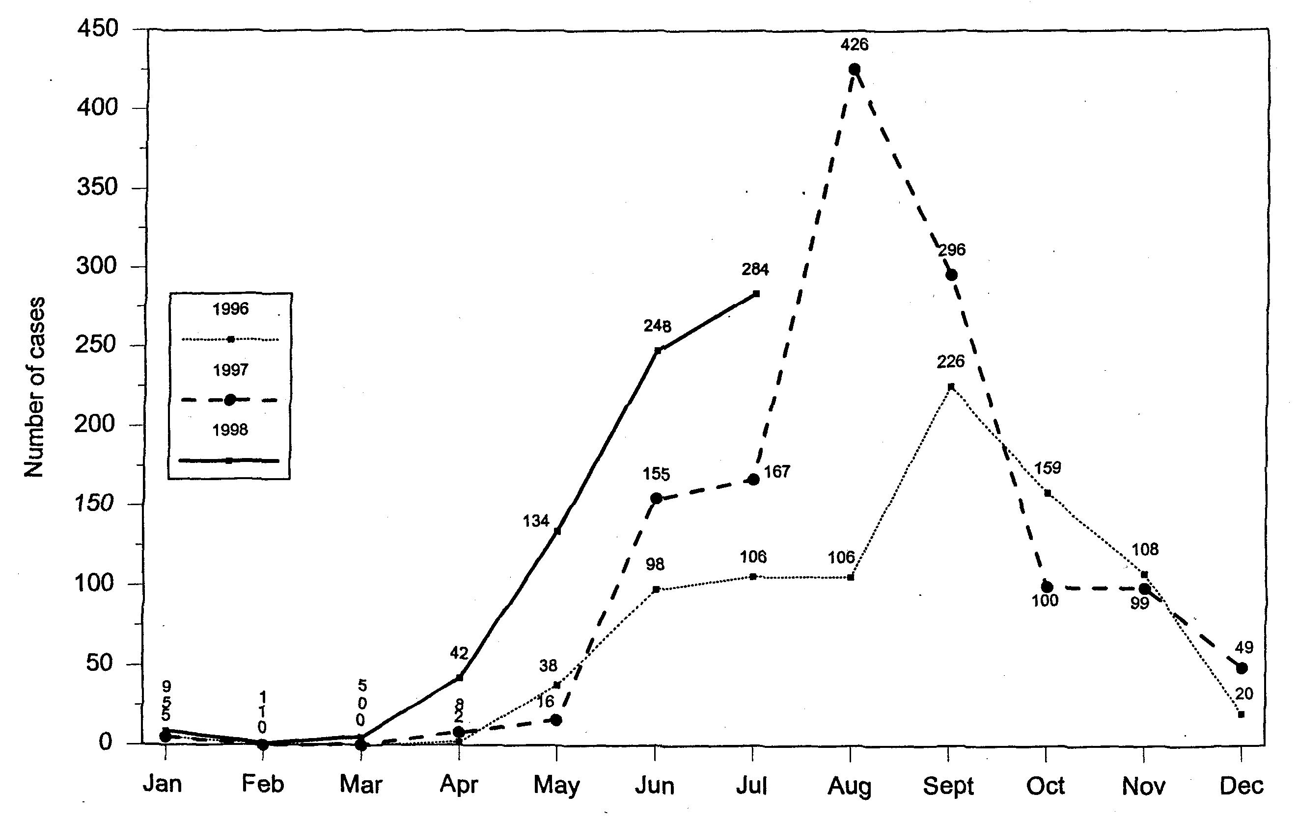
Niger Guinea Worm Eradication Program
Number of cases of dranculiasis reported from Tillabery Department, 1996-1998

Slide 221
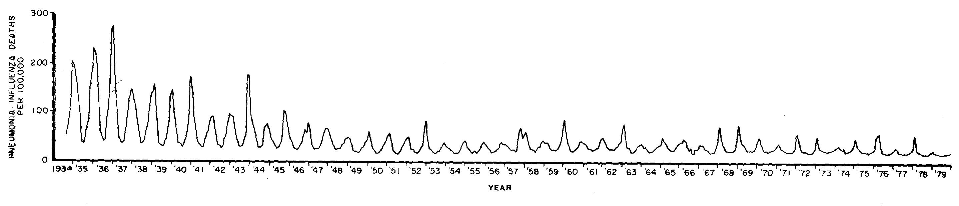
Pneumonia-Influenza Deaths – By Year, 1934-1980

Slide 222
Place
Where patient was exposed
or
Where source became infected.

Slide 223
Place
Geographic Area Example Action Level
Diagnosis is Made
Contact occurred between agent and host
Source became infected
Home – Patient Ill
Restaurant – Food Eaten
Farm – Eggs Infected
Investigation
Control
Prevention

Slide 224
Place
Gives information on :
  Geographic distribution
  Cluster of cases
  Dissemination route
Use of maps
  Representation of cases and possible sources of exposure

Slide 225
Place
Geographical locations
  Place of residence, workplace, services in a hospital…
Geographical units
  District, municipalities, neighbourhoods, streets, rooms…
Categories
  Urban-rural, autochthonous-imported…
Place of exposure vs. place of notification

Slide 226
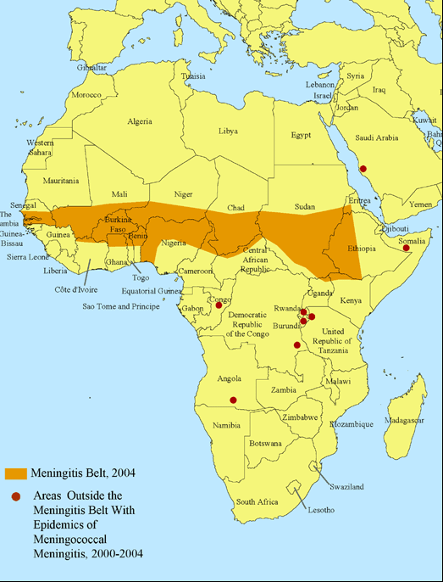
The Meningitis Belt of Africa, 2004
Areas outside the belt with meningoccocal meningitis epidemics, 2002-2004

Slide 227
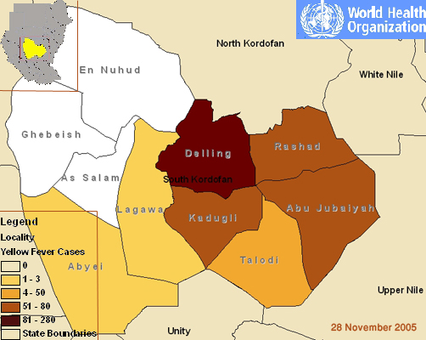
Yellow fever outbreak in South Kordofan, November 2005

Slide 228
Person
Determine who is at risk
Different categories
  Demographic: age, sex, ethnicity…
  Socio-economic: education, occupation, access to services…
  Individuals: blood group, vaccination status, smokers…
Presentation in table, graphs

Slide 229
Person
Age Hobbies
Sex Pets
Occupation Travel
Immunization status Personal habits
Underlying disease Stress
Medication Family unit
Nutritional status School
Socioeconomic factors Genetics
Crowding Religion

Slide 230

Person: Age
Importance +++
Reflects:
  Susceptibility
  Differences in exposure
  Latency, incubation period

Slide 231

Person: Sex
Men and women different in
  Susceptibility
  Physiologic response
  Exposures
    Habits
    Occupations

Slide 232
Person: Others
Ethnic groups
  Common social and biologic characteristics
  Associated with socio-economic factors
Socio-economic
  Difficult to establish
  Occupation, education, income
  Can reflect differences in exposure
  or access to services

Slide 233
Syphilis Cases. US 1981-90

Slide 234
Syphilis Cases by Sex. US 1981-90

Slide 235
Syphilis Cases by Sex and Racial Group. US 1981-90

Slide 236
Descriptive vs. Analytic Epidemiology
Descriptive Epidemiology | Analytical Epidemiology
Who? Which? | Why?
What? | How?
When?
Where?
How much?
Notes:
The goal of descriptive epidemiology is to describe disease or exposures in populations – answering the Who/Which, What, When and Where and How Much questions.
While the goal of analytic epidemiology is to find the causes of disease in populations – answering the Why and How questions.
In this session, we will focus on descriptive epidemiology.

Slide 237
Epidemiological Studies
Descriptive
Analytical
Populations
(Ecological)
Individuals
Observational
Intervention
Cross-sectional
Cohort
Case-
control
Clinical trials
Case-reports
Case-series
Prospective
Retrospective
(What, who, when, where)
(Why, how)
Notes:
Ecological study – study in which units of analysis are populations or groups of people (as opposed to individuals) . Analysis is based on aggregated data.

Slide 238
Descriptive Epidemiology
Provides a systematic method for characterizing a health problem
Ensures understanding of the basic dimensions of a health problem
Helps identify populations at higher risk for the health problem
Provides information useful for allocation of resources
Enables development of testable hypotheses
Identifies and clarifies disease entities
Describes transmission, distribution and evolution (natural history) of disease
Notes:
Descriptive epidemiology provides a systematic method for characterizing a health problem.
By conducting descriptive epidemiology, we can ensure that there is an understanding of the basic dimensions of a health problem.
It also helps identify populations at higher risk for the health problem, provides information useful for the efficient allocation of resources, and enables researchers to develop one or more hypotheses that can later be tested.

Slide 239
Analytic Epidemiology
By the end of the course, the participants should be able to:
define analytic epidemiology.
discuss the uses analytical studies.
describe different types of analytic study designs.

Slide 240
Analytical Epidemiology
Analytical epidemiology is based on the
observations made in the descriptive
epidemiology. The design, execution and
analysis of subjects between groups helps
evaluate potential association between risk
factors and health outcomes to answer the
question “why?”.

Slide 241
Descriptive vs. Analytic Epidemiology
 | Descriptive epidemiology | Analytic epidemiology
Questions | Who/Which What When Where | Why How
Comparison Group? | No | Yes
Notes:
You may remember that descriptive epidemiology deals with the questions: Who/Which, What, When, and Where. Descriptive epidemiology describes the occurrence of disease in a population.
Analytic epidemiology deals with the remaining questions: Why and How. Analytic epidemiology compares one group of people to another group of people to help determine the cause of a disease (e.g., compares an exposure to tobacco smoking in one group (lung cancer patients) vs. tobacco smoking exposure in another group (patients without cancer).

Slide 242
Analytic Epidemiology
Used to help identify the cause or causes of disease.
Typically involves designing a study to test the validity of one or more hypotheses concerning the occurrence of disease.
Notes:
Epidemiologists use analytic methods to help identify the cause of disease. The results of descriptive epidemiology may present some questions as to how or why disease is occurring in certain population groups. Identifying the cause of disease in groups typically involves designing a study to test one or more hypotheses that were developed using descriptive epidemiology.

Slide 243
Examine the relationship between
Cause
Effect
Factors
Disease

Slide 244
Components of Analytic Epidemiology

Slide 245
Exposure and Outcome
Exposure:
  Any factor that might influence the risk of disease
Outcome:
  Disease or condition, standardized using case definitions
Notes:
The hypothesis in an epidemiologic study explores the relationship between two main factors or characteristics of interest: an exposure and an outcome.
Exposure refers to any factor that might influence one’s risk of disease – this could be a virus, a pollutant, genetics, or many other things.
Outcome refers to the disease or health condition in question, which is standardized by a case definition.

Slide 246
Case Definition
Standard diagnostic criteria that must be fulfilled to identify an individual as a case of a particular disease
  Clinical (laboratory results, symptoms, signs)
  Restrictions on individual, place and time
Ensures that all individuals who are counted as cases actually (likely) have the same disease.
Notes:
a case definition is a set of standard diagnostic criteria that must be fulfilled in order to identify a person as a case of a particular disease. A case definition is usually made up of clinical criteria, such as signs, symptoms, and lab results, as well as restrictions on person, place and time.
Using a case definition ensures that all persons who are counted as case-patients actually have the same disease.

Slide 247
Developing Hypotheses
An hypothesis is an educated guess about an association that is testable in a scientific investigation.
Descriptive data provide information to develop hypotheses about disease causation.
Hypotheses tend to be broad initially and are then refined as more data are gathered.
Notes:
A hypothesis is an educated guess about an association between an exposure and an outcome that can be tested in a scientific investigation.
To develop a hypothesis, we have to have some information on which to base our educated guesses. In epidemiology, descriptive data provide information that can be used to develop hypotheses. Hypotheses tend to be broad initially, when less is known about what is causing a disease or health event. They are then refined to have a narrower focus.
Let’s go through some examples to illustrate this concept.

Slide 248
Why do Epidemiological Studies?
What is the problem?
  Coughing out blood among chronic smokers?
How big is the problem?
  How common is lung cancer?
Who has the problem?
  Is lung cancer more common in men?
Where is the problem?
  Is lung cancer more common in Kenya?
What causes the problem
  Does smoking cause lung cancer ?

Slide 249
Descriptive Studies
Some studies simply describe disease/health states/behaviours
    prevalence of smoking
    rates of lung cancer
Describing these factors does not link them
However, we can identify unusual distributions or correlations (e.g. clusters)
These insights can be used to generate interesting hypothesis
Examples
    Case series, cross-sectional, ecological

Slide 250
Descriptive Epidemiology
Cases
Person
Time
Place
Who? Where? When?

Slide 251
After Descriptive Analysis...
Cases described by time, place, person
Percentage of cases exposed to potential risk factor
Hypothesis
  Is the observed exposure among cases higher than expected?
Comparison group
  Baseline (background) exposure in the population

Slide 252
But Sometimes Also: Why?
What is the source of infection for an outbreak of diarrhoeal disease?
What are the risk factors for neonatal tetanus?
What factors are associated with increased mortality for persons with measles?
Does smoking cause lung cancer?
Analytical epidemiology

Slide 253
Epidemiological Studies
Populations
Correlational
Descriptive
Case-series
Individuals
Cross-sectional
Case-control
Observational
Prospective
Cohort
Analytical
Retrospective
Intervention
Clinical trials

Slide 254
Descriptive and Analytic Epidemiology
Descriptive Epidemiology
Generates idea(s) or hypothesis for associations between risk factor and illness.
Analytic Epidemiology
Uses a comparison group to establish an association between risk factors and illness in the two groups.

Slide 255
Analytic Studies
To test whether certain factors are “associated”
Association is a statistical concept
To look at association we need to move away from description of a factor in one group
We need a “comparison group”
Is cancer more common in those exposed to uranium compared to those who have never been exposed?
Is uranium associated with cancer?
Is this association statistically significant?
Could it have occurred by chance?

Slide 256
Analytical Studies
Systematic determination of disease risk association with exposure or non-exposure
Appropriate comparison group important
Two types
  Observational
    Case-control and Cohort
  Intervention
    Experimental or Clinical Trials

Slide 257
Observational Studies
exposure
outcome
cohort
effect-cause
case-control
cause-effect
outcome
exposure
outcome
exposure
cross-sectional

Slide 258
Analytical Studies
Three main study designs:
Cross-sectional study
Cohort study
Case-control study
Notes:
As we mentioned, in observational studies exposure status is not assigned, but instead the investigator simply measures exposures and outcomes that are already occurring. These are "real-world" studies because the population under study is simply being observed; the investigators are not influencing their decisions or exposures. They are the most common type of study conducted in public health.
There are three main study designs that are used. These are the cross-sectional study, the cohort study, and the case-control study.
In all of these study designs, investigators gather data on an exposure and an outcome that is already occurring (or will occur) in a population of people.

Slide 259
Cross-Sectional Studies
Exposure and outcome status are determined at the same time
  “Snapshot” of population being studied
Also includes most opinion and political polls
Notes:
A cross-sectional study collects information about the exposures and outcomes present in a population at a given point in time. A cross-sectional study is often described as a snapshot of the exposures and outcomes because both are assessed simultaneously in a population at a given moment in time.
Most opinion or political polls are also cross-sectional in nature. They assess opinions at one point in time.

Slide 260
Cross-Sectional Studies
Can be descriptive and analytical design
Investigate the association between a putative risk factor and a health outcome
Risk factors and outcome are measured simultaneously
Difficult to determine whether the exposure proceeded or followed the disease
Limited ability to draw conclusions about association between a risk factor and health outcome

Slide 261
Cohort Study Description
Study population is grouped by exposure status
Groups are then followed over time to determine if they develop the outcome of interest
 | Exposure | Outcome
Prospective | Assessed at beginning of study | Followed into the future for outcome
Retrospective | Assessed at some point in the past | Outcome has already occurred
Notes:
A cohort study is another type of observational study design. In a cohort study, members of the study population are in groups, referred to as cohorts, which are usually defined by exposure status. They are categorized as either being exposed or non-exposed (e.g., tobacco smokers vs. non-smokers).
Exposure status is what investigators are observing in the population; exposure is not assigned. These two groups are then followed over time to determine if they develop a specific health outcome. For example, a cohort study might compare people who drink fresh nipah palm sap (the exposed group) to people who do not drink fresh nipah palm sap (the non-exposed group) to determine whether consumption of fresh nipah palm sap increased the risk of infection with nipah virus.
Cohort studies can be prospective. This means that the study population is assessed as being exposed or non-exposed at the beginning of the study, and then they are followed into the future to determine whether or not they eventually develop an outcome.
A retrospective cohort study is one that assesses an exposure that occurred at some point in the past. This exposure can be determined from records or other documentation. Investigators also determine which members of the study population had a disease outcome of interest. This outcome is documented to occur after the exposure, but still may have already occurred by the time the study is being conducted.

Slide 262
Cohort Study Design
Study
Population
Exposure is
self selected
Exposed
Non-exposed
Notes:
Here is a diagram to help illustrate how cohort studies are designed. There is a population that will be studied, and investigators document whether members of the population are exposed or non-exposed. This exposure status is self-selected (for example, exposure could be drinking fresh Nipah palm sap, or not drinking Nipah palm sap at all).

Slide 263
Cohort Study Design
Study
Population
Exposure is
self selected
Exposed
Non-exposed
Follow through
time
Disease
No Disease
Disease
No Disease
Notes:
After following the exposed and non-exposed study populations from the time of exposure forward, each exposure group is assessed for a disease outcome that occurs after the exposure.
Then, for example, the observer (epidemiologist) can compare the rates of disease (e.g., Nipah virus infection) in the two groups.

Slide 264
Case-Control Study Description
Study population is grouped by outcome
1
Cases are individuals who have the outcome of interest
2
Controls are individuals who do not have the outcome of interest
3
Past exposure status is then determined
4
Notes:
Case-control studies are the third type of observational study design.
In case-control studies, the study population is grouped by outcome (e.g., disease).
Cases are individuals who have the outcome (e.g., disease), while controls are individuals who do not have the outcome (e.g. don’t have the disease) at the time the study begins.
Then, the past exposure is determined for cases and controls, to see if cases are more likely to have a specific exposure than controls.

Slide 265
Case-Control Study Design
Study
Population
Select based on disease status
Cases
Controls
Notes:
Let’s look at this diagram to help illustrate this point. As in cohort studies, we start with the study population. However, unlike cohort studies, the population is grouped by cases, who have a disease, and controls, who do not have the disease.

Slide 266
Case-Control Study Design
Study
Population
Select based on disease status
Cases
Controls
Look back in
time
Exposed
Not Exposed
Exposed
Not Exposed
Notes:
Then, both the cases (with disease) and the controls (without disease) in the study are assessed for whether or not they had a specific exposure at some time in the past.

Slide 267
Cohort VS. Case-Control
 | Cohort Study | Case-Control Study
Preferred study design when… | Population members are easily identifiable and accessible Exposure is rare There may be multiple diseases involved | Identifying and/or accessing entire cohort would be too costly or time consuming Illness is rare
Study group | Exposed individuals | Individuals with illness (cases)
Comparison group | Non-exposed individuals | Individuals without the illness (controls)
Notes:
So, how do you determine when it is best to assess exposure groups and then determine whether outcomes occur, as in cohort studies? When might it be best to assess disease status, and then determine whether exposure occurred, as in case-control studies?
Some basic guidelines are given here. Cost and feasibility are two major components of making this decision. Cohort studies are generally the preferred design when all members of the cohort are easy to identify and to access, such as all workers at a plant, all students at a school, or all ducks on a particular farm. If the entire cohort would be too costly or time-consuming to identify and access, a case-control study is preferred.
Cohort studies are preferred when you want to study an exposure that is rare in the general population. For example, if you wanted to study a specific pesticide used by agricultural workers, a large group of workers with this exposure could be gathered at one time and followed to see what diseases may occur.
If you want to study an outcome that is rare, however, a case-control study is the preferred design. A large group of cases can be drawn from medical or other records, and then this group can be investigated to see what exposures might have caused their disease.

Slide 268
Summary
Analytic epidemiology addresses “why” and “how” a health problem occurs
1
In experimental studies investigators assign exposures to participants
2
In observational studies investigators observe exposures and outcomes already occurring in the population
3
Commonly designs are cohort studies and case-control studies
4
Notes:
Analytic epidemiology is a tool that epidemiologists use to assess the potential causes of disease. It addresses the questions of “why and how” a health problem occurs.
In experimental studies such as clinical trials, investigators assign exposures to study participants. These can only be used in humans where an exposure is known not to cause harm, and is suspected to be beneficial. Experimental studies in animals can assign exposures known or suspected to cause harm, but only AFTER REVIEW and APPROVAL of the proposed methodology by official animal care and use committees of whatever organization is conducting the study.
Because epidemiologists often study harmful exposures, they use observational studies. In observational studies, investigators observe exposures and outcomes that are already occurring in the study population.
Commonly used observational study designs are cohort studies and case-control studies.

Slide 269
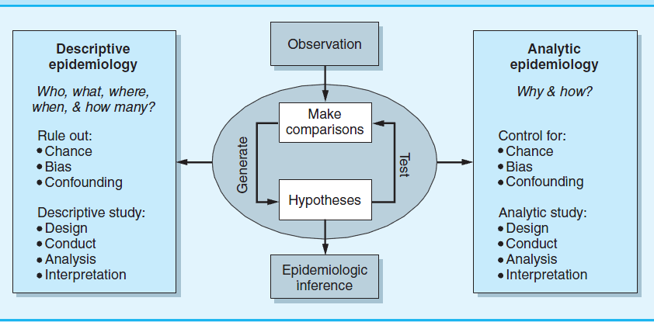
Notes:
This diagram summarizes the differences between descriptive and analytic epidemiology, and what each is used for in the practice of epidemiology.

Slide 270
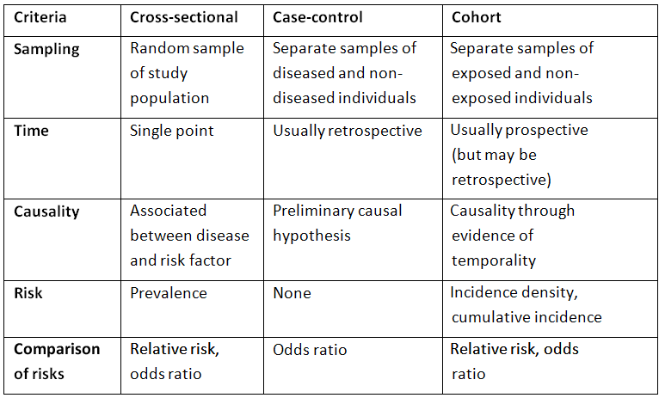
Summary of Study Designs
Notes:
This table provides a similar summary, in a different format.

Slide 271
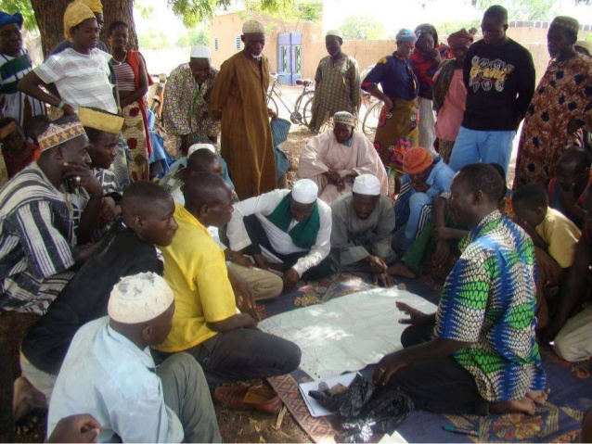
Participatory Epidemiology:
Key Concepts
By the end of the course, participants should be able to describe the key concepts of participatory epidemiology.

Slide 272
Definitions
“Participatory Epidemiology is the systematic use of participatory approaches and methods to improve understanding of diseases and options for disease control”
So,
What is a “participatory approach?”
What are “participatory methods?”
What is the link between the approach and the methods?

Slide 273
Participatory Approaches - Origins
Adult Education Movement
Social Anthropology
Agro ecosystem analysis

Slide 274
Lessons from the Adult Education Movement (1960s)
People are capable of conducting their own problem description and analysis including the poor without formal education.
Educators were required to modify their attitudes, behavior and methods on this basis.
Implies an element of attitudinal change among professionals.

Slide 275
Lessons from Social Anthropology
(from 1980s)
Rural people in developing countries have their own valuable knowledge and conduct their own experiments (indigenous technical knowledge).
Development projects are more likely to succeed if interventions are designed jointly by local people together with technical experts.

Slide 276
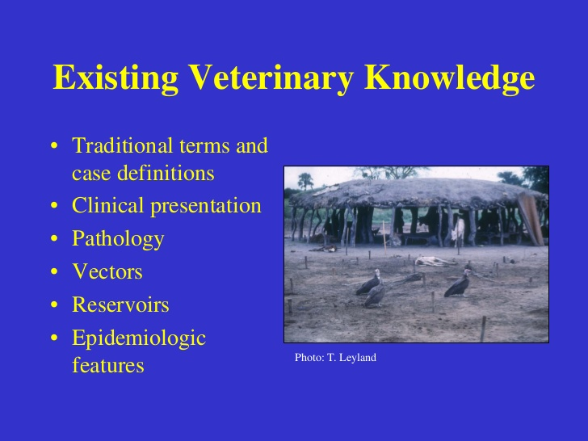

Slide 277
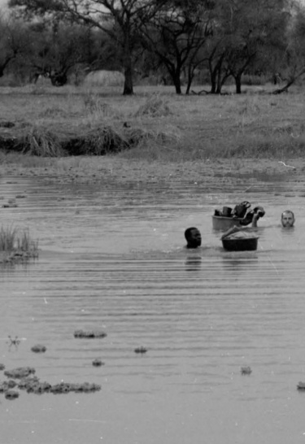
Lessons from Agro ecosystem Analysis (from the 1980s)
Optimal ignorance
We don’t need to know every possible detail of a problem in order to solve the problem.
The importance of applied, locally-relevant research to solve local problems.

Slide 278
Participatory Approach (from 1980s)
Required professionals and researchers to:
Have respect for, and willing to learn with poor rural people; this often required attitudinal change.
Be action-orientated (rather than data-driven).
Became an integral part of Participatory Rural Appraisal (PRA) and Participatory Learning and Action (PLA).

Slide 279
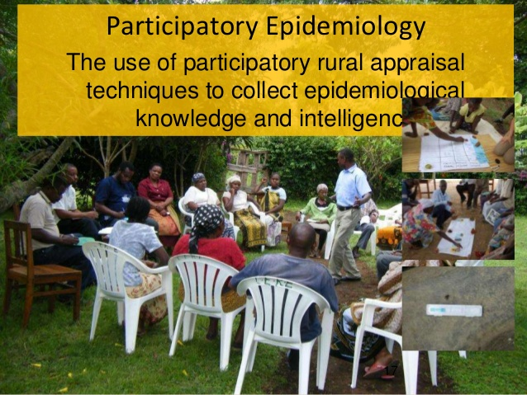

Slide 280
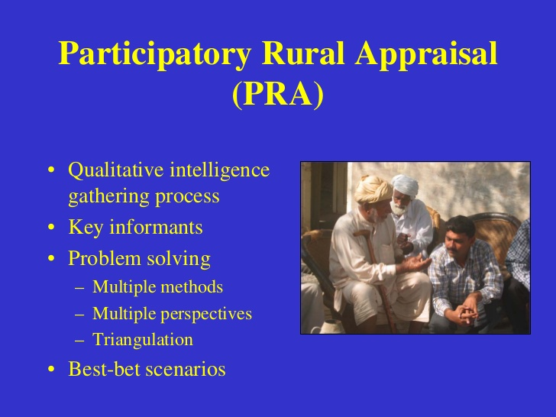

Slide 281
Participatory Methods
Evolved from agro ecosystem analysis and the social sciences, especially social anthropology.
3 main types:
Visualization methods
Informal interviews
Ranking and scoring methods

Slide 282


Slide 283


Slide 284


Slide 285


Slide 286
Goal 7: To understand the importance of diseases surveillance
By the end of the course, the participants should be able to:
define elements and describe functions of public health surveillance.
describe different types of surveillance.
list some of the uses of surveillance data.
indicate the role of laboratory in surveillance.
Explain the surveillance “feedback loop” of data and information flow through local, state, and federal channels.

Slide 287
Public Health Surveillance
“The ongoing, systematic collection, analysis, and interpretation of data on specific health outcomes, closely integrated with the timely dissemination of these data to those responsible for prevention and control.”
Thacker SB, Berkelman RL.
Epidemiol Rev 1988;10:164-90)

Slide 288
Public Health Approach
Implementation:
How do you
do it?
Intervention
Evaluation:
What
works?
Risk Factor
Identification:
What is the
cause?
Surveillance:
What
is the
problem?
Problem
Response
Notes:
This slide indicates the basic steps in public health. The first step is to identify a problem. Once a problem has been identified, we can investigate the causes. Then when can review what interventions are available to us and what might work to solve the problem, and finally, we implement the intervention (disease control program) and monitor it to ensure that it is working.
Surveillance is the tool we use to accomplish that first step, identifying the problem.

Slide 289
Public Health Surveillance Definition
Public Health Surveillance is the ongoing systematic collection, analysis, interpretation, and dissemination of health data.
  This is a mechanism that public health agencies use to monitor the health of their communities. Its purpose is to provide a factual basis from which agencies can appropriately set priorities, plan programs, and take action to promote and protect the public’s health.
Principles of Epidemiology, Second Edition, CDC, 1992.
Notes:
Different definitions of public health surveillance in different books. Here is one definition. Most of the other definitions share many of the elements shown here.

Slide 290
Public Health Surveillance
Systematic
Ongoing
Collection
Analysis
Interpretation
Dissemination of health data
Link to public health practice
Notes:
These are the elements that are (or should be) included in any definition of surveillance:
Systematic - organized, not haphazard
Ongoing - not just a one-time survey
Collection
Analysis
Interpretation
Dissemination
Of health data
Link to public health practice
Notice it is not just “the collection of.” It is not just vital statistics. It is data collected with the expectation that public health officials will look at it and take action.
We will talk about each one of these features.

Slide 291
Purposes of Public Health Surveillance
Assess public health status
Trigger public health action
Define public health priorities
Evaluate programs
Notes:
Public Health Surveillance has several purposes, but they all involve monitoring the health of the population.
Specifically, surveillance is used to
Assess the status of the public’s health - how many people are getting sick, and from what?
Trigger public health action - if the number of people getting sick is high, we’d better do something about it
Define public health priorities - but we can’t do everything immediately, so we can use data to set priorities for action, funding, programs, etc.
Evaluate programs - finally, are those actions and programs having impact, e.g., are disease rates declining? Surveillance data can tell us.

Slide 292
Surveillance provides:
Information for Action
Notes:
In short, surveillance provides data or information for public health action

Slide 293
Data Sources
Notifiable diseases
Laboratories
Vital records
Registries
Surveys
Administrative data systems
Media
Other data sources
Notes:
Many different sources can be used for surveillance data. We will only discuss a few of these.

Slide 294
Types of Surveillance
Surveillance
Population-based
Sentinel
Active
Passive
Active
Passive
Notes:
Surveillance systems can be classified in a variety of ways.
One distinction is whether the system expects reports on the entire population or only a subset. A system that targets the entire population is called (appropriately enough) a population-based system. A system that targets only a subset is often called a sentinel system.
Note in the diagram that both population-based and sentinel systems can be active or passive.
Q. Does anyone know the difference between active and passive surveillance?
A. The terms active and passive are from the perspective of the health agency. Can the health officials sit back, feet up on the desk, and wait for reports to come in? That’s a passive system from the perspective of the health agency. In a passive system physicians, clinics, laboratories and others required to report disease are given the appropriate mailing forms and instructions, with the expectation that they will report all of the cases of reportable disease that come to their attention. So more work for the clinicians, less work for the health agency.
Alternatively, do the health officials make periodic (usually weekly) telephone calls or personal visits to the reporting individuals to obtain the required data? That’s active.
Q. Which is more common? Why?
A. Most routine surveillance systems are passive. Because they are cheaper and less work for the health agency, require fewer resources.

Slide 295
Passive vs. Active Surveillance System
Passive – provider initiated reporting
Active – public health system initiated reporting
Notes:
Give examples of passive system:
for example notification of hepatitis versus active case finding in an outbreak setting.
Ask class for their own examples after you define what active verses passive is
Q. Which system do you think would identify more cases?
A. (See next slide)

Slide 296
Dissemination of Surveillance Data
To Whom?
Public health officials
Governmental officials
Clinicians / labs (reporters)
Public
NGO’s
Religious leaders
How?
Internal briefs
Health agency newsletters (e.g., MMWR)
Press releases
Surveillance summaries / reports
Medical / epidemiologic journal articles
Notes:
For appropriate public health action to be taken, those responsible for taking that action need to know, and need to know in a timely fashion. Public health officials in neighboring areas might want to know, so they can be vigilant for cases that might occur across geographic lines.
Other government authorities (mayor, governor, etc.) usually want to know, particularly if the situation is serious.
Those who sent in the case reports appreciate being “in the loop”, because then they know that their efforts to report are not a waste a time and that the reports they sent in are not just being filed in some dusty file room. Also, clinicians like to know what diseases are prevalent at any given time, since it may help them with a differential diagnosis.
Finally, the public is sometimes interested.
Summary reports can be disseminated in a number of ways, depending on the audience and how timely the information needs to be. For example, your boss or the governor may want to be briefed in person, particularly about a serious case or epidemic. Other methods include newsletters, reports posted to a website, press releases, and articles published in journals.

Slide 297
Surveillance should be
Linked to Action
Outbreak investigation
Disease control
  Vaccination / prophylaxis
  Elimination of cause
  Interruption of transmission
Development, targeting of programs (education, risk reduction, etc.)
Development of policies, regulations
Notes:
Actions can include:
Outbreak investigation
Disease control, such as
Vaccination / prophylaxis (e.g., immune globulin for hepatitis A outbreak)
Elimination of cause (e.g., discarding contaminated food)
Interruption of transmission (e.g., spraying to kill mosquitoes transmitting arthropod-borne disease)
Development, targeting of programs (education, risk reduction, etc.)
Development of policies, regulations
INSTRUCTOR: NOW MAY BE A GOOD TIME TO BREAK

Slide 298
Uses of Public Health Surveillance
Investigate cases and implement control measures
Detect epidemics/define a problem
Estimate magnitude of the problem
Evaluate control measures
Facilitate planning
Determine geographic distribution of illness
Portray the natural history of a disease
Generate hypotheses, stimulate research
Monitor changes in infectious agents
Detect changes in health practices
Notes:
So now that we have talked about the process of surveillance, it is easy to see how surveillance data can be used. Here are a few examples.
Surveillance can be used to estimate the magnitude of the problem.

Slide 299
The Laboratory in Surveillance
“Accurate and timely laboratory information has become the foundation upon which current disease treatment, prevention and control programs are based.”
Notes:
Ask how can the lab be used in surveillance?

Slide 300
Laboratories may be involved in many tasks:
Specimen collection
Specimen processing
Specimen transport
Analysis of trends in isolation/identification
Recording results (manually or electronically)
Reporting results to:
  Sending agency
  Public health authorities

Slide 301
Laboratories may be involved at many levels
Peripheral (e.g. health center, outpatients)
Intermediate (district/regional laboratory)
National (e.g. national meningitis reference) laboratory
International (international polio laboratory)

Slide 302
Laboratory services are useful in all phases of disease response
Detection and confirmation of epidemics
Surveillance of endemic diseases (TB, malaria)
Disease elimination and eradication
ALSO
Detection of new agents
Surveillance of anti-microbial resistance

Slide 303
Information Loop of Public Health Surveillance
Health Care System
Public Health Authority
Reporting
Data
Information
Analysis & Interpretation
Evaluation
Feedback
Action
Decision
Action
Notes:
Public health surveillance is a system involving a different agencies, on different levels and has multiple functions.
Collection of data starts in the public health system and when provided to the public health authorities undergoes analysis and interpretation with following decision for corrective actions and providing feedback back to health care providers.
One of the important part of a surveillance system is its regular evaluation to obtain data for improvement and plan more effective functioning of the system based on the evaluation findings.

Slide 304
“The reason for collecting, analyzing and disseminating information on a disease is to control that disease. Collection and analysis should not be allowed to consume resources if action does not follow.”
- William Foege et al., Int. J of Epidemiology 1976; 5:29-37
Notes:
This quote is from Bill Foege, former director of CDC, and former director of the Carter Center, now a key official at the Gates Foundation.
“The reason for collecting, analyzing and disseminating information on a disease is to control that disease. Collection and analysis should not be allowed to consume resources if action does not follow.”
This is yet another way of saying that surveillance should be information for action. If no one is going to do anything with the information, then don’t do it!

Slide 305
References
Overview of Public Health Surveillance – presentation by Richard C. Dicker, 2005
Principles and Practices of Public Health Surveillance, Steven M. Teutsch. R. Elliott Churchill
Updated Guidelines for Evaluating Public Health Surveillance Systems, MMWR, June27, 2001

