Slide 1
The project management triangle
Power point No. 2

Slide 2
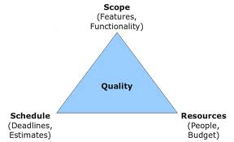
Project management triangle
These elements are critical in defining the limiting constraints on an initiative, or the scope, resources and schedules available in an emergency
The combination of these elements is referred to as the Project Management Triangle
understanding the relationships between the elements helps managers make better choices and tradeoffs.

Slide 3
Project management triangle
Schedule: Refers to the amount of time available to complete a project.
Resources: Refers to the people, budget, materials, etc. available to produce the initiative’s outcomes.
Scope: Refers to what must be done to produce the initiative’s outcomes

Slide 4
Project management cycle
These elements are often competing and termed the ‘triple constraints’ of a project.
Changes in any part of the triangle impact the other parts.
For example, increasing the scope typically means increased time and increased cost, or a tight schedule could mean increased costs and reduced scope, or a tight budget could mean increased time and reduced scope.

