Slide 1
Ecosystem Health
Virunga case study
Power point no.2

Slide 2
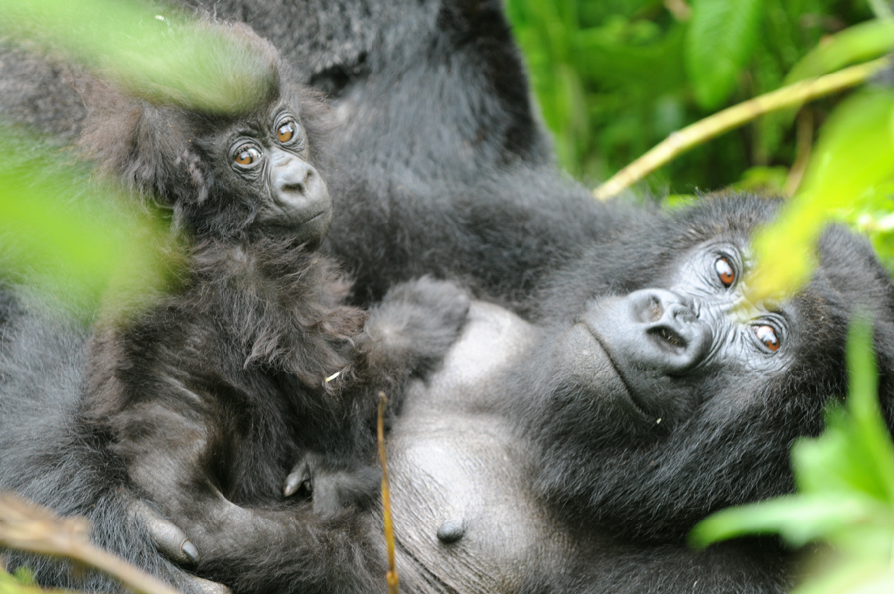
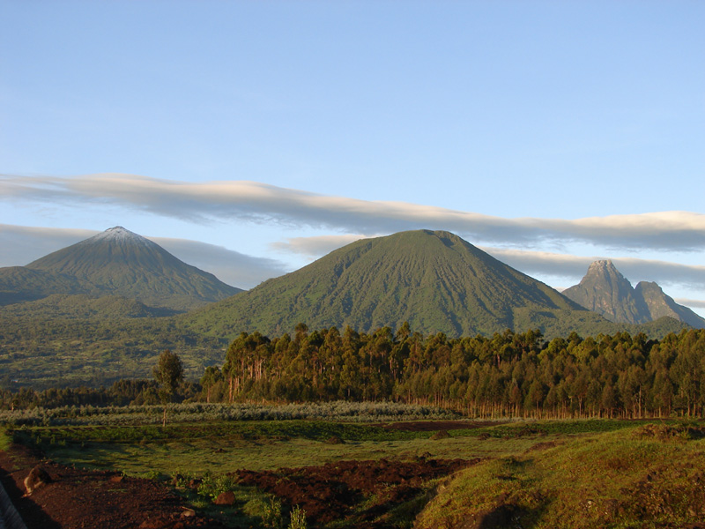
The case of Virunga and Mountain Gorillas - a case study in conservation and conflict
By Katie Fawcett

Slide 3
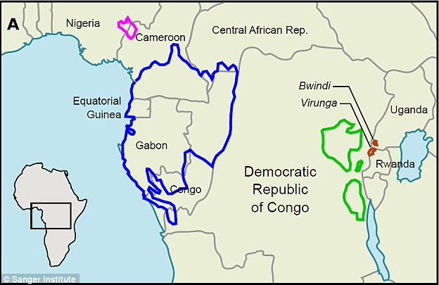
Cross river -300
Grauers gorilla - 3,800
Western lowland
100,000 approx.
Mountain gorilla - 880

Slide 4
All Gorillas are now Critically Endangered
Threats
Poaching
Habitat loss
Disease
Mountain gorillas are the only population that is increasing
A very fragile conservation success story
What lessons can be learned for other species?

Slide 5
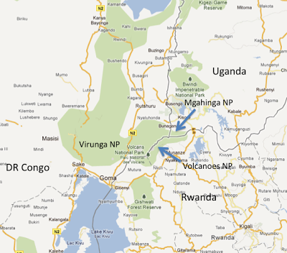

Slide 6
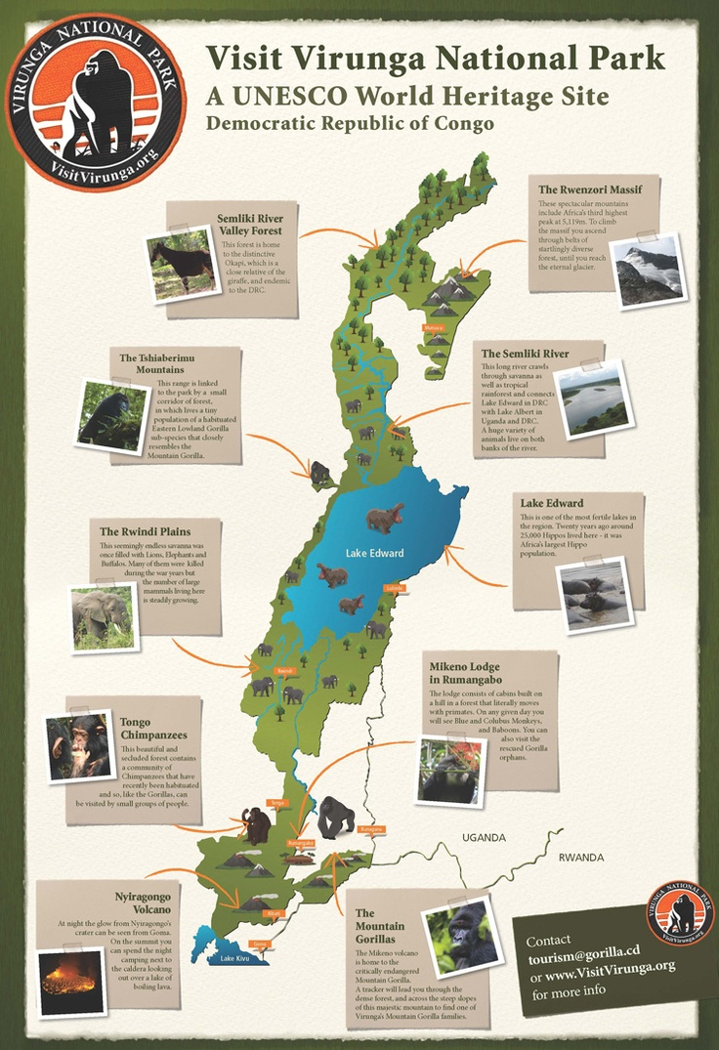

Slide 7
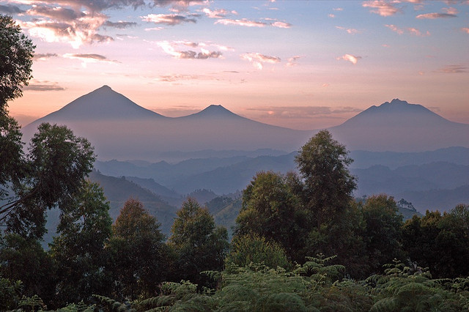
Mountain Gorilla Conservation - Rwanda

Slide 8
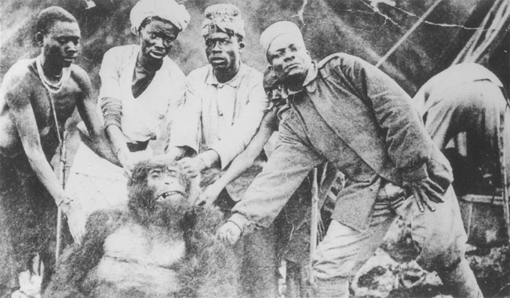
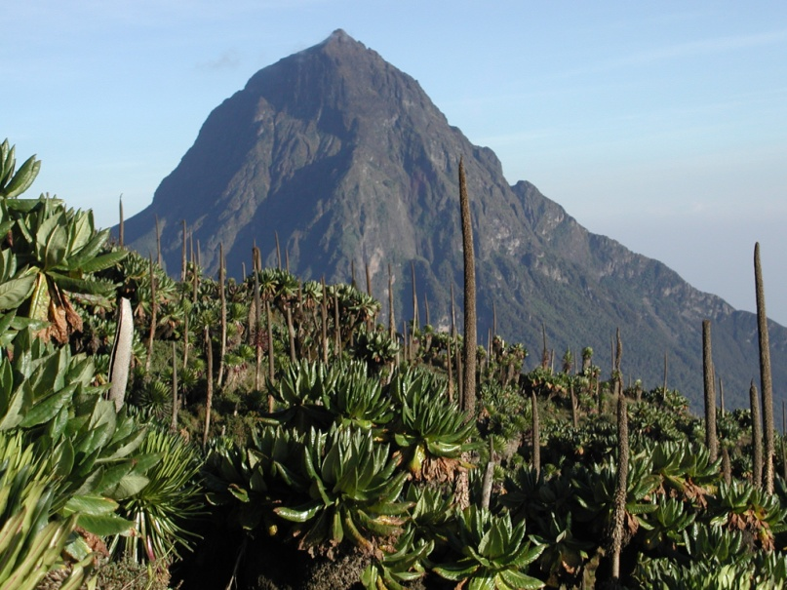
Historical Overview
1901 First examples of mountain gorilla known to science were shot by Cpt Robert von Beringe on Mt Sabyinyo
1920s Carl Akeley expeditions led to the creation of the Albert National Park. Modeled on Yellowstone National Park
1962 Independence, Volcanoes National Park was initially managed within the Rwandan Ministry of Agriculture
1973 Rwanda national park services (ORTPN) created

Slide 9
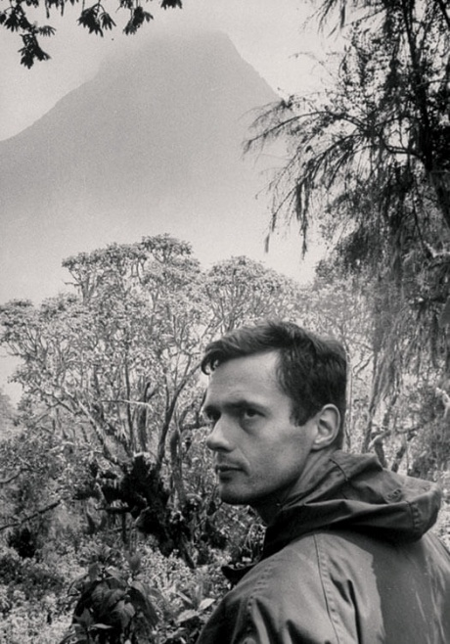
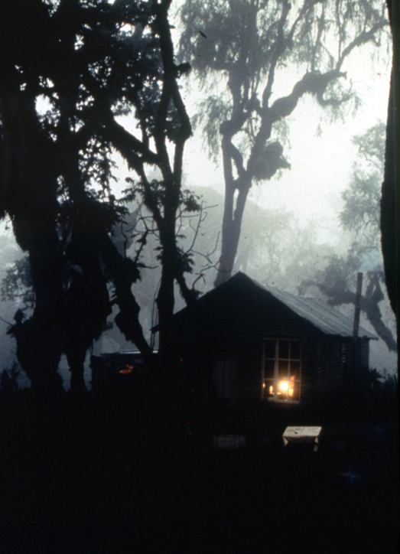
Historical Overview
1959-60 George Schaller, The Year of the Gorilla
1967 –Dian Fossey established the Karisoke Research Center. 50 years research of gorilla behavior and demography
1980’s several gorilla conservation NGO’s- Digit Fund, Mountain Gorilla Project (AWF, FFI, WWF) DFGFI, Gorilla Organization, MGVP. Expanded conservation focus to include tourism, education, health
1990’s Rwanda civil war and 1994 genocide

Slide 10
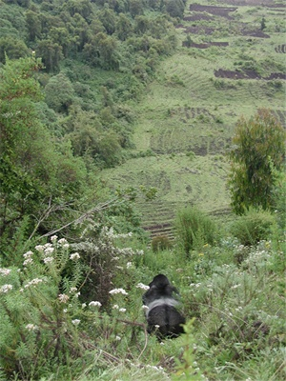
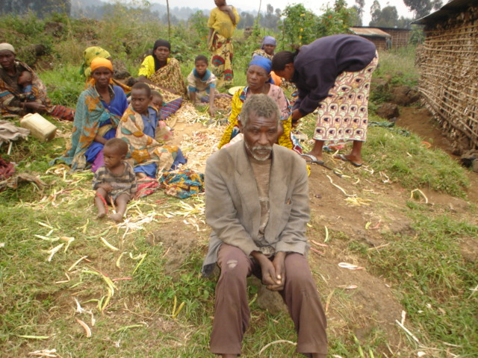
Threats
Indirect
High human population density
Limited buffer zone
High levels of poverty
Conflict and insecurity

Slide 11
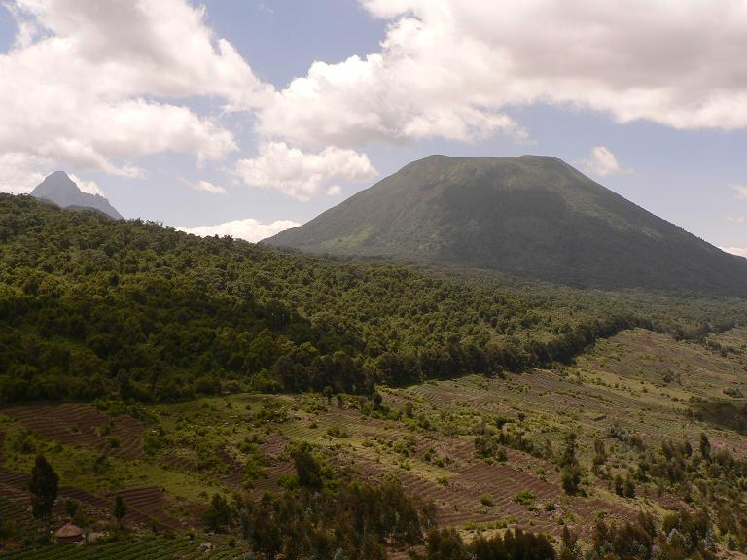
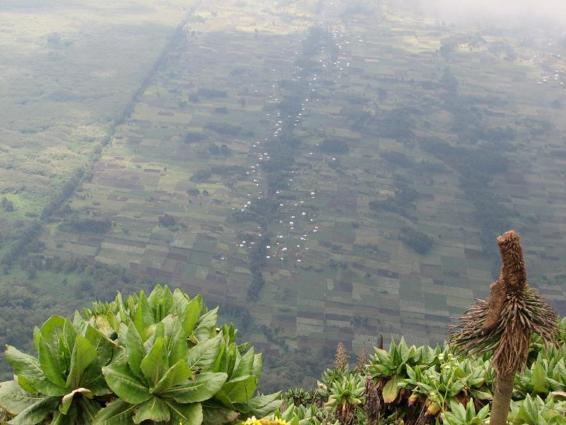
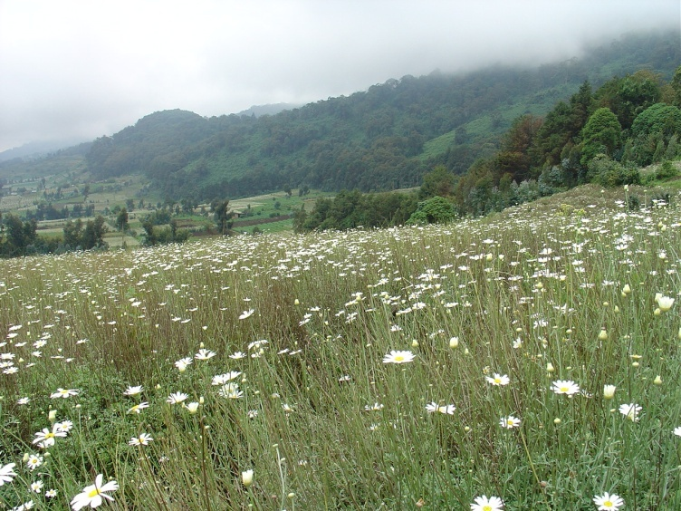
Habitat Loss
Forest cleared for agriculture and resettlement

Slide 12
Habitat Loss
The Rwandan sector of the Virunga ecosystem has been drastically reduced:
1958 Belgian Authorities permitted 70km² cleared for human settlement
1969-1973 105 km² converted to agriculture by Rwanda government funded by EEC
1979 13 km² cleared for human settlement in the western sector
Total reduction 54% - 150Km² remaining
Most loss in the lower elevation zones therefore the associated loss of biological diversity has been significant.
Weber, (1989)

Slide 13
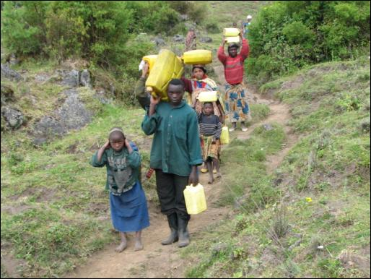
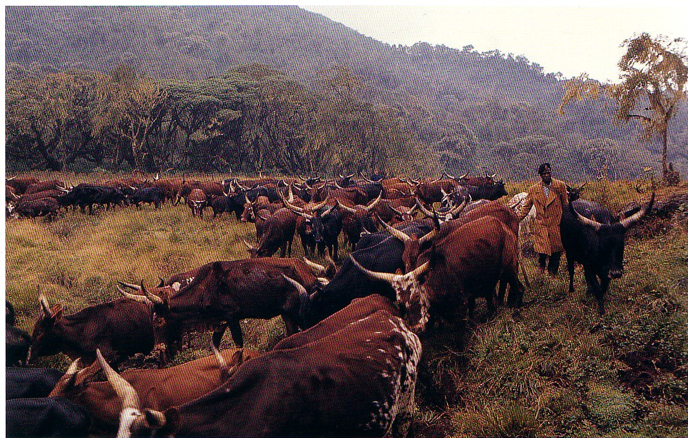
Habitat Disturbance
Cattle grazing, water collection, wood cutting

Slide 14
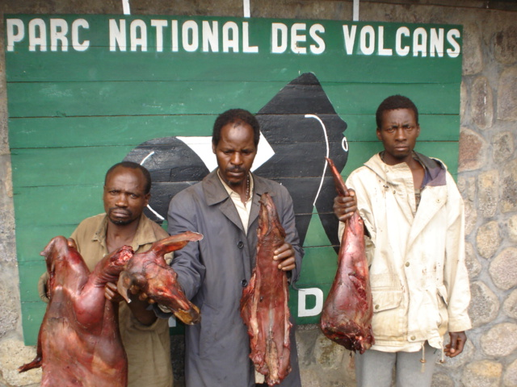
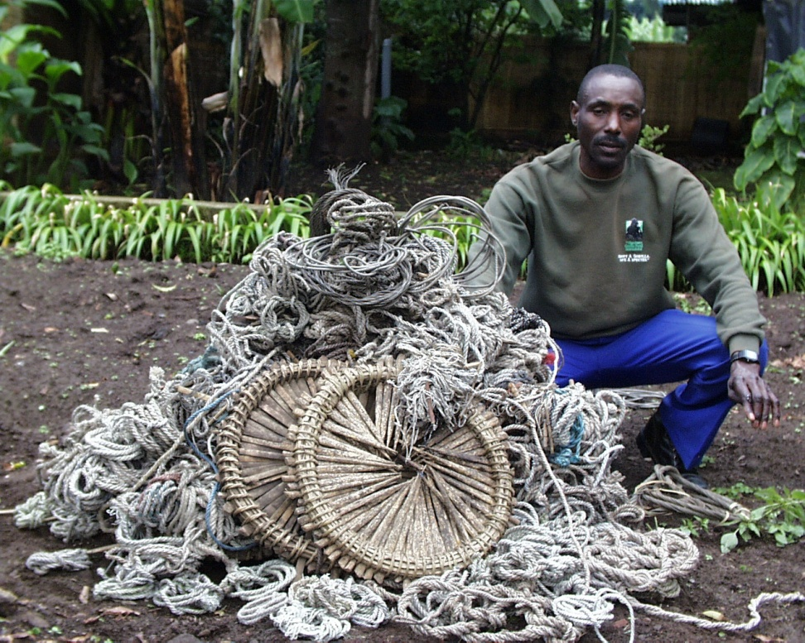
Poaching
Local subsistence bush meat hunting
Gorilla is not targeted but entangled in snares set for other animals (duiker, bushbuck, buffalo)
Without veterinary intervention to remove snares, can be fatal

Slide 15
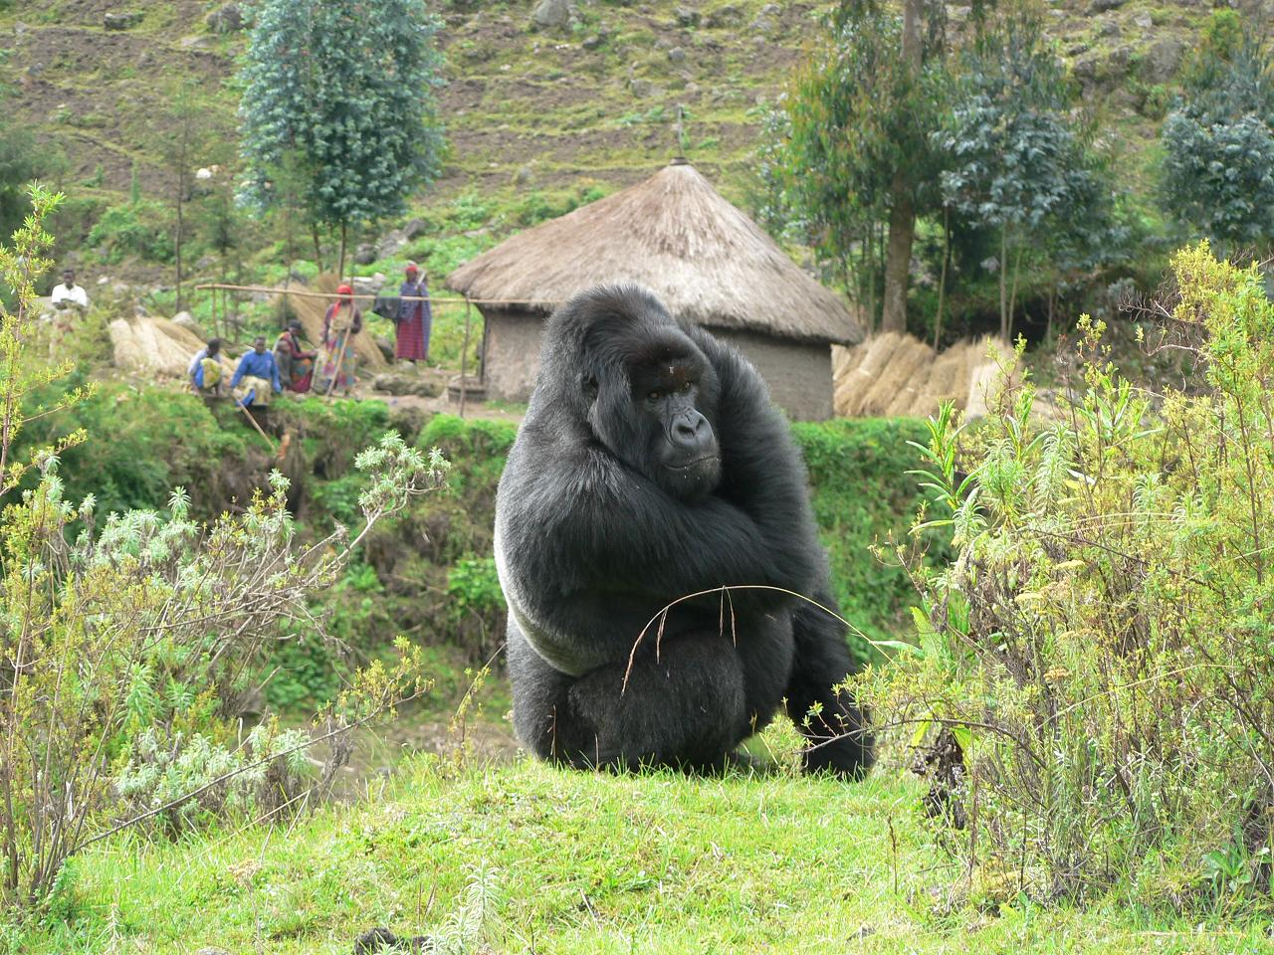
Disease People, Wildlife, Domestic Animals
local population
researchers
park staff
tourists
domestic animals
Military
Armed groups
Refugees

Slide 16
Integrating conservation with social and economic demands
1979 – Mountain Gorilla Program
Tourism program initiated
Conservation education initiatives started
1985 – Ruhengeri Resource Analysis and Management
Applied research on environmental and natural resource management
and pilot projects
1988 – International Gorilla Conservation Program
Trans-boundary park management approach based on MGP experience
Late 90’s – Community Conservation
Local community integrated into conservation approaches
2004 – National Park Revenue Sharing Scheme
Local communities receive 5% of gate receipts

Slide 17
Park adjacent communities attitudes
Proportion of respondents positive about maintenance of the park
Year
Positive response
(%
)
1979*
49
1984*
71
2008**
96.6
* Weber (1987); **Sabuhoro & Bush (2008)
Local community attitudes becoming more positive about the existence of the park

Slide 18
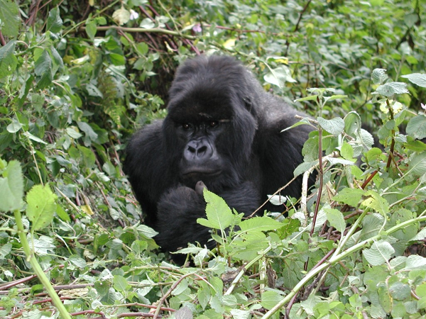
How has the gorilla population fared?

Slide 19
Virunga Volcanoes – Mountain Gorilla Population
600
Habitat loss, poaching and cattle grazing
projected with
3.8 % growth
500
400
actual population size
1.1% growth
Estimated population size
300
200
protection, education, tourism
100
Insecurity and conflict
0
1971-2
1976-8
1981
1986
1989
2000
2003
Year
Gray et al. (2005)

Slide 20
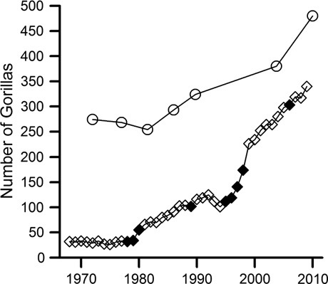
Gray et al. 2013
26.3% growth 2003-2010, 3.7% annual growth rate

Slide 21
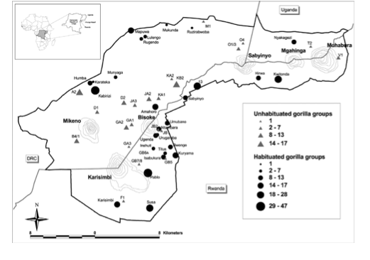
2010 Mountain Gorilla Census Results
Total population size: 480 gorillas
> 70% habituated
Gray et al. (2013)

Slide 22
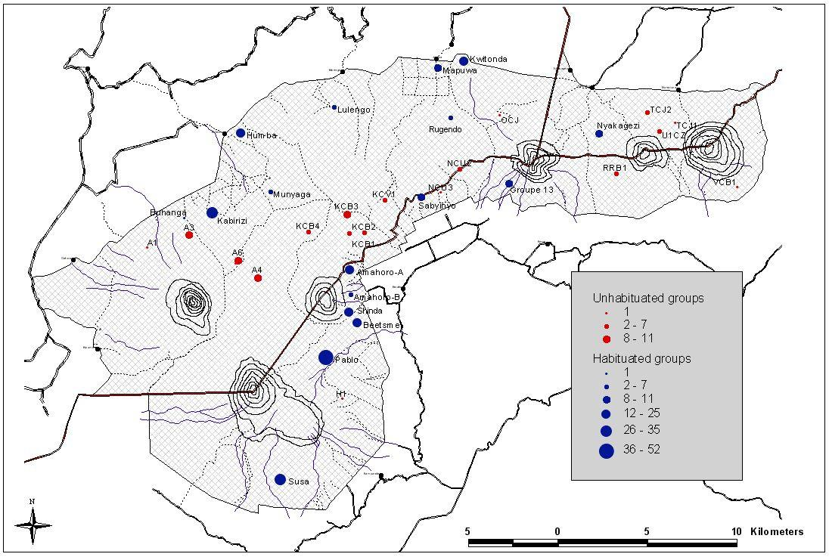
Factors influencing gorilla distribution
Few gorillas – history of temporary group usage
Good habitat – historically many gorillas, now few – high levels of disturbance
Good habitat – no record of gorillas using this area
Majority of population growth
Gray et al. (2005)

Slide 23
Gorilla distribution negatively correlated with areas of high human disturbance
Gray et al. (2005)

Slide 24
Conservation during times of conflict
Context:
Gorillas not the primary target of the armed conflict. Rather the gorilla habitat was a hideout for both armed groups and fleeing refugees - "gorillas caught in the cross fire"
Response:
Focus on monitoring and protection. Concerted communication and coordination resulted in only a very short period when no conservation activity in the park possible. Research, tourism etc. suspended
Non-partisan communication allowed protection and monitoring activities to continue through change in government.
Karisoke Research Center evacuated from inside the park

Slide 25
Conservation during times of conflict
Response continued:
Conservation programs led by local staff who choose to remain in conflict areas with their families.
Support to staff and their families during the conflict e.g. work to have all conservation and staff together at a refugee camp. Conservation staff first to leave refugee camp and return home. Moral support considered important.
Funding - flexible and responsive funding to adapt to changing conservation priorities.

Slide 26
Conservation post conflict
Context:
Continued threat of insecurity and return of violent conflict
Country devastated by conflict- A void of infrastructure, education and health services; development agencies focus on Emergency Aid.
Impact of conflict on mental health
Conservation policy on environment remains fragile: Road proposed through National Park, May/June 2004 - 16km² gorilla habitat destroyed in less than a month; electrification of Karisimbi.

Slide 27
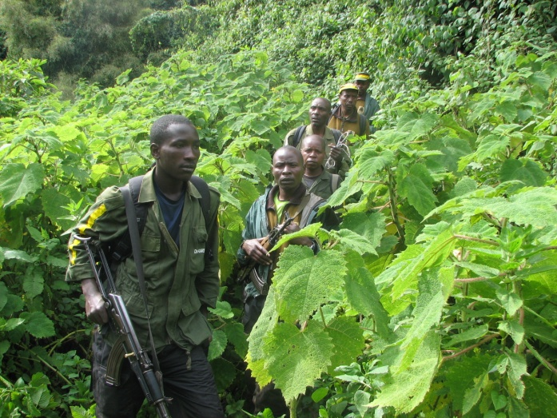
Conservation post-conflict
Response:
Rangers armed and given paramilitary training. All expatriate staff provided military escort in the park. All park activities coordinated with military.
Community conservation activities aimed to rebuild communities. These are the communities where conservation staff work and that are the source of indirect threats on the park. Need to build goodwill.

Slide 28
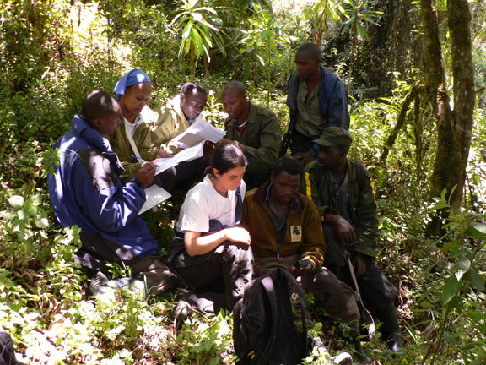
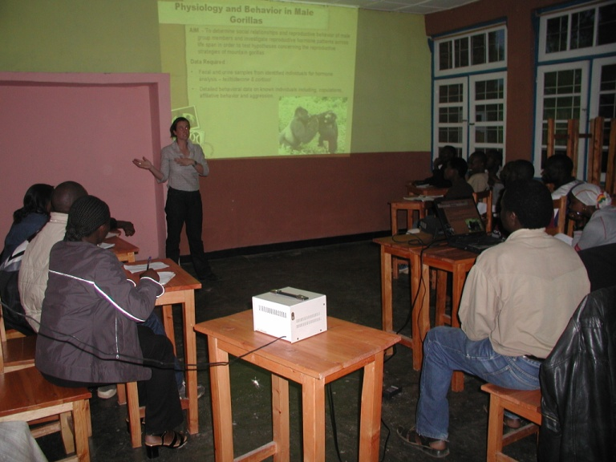
Conservation Post conflict
Conservation post-conflict
Response continued:
Training and Capacity Building - rangers, conservation personnel, researchers, universities.
Strengthen institutions.
Conservation education - local schools, local leaders. tourism guides, local community through community assistance programs, Kwita Izina

Slide 29
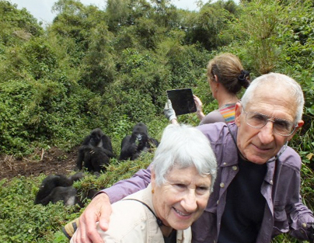
Conservation post-conflict
Rebuilding Tourism
2017 10 gorilla families, 8 tourists a day, $750 per tourist
$21million potential from gate receipts alone

Slide 30
Rapid Research Topics

Slide 31
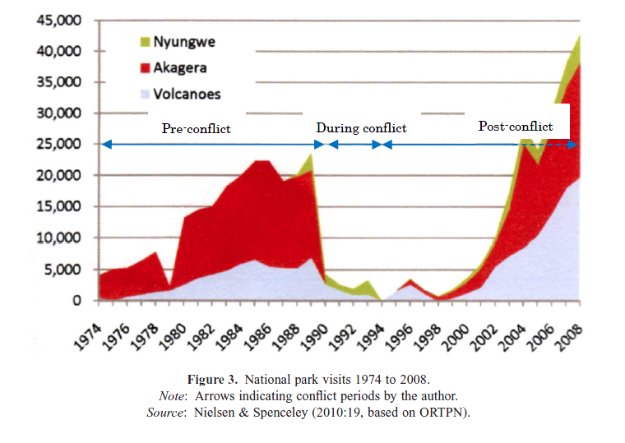
1. Gorilla tourism

Slide 32
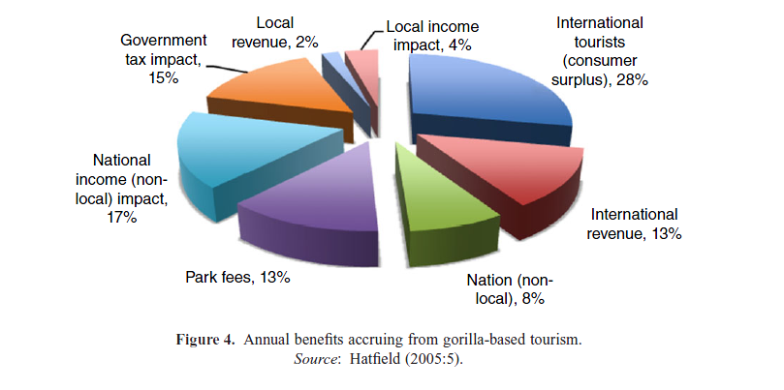
Maekawa, Miko, Annette Lanjouw, Eugène Rutagarama, and Douglas Sharp. 2013. Mountain gorilla tourism generating wealth and peace in post-conflict Rwanda. In Natural Resources Forum, vol. 37, no. 2, pp. 127-137

Slide 33
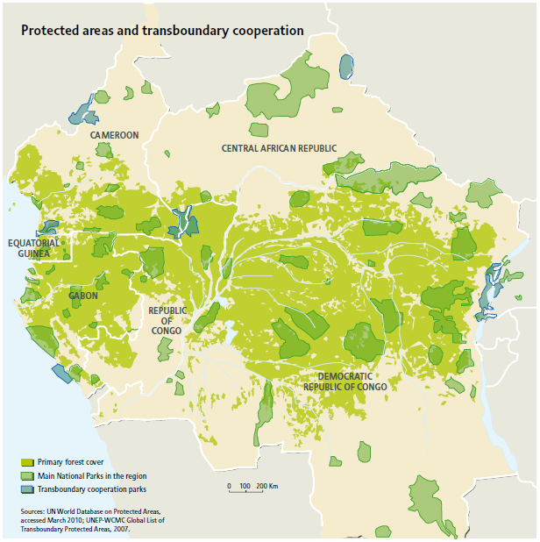
2. Conflict and Cooperation: Transboundary Collaboration

Slide 34
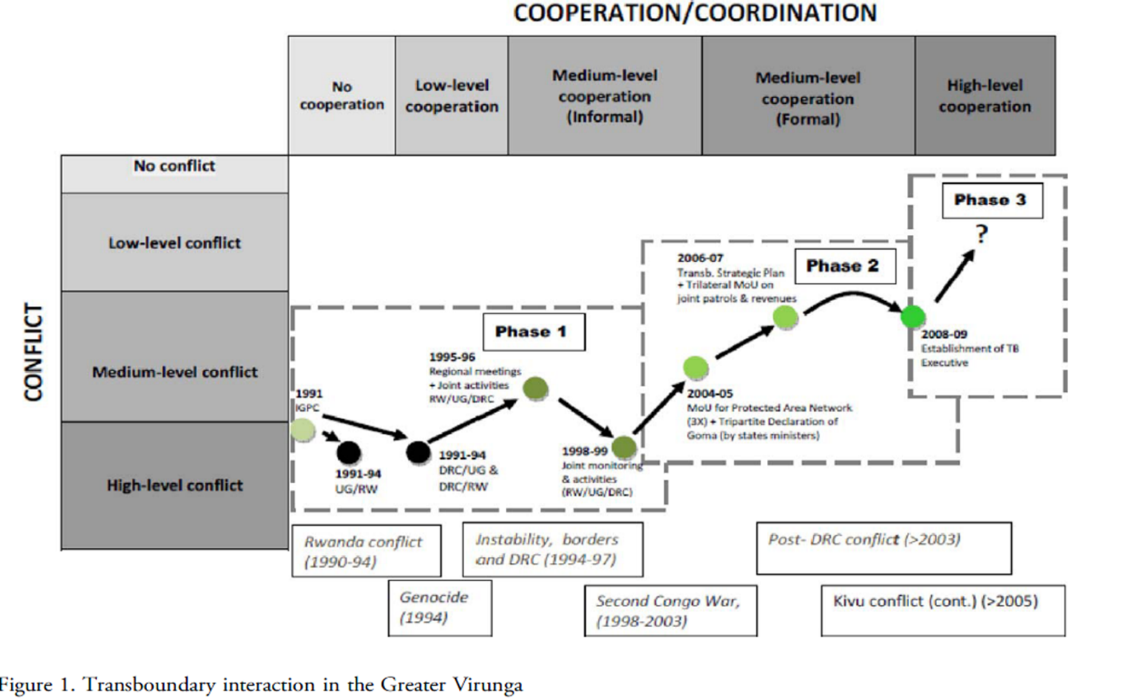
Martin, Adrian, Eugene Rutagarama, Ana Cascão, Maryke Gray, and Vasudha Chhotray. "Understanding the co-existence of conflict and cooperation: Transboundary ecosystem management in the Virunga Massif." Journal of Peace Research 48, no. 5 (2011): 621-635.

Slide 35
Rationale for collaboration
Ecological
Landscape level management
Economic
Benefits accrued by states through cooperation are greater than they could derive individually
Political
Enhance regionalization, mitigate conflicts, open lines of communication
Peace-building
environmental cooperation could have multiplier effect and be a catalyst for regional stability

Slide 36
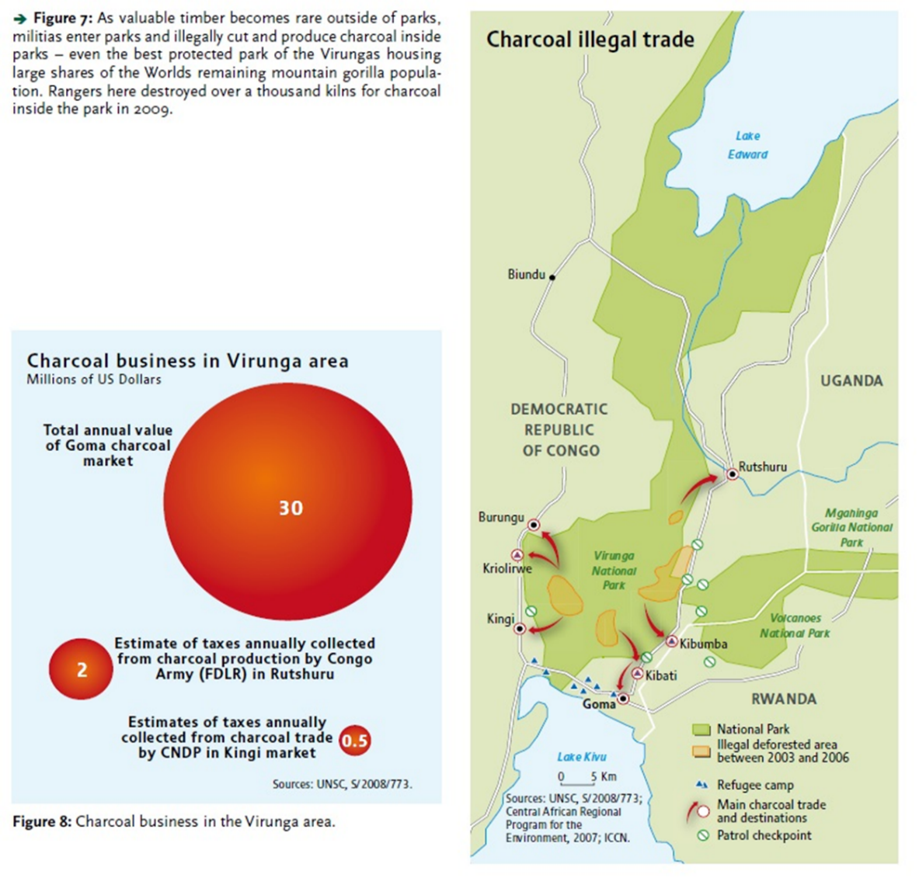
3. Illegal charcoal trade and eco-stoves
http://newgenerationplantations.org/multimedia/file/f693ac73-7a22-11e3-92fa-005056986313/
https://news.mongabay.com/2016/08/a-dangerous-illegal-necessity-charcoal-reform-comes-to-virunga/

Slide 37
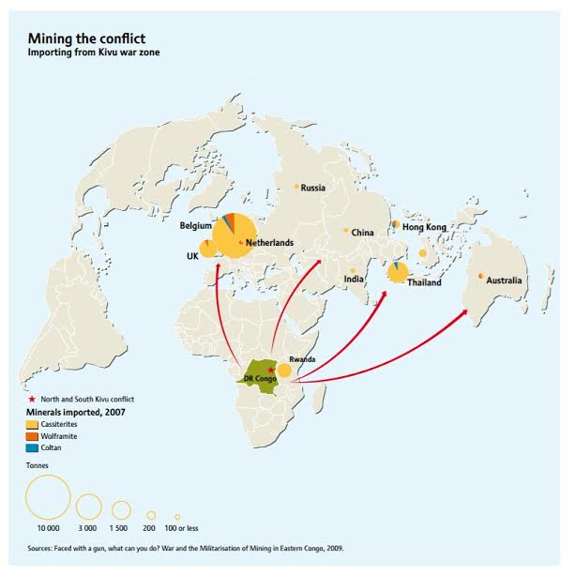
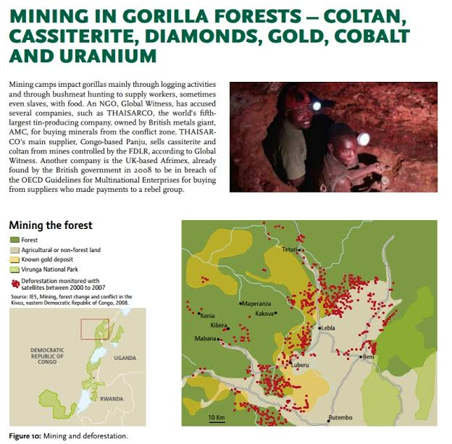
4. Grauer’s gorilla and minerals
http://journals.plos.org/plosone/article?id=10.1371/journal.pone.0162697
Plumptre et al. (2016). Catastrophic decline of World’s Largest Primate

