Slide 1
Fundamentals of Disease Transmission based on Movie Contagion provided by Chris Whittier
PowerPoint No. 3

Slide 2
Lead discussion
Transmission of infectious diseases
Zoonosis
Human-animal environment interactions
Multidisciplinary approach?
Stakeholders engagement
  Media, politics, community, international communities, military, scientists, epidemiologists

Slide 3
https://www.youtube.com/watch?v=4sYSyuuLk5g

Slide 4

Learning Objectives
Learning objectives
By the end of the training, the participant should be able to:
Explain the progression of a disease within an individual.
Describe how infections are transmitted from individual to individual.
Describe the transmission of a disease within a population.

Slide 5
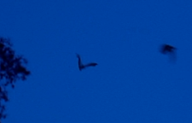

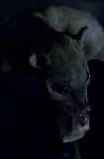




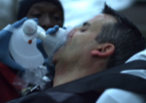



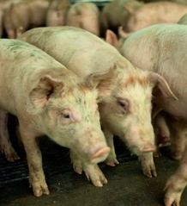
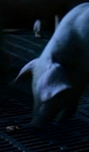

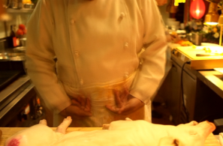


Slide 6

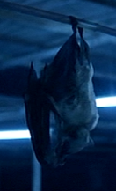

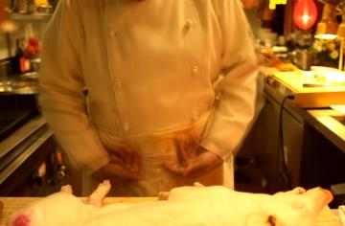
Host? Reservoir?

Slide 7
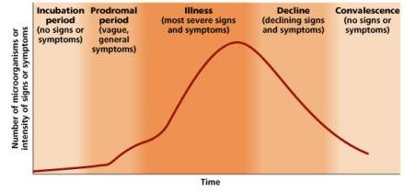
Course of infection
Point of infection
Susceptible
Incu-bation
period
Sickness or “infection”
Recovery
Resistant
Death

Slide 8
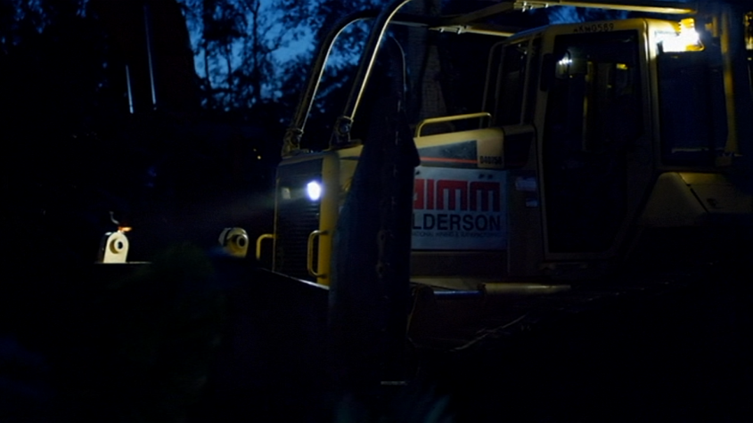
Disturbance...

Slide 9

What could we call the bats?
?
Notes:
reservoir

Slide 10
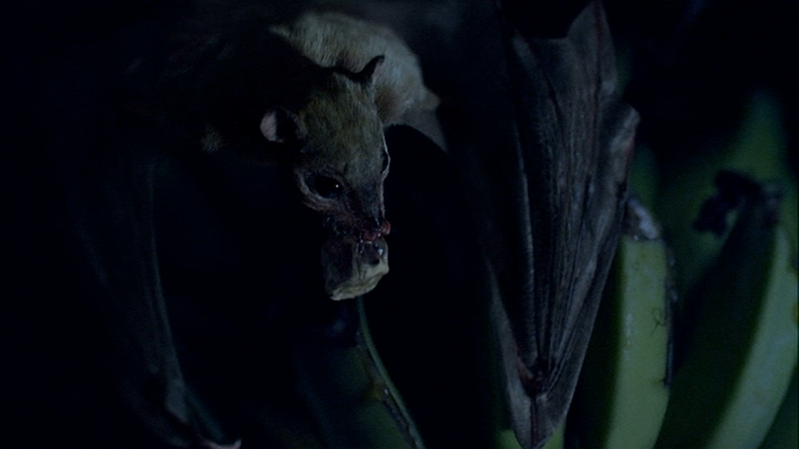

Slide 11
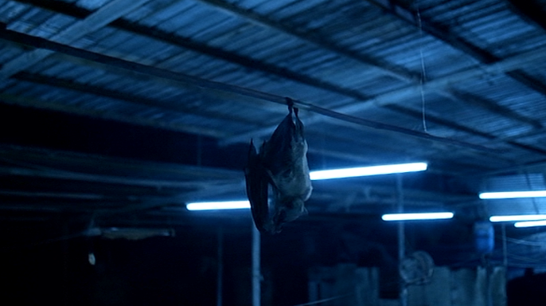

Slide 12
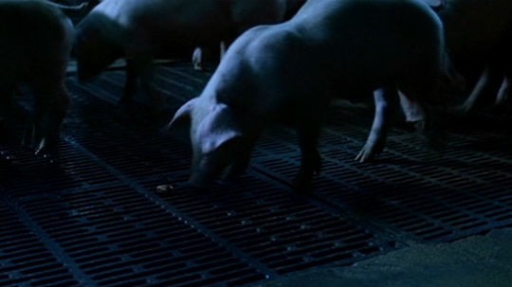
What about the piece of fruit?
?

Slide 13
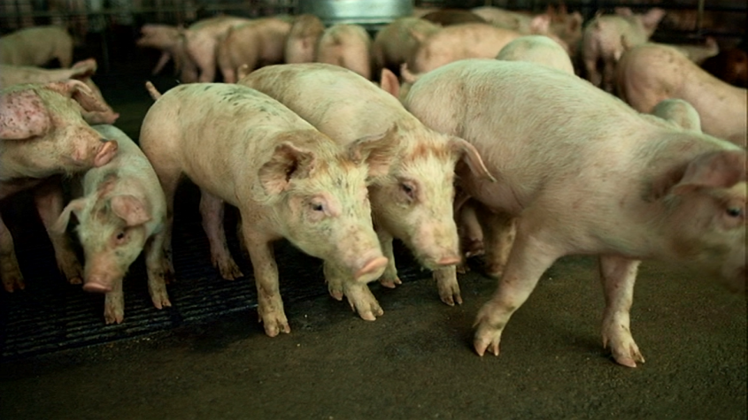
What could we call the pig?
?

Slide 14
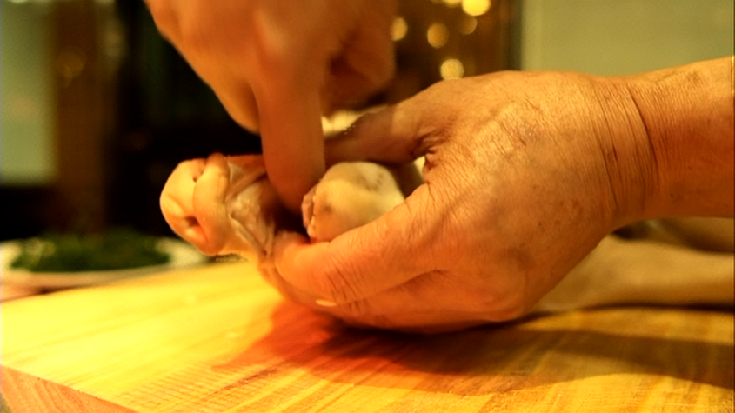
What is missing?

Slide 15
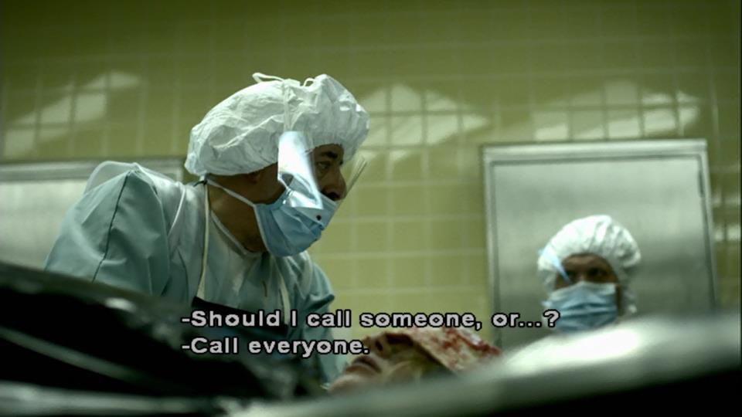

Slide 16


Slide 17

How was the disease spread?

Slide 18
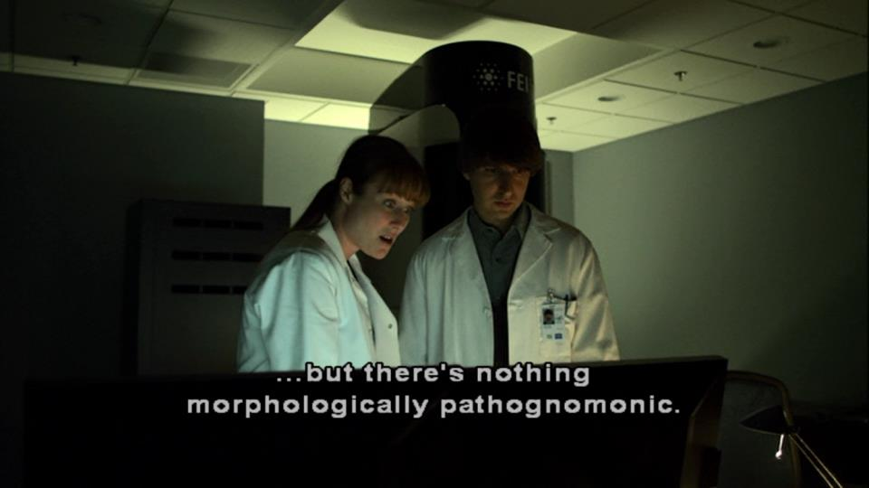
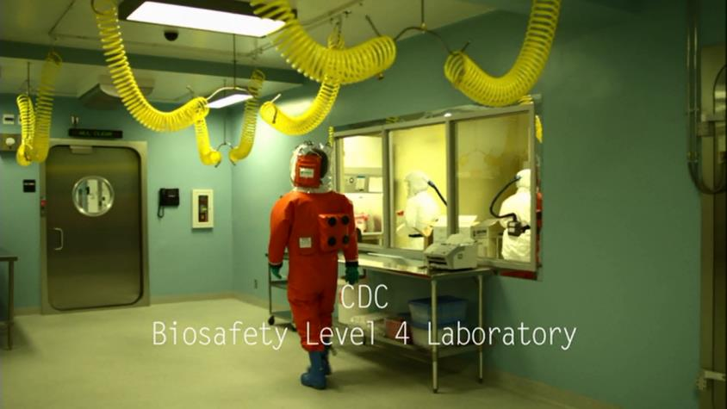

Slide 19
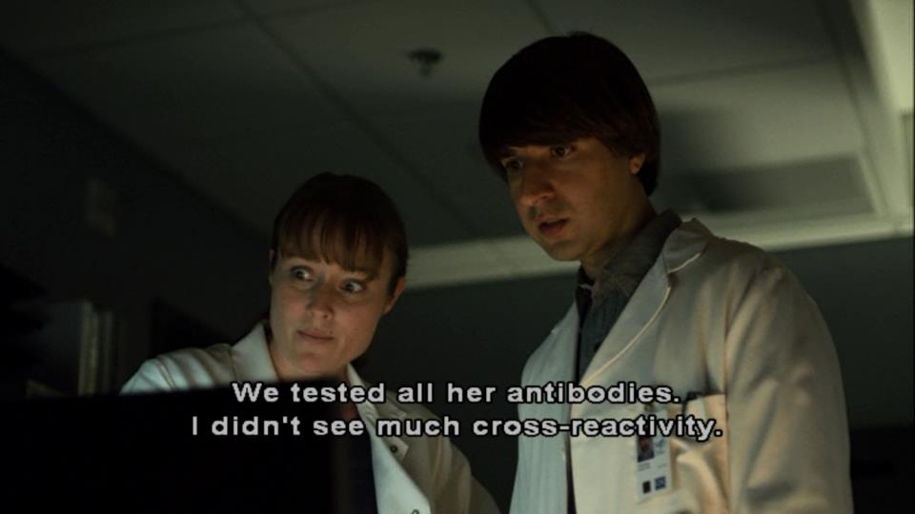

Slide 20
Terms
Agent
Bacteria
Endemic
Enzootic
Epidemic
Epizootic
Fomite/Vehicle
Horizontal Transmission
Host
Incubation Period
Index case
Infective
Outbreak
Outbreak curve
Parasite
Pathogen
Recovered
Reservoir
Resistant
Susceptible
Transmission
Vector
Vertical Transmission
Virus
Zoonosis

Slide 21
Lead discussion
Transmission of infectious diseases
Zoonosis
Human animal environment interactions
Multidisciplinary approach?
Stakeholders engagement
  Media, politics, community, international communities, military, scientists, epidemiologists

Slide 22
Learning Objectives
Learning objectives
Explain the progression of a disease within an individual.
Describe how infections are transmitted from individual to individual.
Describe the transmission of a disease within a population.

Slide 23


Disease v. Infection

Slide 24


Ebola v. MEV-1

Slide 25

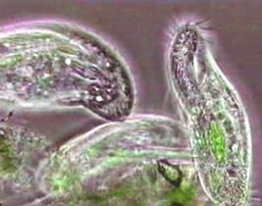
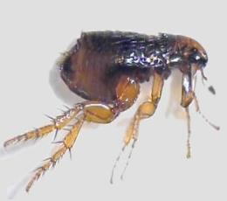
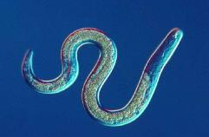
Agents
Virus
Bacteria
Protozoa
Worm
Parasite
v. ‘pathogen?’

Slide 26
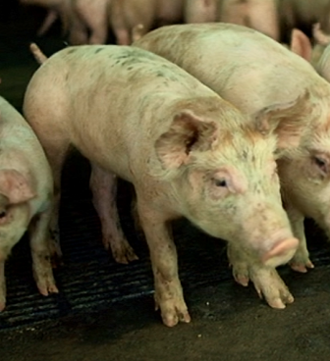
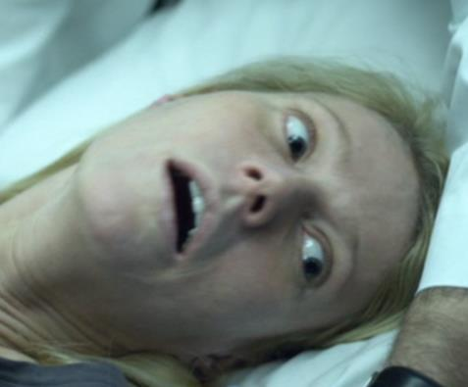
Agent v. Pathogen

Slide 27
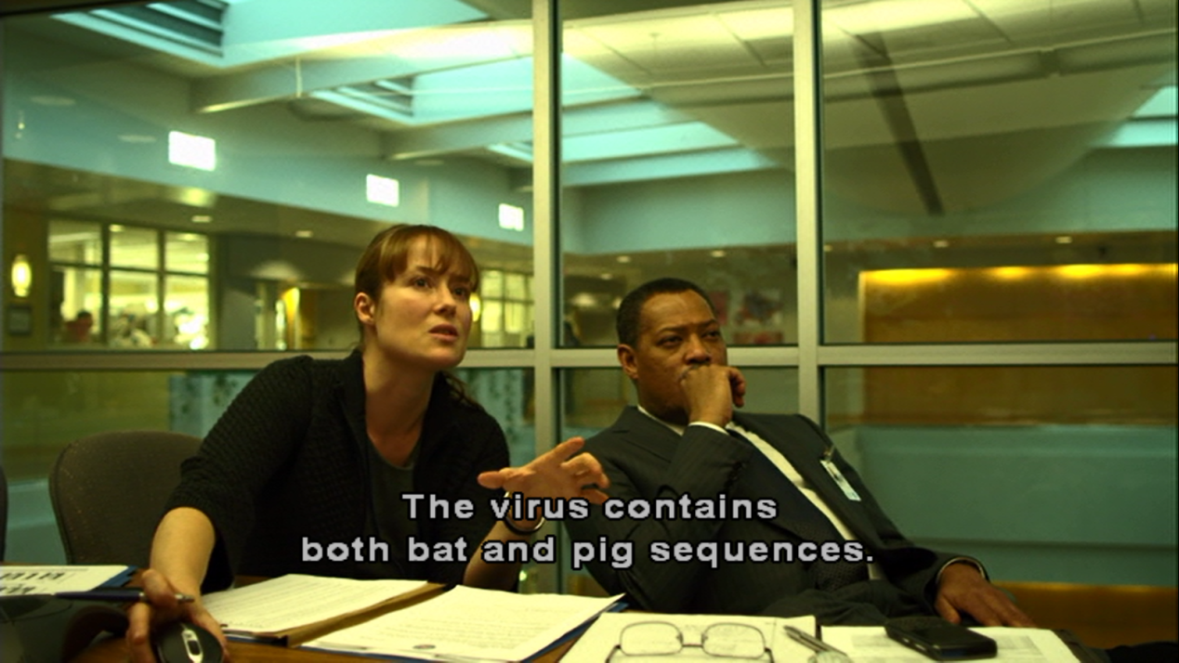

Slide 28
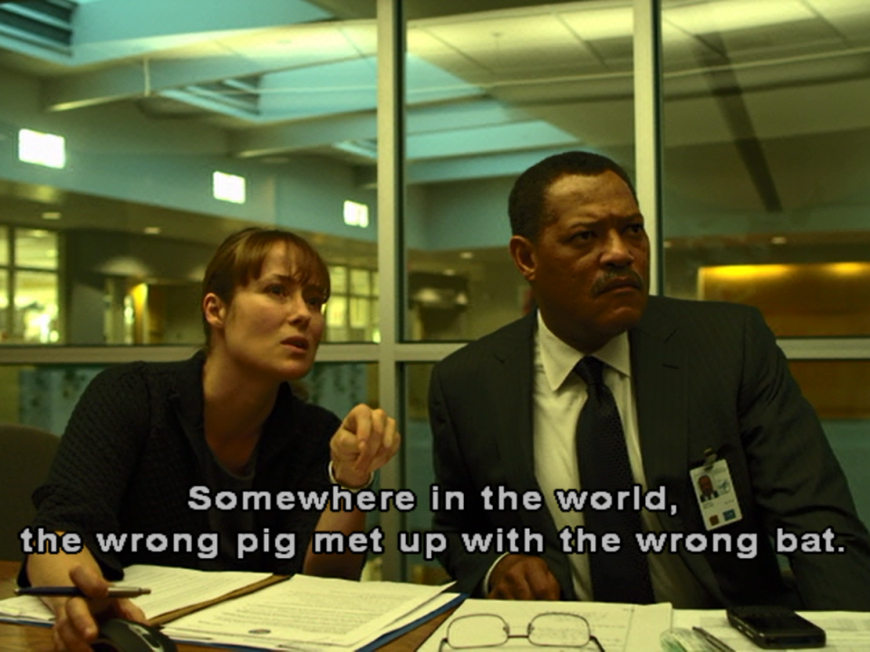
“A fatal encounter between a pig and a bat”

Slide 29


Slide 30


Slide 31
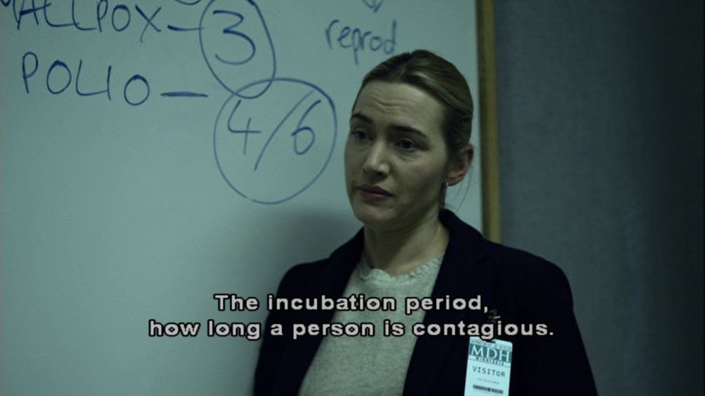
Incubation period, contagious

Slide 32
Course of infection
Point of infection
Susceptible
Incu-bation
period
Sickness or “infection”
Recovery
Resistant
Death

Slide 33
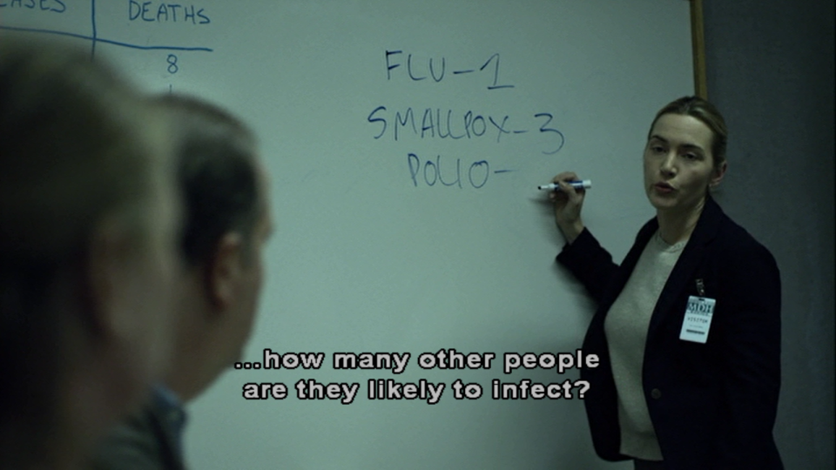


Slide 34
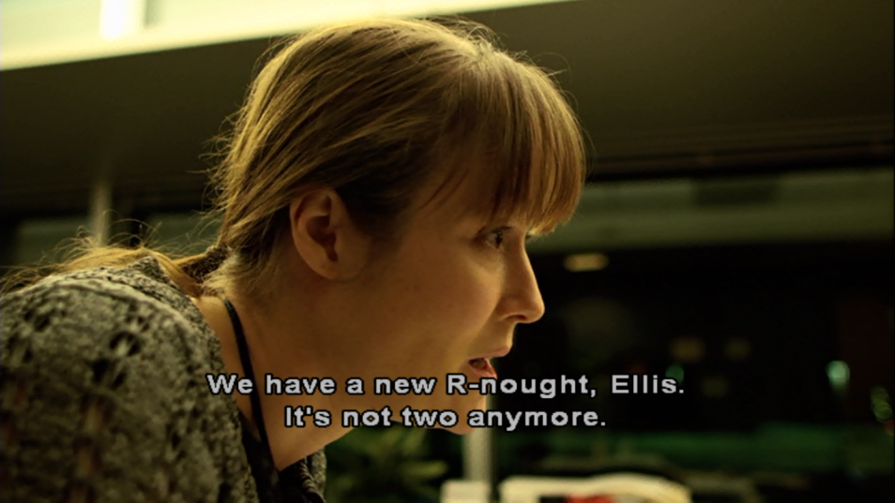

Slide 35
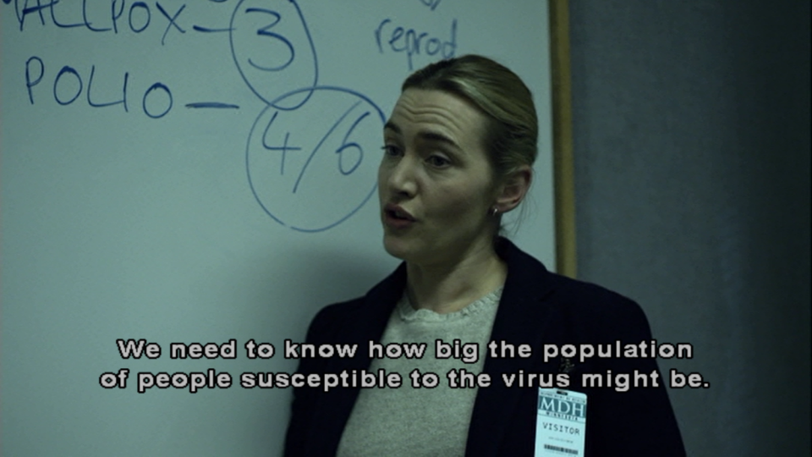

Slide 36
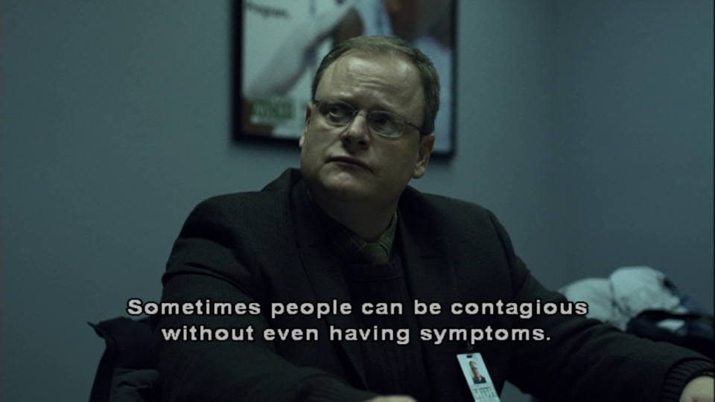

Slide 37
Course of infection
Point of infection
Periode d’incu-bation
Incu-bation
period
Maladie (“infection”)
Sickness or “infection”
Retabli
Sensible
Recovery
Résistant
Resistant
Contagious/Infectious

Slide 38

Contagious without illness

Slide 39

“Some live, some die.”
Age
Fundamentals of Disease Transmission

Slide 40

Individual variation
√
X
X
X

Slide 41








Individual variation
X
X
X
X
Day 1 Day 2 Day 3 Day 4

Slide 42
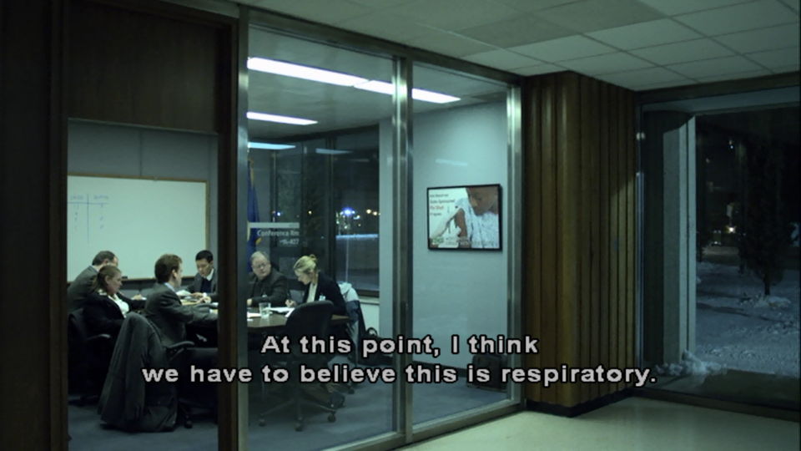
Transmission routes

Slide 43
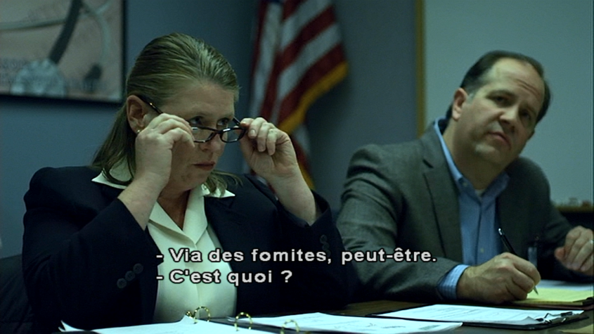

“Fomites –what ‘s a fomite?”

Slide 44


“Fomites –what ‘s a fomite?”
Vehicle
  Fomite or passive vehicle
  Vector or active vehicle

Slide 45
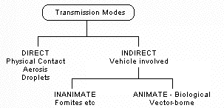
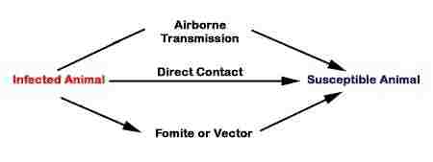
Transmission Routes

Slide 46


Routes?
?

Slide 47



Routes?
?

Slide 48


Routes

Slide 49
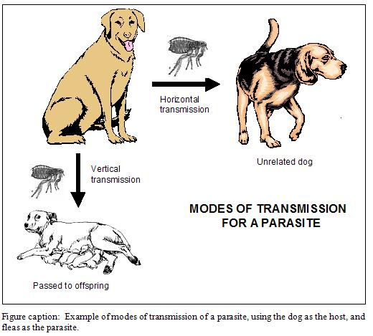
Horizontal v. Vertical

Slide 50







X
X
X
X
X
X
X
X
Day 1 Day 2 Day 3 Day 4 Day 5

Slide 51
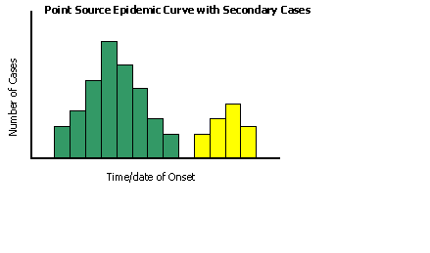
Epidemic curve

Slide 52
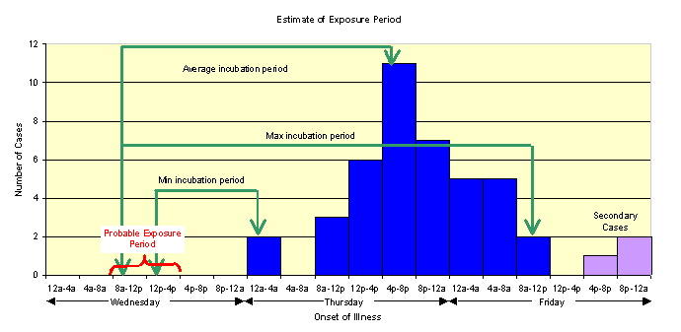
Epidemic curve

Slide 53

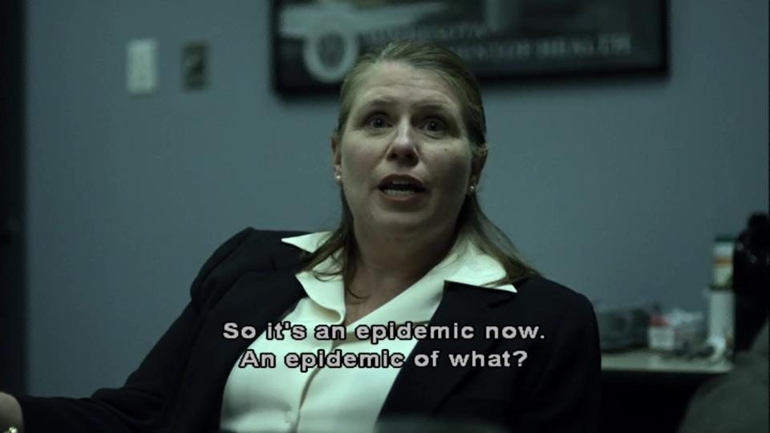
Epidemic

Slide 54
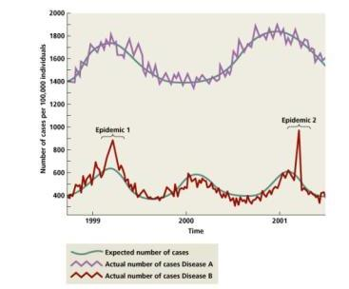
Epidemic v. Outbreak

Slide 55
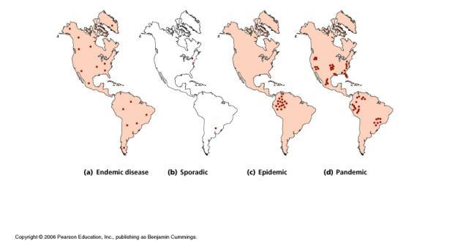
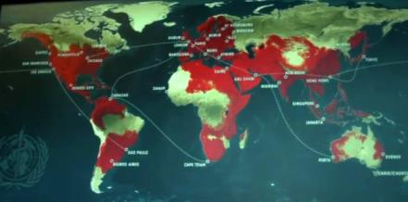
Endemic, Epidemic, Pandemic

Slide 56

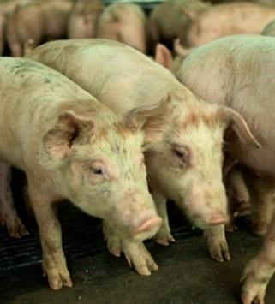
EnDEMic EnZOOtic
EpiDEMic EpiZOOtic

Slide 57

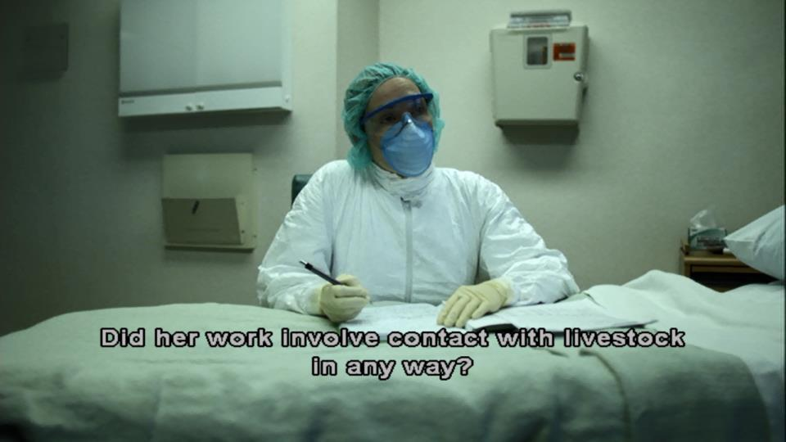
Zoonosis

Slide 58

Zoonosis

Slide 59
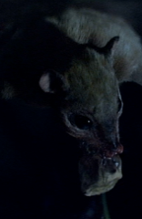
Zoonosis

Slide 60
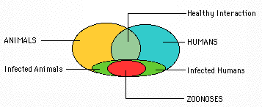
Zoonoses

Slide 61
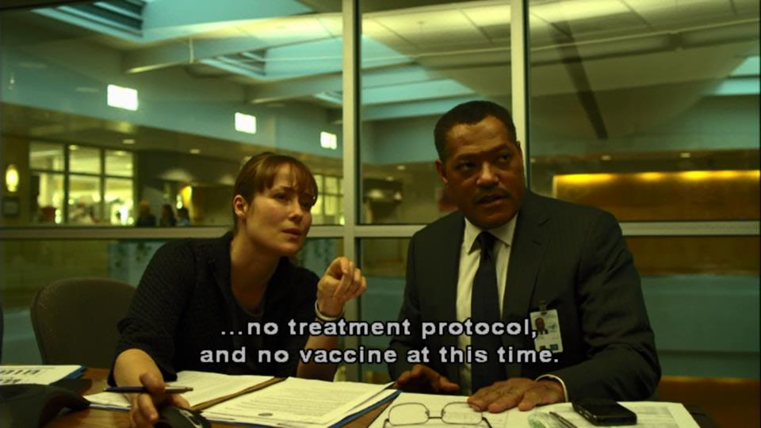
Treatment and vaccination

Slide 62
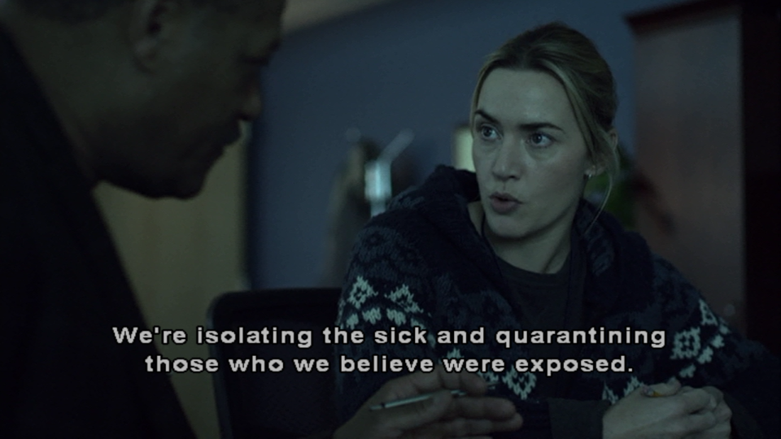
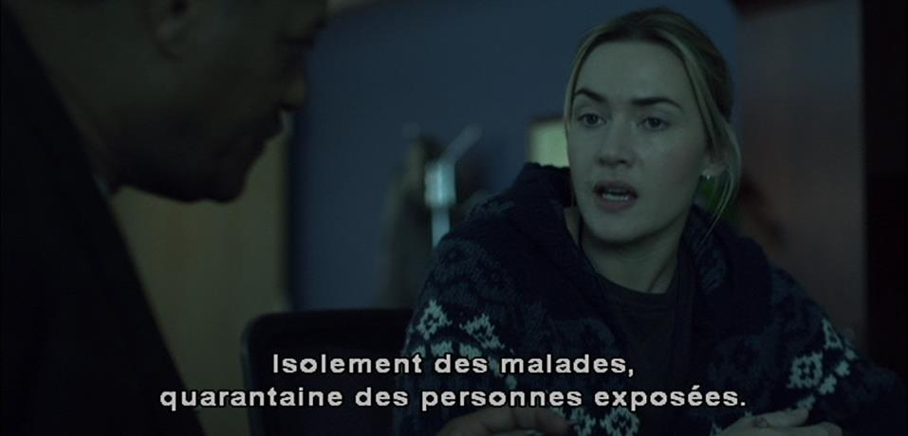
Isolation, quarantine

Slide 63

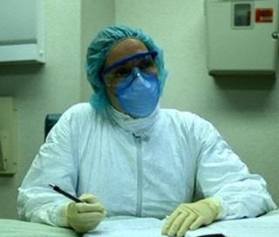


Protection/Prevention
Vaccination
PPE
Hygiene
Quarantine/isolation

Slide 64




Slide 65


Slide 66


Index case, “Patient zero”

Slide 68
What could we call the bats?
?
Notes:
reservoir

Slide 73


Slide 74


Slide 75
Terms
Agent
Bacteria
Endemic
Enzootic
Epidemic
Epizootic
Fomite/Vehicle
Horizontal Transmission
Host
Incubation Period
Index case
Infective
Outbreak
Outbreak curve
Parasite
Pathogen
Recovered
Reservoir
Resistant
Susceptible
Transmission
Vector
Vertical Transmission
Virus
Zoonosis

