Slide 1
Source: ian.umces.edu
Ecosystem health, One Health Course

Slide 2
Module competencies
Competency #1
Understand ecological/ecosystem principles
Competency #2
Understand that the interrelationships between ecosystems, animal health, and human health
Competency #3
Analyze the far reaching affects direct impacts on the environment have.

Slide 3
Module overview
Time | Topic
60 minutes | Introduction to Ecosystem Health
60 minutes | Abiotic Cycles – Overview & Specifics of Water, Carbon & Nitrogen
60 minutes | Biotic Cycles Food Web and Southeast Asian Ecosystems
90 -110 Minutes | Ecosystems of Southeast Asia: Values and Services
Minutes | Factors that Disrupt Ecosystems : Natural and Man Made
60 minutes | Effect of Disruption of Ecosystems and the Impacts on Human and Animal Health
60 minutes | Climate Change, Ecosystems, Human and Animal Health
60 minutes | Gold Mining Simulation
60 minutes | Learning Reflections, Evaluation and Optional Exam

Slide 4
Introduction to Ecosystem Health
Ecosystem health, One Health Course

Slide 5
An ecosystem is…
…“a community of living organisms (plants, animals and microbes) in conjunction with the nonliving components of their environment (things like air, water and mineral soil), interacting as a system. These biotic and abiotic components are regarded as linked together through nutrient cycles and energy flows.”
Wikipedia(http://en.wikipedia.org/wiki/Ecosystem)
Notes:
Although I do not like to reference wikipedia, I think they have a very easy to understand and comprehensive definition of an ecosystem. The facilitator should decide if they would like to use a different reference.

Slide 6
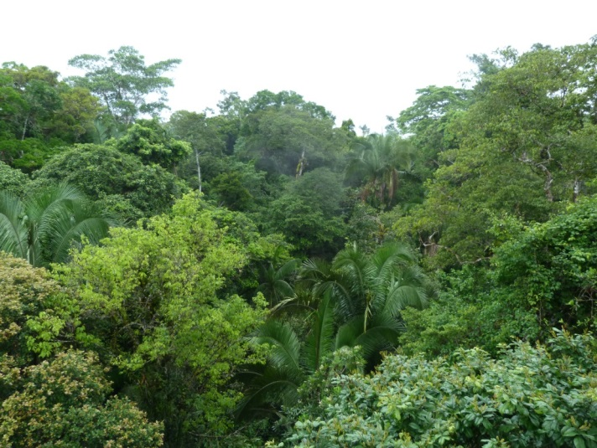
a healthY ecosystem is…
…stable and sustainable, maintaining its character in composition, organization and function over time, and its resilience to stress
Notes:
The above definition is derived from the article Assessing Ecosystem Health by Rapport et al. The students should be given this article to read…….
Picture of is the Amazon Rainforest

Slide 7
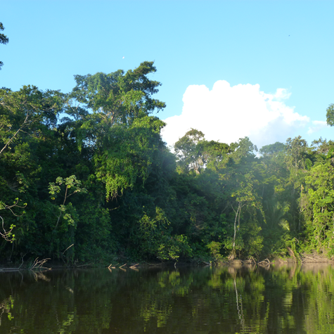
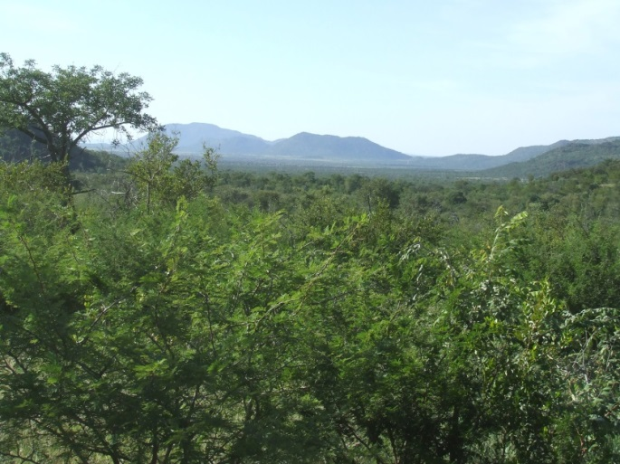
What do you think
What do you think a healthy ecosystem looks like?
What are some examples from the article of things that can affect ecosystem health?
Notes:
Students should give their impressions.
Examples from the article –
Elimination of natural predators
Drought
Extreme weather events
Timber harvesting
Fire suppression
Heavy livestock grazing
Over harvesting of fish
Waste
Decreased biodiversity

Slide 8
Biodiversity is the diversity of life
As defined in the proposed US Congressional Biodiversity Act, HR1268 (1990):
"biological diversity means the full range of variety and variability within and among living organisms and the ecological complexes in which they occur, and encompasses ecosystem or community diversity, species diversity, and genetic diversity.“
D.B. Jensen, M. Torn, and J. Harte,
"In Our Own Hands: A Strategy for Conserving
Biological Diversity in California," 1990
Notes:
Biodiversity is one of the key indicators of a healthy ecosystem Here is a legal definition of biodiversity used in the U.S.
California Biodiversity Council. 2008. Scientific Definitions of Biodiversity. California Biodiversity Council. Accessed from http://biodiversity.ca.gov/Biodiversity/biodiv_def2.html

Slide 9
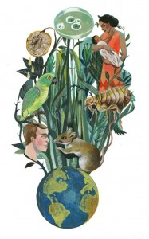
There is much more to biodiversity than the numbers of species and kinds of ecosystems.
Source: sph.umn.edu
Notes:
This seems like it is a statement that will be followed by some explanation…

Slide 10
Primary attributes of an Ecosystem
Ecologist Jerry Franklin portrays ecosystems as having three primary attributes:
Components
Structure
Function
Notes:
This is a quote from Edward Grumbine’s booke Ghost Bears: Exploring the Biodiversity Crisis. Read quote – continues on next slide
Edward Grumbine, "Ghost Bears: Exploring the Biodiversity Crisis," 1993 - Scientific Definitions of Biodiversity. California Biodiversity Council. Accessed from http://biodiversity.ca.gov/Biodiversity/biodiv_def2.html

Slide 11
Ecosystem Components…
…the inhabiting species in all their variety and richness. Many different species, gene-pool abundance, and unique populations are what most people think of when they hear the term "biodiversity". But there is much more to consider.
Notes:
This is a quote from Edward Grumbine’s booke Ghost Bears: Exploring the Biodiversity Crisis. Read quote – continues on next slide
Edward Grumbine, "Ghost Bears: Exploring the Biodiversity Crisis," 1993 - Scientific Definitions of Biodiversity. California Biodiversity Council. Accessed from http://biodiversity.ca.gov/Biodiversity/biodiv_def2.html

Slide 12
Ecosystem structure …
…refers to the physical patterns of life forms from the individual physiognomy of a thick-barked Douglas-fir to the vertical layers of vegetation from delicate herbs to tree canopies within a single forest stand. An ecosystem dominated by old, tall trees has a different structure than one comprised of short, quaking aspen. And there is more structure in a multilayered forest (herbs, shrubs, young trees, canopy trees) than in a single sagebrush grassland, prairie, or salt marsh.
Notes:
This is a quote from Edward Grumbine’s booke Ghost Bears: Exploring the Biodiversity Crisis. Read quote – continues on next slide
Edward Grumbine, "Ghost Bears: Exploring the Biodiversity Crisis," 1993 - Scientific Definitions of Biodiversity. California Biodiversity Council. Accessed from http://biodiversity.ca.gov/Biodiversity/biodiv_def2.html

Slide 13
Ecosystem functions…
…are hard to see in action. "You can't hug a biogeochemical cycle," says one ecologist. But without the part of the carbon cycle where small invertebrates, fungi, and microorganisms work to break down wood fiber, the downed logs in an ancient forest would never decay. Natural disturbances also play a role. Wildfires release nutrients to the soil, weed out weak trees, and reset the successional clock. The energy of falling water creates spawning beds for salmon even while it carves a mountain's bones. Plants breathe oxygen into the atmosphere. Ecological processes create landscapes and diverse environmental conditions out of life itself. Edward Grumbine, "Ghost Bears: Exploring the Biodiversity Crisis," 1993
Notes:
Finish quote and explain that this paints a more comprehensive picture of biodiversity and discusses the linkages between the abiotic and biotic cycles that we will be discussing.

Slide 14
Ecosystem functions (continued)
Ecosystem components, structures, and functions are all interdependent. To understand biodiversity, one has to think like a mountain and consider not only the biotic elements of plants, animals, and other living beings, but also the patterns and processes that shape volcanoes and forests.“
Edward Grumbine, "Ghost Bears: Exploring the Biodiversity Crisis," 1993

Slide 15
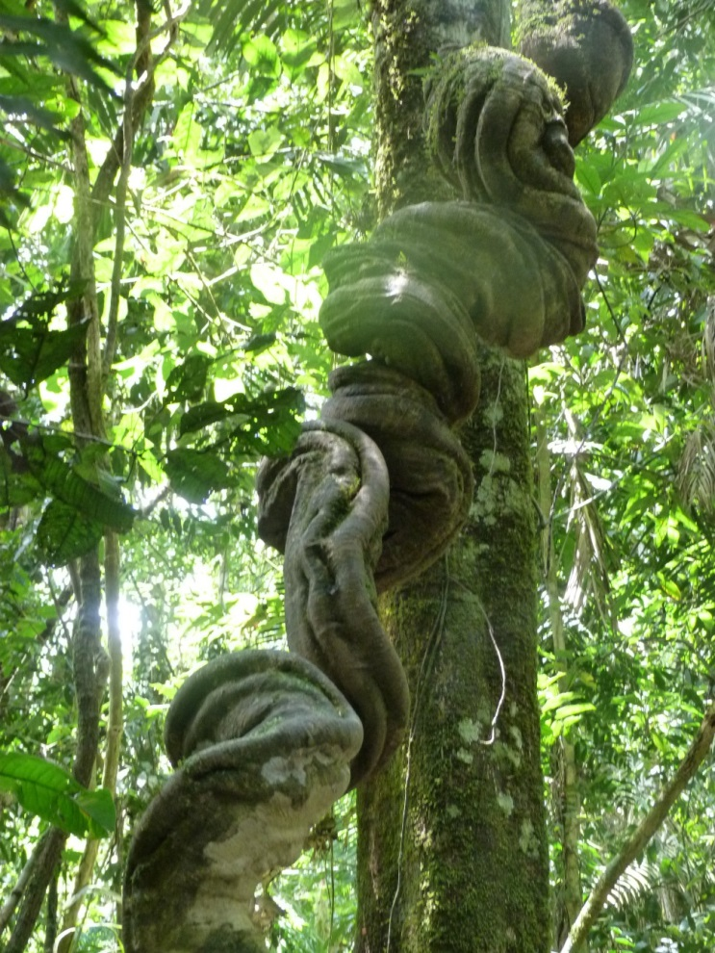
Understanding Ecosystem Health needs a trans-disciplinary approach. It bridges the natural, social and health sciences. It recognizes that ecosystems must be used sustainably to maintain human and animal health.
It can incorporate human values and perceptions that are important in the management of the environment and disease.
Notes:
The facilitator should explain that there are many different definitions of ecosystem health., some of which are based more in ecology. This was the basis for what defined as a health ecosystem. However, ecosystem health is as much a philosophical approach to integrating multiple disciplines to examine human and animal health within the context of the environment or examining the health of the environment with respect to socioeconomics and human health.

Slide 16
One health
Environments
Animal
Humans
Human System
Ecosystem Health
Animal Health
Plant Health
Economic Health
Individual Health
Livestock Health
Wildlife Health
Notes:
Ecosystem Health is one element of one health. Describe the concept of One Health and Ecosystem Health’s role in One Health

Slide 17
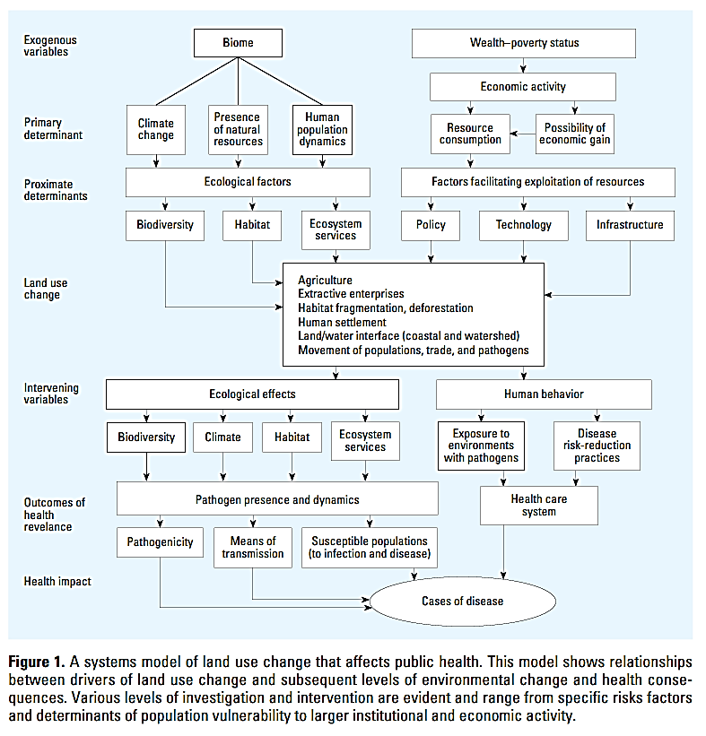
Figure 1. A system model of land use change that affects public health.This model shows relationships between drivers of land use and subsequent levels of environmental change and health consequences. Various level investigation are evident and range from specific risks factors and determinants of population vulnerability to larger institutional and economic activity
Notes:
Describe in general the graph explaining that the class will be focusing on providing information about ecosystem health so that the students will be able to understand the environmental variables in this graphic and how they contribute to One Health. Students should be given the graph to study if possible?

Slide 18
Figure 1. A system model of land use change that affects public health.This model shows relationships between drivers of land use and subsequent levels of environmental change and health consequences. Various level investigation are evident and range from specific risks factors and determinants of population vulnerability to larger institutional and economic activity
Notes:
Describe in general the graph explaining that the class will be focusing on providing information about ecosystem health so that the students will be able to understand the environmental variables in this graphic and how they contribute to One Health. Students should be given the graph to study if possible?

Slide 19
What do you think
In pairs:
List the ecosystems that surround the university.
How do you derive benefits from these ecosystems?
How does your health depend on ecosystems?
Notes:
Give students 10 minutes to develop lists – allow each group to present or ask the group to give answers – write on board – have a general discussion

Slide 20
Homework
Introduction to Abiotic Cycles
Water Carbon Nitrogen
As homework, develop a 10 minute presentation to describe your assigned cycle to your fellow students. It can be presented in the form of a video, a PowerPoint Presentation, a play, a photo essay, etc. Get creative and have fun!
Notes:
In secondary school, you learned about abiotic cycles such as the hydrologic, carbon, and energy cycles. To begin the class, you are going to have the opportunity to teach your fellow students about these cycles to refresh your memories. Keep in mind abiotic cycles provide the basis of ecosystems. They provide essential elements for all of life to function. When these cycles are disrupted, ecosystems do not function as they are supposed to.
Directions:
Divide class into three teams.
Give each team a packet of materials including a graphic of one of the cycles.

Slide 21
References
California Biodiversity Council. 2008. Scientific Definitions of Biodiversity. California Biodiversity Council. Accessed from http://biodiversity.ca.gov/Biodiversity/biodiv_def2.html
Patz, J.A., P. Daszak, G. M. Tabor, A. A. Aguirre, M. Pearl, J. Epstein, N. D. Wolfe, A. M. Kilpatrick, J. Foufopoulos, D. Molyneux, D. J. Bradley, and Members of the Working Group on Land Use Change Disease Emergence. 2004. Unhealthy Landscapes: Policy Recommendations on Land Use Change and Infectious Disease Emergence. Environ Health Perspect. 2004 July; 112(10): 1092–1098. Published online 2004 April 22. doi: 10.1289/ehp.6877
Rapport, D.J., R. Constanza, and A.J. McMichael. 1998. Assessing ecosystem health. TREE v. 14 n. 10 October 1998. Accessed from http://www.uvm.edu/rsenr/nr385fun/reading/AssessEcosysHealth.pdf

Slide 22
Abiotic Cycles Water, Carbon & Nitrogen
Ecosystem health, One Health Course

Slide 23
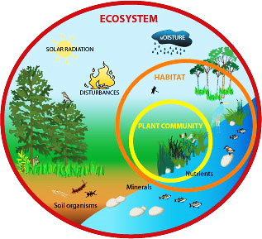
The Concept of Ecosystems
Ecology
Individuals
Populations
Communities
Ecosystem
Abiotic components
Biotic components
Ecosystem Ecology
Functional aspects
Source: tx.english-ch.com/teacher/owen/level-c/amazing-icebergs-and-their-role-in-the-ecosystem/
Notes:
“Ecology is defined as the interactions of organisms with one another and with the environment in which they occur. We can study ecology at the level of the individual, the population, the community, and the ecosystem.
Studies of individuals are concerned mostly about physiology, reproduction, development or behavior, and studies of populations usually focus on the habitat and resource needs of individual species, their group behaviors, population growth, and what limits their abundance or causes extinction. Studies of communities examine how populations of many species interact with one another, such as predators and their prey, or competitors that share common needs or resources.
An ecosystem consists of the biological community in an area and the physical and chemical factors that make up its non-living or abiotic environment. There are many examples of ecosystems -- a pond, a forest, an estuary, a grassland.
Abiotic components include: sunlight, precipitation, water, soil
Biotic components include: primary producers, herbivores, carnivores, omnivores, detritivores (these will be discussed in the next class)
Ecosystem ecology refers to how the system operates as a whole. This means that, rather than worrying mainly about particular species, we try to focus on major functional aspects of the system. These functional aspects include such things as the amount of energy that is produced by photosynthesis, how energy or materials flow along the many steps in a food chain, or what controls the rate of decomposition of materials or the rate at which nutrients are recycled in the system.” (University of Michigan 2013)
Reference:
University of Michigan. 2013. Concept of an Ecosystem. Accessed on September 25, 2013: http://www.globalchange.umich.edu/globalchange1/current/lectures/kling/ecosystem/ecosystem.html

Slide 24
Energy and Biogeochemical Cycling
Main processes of ecosystem ecology
Energy transformations
Photosynthesis + respiration → heat energy
Biogeochemical cycling or abiotic cycles
Water
Carbon
Nitrogen
Notes:
“Ecosystems have energy flows and ecosystems cycle materials.
The study of ecosystems mainly consists of the study of certain processes that link the living, or biotic, components to the non-living, or abiotic, components. Energy transformations and biogeochemical cycling are the main processes that comprise the field of ecosystem ecology.
Energy transformations : Energy enters the biological system as light energy, or photons, is transformed into chemical energy in organic molecules by cellular processes including photosynthesis and respiration, and ultimately is converted to heat energy. This energy is dissipated, meaning it is lost to the system as heat; once it is lost it cannot be recycled. Without the continued input of solar energy, biological systems would quickly shut down. This process is discussed in the next class.
Biogeochemical cycling: Elements such as carbon, nitrogen, or phosphorus enter living organisms in a variety of ways. Plants obtain elements (water, nitrogen, carbon) from the surrounding atmosphere, water, or soils. Animals may also obtain elements directly from the physical environment, but usually they obtain these mainly as a consequence of consuming other organisms. These materials are transformed biochemically within the bodies of organisms, but sooner or later, due to excretion or decomposition, they are returned to an inorganic state. For example, often bacteria complete this process, through the process called decomposition or mineralization.” (University of Michigan 2013)
Student presentations on water, carbon and nitrogen cycles begin here.
Reference:
University of Michigan. 2013. Concept of an Ecosystem. Accessed on September 25, 2013: http://www.globalchange.umich.edu/globalchange1/current/lectures/kling/ecosystem/ecosystem.html

Slide 25
Notes:
The water cycle is also called the hydrologic cycle.
The chart shows where water exists throughout the world. The water cycle describes the movement of Earth's water. The chart represents the presence of Earth's water at a single point in time. The numbers will be different in a thousand years.
Discuss the distribution of saline versus freshwater.

Slide 26
http://pmm.nasa.gov/education/sites/default/files/article_images/Water-Cycle-Art2A.png
Notes:
“Water is necessary to sustaining life on Earth, and helps tie together the Earth's lands, oceans, and atmosphere into an integrated system. Precipitation, evaporation, freezing and melting and condensation are all part of the hydrological cycle - a never-ending global process of water circulation from clouds to land, to the ocean, and back to the clouds. This cycling of water is intimately linked with energy exchanges among the atmosphere, ocean, and land that determine the Earth's climate and cause much of natural climate variability. The impacts of climate change and variability on the quality of human life occur primarily through changes in the water cycle.” (NASA 2013)
The hydrologic cycle describes the movement of Earth’s water the pilgrimage of water as water molecules make their way from the Earth's surface to the atmosphere, and back again. This gigantic system, powered by energy from the sun, is a continuous exchange of moisture between the oceans, the atmosphere, and the land.
Evaporation:
“Evaporation occurs when the physical state of water is changed from a liquid state to a gaseous state. A considerable amount of heat, about 600 calories of energy for each gram of water, is exchanged during the change of state. Typically, solar radiation and other factors such as air temperature, vapor pressure, wind, and atmospheric pressure affect the amount of natural evaporation that takes place in any geographic area. Evaporation can occur on raindrops, and on free water surfaces such as seas and lakes. It can even occur from water settled on vegetation, soil, rocks and snow. There is also evaporation caused by human activities. Heated buildings experience evaporation of water settled on its surfaces. Evaporated moisture is lifted into the atmosphere from the ocean, land surfaces, and water bodies as water vapor. Some vapor always exists in the atmosphere.”
Condensation:
Condensation is the process by which water vapor in the air is changed into liquid water. Condensation is crucial to the water cycle because it is responsible for the formation of clouds. “Condensation is the process by which water vapor changes it's physical state from a vapor, most commonly, to a liquid. Water vapor condenses onto small airborne particles to form dew, fog, or clouds. The most active particles that form clouds are sea salts, atmospheric ions caused by lightning, and combustion products containing sulfurous and nitrous acids. Condensation is brought about by cooling of the air or by increasing the amount of vapor in the air to its saturation point. When water vapor condenses back into a liquid state, the same large amount of heat ( 600 calories of energy per gram) that was needed to make it a vapor is released to the environment.”
Precipitation:
“Precipitation is the process that occurs when any and all forms of water particles fall from the atmosphere and reach the ground. There are two sub-processes that cause clouds to release precipitation, the coalescence process and the ice-crystal process. As water drops reach a critical size, the drop is exposed to gravity and frictional drag. A falling drop leaves a turbulent wake behind which allows smaller drops to fall faster and to be overtaken to join and combine with the lead drop. The other sub-process that can occur is the ice-crystal formation process. It occurs when ice develops in cold clouds or in cloud formations high in the atmosphere where freezing temperatures occur. When nearby water droplets approach the crystals some droplets evaporate and condense on the crystals. The crystals grow to a critical size and drop as snow or ice pellets. Sometimes, as the pellets fall through lower elevation air, they melt and change into raindrops. Precipitated water may fall into a waterbody or it may fall onto land. It is then dispersed several ways. The water can adhere to objects on or near the planet surface or it can be carried over and through the land into stream channels, or it may penetrate into the soil, or it may be intercepted by plants. When rainfall is small and infrequent, a high percentage of precipitation is returned to the atmosphere by evaporation. The portion of precipitation that appears in surface streams is called runoff. Runoff may consist of component contributions from such sources as surface runoff, subsurface runoff, or ground water runoff. Surface runoff travels over the ground surface and through surface channels to leave a catchment area called a drainage basin or watershed. The portion of the surface runoff that flows over the land surface towards the stream channels is called overland flow. The total runoff confined in the stream channels is called the streamflow.”
Infiltration:
“Infiltration is the physical process involving movement of water through the boundary area where the atmosphere interfaces with the soil. The surface phenomenon is governed by soil surface conditions. Water transfer is related to the porosity of the soil and the permeability of the soil profile. Typically, the infiltration rate depends on the puddling of the water at the soil surface by the impact of raindrops, the texture and structure of the soil, the initial soil moisture content, the decreasing water concentration as the water moves deeper into the soil filling of the pores in the soil matrices, changes in the soil composition, and to the swelling of the wetted soils that in turn close cracks in the soil. Water that is infiltrated and stored in the soil can also become the water that later is evapotranspired or becomes subsurface runoff.”
Percolation:
“Percolation is the movement of water though the soil, and it's layers, by gravity and capillary forces. The prime moving force of groundwater is gravity. Water that is in the zone of aeration where air exists is called vadose water. Water that is in the zone of saturation is called groundwater. For all practical purposes, all groundwater originates as surface water. Once underground, the water is moved by gravity. The boundary that separates the vadose and the saturation zones is called the water table. Usually the direction of water movement is changed from downward and a horizontal component to the movement is added that is based on the geologic boundary conditions. Geologic formations in the earth's crust serve as natural subterranean reservoirs for storing water. Others can also serve as conduits for the movement of water. Essentially, all groundwater is in motion. Some of it, however, moves extremely slowly. A geologic formation which transmits water from one location to another in sufficient quantity for economic development is called an aquifer. The movement of water is possible because of the voids or pores in the geologic formations. Some formations conduct water back to the ground surface. A spring is a place where the water table reaches the ground surface. Stream channels can be in contact with an unconfined aquifer that approach the ground surface. Water may move from the ground into the stream, or visa versa, depending on the relative water level. Groundwater discharges into a stream forms the base flow of the stream during dry periods, especially during droughts. An influent stream supplies water to an aquifer while and effluent stream receives water from the aquifer.”
Transpiration:
“Transpiration is the biological process that occurs mostly in the day. Water inside of plants is transferred from the plant to the atmosphere as water vapor through numerous individual leave openings. Plants transpire to move nutrients to the upper portion of the plants and to cool the leaves exposed to the sun. Leaves undergoing rapid transpiration can be significantly cooler than the surrounding air. Transpiration is greatly affected by the species of plants that are in the soil and it is strongly affected by the amount of light to which the plants are exposed. Water can be transpired freely by plants until a water deficit develops in the plant and it water-releasing cells (stomata) begin to close. Transpiration then continues at a must slower rate. Only a small portion of the water that plants absorb are retained in the plants. Vegetation generally retards evaporation from the soil. Vegetation that is shading the soil, reduces the wind velocity. Also, releasing water vapor to the atmosphere reduces the amount of direct evaporation from the soil or from snow or ice cover. The absorption of water into plant roots, along with interception that occurs on plant surfaces offsets the general effects that vegetation has in retarding evaporation from the soil. The forest vegetation tends to have more moisture than the soil beneath the trees.”
Runoff:
“Runoff is flow from a drainage basin or watershed that appears in surface streams. It generally consists of the flow that is unaffected by artificial diversions, storages or other works that society might have on or in a stream channel. The flow is made up partly of precipitation that falls directly on the stream , surface runoff that flows over the land surface and through channels, subsurface runoff that infiltrates the surface soils and moves laterally towards the stream, and groundwater runoff from deep percolation through the soil horizons. Part of the subsurface flow enters the stream quickly, while the remaining portion may take a longer period before joining the water in the stream. When each of the component flows enter the stream, they form the total runoff. The total runoff in the stream channels is called streamflow and it is generally regarded as direct runoff or base flow.”
Storage:
“There are three basic locations of water storage that occur in the planetary water cycle. Water is stored in the atmosphere; water is stored on the surface of the earth, and water stored in the ground. Water stored in the atmosphere can be moved relatively quickly from one part of the planet to another part of the planet. The type of storage that occurs on the land surface and under the ground largely depend on the geologic features related to the types of soil and the types of rocks present at the storage locations. Storage occurs as surface storage in oceans, lakes, reservoirs, and glaciers; underground storage occurs in the soil, in aquifers, and in the crevices of rock formations. The movement of water through the eight other major physical processes of the water cycle can be erratic. On average, water the atmosphere is renewed every 16 days. Soil moisture is replaced about every year. Globally, waters in wetlands are replaced about every 5 years while the residence time of lake water is about 17 years. In areas of low development by society, groundwater renewal can exceed 1,400 years. The uneven distribution and movement of water over time, and the spatial distribution of water in both geographic and geologic areas, can cause extreme phenomena such as floods and droughts to occur. “
Reference:
National Aeronautics and Space Administration (NASA). Water Cycle. Accessed on September 23, 2013: http://science.nasa.gov/earth-science/oceanography/ocean-earth-system/ocean-water-cycle/
National Oceanic and Atmospheric Administration (NOAA). Northwest River Forecast Center. Hydrologic Cycle. Accessed on September 23, 2013: http://www.nwrfc.noaa.gov/info/water_cycle/hydrology.cgi

Slide 27
Water Cycle
http://science.nasa.gov/media/medialibrary/2010/03/31/water_cycle.jpg
Notes:
Another example of the water cycle.
Image from NASA 2013.

Slide 28
Water Cycle Discussion Points
Why is the water cycle important?
What disrupts the water cycle?
How do impacts to the water cycle affect human health?
Notes:
Importance of the water cycle:
Water is essential for all life forms.
Water covers 75% of the Earth’s surface. The total amount of water on Earth remains about the same from one year to the next, as it circulates between the oceans, land and atmosphere in a cycle of evaporation and precipitation. This process modifies and regulates the Earth’s climate.
Water is significant to cultures and religions across the globe.
See what else the class can come up with.
What are some examples that disrupt the water cycle?
- Farming
- Deforestation. For example, with deforestation, water can run-off easily. This results in soil leeching, erosion, flooding and a drier climate.
- Air Pollution
- Pollutant Runoff (e.g., fertilizer)
-

Slide 29
Additional Terms
Aquifer
Delta
Deposition
Erosion
Groundwater
Glacier
Sediment
Spring
Surface water
Water molecule
Watershed
Water vapor
Notes:
Aquifer: The saturated zone beneath the water table (http://ga.water.usgs.gov/edu/earthgwaquifer.html)
Delta: the flat, low-lying plain that sometimes forms at the mouth of a river from deposits of sediments (http://education.nationalgeographic.com)
Deposition: Deposition is the laying down of sediment carried by wind, water, or ice. Sediment can be transported as pebbles, sand & mud, or as salts dissolved in water. (http://www.geolsoc.org.uk/ks3/gsl/education/resources/rockcycle/page3463.html)
Erosion: act in which earth is worn away, often by water, wind, or ice (http://education.nationalgeographic.com)
Groundwater: water beneath the surface of the earth that saturates the pores and fractures of sand, gravel, and rock formations. (http://www.eoearth.org/view/article/153161/)
Glacier: mass of ice that moves slowly over land (http://education.nationalgeographic.com)
Sediment: the flat, low-lying plain that sometimes forms at the mouth of a river from deposits of sediments (http://education.nationalgeographic.com)
Spring: small flow of water flowing naturally from an underground water source (http://education.nationalgeographic.com)
Surface Water: the water from all sources that occurs on the Earth's surface either as diffused water or as water in natural channels, artificial channels, or other surface water bodies (http://ohioline.osu.edu/aex-fact/0460.html)
Water molecule: Water is a chemical compound and polar molecule, which is liquid at standard temperature and pressure. It has the chemical formula H₂O, meaning that one molecule of water is composed of two hydrogen atoms and one oxygen atom. (http://www.worldofmolecules.com/solvents/water.htm)
Watershed: entire river system or an area drained by a river and its tributaries (http://education.nationalgeographic.com)
Water vapor: visible liquid suspended in the air, such as fog (http://education.nationalgeographic.com)

Slide 30
Carbon Cycle
http://www.esrl.noaa.gov/gmd/outreach/carbon_toolkit/basics.html
Notes:
What is carbon? Carbon is everywhere- oceans, rocks, soil, in all forms of life. Life would not exist without carbon. The functioning of the Earth depends on carbon. (http://serc.carleton.edu/eslabs/carbon/index.html)
The carbon cycle regulates the Earth’s temperature and climate by controlling the amount of carbon dioxide in the atmosphere. CO2 is a greenhouse gas that makes the earth warm enough for life to exist also known as the greenhouse gas effect. CO2 helps the atmosphere retain heat generated from the sun. Too much CO2 trapped in the atmosphere will increase temperatures throughout the world. (http://serc.carleton.edu/eslabs/carbon/index.html)
“The carbon cycle is the continuous exchange and recycling of carbon through the Earth system, from the atmosphere (mostly CO2, but also other carbon containing gases) to the biosphere (wood, biomass), to the oceans (bicarbonate ions, a component of sea salt), from fossil fuels, and to carbonate rock such as limestone and marble. As carbon is transferred between reservoirs, processes which release CO₂ into the atmosphere are called sources, and processes which remove CO₂ from the atmosphere are called sinks.
Carbon is continuously exchanged and recycled among the reservoirs through natural processes. These processes occur at various rates ranging from short-term fluctuations which occur daily and seasonally to very long-term cycles which occur over hundreds of millions of years. For example, there is a clear seasonal cycle in atmospheric CO₂ as plants photosynthesize during the growing season, removing large amounts of CO₂. Respiration (from both plants and animals) and decomposition of leaves, roots, and organic compounds release CO₂ back into the atmosphere. On a scale spanning decades to centuries, CO₂ levels fluctuate gradually between the ocean and atmospheric reservoirs as ocean mixing occurs (between surface and deep waters) and the surface waters exchange CO₂ with the atmosphere. Much longer cycles also occur, on the scale of geologic time, due to the deposition and weathering of carbonate and silicate rock. Carbonate rocks like limestone are formed from the shells of marine organisms buried on the ocean floor, and they are chemically eroded by reaction with CO₂ (remember that CO₂ mixed with water is an acid) in the air and in soils. Silicate rock reacts with carbonate rock deep underground, producing CO₂ gas coming out of volcanoes. Fossil fuels form a relatively small part of these natural geologic cycles.”
Reference:
National Oceanic and Atmospheric Administration (NOAA). Basics of the Carbon Cycle and the Greenhouse Effect. Accessed on September 23, 2013: http://www.esrl.noaa.gov/gmd/outreach/carbon_toolkit/basics.html

Slide 31
Carbon Cycle Discussion Points
Carbon pools and fluxes
What are some examples of pools and fluxes?
What are sources and sinks?
What are some examples of carbon containing substances and their global locations?
What happens if the normal movement of carbon through the carbon cycle is disrupted?
Notes:
Carbon is found in the Earth’s atmosphere, oceans, soils and crust. These locations are known as carbon pools or reservoirs because they store carbon. Movement between these pools is known as a carbon flux.
Have students identify the pool or reservoir with the most and least amount of carbon:
Earth’s Crust/Land (soil/rocks/fossil fuels) – largest amount of carbon on Earth is stored in sedimentary rocks within the crust.
Oceans (including mid and deep waters)
Atmosphere
Terrestrial ecosystems- contain carbon in the form of plants, animals, soils and microorganisms (bacteria and fungi) (University of New Hampshire 2013)
Some likely examples of carbon fluxes:
fossil fuels →(burning) → atmosphere atmosphere → (photosynthesis) → plants plants & animals → (respiration) → atmosphere land- (acid rain attack on carbonates)- atmosphere dead plants & animals →(decomposition) →soil atmosphere → (dissolving) → ocean plants →(digestion) → animals animals→ (create waste) → soil decomposed organic materials → (heat, pressure, time) → fossil fuels
What are Sources and Sinks? Processes which release CO₂ into the atmosphere are called sources, and processes which remove CO₂ from the atmosphere are called sinks.
Examples of carbon containing substances and their global locations include: Co² (atmosphere), plants and animals (biosphere), rocks, minerals, soils, fossil fuels (geosphere)
What happens if the normal movement of carbon through the carbon cycle is disrupted?
“The increase in atmospheric carbon dioxide and other carbon-containing compounds (methane and other hydrocarbons) has a direct effect on climate change. The concentration of carbon dioxide has increased in the Industrial Age from 270 parts per million (ppm) in the atmosphere in 1800 to the current 365 ppm. It is continuing to increase at a rate of approximately half a percent per year. The increase has been due partly to:
the burning of fossil fuels;
changes in land use and management, including deforestation, conversion of grasslands to croplands; and
farming practices that accelerated oxidation, or breakdown, of soil organic matter (USDA 2008).”
References:
University of New Hampshire. An Introduction to the Global Carbon Cycle. Accessed on September 26, 2013: http://globecarboncycle.unh.edu/CarbonCycleBackground.pdf
United States Department of Agricultural Research Service (USDA). 2008. National Program 204: Global Change. Component I: Carbon Cycle and Carbon Storage. Accessed on September 23, 2013: http://www.ars.usda.gov/research/programs/programs.htm?docid=308&np_code=204&page=1

Slide 32
All About Carbon Dioxide
Notes:
SHOW THE CARBON VIDEO: http://epa.gov/climatestudents/basics/today/carbon-dioxide.html#
Reference:
Environmental Protection Agency (EPA). All About Carbon Dioxide: VIDEO. Accessed September 23, 2013.

Slide 33
http://swroc.cfans.umn.edu/ResearchandOutreach/SoilManagement/SoilResearch/NitrogenCycle/index.htm
Notes:
“Nitrogen is an element that is found in both the living portion of our planet and the inorganic parts of the Earth system.
The nitrogen cycle is one of the biogeochemical cycles and is very important for ecosystems. Nitrogen moves slowly through the cycle and is stored in reservoirs such as the atmosphere, living organisms, soils, and oceans along its way. Nitrogen undergoes many different transformations in the ecosystem, changing from one form to another as organisms use it for growth and, in some cases, energy. This process is known as the Nitrogen (N) cycle. The N cycle illustrates how N from manure, fertilizers and plants moves through the soil to crops, water and the air. In general, the N cycle processes of fixation, mineralization and nitrification increase plant available N. Denitrification, volatilization, immobilization, and leaching result in permanent or temporary N losses from the root zone. The transformation of nitrogen into its many oxidation states is key to productivity in the biosphere and is highly dependent on the activities of a diverse assemblage of microorganisms, such as bacteria, archaea, and fungi.” (Cornell 2005)
“Most of the nitrogen on Earth is in the atmosphere. Approximately 80% of the molecules in Earth’s atmosphere are made of two nitrogen atoms bonded together- dinitrogen gas (N2). All plants and animals need nitrogen to make amino acids, proteins and DNA, but the nitrogen in the atmosphere is not in a form that they can use. The molecules of nitrogen in the atmosphere can become usable for living things when they are broken apart during lightning strikes or fires, by certain types of bacteria, or by bacteria associated with legume plants. Other plants get the nitrogen they need from the soils or water in which they live mostly in the form of inorganic nitrate (NO3-). Nitro­gen is a limiting factor for plant growth. Animals get the nitrogen they need by consuming plants or other animals that contain organic molecules composed partially of nitrogen. When organisms die, their bodies decompose bringing the nitrogen into soil on land or into the oceans. As dead plants and animals decompose, nitrogen is converted into inorganic forms such as ammonium salts (NH4+ ) by a process called mineralization. The ammo­nium salts are absorbed onto clay in the soil and then chemically altered by bacteria into nitrite (NO2- ) and then nitrate (NO3- ). Nitrate is the form commonly used by plants. It is easily dissolved in water and leached from the soil system. Dissolved nitrate can be returned to the atmosphere by certain bacteria in a process called denitrifi­cation.” (Roche 2013)
Denitrification “occurs when N is lost to the atmosphere through the conversion of nitrate to gaseous forms of N, such as nitric oxide, nitrous oxide and dinitrogen gas. This occurs when the soil is saturated and the bacteria use nitrate as an oxygen source. Denitrification is common in poorly drained soils. Denitrification is the opposite of fixation because organisms use N nutrients as their energy source and return N to the atmosphere, completing the cycle.”
Fixation refers to the conversion of atmospheric nitrogen (N2) into reactive compounds such as ammonia (NH3) and nitrate (NO3-). Microbes use enzymes to convert N from the environment into the forms that plants can use as nutirents. Nitrogen fixation requires energy, enzymes and minerals.” (Cornell 2005)
“The breaking of the bonds between the nitrogen atoms requires a great deal of energy and occurs naturally in two primary ways:
1. Abiotic Fixation: Nitrate is the result of high energy fixation in the atmosphere from lightning and cosmic radiation. In this process, N2 is combined with oxygen to form nitrogen oxides such as NO and NO2, which are carried to the earth’s surface in rainfall as nitric acid (HNO3). This high energy fixation accounts for approximately 10% of the nitrate entering the nitrogen cycle.
2. Biological fixation: Biological fixation is accomplished by a series of soil micro-organisms such as aerobic and anaerobic bacteria. Often, symbiotic bacteria such as Rhizobium are found in the roots of legumes and provide a direct source of ammonia to the plants. In root nodules of these legumes, the bacteria split molecular nitrogen into two free nitrogen atoms, which combine with hydrogen to form ammonia (NH3). The following plants are common examples of legumes: clover, alfalfa, soy beans, and chick peas. The breakdown of these legumes by bacteria during ammonification actually returns excess nitrogen not utilized by the plant to the surrounding soil. Therefore, to promote sustainable soil fertility, it is beneficial to use these agricultural crops in rotation with other plants, such as corn, that are more profitable but deplete the available nitrogen in the soil-Some free-living aerobic bacteria, such as Azotobacter, and anaerobic bacteria, like Clostridium, freely fix nitrogen in the soil and in aquatic environments. Some members of the photosynthetic Cyanobacteria phylum fix nitrogen in aquatic environments as well.” (College Board)
Mineralization “is the process by which microbes decompose organic N from manure, organic matter and crop residues to ammonium. Because it is a biological process, rates of mineralization vary with soil temperature, moisture and the amount of oxygen in the soil (aeration). Mineralization readily occurs in warm (68-95°F), well-aerated and moist soils.
Nitrification is the process by which ammonia is oxidized to nitrite ions (NO2-) and then to nitrate ions (NO3-), which is the form most usable by plants. Nitrate is highly susceptible to leaching losses. Nitrification is most rapid when soil is warm (67-86°F), moist and well-aerated, but is virtually halted below 41°F and above 122°F.” (Cornell 2005)
Assimilation: “Nitrates are the form of nitrogen most commonly assimilated by plants through root hairs. Since heterotrophic organisms cannot readily absorb nitrogen as plants do, they rely on acquiring nitrogen-based compounds through the food they eat. Since plants are the base of the food chain, the nitrogen-based compounds they have assimilated into their tissue will continue to pass from one organism to another (through consumption) as matter and energy transfers through the ecosystem’s food web.” (College Board)
Ammonification: “In ammonification, a host of decomposing microorganisms, such as bacteria and fungi, break down nitrogenous wastes and organic matter found in animal waste and dead plants and animals and convert it to inorganic ammonia (NH3) for absorption by plants as ammonium ions. Therefore, decomposition rates affect the level of nutrients available to primary producers.” (College Board)
Volitalization is the loss of N through the conversion of ammonium to ammonia gas, which is released to the atmosphere. The volatilization losses increase at higher soil pH and conditions that favor evaporation (e.g. hot and windy). Volatilization losses are higher for manures and urea fertilizers that are surface applied and not incorporated (by tillage or by rain) into the soil. Manure contains N in two primary forms: ammonium and organic N. If manure is incorporated within one day, 65% of the ammonium N is retained; when incorporated after 5 days the ammonium N will have been lost through volatilization. Organic N in manure is not lost through volatilization, but it takes time to mineralize and become plant available.
Immobilization is the reverse of mineralization. All living things require N; therefore microorganisms in the soil compete with crops for N. Immobilization refers to the process in which nitrate and ammonium are taken up by soil organisms and therefore become unavailable to crops. Incorporation of materials with a high carbon to nitrogen ratio (e.g. sawdust, straw, etc.), will increase biological activity and cause a greater demand for N, and thus result in N immobilization. Immobilization only temporarily locks up N. When the microorganisms die, the organic N contained in their cells is converted by mineralization and nitrification to plant available nitrate.
Leaching is a pathway of N loss of a high concern to water quality. Soil particles do not retain nitrate very well because both are negatively charged. As a result, nitrate easily moves with water in the soil. The rate of leaching depends on soil drainage, rainfall, amount of nitrate present in the soil, and crop uptake. The EPA has set the maximum contaminant level for drinking water at 10 ppm N as nitrate. Well-drained soils, unexpected low crop yield, high N inputs (especially outside of the growing season) and high rainfall are all conditions that increase the potential for nitrate leaching.
Plant Uptake/Crop Removal is the prime goal of N management on farms. The greatest efficiency occurs when adequate N is applied at a time when the crop is actively taking it up. Efficient N use also depends on a number of other factors including temperature, soil moisture, pest pressure, and soil compaction. In the moist Northeast climate, nitrate remaining in the soil after the growing season will be lost to leaching or denitrification between crop harvest and the next planting season. Efficient N use during the growing season and the use of cover crops can minimize such losses.” (Cornell 2005)
References:
Johnson, Courtney, Greg Albrecht, Quirine Ketterings, Jen Beckman and Kristen Stockin. 2005. Nitrogen Basics- The Nitrogen Cycle. Cornell University Cooperative Extension. Agronomy Fact Sheet Series.
Roche, Darlene. Biogeochemical Cycles. Clarkson Schools. Accessed on September 24, 2013: http://www.cpalms.org/resources/PublicPreviewResource11743.aspx

Slide 34
Nitrogen Cycle Discussion Points
Why is the nitrogen cycle important?
What human activities have disrupted the nitrogen cycle? How have they affected humans?
Identify other gases besides N₂ that can be produced during denitrification. What human activities facilitate the production of these gases?
Notes:
Why is the nitrogen cycle important? N plays a central role in the production of food. Plants extract N from the environment to make food. N is needed by all living things because it is an essential component of amino acids (building blocks of proteins) and of nucleotides (building blocks of DNA).
What human activities have disrupted the nitrogen cycle? How have they affected humans? “Until recent times, nitrogen fixation by microorganisms (with an additional small amount from lightning strikes) was the only way in which nitrogen made its way from the environment into living organisms. Human production of additional nitrogen nutrients, however, has now disrupted the natural nitrogen cycle, with fertilizer accounting for more than half of the annual amount of nitrogen fixation attributed to human activity. Another large contribution comes from planting legumes, including soybeans and alfalfa, which are attractive hosts for nitrogen-fixing microbes and therefore enrich the soil where they grow. A third contributor is nitrogen oxide formed during burning of fuels, where the air becomes so hot that the nitrogen molecule breaks apart.
Such human activity has doubled the amount of fixed nitrogen over the levels present during pre-industrial times. Among the consequences are worsening of the greenhouse effect, reducing the protective ozone layer, adding to smog, contributing to acid rain, and contaminating drinking water.”
“Fertilizer for agricultural fields is the major source of nitrous oxide, a potent greenhouse gas. One nitrous oxide molecule, in fact, traps heat about 200 times more effectively than each molecule of carbon dioxide, the most plentiful greenhouse gas. Nitrous oxide also remains in th-e air for a long time — on the order of a century — because it does not dissolve easily in water and resists reacting with other chemicals. Consequently it eventually reaches the stratosphere where sunlight breaks it into nitric oxide, a key link in the chain of reactions that damages the Earth’s protective ozone layer.”
At the same time, other fixed-nitrogen gases released from fertilizers contribute to producing ozone in the lower atmosphere, where it is a pollutant rather than a protector. This reactive nitrogen can also lead to production of aerosols that can induce serious respiratory illness, cancer, and cardiac disease when in the air we breathe. Yet another pollution problem, acid rain, is fueled in part by nitrogen oxides from fertilizer.”
Other forms of fixed nitrogen that are applied during fertilization, particularly nitrite ions, also exacerbate water pollution problems. High nitrate concentrations in drinking water are a direct human health problem, causing “blue baby syndrome.” Additional ecological concerns arise from the role of fixed nitrogen compounds in over-enriching aquatic ecosystems, producing large amounts of phytoplankton (small water plants) that deplete oxygen supplies in the water and lead to “dead zones. (National Academy of Engineering 2012).
“Finally, much of the nitrogen applied to agricultural and urban areas ultimately enters rivers and nearshore coastal systems. In nearshore marine systems, increases in nitrogen can often lead to anoxia (no oxygen) or hypoxia (low oxygen), altered biodiversity, changes in food-web structure, and general habitat degradation. One common consequence of increased nitrogen is an increase in harmful algal blooms. Toxic blooms of certain types of dinoflagellates have been associated with high fish and shellfish mortality in some areas. Even without such economically catastrophic effects, the addition of nitrogen can lead to changes in biodiversity and species composition that may lead to changes in overall ecosystem function. Some have even suggested that alterations to the nitrogen cycle may lead to an increased risk of parasitic and infectious diseases among humans and wildlife. Additionally, increases in nitrogen in aquatic systems can lead to increased acidification in freshwater ecosystems.” (Bernhard 2012).
Identify other gases besides N₂ that can be produced during denitrification. What human activities facilitate the production of these gases? “Dinitrogen gas (N₂) is the ultimate end product of denitrification. Nitrous oxide (N₂O)= another end product and is considered a greenhouse gas, reacting with ozone and contributing to air pollution. Our rapidly increasing use of nitrogen based fertilizers on tropical soils for example, is giving rise to ballooning nitrous oxide emissions from this source. Additionally, increased atmospheric nitrogen deposition due to man-made nitrogen emissions, such as intensive livestock rearing, can induce elevated rates of nitrous oxide emission over large areas of otherwise untouched tropical soil. Rates of nitrous oxide from natural tropical soils are also likely to change in response to human-induced variations in temperature and rainfall.” (College Board)
References:
Bernhard, A. (2012) The Nitrogen Cycle: Processes, Players, and Human Impact. Nature Education Knowledge 3(10):25
College Board. 2013. Nitrogen Cycling in Ecosystems. Accessed on September 25, 2013: http://apcentral.collegeboard.com/apc/public/repository/nitrogen-cycling-in-ecosystems.pdf
National Academy of Engineering of the National Academies. 2012. Manage the nitrogen cycle. Accessed on September 25, 2013: http://www.engineeringchallenges.org/cms/8996/9132.aspx

Slide 35
Biotic Cycles, Food Web and Southeast Asian Ecosystems
Ecosystem health, One Health Course

Slide 36
Ecosystem Components
Abiotic
Biotic
Sunlight
Temperature
Precipitation
Soil cycles
Nutrient cycles
Primary producers
Herbivores
Carnivores
Omnivores
Detritivores
University of Michigan 2008. The Concept of the Ecosystem. Accessed from http://www.globalchange.umich.edu/globalchange1/current/lectures/kling/ecosystem/ecosystem.html

Slide 37
Energy Cycle
Ecosystem health, One Health Course

Slide 38
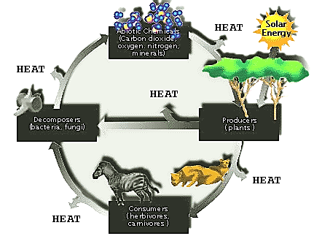
University of Michigan 2008. The Concept of the Ecosystem. Accessed from http://www.globalchange.umich.edu/globalchange1/current/lectures/kling/ecosystem/ecosystem.html
Notes:
All components of the ecosystem are interdependent. For example, the Energy flow and material (Abiotic) cycles are intertwined as shown on this figures. The material cycles represent the continuous movement of chemicals or nutrients through ecosystem and their conversion to utilizable forms by a combination of biological, geological and chemical processes. The energy flow or cycles includes the food chains in which a series of one organism eat or cause the decomposition of another organism.
Energy enters biological systems as light energy is transformed into chemical energy by cellular processes including photosynthesis and respiration, and ultimately is converted to heat energy. This energy is lost as heat; once lost energy cannot be recycled. Without the continued input of solar energy, biological systems would die.
Plants obtain elements, such as carbon and nitrogen from the atmosphere, water, or soils. Animals may also obtain some elements directly from the environment, but mostly from consuming other organisms. These chemicals are transformed biochemically within the bodies of organisms, but are eventually returned to their inorganic state through excretion or decomposition. Bacteria through the process decomposition or mineralization complete the process. During decomposition these materials are not destroyed or lost. The elements are cycled endlessly between their biotic and abiotic states within ecosystems. Those elements whose supply tends to limit biological activity are called nutrients.
University of Michigan 2008. The Concept of the Ecosystem. Accessed from http://www.globalchange.umich.edu/globalchange1/current/lectures/kling/ecosystem/ecosystem.html

Slide 39
Photosynthesis
6CO₂ + 6H₂O (+ light energy) C₆H₁₂O₆ + 6O₂
Sabali Communications 2013. About the MCAT - MCAT Biology - Cellular Respiration – Photosynthesis.
Accessed from http://www.aboutthemcat.com/biology/cellular-respiration.php
Notes:
The energy cycle begins with the transfer of energy from the sun to plants. Plants convert this energy via photosynthesis, using water, carbon dioxide, and oxygen, to carbohydrates. Plants, algae, and some bacteria have chlorphyll and are able to photosynthesize. They are consider primary producers of energy. They are also at the base of the biomass pyramid. A biomass pyramid is the total mass of organisms in a trophic level.

Slide 40
Tropic Levels, Food Chains and Food Webs
Ecosystem health, One Health Course

Slide 41
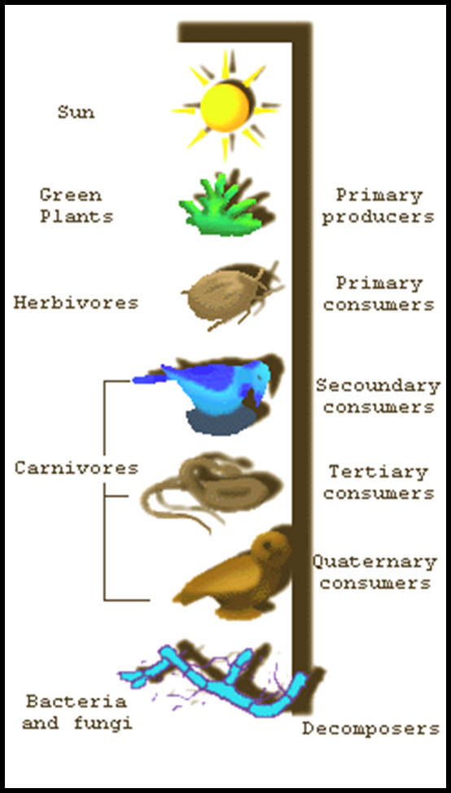
First Trophic Level or Producers: Organisms that have a capability to convert energy from sun to chemical energy (photosyntesis), ex. Plant (corn, rice, grass, etc.), Phytoplankton, and seaweed.
Second Trophic Level: Primary consumer or herbivora
3rd Trophic Level: Secondary consumer or carnivora
Higher Trophic Level: Humans or Omnivora. Tertiary consumers can occupy any tropic level, except as producers.
Decomposers: Detritivores, scavengers
Notes:
First trophic level: It is represented by producers. Producers are organisms like plants that produces food from carbon dioxide and water using photosynthesis. Producers can be plant, algae, plankton or bacteria. Primary producers in an aquatic ecosystem are various species like phytoplankton, algae and higher plants. Primary producers in an terrestrial ecosystem are various species like green plants.
Second trophic level: Second trophic level is represented by primary consumers. The primary consumers are herbivores that feeds on plants. Eg insects, birds and mammals in terrestrial ecosystem and mollusc's in aquatic ecosystem.
Third trophic level: This level is represented by secondary consumers. These are Primary carnivores .The consumers that feed on herbivores are carnivores, are called primary carnivores
Fourth trophic level: It is represented by tertiary consumers. They are usually top carnivore,a consumer at the top of a food chain with no predators.
Dead tissue and waste products are produced throughout. Scavengers, detritivores, and decomposers use the "waste“. They eat carcasses and fallen leaves. They could be animals, such as crows and beetles, but ultimately microbes are responsible for decomposition.

Slide 42
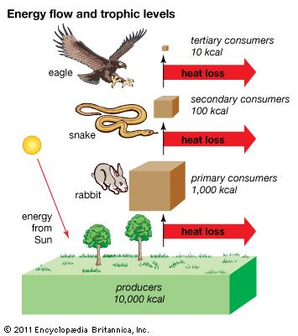
trophic level: energy transfer through an ecosystem. [Art]. In Britannica Online for Kids. Retrieved from http://kids.britannica.com/comptons/art-90132
Notes:
This figure illustrates the energy or heat loss at each trophic level of a terrestrial food chain. A food chain is the sequence of organisms that are the food for the next member of the chain. In this example, the rabbit eats the plant, who, in turn, is eaten by the snake, who is eaten by the eagle.
Energy transfer between the different trophic levels is inefficient.
Energy is lost as you move up the trophic levels with the primary producers containing the most energy and it is lost as it is consumed as food through at the food web. This is also is true of biomass. The greatest biomass is found with the producers and it decreases with each trophic level.

Slide 43
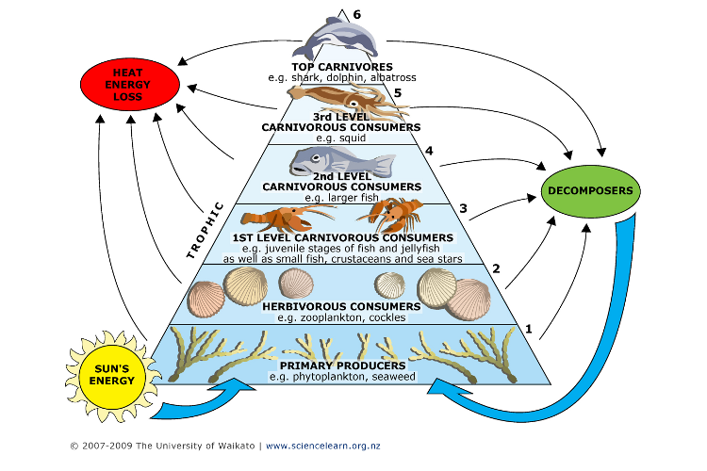
MARINE TROPHIC LEVEL PYRAMID
University of Waikato. 2007-2009. Marine Trophic Pyramid. Accessed from http://www.sciencelearn.org.nz/Contexts/Toxins/Sci-Media/Images/Marine-trophic-pyramid
Notes:
Trophic levels are not confined to the terrestrial environment

Slide 44
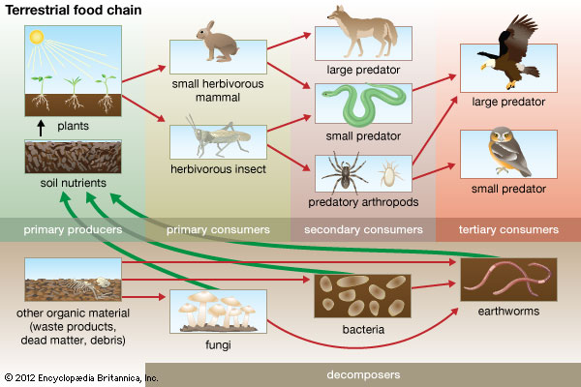
Encyclopedia Brittanica 2013.http://www.britannica.com/EBchecked/topic/212636/food-chain
Notes:
This is an illustration of a typical terrestrial food chain. Plants are the primary producers. Small herbivores including insects and rabbits consume the plants. Small and large predators consume these primary consumers. Secondary consumers are consumed by tertiary consumers. Decomposers are organisms that breakdown other organisms into simple compounds. For example, fungi, bacteria, and earthworms are decomposers. They breakdown dead animals or plant material and convert it to organic material.

Slide 45
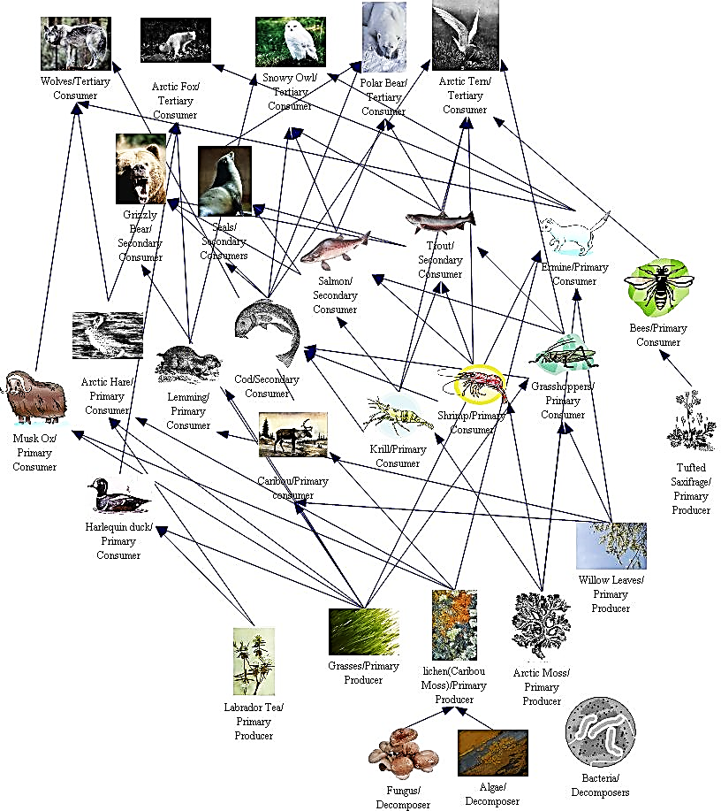
Tundra Food Web
http://cougarbiology.pbworks.com/w/page/9016288/Tundra%20Group%20B
Notes:
Food web are a bit more complex than food chains. They integrate multiple food chains. This one illustrates one could be applied to parts of Canada or Alaska. It integrates arctic saltwater, freshwater, and terrestrial ecosystems.
Students will not be expected to know the details of this food web but should appreciate the complexity of it and the

Slide 46
Ecosystems of Southeast Asia Values and Services
Ecosystem health, One Health Course

Slide 47
Mangroves
Ecosystem Health, One Health Course

Slide 48
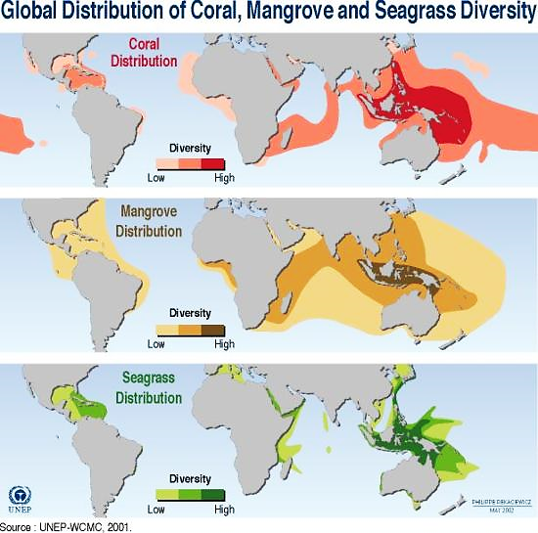
Rekacewicz, P. 2012. Distribution of coral, mangrove, and seagrass diversity. Access from http://www.grida.no/graphicslib/detail/distribution-of-coral-mangrove-and-seagrass-diversity_30dc
Notes:
“Similar to corals, the region of greatest mangrove diversity is in Southeast Asia, particularly around the Indonesian Archipelago (Burke et al., 2001). …This graphic illustrates the distribution and biodiversity (low, medium and high diversity) of corals, mangroves and seagrass in the world's coastal and marine areas”
Rekacewicz, P. 2012. Distribution of coral, mangrove, and seagrass diversity. Access from http://www.grida.no/graphicslib/detail/distribution-of-coral-mangrove-and-seagrass-diversity_30dc

Slide 49
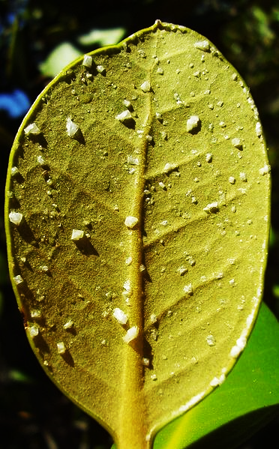
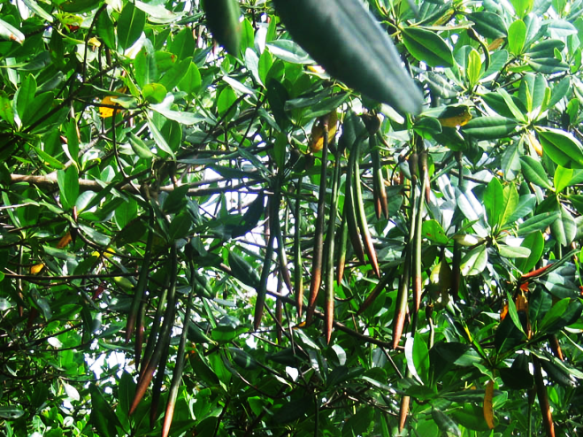
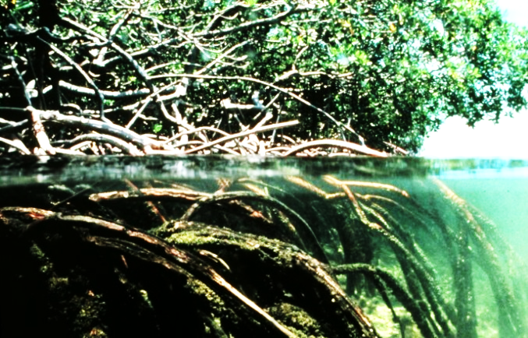
Mangroves
http://en.wikipedia.org/wiki/File:Mangroves.jpg
Notes:
Mangrove soils are saline, roots are extensive but only do not go deeply into the soil. Most of the sediments are anoxic or contain little oxygen so the mangrove has adapted with roots having “knees” where they draw in oxygen. Some species also have breathing tubes in their roots to access oxygen.
Mangrove plants have thick waxy leaves to reduce water loss. They are adapted to highly saline, low oxygen, poor nutrient availability, and windy, wavy conditions. Mangrove plants are either salt excluders (they do not uptake salt), salt excreters (they can get rid of excess salt), or are salt tolerant.
Sea grasses occur in the intertidal zone
Osbourne, P.L. 2000. Tropical Ecosystems and Ecological Concepts. Cambridge University Press. Cambridge.

Slide 50
Mangrove Animals
Habitats for terrestrial and marine animals- tree canopy, water-filled holes in trees, soil surface, soil, permanent and temporary pools
Terrestrial invertebrates – insects, spiders
Birds, reptiles, and mammals –
Fish-eating birds, flycatchers, honey-eaters, warblers
Saltwater crocodiles, snakes, monitor lizards
Flying foxes, monkeys, rats
Sediment fauna – hermit, mud, and fiddler crabs; mud lobster
Osbourne, P.L. 2000. Tropical Ecosystems and Ecological Concepts.
Cambridge University Press. Cambridge.

Slide 51
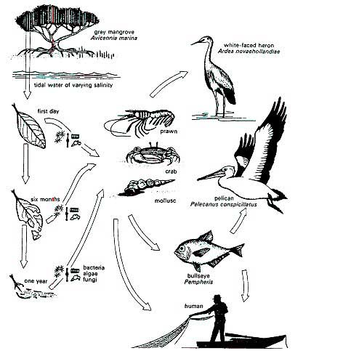
Mangrove Ecosystem Food Web
FAO 2005. Mangrove Management. http://www.fao.org/forestry/mangrove/3648/en/
Notes:
Energy flows through the mangrove ecosystem from mangrove leaf detritus - Bacteria and fungi - Detritus consumers (herbivores and omnivores) - Lower carnivores - Higher carnivores. The chain begins with the mangrove plants producing energy through photosynthesis. Leaves fall in to the water, break apart, and grazed on by amphipods and crabs. Microbes and fungus further decays the leaf litter. Detritivores, including very small invertebrates, worms, molluscs, prawns and crabs, also consume the leaf litter. These, in turn, are preyed upon by lower carnivores. higher carnivores such as large fish, birds of prey, wild cats or man himself are at the top of the food chain.
FAO 2005. Mangrove Management. Accessed from http://www.fao.org/forestry/mangrove/3648/en/

Slide 52
Video - MANGROVES
Clip 1
Notes:
Mangrove (about mangrove plants)
http://www.youtube.com/watch?v=AUyUXacqYyE
Or
Mangroves – Guardians of the Coast
http://www.youtube.com/watch?v=4SY7X9zdZ-U
(28 minutes – 1st 12 minutes for this class)

Slide 53
Tropical rainforests
Ecosystem Health, One Health Course

Slide 54
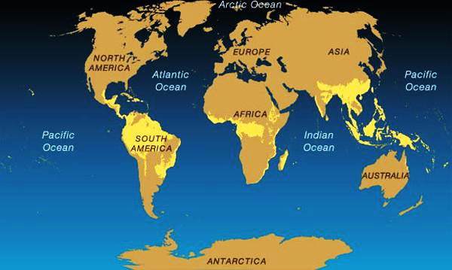
Tropical Rainforests of the World
National Geographic 2013. Tropical Rain Forest Map. Accessed from http://environment.nationalgeographic.com/environment/habitats/rainforest-map/#close-modal
Notes:
National Geographic 2013. Tropical Rain Forest Map. Accessed from http://environment.nationalgeographic.com/environment/habitats/rainforest-map/#close-modal

Slide 55
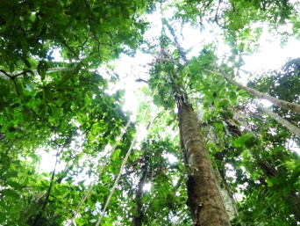
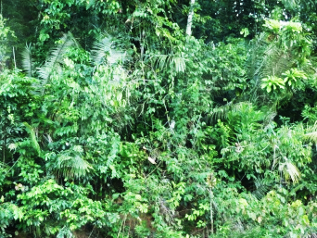
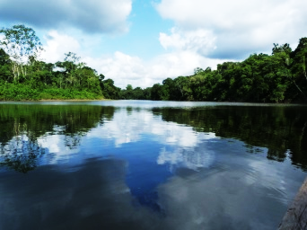
Tropical Rainforests
Lowland tropical rainforests – world’s most species rich communities
Home to 90% of the world’s insects
Number of species of trees is large with no single species dominating
Trees in rainforest have similar structure and appearance throughout the world
Forests of Southeast Asia and the Pacific Islands – 30% of the world’s tropical forest
http://www.blueplanetbiomes.org/rainforest.htm
Notes:
Views of the rainforest in Ecuador
Osbourne, P.L. 2000. Tropical Ecosystems and Ecological Concepts. Cambridge University Press. Cambridge.

Slide 56
Characteristics
Climate
>2000 mm rain annually
Average humidity 80%
Very short or no dry season
Mean monthly temperatures – approximately 25ºC rarely >35ºC
At the canopy – more temperature and humidity (60 to 100%) variation
Characteristics of canopy very different that life under the canopy
Very little changes in temperature – daily and seasonally, always humid – 80%
Notes:
Rainforest occur in areas of the world where the climate is very rainy and humid.
The rainforest itself has its own climate – at the top of the canopy, the temperature can vary and the leaves can get dry, but under the canopy layer- both the temperature and humidity remains fairly constant daily and seasonally
Osbourne, P.L. 2000. Tropical Ecosystems and Ecological Concepts. Cambridge University Press. Cambridge.

Slide 57
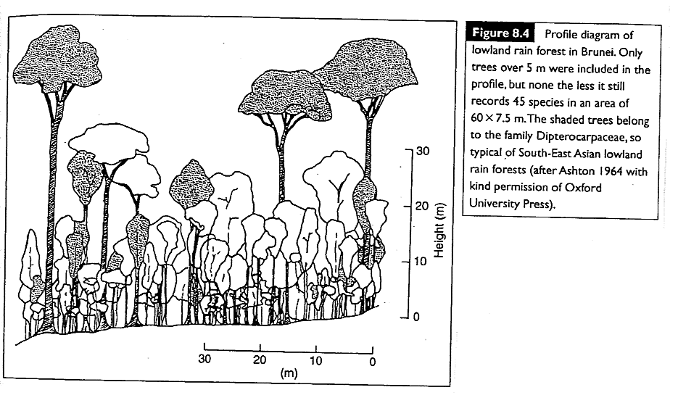
Vegetation structure
Osbourne, P.L. 2000. Tropical Ecosystems and Ecological Concepts. Cambridge University Press. Cambridge.
Notes:
Tropical rainforest have a stratified structure. They can have 2 to 3 tree layers
Tall trees (45 to 50 m.) – form the canopy, wide tree crowns
Middle story trees (25-35m) - form a middle level canopy, smaller tree crowns
Bottom layer – dense, closely packed, narrow crowns – competing for sunlight so often a discontinuous layer
Trees have buttressed roots
Shrub layer
Herb layer
Epiphytes and lianas – grow on other plants – not parasitic
Osbourne, P.L. 2000. Tropical Ecosystems and Ecological Concepts. Cambridge University Press. Cambridge.

Slide 58
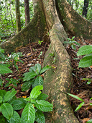
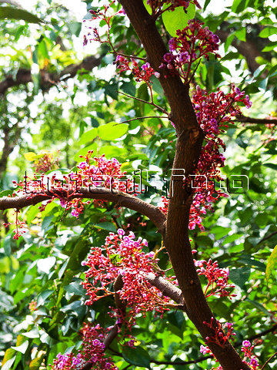
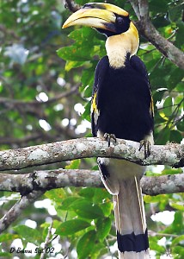
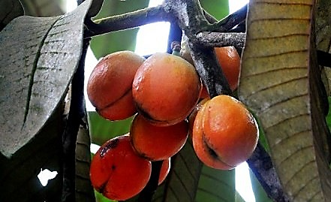
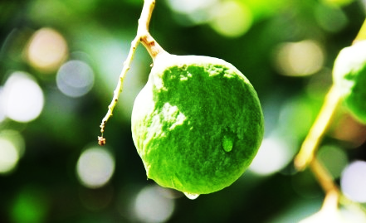
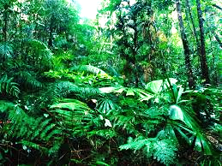
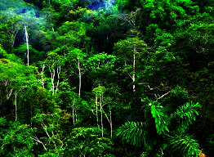
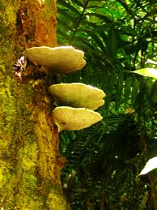
http://www.travelblog.org/Photos/5935372.
http://kikirikipics.com/rainforests-in-the-world.
http://www.rainforestoutdoor.com/p/rainforest.html’
http://www.orangutan.org/rainforest/tanjung-puting-national-park.
http://www.isan.clubs.chula.ac.th/insect_sara/index.php?transaction=insect_1.php&id_m=24780
http://www.saisawankhayanying.com/s-featured/hornbill/
Notes:
Different perspectives on the southeast Asian rainforest

Slide 59
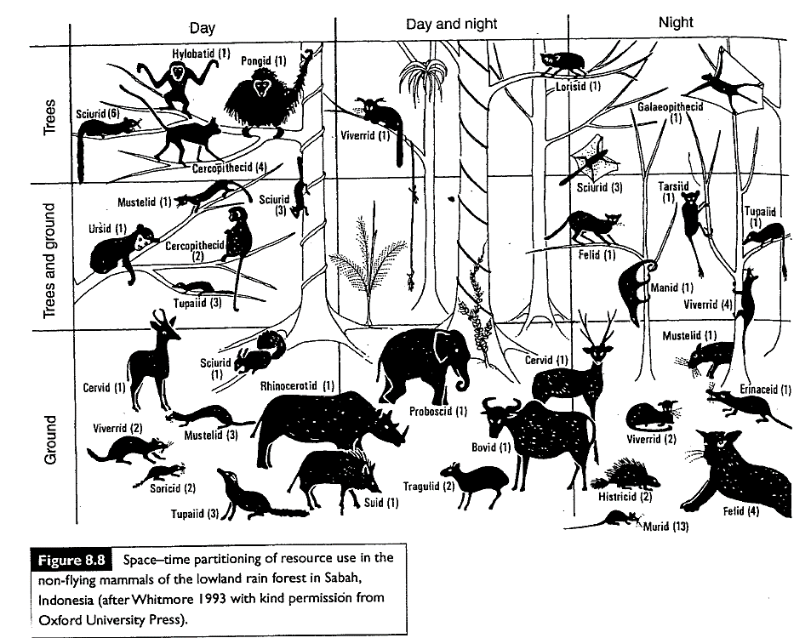
Rainforest animals
Osbourne, P.L. 2000. Tropical Ecosystems and Ecological Concepts. Cambridge University Press. Cambridge.
Notes:
Insects make up most of the animals in rainforests. There are many different types of birds because there are so many different available and food sources. As a result, many birds are specialist feeders who feed on the wide diversity of fruits and insects. Most mammals in rainforest are arboreal – they live in the trees – so mammals include monkeys and bats. This figure illustrates the types of the mammals that occur in the rainforest of Sabah Malyasia.
Osbourne, P.L. 2000. Tropical Ecosystems and Ecological Concepts. Cambridge University Press. Cambridge.

Slide 60
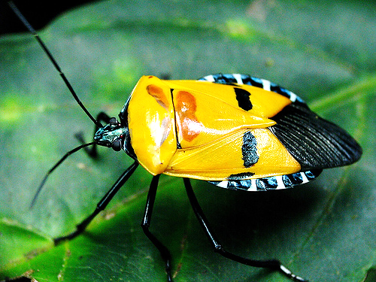
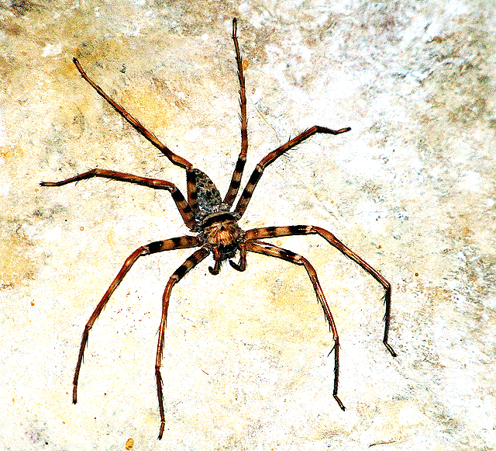
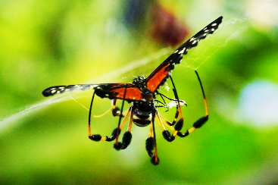
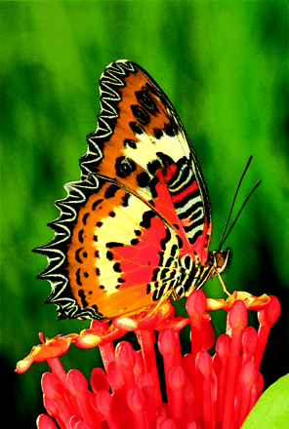
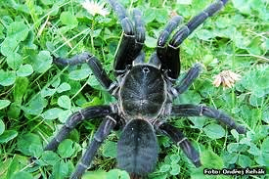
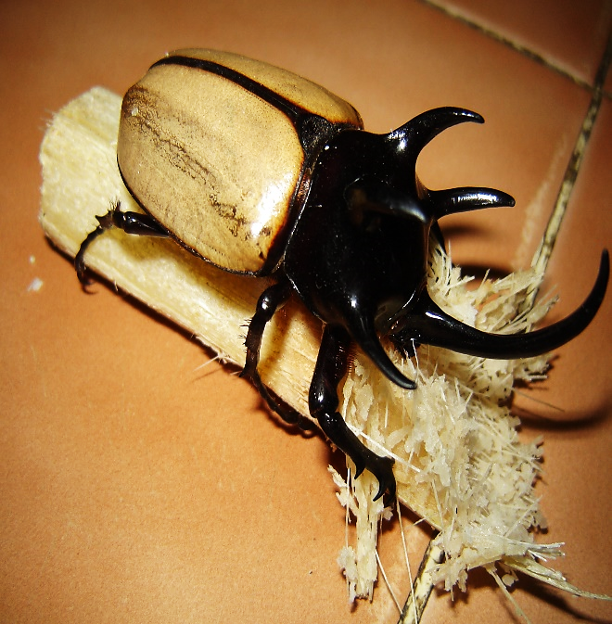
http://www.calacademy.org/blogs/rainforest/
http://www.nature.com/emboj/journal/v22/n3/about_cover.html
http://simple.wikipedia.org/wiki/Huntsman_spider
Notes:
Insects in the Southeast Asian Rainforest

Slide 61
Video – Rainforest: Beneath the Canopy

Slide 62
Coral reefs
Ecosystem health, One Health Course

Slide 63
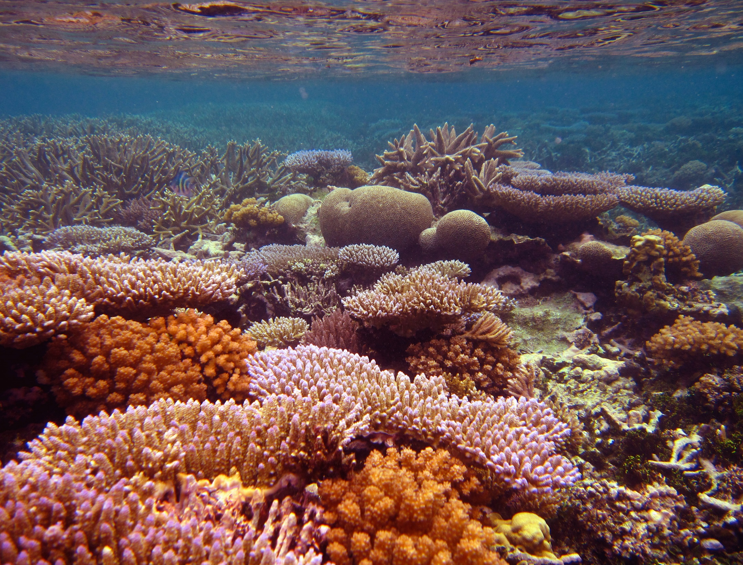
(http://www.marine.sc.chula.ac.th/admin/editor/file_uploads/files/reefbio/aboutus.html)
Notes:
Coral reef in Thailand

Slide 64
Coral Reefs
Complex biological structures
Corals
Composed of organisms called polyps (2 cells thick, secrete calcium carbonate skeleton)
Can live for centuries
Found in deep sea, temperate and tropical areas
Reefs only in areas where water do not fall below 18oC, clean-clear water, moderately high salinity, and sunlight
Live symbiotically with photosynthetic algae – essential for the survival of the reef and provide much of the color of the reef – algae receive nutrients form coral waste, coral receives oxygen from algae
Filter feeders – feed on small fish and zooplankton
Osbourne, P.L. 2000. Tropical Ecosystems and Ecological Concepts. Cambridge University Press. Cambridge.
Notes:
NOAA’s Coral Reef Information System - http://www.coris.noaa.gov/
Very productive and biodiverse
Specialized feed species that only occur with the corals
Probably the most biodiverse regions of the ocean

Slide 65
Coral Reef Food Web - Algae
Algae
Different than other marine algae
Contain calcite crystals embedded in their cells
Crystals protect from wave action and plays a role in the formation of reefs
Colonize areas exposed to storms
Fish, urchins, molluscs, crustaceans – consume algae, without these herbivores corals can be overrun with algae
Osbourne, P.L. 2000. Tropical Ecosystems and Ecological Concepts. Cambridge University Press. Cambridge.

Slide 66
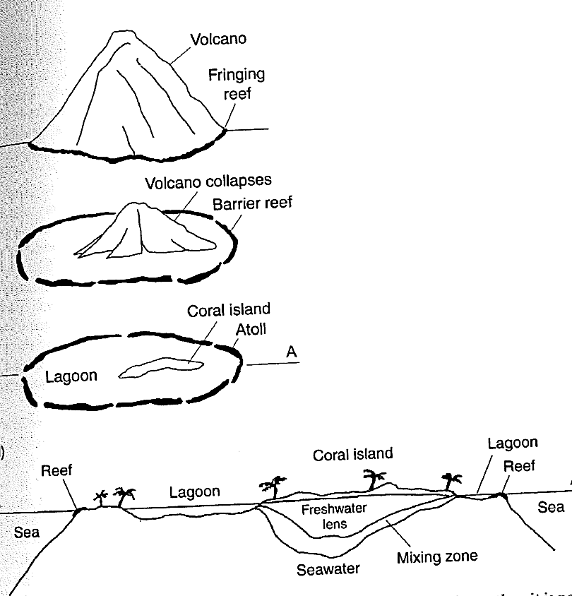
Coral Reefs
Three types of reefs:
Fringing
Barrier
Atolls
Osbourne, P.L. 2000. Tropical Ecosystems and Ecological Concepts. Cambridge University Press. Cambridge.
Notes:
Fringing reefs occur on the shores of tropical coasts, develop along rocky coastlines in tropical areas
Barrier reefs are further offshore and usually separated from land by a lagoon. An example is the Great Barrier Reef of Australia – borders 2,000 km of the Australia’s northeast coast. These occur parallel to shore and occur 100 km offshore.
Atolls are ring-shaped reefs that are formed following the subsidence of an volcanic island.

Slide 67
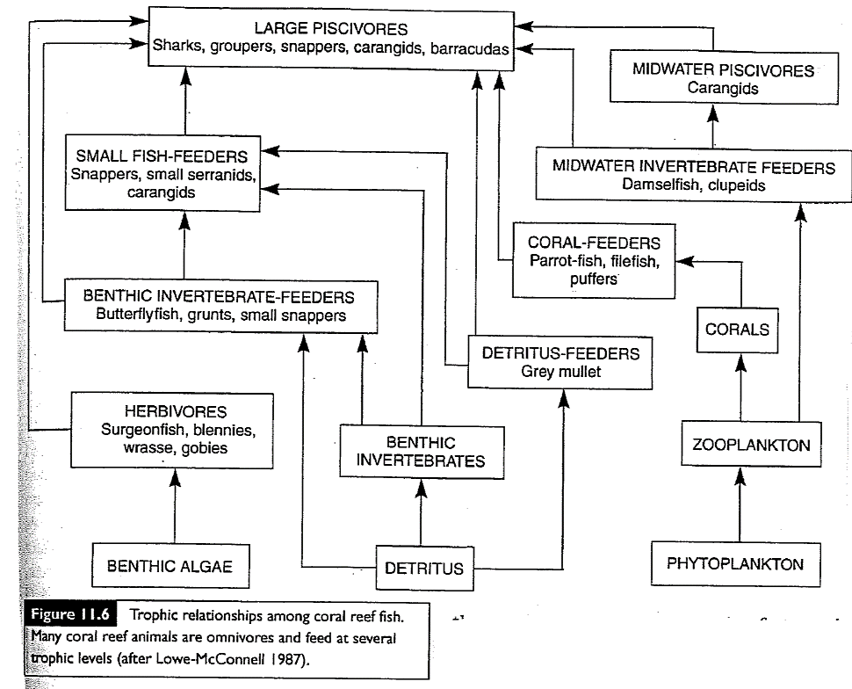
Osbourne, P.L. 2000. Tropical Ecosystems and Ecological Concepts. Cambridge University Press. Cambridg
Notes:
This is a simplified food web for a coral reef with the reef algae as the primary producers who are consumed by herbivorous fish, molluscs, and crustaceans who, in turn, are consumed by piscivorous fish. Detritus also represents a food source in a coral reef. Benthic invertebrates and detritus eating fish consume the detritus and they are consumed by benthic invertebrate feeders and piscivorous fish, respectively. Another branch of the food web begins with phytoplankton which is consumed by zooplankton. Coral consume zooplankton. Certain fish feed on corals.

Slide 68
The Bounty of Coral Reefs
Notes:
Video

Slide 69
Next Steps
Ecosystem health, One Health Course

Slide 70
Ecosystem Services
Fresh water
Food
Timber, fiber, fuel
Biological products
Regulation of infectious disease
Nutrient and waste management, processing and detoxification
Climate regulation

Slide 71
Ecosystem values
Aesthetic appreciation
Tourism
Recreation
Education
Motivation
Genetic resources
Cultural and spirituality

Slide 72
Ecosystems
Identify 5 ecosystem services from:
Mangroves
Rain Forests
Coral Reefs

Slide 73
homework
Divide into three groups and select an ecosystem
Tropical Rainforest Mangrove Coral Reef
Group must become experts on
Nutrient cycle
Food web
Status in your country (positive and negative)
Threats to the ecosystem
Services provide that ecosystem
Things that disrupt the ecosystem
How that ecosystem affects animal and human health
Each group will give a 5 minute presentation on the food web ecosystem for your country. Get creative!
Notes:
Explain that the students are going to be divided into three teams and each is going to take on one of the ecosystems and they are responsible for becoming experts on that ecosystem. They must understand that nutrient cycling, the food web, its status in their country (as applicable), the threats to the ecosystem, what services the ecosystem provides, and what can disrupt the functioning of the ecosystem, and how that ecosystem affects animal and human health.
For the next class, each team must present a food web for their ecosystem to the class. There are versions on the web, but make sure that they are accurate. Often they include animals that are not found on the same continent. Make sure that your food web is accurate for your area and you should be able to explain the role of each.
Give the students the remaining time in class to get started.

Slide 74
Resources - Mangroves
http://www.fao.org/docrep/field/003/ab751e/AB751E01.htm#tbl6
http://www.sciencedirect.com/science/article/pii/B9780123847195002471
http://www.sciencedirect.com/science/article/pii/S2212041612000046
http://www.wri.org/stories/2008/09/natural-coastline-defense-mangrove-forests-southeast-asia
http://www.teebweb.org/wp-content/uploads/2013/02/FLYER-ASEAN-TEEB-Side-Event-v01-Oct-12.pdf
http://www.slideshare.net/WetlandsInternational/status-of-mangrove-in-south-east-asia-the-issues-and-opportunities-for-rehabilitation
http://www.sciencedirect.com/science/article/pii/B9780123747112006069
http://ocw.unu.edu/international-network-on-water-environment-and-health/unu-inweh-course-1-mangroves/Importance-of-mangroves.pdf
Notes:
Here are some places to start – but these will not be country specific

Slide 75
Resources – Tropical Rainforests
http://www.blueplanetbiomes.org/se_asian_rnfrst.htm
http://learnline.cdu.edu.au/units/sbi507/introduction/ecosystems.html
http://learnline.cdu.edu.au/units/sbi507/module3/fundamentals.html
The Forests of Southeast Asia in Vital Forest. Accessed from http://www.unep.org/vitalforest/Report/VFG-15-The-forests-of-southeast-asia.pdf
http://rainforestsasia.blogspot.com/2011/11/human-impacts-on-southeast-asian.html

Slide 76
Resources – Coral Reefs
http://www.wri.org/publication/content/8246
http://eascongress.pemsea.org/sites/default/files/document-files/presentation-st12-chou.pdf
http://sanctuaries.noaa.gov/about/ecosystems/coralwelcome.html
http://www.coris.noaa.gov/about/what_are/
http://reefrelief.org/learn/coral-reef-ecosystem/
http://pdf.wri.org/rrseasia_full.pdfhttps://sites.google.com/site/coralreefsystems/videos/short-movies/reef-dynamics
http://www.pnas.org/content/103/22/8425.abstract
http://rspb.royalsocietypublishing.org/content/279/1744/3899.full
http://www.sciencedirect.com/science/article/pii/S0169534700019480
http://reefkeeping.com/issues/2006-08/cj/index.php

Slide 77
Factors that Disrupt Ecosystems Natural And Man Made
Ecosystem Health, One Health Course

Slide 78
Ecosystem disruption
How does the movie Avatar portray ecosystems and factors that disrupt ecosystems?
What ecosystems have you experienced and what are the factors that can cause those to change?
What is biodiversity
Why is biodiversity important?
What would happen if we logged all the forests of (insert country name)?
Why do we need natural areas?
We all know that it would be bad to remove all the forests, but what are the reasons why?
How would human health be affected?

Slide 79
Biodiversity
Biodiversity – the diversity in living things in an ecosystem.
Increased biodiversity increases the stability of an ecosystem.
Increased biodiversity increases the chance that at least some living things will survive in the face of large changes in the environment.
Notes:
Biodiversity ensures the availability of a rich variety of genetic material that may lead to future agricultural or medical discoveries with significant value to humans. Biodiversity adds aesthetic qualities to the environment.

Slide 80
Direct effects on ecosystems
Changes in local land use and cover
Changes in climate
Species introduction, invasion, or removal
Over fishing
Nutrient loading from activities such as fertilizer, pest control, irrigation
Modification of rivers
Water withdrawal/dams
Pollution
Habitat loss/degradation/ fragmentation
Over hunting
Forest Fires
Tsunamis
Notes:
Facilitator can explain these or show pictures
A direct effect is anything that will cause a change – negative or positive on an ecosystem. Changes in local and regional land use that could effect ecosystems includes the conversion of forests to agriculture or urban/suburban areas. Removal of vegetation will change the hydrology of the area, the climate, and the ability of the area to weather storms.
By changing land use or constructing roads, habitats can be lost, degraded or fragmented. Many species need a minimum size of uninterrupted to survive – they either have migration corridors or they can need a certain amount of space in which to hunt. If habitat is degraded, species may be lost. As we discussed there are some species that have very specific habitat requirements. It may be that they need to have conditions that require them to be in the center of the forest.
Over fishing can upset marine ecosystems because large portions of the marine food web may be eliminated

Slide 81
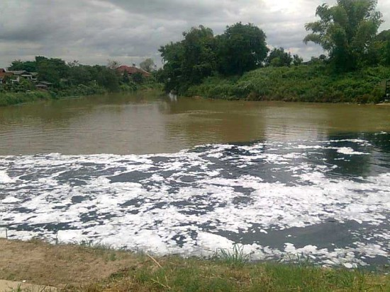
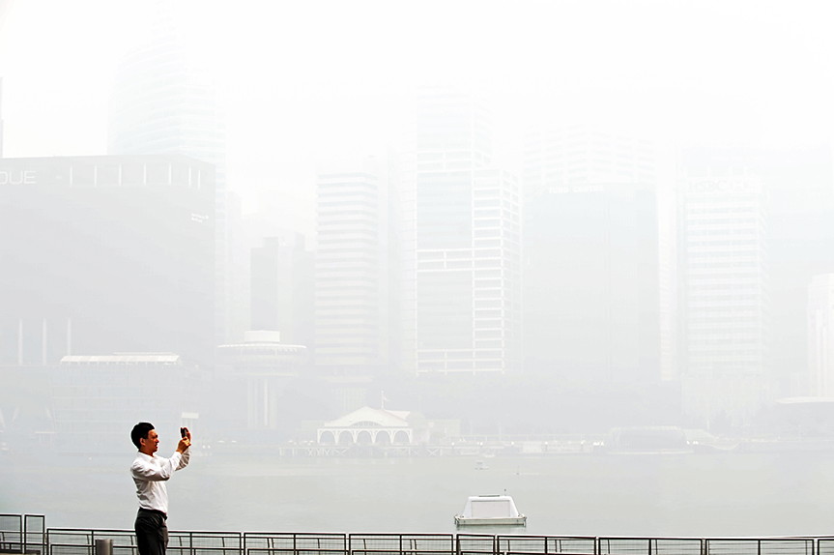
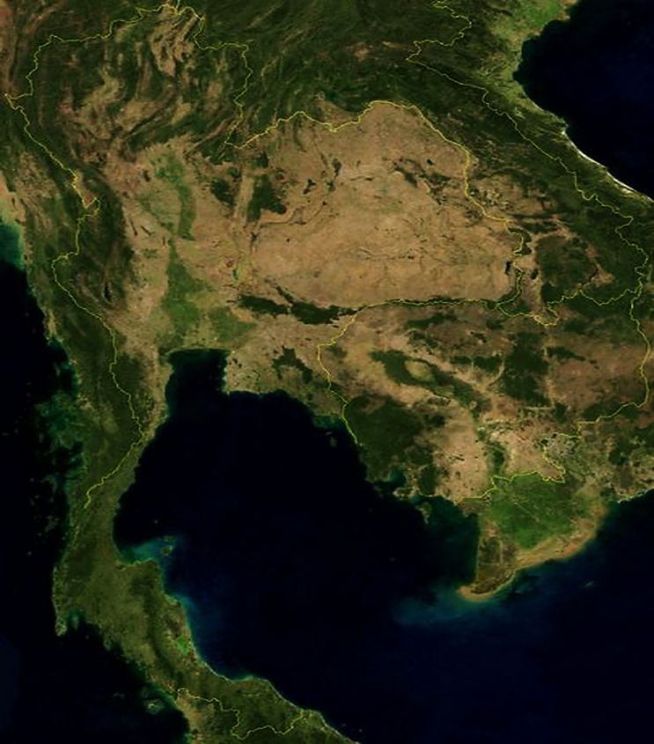
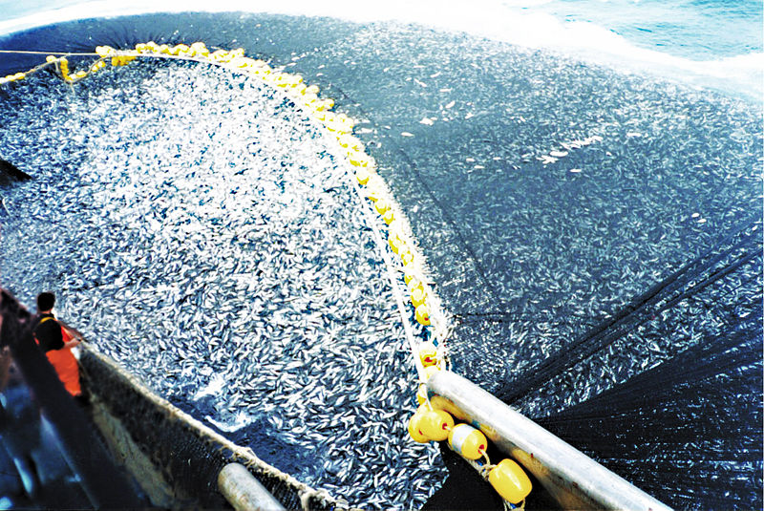
Eutrophication in Ping River at a waste water outlet in Chiang Mai, Thailand
Haze in Singapore – haze generated from forest fires
http://nongkhainewsonline.blogspot.com/2011/06/blog-post_8664.html
http://www.rid-1.com/webboard/board_view.php?forum_id=18
Overfishing.
Deforestation in Thailand
Notes:
Example photos –
Haze in Singapore – haze generated from forest fires – Fisher, Max June 21, 2013. Satellite images and NASA data show vast forest fires blanketing Singapore with record pollution. Washington Post. Published: June 21 at 3:02.pm. Accessed from http://www.washingtonpost.com/blogs/worldviews/wp/2013/06/21/satellite-images-and-nasa-data-show-vast-forest-fires-blanketing-singapore-with-record-pollution/
Satellite image of deforestation in the Amazon. Wikipedia 2012. Habitat fragmentation. Accessed from http://en.wikipedia.org/wiki/Habitat_fragmentation
Eutrophication in the Potomac River at a waste water outlet in Washington, D.C. Wikipedia 2013. Eutrophication. Accessed from http://en.wikipedia.org/wiki/Eutrophication
Overfishing. Wikipedia 2013. Chilean purse seine. Accessed from http://en.wikipedia.org/wiki/File:Chilean_purse_seine.jpg

Slide 82
Indirect Effects
Indirect drivers to change in ecosystems include:
Population growth
Economic (e.g., globalization, trade, market and policy framework)
Sociopolitical (e.g., governance, institutional and legal framework)
Science and technology
Cultural and religious (e.g., beliefs, consumption)
What are some examples?
Notes:
Indirect effects are those effects that do not directly cause changes to ecosystems but can result in other activities/actions that can alter ecosystems. For example- human population increase can lead to an increase in fertilizer use to increase food production. However the increase in fertilizer if not done properly can increase the nutrient load of nitrogen and phosphorus to streams, rivers, and lakes. This can lead to eutrophication.
EXAMPLE: As income rises, diets tend to become higher in protein.

Slide 83
Human Economic Activities and Impacts on Ecosystems
 | Habitat Alteration | Over-harvesting | Pollution | Introduction of Exotic Species | Climate Change
Agriculture | X |  | X | X | X
Forestry | X | X |  |  | X
Fishing | X | X |  | X
Urbanization | X |  | X | X
Manufacturing | X |  | X |  | X
Notes:
This table summarize what type of effects human economic activities can have on ecosystems. Specifically, agriculture often expands into land that was previously undisturbed or in-tact ecosystems so the habitats within that ecosystem would be altered. Agricultural runoff often contains fertilizer and pesticides. These chemicals can enter ecosystems through streams or erosion. Seeds from agricultural fields can enter ecosystems through the wind or water ways.
Discuss another mechanism that is relevant to the area.

Slide 84
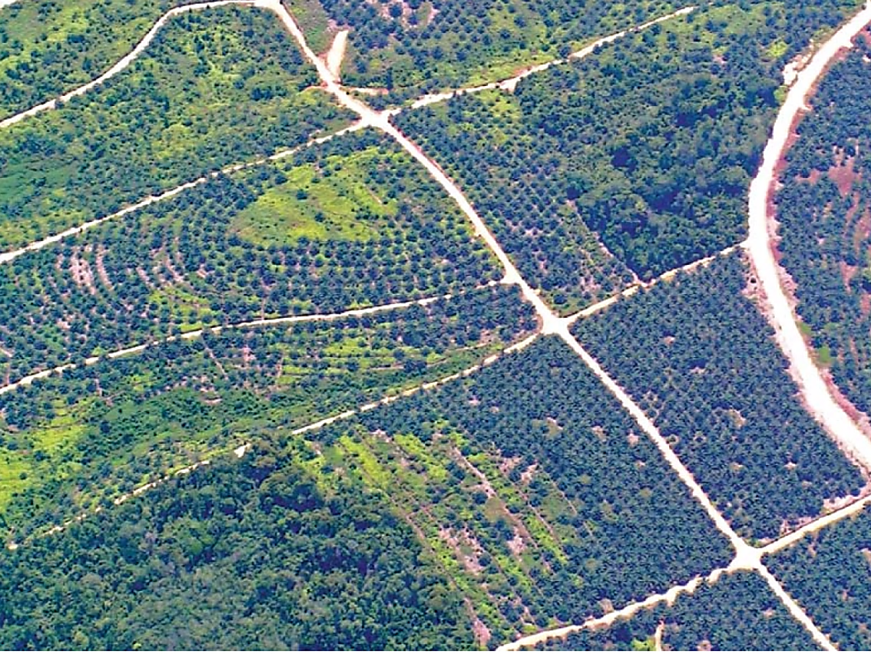
Palm Oil Plantations
Aerial view of oil palm developments in Kutai, East Kalimantan, Indonesia. (Photo:Douglas Sheil) Source: Sheil, D. et al. 2009. The impacts and opportunities of oil palm in Southeast Asia: What do we know and what do we need to know? CIFOR. Indonesia.
Notes:
Monoculture – planting a single species over a large area. Monocultures are vulnerable to predation and/or disease.
A 2005 FAO evaluation of land cover data suggests that between 1990 and 2005, 55–59 per cent of oil palm expansion in Malaysia (that is 834 000–1 109 000 ha of a total of 1 874 000 ha), and over 56 per cent of that in Indonesia (1 313 000–1 707 000 ha of a total of 3 017 000 ha) occurred at the expense of natural forest cover
In Indonesia, the majority of oil palm is established in industrial scale monoculture plantations ranging in size from 4000 to 20 000 hectares. The establishment of these plantations usually results in the near total clearing of former vegetation.
Burning is the quickest and cheapest method to clear land for plantations. This is true for ‘high volume’ forest and forests on peat soils, where the costs of removing wood with heavy machinery are high,for existing large-scale plantations, secondary vegetation or heavily logged forest, zero burning is more cost effective .
On Sumatra, oil palm plantations result in a significant reduction in biodiversity if plantations replace natural forests, secondary forests, agroforests, or even degraded forests and scrubby unplanted areas.
A 4-year study of terrestrial mammals living in and around an oil palm plantation concession in Jambi in Sumatra, Indonesia, found that oil palm monocultures are very poor habitats for most terrestrial mammal species, especially for endangered species, such as Sumatran tiger, tapirs (Tapirus spp.) and clouded leopards (Neofelis spp.). Only four mammal species (10 per cent of the number detected within the landscape) were regularly detected in the oil palm itself and none of these species had a high conservation value.
Some species, including deer, macaques and pangolins, have some tolerance for oil palm habitats and with the exception of pigs, all species showed a general preference for non-oil palm habitats—even heavily degraded natural habitats..
Birds are also affected by forest conversion to plantations resulting in a reduction in species richness of at least 60 per cent, especially affecting threatened forest-dependent birds.
Endangered species (and subspecies), such as orangutan, Sumatran elephant (Elephasmaximus sumatrensis) and Sumatran tiger, are especially threatened. During palm oil expansion, animals are often captured or killed when vegetation is cleared to make way for new plantations. Elephants are considered a risk to the oil palm plantations because they often destroy plantations and feed on the oil-rich palm nuts. Orangutans have become violent around oil palm plantations when their food source is threatened or destroyed. Tigers can also be killed if they are considered to pose a threat to plantation workers. All of these species are vulnerable to illegal wildlife poachers when forested areas are opened up to establish oil palm plantations.
Land clearing and road construction increase soil erosion in previously forested regions—especially in steeper sites. This can result in landslides. Even after trees have become established, erosion on paths and open areas can be high.
Sheil, D. et al. 2009. The impacts and opportunities of oil palm in Southeast Asia: What do we know and what do we need to know? CIFOR. Indonesia.

Slide 85
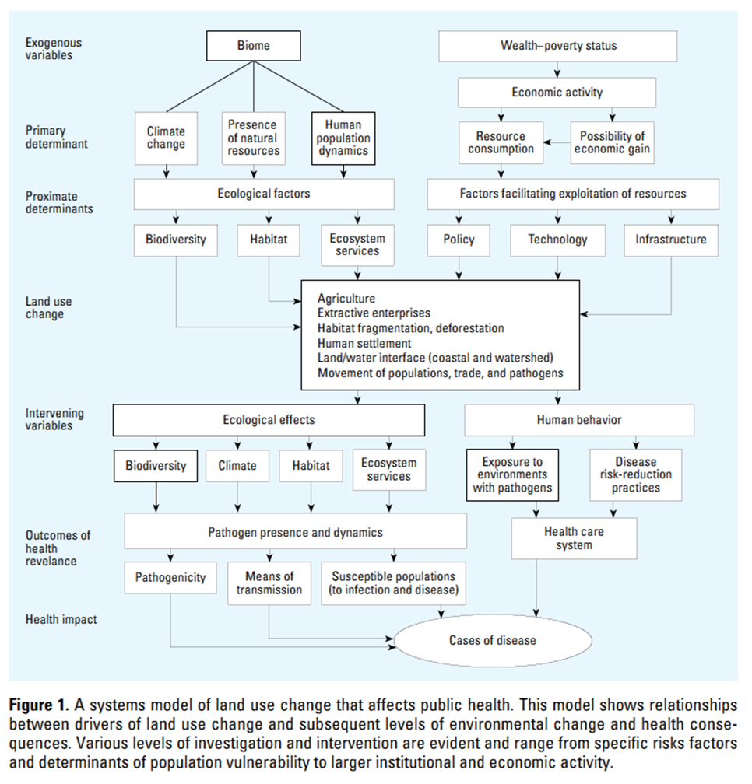
Critical Drivers Affecting Changes to Human Health
Patz et al. 2004. Unhealthy Landscapes: Policy Recommendations on Land Use Change and Infectious Disease Emergence. Environmental Health Perspectives: VOLUME112 NUMBER10 | July 2004
Notes:
This figure was developed to guide the development of land use policy. It provides a framework that illustrates the linkages and relationships between land use changes and the subsequent environmental changes and health consequences. Part of their intent was for health policy makers to look at the “upstream” factors that lead to health consequences.
As you can see, this group of scientists have concluded that resource consumption and human population dynamics are primary determinants that human based. In addition climate change can be linking to resource consumption.
Key land use change agents are agriculture, extractive industries, deforestation, expansion of human settlement, and population movement. As we discussed above, these changes can alter ecosystems and specifically the biodiversity of the area. With these types of changes, pathogen dynamics and increase or decrease the transmission of disease.

Slide 86
How do impacts to ecosystemS affect public health?
Habitat Fragmentation
Loss of Large Predators in the Northeast US
Increase Population of Rodents
Increase incidence of Lyme Disease
Two examples:
Deforestation
Sunlight, Pooled Water, Temperature Increase
Mosquito Breeding Habitat
Malaria Outbreaks
Notes:
White-footed mice, a generalist species that is the main carrier of Lyme disease, are more abundant in the small patchy forests of the northeastern United States than in large continuous forests because predators and competitors are absent. Therefore, the risk of Lyme disease transmission to people is higher in fragmented forests than if the forest was continuous (Ostfeld & Keesing 2000a; Ostfeld & Keesing 2000b; Patz et al. 2004).
Deforestation can in some cases increase the breeding habitats of Anopheles mosquitos and in other decrease. There are some Anopheles mosquitos that breed in shaded water bodies. Other Anopheles have increased survival rates in deforested environments so the seasonal transmission of malaria is prolonged. In Malaysia, clearing for rubber plantations in the 1990s increased the incidence of malaria. Other places where fruit trees were planted also experienced an increased incidence of malaria because the ecological conditions favored an Anopheles mosquito. As a result there was a local reemergence of malaria. Irrigation system often increase the density of breeding habitats and an increase in malaria incidence.
Deforestation for mine development is one of the examples that not only create breeding sites, but also
significantly increase human contacts with vectors. Where settlement and mining activities took place in
the Amazon, An. darlingi increased because of the increase in breeding sites, including borrow pits after
road or settlement constructions, drains, and opencast mine workings. As a result, malaria, which was
present in the Amazon’s indigenous population, was spread to immigrants and miners
In Thailand, the transformation from forest to cassava or sugarcane cultivations eliminated shady breeding habitats for the primary vector species, An. dirus, but created widespread breeding grounds for An. minimus, which have greater sun preference and was the predominant species throughout the year. Consequently, malaria transmission among resettled cultivators became high.
Subhrendu K. Pattanayak and Junko Yasuoka 2008. Deforestation and malaria: Revisiting the human ecology perspective
In CJP Colfer (ed.), People, Health, and Forests: A Global Interdisciplinary Overview. Earthscan.

Slide 87
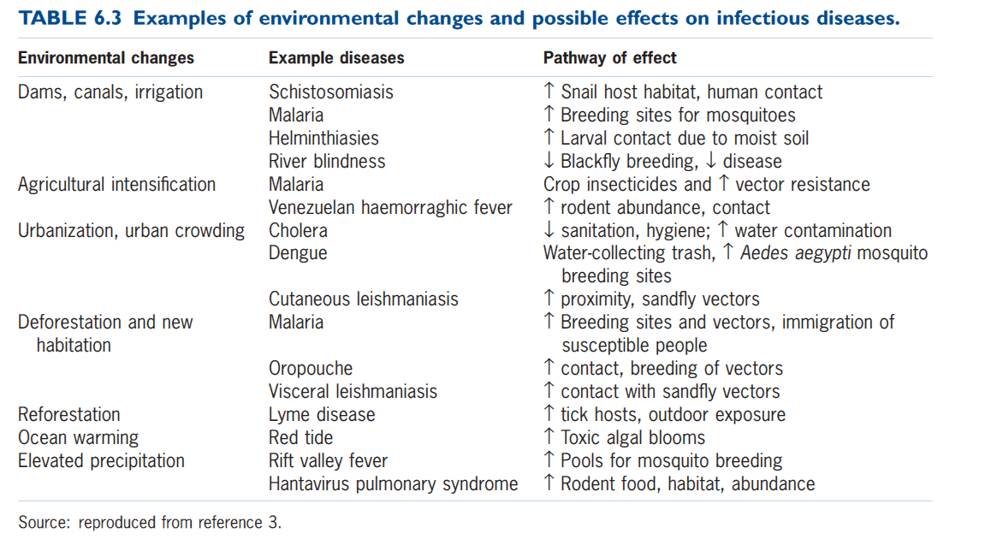
Notes:
Explain this by giving some examples –
Many of these are disease that are associated with insect. Environmental changes can change the availability of breeding sites of insects for mosquitos, sand flies, and ticks
Urbanization is affecting dengue. The Aedes aegypti mosquito can find many breeding sites in urban areas and therefore there is an anticipated increase in dengue as urbanization continues.
There was outbreak of hantavirus in the southwestern portion of the U.S. in 1993. It was traced back to an unusually wet winter. With the increased water, vegetation was more abundant and as a result the rodent population grew tenfold. With the increase in the number of rodents, there was increase potential contact of people with rodents. As more rodents entered human dwellings, more humans happened to aerosolize rodent excreta harboring virus – usually through cleaning (http://www.stanford.edu/~siegelr/uda.html)
White-footed mice, a generalist species that is the main carrier of Lyme disease, are more abundant in the small patchy forests of the northeastern United States than in large continuous forests because predators and competitors are absent. Therefore, the risk of Lyme disease transmission to people is higher than if the forest was continuous (Ostfeld & Keesing 2000a; Ostfeld & Keesing 2000b; Patz et al. 2004).

Slide 88
In-Class Game
Divide into your ecosystem teams.
From your homework, readings and the internet develop a list of the factors that are disrupting your ecosystem.
The rest of the class will evaluate your list to determine if anything is missing
Points will be given for each factor identified. The other teams will get a point for any factor identified that is missing from an ecosystem team’s list
Notes:
The students should be prepared to explain their list. Once the lists are developed, the other teams will have decide whether the list is complete or what could be missing. Each team gets a point for a factor for their ecosystem and for any that they identify that is missing on the other team’s list

Slide 89
Class discussion and presentations for next class
What is the current status of the ecosystem in your province or country in Southeast Asia? Discuss the historical changes that have occurred.
What function(s) does your ecosystem serve that affect(s) animal and human health?
What are the factors disrupting your ecosystem? What functions are being disrupted and how do they affect health locally, regionally, nationally?
What actions should be taken to address the health consequences of ecosystem change?

Slide 90
References
McMichael et al. (eds) 2006 Climate change and human health: risks and responses
Ostfeld, R. & F. Keesing. 2000a. The function of biodiversity in the ecology of vector-borne zoonotic diseases. Canadian Journal of Zoology. 78: 2061–2078.
Ostfeld, R. & F. Keesing. 2000b. Biodiversity and Disease Risk: the Case of Lyme Disease. Conservation Biology. 14(3): 722-728.
Patz et al. 2004. Unhealthy Landscapes: Policy Recommendations on Land Use Change and Infectious Disease Emergence. Environmental Health Perspectives: VOLUME112 NUMBER10 | July 2004
WHO. 2005. Ecosystems and Human Well-Being. Health Synthesis.

Slide 91
Climate Change, Ecosystems, Human and Animal Health
Ecosystem health, One Health Course

Slide 92
OBJECTIVES
By the end of this session, the participants should be able to:
Analyze regional climate changes and their resulting effects on ecosystem health
Analyze regional climate changes and their resulting effects on human and animal health

Slide 93
References
McMichael et al. (eds) 2006 Climate change and human health: risks and responses
Haines et al. 2006. Climate change and human health: impacts, vulnerability, and mitigation. The Lancet. 367:2101-09.
WHO, 2003, methods to assess climate change effects on human health
WHO, 2003, Climate change and human health, risk and response

Slide 94
INDIVIDUAL EXERCISE
What is climate? Is it the same as weather?
What is climate change?
What is climate variability?

Slide 95
DEFINITIONS
Climate is the average state of the atmosphere and the underlying land or water, in a particular region, over a specific time period.
Weather is the day-to-day manifestation of climate in a particular place at a particular time.
Climate change is a statistically significant variation in either the mean state of the climate or in its variability, persisting over an extended period (typically decades or longer).
Climate variability refers to variations around the mean state, including the occurrence of extreme weather events.

Slide 96
Climate change…
…operates over decades or longer. Changes in climate occur as a result of both internal variability within the climate system and external factors (both natural and anthropogenic).
Notes:
Define anthropogenic

Slide 97
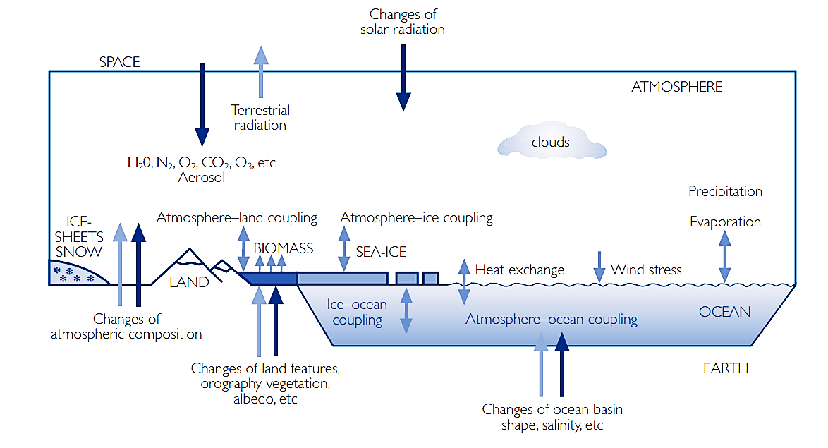
McMichael et al. (eds) 2003 Climate change and human health: risks and responses. World Health Organization. Geneva, Switzerland.
Notes:
This figure shows the dynamics of what is occurring as a result of climate change.
Earth’s climate is determined by complex interactions among the Sun, oceans, atmosphere, cryosphere, land surface and biosphere (shown schematically in the figure). These interactions are based on physical laws (conservation of mass,
conservation of energy and Newton’s second law of motion). The Sun is the principal driving force for weather and climate. The Sun’s energy is distributed unevenly on Earth’s surface due to the tilt of Earth’s axis of rotation. Over the
course of a year, the angle of rotation results in equatorial areas receiving more solar energy than those near the poles. As a result, the tropical oceans and land masses absorb a great deal more heat than the other regions of Earth. The atmosphere
and oceans act together to redistribute this heat. As the equatorial waters warm air near the ocean surface, it expands, rises (carrying heat and moisture with it) and drifts towards the poles; cooler denser air from the subtropics and
the poles moves toward the equator to take its place.
This continual redistribution of heat is modified by the planet’s west to east rotation and the Coriolis force associated with the planet’s spherical shape, giving rise to the high jet streams and the prevailing westerly trade winds. The winds,
in turn, along with Earth’s rotation, drive large ocean currents such as the Gulf Stream in the North Atlantic, the Humboldt Current in the South Pacific, and the North and South Equatorial Currents. Ocean currents redistribute warmers
waters away from the tropics towards the poles. The ocean and atmosphere exchange heat and water (through evaporation and precipitation), carbon dioxide and other gases. By its mass and high heat capacity, the ocean moderates
climate change from season to season and year to year. These complex, changing atmospheric and oceanic patterns help determine weather and climate. Five layers of atmosphere surround Earth, from surface to outer space. The
lowest layer (troposphere) extends from ground level to 8–16km. The heightvaries with the amount of solar energy reaching Earth; it is lowest at the poles and highest near the equator. On average, air temperature in the troposphere
decreases 7°C for each kilometre increase in altitude, as atmospheric pressure decreases. The troposphere is the level where the weather that affects the surface of Earth develops. The level at which temperature stops decreasing with height
is called the tropopause, and temperatures here can be as low as -58°C. The next layer (stratosphere) extends from the tropopause to about 50km above the surface, with temperatures slowly increasing to about 4°C at the top. A high concentration of ozone occurs naturally in the stratosphere at an altitude of about 24km. Ozone in this region absorbs most of the Sun’s ultraviolet rays that would be harmful to life on Earth’s surface. Above the stratosphere are three more
layers (mesosphere, thermosphere and exosphere) characterized by falling, then rising, temperature patterns.
McMichael et al. (eds) 2003 Climate change and human health: risks and responses. World Health Organization. Geneva, Switzerland.

Slide 98
What Do You Think?
Why does climate change occur?
Which cycles are disrupted in climate changes?

Slide 99
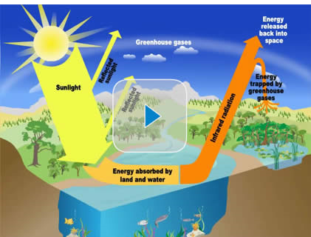
WHY DOES CLIMATE CHANGE OCCUR?
Notes:
Encourage students to give their ideas about the causes of climate change – write them on a flip chart – play video of the greenhouse effect (2 minutes) – please note it is little simplistic but provides a good overall picture.
To play video, click on picture.

Slide 100
McMichael et al. (eds) 2003 Climate change and human health: risks and responses. World Health Organization. Geneva, Switzerland.
Notes:
The video goes over the greenhouse effect – check the students understanding of it by asking them to talk through it using this graphic.
Overall, the atmosphere reduces the amount of sunlight reaching Earth’s surface by about 50%. Greenhouse gases (including water vapour, carbon dioxide, nitrous oxide, methane, halocarbons, and ozone) compose about 2% of
the atmosphere. In a clear, cloudless atmosphere they absorb about 17% of the sunlight passing through it ... Clouds reflect about 30% of the sunlight falling on them and absorb about 15% of the sunlight passing through them. Earth’s
surface absorbs some sunlight and reradiates it as long-wave (infrared) radiation. Some of this infrared radiation is absorbed by atmospheric greenhouse gases and reradiated back to Earth, thereby warming the surface of Earth by more than would be achieved by incoming solar radiation alone. This atmospheric greenhouse effect is the warming process that raises the average temperature of Earth to its present 15°C (see above figure). Without this warming, Earth’s diurnal temperature range would increase dramatically and the average temperature would be about 33°C colder …. Changes in the composition of gases in the atmosphere alter the intensity of the greenhouse effect. This analogy arose because these gases have been likened to the glass of a greenhouse that lets in sunlight but does not allow heat to escape. This is only partially correct—a real greenhouse elevates the temperature not only by the glass absorbing infrared radiation, but also by the enclosed building dramatically reducing convective and advective losses from winds surrounding the building.
McMichael et al. (eds) 2003 Climate change and human health: risks and responses. World Health Organization. Geneva, Switzerland.

Slide 101
Green house effect
Notes:
More information at: http://tunza.eco-generation.org/resourcesView.jsp?boardID=climateChange&viewID=827

Slide 102
What Abiotic Cycle is disrupted
Notes:
The carbon, nitrogen, and water cycles have been disrupted. The video is 4 minutes and describes the carbon cycle and how it is disrupted. It is a bit simplistic, but provides a good overview.
The IPCC states –
The atmospheric concentrations of carbon dioxide (CO2), methane, and nitrous oxide have increased to levels unprecedented in at least the last 800,000 years. CO2 concentrations have increased by 40% since pre-industrial times, primarily from fossil fuel emissions and secondarily from net land use change emissions. The ocean has absorbed about 30% of the emitted anthropogenic carbon dioxide, causing ocean acidification.
Climate change will affect carbon cycle processes in a way that will exacerbate the increase of CO2 in the atmosphere (high confidence). Further uptake of carbon by the ocean will increase ocean acidification.
Changes in the global water cycle in response to the warming over the 21st century will not be uniform. The contrast in precipitation between wet and dry regions and between wet and dry seasons will increase, although there may be regional exceptions.
http://www.climatechange2013.org/images/uploads/WGIAR5-SPM_Approved27Sep2013.pdf

Slide 103
CO₂
Notes:
Greenhouse gas include carbon dioxide, nitrous oxide, and methane. CO2 is considered a major cause of climate change. Other greenhouse gases have strong capacity to hold heat, but CO2 remains inside the atmosphere for a long period of time.
What is the relationship between the increasing amount of carbon dioxide concentration and the temperature?
There is trend that the average temperature is gradually increasing as the carbon dioxide concentration increases.

Slide 104
Signs of Climate Change
Historic global warming
Weather extremes: heat waves, cold spells, flooding, storms, typhoons, smog periods
Sea level increases
Notes:
Warming trends are discussed on subsequent slides –
Global climate change is likely to change the frequency of extreme weather events: tropical cyclones may increase as sea surface waters warm; floods may increase as the hydrological cycle intensifies; and heatwaves may increase in midcontinental locations.
The IPCC states - Over the last two decades, the Greenland and Antarctic ice sheets have been losing mass,
glaciers have continued to shrink almost worldwide, and Arctic sea ice and Northern Hemisphere
spring snow cover have continued to decrease in extent (high confidence).
The rate of sea level rise since the mid-19th century has been larger than the mean rate during the
previous two millennia (high confidence). Over the period 1901–2010, global mean sea level rose
by 0.19 [0.17 to 0.21] O.
http://www.climatechange2013.org/images/uploads/WGIAR5-SPM_Approved27Sep2013.pdf

Slide 105
20th century warming
The global climate has been warming rapidly since the start of industrialization
Human activities well explain this change
According to the Intergovernmental Panel on Climate Change (IPCC) much of this trend is likely due to the increase in carbon emissions resulting from human activities
Notes:
Please note that the IPCC published a final draft of the their scientific technical assessment in September 2013 – however it is draft and expressly states not to cite the document. Once published formally this PPT should be updated with information from this document.
In their summary document for policy makers that has been approved for distribution the IPCC states -Warming of the climate system is unequivocal, and since the 1950s, many of the observed changes are unprecedented over decades to millennia. The atmosphere and ocean have warmed, the amounts of snow and ice have diminished, sea level has risen, and the concentrations of greenhouse gases have increased
http://www.climatechange2013.org/images/uploads/WGIAR5-SPM_Approved27Sep2013.pdf

Slide 106
McMichael et al. (eds) 2003 Climate change and human health: risks and responses. World Health Organization. Geneva, Switzerland.
Notes:
This figure summarizes the history of climatic fluctuations since the end of the last global glaciation around 15000 years ago and includes the IPCC’s projected rapid warming in the current century. Climatic variations before around 1850 were due to natural forcing processes—cosmological alignments, volcanic activity, solar activity and so on. Since 1850 there has been an increasing influence via human emission of greenhouse gases in excess of the biosphere’s capacity to absorb them without an increase in atmospheric concentration.
Please note this figure should be replaced once the IPCC has finalized their 2013 report. This figure is dated, but has the correct trends.
According to the latest IPCC report -
The IPPC states - Each of the last three decades has been successively warmer at the Earth’s surface than any preceding decade since 1850 (see Figure SPM.1). In the Northern Hemisphere, 1983–2012 was likely the warmest 30-year period of the last 1400 years (medium confidence).
Ocean warming dominates the increase in energy stored in the climate system, accounting for more than 90% of the energy accumulated between 1971 and 2010 (high confidence). It is virtually certain that the upper ocean (0-700 m) warmed from 1971 to 2010 …, and it likely warmed between the 1870s and 1971.
http://www.climatechange2013.org/images/uploads/WGIAR5-SPM_Approved27Sep2013.pdf

Slide 107
FIGURE 2.3 Observed and projected atmospheric CO₂ concentrations from 1000 to 2100. From ice core data and from direct atmospheric measurement over the past few decades. Projects of CO₂ concentrations for the period 2000-2100 are based on the IS92a scenario (medium), and the highest and lowest of the range of SRES scenarios. Source: reproduced from reference 11.
McMichael et al. (eds) 2003 Climate change and human health: risks and responses. World Health Organization. Geneva, Switzerland.
Notes:
Please note this figure should be replaced once the IPCC has finalized their 2013 report. This figure is dated, but has the correct trends.
According to the latest IPCC report -
The atmospheric concentrations of carbon dioxide (CO2), methane, and nitrous oxide have increased to levels unprecedented in at least the last 800,000 years. CO2 concentrations have increased by 40% since pre-industrial times, primarily from fossil fuel emissions and secondarily from net land use change emissions. The ocean has absorbed about 30% of the emitted anthropogenic carbon dioxide, causing ocean acidification
http://www.climatechange2013.org/images/uploads/WGIAR5-SPM_Approved27Sep2013.pdf

Slide 108
Climate change and ecosystem health

Slide 109
Climate change and ecosystem health
Break into groups to read a paper on climate change and ecosystem health (homework)
Report in class by group how climate changes can affect ecosystem health (5 minutes)
Notes:
Ecosystem health: focus
Provide copies of paper for students

Slide 110
climate change and human, Animal health

Slide 111
McMichael et al. (eds) 2006 Climate change and human health: risks and responses
Notes:
Climate change will affect human health in multiple different ways. Changes will vary depending on location, environment, and vulnerability. There will be both positive and negative impacts. The direct impacts will occur due to weather extremes such as heat waves or winter cold or winter events such as floods or droughts. While these weather extremes could increase morbidity and/or mortality, winter temperatures may be milder in some areas.
An indirect effect would be the transmission of infectious disease. Ones like to be affected will be water, food, and vector-borne. The distribution and abundance of vectors and intermediate host are affected by many climatic factors such as temperature, precipitation, humidity, wind, and water.
Modelling studies have forecasted that an increase in ambient temperature worldwide would cause net increases in the geographical distribution of some
vectors, such as malarial mosquitoes, although some decreases also might occur in certain areas. Temperature could also change the life-cycle dynamics of the vector species (mosquitos, sandflies, ticks) and the pathogens (flukes, protozoa, bacteria and viruses). This is likely to increase the potential transmission of many vector-borne diseases such as malaria (mosquito), dengue fever (mosquito) and leishmaniasis (sand-fly). But, schistosomiasis (water-snail) may undergo a net decrease in response to climate change.
McMichael et al. (eds) 2003 Climate change and human health: risks and responses. World Health Organization. Geneva, Switzerland.

Slide 112
Many infectious diseases are climate sensitive:
Cholera
Meningococcal meningitis
Dengue/dengue haemhorrhagic fever
Chikungunya virus
African trypanosomiasis
Yellow fever
Japanese and St. Louis encephalitis
Rift Valley fever
Leishmaniasis
West Nile virus
Ross River virus and Murray Valley encephalitis

Slide 113
CLIMATE CHANGES & ANIMAL HEALTH
Animal health may be affected by CC in four ways:
Heat-related diseases and stress
Extreme weather events
Adaptation of animal production systems to new environments
Emergence or re-emergence of infectious diseases, especially vector-borne diseases critically dependent on environmental and climatic conditions.
Notes:
The threat of climate change and global warming is now recognised worldwide and some alarming manifestations of change have occurred. The Asian continent, because of its size and diversity, may be affected significantly by the consequences of climate change, and its new status as a 'hub' of livestock production gives it an important role in mitigating possible impacts of climate variability on animal health. Animal health may be affected by climate change in four ways: heat-related diseases and stress, extreme weather events, adaptation of animal production systems to new environments, and emergence or re-emergence of infectious diseases, especially vector-borne diseases critically dependent on environmental and climatic conditions. To face these new menaces, the need for strong and efficient Veterinary Services is irrefutable, combined with good coordination of public health services, as many emerging human diseases are zoonoses. Asian developing countries have acute weaknesses in their Veterinary Services, which jeopardises the global surveillance network essential for early detection of hazards. Indeed, international cooperation within and outside Asia is vital to mitigating the risks of climate change to animal health in Asia

Slide 114
McMichael et al. (eds) 2003 Climate change and human health: risks and responses. World Health Organization. Geneva, Switzerland.
Notes:
Recognizing that climate change is occurring and that the effects are being seen. Adaptation to the potential impacts and measures to reduce vulnerabilities should and are being taken. Due to the nature of climate change, autonomous adaptation by individuals, regions, or even nations would not be sufficient to affect appreciable change. Coordinated international mitigation measures are needed to address the source of the problem, but also for adaptation. Recognizing that, nations, regions, and districts need to assess the potential impacts on them to plan for future changes.
Adaptive measures to reduce human health impacts include primary, secondary, and tertiary prevention strategies.
Primary prevention strategies seek to avoid or prevent disease or injury – such as avoiding exposure,
removing causative risk factors, or protecting people from hazards. Examples include - bed nets can be supplied to populations at risk of exposure to malaria and early warning systems (e.g. extreme heathealth warnings, famine early warning) established to provide information on hazards and recommended actions to avoid or reduce risks.
Secondary prevention involves intervention implemented after disease has begun, but before it is symptomatic (e.g. early detection or screening), and subsequent treatment that averts full progression to disease. Examples include
enhancing monitoring and surveillance; improving disaster response and recovery; and strengthening the public health system’s ability to respond quickly to disease outbreaks. Secondary prevention is analogous to reactive adaptation.
Finally, tertiary prevention attempts to minimize the adverse effects of an already present disease or injury (e.g. better treatment of heat stroke, improved diagnosis of vector-borne diseases). As the adverse health outcome is not prevented,
tertiary prevention is inherently reactive.

Slide 115
McMichael et al. (eds) 2003 Climate change and human health: risks and responses. World Health Organization. Geneva, Switzerland.
Notes:
Climate change is only one of several large-scale environmental changes that are impacting human health. These changes include ozone depletion, land degradation, biodiversity loss, and the decline in the amount of freshwater as well as the global dissemination of persistent organic pollution, disruption of nutrient cycles. These have consequences on ecologic sustainability, food production, and human economic activities, and health. This figure illustrates how some of these factors can impinge on human health. This model is simplified and would not apply in all areas equally. In addition, governments and technology can address some of these problems locally and regionally.
Climate-related adaptation strategies cannot be considered in isolation of other public health concerns such as population growth; poverty; public health infrastructure; sanitation, availability of health care; nutrition; dangerous personal behaviours; pesticide resistance; and environmental degradation. These factors and others will influence the vulnerability of populations and the health impacts they experience,
as well as possible adaptation strategies.
McMichael et al. (eds) 2003 Climate change and human health: risks and responses. World Health Organization. Geneva, Switzerland.

Slide 116
Haines et. al 2006. Climate change and human health: Impacts, vulnerability and public health. Public Health: 585 -596. Access from http://www.idpublications.com/journals/PDFs/PUHE/PUHE_MostDown_1.pdf
Notes:
This figure provides additional details about the where mitigative policies and adaptation measures should be addressed. Beginning at the left, mitigative policies to reduce greenhouse gases through energy efficiency, expansion of the use of alternative sources than fossil fuels, and forest preservation.
Factors that will modulate the potential impacts on health due to climate change include the quality and accessability of health care, the standard of living and the environmental conditions in an area, as well as the population and housing density.

Slide 117
To address the PH and EH impacts of climate change a multi-disciplinary team would be needed. . .
McMichael et al. (eds) 2003 Climate change and human health: risks and responses. World Health Organization. Geneva, Switzerland.
Notes:
As stated in this WHO publication, to address the public health and ecosystem health impacts of climate change a multidisciplinary team would be needed –
Ask the students who should be on that team.

Slide 118
Public health adaptation measures for health impacts of climate change
Health Outcome | Public Health | Surveillance
Mortality and morbidity due to heat waves | Public-health education Heat health warnings systems Emergence preparedness | Enhance health surveillance of routine data for early detection of heat wave effects
Floods | Public-health education Emergency preparedness Check ist of post-flood activities | Surveillance for flood effects with long-term follow-up Coordinated national surveillance for flood deaths, injuries and illnesses
Air quality | Warning of high pollution days | Daily air pollution measures
Water-borne diseases | Public education | Monitoring of vectors and reservoir hosts Integrated surveillance for human and internal disease
Food-borne diseases | Maintenance and strengthening of food hygiene measures | Integrated surveillance for human and animal diseases
Water-borne diseases | Risk assessment for extreme rainfall events Risk assessment of health effects of algal blooms | Increased microbiological monitoring of public water supplies and private wells, and enhanced surveillance during and following heavy rainfall events
Notes:
This table lists some of the adaptations that have been proposed for European populations. Go through some of the examples.
Reference: Haines et. al 2006. Climate change and human health: Impacts, vulnerability and public health. Public Health: 585 -596. Access from http://www.idpublications.com/journals/PDFs/PUHE/PUHE_MostDown_1.pdf

Slide 119
What do you think?
What adaptation strategies are applicable in your country?

Slide 120
Gold Mining Simulation
Ecosystem health, One Health Course

Slide 121
What will happen at the mine?
Ecosystem health, One Health Course
Notes:
Have the students guess what could happen. Direct the questions first to the group that did the rainforest presentation and then let other chime in. Have students capture the answers on the board.

Slide 122
What will happen at the mine?
What types of changes will happen to the ecosystems?
Which abiotic cycles will be affected?
Will the food webs be affected?
What will be the effects to animal health?
What will be the effects to human health?
Notes:
Have the students guess what could happen using the questions above. Direct the questions first to the group that did the rainforest presentation and then let other chime in. Have students capture the answers on the board. Refine the answers as you go through the presentation

Slide 123
The forest may start like this
Wikipedia 2013. Rainforest canopy at the Forestry Research Institute Malaysia.
Accessed from http://en.wikipedia.org/wiki/Tropical_rainforest
Notes:
Rain forest canopy at the Forestry Research Institute Malaysia (Kapur trees (Dryobalanops aromatica))
Wikipedia 2013. Rainforest canopy at the Forestry Research Institute Malaysia. Accessed from http://en.wikipedia.org/wiki/Tropical_rainforest
Have the student explain what happens with forest removal – how does that affect the abiotic and biotic cycles? What will happen to the animals in the forest? What happens when trees are removed? How are they removed? What happens to the soil once the trees are removed?

Slide 124
And change to this
Freeport-McMoran Grasberg Mine – World Largest Gold mine in the world
Obel, Mike 2011. 10 Biggest Gold Mines in the World [PHOTOS]. International Business Times. November 4, 2001. Accessed from http://www.ibtimes.com/10-biggest-gold-mines-world-photos-553223
Notes:
This is the largest gold mine in the world. It is the Freeport-McMoran Grasberg Mine. It is located in Indonesia.
Direct the Rainforest Ecosystem group to begin the discussion of changes -
The forest will be removed, removing habitat, soil stability, and a carbon sink.
Changes will occur to -
Abiotic cycles – Carbon, H2O, Nitrogen, nutrient cycles associated with soil. There will be a net loss of the carbon stocks in the forest and a loss of the carbon capturing capabilities of the forest lost. Nitrogen held in the trees will also be removed; therefore it will not return to the soil. This could decrease the fertility of the soil. The water cycle is disrupted because the trees slowed the impact of precipitation and took up a lot of water. With the removal of trees, there is an increased risk of flooding and erosion. With the loss of the forest, soil is much more susceptible to erosion, so the nutrients in the soil could be transported from the area via stormwater runoff. This can lead to sedimentation of local streams. In addition,
General animal health will be disrupted. Wildlife will be stressed and may have difficulty feeding, reproducing, and migrating. The food web will be disrupted. There likely will be mortality among smaller animals who cannot leave quickly enough. Larger animals will move but will their habitat will be disrupted and fragmented. There may not be sufficient prey and vegetation to support all wildlife populations. In addition, some animals will not be able to move or adapt to the new circumstance.
Human health – Human health may improve because people will be employed for the construction and operations of the mine. This will supplement their ability to support their families. Workers may be exposed to chemicals at the mine. In addition, water sources could be contaminated by mining activities either from acid mine drainage or wastewater discharge.
As a result of forest removal, wildlife in the area will have to move to find new habitats or may be killed during timber operations. The overall size of the habitat will be reduced which can affect the viability of predator species. The composition of the remaining forest also may change because the light dynamics will have changed. Animals will be disturbed by the noise of construction, the physical removal of the forest trees, and the loss of habitat. The removal of the forest could affect their ability to eat, reproduce, and migrate. Species that are tolerant of being closer to humans and being at the edge of forest will begin to populate those areas near the mine site and may out-compete more specialized species.

Slide 125
What will happen as a result of road construction and existence of the road?
Wikipedia 2013. East Kalimantan. Logging Road. http://en.wikipedia.org/wiki/File:Logging_road_East_Kalimantan_2005.jpg
Notes:
Have the students guess what they think will happen –
A road similar to the above will connect the port to the mine. The construction of roads will have some of the same impacts as the forest removal for the mine site. There will be a loss of forest and habitat as well as an increase in erosion and sedimentation in streams. In addition, road construction provides increase access to forest and forest products. This can increase bushmeat hunting. In addition, road can serve people to develop new communities along the road where there previously have not been communities.
Roads serve as barriers for wildlife migration for slow moving and small animals and for arboreal animals such as monkey. Wildlife can be hurt or killed if they are hit by vehicles. Roads also represent a migration corridor for certain species such as rats.

Slide 126
What could happen at the port site?
Wikipedia 2013. Sampit. Acessed from http://en.wikipedia.org/wiki/Sampit
Notes:
Begin the discussion of what could happen to mangroves and coral reefs.

Slide 127
It could change to this
Balikpapan View Blogspot 2010. Balikpapan Port. Accessed from http://balikpapanview.blogspot.com/2010/11/oil-refinery-oil-refinery-in-jalan.html
Notes:
These are both ports in Indonesia.
In general, it is necessary to avoid critical habitats such as mangroves and coral reefs when constructing anything in a coastal area, but this is included for the sake of the class discussion.
The removal of mangrove and/or coral reefs, depending on the amount removed can disrupt the local fisheries as well as coastal protection against storm surges and coastal storms. Waste water discharges from the mine could contaminate either the mangroves or the coral reef. This may affect their productivity or if severe enough could cause mortality.
Mangroves not only form dense barriers against storms and tsunamis that help protect property, they also stabilize shores by trapping sediments and building land. They improve water quality by filtering runoff and polluted waters. They protect the climate by absorbing carbon dioxide and reducing the amount of greenhouse gas.
(Ocean Portal Team. 2013. Mangroves. Ocean Portal Smithsonian Museum of Natural History. Accessed from.http://ocean.si.edu/mangroves) and http://indigiscapes.redland.qld.gov.au/Plants/Mangroves/Pages/WhyProtect.aspx
Coral reefs maintain much of the biodiversity of the oceans and they protect coastal environments. Many people are dependent upon the fish that breed and live in coral reefs. The ecological value of coral reefs is that they are integral to the well-being of the oceans and are the undersea equivalent of rainforest trees. Tropical waters are naturally low in nutrients because the warm water limits nutrients essential for life from welling up from the deep. Photosynthesis carried out by their algae, coral serve as a vital input of food into the tropical/sub-tropical marine food-chain, and assist in recycling nutrients. Reefs provide home and shelter to over 25% of fish in the ocean and up to two million marine species. They are also a nursery for the juvenile marine creatures
Shah, Anup 2013. Coral Reefs. Global Issues. March 3, 2013 Access from http://www.globalissues.org/article/173/coral-reefs#CoralReefsEcosystemsofEnvironmentalandHumanValue
What happens in a community?

Slide 128
What happens in a community?
Notes:
Community members could be employed by the mine, so that they would be able to better support their families. The community will receive additional taxes, so additional money will be available for local programs. The mine may provide additional services for the community, such as recreational or health facilities.
In areas where there previously has not been industrial development or small communities, there can be dramatic changes to the fabric of the community. With the influx of new workers, there is much more money in the community. As a result, prices can go on all types of goods, including housing, and food. This can affect everyone in the community, especially those not benefiting from the mine. The poor may have a harder time affording food and housing.
Depending on the socioeconomic status and level of infrastructure of the existing community, the infrastructure could be strained. With the increase in the population, there can be strains on the existing infrastructure. For example, there may not be sufficient housing or health care facilities for the new population. With the potential increase in crime, there may not be sufficient police. Water or wastewater treatment facilities may have to be expanded to accommodate new demand.
Other things that can happen in “boom towns” is that narcotic and alcohol use, domestic violence, and other crimes can increase. If the influx of workers is primarily men, prostitution will also increase. Unwed and teen pregnancies can increase.
Other potential effects are illustrated in this graphic. It illustrates how there could be increased contact between people, domestic animals, and wildlife as a result of mine development. This could increase the potential for zoonotic disease transmission.

Slide 129
Artisanal Gold Miners in Indonesia
Pressly, Linda .2013.How mercury poisons gold miners and enters the food chain - Crossing Continents. BBC Radio 417 September 2013 Last updated at 20:59 ET Accessed from http://www.bbc.co.uk/news/magazine-24127661
Notes:
About 15% of the world's gold is produced by artisanal and small-scale miners, most of whom use mercury to extract it from the earth. In Indonesia, the industry supports some three million people - but the miners risk poisoning themselves, their children and the land.
Miners in Indonesia are being slowly poisoned by mercury.
“Often where commercial or industrial gold mining occurs, artisanal mining follows. Artisanal mining involves individuals or groups of individuals that are mining independently of the commercial gold mine. This occurs with gold and diamond mining because there are large profits for small quantities of products. Some of the environmental and health effects that occur are associated with mercury use during the amalgamation of the gold. Both the miners are affected through exposure to mercury and the environment through the discharge of mercury into water bodies, principally affecting fish and shellfish.
“Mercury is a neuro-toxin….It affects the cerebellum, which is the part of the brain that helps you move properly, and co-ordinate your movements. Mercury also harms the kidneys and other organs, but the neurological damage it does is irreversible."
17 September 2013 Last updated at 20:59 ET How mercury poisons gold miners and enters the food chain By Linda Pressly BBC Radio 4, Crossing Continents
Accessed from http://www.bbc.co.uk/news/magazine-24127661

Slide 130
Gold miners have driven orangutans from the area
There will never be rainforest here again
Pressly, Linda .2013.How mercury poisons gold miners and enters the food chain - Crossing Continents. BBC Radio 417 September 2013 Last updated at 20:59 ET
Accessed from http://www.bbc.co.uk/news/magazine-24127661
Notes:
There are an estimated 10-15 million unregulated gold miners around the world, operating in 70 countries. Artisanal small-scale gold mining (ASGM) is the largest source of mercury pollution in the world after the burning of fossil fuels. In Central Kalimantan the effects of this unregulated industry on the environment have been devastating. Around Kereng Pangi, the miners have cleared virgin forest once home to orangutans and hornbills. What is left is a lunar-like landscape, its pools polluted with mercury.
"There are 60,000 hectares of denuded area that are completely pitted like this," explains Sumali Agrawal the technical director of YTS, a local NGO working to mitigate the impact of mercury.
Pressly, Linda .2013.How mercury poisons gold miners and enters the food chain - Crossing Continents. BBC Radio 417 September 2013 Last updated at 20:59 ET Accessed from http://www.bbc.co.uk/news/magazine-24127661

Slide 131
Why mercury is used?
Miners excavate and crush large quantities of earth or rock, containing a small quantity of gold
Mercury is mixed with the slurry and amalgamates with gold - and the amalgam sinks to the bottom
The amalgam is separated out, some excess mercury is removed, and the rest is boiled off
A ton of ore may contain less than an ounce (28g) of gold
Pressly, Linda. 2013. How mercury poisons gold miners and enters the food chain - Crossing Continents. BBC Radio 417 September 2013 Last updated at 20:59 ET Accessed from http://www.bbc.co.uk/news/magazine-24127661
Notes:
See above

Slide 132
Cyanide and mercury contaminated waste, next to working rice paddies on Lombok
Pressly, Linda. 2013. How mercury poisons gold miners and enters the food chain - Crossing Continents. BBC Radio 417 September 2013 Last updated at 20:59 ET Accessed from http://www.bbc.co.uk/news/magazine-24127661
Notes:
Mercury is a persistent pollutant - it does not break down in the environment.
On the island of Lombok, it is being used in conjunction with cyanide.
Cyanide helps to dissolve the mercury, and when the waste is spilled into paddy fields it binds with organic molecules in the environment, becoming methyl mercury which is far more toxic.
Scientists have analyzed samples of rice seeds and leaves from the paddy fields in the south-west of the island.
The concentration of methyl mercury was the highest ever recorded in a laboratory - 115 parts per billion. This is of concern because methyl mercury can be absorbed by plants, get into the food chain and affect human health.
The same methods are used to recover gold in other Asian countries too, and these are also rice-eating nations. If the contamination of paddy fields was found to be widespread, it could be devastating.
Pressly, Linda. 2013. How mercury poisons gold miners and enters the food chain - Crossing Continents. BBC Radio 417 September 2013 Last updated at 20:59 ET Accessed from http://www.bbc.co.uk/news/magazine-24127661

Slide 133
Notes:
This is a short video that illustrates some of the issues in Indonesia

Slide 134
References
McMichael et al. (eds) 2006 Climate change and human health: risks and responses
Haines et al. 2006. Climate change and human health: impacts, vulnerability, and mitigation. The Lancet. 367:2101-09.
WHO, 2003, methods to assess climate change effects on human health
WHO, 2003, Climate change and human health, risk and response

Slide 135
Module Review
Management, One Health Course

Slide 136
One thing..
That you liked and felt was a strength of the module.
That you would suggest we change (delete, alter or add)
Thank you.

Slide 137
This publication was made possible in part through the support provided by the United States Agency for International Development. The opinions expressed herein are those of the author(s) and do not necessarily reflect the views of the US Agency for International Development or the US Government. USAID reserves a royalty-free nonexclusive and irrevocable right to reproduce, publish, or otherwise use, and to authorize others to use the work for Government purposes.

