Slide 1






Communication
Risk Communication
Power point 4

Slide 2

One Health Risk Communication
Goal
To appreciate effective OH risk communication
Learning objectives
By the end of this module, participants should be able to:
Describe methods and tools of OH risk communication.
Develop key messages on OH risk communication.
Communicate the information to the stakeholders in due time transparently, effectively and adequately (what, when, how, to whom, with who).
Justify the issues of socio-cultural norms, beliefs and values while communicating OH risks.

Slide 3

One Health Risk Communication
Exercise 12: Introductory questions:
What is communication?
Why is communication so difficult?
What skills do you need to be a good communicator?
How do we communicate in today's world?
What are the components of communication?

Slide 4
One Health Risk Communication
Definition – sensu strictu to Risk Communication
Risk communication is the process by which information and opinions regarding hazards and risks are gathered from potentially affected and interested parties and by which the results of a risk assessment and proposed risk management measures are communicated to the decision-makers and interested parties.

Slide 5
One Health Risk Communication
Common Definitions:
The imparting and exchanging of information or news
Means of connection between people
The act or process of using words, sounds, signs, or behaviors to express or exchange information or to express your ideas, thoughts, feeling to another
Conceptual Definition to OH risk Communication
The open exchange of information and opinion, leading to a better understanding of risk and risk-related decisions
  ongoing throughout the analysis
  information acquisition
  information distribution

Slide 6
One Health Risk Communication
Risk communication definitions
Risk communication is the “process of exchanging information among interested parties about the nature, magnitude, significance, or control of a risk” (Covello,1992).
Risk communication often focuses on developing and conveying messages prior to and during an event.

Slide 7
One Health Risk Communication
Participant/Plenary Discussion/Experience sharing
What is your real experience about risk communication?
Have you ever communicated about a certain risk in your life?
Notes:
Facilitator to guide discussion by requesting for responses from audience to offer their experiences.

Slide 8
One Health Risk Communication...
Risk communication is an open, two-way exchange of information and opinion about risk that leads to better understanding and better risk management decisions by all involved.
Timely, transparent sharing of information among risk assessors, risk managers and stakeholders (including the public).
Interactive exchanges of information and viewpoints between representatives of risk management staff and any other parties (when concerned by the problem) regarding risk.

Slide 9
OH risk communication Strategies
OH risk communication strategies should address the Who, What, Why, When and How questions.
Name of community or organization (Who)
Current One Health issues or challenges (What)
Key stakeholders (Who)
Key messages (what, Why)
Communication methods (How)
Resources and time needed (What and when)

Slide 10
Purposes of OH Risk communication
Advocacy and policy development
Information and education (communities, health personnel and decision-makers) to stimulate behavior change
Emergency information for action
Prevent misallocation and wasting of resources
Decrease illness, injury & deaths (of both humans and animals)
Decrease outrage!
Take into account emotional response to event
Empower audiences to make informed decisions
Discourage negative behavior

Slide 11
Purposes…
Encourage constructive responses to risk or danger
Enhance the participation of the risk analysis stakeholders
Enhanced knowledge of the decision-making process and risk management
Help policy makers to make transparent, consistent and effective decisions
Empower audiences to make informed decisions concerning risk
Counter/correct rumors
Build support for a response plan
Assist in executing a response plan
Keep decision-makers well informed (policy makers, politicians)

Slide 12
Principles of Risk Communication
Risk communication addresses information and opinions regarding hazards and risks that are gathered from potentially affected and interested parties during a risk analysis, and by which the results of the risk assessment and proposed risk management measures are communicated to the decision-makers and interested parties in the importing and exporting countries.
It is a multidimensional and iterative process and should ideally begin at the start of the risk analysis process and continue throughout.

Slide 13
Principles of Risk Communication
A risk communication strategy should be put in place at the start of each risk analysis.
The communication of the risk should be an open, interactive, iterative and transparent exchange of information that may continue after the decision on importation.
The principal participants in risk communication include the authorities in the exporting country and other stakeholders such as domestic and foreign industry groups, domestic livestock producers and consumer groups.

Slide 14
Principles of Risk Communication
The assumptions and uncertainty in the model, model inputs and the risk estimates of the risk assessment should be communicated.
Peer review is a component of risk communication in order to obtain scientific critique and to ensure that the data, information, methods and assumptions are the best available.

Slide 15
Principles of Risk Communication
Accept and involve the public as a legitimate partner.
Respect the public’s fundamental right to information about risks.
Share dilemmas.
Share responsibilities to arrive at better choices.

Slide 16
Principles of Risk Communication
Listen to the public’s concerns:
Don’t ridicule the public’s emotions.
Legitimise people’s fears.
Tolerate early overreactions but warn against their possible negative consequences.
Establish yourself as human (can make mistakes).
Speak clearly and with compassion.

Slide 17
Principles of Risk Communication...
SUMMARY - Steps in Disaster Risk Communication Planning
Identification of risks to be addressed
Design of risk communication strategy and plan
Target group
Message
Source
Communication channel
How media may be involved
Pre-testing for appropriateness of content, design and mode of communication as perceived by the target group
Implementation
Programme evaluation and impact assessment

Slide 18
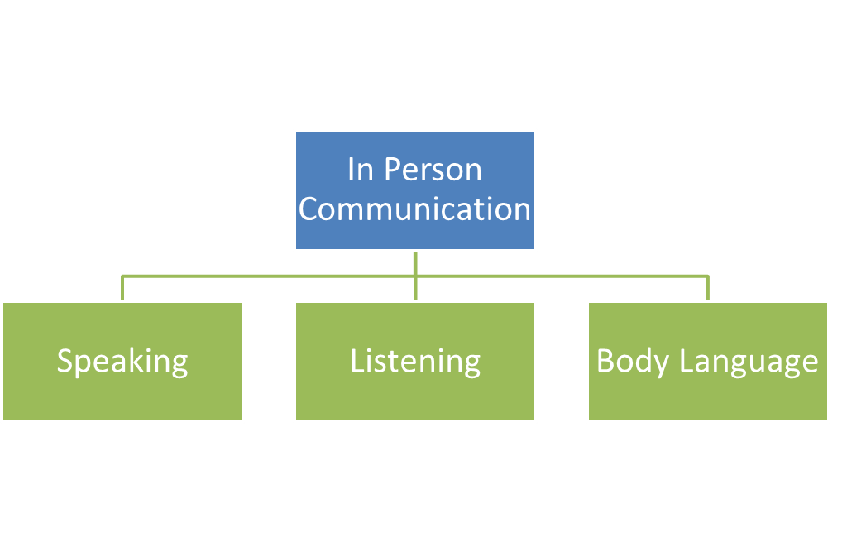
OH Risk Communication components
Overview of communication
Important components of communication

Slide 19
role plays
Your topic will be non-verbal (e.g., body language, tone) communication and culture.
The interviewer will have 5 minutes to discuss this topic with the interviewee.
During the discussion, the observer will take notes on the communication between the interviewer and the interviewee and may be capturing the discussion on video.
Notes:
Facilitator to guide the role plays in one of the following ways:
A)
Participants to be grouped in sets of threes and discuss as outlined in the slide
In their groups, participants to nominate amongst themselves: an interviewer, interviewee and observer
Have an observer from any group report in plenary, their observations on the communication that has taken place
B)
Nominate some participants or ask for volunteers, to act out scenarios where you have a sender of a message and a recipient. The scenarios could have multiple participants and could revolve around a topical issue.
Have the audience act as observers
After the skit, guide the discussion and take down responses on the elements of communication witnessed, and even as guided by the proceeding slide and this will aid in the smooth transition of slides.

Slide 20
Important components of communication
  Speaking skills include:
  Verbal
  Tone
  Non –verbal
  Listening skills
  Have you ever had someone carefully listen to what you said?
  How did that feel?
  What did that person do that communicated to you that they were listening?

Slide 21
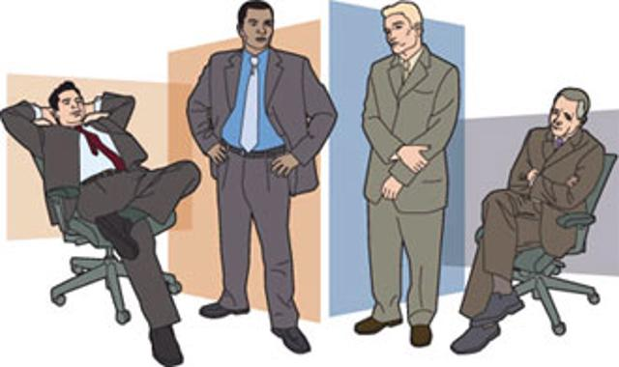
Important components ...
Watch out your body language .
Have you ever Noticed this in your friend or any one (bosses, presidents)?
Your stance
How you sit
Facial expressions
Eye contact
Gesturing and fidgeting
Nodding

Slide 22
Develop key messages on OH risk communication (planning)
Elements of Risk Communication
WHO says WHAT to WHOM
through WHAT CHANNELS
with WHAT EFFECTS
WHO: The “Spokesperson”
Key position
Media experience
Responsible, calm and confident
Ability to speak clearly and convincingly

Slide 23
Develop key messages on OH risk communication (planning) & Elements
Exercise 13: Elements of risk communication
What are the elements of risk communication?
Write your answers on sticky notes and place them on the flip chart paper.

Slide 24
Develop key messages on OH risk communication (planning)…
WHAT: The Message
What we (authorities) know about the situation.
What ‘we’ (e.g. health authorities) are doing about the situation.
What ‘you’ (the community) can do about the situation.
What -Message Development
Bring it down to the basics: simplify
Provide recommended actions
Be positive: provide more “do” than “don’t”
Don’t lie
Be sympathetic

Slide 25
Develop key messages on OH risk communication (planning)…
To WHOM: The “Audience”
Some questions for the risk communicator to ponder:
Why do people react to risks – real or perceived – the way they do?
How do we deal with the emotional component of how people respond?
How do we help people to interpret the risk and respond to risk in constructive ways?

Slide 26
Develop key messages on OH risk communication (planning)…
HOW: Communication Channels
How should the message be communicated?

Slide 27
Communication Channels
Exercise 14;
In groups of 3 or 4, select one case scenario of either aflatoxins in milk or Avian influenza or any other similar scenario.
Discuss and list the different possible channels of communication with the public, stakeholders or even colleagues.
Post your answers on the flip chart on the wall.

Slide 28

Communication Channels

Slide 29
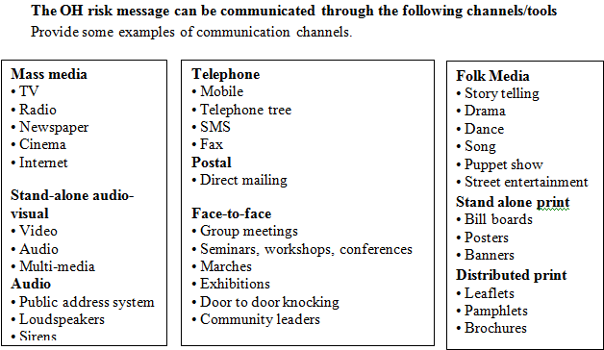
Communication Channels...

Slide 30
Challenge of risk communication
Defining risk: differences between experts and consumers
Uncertainty is inherent in risk
Highly technical = Highly misunderstood

Slide 31
Challenge of risk communication...
Conflicting perceptions about risk
For Health Professional / Veterinarian / Scientist
Risk = Probability x Consequence
For Policy Makers / Decision Makers / Public
Risk = Hazard + Outrage

Slide 32
Challenge of risk communication perceptions of public
High
Outrage Management (Calm down) | Crisis Communication (We’ll get through this together)
Public Relations | Precaution Advocacy (Watch out)
Outrage
Low
Danger (Hazard))
High
Notes:
Facilitator to emphasize the goals as:
Outrage management – reduce outrage so that people do not take unnecessary precautions
Crisis communication – acknowledge hazard, validate concern and give people ways to act
Public relations – to educate people
Precaution advocacy – increase concern for a real hazard to motivate preventive action

Slide 33
Challenge of risk communication perceptions of public...
Type two (outrage management)
After unconfirmed reports that several house cats had died of avian flu in Thailand, a spokesperson said this would probably not pose a high risk of spread to humans, explaining that transmission of the disease from cats to humans was unlikely.

Slide 34
Challenge of risk communication perceptions of public...
When people are ignoring a serious risk, apathetic, passive, in denial, etc:
Inform people.
Mobilise their concern to a level of fear or worry proportionate to the hazard.
Help them to manage the risk, i.e. inform them of “things they can do”, otherwise they will try to manage their fear (by way of denial, apathy, humour, etc.) or they will panic.

Slide 35
Challenge of risk communication perceptions of public...
Type three crisis communication
• Inform: What are the real risks?
• Inform: what we (e.g. health authorities) are doing
• Inform: what you can do

Slide 36
Developing Messages and Mapping Stakeholders
Exercise 15: Key risk message for communication
In groups of 3-4 consider the following;
You have been asked to speak to a community or an organization about One Health. Your goal is to promote the One Health approach as it relates to a recent outbreak.
Use the Communication Strategy Scenarios in your Student Guide. Each scenario contains information on a current One Health issue, details on key stakeholders and limitations of communication methods.

Slide 37
Developing Messages and Mapping Stakeholders
Exercise 15: Key risk message for communication
In your group, select one of the scenarios, develop a key message for the threat and prepare a 5-10 minute presentation to give to the class. Use the Communication Strategies Worksheet to guide your strategy development process.
Present your key messages related to your group scenario to the rest of the class and discuss it.
Notes:
Facilitators may also be required/requested to encourage the participants to come up with other topics scenarios to practice key message development e.g.
A significant population of pregnant women developing Anti Microbial Resistance
Inform about the relationship between the nitrites in meats and cancer
Explain the ban on plastics in Kenya
Inform about an Anthrax outbreak that has killed 5 children in a small town

Slide 38
Developing Messages and Mapping Stakeholders
When developing key messages, messages should be “STARC”:
Simple
Timely
Accurate
Repeated
Consistent

Slide 39
Stakeholders and their role in risk communication
Who are the stakeholders of risk communication?

Slide 40
Developing Messages and Mapping Stakeholders
The individual who has information that can be incorporated in the analysis of risk;
The individual trying to incorporate the outcome of the risk analysis in their personal view of risks;
The resource manager who may incorporate the results of analysis in his decision-making;

Slide 41
Developing Messages and Mapping Stakeholders
The public who use the risk report;
Political leadership that makes decisions;
Technical peers who will evaluate and contribute to a risk analysis exercise. (Peer-review of risk analyses is an essential component of risk communication.
It ensures the best information is incorporated in the analysis and acts as a quality control function for the final product.

Slide 42
Developing Messages and Mapping Stakeholders
Technical peers who will evaluate and contribute to a risk analysis exercise. (Peer-review of risk analyses is an essential component of risk communication.
It ensures the best information is incorporated in the analysis and acts as a quality control function for the final product.);

Slide 43
Consideration of socio-cultural norms, beliefs and values diversities
Exercise 16: Barriers to risk communications
Split participants into 3 groups; each group will select and discuss one of the 3 following tasks;
Task 1 - how personal skill or behavior of a communicator affects risk communication.
Task 2 - How gender diversity affects or could be a barrier for effective risk communication.
Task 3 - How social and cultural factors affect or could be a barrier for effective risk communication.
Present your group summary to the class and discuss.

Slide 44
Consideration of socio-cultural norms, beliefs and values diversities
Barriers in risk communication
Timing
Place
Disrespect
Traditions
Knowledge barrier
Lack of clarity

Slide 45
Consideration of socio-cultural norms, beliefs and values diversities
Give attention to:
  Gender issues
  Values
  Norms
  Practices
  Traditions practices diversity
  Language diversity
  Religion diversity
  Beliefs diversity

Slide 46
How will you know if your communication about risk has been successful?
Success means reaching a shared understanding of risk with the relevant target audience.
This can be assessed in terms of how close you have come to fully meeting your objectives about the purpose of the communication.
Absence of outrage is usually the desirable outcome, and, as usual, this attracts little attention or gratitude!

Slide 47
SUMMARY: Different Audiences; Different Needs
There is no “general public”, each one of us is unique
There are differences among groups
  Veterinarians versus human physicians
  Mothers versus business people
  Landowners versus university students
Effective risk communication must identify key audiences and then meet the need of each.

