Slide 1






Ecosystem health
Basic gender terms and consequences of gender roles
Power point no. 4

Slide 2
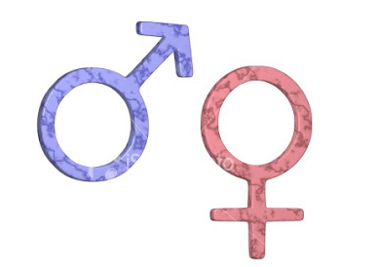

Sex and gender
Sex refers to the biological and physiological factors that define males and females.
Gender refers to the socially constructed roles, behaviors, activities, and attributes that a given society considers appropriate for males and females. Gender differences include both socio-cultural factors as well as male-female differences in access and control over resources
In many countries, gender influences access to economic resources and the lack of access to economic resources is sometimes a barrier to prompt and effective health care for women

Slide 3
Definitions
.
Gender differences include both socio-cultural factors as well as male-female differences in access and control over resources.
Skufca, J. and Arima, Y., Western Pacific Surveillance and Response Journal. Source: http://www.wpro.who.int/topics/gender_issues/Takingsexandgenderintoaccount.pdf

Slide 4
Examples of biological Differences
Women become pregnant, men do not. Physiological changes in the immune system during pregnancy predispose to disease.
Examples of Gender Differences
It is common for more men to smoke compared to women. Smoking may affect vulnerability to respiratory disease or TB.
Daily activities of male or females in a society gives them different patterns of exposure to pathogens. (Fishermen and bilhaziasis?)
Gender influences access to Health facilities and funds
Skufca, J. and Arima, Y., Western Pacific Surveillance and Response Journal. Source: http://www.wpro.who.int/topics/gender_issues/Takingsexandgenderintoaccount.pdf

Slide 5
Common Gender stereotypes

Slide 6
Both Sex and Gender are important considerations during disease investigation
  Identify gender related practices that put either men or women at risk of getting an infectious disease
Sex and Gender within the different age groups is also important during disease investigation
  Biological changes are accompanied by changes in gender norms, roles responsibilities (which differ in each society)
Skufca, J. and Arima, Y., Western Pacific Surveillance and Response Journal. Source: http://www.wpro.who.int/topics/gender_issues/Takingsexandgenderintoaccount.pdf

Slide 7
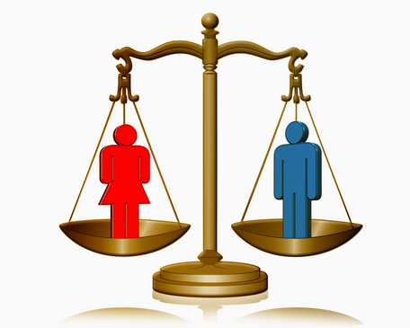
Gender EQUALITY
Equal treatment of men and women in laws and policies
equal access to resources and services within families, communities and societies at large

Slide 8
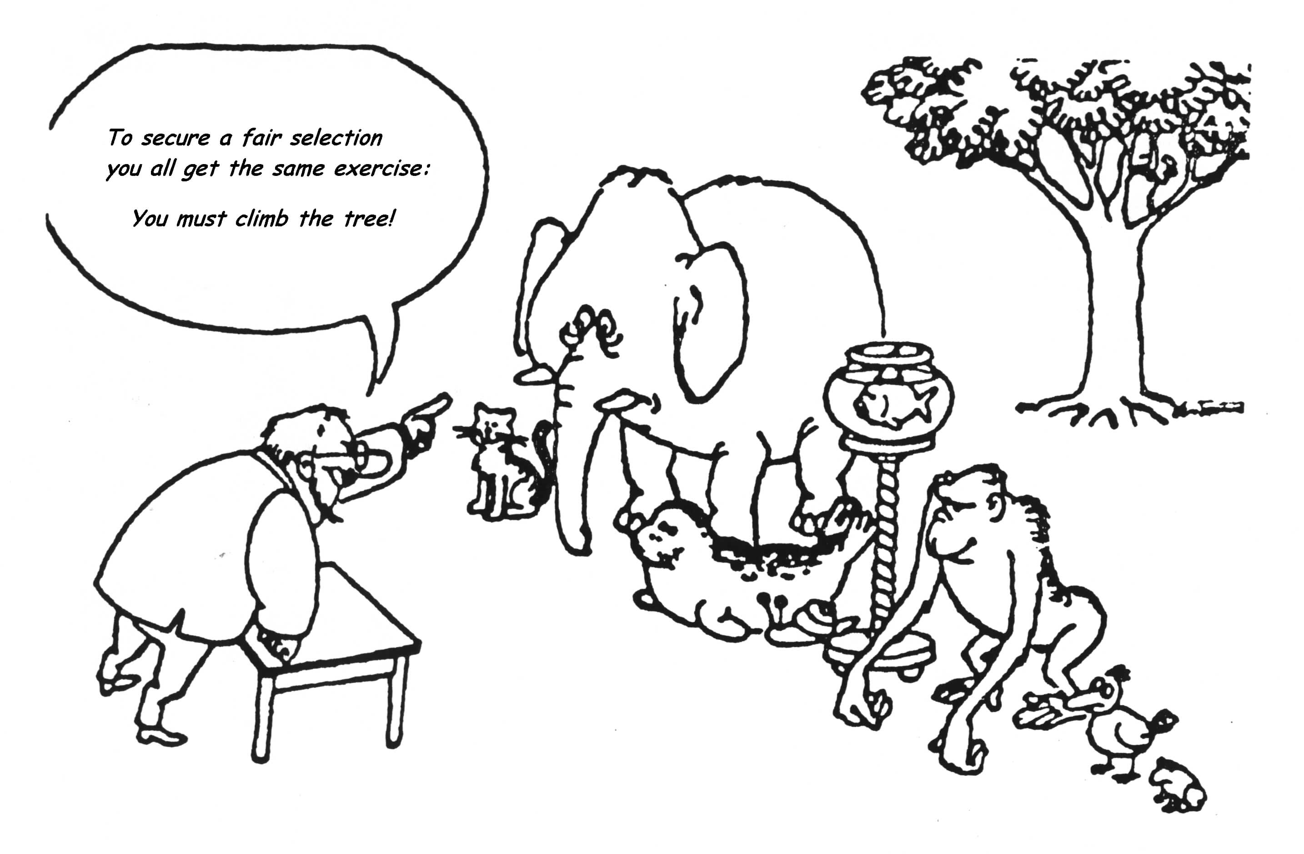
Equal opportunities?
Notes:
8

Slide 9
Gender equity
Fairness and justice in the distribution of benefits and responsibilities between men and women
Often requires women specific programs to end inequities
Reproductive roles acknowledged as work

Slide 10
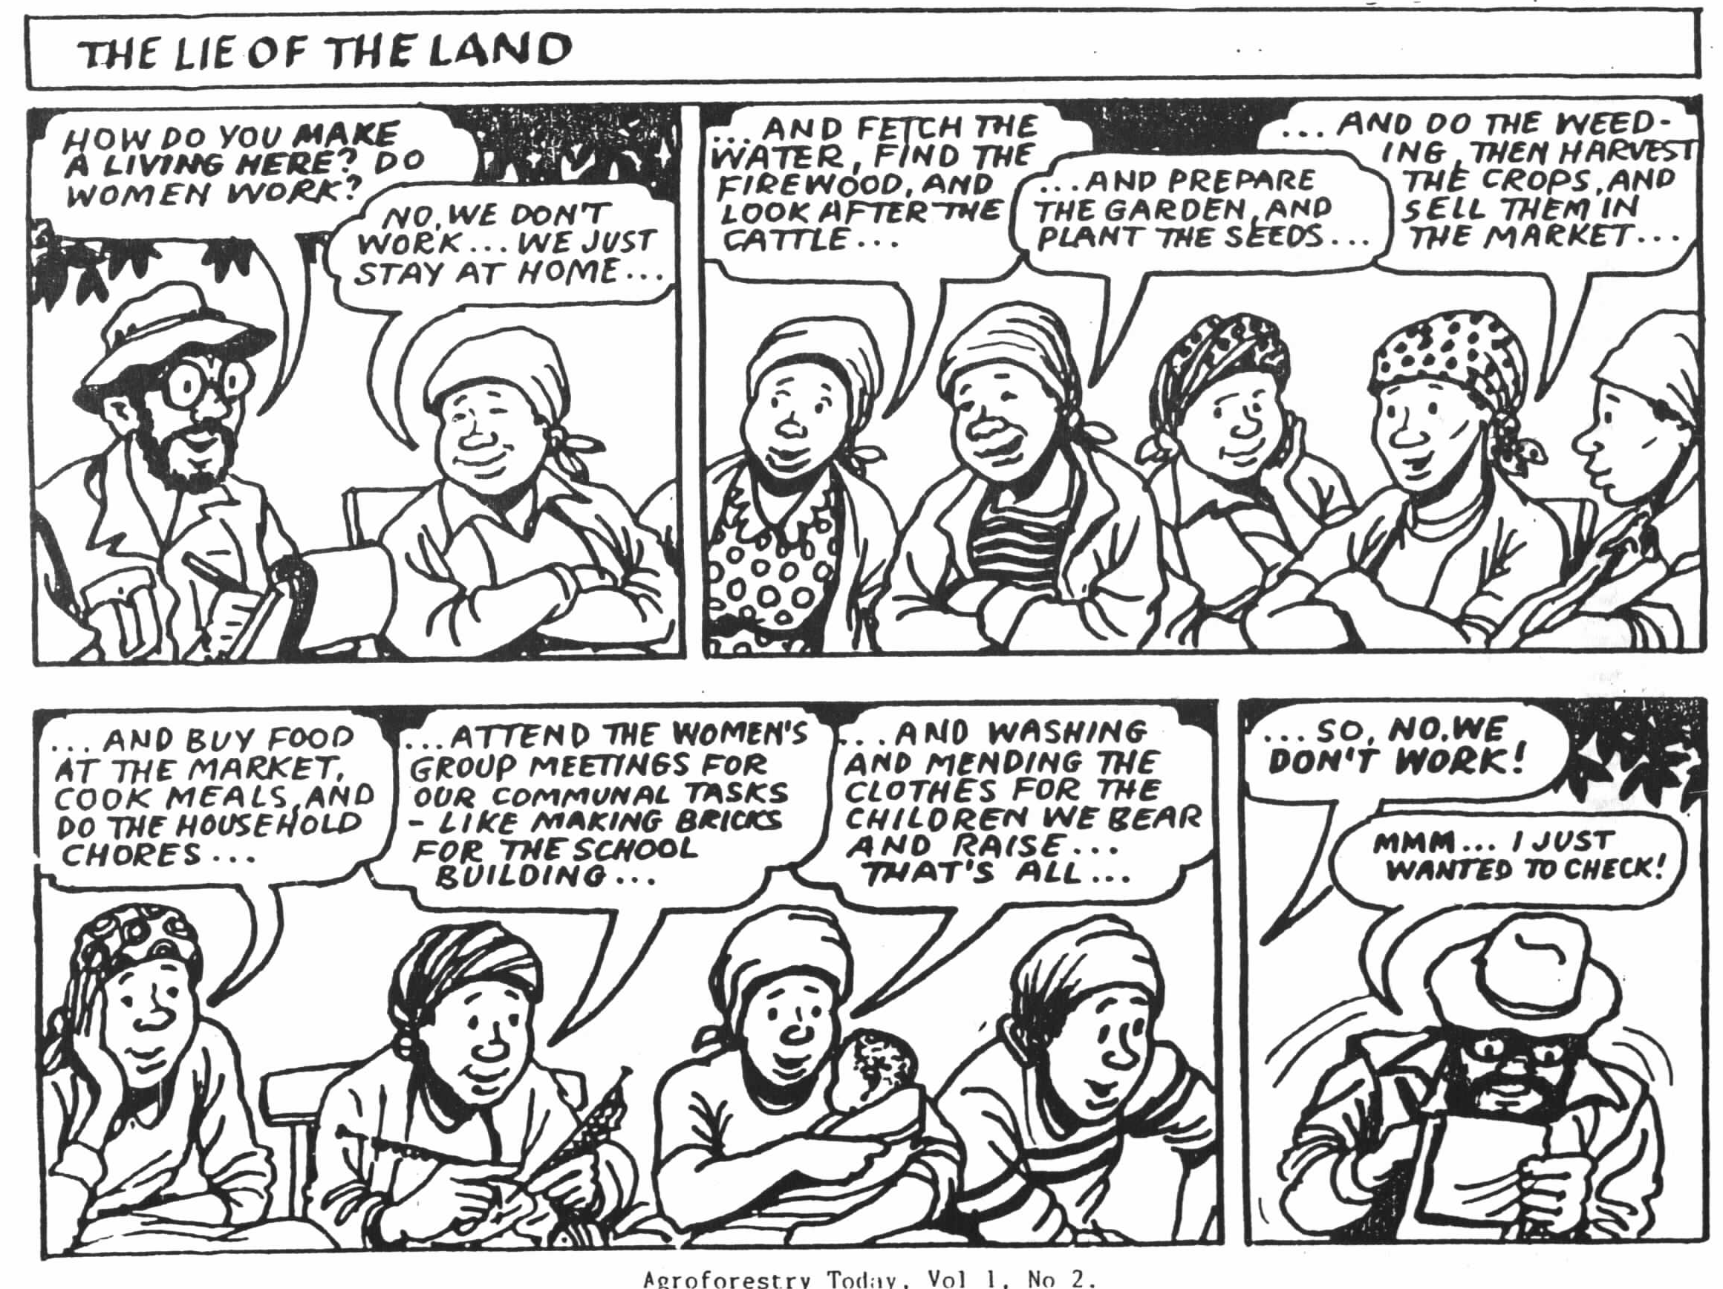

Slide 11
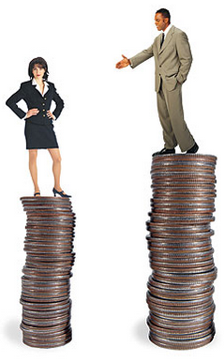
Gender discrimination
Refers to any distinction, exclusion or restriction made on the basis of socially constructed gender roles and norms that prevent someone from enjoying full human rights

Slide 12
Close out
Gender roles are learnt
Socialization into gender roles begins early in life
Learning to be different in terms of appearance and dress, activity and pastimes, behavior, emotions, responsibilities, intellectual pursuits
Gender roles are not unchangeable_ they can be unlearnt

Slide 13
Society
Role of family, other social institutions and women themselves- women play as significant a role on socializing girls and boys( the girl with unshaved legs at the hair salon)
Society generally values women less than men(First Lady-Michelle Obama and fashion)
It is difficult to put pressure on the family to change-private sphere-absolute power to male heads of households
Gender based inequality is often written in laws and policies( Kenya – polygamy law)
Men are also constrained by construction of masculinity
Fighting gender inequality is about challenging an ideology-an ideology that is perpetuated by both men and women- and vests great power

Slide 14
Laws and policies
Gender norms have often been formalized in law and policy
Laws of inheritance often favor males
Marriage and divorce laws in many countries
Resource ownership
For long time domestic violence was considered in the personal sphere

Slide 15
Institutions of gender socialization
Behind the institutions that introduce and reinforce gender norms are a range of social institutions:
the family, religious institutions, communities, schools, the media, and the state
List the three you think play the most role?
Family, media, religion

Slide 16
Gender roles
Women considered “caring”
Care for sick - most likely to become infected
Women spend a great deal of their time in the caring activities which involve feeding, cleaning, washing, preparing food.
As a consequence, often women and young girls are less likely to be involved in political, educational, and professional activities
Because they are less educated and informed, their knowledge about the disease is often less than what men have

Slide 17
Institutional gender policies
Three categories of gender policies:
  Gender- blind
  Gender-aware
    Gender-neutral
    Gender-specific practical
  Gender-redistributive: strategic
Notes:
17

Slide 18
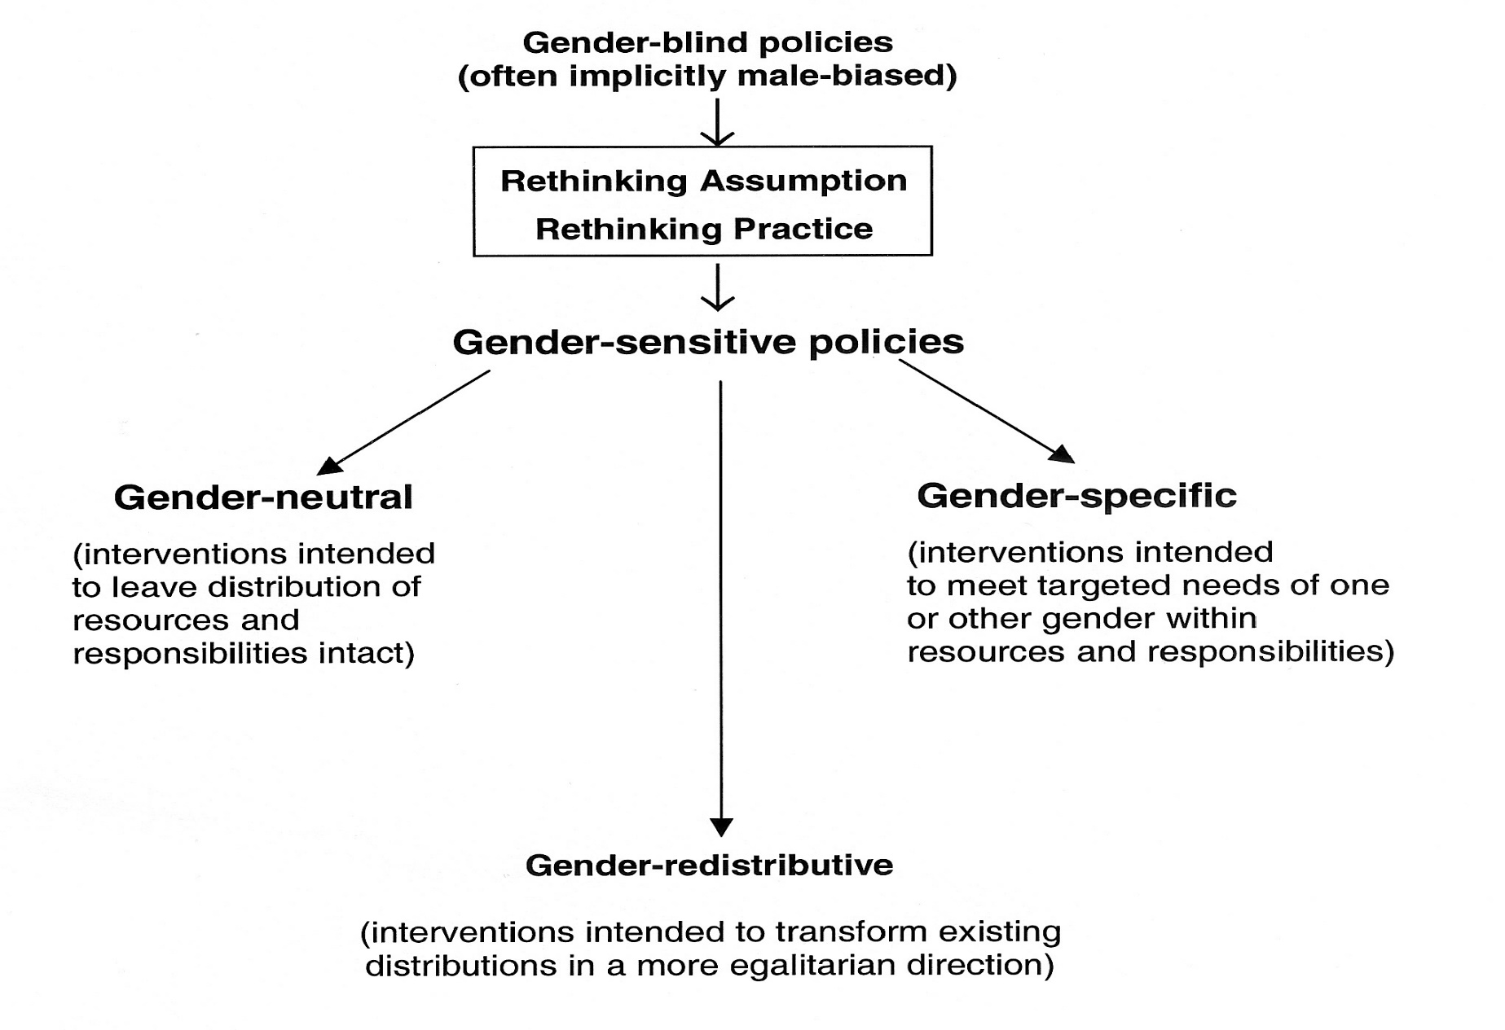
Notes:
o till now we have develpoped a tool to knockdown the expression of the three NMEEs together in the parasites, and seen that knocking down these NMEEs ex vivo debilitate worm’s ability to cleave ATP. Now we wanted to ask the question what happens to the worms if their ability cleave ATP is debiiated in the host ..
18

Slide 19
Gender friendly Innovations
Innovation in production practices
Innovation in delivery system
Innovation in infrastructure
Insurance
Land dev. / water cons. exercises
Agriculture techniques
Marketing
Activism for infrastructure access and use
Collective farming
Service delivery leading to women’s empowement
Allied livelihood options
Notes:
o till now we have develpoped a tool to knockdown the expression of the three NMEEs together in the parasites, and seen that knocking down these NMEEs ex vivo debilitate worm’s ability to cleave ATP. Now we wanted to ask the question what happens to the worms if their ability cleave ATP is debiiated in the host ..
19

Slide 20

Gender tree: Understanding reasons for differences and Impacts of these differences in roles men and women play
Root: why are there gender role differences? Culture, stereotypes, religion, legal system, political system
Trunk: what are the gender role differences seen? When we did the calendar
Branches: what creates and maintains those differences? e.g. policies, institutions, legislation
Leaves: consequences: disease , food insecurity, poverty, lack of access to resources like education

Slide 21

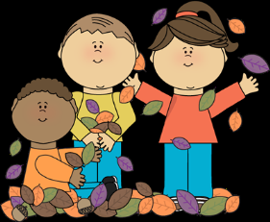
GENDER ROLES
Source: mycutegraphics.com

Slide 22
GENDER ROLES
Roots – Causes

Slide 23
GENDER ROLES
Trunk – Gender Roles
Roots – Causes

Slide 24
GENDER ROLES
Branches – Create and Maintain
Trunk – Gender Roles
Roots – Causes

Slide 25
GENDER ROLES
Leaves - Consequences
Branches – Create and Maintain
Trunk – Gender Roles
Roots – Causes

Slide 26
Discuss the following based on the gender tree:
Women in the work place in this country
Women in politics

Slide 27
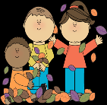
Discovery activity
Draw your tree describing:
Why there are role differences between men and women (ROOTS)
The different roles men and women (TRUNK)
What institutions, legislation policies create and maintain gender differences (BRANCHES)
The consequences of institutionalized gender differences (LEAVES)
Source: mycutegraphics.com

Slide 28
What do you think?
Which part of the tree would you target for long-term, systemic intervention in order to manage disease sustainably?
What would you do?

Slide 29
Framework
Outlines the pathways by which a person’s sex and gender affect:
  incidence, duration, severity, and mortality from emerging infectious diseases:
directly through:
  effects on vulnerability of men and women to infectious diseases
  exposures to infectious pathogens
  responses to illness
Indirectly through effects on disease prevention and control programmes.

Slide 30
Three areas
Gender influences the risk of acquiring infections during health care encounters
Gender roles and access to resources affect exposure to animals and the risk of acquiring diseases from animals
Implications of sex and gender for surveillance

Slide 31
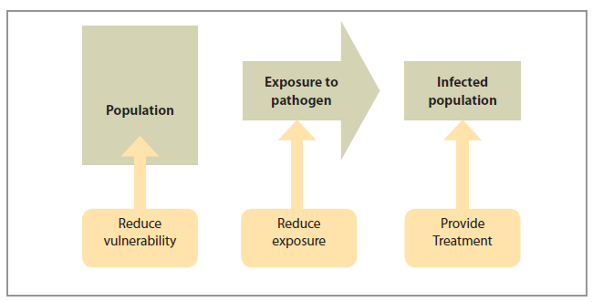
Transmission model
Notes:
The transmission model begins with a population into which an infectious pathogen
is introduced. For an outbreak to occur, some individuals must be exposed to the
pathogen and a proportion of exposed individuals must become ill ( Figure 1). Health
interventions can take place at any time before, during, and after an outbreak. In general,
these interventions aim to:
• reduce the vulnerability (and increase resistance) of people to the effects of
infectious pathogens;
• reduce exposure to infectious pathogens; and
• treat people who become infected.

Slide 32
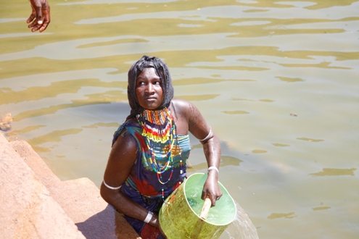
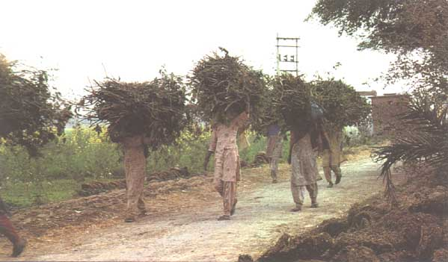
How gender differences influence emerging infectious diseases
Vulnerability
Exposure
Response to infection
Public health interventions
gender differences vary from country to country
Gender differences also vary within countries according to a host of socio-economic variables

Slide 33

Gender Analysis in Infectious Diseases
Why do Gender
Analysis?
Who does what?
Who has what?
Who decides?
How?
Who gains?
Who looses?
It is important to identify the Gender-related practices which increase the probability of men or women getting an infectious disease.
Harmful practices can then be discouraged while helpful ones adopted.

Slide 34
WHO Framework for Sex and Gender and Emerging Infectious Diseases
Skufca, J. and Arima, Y., Western Pacific Surveillance and Response Journal. Source: http://www.wpro.who.int/topics/gender_issues/Takingsexandgenderintoaccount.pdf
Notes:
The WHO framework described is an aid that identifies the effect of Sex and Gender has on the vulnerability of males and females in the society to disease. Gender and Sex will also influence the exposure of the society to pathogens. Lastly the way the individual responds to the resulting illness too is dependent on Sex and Gender.
Therefore as the Response Team plans strategies of interventions or emerging disease policies and programmes, the different needs of men, women, girls, and boys are considered. This is because gender often plays an important role in the capacity and willingness of individuals, households, and communities to protect themselves from infection and obtain treatment when they become ill.
In the figure the tree major components of gender (norms, roles and responsibilities, decision-making and access to resources) are highlighted
Similarly the three major components of sex (anatomy, the immune system, and pregnancy) are given.
The three key elements of the disease transmission model (vulnerability, exposure to pathogens, and response to illness) are shown in the middle circle, which in turn determine determine incidence, duration, and severity of a disease situation.

Slide 35
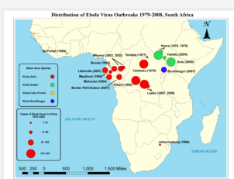
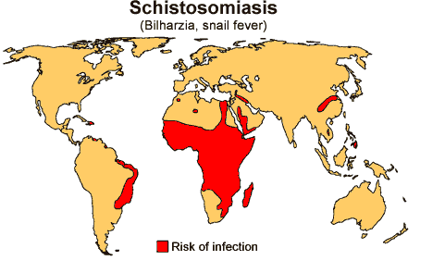
Vulnerability to infectious diseases
First contact
  Ebola, TB, anthrax
Gender related norms
  Value of males against females
  Vaccination rates
  Risk factors: pastoralist communities and cholera outbreak
Gender roles and responsibilities
  Schistosomiasis
  Guinea worm

Slide 36
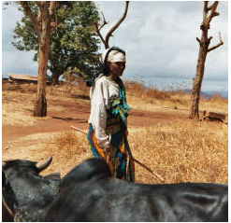
Exposure to Pathogens
Occupational exposure
  Hunters, gatherers, preparing meals
  Outdoor activities and rabies in Ethiopia
  Raw milk and TB among the Somali community
Caring for sick/dead family members
Child care and care takers
Exposure in health care setting
Exposure to livestock
  Slaughter and marketing

Slide 37
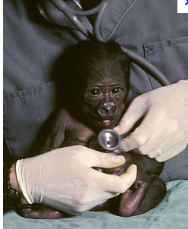
Response to infections
Prompt treatment
  Role of culture
  Access to information
  Access to resources
Use of informal health services
Cheaper health care
  TB treatment in Ethiopia
Adherence to treatment
  MDR TB
  Time constraints

Slide 38
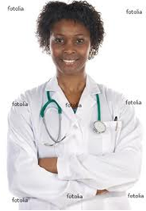
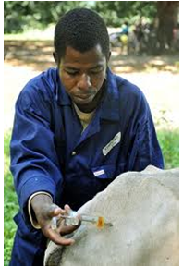
Effectiveness of Health Interventions
The gendered structure of societies
Interventions need to take gender/culture into consideration
  Vector control activities: malaria
Gender sensitive communication
  Risk communication during outbreaks
  Women not as active in public sphere
  Ebola outbreak
  Avian influenza extension workers
Interventions in animal health

Slide 39
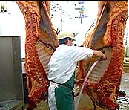
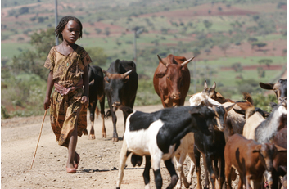
Gender and diseases of zoonotic origin
75% of all emerging pathogens
More than half of all human pathogens
Gender division of labor
  Care and marketing
Extension services focus more on larger enterprises than backyard farms
Reduces access to information, medical veterinary services
Not actual owners of farms: Avian
influenza

Slide 40
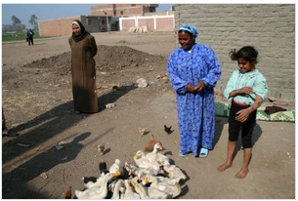
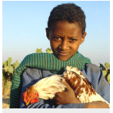
Avian influenza
Small poultry farms run by women were excluded from extension
Excluded from compensation
Risk of exposure was very high
Little or no biosecurity
If there is no compensation, people sell their birds

Slide 41
Gender and disease surveillance
Need for disaggregated data by sex
  Assumption that sex and gender not crucial
Need for data on pregnancy status
Gender biases in surveillance data
  undercount the relative importance of symptoms that can only affect one sex
  TB diagnosis cough/sputum
  Tuberculin test negative for women
Gender issues in analysis

Slide 42
Questions
Any there Gender roles in your community that can make:
Individuals vulnerable to infectious disease?
Expose Individuals to infectious disease?
(Distinguish if male/ female/ age group involved)

Slide 43
Questions
Any practices in your community that prevent your community from accessing health services?
Any practices in your community that prevent health interventions in your community from being effective

Slide 44
Conclusion
In any strategy to investigate, prevent and manage Infectious disease, Sex and Gender across the different age groups, are important considerations.
Communication, especially Risk communication should be tailored in a manner that takes into account the needs, roles and responsibilities of the males and females in a society and their impact on decision making or access to Health resources.

