Slide 1
Management Social Styles and Building Self-awareness Power point No 5

Slide 2
Objectives
Identify the four social styles.
Help participants identify with the different social styles.
Understand the styles in relation to One Health leadership.

Slide 3
Presentation Outline
Slides
Group discussions
Exercises

Slide 4
The Four Cornerstone Competencies for One Health
Self-awareness
Visionary & Strategic
Teamwork & Team-building
Communication
Change Management
Social Styles and Building self-awareness
Understand the importance of self -awareness and EQ in being an effective OH leaders
Develop your self -awareness and skills in adapting your communication skills to connect more effectively with others

Slide 5
How self-aware are you?
Self-awareness: the ability to recognise and understand your moods, emotions and drives as well as your effect on others
Self Regulation: the ability to control or redirect disruptive impulses and moods: the ability to think before acting and to suspend judgement
Empathy: the ability to understand the emotional make up of other people and to be sensitive to their emotional needs

Slide 6
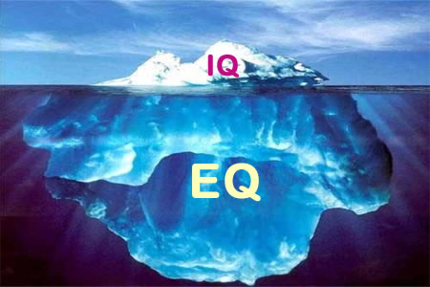
Emotional Intelligence?

Slide 7
Emotional Intelligence
Emotional Intelligence is the habitual practice of:
using emotional information from ourselves and other people.
integrating this with our thinking.
using these to inform our decision making to help us choose behaviours to get what we want from the immediate situation and life in general.
“thinking about feeling and feeling about thinking to guide our behaviour”

Slide 8
“Social Styles” Robert and Dorothy Bolton
Builds our self-awareness around how we like to communicate.
Provides clues as to why we find some communication situations difficult.
Helps us to appreciate difference.
Equips us to recognise different styles and
TO ADAPT TO CONNECT MORE EFFECTIVELY.

Slide 9
Exercise
Write your name and address using :
the HAND YOU DON’T NORMALLY WRITE WITH
And then,
the HAND YOU NORMALLY WRITE WITH

Slide 10
Exercise
Fold your arms over your chest.
Notice which arm crosses over the other; which hand is on the outside of the arm?
Unfold your arms, then cross them again with your other arm on top and your hands in the opposite position.

Slide 11
Complete the Questionnaire

Slide 12
What Makes them Tick: Social Styles
“Task” Responsive
ANALYTICAL
“Get the job done thoroughly and right.”
DRIVER
“Get the job done now”
“Ask” Assertive
“Tell” Assertive
AMIABLE
“How will this impact our stakeholders?”
EXPRESSIVE
“Let’s talk about the bigger picture.”
“People/Relationship” Responsive
Notes:
Notes
Background:
“Social Styles”: developed by Robert and Dorothy Bolton
Focuses on people styles at work
Handy tool for diagnosing styles (quickly!) in order to engage your stakeholders.
Two Dimensions of Observable Behavior:
Responsiveness
The extent to which someone expresses or controls his/her emotions
Focus on Task/Results vs. People/Relationships
Assertiveness
The effort one makes to influence the thoughts, feelings and/or actions of others
Tendency to Ask/Question vs. Tell/Direct

Slide 13
What Makes Them Tick: Social Styles
“Task” Responsive
ANALYTICAL
Focus on facts and logic
Act when payoff is clear
Careful not to commit too quickly
DRIVER
Focus on results
Take charge
Make quick decisions
Like challenges
“Ask” Assertive
“Tell” Assertive
AMIABLE
Cooperate to gain agreement
Provide support
Communicate trust and confidence
EXPRESSIVE
Create excitement and involvement
Share ideas and enthusiasm
Motivate, inspire persuade
“People/Relationship” Responsive
Notes:
Notes

Slide 14
What Makes Them Tick: Social Styles – Characteristics
Analyticals – The “Greens”
Dislike rapid change
Dislike personal attention
Accuracy
Task focused – method and detail
Serious, orderly and persistent
Cautious
High standards
Like clear organisation structures
Neat and tidy
Decide when information is complete and have taken time to reflect
Drivers – The “Reds”
Tangible results
Shape their own world
Task focused – getting it done now
Control and dominance
Assess benefits and risks
Emotion averse
Independent and strong willed
Cool, calculating and competitive
Love a challenge
Can be impatient
Work independently
Entrepreneurial
Amiables – The “Blues”
Relationships
Build trust
Personal worth measured by response from others
Supportive, approachable
Aggressive behavior switches them off
Steady, agreeable
Relaxed
Decide after careful consideration
Change in small doses
Criticism and conflict averse
Informal and welcoming
Expressives – The “Yellows”
Acknowledgement and recognition
Fast-paced manner
Relationship driven
Like to join in
Enjoy visibility
Visionaries
Enthusiastic, charismatic
Optimistic - glass is half full
Detail averse
May jump to conclusions
Like open friendly environments
Quick to say yes to an exciting opportunity
Notes:
Notes

Slide 15
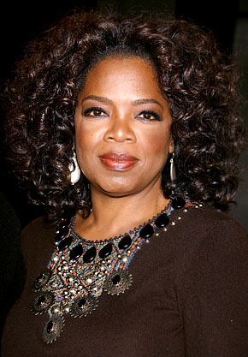
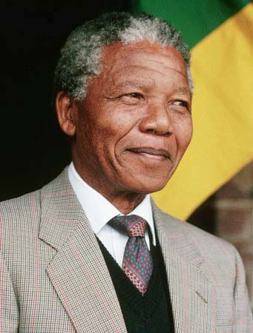
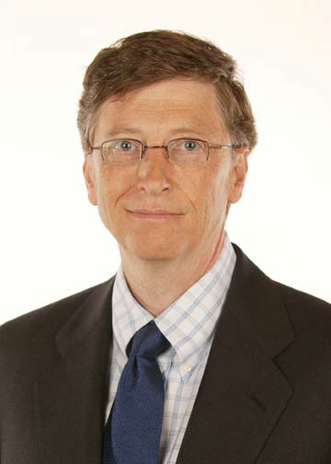
Who do you know with these styles that you may need to influence?

Slide 16
Exercise
Line up along an imaginary line for responsiveness
Left corner = people high scores
Right corner = task high scores
Provide “constructive feedback” to your colleagues:
Is this how you see them, how have you seen/ not seen this demonstrated?
Where would you put them on this continuum?

Slide 17
Our Team?
“Task” Responsive
ANALYTICAL
DRIVER
“Ask” Assertive
“Tell” Assertive
AMIABLE
EXPRESSIVE
“People/Relationship” Responsive
Notes:
Notes

Slide 18
Essential Mindsets for Adapting to Connect and Influence Others
Mindset 1: look for signal and understand someone else’s style
Mindset 2: Be prepared to adapt to influence and connect effectively
Mindset 3: Remember diversity is enriching but requires understanding

Slide 19
What Makes Them Tick: Social Styles – Activity
ACTIVITY INSTRUCTIONS:
FIND SOMEONE WITH A DIFFERENT STYLE, THEN
ASK THEM THESE QUESTIONS:
WHAT COMMUNICATION STYLE WORKS BEST FOR YOU? (FORMAL, INFORMAL, FAST, SLOW, FACE TO FACE, VERBAL, WRITTEN)
HOW DO YOU LIKE TO GET INFORMATION? (DETAIL, SUMMARY, FACTS, PEOPLE)
SWITCH ROLES AND LET THEM ASK YOU QUESTIONS.
Notes:
Notes

Slide 20
My Social Style Is:
What are the advantages of collaborating with someone who does not have the same social style as you?
What are the challenges of collaborating with someone who has not the same social style as you?
Notes:
Notes

Slide 21
Practical exercise: In Pairs
Think of a “real person” that you will have to influence
What is your “goal”; have you established a common goal?
Plan how you will need to flex your style (use the worksheet
Role play it in pairs

Slide 22
My Social Style is:
This worksheet shows how I work with:
1. How will you prepare for the interaction? (Documentation, advance communication, level of detail, etc)
2. How will you flex your preferred style during the interaction? (behavior, pace, structure, body language, etc)
3. When should you ask for a decision – now or later? Why?
4. What is the best way to follow up after the interaction? What should you emphasize or de-emphasize?
Notes:
Notes

Slide 23
Key Insights and Commitment to Action
Finish SMART Plan
Key Insights from this session y (What did you learn?)
Commitment to Action (What are the key actions you will take within the next week to bring your Strategic Influencing Plan to life?)
Notes:
Notes

Slide 24
The Four Cornerstone Competencies for One Health
Self awareness
Visionary & strategic
Teamworking & teambuilding
Communication
Change Management
Developing competencies using K.A.S.H
Appreciate that behavioural change requires a structured long term approach to development
Understand how to use the K.A.S.H model can be used to support this development of competencies

