Slide 1
Ecosystem health
Introduction to Gender Analysis-power point no.5

Slide 2
Concepts and tools for Gender analysis

Slide 3
Gender analysis
We live in societies that are permeated by gender differences and gender inequalities.
There is no country in which the outcomes of public policy are equal for men and women.
Dimensions of these inequalities are often so deeply embedded that they are difficult to perceive.

Slide 4
Gender analysis
Reveals these differences, and the fact that in such a social context any gender interventions that profess to be gender-neutral will in fact reflect and probably reinforce the imbalances that exist.
Required to bring these inequalities to the surface and to the attention of people who can make a difference, so that their decisions are taken in a manner that is sensitive to and reflects the outcome of gender analysis

Slide 5
Gender analysis
An intrinsic dimension of policy analysis
Identifies specifically how public policy affects women and men differently.
Demonstrates that policy and implementation cannot be gender neutral in gendered societies.
Is supported by specific analytic tools.

Slide 6
A good gender analysis should provide
Gender awareness - understanding of gender relations and their implications for development policy and implementation
Analysis of the division of labor-activities, access and control
A review of men and women’s priorities - restraining and driving forces
Recommendations to address practical and strategic needs
Productive and unpaid/reproductive work

Slide 7
Purpose
To reveal the connections between gender relations and the development problem to be solved -infectious disease preparedness prevention and control.
To “surface” the fact that gender relations are likely to have an impact on the solution to the problem.
To indicate exactly what that impact is likely to be, and alternative courses of action.

Slide 8
What is Gender analysis
Systematic gathering and examination of information on gender differences and social relations in order to identify, understand and redress inequities based on gender.
Gender analysis is a valuable descriptive and diagnostic tool for anyone wishing to become a transformative agent or development planner.

Slide 9
Gender analysis
What is gender analysis?
Why conduct gender analysis?
Who
When
How?(what tools)

Slide 10
Gender indicators
Sex-disaggregated statistics : gives the straightforward numbers of males and females in a given population, and
Gender statistics: can reveal the relationships between women and men that underlie the numbers.
Gender-sensitive indicators: provide direct evidence of the status of women and men in relation to each other, relative to some agreed normative standard or explicit reference group.

Slide 11
Gender statistic/gender sensitive indicators
For example, “a gender statistic could be “60% of women in country X are literate, as opposed to 30% five years ago.
A gender-sensitive indicator could be “60% of women in country X are literate, as compared to 82% of men, and compared to 30% and 52% respectively five years ago”.

Slide 12
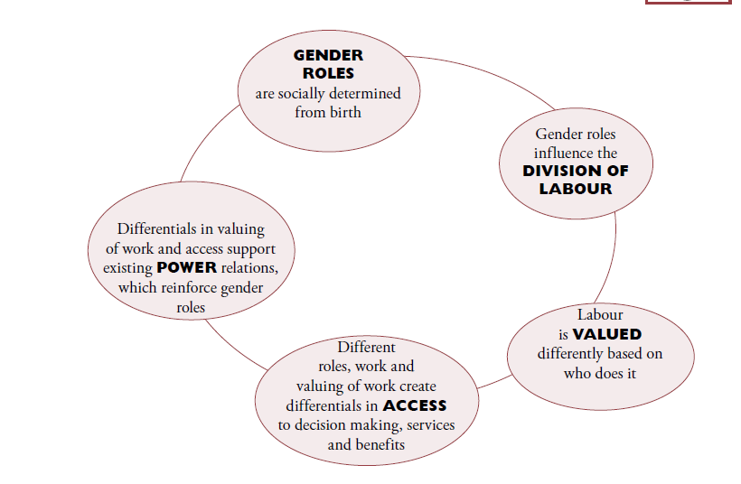
Key components of Gender analysis

Slide 13
Gender Analysis Concepts-1
Sex and gender
Gender relations: power/position distributions
Veterinary medicine/caring
Mechanization and increased values
Relationship with extension workers
Changes in gender identity and gender relations
Gender division of labor
most significant social structure governing gender relations.
Gender roles and responsibilities
Productive work
Reproductive work
The intersection of people’s productive and reproductive responsibilities with policy priorities, which has repercussions at all levels of an economy and society, is the principal focus of a gender analysis.
Differential Access to and Control over Resources and Benefits
Notes:
Gender relations are concerned with how power is distributed between the sexes. They create and reproduce systemic differences in men’s and women’s position in a given society. They define the ways in which responsibilities and claims are allocated and the way in which each are given a value
The term “gender relations” also refers to the relationships between people and their broader community, if these relationships vary with the sex of the people concerned. For example, the relationship between members of a village community and their local government entity is a gender relationship if men and women experience different benefits and controls from it.

Slide 14
Differential Access to and Control over Resources and Benefits
Access: gives a person the use of a resource e.g. land to grow crops.
Control: allows a person to make decisions about who uses the resource or to dispose of the resource e.g. sell land.
Economic/Productive/Resources: (land, credit, cash income, employment)
Political Resources: (education, political representation, leadership)
Time: (a critical resource, which increasingly acquires a monetary value)

Slide 15
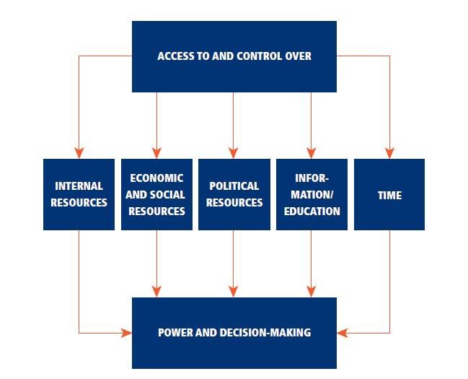

Slide 16
Gender Analysis Concepts-2
Practical needs & and strategic gender interests
Condition and Position: In addition to the specific conditions which women share with men, differential access means women’s position in relation to men must also be assessed when interventions are planned and implemented.
Transforming gender relations
Transformatory potential
Empowerment: Women’s empowerment means developing their ability to collectively and individually take control over their own lives, identify their needs, set their own agendas and demand support from their communities and the state to see that their interests are responded to.
Notes:
Women’s empowerment means developing their ability to collectively and individually take control over their own lives, identify their needs, set their own agendas and demand support from their communities and the state to see that their interests are responded to. In most cases the empowerment of women requires transformation of the division of labour and of society

Slide 17
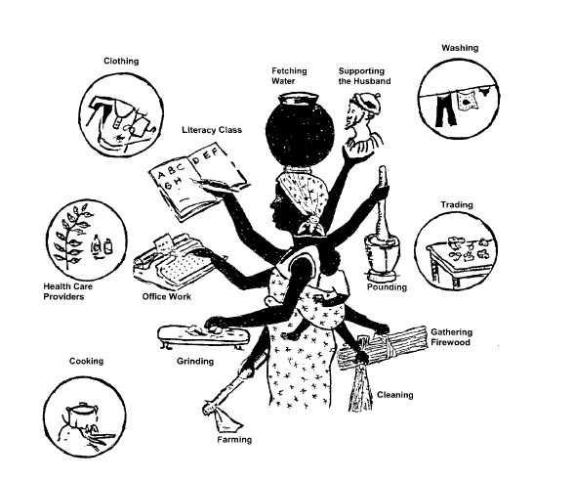

Slide 18
Gender analysis Tools

Slide 19
Gender analysis tools
Gender analysis matrix
Social network analysis
Access and control over resources
Communication profile
SWOT analysis
Gender continuum

Slide 20
Gender analysis matrix
The gender analysis matrix is an analytical tool that uses participatory methodology to facilitate the definition and analysis of gender issues by the communities that are affected by them.
Using the gender analysis matrix will provide a unique articulation of issues as well as develop gender analysis capacity from the grassroots level up.
Community based technique: community itself can identify and challenge their assumptions about gender roles in a constructive manner
Includes men, women and community as categories

Slide 21
Gender Analysis Matrix

Slide 22
Gender analysis matrix
The gender analysis matrix is based on the following principles:
All requisite knowledge for gender analysis exists among the people whose lives are the subject of the analysis.
Gender analysis does not require the technical expertise of those outside the community being analyzed, except as facilitators.
Gender analysis cannot be transformative unless the analysis is done by the people being analyzed.

Slide 23
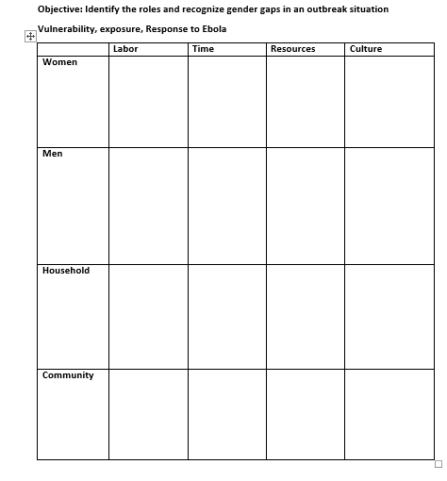

Slide 24
Social Network Analysis (SNA)

Slide 25
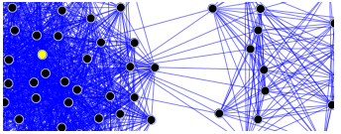
Social network analysis: mapping tool to help people understand
visualize, discuss, and improve situations in which many
different actors and places influence outcomes.
Also used to better understand the implications
of the position of individual actors and areas in a social structure.

Slide 26
Social Network Analysis
Social network analysis [SNA] is the mapping and measuring of relationships and flows between people, groups, places, organizations, computers, URLs, and other connected information/knowledge entities.
The SNA will specifically focus on participants mapping and identifying what they consider are places of significance in a community for different stakeholders.
The nodes in the network are the people, places, things, organizations and groups while the links show relationships or flows between the nodes.
SNA provides both a visual and a mathematical analysis of human/stakeholder relationships.

Slide 27
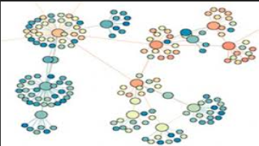
Bridge
Centrality
Density/size of circle
Cliques/places
Who are the most important nodes?
Is there a hidden community structure
How does this structure affect decision making, policy and cultural issues?

Slide 28
These measures give us insight into the various roles and groupings in a network:
Who are the connectors, leaders, bridges, isolates?
Where are the clusters and who is in them?
Who is in the core of the network, and who is on the periphery?

Slide 29
Social network map
Individuals create influence network maps using materials from a physical toolkit.
Actor names, places, organizations are written on it and distributed on a large sheet of paper.
Lines are drawn to link the actors and reveal how they are connected or not connected, and “influence towers” are built to reflect the relative power of each actor (the higher the influence tower, the greater the influence).
Size of the circle is important

Slide 30
Social Network Analysis in an Ebola outbreak
4 different groups
Men, women, media, health care professionals
Map out stakeholders and specific resources.
Identify individuals, places, organizations that are of importance.
Develop a SNA and stakeholders as you perceive them.
Identify who the stakeholders/players / places of importance are.
Link them/size of circle matters in terms of importance
They can be individuals or groups
15 minutes
Present your SNA

Slide 31
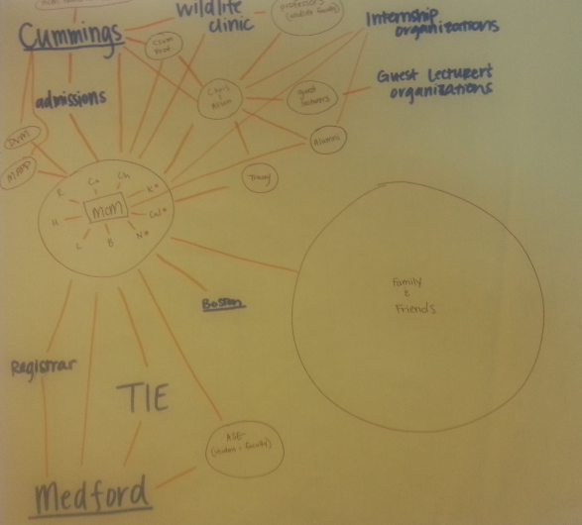

Slide 32
Walk through
Group 1 will identify similarities in groups
Group 2 will identify difference in groups
Group 3 will think of why there are differences
Group 4: How do the differences affect access to and control over resources for men and women?

Slide 33
Monitoring and Evaluation using Gender tools

Slide 34
From planning to post implementation review
Analysis tool must be useful/provide gender sensitive information/address gender relations and issues
The norm is not to do it-subconsciously
Conscious effort
Mapping for media
Mapping for health care workers
Communication profile
Can use tools for other things

Slide 35
Vulnerability to risk mapping
Essential to identify who is the most vulnerable in an infectious disease outbreak and why?
Which capacities need to be strengthened and what relief and services are needed?
Vulnerabilities and capacities of people evolve over time and determine people’s abilities to cope and recover from disaster.

Slide 36
Vulnerability mapping
Map out the risks faced by their teams: (lack of health care, few health care workers, lack of resources to purchase medication, reduced education, lack of information, cultural norms, stereotyping, consumption of bush meat, hunting).
Identify –map out signs of those risks in the community.
Add resources that can be used to mitigate those risks in different colors.

Slide 37
Laws and policies
Gender norms have often been formalized in law and policy
Laws of inheritance often favor males
Marriage and divorce laws in many countries
Resource ownership
For a long time domestic violence was considered in the personal sphere

Slide 38
Institutions of gender socialization
Behind the institutions that introduce and reinforce gender norms are a range of social institutions: the family, religious institutions, communities, schools, the media and the state.
What three do you think play the most role?
- Family, media, religion

Slide 39
Gender statistics are defined by the sum of the following characteristics
Data are collected and presented by sex as a primary and overall classification.
Data reflect gender issues: roles, laws, division of labor, access to and control over resources, benefits, power and decision making.
Data are based on concepts and definitions that adequately reflect the diversity of women and men and capture all aspects of their lives.
Data collection methods take into account stereotypes and social and cultural factors that may induce gender bias in the data.

Slide 40
Gender statistics versus Sex- disaggregated data
Gender statistics are more than data disaggregated by sex. The characteristics listed above are useful in differentiating between sex-disaggregated statistics (the first requirement in the list above) and gender statistics (which incorporate all four requirements). Sex-disaggregated statistics are simply data collected and tabulated separately for women and men.

Slide 41
Gender sensitive indicators
Indicators that track gender-related changes over time. Their value lies in measuring whether gender equality/equity is achieved through a number of ways:
Example: women in engineering; track increase in number of women registered in engineering programs over the past 5 years compared to men
Track why increase and what was done: gender awareness training done among faculty every year
Policy change at university to ensure equal opportunities for both men and female registration
Improvement in the gender content of the curriculum in high schools and colleges

Slide 42
Continued-
Gender indicators take into account that gender roles exist and point to changes in the status and roles of women and men over time.
They help illustrate the ways a project affects gender roles and confirms or disregards gender discrimination.
Gender indicators should be drawn from identifying gender issues within a specific context of a project or activity.
Many indicators that look into gender such as measuring gender empowerment, human and development index, and gender development indices are useful tools in tracking gender equality/ equity
KEY QUESTION: “Is it life-changing?”

Slide 43
Cont…
All activities developed and implemented should include gender awareness and gender relevant issues. Monitoring and evaluation of these activities needs to take into consideration the development of quantitative and qualitative indicators to monitor the impact and progress of the project in relation to the inclusion of gender aspects.

Slide 44
Gender Communication profile

Slide 45
Gender Communication profile
Provides information on how women and men access and share information
It can be community driven – having community members do it themselves
Think specifically in terms of an outbreak like Ebola
Who is providing information and how are they providing it- key players
Add any communication methods that you think are missing.

Slide 46
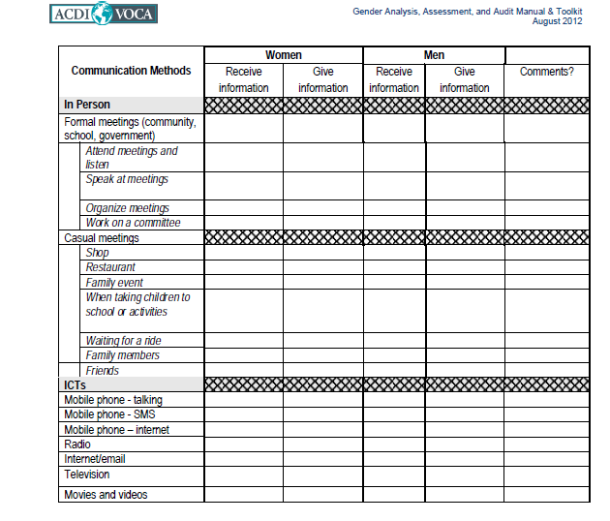

Slide 47
Women’s empowerment framework

Slide 48
Women’s Empowerment Framework
The aim of the framework is intended to help planners question what women’s empowerment and equality means in practice and assess critically to what extent a development intervention is supporting this empowerment.

Slide 49
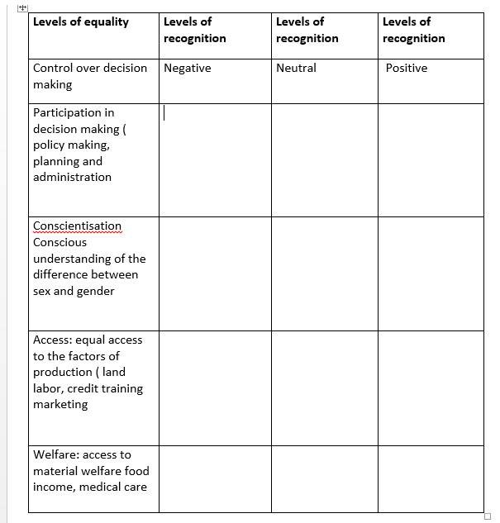

Slide 52
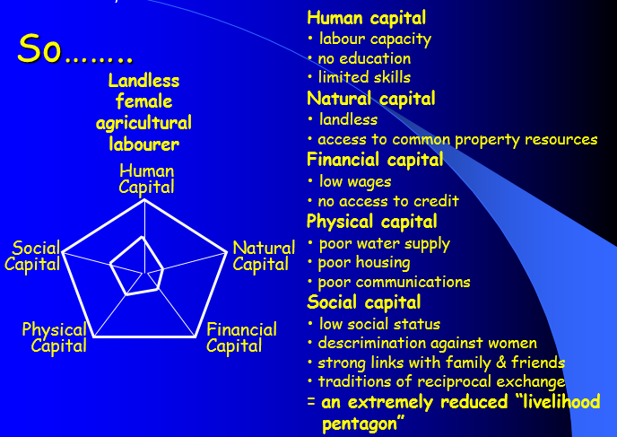

Slide 57
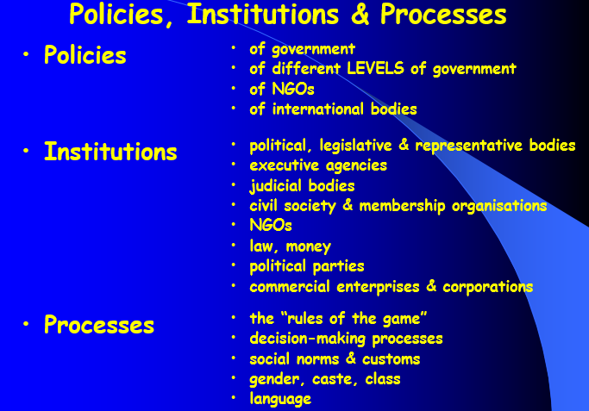

Slide 58
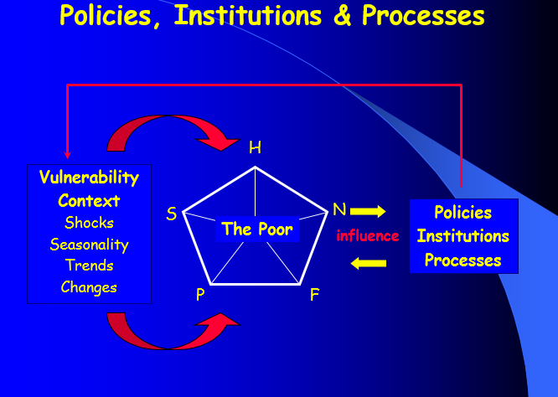

Slide 62
groups
Female trader
Female poultry keeper
Woman whose husband has died of Ebola
Health care worker in Liberia

Slide 63
 | ACCESS |  | CONTROL
 | Women | Men | Women | Men
Resources Land Equipment Labour Cash Education/Training Other
Benefits Outside Income Asset Ownership Basic Needs (e.g., food, clothing shelter) Education Political Power/Prestige Other:

