Slide 1

Ecosystem health
Climate Change and Health
Power point no. 6A

Slide 2
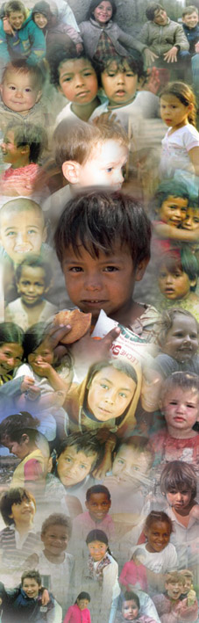

Climate Change and Health
Impact and Response
Slides from Public Health and Environment
World Health Organization

Slide 3
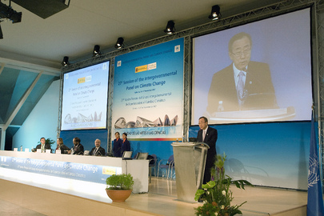
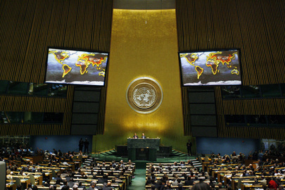
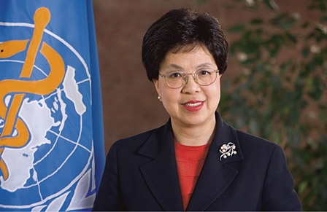
Background:
Growing body of scientific evidence on climate change
Increasing global political will
Stronger engagement by the health sector
Notes:
IPCC report in 2007: Over 2,500 scientists, over 70,000 thousand papers reviewed, just since 2001.
Not just annual UNFCCC Conference of the Parties (5-10,000 participants), but also special UN summits, session of the security council in last 18 months. All expected to continue to gather momentum with change of US Administration.
Health increasingly vocal. DG has highlighted this for the last year (Speech, World Health Day, Statements to Regional Committees).

Slide 4
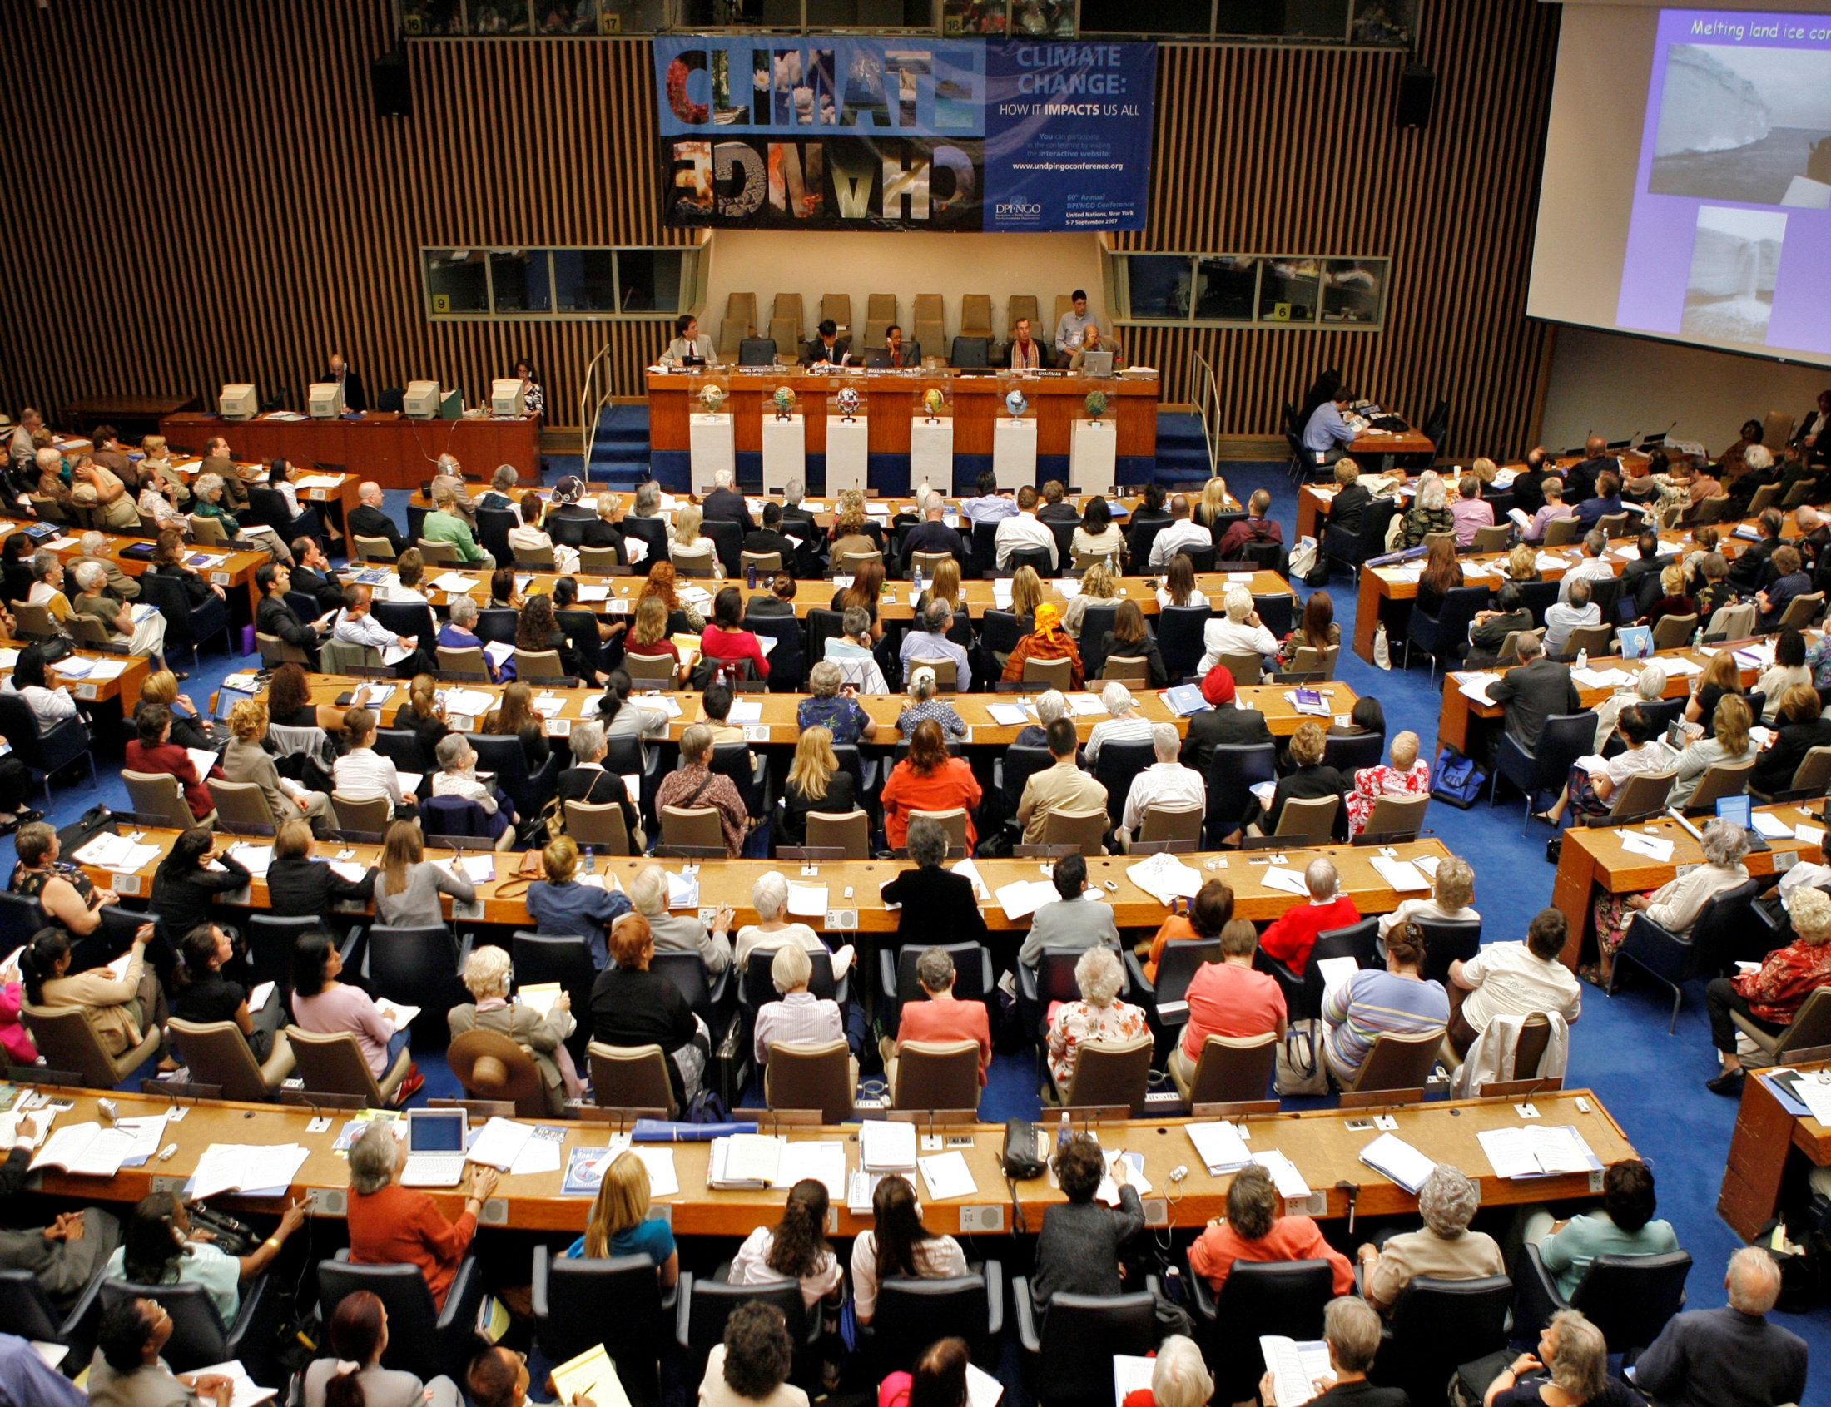
Climate change

Slide 5
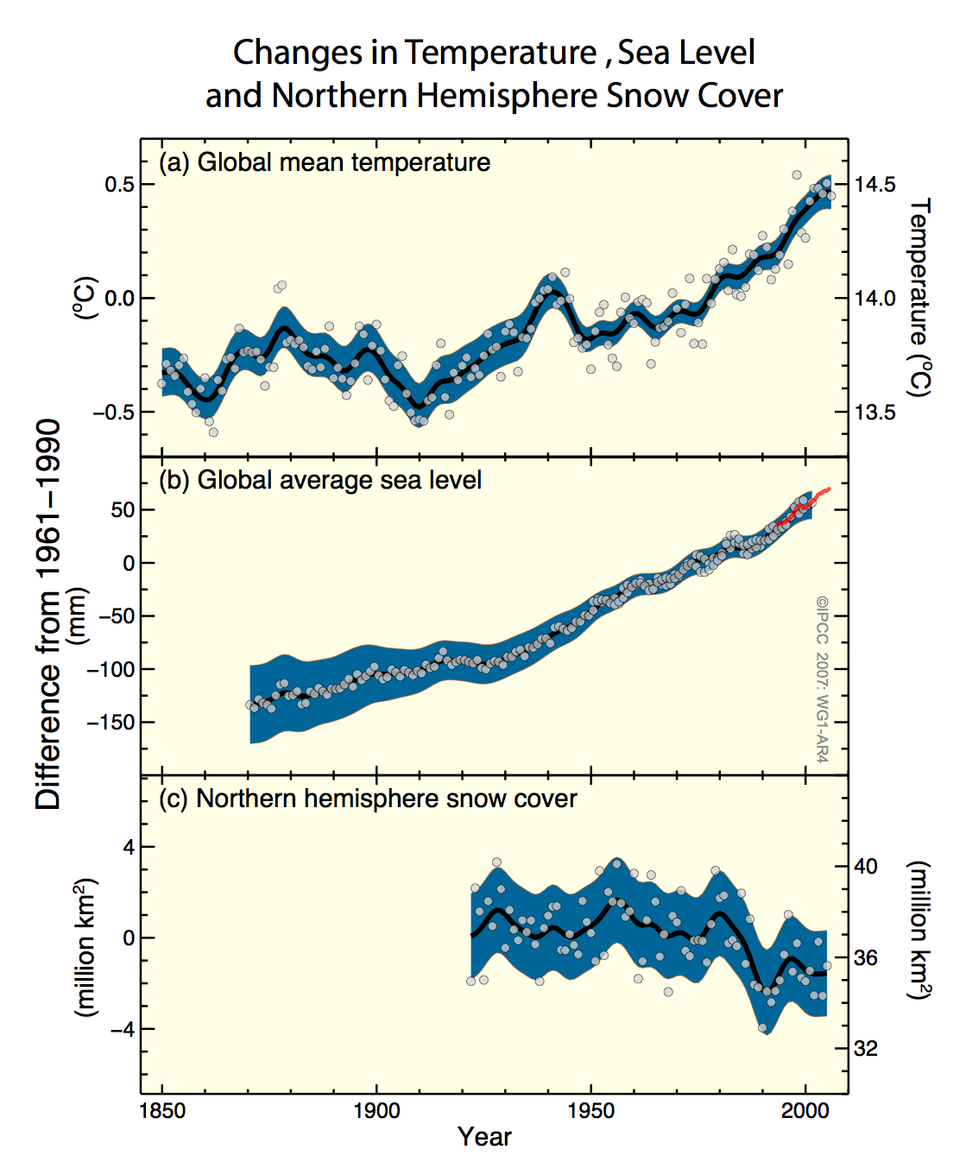
Warming is Unequivocal
Rising atmospheric temperature
Rising sea level
Reductions in North Hemisphere snow cover
Notes:
In this report, the climate scientist are telling us that there is no real debate - the world is warming, and indeed the warming is accelerating. They are also telling us that sea levels are rising; that the snow and glaciers that supply freshwater to many populations are receding.

Slide 6
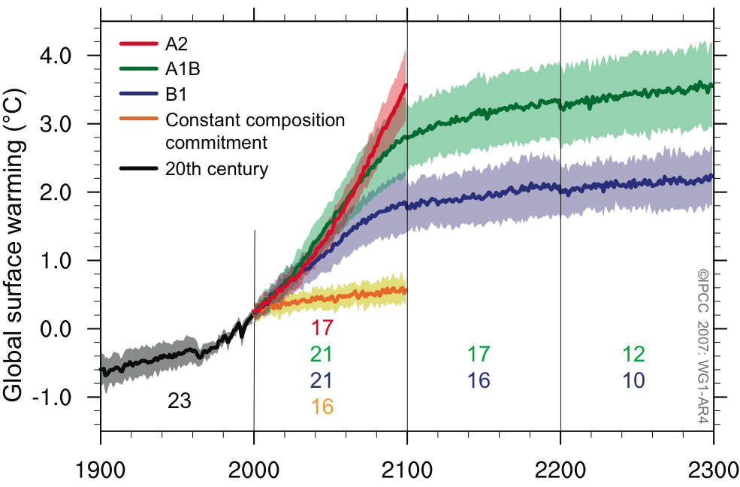
What will happen, and what could happen?
850
ppm CO₂ Eq
3.4ºC = 6.1ºF
2.8ºC = 5.0ºF
600
1.8ºC = 3.2ºF
Even if we stop emitting today
0.6ºC = 1.0ºF
IPCC, WG 1
Notes:
This slide shows that even if we would stabilize CO2 emissions at today level – we still would have a 0.6 degree C of temperature rise; this is an additional call for adaptation.

Slide 7
Climate Congress, Copenhagen, March 10-12, 2009
(first draft,March 13)
Keymessage 1: climatic trends
Recent observations confirm that, given high rates of observed
emissions, the worst-case IPCC scenario trajectories (or even
worse) are being realized. For many key parameters, the climate
system is already moving beyond the patterns of natural
variability within which our society and economy have developed
and thrived. These parameters include global mean surface
temperature, sea-level rise, ocean and ice sheet dynamics, ocean
acidification, and extreme climatic events. There is a significant
risk that many of the trends will accelerate, leading to an
increasing risk of abrupt or irreversible climatic shifts.

Slide 8
Why the response needs to be global
Cumulative emissions of greenhouse gases, to 2002
WHO estimates of per capita mortality from climate change, 2000
WHO Comparative Risk Assessment estimated that by 2000, climate change that had occurred since the 1970s was causing over 150,000 additional deaths per year (WHO, 2002, McMichael et al 2004)
Map projections from Patz et al, Ecohealth 2007.

Slide 9
The relationship between health and climate change
Health system
conditions
Social conditions
(‘upstream’ determinants of health)
Environ-
mental conditions
Direct exposures
(temperature, precipitation, sea level rise, extreme events)
*
Indirect exposures (changes in water, air, food quality; vector ecology; ecosystems, agriculture, industry and settlements) Social & economic
Climate change
Health impact
disruption
*
Modifying influence
Confalonieri, Menne et al, 2007
Notes:
This figure shows in EH terminology that health is both affected through direct and indirect exposures. This means changes in temperature extremes or temperature as well as sea level rise affect health directly – and changes in water and air and food quality induced by climate change – affect health indirectly. One can now show what has already been observed in terms of climate change and some projections.

Slide 10
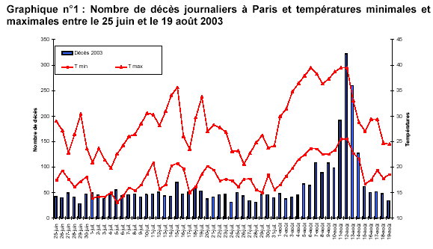
Heat waves, a modern health determinant
going across borders
European temperatures, Summer 2003
Deaths During Summer Heatwave Paris Funeral Services (2003)
Notes:
But those of us who live in developed countries, sometimes forget this, because we are protected by our infrastructure, from houses to well-functioning public health systems. But occasionally we get shocking reminders.
On the left, we see the sustained high temperatures of the summer of 2003.
On the right, the red line graph shows the daily minimum and maximum temperatures recorded in Paris, from mid-June to mid August.
Also on the right, the bar chart shows the numbers of bodies arriving at Paris morgues. When temperatures reached a peak in early August, this was immediately reflected in many more deaths.
It is now estimated that over 14,000 more people died in France in those two weeks.
Across central and Western Europe, the total was over 35,000.

Slide 11
Small changes to large disease burdens are important
Malaria: Climate change is estimated to increase the population at risk in Africa by about 13% (84 million) by 2015 (with wide uncertainty, and against a background of other changes). - Hay et al, 2006

Slide 12
Future climate change and dengue
Climate change is expected to increase the proportion of the global population exposed to dengue from about 35% (upper figure), to 50-60% (lower figure), by 2085.
Hales et al, Lancet 2002
Notes:
And we can look not just at the past, but at the future risks of global warming.
Here is the example of dengue. The distribution of dengue is very closely correlated with warm, humid conditions.
We can use this known relationship, to link to the projections of future climate changes.
What we can see, is that the expected climate change is likely to increase the risks of dengue for many millions of people over the coming decades.

Slide 13
Some Basic Principles
Choose "no regrets" interventions.
Climate is just one of many determinants of health, and projections of future climate are uncertain – so need to choose interventions that should be effective in any plausible future climate.
Invest in preventive health strategies:
Many "good deals now" (e.g. water and sanitation) will protect health immediately - and reduce vulnerability to climate change.
Take opportunities to promote health:
The health sector needs to describe the health implications of climate change mitigation decisions, e.g. in energy and transport.

Slide 14
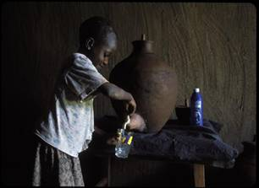
Increased awareness of the human dimensions of climate change:
With impoverished populations in the developing world the first and hardest hit, climate change is very likely to increase the number of preventable deaths. The gaps in health outcomes we are trying so hard to address right now may grow even greater.
This is unacceptable.
Climate change and health: preparing for unprecedented challenges.
WHO Director General Margaret Chan.
December, 2007
Climate change hurts
World Health Day 2008: Protecting health from climate change.
www.who.int/world-health-day/en/
Notes:
Plus World Health Day 2008

Slide 15
Health sector actions as climate change adaptations
Infectious disease
surveillance
Integrated vector
management
Diseases affected by climate
Environmental
health capacity
building
Health action
in emergencies
Safe drinking
water
Healthy development

Slide 16
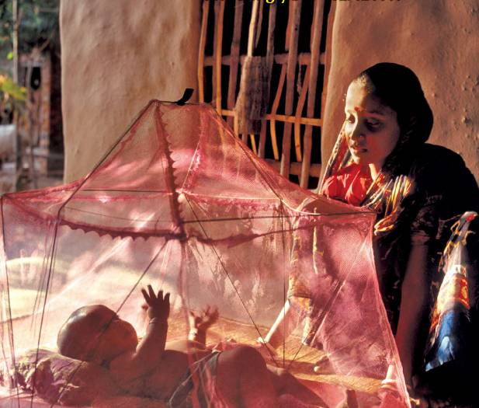
Proven, cost-effective "adaptations" to climate change
Disease surveillance and response: E.g. International Health Regulations to prevent international spread of disease, cheap and effective heat-health warning systems.
Management of environmental health determinants: Known environmental health interventions could avoid 25% of global disease, and reduce vulnerability to climate change.
Effective programmes on climate-sensitive diseases of poverty: From vector control to vaccination and treatment programmes.

Slide 17
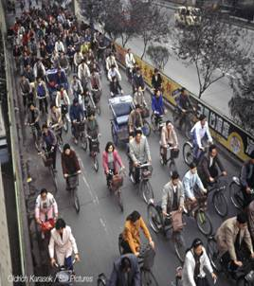
The potential for immediate, local and large cobenefits
Policies that cut greenhouse gas emissions can also reduce:
The 800,000 annual deaths from urban air pollution, and the 1.5 million from indoor air pollution
The loss of 1.9 million lives, and 19 million years of healthy life, from physical inactivity
The 1.2 million deaths and over 50 million injuries from road traffic accidents
-WHO, 2002, 2006

Slide 18
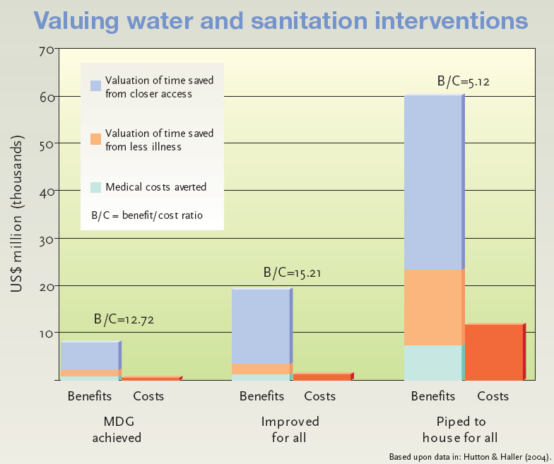
High Returns on Economic Investments
"Health benefits from reduced air pollution as a result of actions to reduce greenhouse gas emissions… may offset a substantial fraction of mitigation costs". (IPCC, 2007).
Cleaner energy decisions can bring major, health-dominated, benefit/cost ratios; e.g. 42:1 for US clean air act. (USEPA, 1999).
Environmental management "adaptations" are highly cost-beneficial – e.g. each $1 invested in clean water and sanitation brings $3-34 in benefits for health and wellbeing. (WHO, 2004).

Slide 19
The Request from 193 National Governments

Slide 20
WHA Resolution Requests WHO to:
Raise awareness of health implications of climate change among policy-makers and public:
Contribute to the UNFCCC Work Programme on Adaptation to Climate Change
Increase consideration of health consequences of climate change among the relevant UN bodies
Develop capacity for risk assessment and response by promoting research and pilot projects in defined areas
Consult member states on work plan for scaling up WHO technical support to countries
Notes:
(See resolution text for precise wording)
Clarification on where this meeting fits into the overall agenda

Slide 21
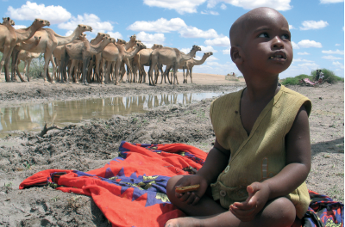
Health is still low on the climate change radar
UN SG now emphasises the "human face" of climate change, and health impacts often cited to justify GHG reductions
But….
Negotiations are through the UNFCCC – near zero health representation on national delegations or National Communication teams.
GHG mitigation by national commitments and Clean Development Mechanism - nothing on health co-benefits.
Adaptation through national funding, ODA, global CC Adaptation Funds - near zero health representation on governing mechanisms, few health projects funded.
Notes:
Health sector has neglected its rightful position since the UNFCCC in 1992.
We need to get more health messages, and informed health people, involved in the relevant climate change processes.
Figures below.
In negotiations:
The first line of the UNFCCC text states that the aim is to avoid adverse impacts of climate change, and specifies the need to avoid harm to health on equal basis alongside the natural environment and economic development (UNFCCC, 1992).
But....
Health is mentioned in only 4 of 47 (9%) of national submissions received on the negotiation of the post-Kyoto climate change treaty (Marina's review, May 09).
Only 1(?) out of about 190? national delegations to the UNFCCC meeting in Bali included any health personnel (external source, need to confirm).
In funding:
Health is identified as a priority in 32 out of 38 (84%) UNFCCC National Adaptation Plans of Action (NAPAs) from the poorest countries (UNFCCC data at end 2008)
But..
is the focus of 31 of 430 ( 7%) projects submitted for NAPA funding (UNFCCC data at end 2008)
has received ~ $2.5 million of $1.3 billion (0.2%) of support granted under the UNFCCC (UNFCCC data at end 2008)
In design of mitigation measures:
The UNFCCC text specifies that mitigation measures should aim to achieve social cobenefits at the same time as cutting greenhouse gas emissions (UNFCCC 1992).
IPCC lists health as the first co-benefit of mitigation of GHG, stating that the health benefits are significant, and may offset a large part of the cost of mitigation measures (IPCC, 2007).
But...
Health cobenefits are mentioned by 1 out of 47 national submissions received on the negotiation of the post-Kyoto climate change treaty (Marina's review, May 09).

Slide 22
Director General’s paper for the Danish Government Blog on Climate Change
May 2009
Climate change is one of the defining challenges of the century and increasingly recognized as a public health priority.
Of major concern to us is the fact that climate change threatens to reverse progress made towards the Millennium Development Goals (MDGs). Poverty cannot be eliminated while climate change exacerbates malnutrition, disease and injury.
Notes:
Observed changes in (a) global average surface temperature, (b) global average sea level from tide gauge (blue) and satellite (red) data and (c) Northern Hemisphere snow cover for March-April. All changes are relative to corresponding averages for the period 1961–1990. Smoothed curves represent decadal average values while circles show yearly values. The shaded areas are the uncertainty intervals estimated from a comprehensive analysis of known uncertainties (a and b) and from the time series (c).

Slide 23
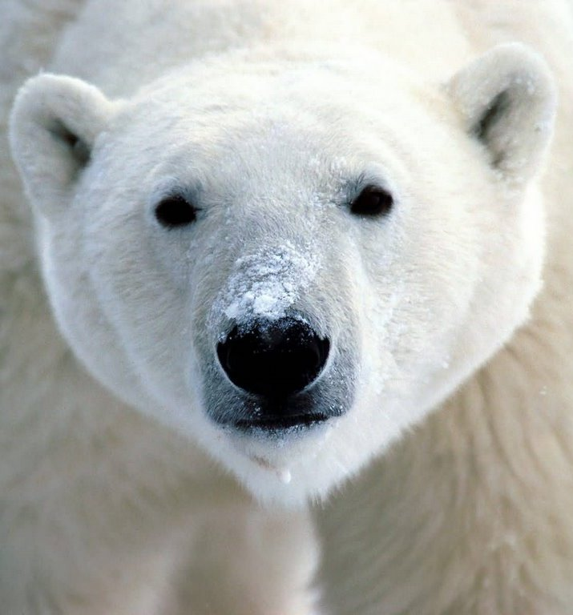
The face of climate change ?
Notes:
But until now, this has been the face of the climate change discussion. People have mainly been concerned about the effect that climate change will have on the environment.
The reason that I need to talk about this issue, is that this is also the face of climate change. [fade from polar bear to African boy]
I have a commitment that my term in office will be judged by what we do for the health of the most vulnerable; of women, and of people in Africa. We therefore need to consider what we need to do to safeguard the health of this African boy throughout his life.

Slide 24


