Slide 1
Ecosystem Health
Creating resilience to climate change –power point no.8
Power point presented by Professor William Moomaw

Slide 2
Creating Resilience to Climate Change
Mitigation – Emissions reduction
Adaptation – Altering practices
Geoengineering – Modifying the planet
Restorative Development – Fixing what is broken

Slide 3
What is happening in a changed climate system?
Temperatures of oceans, land and atmosphere are rising throughout the world.
Glaciers, ice caps and sea ice are melting.
Sea level is rising and causing coastal flooding.
Higher temperatures adversely affect human health, air quality, food production natural ecosystems and biodiversity
Frequency and intensity of extreme weather events is increasing
Precipitation is becoming more intense when it occurs causing flooding.
Droughts are occurring with greater intensity and lasting longer
Typhoon and hurricane intensity is increasing.

Slide 4
What is “Resilience?”
Resilience is the capacity to respond to altered conditions so as to minimize damage to human society and natural systems, or to ensure that the economic, societal and environmental factors retains their “functionality”.

Slide 5
Strategies for Increasing Resilience
Mitigation – Reduction in carbon dioxide emissions from fossil fuels and bioenergy and from deforestation, degradation of soils and from industrial sources
Adaptation – Altering practices to perform in the changed circumstances resulting from altered climate systems
Geoengineering – Modifying the planet or its processes to slow climate change
Restorative development – Fixing what is broken while meeting individual and societal needs

Slide 6
Mitigation
Resilience can be enhanced by limiting climate change through mitigation actions.

Slide 7
Figure prepared by Dr. Edward Spang

Slide 8
Key to Figure
The Path of Energy from Source to Service
Original Source
of Energy
Solar Radiation
(from Nuclear Fusion)
Nuclear
Decay
Gravitational
Force
Primary
Energy Source
Biomass Energy
Fossil Energy
Nuclear Energy
Solar Energy
Wind Energy
Hydro Energy
Geothermal Energy
Ocean Energy
Form of Energy
Storage and Secondary
Carriers
Carbon
Gaseous Fuel
Liquid
Fuel
Solid
Fuel
Hydrogen
Energy
Type of Energy
Conversion
Thermal
Conversion
Kinetic
Conversion
Electrochemical Conversion
Electrochemical Storage
(Batteries)
Form of Usable
End Use Energy
Carriers
Heat
Electricity
Mechanical Work
Energy Service
Demanded
Industrial and
Mechanical Processes
Electronics
Lighting
Heating
Cooling
Transportation

Slide 9
Energy strategy
Begin with the energy service required.
Reduce energy needed for the desired task as much as possible by improving energy productivity at the end use.
Provide energy required using the technology that can provide the service with the least amount of GHG emissions.

Slide 10
Insulation and Air Sealing of buildings

Slide 11
Lighting

Slide 12
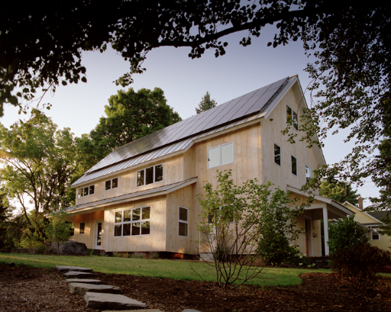
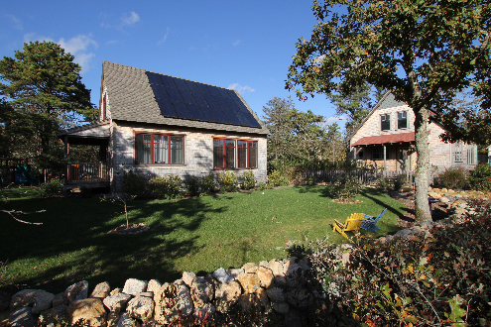
Zero Net Energy Retrofit
Amherst MA
Zero Net Energy
Affordable Housing
Martha’s Vineyard MA

Slide 13
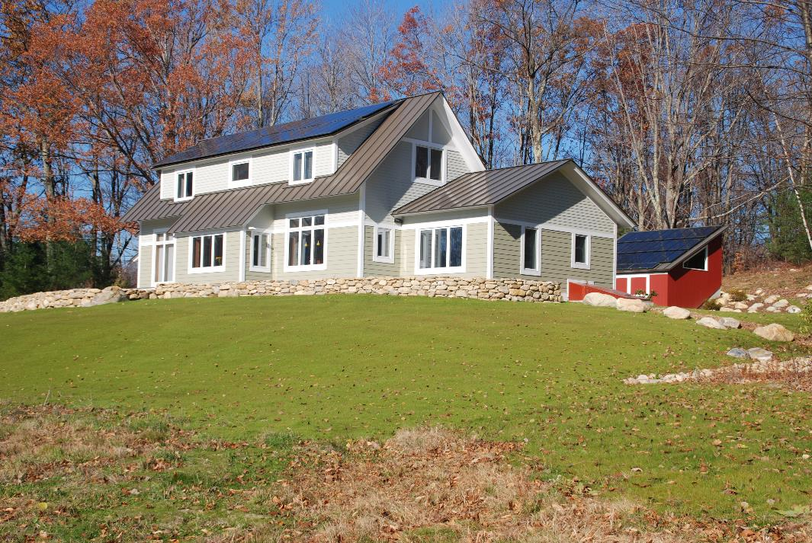
U.S. cold weather house uses 86% less energy for heating than code built house.
Grid connected 7.3kw PV, zero net energy design includes ground source heat pump for heat and hot water at 42º N latitude and temperatures as low as -25º C.

Slide 14
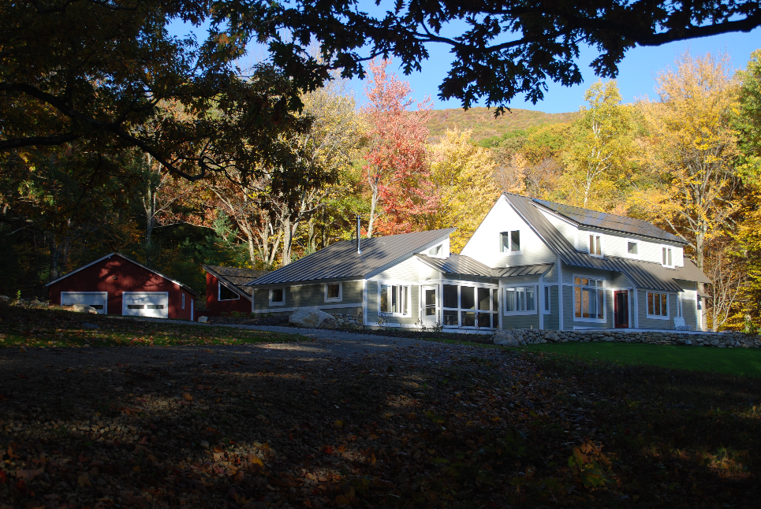

Slide 15
Moomaw Residential Energy Use 1970-2010

Slide 16
Insulation Return on Investment

Slide 17
PV Return on Investment May 1, 2008 - April 30, 2013
An 8.0 kw PV array would require an investment of $40,000 and produce 9000 kilowatt hours of electricity per year in New England. The payback period would be 10.9 years.

Slide 18
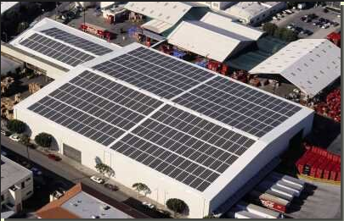
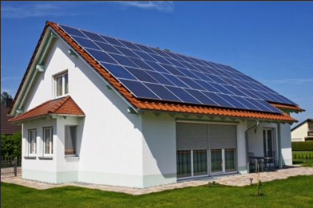
Distributed Rooftop Solar

Slide 19
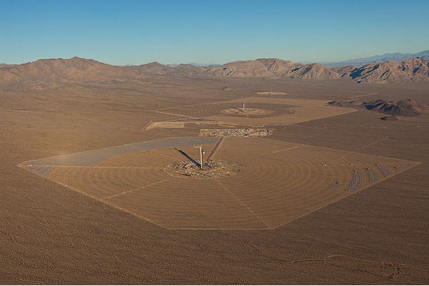
Ivanpah 370 MW Central Solar Thermal Power Plant

Slide 20
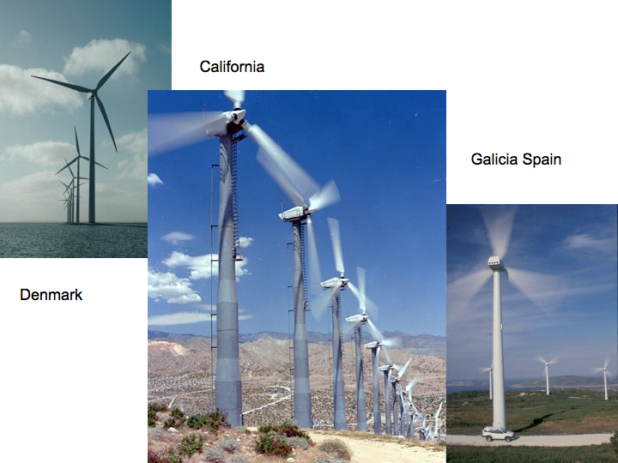
Wind Turbines

Slide 21
Adaptation
Resilience can be enhanced by adapting to a changed climate system

Slide 22
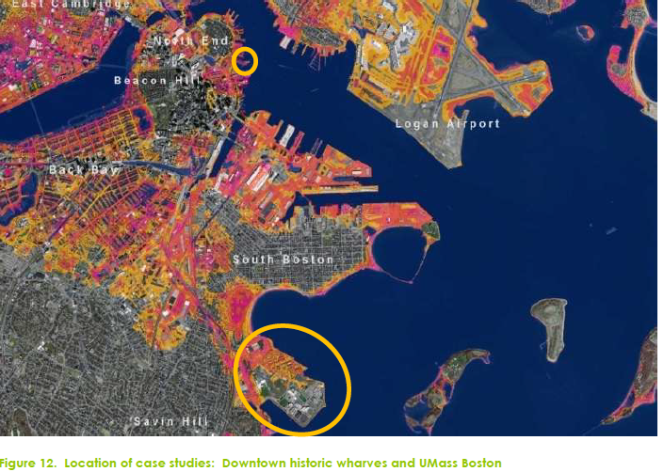

Slide 23
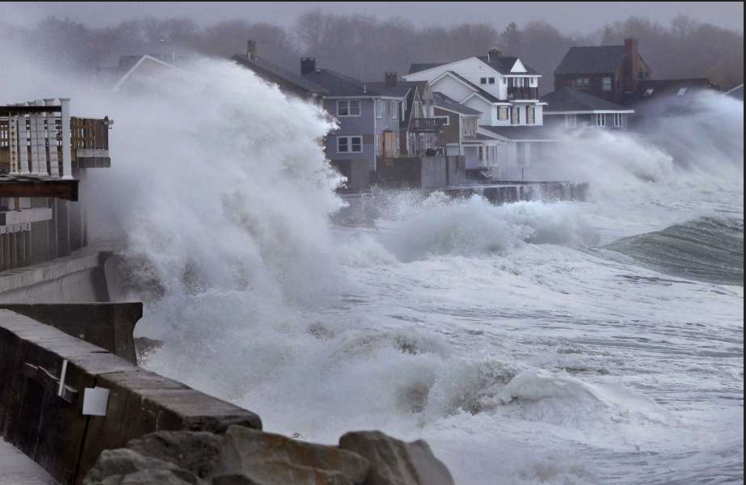
Boston coastal storm

Slide 24
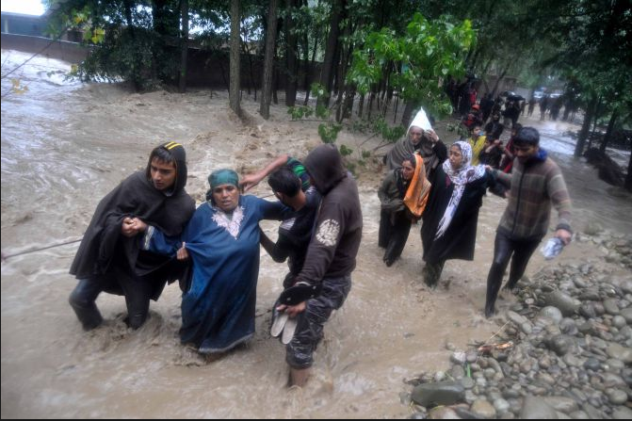
Pakistan flood

Slide 25
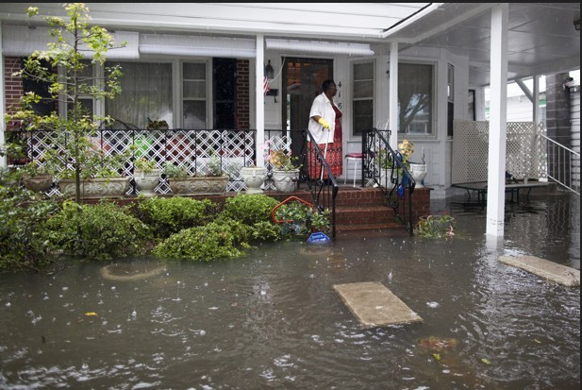
Charleston South Carolina

Slide 26
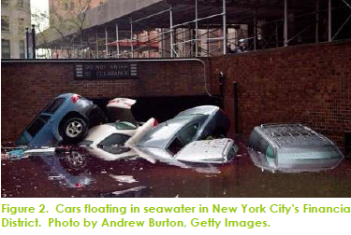
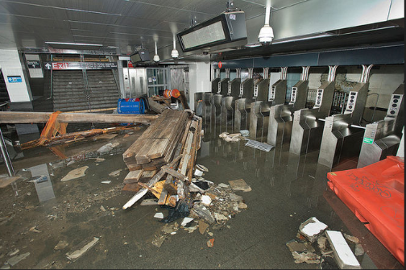
New York City Subway following
super storm sandy

Slide 27
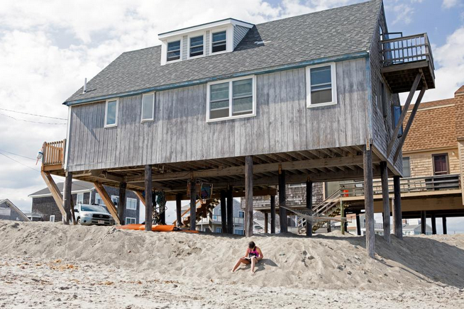

Slide 28
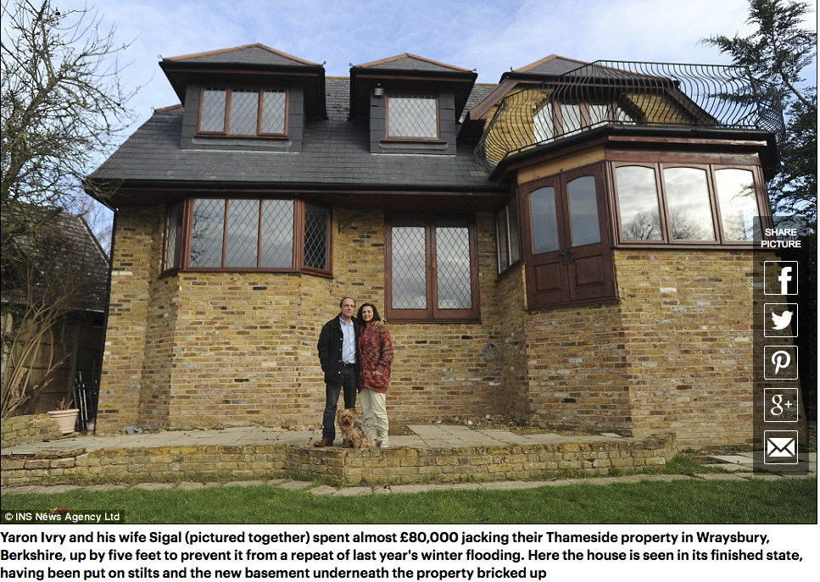

Slide 29
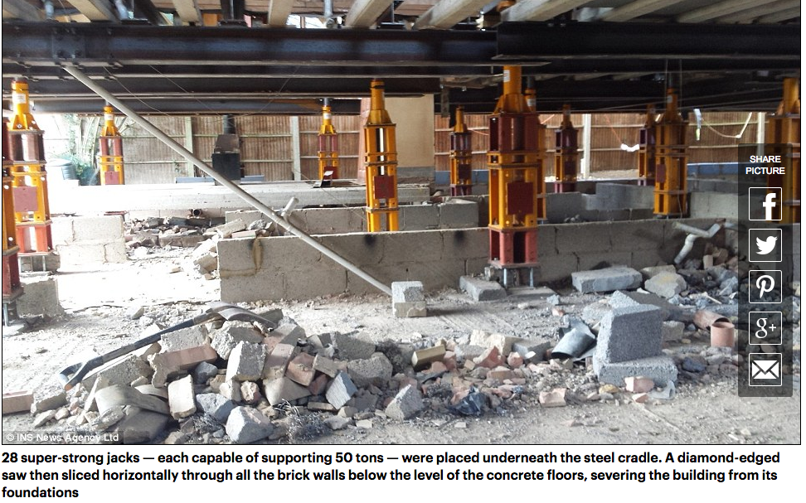

Slide 30
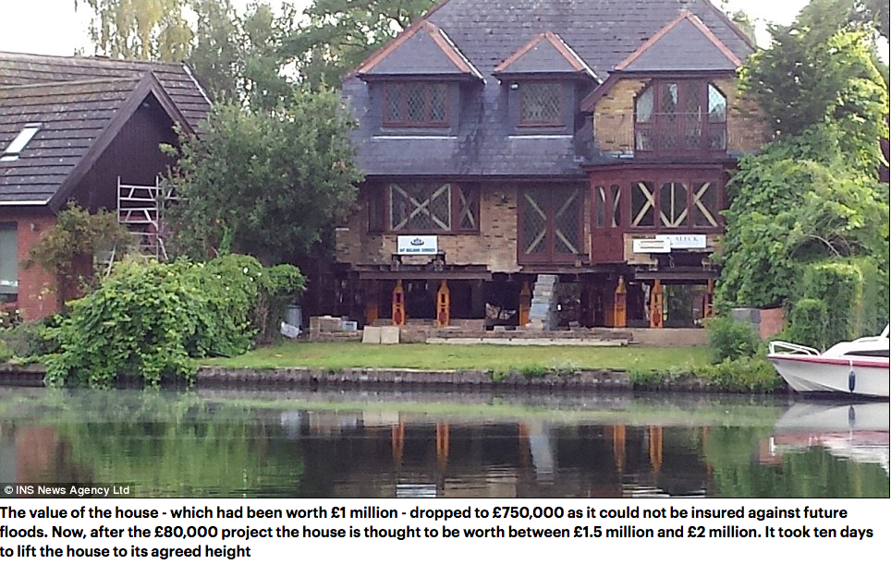

Slide 31
Geoengineering
‘Geoengineering is the deliberate large-scale intervention in the earth's natural systems to counteract climate change” – Oxford University

Slide 32
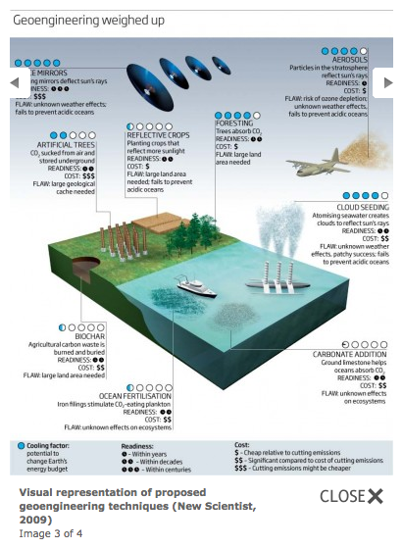
Geoengineering options
Solar radiation
management
Carbon dioxide removal

Slide 33
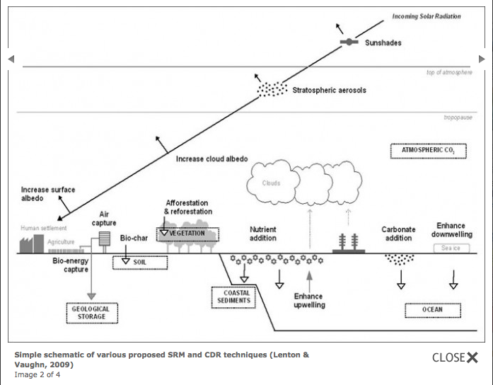

Slide 34
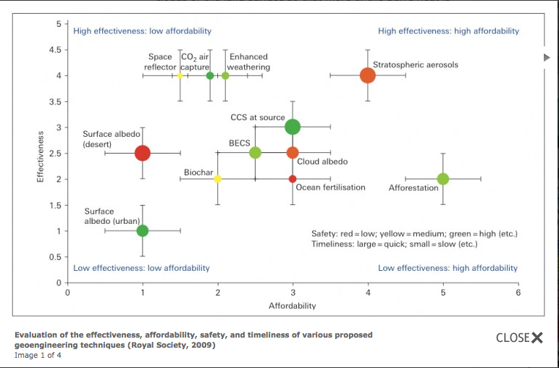

Slide 35
Restorative Development
Restorative Development is development that repairs natural systems such as degraded forests, grasslands, wetlands and agricultural and other soils while meeting personal and societal needs.

Slide 36
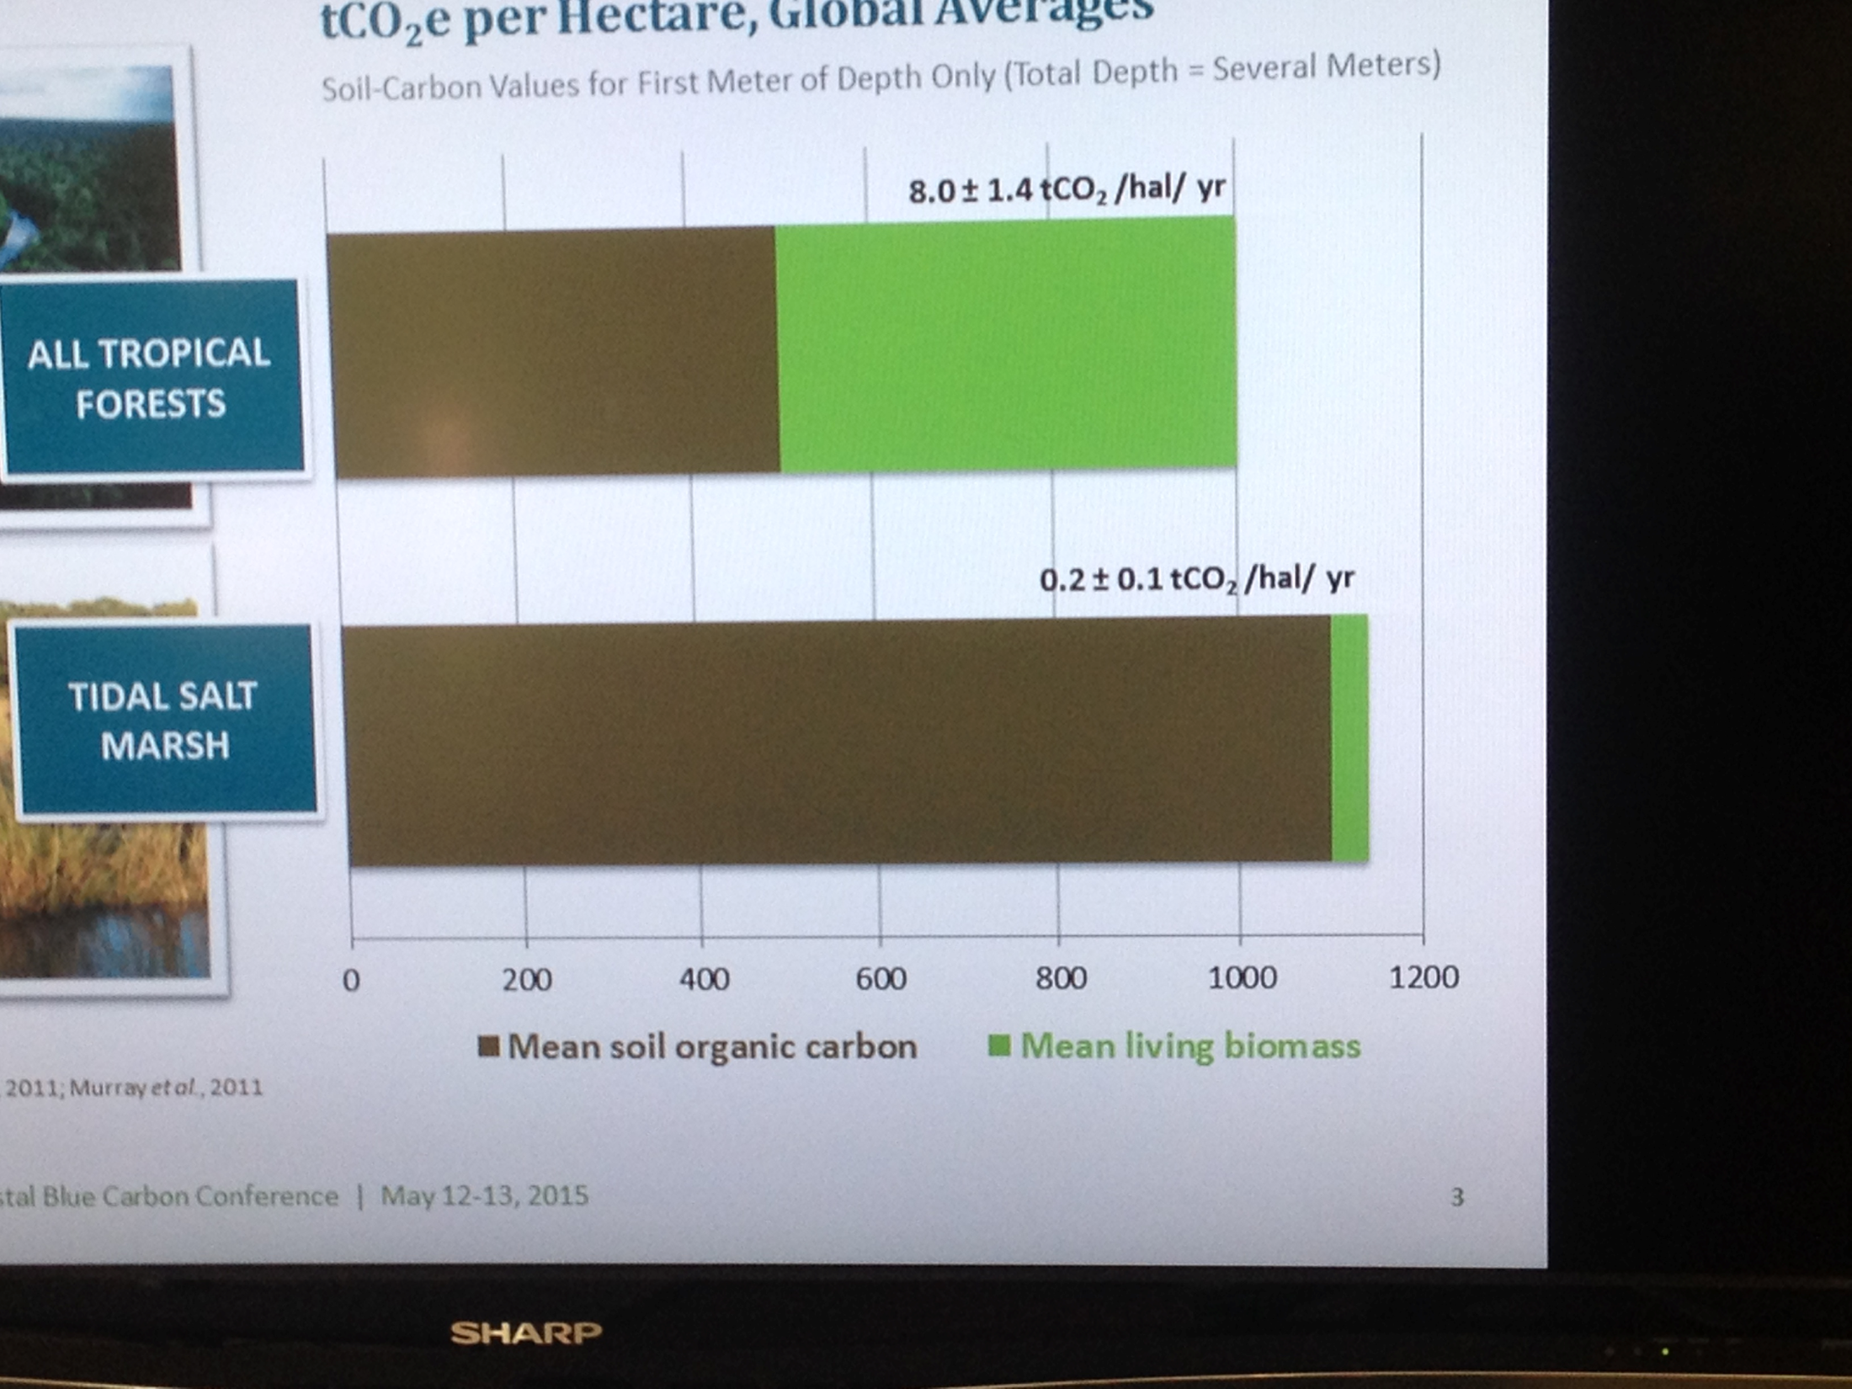
Comparisons of sinks
Burning all fossil fuels would add 12.5 x the current amount of CO2 to the atmosphere
Burning all forests and plants would add
0.63 x current amount
Adding all soil carbon would add 2.9 x current amount

Slide 37
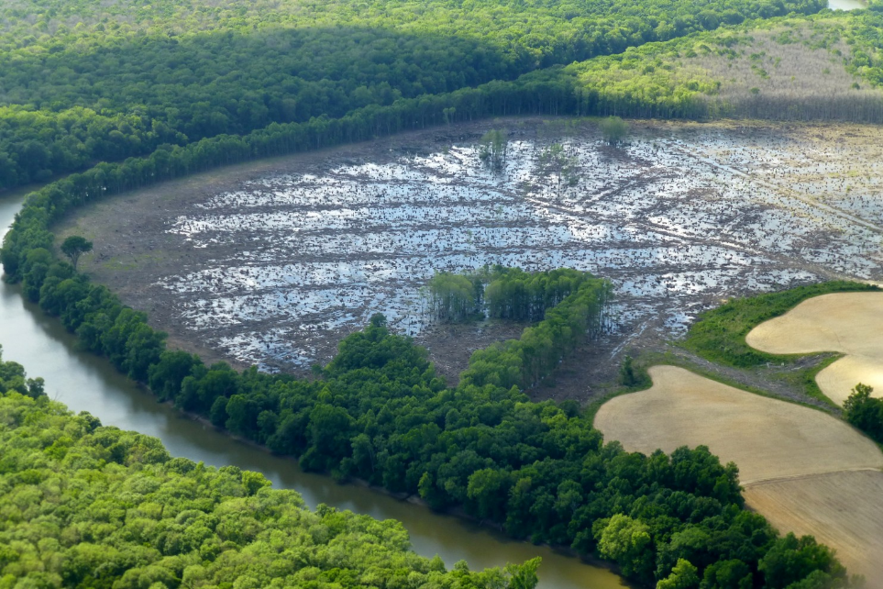
Pellet industry harvesting in North Carolina: “Little remains but stumps and puddles in what was once a bottomland hardwood forest”

Slide 38
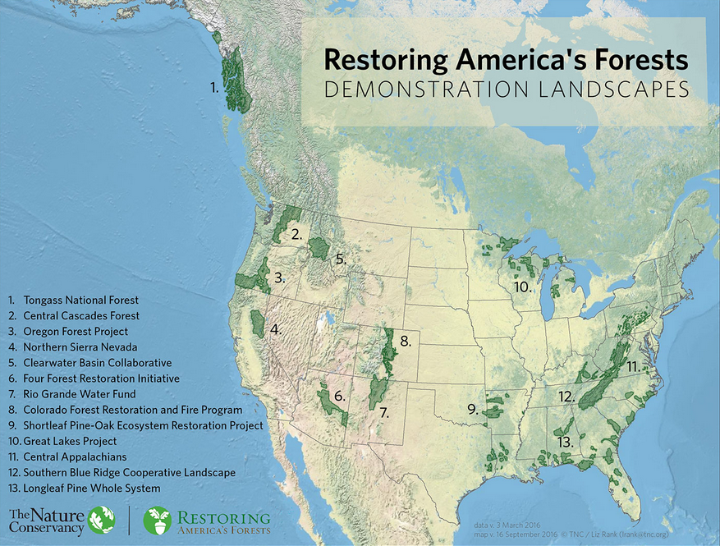

Slide 39
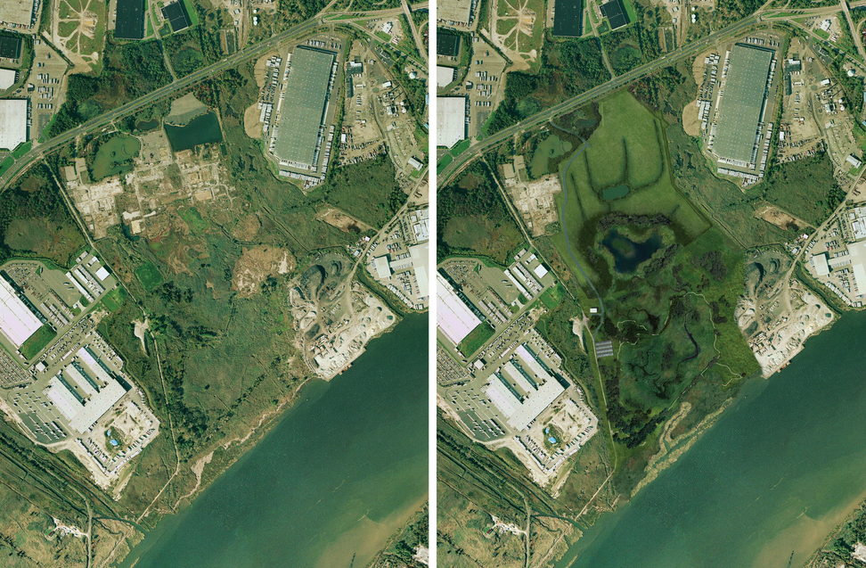

Slide 40
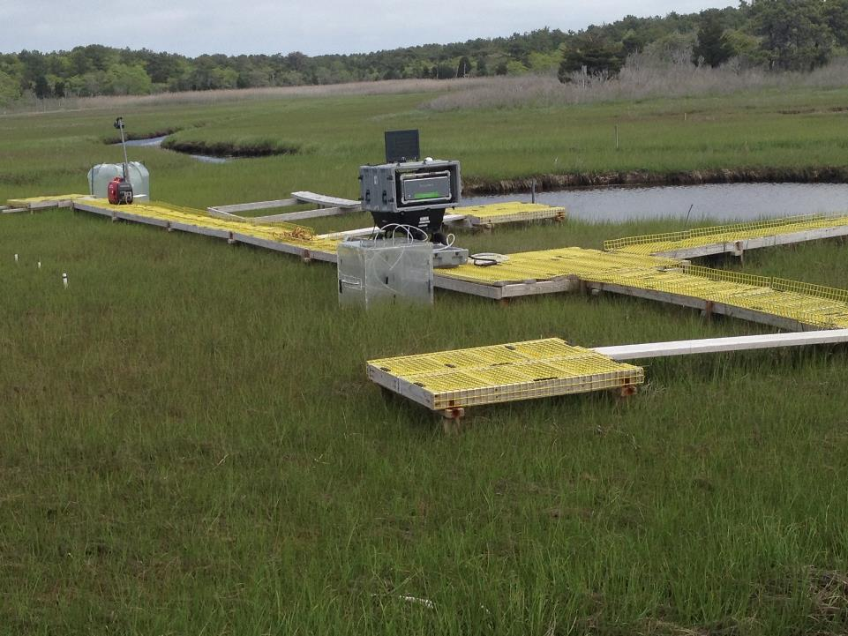

Slide 41
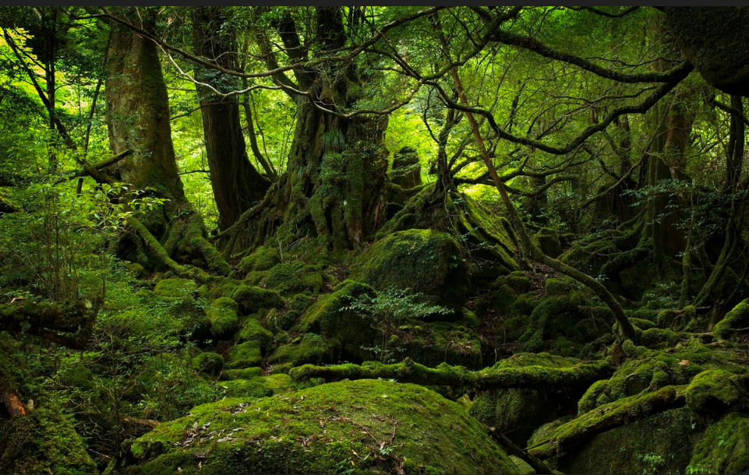
Forest and land restoration can reduce net emissions by 3 billion tonnes C/yr

Slide 42
Restoration as development
Restoring degraded forests can enhance human well being by restoring many ecosystem services:
Flood control
Water quality and quantity
Biodiversity
Improved nearby crop production
Recreation

Slide 43
Policies
Use market mechanisms.
Stop subsidizing fossil fuels at a global level of $500 billion/year.
Provide subsidies to low carbon technology such as wind, solar, hydro, geothermal and nuclear.
Put a price on carbon either as a “carbon tax” that is rebated or used to support lower emission technologies or as a cap and trade system.

Slide 44
Policies
Use regulations.
Set renewable portfolio standards for adoption.
Support R&D for technology and for implementation processes.
Set energy efficiency standards for appliances, vehicles and homes.
Plan more efficient communities and transportation systems.

Slide 45
Non-policy measures that promote action
RE 100 now has 87 major corporations committed to using 100% low carbon renewable electricity
States and regions committed to major emission reductions
Mayors of over 400 cities have pledged to take action to reduce emissions
Universities are now ranked in terms of their climate actions
Individuals and civil society have taken actions in their homes, transportation choices, diet and purchases to reduce their “carbon footprint”.

Slide 46
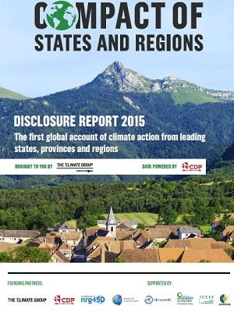
States & Regions Leadership
Paris COP-21 – Monday December 7, 2015
“Dream Team” for press briefing:
Governor Jerry Brown - California
First Minister Nicola Sturgeon - Scotland
Premier Jay Weatherill - South Australia
President Inigo Urkullu - Basque Country
Premier Philippe Couillard - Quebec
Compact of States and Regions Assessment Report is publicly released.
44 states and regions, together representing 325 million people and over $10.5 trillion GDP, revealed their emissions reduction targets
The result, in cumulative emission reductions will be 12.4 GtCO2e by 2030, and 47.5 by 2050, representing a collective reduction by almost 55% in absolute terms.
Celebration of 10 years of States & Regions Alliance
6

Slide 47
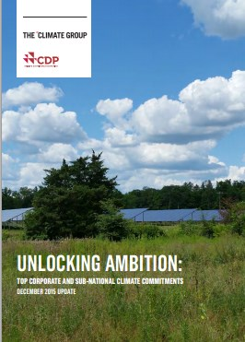
Paris COP-21 – Monday December 7, 2015
Unlocking ambition: Top corporate and sub-national climate commitments from CDP and The Climate Group identifies 200 companies, states, regions, and cities that have committed to full de-carbonization
Launch of 3rd and final series of reports tracking the ambitious climate commitments made by “non-state” actors (i.e. non-national governments)
87 companies have set goals to reduce their GHG emissions by 80-100%, or to procure 100% of their power from renewable sources, including Google (US), Infosys (India) and Broad Group (China), and
23 states and regions and 90 cities, including California and Basque Country, and Yokohama and Vancouver, have declared similar goals that will strategically position their communities and economies for low-carbon growth and prosperity.
8

Slide 48
Carbon Footprint Individual Actions
How much does each person contribute to the carbon burden (really heating burden) of the planet?
Calculate your own carbon footprint.
https://www3.epa.gov/carbon-footprint-calculator/

