Slide 1
Ecosystem Health
Biodiversity- Uganda as case study-PowerPoint No. 9

Slide 2
What is Biodiversity?
Biological diversity - or biodiversity
is the term given to the variety of life on Earth and the natural patterns it forms.
It is the result of billions of years of evolution, shaped by natural processes and, increasingly, by the human influence.

Slide 3
Formal Definitions
“‘Biological diversity’ means the variability among living organisms from all sources including, inter alia, terrestrial, marine and other aquatic ecosystems and the ecological complexes of which they are part; this includes diversity within species, between species and of ecosystems” (Convention on Biological Diversity, 1992, Article 2);
“Broad unifying concept, encompassing all forms, levels and combinations of natural variation, at all levels of biological organization “ (Gaston and Spicer 2004)

Slide 4
Whichever definition is used…
One can refer to the biodiversity of some given area or volume of:
the land or sea,
a continent or an ocean basin, or
the entire planet Earth
Likewise, one can speak of biodiversity at present, at a given time or period in the past or in the future, or over the entire history of life on earth.

Slide 5
3 Key Elements/Levels/Groups of Biodiversity (source Sodhi and Ehrlich 2010) /3 key levels of measuring

Slide 6
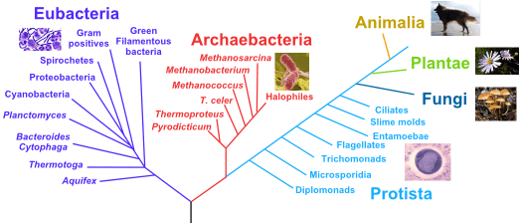
Kingdoms of life

Slide 7
The three key levels/elements/groups are intimately linked and share some elements in common
Genetic diversity
Encompasses the components of:
the genetic coding that structures organisms, and
variation in the genetic make-up between individuals within a population and between populations.
This is the raw material on which evolutionary processes act.
Populations with more genetic diversity tend to be:
larger
more stable than those that wildly fluctuate; and
at the center of species’ geographic ranges, rather than periphery

Slide 8
Species richness, evenness and diversity
Species richness:
number of different species represented in an ecological community, landscape or region.
does not take into account the abundances of the species or their relative abundance distributions.
Species evenness:
quantifies how equal the abundances of the species are.
Species diversity:
takes into account both species richness and species evenness.
is the effective number of different species that are represented in a collection of individuals (a dataset).
Notes:
The effective number of species refers to the number of equally abundant species needed to obtain the same mean proportional species abundance as that observed in the dataset of interest (where all species may not be equally abundant).
The observed species diversity is affected not only by the number of individuals but also by the heterogeneity of the sample. If individuals are drawn from different environmental conditions (or different habitats), the species diversity of the resulting set can be expected to be higher than if all individuals are drawn from a similar environment. Increasing the area sampled increases observed species diversity both because more individuals get included in the sample and because large areas are environmentally more heterogeneous than small areas.

Slide 9
Second Key Level/Element/Group: Organismal Diversity
Organismal diversity encompasses the full taxonomic hierarchy and its components, from individuals upwards to populations, sub-species and species, genera, families, phyla, and beyond to kingdoms and domains.
Measures of organismal diversity include some of the most familiar expressions of biodiversity, such as the numbers of species (i.e. species richness).

Slide 10
The measurement of species diversity
Species diversity is influenced by species richness. All else being equal, communities with more species are considered to be more diverse;
For example, a community containing 10 species would be more diverse than a community with 5 species.

Slide 11
Species diversity is also influenced by the relative abundance of individuals in the species found in a community.
‘Evenness’ measures the variation in the abundance of individuals per species within a community.
Communities with less variation in the relative abundance of species are considered to be more “even” than a community with more variation in relative abundance.

Slide 12
CASE STUDY: Conservation in Uganda
Out of a total surface area of 241,551sqkm (both land and water),
25,981.57sqkm (10%) is gazetted as wildlife conservation areas,
24% is gazetted as forest reserves and
13% is wetlands.
Total in directly or indirectly protected = 47%
Area outside = 53%

Slide 13
Uganda has:
10 National parks.
12 Wildlife reserves.
10 wildlife sanctuaries.
5 community wildlife areas.
506 central forest reserves.
191 local forest reserves.
Over 50% of Uganda’s wildlife resources are outside designated protected areas, mostly on privately owned land; and this is of most urgent concern for protection and development.

Slide 14
Species Diversity
Uganda is host to 53.9% of the World’s remaining population of mountain gorillas.
11% (1063 species) of the world’s recorded species of birds (50% of Africa’s bird species richness)
7.8% (345 species) of the Global Mammal Diversity (39% of Africa’s Mammal Richness)

Slide 15
19% (86 species) of Africa’s amphibian species richness
14% (142 species) of Africa’s reptile species richness
6.8% of the world butterfly species (1,249 species)
600 species of fish.

Slide 16
Biodiversity Conserved
Numbers of Ugandan species in those taxonomic groups for which at least preliminary data exist
Taxon | Total no. of species in Uganda | Global Total | % of global species |  | Globally-threatened species in Ugandaª |  |  |  | Albertine Rift endemics
 |  |  |  |  | CR | EN | VU | LR | Total | Uganda
Liverworts | 275 | 6,000 | 4.6
Mosses | 445 | 12,800 | 3.5
Ferns | 386<1 | 12,000n | 3.2
Flowering plants | 4500 | 422,000 | 1.1 |  | 4 | 15 | 22
Termites | 93 | 2,761 | 3.4
Dragonflies | 24<)11 | 5,373 | 4.6
Butterflies | 1,242 | 18,265 | 6.8 |  |  |  |  |  | 123 | 63
Molluscs | 257 | 40,000 | 0.6
Fish | 501 | 25,000 | 2.0
Amphibians | 86 | 4,950 | 1.7 |  |  |  | 14 | 28 | 32¹ | 111
Reptiles | 147-180 | 7,400 | 1.9 |  |  | 20 | 25 | 55 | 21¹ | 13¹
Birds | 1012 | 9,946 | 10.2 |  | 1 | 10 | 48 | 69 | 41^{u} | 36^{u}
Mammals | 345 | 4,630 | 7.5 |  | 1 | 4 | 5 | 75 | 29~v | 23~v
CR = Critical; EN = Endangered, VU = vulnerable, LR = lower risk.
NB: Most taxa have yet to be assessed

Slide 17
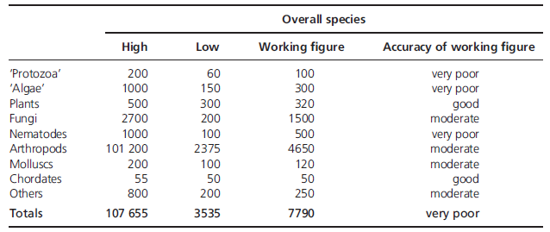
Highly probable that the majority of species are parasites; Few people think about biodiversity from this viewpoint
Estimates in 1000s of different taxonomic groups
(Source: Sodhi and Ehrlich 2010)
Notes:
Our knowledge of many micro-organisms is poor but increasing.
The Chordata is the animal phylum with which everyone is most intimately familiar, since it includes humans and other vertebrates. However, not all chordates are vertebrates. All chordates have the following features at some point in their life (in the case of humans and many other vertebrates, these features may only be present in the embryo):
pharyngeal slits - a series of openings that connect the inside of the throat to the outside of the "neck". These are often, but not always, used as gills.
dorsal nerve cord - a bundle of nerve fibers which runs down the "back". It connects the brain with the lateral muscles and other organs.
notochord - cartilaginous rod running underneath, and supporting, the nerve cord.
post-anal tail - an extension of the body past the anal opening.

Slide 18
The ‘population’ is a particularly important element of biodiversity
It provides an important link amongst the different groups of elements of biodiversity.
Population: A group of organisms of the same species (or other groups within which individuals may interbreed) occupying a particular space.
At the population scale, consider linkages between biodiversity and the provision of Ecosystem Services (e.g. think of insects, bats, birds, soil microbes, etc. in addition to commonly-held ideas of ecosystem services of wetlands, soils, rivers, and forests).
Notes:
Nature’s services alone insure basic needs and survival, but ultimately limit growth, and while some species or populations prosper, others can go extinct as environmental conditions change.

Slide 19
Third Key Element/Level/Group of Biodiversity: Ecological Diversity
Encompasses the scales of ecological differences from populations, through habitats, to ecosystems, ecoregions, provinces, and up to biomes and biogeographic realms.
Is most immediately apparent, given the structure of the natural and semi-natural world in which we live.
Understanding of ecological diversity is ambiguous:
Is a continua of phenomena: often no beginning/ending;
some of the elements of ecological diversity have both abiotic (soil, water, air, temperature, sunlight) and biotic components (e.g. ecosystems, ecoregions, biomes), and yet biodiversity is defined as the variety of LIFE.
Notes:
Abiotic: non-living chemical and physical parts of the environment that affect living organisms and the functioning of ecosystems
These include Soil, Water, Air, Temperature, Sunlight

Slide 20
Source: Ebonph.wordpress.com

Slide 21
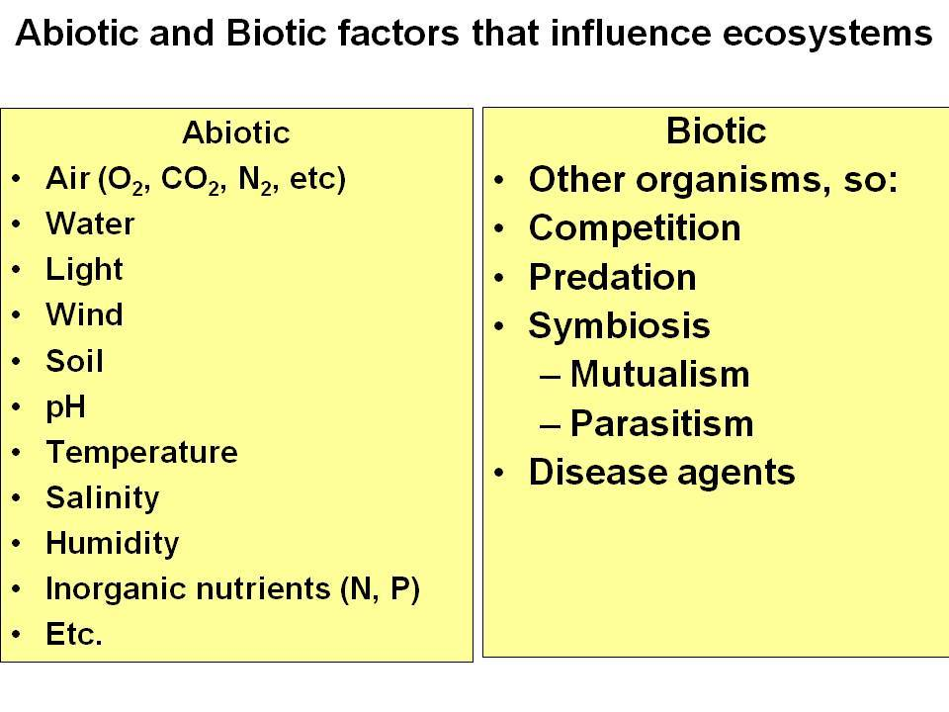
Source: www.successing.com

Slide 22
Scales of Ecological Diversity (Source: Sodhi and Ehrlich 2010)
Province: biogeographical zone characterized by 25-50% endemic flora or fauna (e.g. Cape Floristic Province, South Africa/Guieneo-Congolean zone/Afro montane zone).
Ecoregions are large areal units containing geographically distinct species assemblages and experiencing geographically distinct environmental conditions.
Species assemblage: describes the collection of species making up any co-occurring community of organisms in a given habitat or area (e.g. grazing mammals of grasslands).

Slide 23
Provinces and ecoregions can in turn be grouped into biomes, global-scale biogeographic regions distinguished by unique collections of species assemblages and ecosystems.
Ecosystem: a dynamic complex of plant, animal and micro-organism communities and their non-living environment interacting as a functional unit. An ecosystem may be large (forest, savannah) or small (pond).

Slide 24
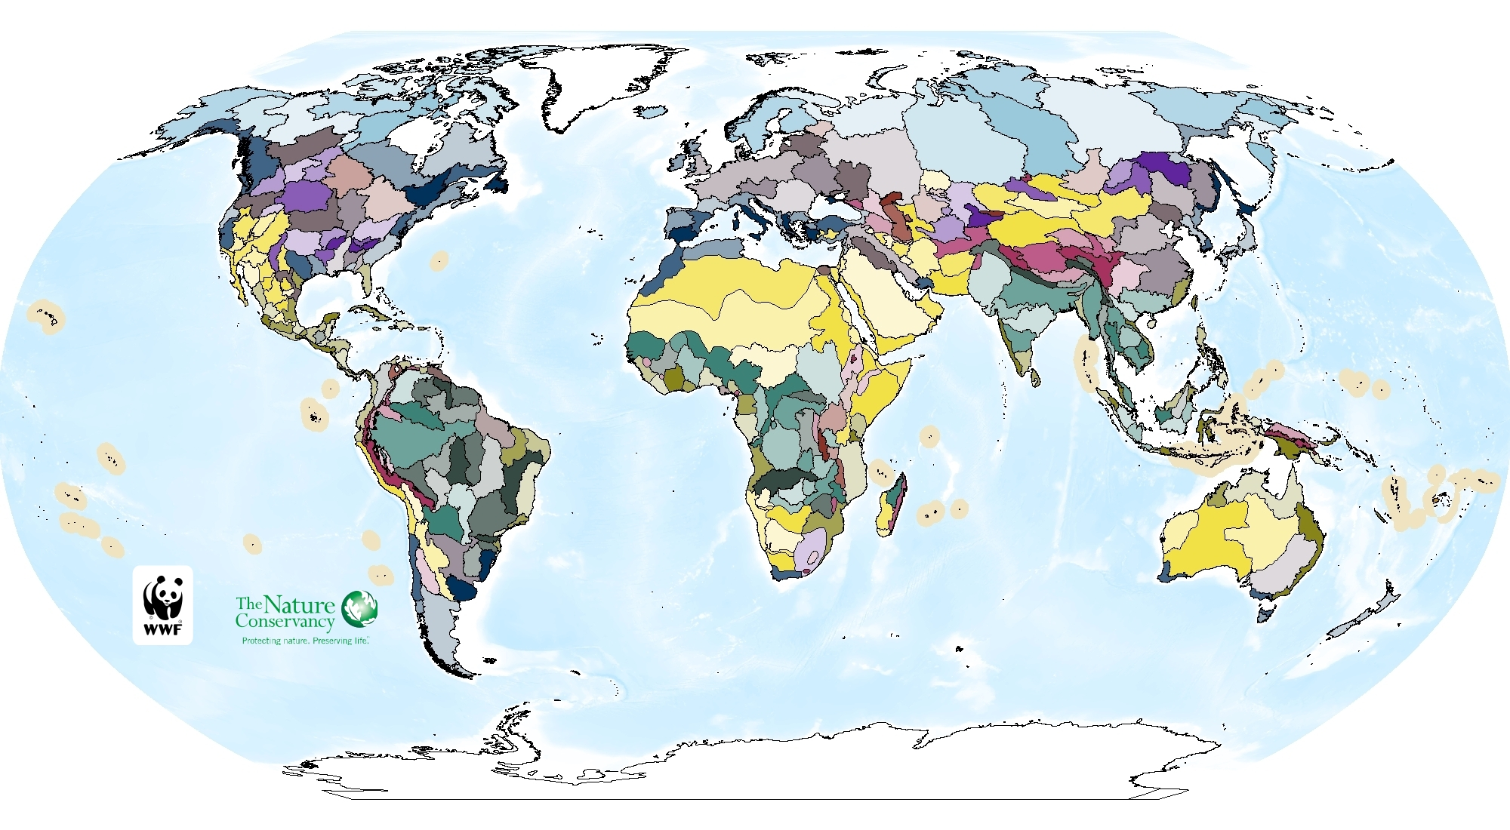
Ecoregion Example: Global Freshwater Ecoregions
Source: Abell et al. 2008
Notes:
With the exception of islands, individual freshwater ecoregions typically cover tens of thousands to hundreds of thousands of square kilometers. Ecoregion size varies in large part because of landscape history.
The map of freshwater ecoregions contains 426 units, covering nearly all non-marine parts of the globe, exclusive of Antarctica, Greenland, and some small islands. There is large variation in the area of individual ecoregions. Large ecoregions, such as the dry Sahel (4,539,429 km2), tend to be found in more depauperate desert and polar regions exhibiting low species turnover. Smaller ecoregions are typically found in non-continental settings where systems are by nature smaller and species turnover is higher, as in the Indo-Malay region

Slide 25
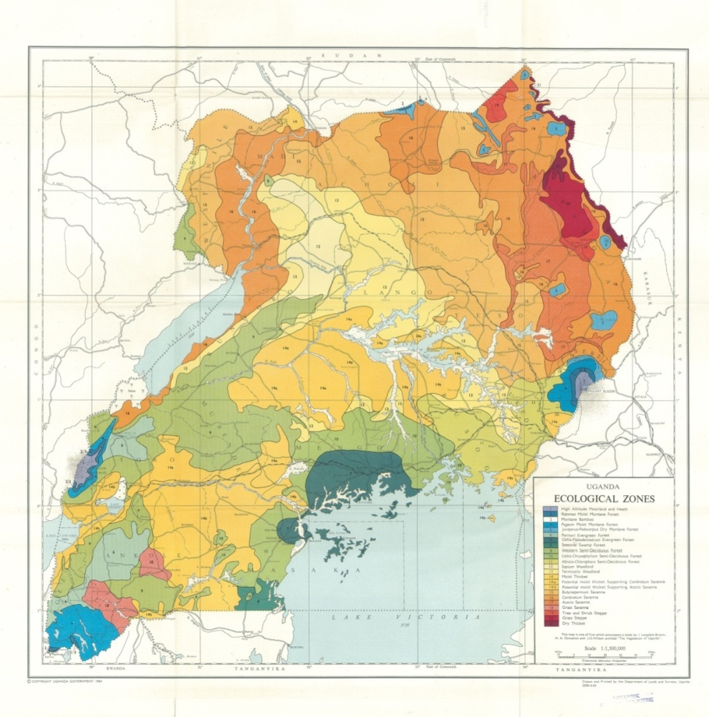
Ecological map of Uganda
Source: Langdale Brown

Slide 26
Ecological map of Uganda
Legend:
1 – High altitude moorland and heath
7 – Celtis-Peptidenistrum evergreen forest
20 – Grass steppe
21 – Dry thicket
There are 21-23 eco-regions based on vegetation according to Langdale Brown

Slide 27
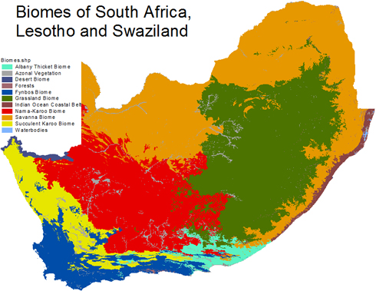
Vegetation Biomes of Africa (Source: www. bgis.sanbi.org)

Slide 28
Other components of Ecological Diversity
Catchment: an area with several, often interconnected water bodies (streams, rivers, lakes, swamps, marshes, groundwater. coastal waters). Management approaches differ according to focus and discipline (hydrology, forests, human use, integrated approach, etc.).
Community: groups of organisms of two or more different species living together within the same habitat or geographical area where they are likely to interact through trophic and spatial relationships (e.g. vegetation, birds).
Notes:
**Examples of ecological niches of species:
1) The niche of a plant species might consist of the type of soil on which it is found, the amount of sunlight and moisture it requires, the type of pollination system it has, and its mechanism of seed dispersal;
2) The niche of an animal might include the type of habitat it occupies, thermal tolerances, dietary requirements, home range or territory, and water requirements.

Slide 29
Habitat: A terrestrial, freshwater or marine geographical unit or an airway passage that supports assemblages of living organisms, individual organisms, and their interactions with the non-living environment (IFC PS6)
Ecological niche: An organism's niche is its unique position or adaptive role in the ecosystem (e.g. giraffe, baobab tree, crocodile, dung beetle).
A habitat denotes the physical place. The characteristics of a habitat can be used to help define the niche, but cannot describe it entirely.**
Carrying capacity of a biological species in an environment is the population size of the species that the environment can sustain indefinitely, given the food, habitat, water and other necessities available in the environment.

Slide 30
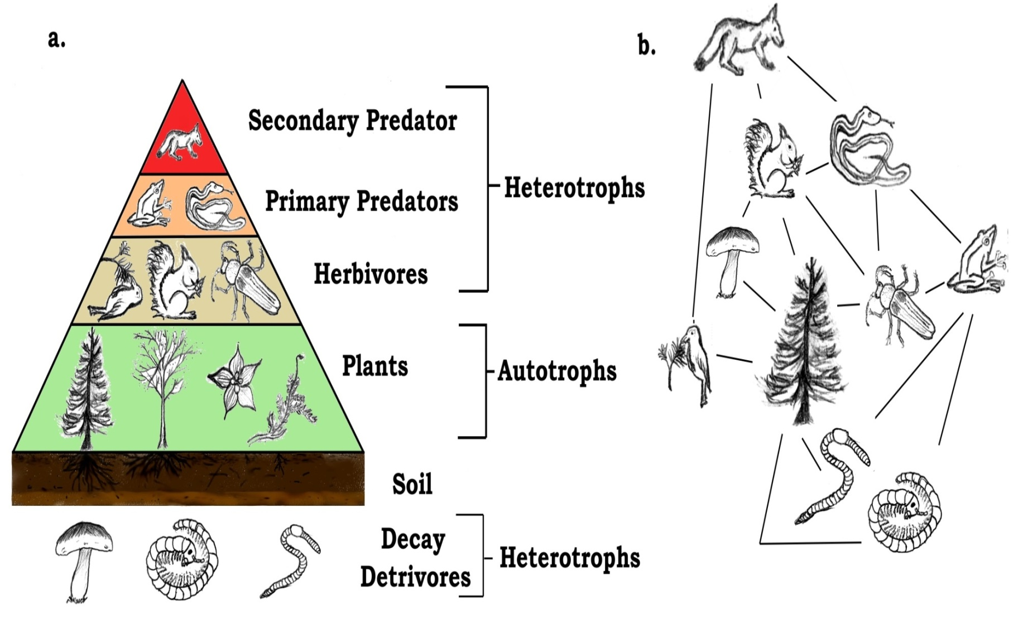
Pyramid Terrestrial Trophic Levels and Food Web
Notes:
Source: www.en.wikipedia.org.
Trophic level: Any class of organisms that occupy the same position in a food chain, as primary consumers, secondary consumers, and tertiary consumers.
Food webs largely define ecosystems, and the trophic levels define the position of organisms within the webs. But these trophic levels are not always simple integers, because organisms often feed at more than one trophic level. For example, some carnivores also eat plants, and some plants are carnivores.

Slide 31
Food web of soil ecosystem

Slide 32
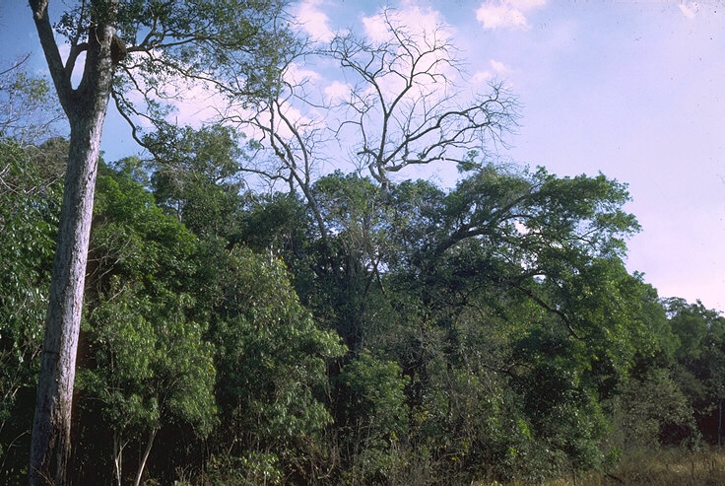
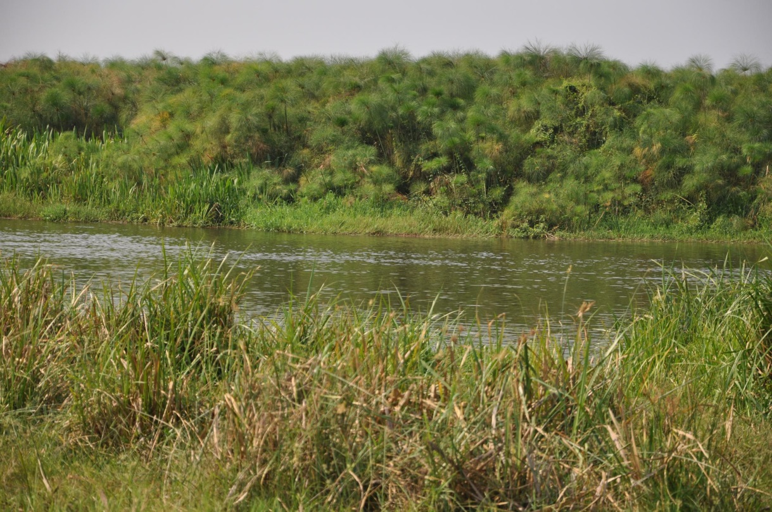
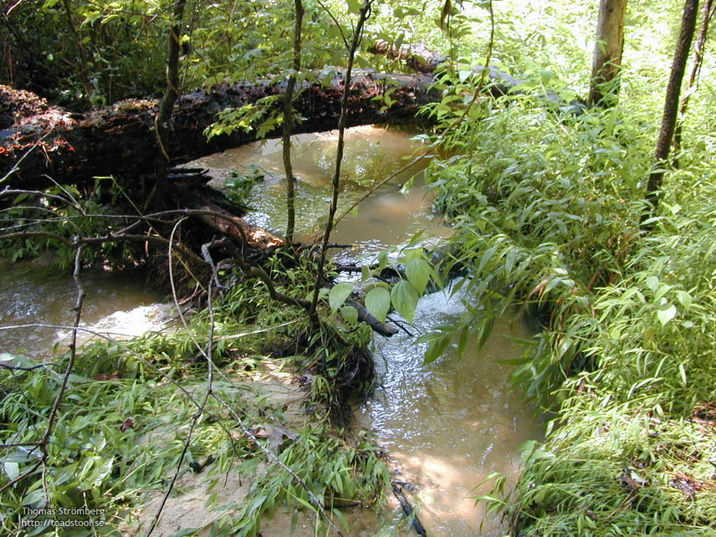
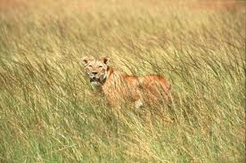
Examples of habitats
Notes:
Top left: Bush or shrub savannah; Top right: Forest/savannah edge; Lower left: stream and riparian habitat;
Lower right: Grassland savannah; Overlay: Riverine or riparian ecosystem comprised of seasonally inundated floodplain (foreground), river (middle) and papyrus swamp (background).
Altogether, this could be classed as an aquatic ecosystem of different components

Slide 33
Differing Definitions of Landscapes (Source: www.umass.edu/landscape)
Notes:
Landscape ecology explores the interaction of actual land use patterns and conservation theory and investigates patterns of habitat types on a regional scale and their influence on species distribution and ecosystem processes. Many species are not confined to a single habitat, rather, they move between habitats or live on borders where two habitats meet. For these species, the patterns of habitat types on a regional scale are of critical importance. The presence and density of many species may be affected by the size of habitat patches and their degree of linkage. Landscapes are defined according to the subject of interest, as illustrated in the following slides.

Slide 34
Landscape from a Wildlife Perspective (Source: www.umass.edu/landscape)
Notes:
For example, from a wildlife perspective, we might define landscape as an area of land containing a mosaic of habitat patches, often within which a particular "focal" or "target" habitat patch is embedded. Because habitat patches can only be defined relative to a particular organism's perception and scaling of the environment, landscape size would differ among organisms. However, landscapes generally occupy some spatial scale intermediate between an organism's normal home range and its regional distribution.

Slide 35
Other perspectives (Source: www.umass.edu/landscape)
Notes:
Each of these perspectives would require a different definition of a landscape.

Slide 36
The essential first step in any landscape-level research or management endeavor is to define the landscape

Slide 37
Landscapes vary in structure (patterns) and function (process) due to natural and anthropogenic factors
Notes:
(Source: www.umass.edu/landscape) Regardless of how landscape is defined, the “concept” of a landscape is unequivocal. All landscapes have a user-defined structure (pattern) that is hypothesized to influence its function (process). This interaction between spatial pattern and process defines the landscape concept.

Slide 38
CARPE Landscape Management Approach (Source: www.carpe.umd.edu)
Notes:
The CARPE program was first authorized by the U.S. Government in 1995 and was initially proposed as a 20-year regional initiative divided three strategic phases. The strategic objective of CARPE is to reduce the rate of forest degradation and loss of biodiversity in the Congo Basin by increasing local, national, and regional natural resource management capacity.
The majority of CARPE funds are allocated to support activities in designated landscapes. By implementing a landscape approach to natural resource management, CARPE works to assure that conservation activities are integrated into commercial forest exploitation activities, and address the unsustainable environmental practices of a myriad of local communities subsisting throughout the tropical forest landscapes.
The program began in four countries; the Central African Republic, Equatorial Guinea, Gabon, and the Republic of Congo. Since its beginning five additional countries have been added; Burundi, Cameroon, the Democratic Republic of the Congo, Rwanda, and Sao Tome & Principe.
CARPE currently works within 12 key biodiversity landscapes in seven countries. Several of CARPE's landscapes are transboundary and are recognized by international agreements promoting cooperation on environmental monitoring and law enforcement. These 12 landscapes form the pillar of CARPE's regional conservation strategy and cover an area of 680,300 km2.

Slide 39
Echuya Forest Landscape (Source: www.arcos.org) Albertine Rift Conservation Society & Nature Uganda
Notes:
Explain concept of Echuya Forest Landscape program. It forms part of the Greater Virungas Landscape, and is the object of a smaller scale project with two other landscapes, the Mukura Forest Landscape (Rwanda) and Kibira-Rusizi Landscape (Burundi), to promote and support collaborative actions at all levels, protect biodiversity and restore the ecosystems and their services, enhance communities’ sustainable livelihoods and empower stakeholders to take informed decisions and address environmental challenges.
Echuya forest is a montane rainforest located in Kabale and Kisoro Districts in south-western Uganda at altitudes ranging between 2,270 and 2,570m. The area under forest cover has been reduced from 13,320.3 ha in 1954 to 3,730.7 ha in 1990 and the current size consists of 34 km² of a mixture of closed canopy tropical broad leaved forest and bamboo forest.

Slide 40
Conservation Area Management Concept in Uganda (Source: Oluput et al. 2009)
Notes:
Murchison Falls Conservation Area is comprised of Murchison Falls National Park (3,893 km2), Karuma Wildlife Reserve (678 km2) in the east and south east, and Bugungu Wildlife Reserve (474 km2) in the southwest
Queen Elizabeth Conservation Area is comprised of Queen Elizabeth National Park (1,978 km2), Kyambura Wildife Reserve (154 km2), and Kigezi Wildlife Reserve (269 km2) and is 2,401 km2 in size

