Slide 1





Culture and Ethical Values in One Health and Infectious Disease Management Module
Introduction to one health
PowerPoint 1A

Slide 2

Goals of the Module
Understand the roles that culture plays in the management and control of diseases
Appreciate the values of cultural diversity
Develop culturally sensitive and appropriate tools useful during the management and control of infectious diseases using One Health approaches
Ensure protection of human subjects and animal welfare during One Health practice

Slide 3
INTRODUCTION TO CULTURE, VALUES AND BELIEF SYSTEMS

Slide 4
Objectives
To define culture, beliefs, values and ethics in the context of One Health
To map local cultural beliefs and practices related to human animal and environmental health
To examine/understand the complexity of cultural values, beliefs systems and practices that influence the management and control of infectious diseases

Slide 5
What is culture?
Culture is the customary behavior, beliefs, values and ideals that are passed on through the generations among members of a social group. Culture can be thought of as the total life way of a group encompassing its symbolic beliefs”
……that complex whole which includes knowledge, belief, art, law, morals, custom, and any other capabilities and habits acquired by man as a member of society.”
Edward Taylor,1871

Slide 6
What is “culture”
Dynamic, responsive coherent systems of beliefs, values, and lifestyles that have developed within particular geographic locations, using technology and economic resources; cultures evolve as needed to adapt to changing environmental conditions. Kagawa-Singer, M. and Kassim-Lakha, S. 2003. Academic Medicine 78:577-587.
…the capacity for constantly expanding the range and accuracy of one's perception of meanings.” John Dewey, 1916

Slide 7
What is culture….
“means the whole complex of traditional behavior which has been developed by the human race and is successively learned by each generation. A culture is less precise. It can mean the forms of traditional behavior which are characteristics of a given society, or of a group of societies, or of a certain race, or of a certain area, or of a certain period of time.”
Margaret Mead,1973

Slide 8
Common Characteristics
Universality
Uniqueness
Stability
Changeability
Unconsciousness
Variability
http://www.wilderdom.com/games/descriptions/HaveYouEver.html

Slide 9
Beliefs
Beliefs are interpretations or conclusions that people accept as true.
Based more on faith than fact and may or may not be true.
It embodies the myths, values, and ideologies of the group.
Are often invisible to those who hold them

Slide 10
Beliefs
shape practices, guide how people do things, and, in turn, determine what skills and capabilities people develop

Slide 11
Values
Values are the social principals, goals, and standards that cultural members believe have worth.
They define what the members care about most and are revealed by their priorities.
Values are what is desirable or “good”.
Values can be good or bad.
They are concerned with what it is good to desire.

Slide 12
Ethics
Ethics deal with the “rightness” or “wrongness” of human behavior and the level of consciousness of what is good and wrong behavioral conduct
Ethical Behavior - acting in ways consistent with one’s personal values and the commonly held values of the organization and society

Slide 13
Value system
A Value System is molded by one's or society’s virtues or vices. A person's or society’s standards and self-discipline set, based on the common sense and wisdom of knowing what the proper moral rules and discipline are, and the amount of willingness to see themselves and others abide by them.
Individuals in society abide by these values sometimes subconsciously

Slide 14
What is Gender?

Slide 15
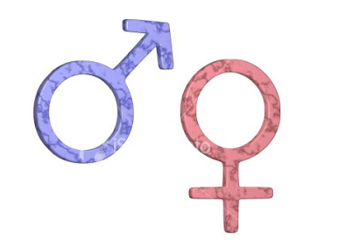

Sex and gender
Sex refers to the biological and physiological factors that define males and females.
Gender refers to the socially constructed roles, behaviors, activities, and attributes that a given society considers appropriate for males and females. Gender differences include both socio-cultural factors as well as male-female differences in access and control over resources
In many countries, gender influences access to economic resources and the lack of access to economic resources is sometimes a barrier to prompt and effective health care for women

Slide 16
Definitions
.
Gender differences include both socio-cultural factors as well as male-female differences in access and control over resources.
Skufca, J. and Arima, Y., Western Pacific Surveillance and Response Journal. Source: http://www.wpro.who.int/topics/gender_issues/Takingsexandgenderintoaccount.pdf

Slide 17
Examples of Biological Differences
Women become pregnant, men do not. Physiological changes in the immune system during pregnancy predispose to disease.
Examples of Gender Differences
It is common for more men to smoke compared to women. Smoking may affect vulnerability to respiratory disease or TB.
Daily activities of male or females in a society gives them different patterns of exposure to pathogens. (Fishermen and bilhaziasis?)
Gender influences access to Health facilities and funds
Skufca, J. and Arima, Y., Western Pacific Surveillance and Response Journal. Source: http://www.wpro.who.int/topics/gender_issues/Takingsexandgenderintoaccount.pdf

Slide 18
Common Gender stereotypes

Slide 19
Both Sex and Gender are important considerations during disease investigation
  Identify gender related practices that put either men or women at risk of getting an infectious disease
Sex and Gender within the different age groups is also important during disease investigation
  Biological changes are accompanied by changes in gender norms, roles responsibilities (which differ in each society)
Skufca, J. and Arima, Y., Western Pacific Surveillance and Response Journal. Source: http://www.wpro.who.int/topics/gender_issues/Takingsexandgenderintoaccount.pdf

Slide 20
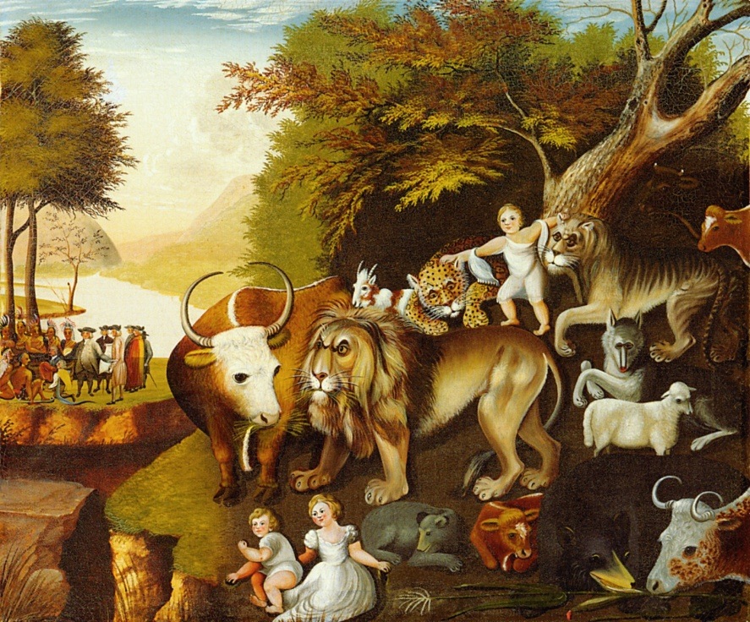

One Health :Why need an integrated approach?

Slide 21
Emerging infectious diseases
Jones, et al Global Trends in Emerging Infectious Diseases
  On the rise – 335 (1940-2004)
  60.3% are zoonotic
    71.8% from wildlife
Wolfe et al. Origins of Major Human Infectious Diseases
  New evidence on origins of human malaria

Slide 22
Emerging Diseases
Not just humans….
Avian Influenza H5N1
  475 humans : how many birds?
BSE & Chronic Wasting Disease
Tuberculosis in wildlife reservoirs
Chytridiomycosis in amphibians
Morbillivirus in marine mammals
White-Nose Syndrome in bats

Slide 23
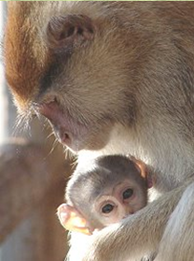
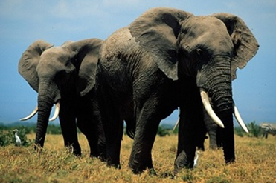
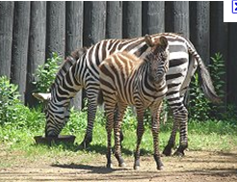
Shrinking habitats

Slide 24
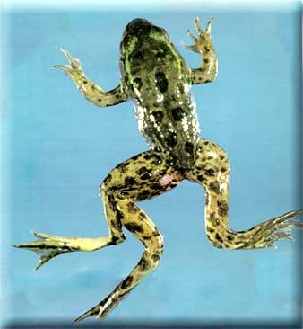
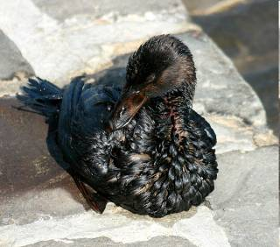
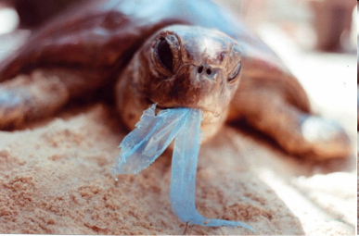
Pollution

Slide 25
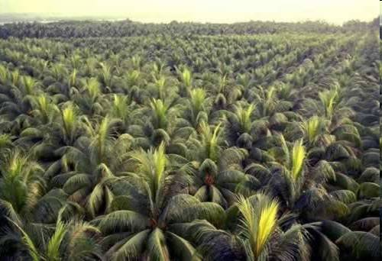
Loss of biodiversity

Slide 26
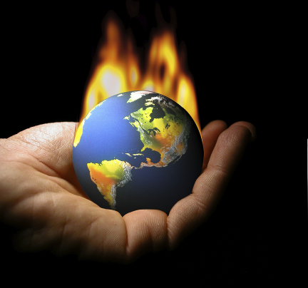
Climate change: changes in environment and Land use

Slide 27
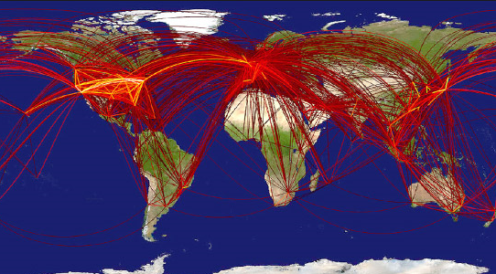

Globalization and travel

Slide 28
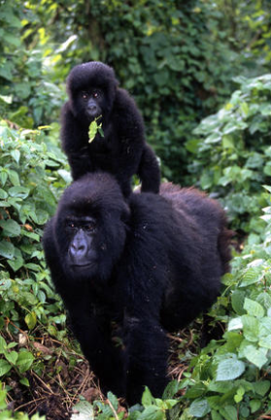
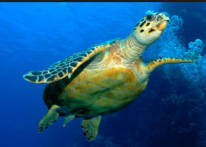
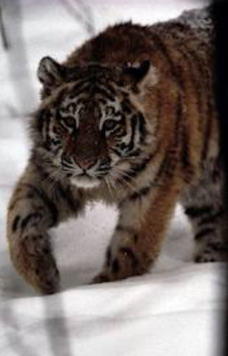

Global trade of wildlife

Slide 29
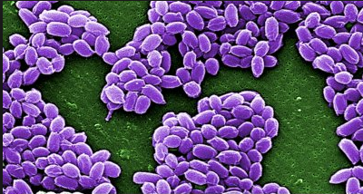
Bio-Terrorism as part of the threat

Slide 30
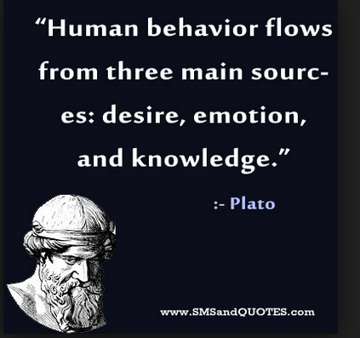
Human behavior
Sexually transmitted diseases
increased three fold when minimum
age for teenagers having sex dropped.
The development of complacent
attitudes and lack of basic knowledge
about risks have led to re-emergence of
Syphilis in the UK.
Sharing of blood contaminated
needles by drug users has led to
spread of hepatitis B and C.
Increased popularity of body piercings and tattoos provides an opportunity for the spread of blood borne viruses.

Slide 31
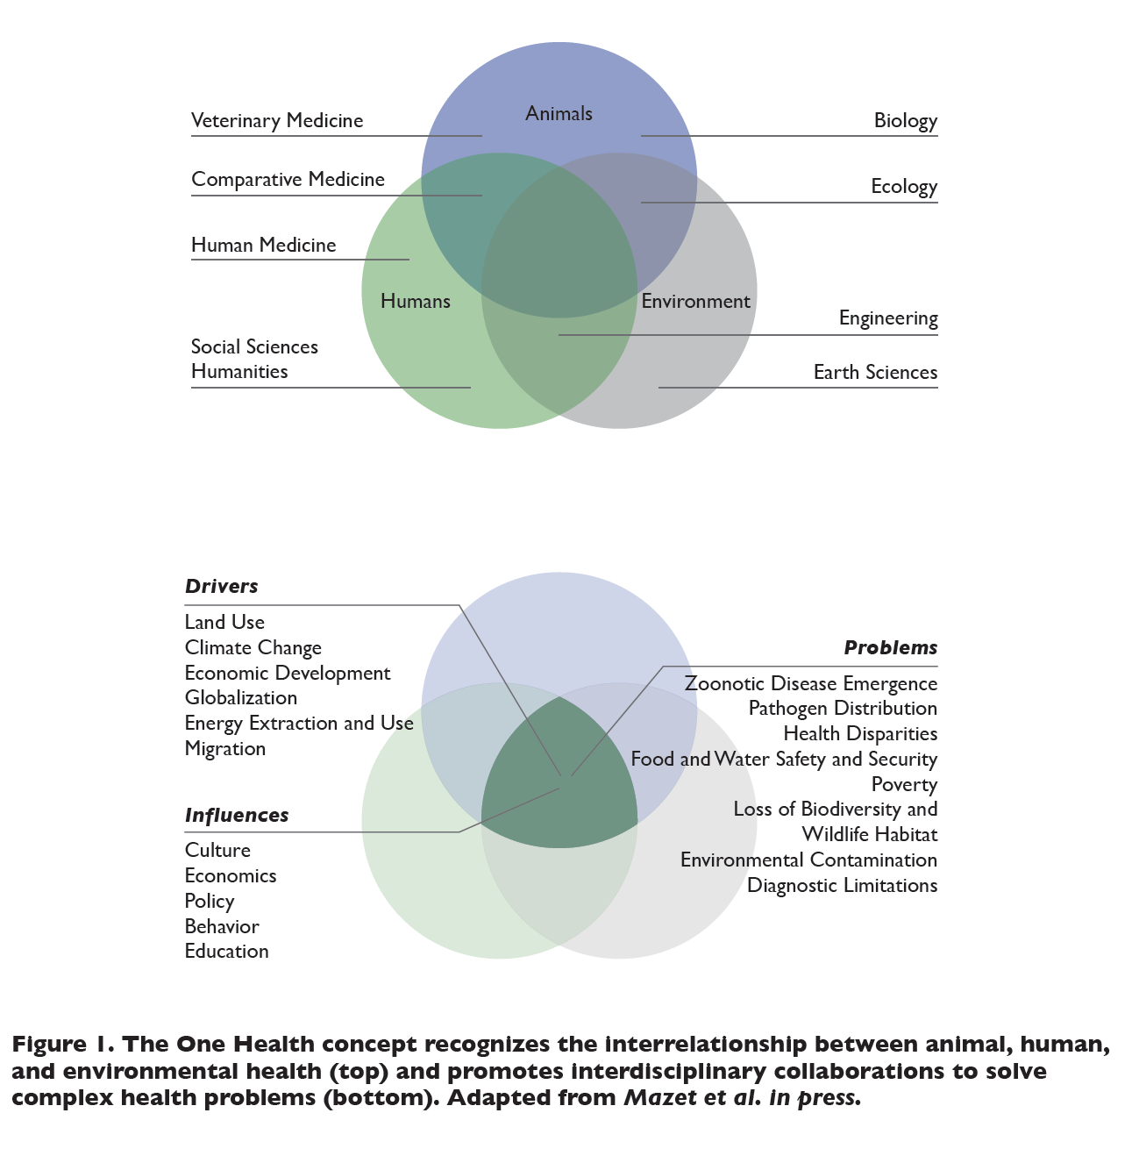

Slide 32


Why?
Prevent and Respond to disease outbreaks
Reduce risk of infectious diseases outbreak
Recognize and Identify zoonoses
ONE world: ONE health

Slide 33
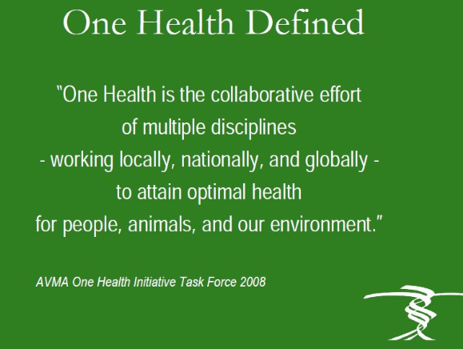

Slide 34

One Health
An interdisciplinary strategy to address health from an integrated perspective rather than a discipline-based fragmented perspective ….
Is not a discipline, it is an approach.

Slide 35
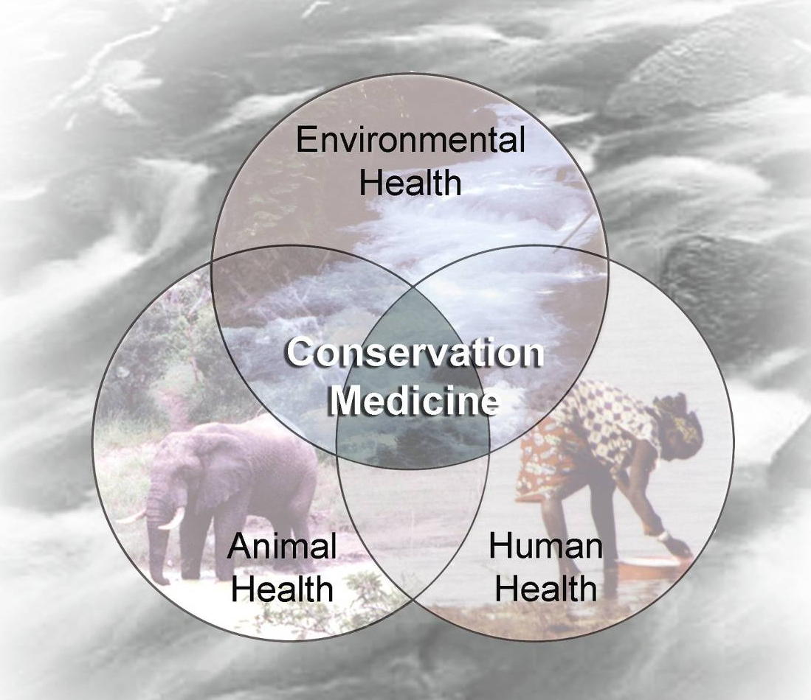
One Health

Slide 36
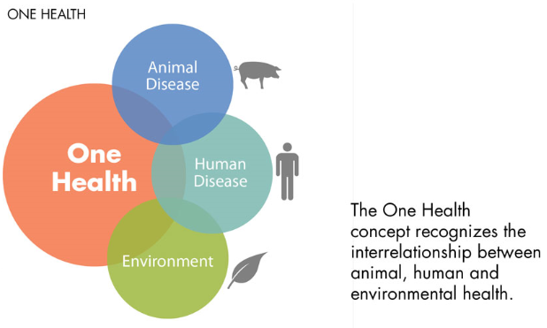


Slide 37
One Health
Human, livestock or wildlife health cannot be discussed in isolation anymore.
Public health depends on a clean environment: Hippocrates.
Objective of One Health approach is to create stronger, more efficient, integrated health systems with input from multiple stakeholders in addressing global health issues

Slide 38
Scope of One Health
Combating existing and emerging diseases and zoonosis, biomedical research and clinical medicine, conservation medicine, diagnosis, surveillance, control, response and recovery directed at natural and or intentional threats that are chemical, toxicological or radiological in nature, ethics, entomology food safety and security, global food and water systems, global trade and commerce, health of the environment and environmental conservation, implications of climate change, infectious disease ecology and integrated systems for disease detection, land use production systems and practice, mental and occupational health, public health , awareness and communication, support of biodiversity, wildlife promotion and conservation

Slide 39
Principles of One Health
Use of holistic systems approach in the management of health challenges
- Multidisciplinary and/or inter-sectoral collaboration
- Sharing of resources: technical, information, structural, human, etc.
- Promotion of transparent communication and sharing of information between stakeholders
- Cooperation between the public and private sectors
- Unified and cooperative capacity building within the health sector.

Slide 40


Major challenges
Transform systems and professions to respond more efficiently and sustainably to disease prevention and control requirements?
Work with industries currently active in locations where animal-human-environment interface is a daily reality
Enable disciplines to work together

Slide 41

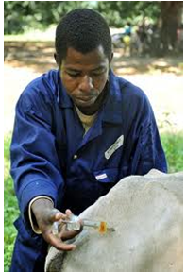
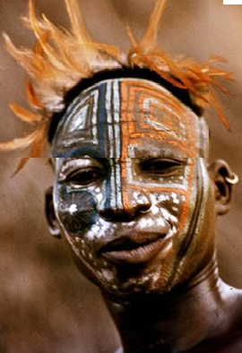
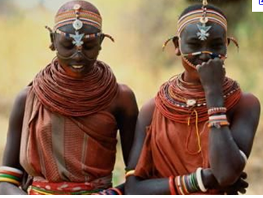

Barriers
History
Professional biases
Policies
Jurisdiction
Resources
Culture
Inertia
- Organizational
- Surveillance skills

Slide 42
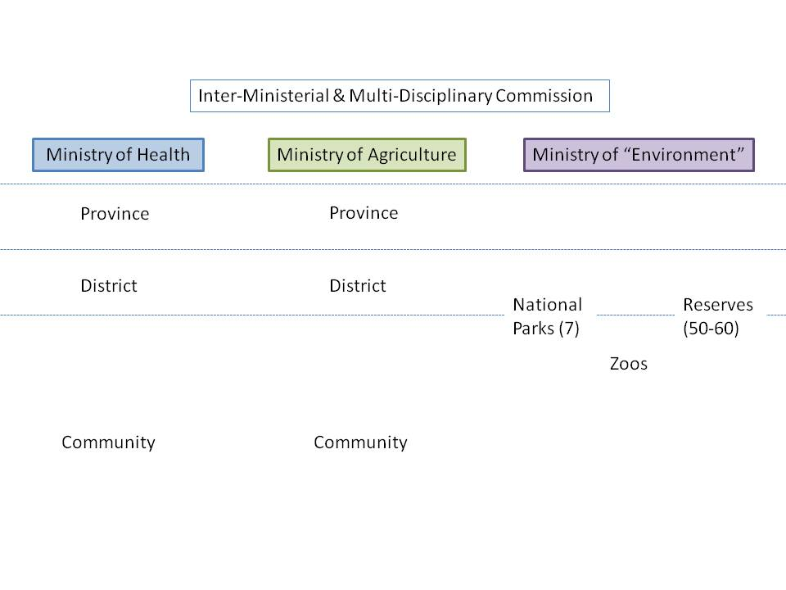
Thanks to H5N1
Management silos
One way flow of information
Limited feedback
Limited lateral flow
Notes:
“environment”

Slide 43
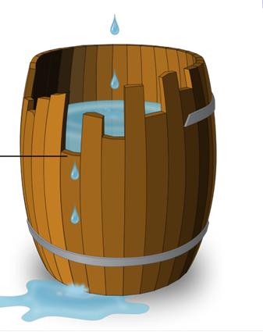
Unequal human resource capacity …
… lack of front line responders from all health professions

Slide 44
Leveling interdisciplinary understanding
Understanding limitations of own discipline
Developing a common language
Identifying gaps in past approaches to the problem

Slide 45

Each One Health professional is well-trained for their roles, mandated and appropriately equipped
Professions have improved skills to work collaboratively with each other
Health systems benefit from One Health efficiencies

