Slide 1
One Health and Wicked Problems PowerPoint No. 10
-

Slide 2
DISCLAIMER!
Practice is not what you do when you are better, it is what you do to become better

Slide 3
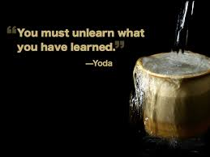

Slide 4
What is “health”?
Notes:
Ask the question
Call on THREE people to provide definitions, repeat the key words they use in their definition
After you get three people’s comments, move to the next slide

Slide 5
What is “health”?
Health is a state of complete physical, mental and social well-being and not merely the absence of disease or infirmity.
WHO 1946
Notes:
This is the definition agreed when the World Health Organization was created just after World War II.
Look how broad a definition of “HEALTH” they described!

Slide 6
“Complete physical, mental and social well-being”….
Includes the following interdependent systems:
Individual health
Population (community) health
Ecosystem health
Societal health
Economic health

Slide 7
The Four Cornerstone Competencies for One Health
Self awareness
Visionary & strategic
Teamworking & teambuilding
Communication
Change Management
Developing competencies using K.A.S.H
Appreciate that behavioural change requires a structured long term approach to development
Understand how to use the K.A.S.H model can be used to support this development of competencies

Slide 8
The “One Health” approach is based on systems thinking

Slide 9
What is Systems Thinking?
Holistic approach bringing together multiple perspectives.
An issue is best understood in the context of its relationships within the larger reality (as part of a process).

Slide 10
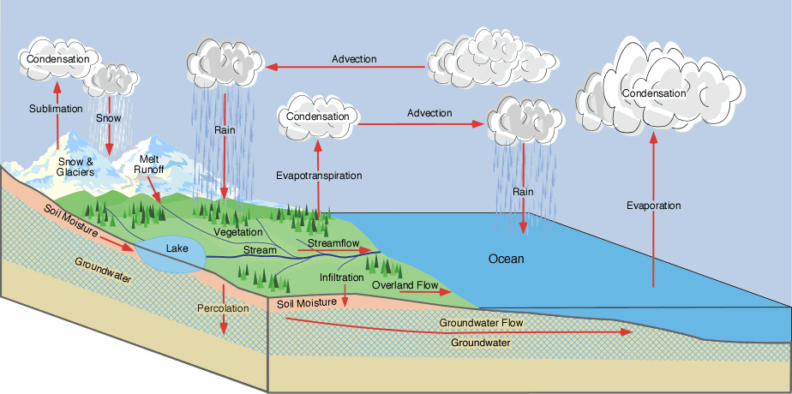
Notes:
Denotes complex nature of climate change: there is no single solution to the issue

Slide 11
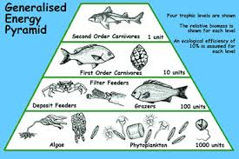

Slide 12
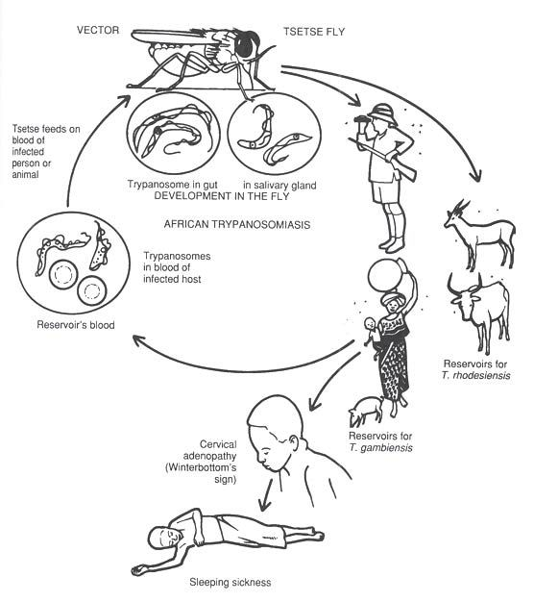

Slide 13
Why can’t we ‘solve’ the health problems at the human, animal, ecosystems interfaces?
They are compelling issues
Public and political support exists
Lots of good science available

Slide 14
Why can’t we ‘solve’ the health problems at the human, animal, ecosystems because they are….
Wicked

Slide 15
Why can’t we ‘solve’ the health problems at the human, animal, ecosystems because they are….
NOTE:
Wicked is the opposite of “tame”; it doesn’t mean “evil”!
Wicked

Slide 16
Characteristics of Wicked Problems
Too complex to fully understand
No simple technical “solution”
Actions precipitate unanticipated and unintended consequences
Compelling and demand action
Require innovative approaches
Notes:
An example that would suffice would be the issue of GM foods, where the action of genetically modifying food to solve the issue of food insecurity brings up the issue of the associated side effects of the same to human health

Slide 17
Wicked problems require dynamic approaches
Systems thinking
One Health approaches
Trans-disciplinary teams
Collective action

Slide 18
Trans-disciplinary Teams?
Discipline
a branch of knowledge, instruction, or learning
Multi-disciplinary
Involving or of several disciplines
Additive not integrative
Inter-disciplinary
Synthesis of two or more disciplines establishing integration of knowledge

Slide 19
Trans-disciplinary
Using a shared conceptual framework to go across, beyond and over disciplinary boundaries.

Slide 20
“One Health” approach…
Health involves many aspects:
Nutrition, livelihoods, infectious disease…
And many other factors affect health
Political stability, natural and built environment, economic climate…
One Health considers all of these together

Slide 21
Emerging Infectious
Diseases
Translocation
Human encroachment
Ex situ contact
Ecological manipulation
Encroachment
Introduction
“Spill over” &
“Spill back”
Wildlife EID
Domestic
Animal EID
Human
EID
Global travel
Urbanization
Biomedical
manipulation
Agricultural
Intensification
Technology and
Industry
Dasazak P. et.al.
Science 2000 287:443

Slide 22
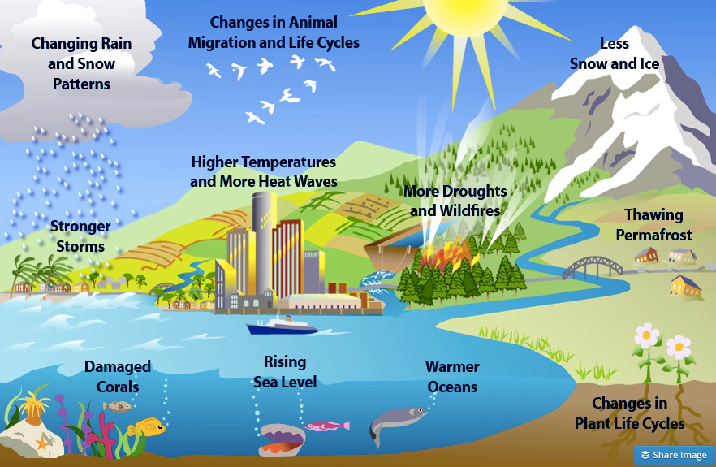

Slide 23
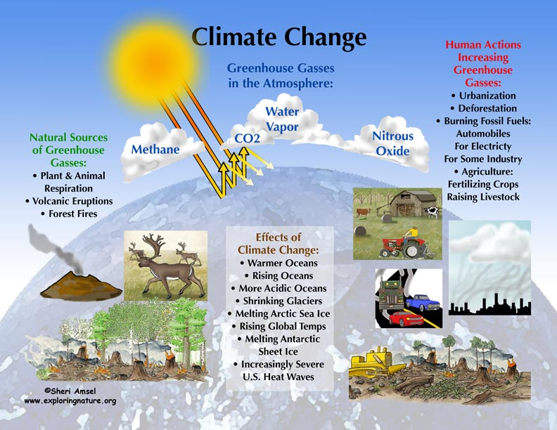

Slide 24
Headline -
Kenya
8 Dec 2009
A One Health
Wicked Problem

Slide 25
Consequences if El Nino doesn’t arrive
A One Health
Wicked Problem

Slide 26
Lost wealth,
Reduced electricity,
Increased illness…..
A One Health
Wicked Problem

Slide 27
Putting Health in Context
Health is an outcome shaped by a wide range of social, economic, natural, built, and political environments that form a complex and ever-changing dynamic. Because of this broad perspective, public health teams themselves also need to reflect this reality.
Slide prepared by Lonnie King

Slide 28
Word association…

Slide 29
Lead

Slide 30
LEADER
“If your actions inspire others to dream more, learn more, do more, you are a leader” – John Quincy Adams

Slide 31
Leadership
The ability to catalyze collective action
“It takes a village”
A shared responsibility…

Slide 32
Why do complex problems demand ‘shared leadership’?
Because no “one” is in charge!
Who is in charge of food security or emerging infectious disease?
Leadership is a shared responsibility that requires resources and initiative from many perspectives, disciplines and sectors.

Slide 33
The “One Health” Approach

Slide 34
Why “One Health” now?
Traditional disciplinary approach not working well enough…
Increasing public impatience with lack of progress toward complete physical, mental and social well-being.
One Health catalyzes creativity and innovation by working across disciplines, sectors and cultures.

Slide 35
Why is “One Health approach” so difficult?
Training increasingly specialized
Narrow and deep
Disciplinary ‘silos’ and paradigm paralysis
Thinking constrained by education and discipline
Lack of rewards for thinking differently
Focuses on individual rather than team
Discomfort
Lack the skills to lead One Health approaches
One Health is different!

Slide 36
Small Group Activity… to practice the One Health team approach
Get into small groups of 5-6
Share your homework assignment
Choose one real life in-country scenario.
Identify one problem within the scenario that needs to be addressed.
Reframe it as a challenge opportunity.
Create a trans-disciplinary team and an action plan.

Slide 37
Report outs in large group
Debrief…

