Slide 1

A CHALLENGE MODEL: A STRATEGIC PLANNING TOOL
POWERPOINT No.11
Notes:
*

Slide 2
Objectives
Helps to understand the importance of a shared vision and have the ability to think strategically for developing a plan to reach that vision.
To understand the concept and importance of a shared vision and the practicality of developing a step-by-step strategy for moving towards that vision.

Slide 3
Challenge Model
Systematic approach
Focus on one challenge
Shared vision
Priority actions for implementation
Working together to achieve results

Slide 4
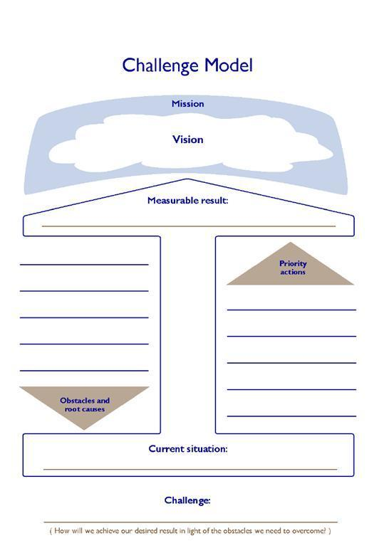

Slide 5
Steps in Using A Challenge Model
Review mission and priorities
Agree on measurable result
Assess current situation
Identify obstacles and root causes
Define key challenge
Select priority actions
Create shared vision
Develop action plan
Implement, monitor and evaluate progress
Disease mergence
Prevent transmission and prevent emergence
Manage diseases and infections in humans

Slide 6

Mission and strategic priorities
Form common understanding of your mission and strategic priorities
Will help shape your vision
Ensure vision contributes to larger priorities
MSDN Blogs

Slide 7
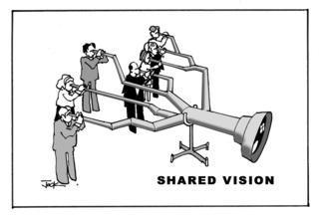
Create a shared vision of future
Contributes to accomplishing your mission and priorities.
Will inspire the team to face each new challenge.

Slide 8

Measurable result
Pick an aspect of your shared vision and create one measurable result
Achievable in a short time
Drives your work (focus)
Allows you to monitor and evaluate progress
http://www.fotosearch.com/clip-art/result.html

Slide 9
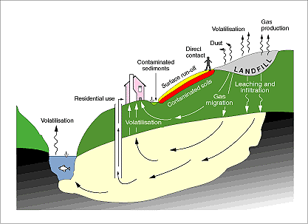
Assess the current situation
Scan internal and external environments to form accurate baseline of current situation
http://www.eea.europa.eu/publications/GH-07-97-595-EN-C2/chapter7h.html
Notes:
Scan your internal and external environments to form an accurate baseline situation in relation to your stated result(e.g. mass animal deaths due to poisoning)
*

Slide 10


Identify obstacles and root causes
List obstacles that you will have to overcome to reach your stated result.
Use root cause analysis tools to analyze the underlying causes of these obstacles.
Notes:
Use root cause analysis tools to analyze the underlying causes of these obstacles to make sure you are addressing the causes and not just the symptoms.
*

Slide 11
Key challenge & priority actions
State what you plan to achieve in light of the root causes of the obstacles identified.
Begin challenge statement with “How will we…?
Select priority actions that you will implement to address the root causes.

Slide 12
Develop an action plan
Estimate the human, material, and financial resources needed and define its timeline

Slide 13
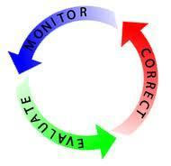
Implement, monitor and evaluate
Support your team:
Implement the plan
Monitor and evaluate progress

Slide 14
Thank you

