Slide 1
Change Management
For One Health Leadership
PowerPoint No. 12

Slide 2
Change management process and people factors

Slide 3
Simple principles to achieve change
Change management entails thoughtful planning and sensitive implementation.
At all times involve and consent support from people within system.
Understand where you/the organization is at the moment.

Slide 4
Principles to achieve change
Understand where you want to be, when, why, and what measures will be put in place to get you there.
Plan and develop achievable measurable targets.
Communicate, involve, enable and facilitate involvement from people, as early and openly and as fully as is possible.

Slide 5
Some rules for effective management of change
Consultation with and involvement of the people affected by the changes.
If you force change on people, normally problems arise.

Slide 6
Change must be realistic, achievable and measurable.
These aspects are especially relevant to managing personal change. Before starting organizational change, ask yourself:
What do we want to achieve with this change (END RESULTS)

Slide 7
Factors to consider in change management
Why and how will we know that the change has been achieved?
Who is affected by this change, and how will they react to it?
How much of this change can we achieve ourselves, and what parts of the change do we need help with?

Slide 8
What is Change Management? Change management is the processes, tools and techniques for managing the people-side of change. Change management is a method for reducing and managing resistance to change when implementing change.

Slide 9
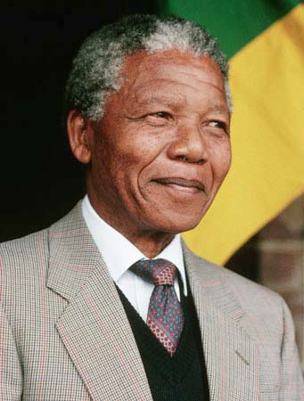
Change Impacts us All!
Jobs
Relationships
Locations
Perspectives
Goals

Slide 10
Change affects all
Every organization is affected by change.
Still, organizational change initiatives fail at an alarming rate.
This is because most initiatives fail to consider how changes affect the people in an organization.

Slide 11
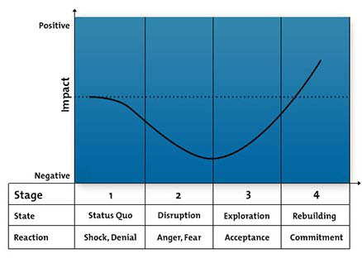
Change Curve: Accelerating Change, and Increasing its Likelihood of Success

Slide 12
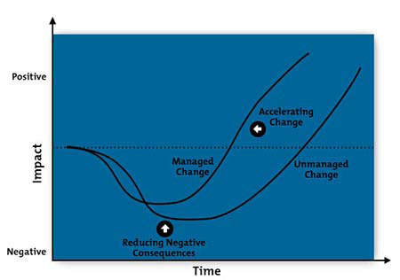
USE Change Curve: To minimize the negative impact of change
AIM: To make a curve shallower and narrower

Slide 13
Why Change Fails? (John Kotter)
A. THE WRONG CLIMATE: Fails to help people see
B.NO INVOLVEMENT OR ENGAGEMENT : Fails to help people do
Step 1: No sense of urgency
Step 2: No strong Guiding Team
Step 4: Under-communicating the vision
Step 3: Lack of Vision
Step 5: Not removing obstacles to the new vision
Step 6: Not systematically planning for and creating Short Term Wins
C. NOT BUILDING SUSTAINABILITY: Fails to get results because no sustained change in actions & behaviour
Step 7: Declaring victory too soon
Step 8: Not anchoring changes in the new culture

Slide 14
Making Change Work: ABC
C
The Heart of Change: J. Kotter & co
B
Implementing &
sustaining change
A
Engaging and
enabling others
Creating a climate
for change
8
7
6
5
4
3
2
1
Establish
necessity
Build a
Guiding
Team
Get the
Vision
Right
Communicate for
buy in
Enable
Action
Create Short
Term
Wins
Don’t Let
Up
Make it
Stick

Slide 15
Making Change Work
Increase importance - inspire people to move, make objectives real and relevant.
Build the guiding team - get the right people in place with the right emotional commitment, and the right mix of skills and levels.
Get the vision right - get the team to establish a simple vision and strategy, focus on emotional and creative aspects necessary to drive service and efficiency.

Slide 16
Making Change Work
Communicate for buy-in - Involve as many people as possible, communicate the essentials, simply, and to appeal and respond to people's needs. De-clutter communications - make technology work for you rather than against.
Empower action - Remove obstacles, enable constructive feedback and lots of support from leaders - reward and recognise progress and achievements.

Slide 17
Making Change Work
Create short-term wins - Set aims that are easy to achieve - in bite-size chunks. Manageable numbers of initiatives. Finish current stages before starting new ones.
Don't let up - Foster and encourage determination and persistence - ongoing change - encourage ongoing progress reporting - highlight achieved and future milestones.

Slide 18
Making Change Work
Make change stick - Reinforce the value of successful change via recruitment, promotion, new change leaders.
Weave change into culture.

Slide 19
Step 6: Create Short Term Wins
Short term wins that are timely, visible and meaningful to people you need to influence. They address anxieties, fears and concerns and build the credibility to sustain change over time.

Slide 20
Criteria for determination of “Quick Wins”
Action and time specific, value adding with clear accountability for delivery
Easy to do in a relatively short timeframe (within 3 months)
Relevant and important to the people you want to influence
Limited available resources required
Performance easily measured and achievable

Slide 21
Exercise: What “Short term wins”
In Pairs discuss - listen / dialogue with a partner on what you think are the “quick wins” “low hanging fruit” that will be most important to address in your One Health country plan in the next three months. Remember to consider the people you want to influence, and what they will consider is important.
In your country group, prioritise the top two to be addressed in either of the two categories of “quick wins” & “low hanging fruit”.

Slide 22
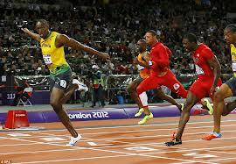
Short term wins payoff matrix
Why bother? | Big Wins
Low hanging fruit | Quick Wins
Tough
Ease
of
Implementation
Easy
Small
Payoff
Big

Slide 23
Short Term Win Checklist
Are they timely meaningful and visible to all?
Are they clearly specified in your plans?
Have you planned who you will communicate these to and how?

Slide 24
Plan for Quick Wins: 4 Steps Engage Heart & Mind
Plan for visible improvements in the short term in performance that will convince people you need to influence that your plan will work
Engage & enable others to achieve these wins
Communicate the wins visibly and convincingly and celebrate success
Embed the learning into the plan going forward

Slide 25
People Involvement Options
Address the “human side” systematically
Start at the top
Involve every layer
Make the formal case
Create ownership
Communicate the message
Assess the cultural landscape
Address culture clearly
Prepare for the unexpected
Speak to the individual

Slide 26
Change Leadership Characteristics & Supporting Behaviors
Leadership Characteristics
Getting honest input from others
Active listener
…..
…..
Supporting Behaviors
Not violating another's trust
Physically attending to what others are saying
…..
…..

Slide 27
Quote - Change
You can't cross a sea by merely staring into the water."
------------ Rabindranath Tagore

