Slide 1

Conflict Management in One Health Leadership
PowerPoint No. 13

Slide 2
Objectives
Understand the different modes of conflict handling.
Become more aware of your own conflict management style.
Recognize the conflict modes of others.
Assess conflict situations.

Slide 3
What is conflict?

Slide 4
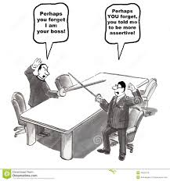
Conflict?
Any situation where your concerns or desires differ from another person’s.
Notes:
WARM UP EX
Ideal holiday irrespective of money
Share in 3s
Different opinions..background experience / conflict inevitable…OHP

Slide 5
When is conflict useful?
Negative emotions tell us that issues are important and need attention.
Surfaces issues.
All high performing teams have some conflicts. i.e. about 3:1 ratio of positive to negative.

Slide 6
A
s
s
e
r
t
i
v
e
n
e
s
s
Two basic aspects of all
conflict handling modes
Cooperativeness
Skill
Situation
Your Conflict
Mode
=
+
Notes:
5 Modes
Differ on 2 basic scales
Assertiveness: the degree to which a person attempts to satisfy their own concerns
Co-op: degree to which they attempt to satisfy concerns of others
WE all use the 5 but tend to rely on 1 or 2 above the others.
The effectiveness will depend on skill and the sit. Often if I is either over used or under used there can be more negative outcomes. Usually habit developed over period of time.
To-day about consciously raising your awareness on this and giving you more Choice about being effective….Like all skills will take practice.

Slide 7
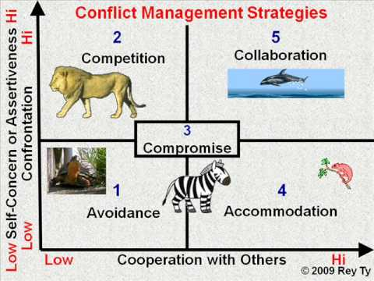
The Five Conflict Handling Modes
+
A
s
s
e
r
t
i
v
e
n
e
s
s
Competing
Collaborating
Compromising
Avoiding
Accommodating
-
Cooperativeness
+
-
Notes:
5 Minutes
Competing: goal is to win
Avoiding : goal is to delay
Compromising: goal is to get middle ground
Accommdating: goal is to yield
Collaborating : goal is to find win/ win solution

Slide 8
Exercise 1
Listen to the description of each style
AND LATER YOU WILL BE REQUIRED TO:
Consider how frequently you use that style i.e. 100% to 10% of the time?

Slide 9

Competing
“My way or the highway”
A
s
s
e
r
t
i
v
e
n
e
s
s
Quick Action
Unpopular Decisions
Vital Issues
Protection
Cooperativeness
Notes:
Competing : assert your opinion and don’t consider others
May be standing up for your rights or throwing your weight around.
APPROPRIATE USES:
Quick Action: no time / emergency
Unpop: no choice e.g. salary freeze
Vital issues: know a client does not want you to use their name but boss is insisting
Protection: assert you opinion with a highly competeitive group because it is the only way to be heard

Slide 10
Accomodating
“It would be my pleasure”
A
s
s
e
r
t
i
v
e
n
e
s
s
Showing reasonableness
Developing performance
Creating good will
Keeping “peace”
Retreating
Low importance
Cooperativeness
Notes:
Totally forgoing your concerns
Situations:
When you realise you are wrong..
Coaching mode allowing others to experiment and lose from their mistakes
Giving fosters good will with payoff when another issue is more important to you.
Can be helpful to preserve harmony e.g. idfdept going through significant change
If losing ground and further conflict may harm e.g. pick your battles
Allow them to have if more important to them.

Slide 11
Avoiding
“I’ll think about it tomorrow”
A
s
s
e
r
t
i
v
e
n
e
s
s
Issues of low importance
Reducing tensions
Buying time
Low power / control
Allowing others
Symptomatic problems
Cooperativeness
Notes:
Stalling or ignoring.
Trivial leave it alone
If tension is high the danger of engaing in conflice outweighs the benefits
Want to gather info.
If no power may be wise
Someone else is more appropriate
Focus on root rather than symptoms

Slide 12
Compromising
“Let’s make a deal”
A
s
s
e
r
t
i
v
e
n
e
s
s
Moderate importance
Equal power – strong
commitment
Temporary solutions
Time constraints
Backup
Cooperativeness
Notes:
Finding a middle ground, forgoing some of your concerns…moderate asset / collab “split the difference”
2. Each sides goals are mutually exclusive and neither has ultimate power.
5. Back up: If competing or collaborating fail useful to move to thia as a back up.

Slide 13
Collaborating
“Two heads are
better than one”
Integrating Solutions
Learning
Merging Perspectives
Gaining Commitment
Improving Relationships
A
s
s
e
r
t
i
v
e
n
e
s
s
Cooperativeness
Notes:
Concerned with fully satisfying both sides of an issue High C and A
Some appropriate uses:
Both sides are important or interdependent: your patner needs a lift to airport and you have an appointment at the same time
You learn / test ideas e.g. work with colleague in another department
Innovation
People support what they create
Build rapport / trust

Slide 14
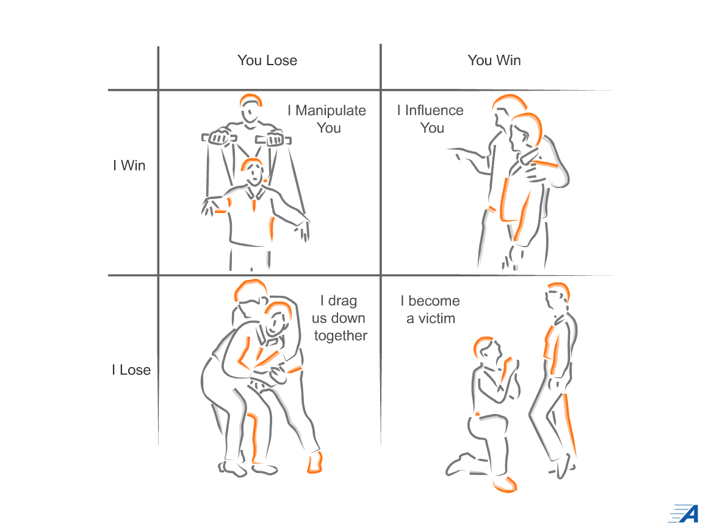
4 Paradigms of Human Interaction
You influence
me

Slide 15
Exercise 1
Discuss in pairs
What are the benefits / disadvantages of the styles you use most / least? (2 minutes)
When might it have been helpful to use another style? (1 minute)
When might it be important in the future, in your current role to apply this learning? (4 minutes)

Slide 16
Managing conflict constructively: the behaviours
Surfaces unacknowledged differences in perspectives on work issues that may be preventing achievement of goals
Tolerates hostility
Demonstrates an openness to others’ views
Manages anger in themselves and others effectively
Chooses an effective conflict management style to resolve the conflict
Demonstrates an ability to manage crucial conversations effectively and achieve “win-win” outcomes

Slide 17
Crucial Conversations
Change happens one conversation at a time
“The path to organisational change is personal change”
Conversations that;
    Surface assumptions
    Clarify responsibilities
    Identify and remove barriers
    Provide meaningful and honest feedback on actions
    Create possibility
“We can only change one conversation at a time”

Slide 18
Elephants in the Room
Are you aware of important conversations in your head?
In other people’s heads?
How long does it take for those crucial conversations to get out into the open?
Ignoring the Elephant in the Room only makes it bigger

Slide 19
Crucial Conversations
1.Common Purpose
“What is important to me … and you”
2. Current reality vs pretence
“You know the way we say ... in reality we ...
3. Impact of pretence
“When we do that this happens ..”

Slide 20
Crucial Conversations
4. Cost... to me personally”
5. Creating Future Possibilities
“What I want to happen is…” “ How do you think we could change this?
6. Commitment to change: what you will do and what you would like them to do
“ I want to commit to …could you…?”...CREATING POSSIBILITIES.

Slide 21
Thank you

