Slide 1
Behavior change
Introduction to Behavior Change
PowerPoint 1B

Slide 2
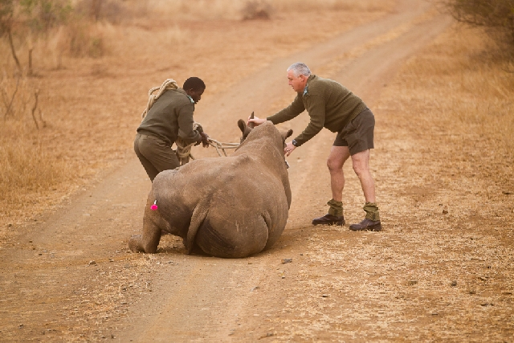
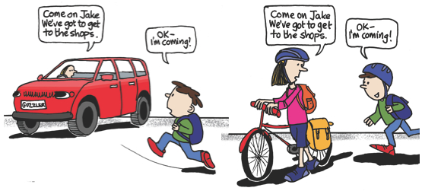
What is Behavior?
Notes:
Psychologists define behavior as a function of the interaction between the person and the environment.
All the behaviors shown here can only take place in a particular environment.
You can only wash your hands if you have access to clean water
You can only poach or protect rhinoceroses in an area that supports rhinoceri
And you can only ride a bike if there is a bicycle available to you and, if you’re a child, it is allowed by your parents

Slide 3
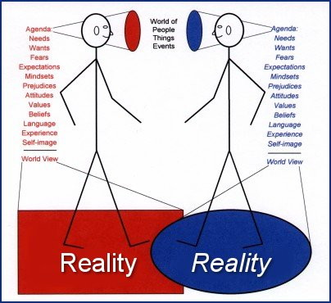
What influences behavior?
Notes:
As you know…
What we do depends to a large extent on how we perceive and interpret the world around us.
Different people can see the same situation differently, and their behavior will vary accordingly.
--→ add photos of looking through diff colored glasses? Or seeing something in the day and night
3

Slide 4
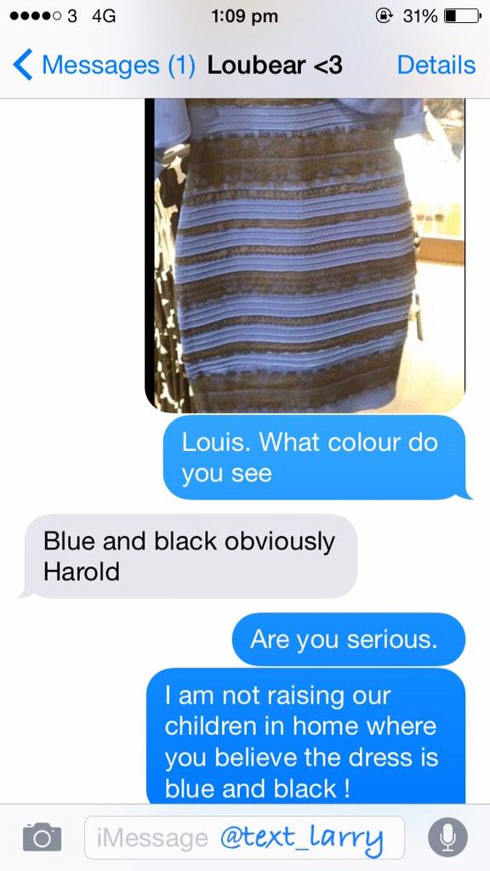
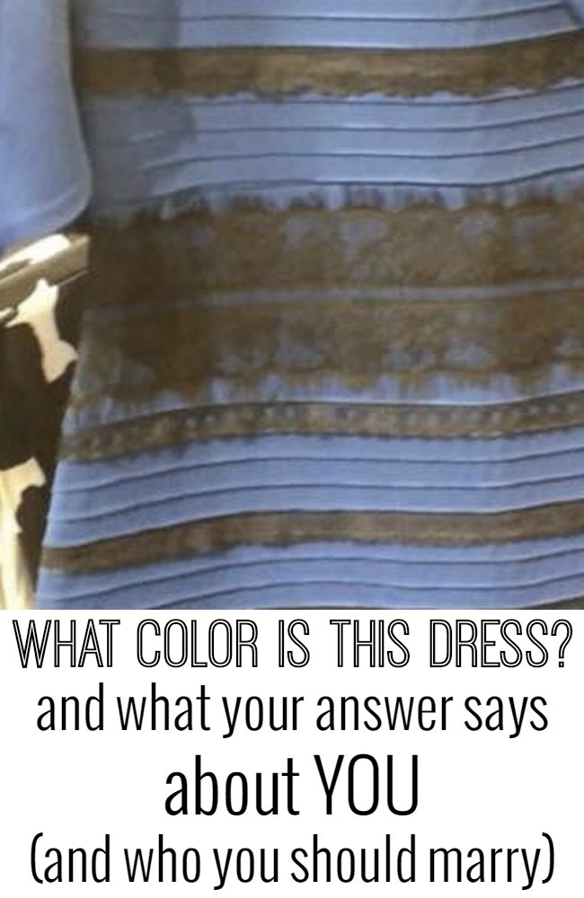
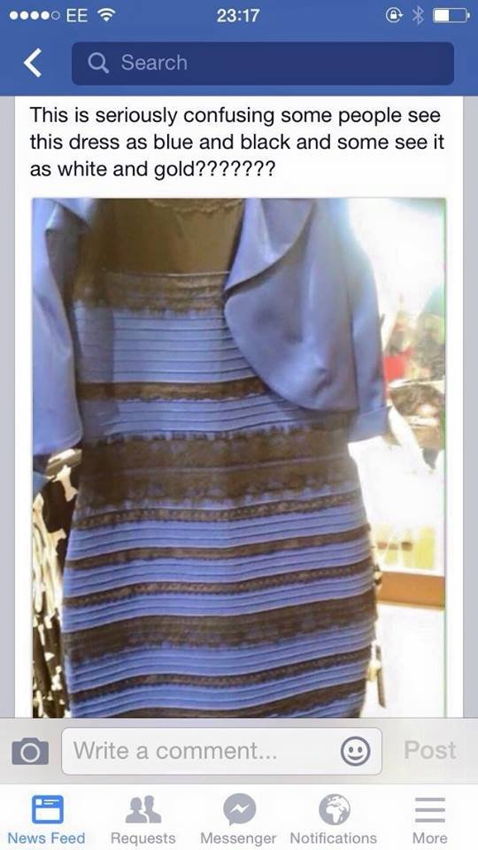
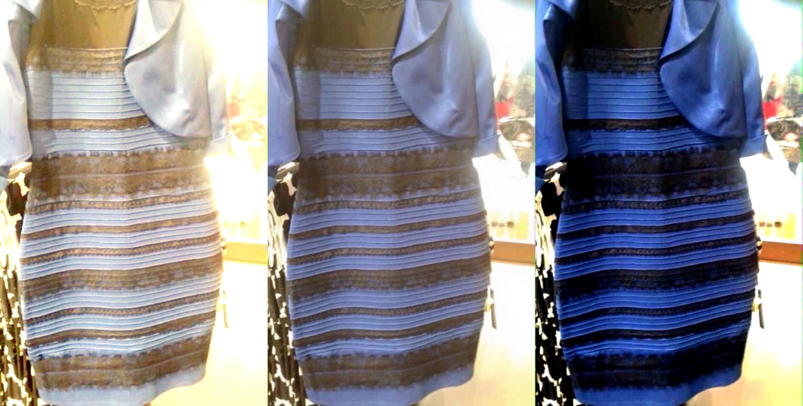
Notes:
When people see the same things in a different way they will interpret it according to their personal values, attitudes and beliefs.
This can have real consequences

Slide 5
Many factors influence behavior
I believe…
I value…
I like/dislike…
Notes:
Lots of factors that influence our behaviors. The thing that complicates this is that we’re all affected differently by these factors, as things like risk perception, emotions, attitudes, and norms vary from person to person, from culture to culture, and so on.
CLICK Our Beliefs, values, and attitudes are more likely predictors of behavior than knowledge, as I’ll explain more about later
Beliefs – something you’re convinced is true (may be based on fact, faith, or hearsay, ex: I believe in climate change because 97% of scientists say it’s happening)
Values – guiding principles (ex: I value a healthy environment)
Attitudes – +/-/0 feelings based on beliefs and values (I dislike Hummers because they use a lot of fuel; this attitude meshes well with my belief in climate change and value of a healthy Earth)

Slide 6
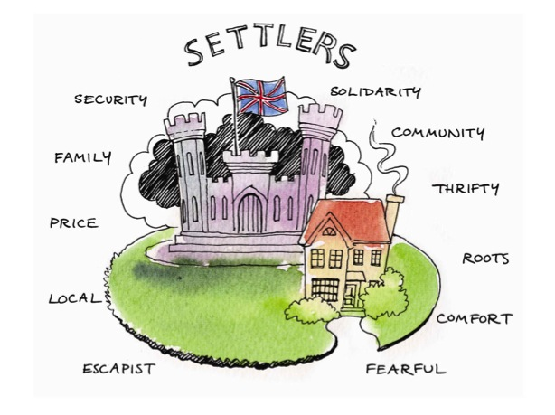
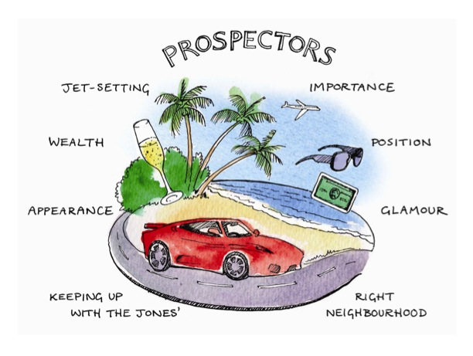
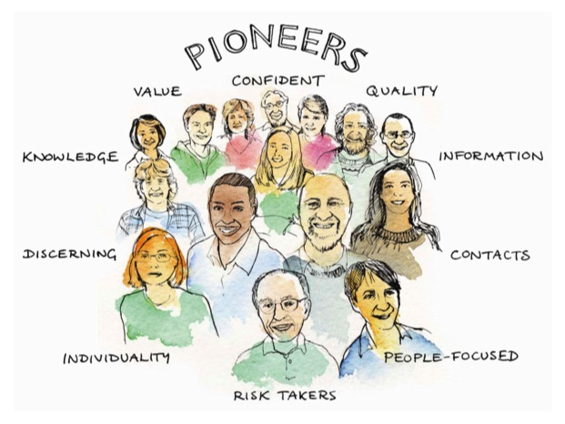
Value modes
Settlers
Prospectors
Pioneers
Attitude towards environmental issues
“it’s not a problem unless it immediately affects my family, my local area, my identity, my traditions”
“it’s not my problem unless it affects my prospects for achievement and success”
“it’s a problem”
Notes:
Over a quarter of a century of quantitative research has shown that the determining factor in why a person does what they do is a person's Values.
They are tied directly into our emotions, not our rational faculties. They are what so frequently make us choose something or perform an action before we have really thought about the consequences
Cultural Dynamics Strategy & Marketing, a UK-based company, studied the Values, Beliefs and Motivations of (primarily) the population of the United Kingdom and determined that people can be divided into groups called value modes, which fall into 3 broad categories.
It is relevant for people interested in studying behavior because a person’s value mode will affect what they perceive as barriers and benefits. The 3 categories are:
Settlers (sustenance driven, focused on meeting own needs/those in innermost circle)
Tend to look backwards, to yesterday (which was better) and dislike anything new or different. Aim to establish a sense of identity, belonging, and security.
Prospectors (driven by what others think and on upward mobility)
Live in the now, for today, and seek rewards in terms of status, fashion, and achievement. They don’t like to be told they are doing anything wrong, or that they ought to give anything up.
Pioneers (driven by intrinsic values and making the world a better place)
Look forward, both in time and to new horizons: like change, discovery, and the unknown so long as it is ethically acceptable. They have already met their need for belonging and status.

Slide 7
Notes:
Different barriers/benefits seen for different value modes –
Settlers might feel it’s unsafe and risky to ride a bike in downtown Boston, but safe to take the Train
Prospectors might think it’s uncool to ride a bike, but cool to carpool with friends
Pioneers might feel that carpooling won’t make the world a better place, but like the idea of riding a bike because it doesn’t cause any pollution

Slide 8
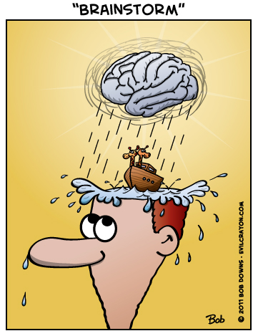
Exercise
With your group, brainstorm and write down a message that will appeal to each value mode.
Notes:
With your group brainstorm and write down a message that will appeal to each value mode

Slide 9
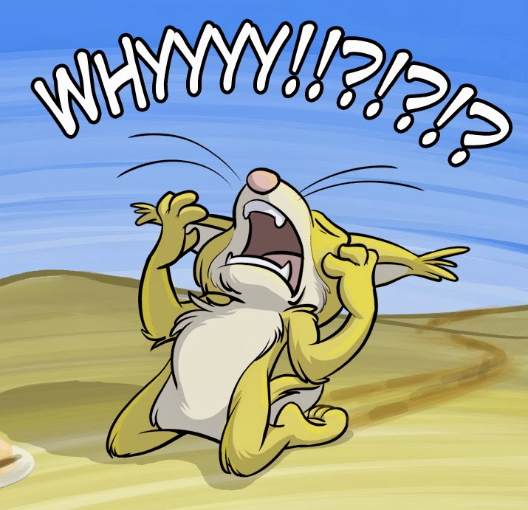
Why did you do that?!
Internal motives (personal values)
External motives (rewards, punishments)
Interactionist perspective (both)
Notes:
So we know that a person’s beliefs, values and attitudes play a large role in determining which behaviors they will choose in a given situation. Now, we’re going to talk about some other things that impact behavior.
Not only internal motives (intrinsic values)
External motives (rewards and punishments)
Interactionist perspective: An emphasis on how both an individual’s personality and environmental characteristics influence behavior.

