Slide 1
Behavior change
Theories of Behavior Change
PowerPoint 2

Slide 2
Lecture One
Concepts and Theories of
Behavioral Change

Slide 3
Lecture Outline
Behavior Change Theories
Why Theories and Models in One Health?
Application of Theories in Behavior Change
PRECEDE-PROCEED (Green and Kreuter)
Social-Ecological Model for Evaluation of Spheres of Influence
Behavior Concepts at Individual Level
Behavior Concepts at Community Level
Using Theory to Plan Multilevel Interventions

Slide 4
Behavior Change Theories
A theory is a set of concepts, definitions, and propositions used for systematic view of events or situations
Theories allow explanation of events or situations
Different theories work in different situations but combinations of theories are often most effective
The most prevalent theories exist for behavior change
Learning theories
Social Cognitive Theory
Theories of Reasoned Action and Planned Behaviour
Trans-theoretical Model
Health Action Process Approach

Slide 5
Why Theories and Models in One Health?
Builds clarity in understanding targeted health behavior and environmental context.
Directs program planning - why, what and how?
Directs evaluation as integral part
Explanatory Theory = Theory of the Problem (Health Belief Model, the Theory of Planned Behavior, Precaution Adoption Process Model)
Change Theory = Theory of Action (Ex: Community Organization, Diffusion of Innovations)

Slide 6
Application of Theories in Behavior Change

Slide 7
PRECEDE-PROCEED (Green and Kreuter)

Slide 8
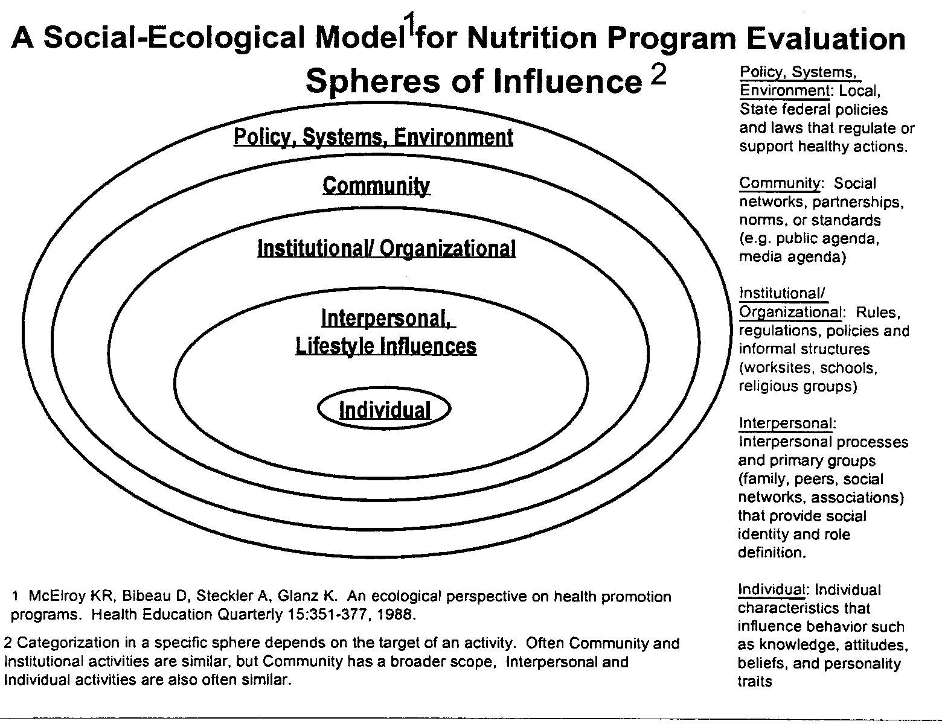

Slide 9
Behavior Concepts at Individual AND Intrapersonal Level
1) Behavior is mediated by cognitions; that is, what people know and think affects how they act.
2) Knowledge is necessary for, but not sufficient to produce, most behavior changes.
3) Perceptions, motivations, skills, and the social environment are key influences on behavior.

