Slide 1
CULTURAL DIMENSIONS, UNDERSTANDING DIVERSITY AND MODELS

Slide 2
Learning objectives
To explain cultural responsiveness, understand diversity and models
To examine and uncover diversity across cultures
Analyze local cultures, belief and practices about diseases among human and animal health workers, traditional healers and environmentalists

Slide 3
Cultural Adaptation
Cultural adaptation involves all that process and time a person takes to integrate into a new culture and attain that level of comfort within that particular culture.
The person integrating in a society for the purpose of an intervention needs to strike between the stranger and Native values.
The person encounters various emotions at four different stages such as the honey moon, cultural shock, recovery and adjustment.

Slide 4
Cultural Diffusion & Cultural Assimilation
Cultural diffusion is how beliefs and social activities of one culture are passed to different ethnicities, religions and nationalities and other societal groups.
Cultural assimilation; is the process by which different cultural groups become more and more alike.
When full assimilation is complete, there is no distinguishable difference between the formerly different groups.

Slide 5
Cultural Uniformity and Diversity
Cultural uniformity: is the observed and revealed behaviours of the community
Cultural Diversity: is the form and process of appreciating individuals and societies. It is indeed the antithesis of cultural uniformity

Slide 6
CASE STUDY 1
EBOLA IN WEST AFRICA

Slide 7
CASE STUDY: Ebola in West Africa, 2014 /2015
Identify factors responsible
What factors were related to culture, values beliefs and ethical codes of conduct
What does this mean for One Health and infectious disease management and control?
Make reflections on your own cultures related to the above
Summarize your findings

Slide 8
Ethnocentrism
The belief that one’s cultural, ethnic, or professional group is superior to that of others
Positive ethnocentrism
Negative ethnocentrism

Slide 9
Stereotyping
Exaggerated beliefs and images that are popularly depicted in the mass media, folklore, and general conversation

Slide 10
Cultural Diversity
Myth of the “melting pot” is being displaced with a sense of identity among various ethnic groups

Slide 11
Cultural Environment
Understanding culture helps in understanding yourself and get along with others.
Culture can help you see what all people have in common. It can help you recognize the variety of ways in which people solve the same basic problems.
Finally, your culture gives you a sense of identity as you take your place in a multicultural world.

Slide 12
Cultural Identity
Ethnicity
Race
Country of origin
Language
Gender
Age
Marital status
Religious/ spiritual beliefs
SES
Education
Other identified groups
Sexual orientation
Migration history
Level of acculturation

Slide 13
Three models for understanding culture
Iceberg model of culture – Edward T. Hall
6-D model – Geert Hofstede
Seven cultural dimensions – Fons Trompenaars et al
Notes:
See Detailed Facilitator Notes in the facilitator guide for a complete description of each of the four models.

Slide 14
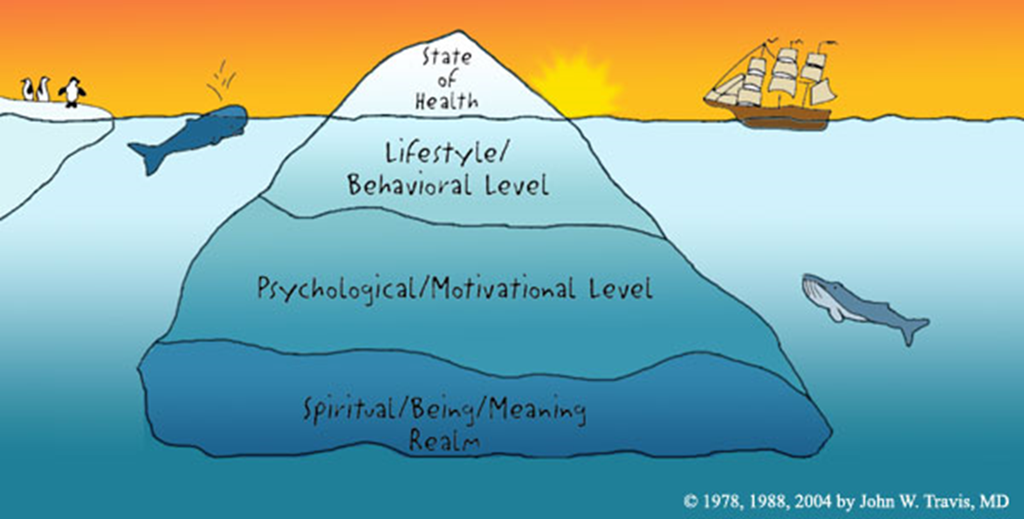
Culture is like an iceberg…
Notes:
A metaphor that has been used to describe culture is: “Culture is like an iceberg.”
Note: Go through the next three slides talking about the three layers of culture: surface, deep, unconscious rules.

Slide 15
Culture is like an iceberg
SURFACE CULTURE
Above the surface
What we can see
Low Emotion

Slide 16
Culture is like an iceberg
SURFACE CULTURE
Above the surface
What we can see
Low Emotion
DEEP CULTURE
Just below the surface
Unspoken rules
Behavior based
High Emotion

Slide 17
SURFACE CULTURE
Above the surface
What we can see
Low Emotion
Culture is like an iceberg
DEEP CULTURE
Just below the surface
Unspoken rules
Behavior based
High Emotion
UNCONSCIOUS RULES
Far below the surface
Value based
Intensive emotion
Notes:
30 minute class discussion

Slide 18
Hofstede’s 6-D Model
Power Distance
Individualism vs. collectivism
Uncertainty avoidance
Masculinity vs. femininity
Long-term vs. short term orientation

Slide 19
Hofstede’s Cultural Dimensions Power Distance
Power distance: The extent to which less powerful members of institutions and organizations accept that power is distributed unequally
High power distance countries: people may blindly obey the orders of their superiors and are less likely to question authority. Companies tend to use centralized decision-making and tall organization structures (many levels of management)
Low power distance countries: flatter and decentralized organization structures, smaller ratio of supervisors. Employees are more likely to question their bosses. Participative management may be used.

Slide 20
Hofstede’s Cultural Dimensions Individualism and Collectivism
Individualism: Tendency of people to look after themselves and their immediate family only
Countries high in individualism: High individual initiative. Promotions are based on achievement. Salaries are based on market value.
Collectivism: Tendency of people to belong to groups or collectives and to look after each other in exchange for loyalty
Countries high in collectivism: Low individual initiative. Salaries and promotions may be based on seniority

Slide 21
Hofstede’s Cultural Dimensions Uncertainty Avoidance
Uncertainty avoidance: Extent to which people feel threatened by ambiguous situations and have created beliefs and institutions that try to avoid such situations
High uncertainty avoidance countries: people have high need for security, strong belief in experts and their knowledge, more written rules and procedures, less risk taking by managers
Low uncertainty avoidance countries: people are more willing to accept risks associated with the unknown, fewer written rules and procedures, more risk taking by managers, higher employee turnover, more ambitious employees

Slide 22
Trompenaars: Roles & Pattern Variables
Universalism vs. particularism
Individual vs. collectivism
Neutral vs. emotional
Specific vs. diffuse
Achievement vs. ascription
Sequential vs. synchronic
Internal vs. external control
Parsons, (1951)

Slide 23
CASE STUDY 3: HALI PROJECT
Review models for understanding cultures as you read thru the case study in small groups
Assuming the project was in your community where you come from, identify local knowledge and beliefs that would impact the project objectives negatively and positively.
Discuss cultural practices in these case studies and compare with practices in your own communities that would influence the control and prevention of tuberculosis or any other infectious diseases

