Slide 1
Behavior Change
Stages of behavioral change
PowerPoint 3

Slide 2
Behavioral Change Module
Lecture Two
Stages of Behavioral Change
(Change Management Model)

Slide 3
Outline of Presentation
Five stages of behavior change
Diffusion of Ideas Model
Determinants of behavior
Stages of behaviour change
Behaviour change process
Enabling factors
Channels of communication
Myths and facts regarding behaviour change
Conclusions

Slide 4
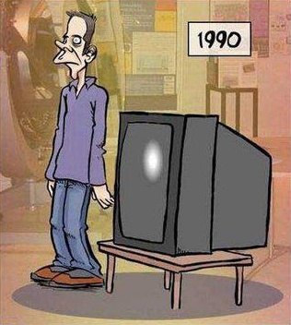
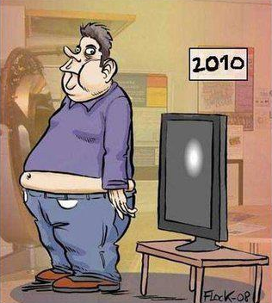
Illustration of Behavior Change (1)
List the important changes in the pictures ???

Slide 5
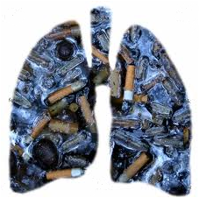
Illustration of Behavior Change (2)
Today its me, because of u... Tomorrow its u, because of me...
Fully burnt Cigarette ash
Smokers Lung
Quit smoking... Tar the roads... NOT your LUNGS!

Slide 6
Five stages of behaviour change
Stage 5
Maintenance
Stage 1
Precontemplation
Stage 4
Action
Stage 2
Contemplation
Stage 3
Preparation

Slide 7
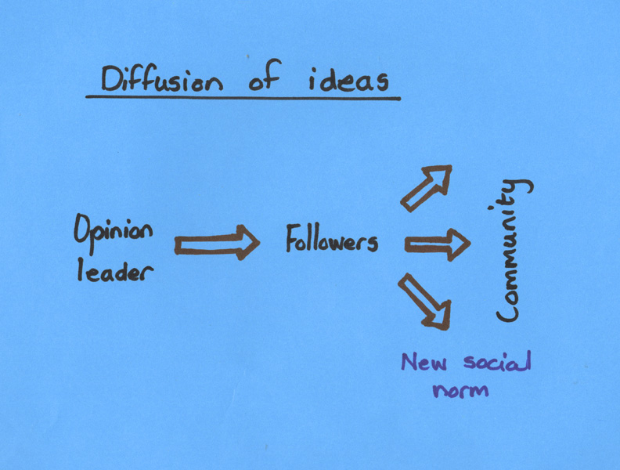
Diffusion of Ideas Model
People are more likely to adopt a new behavior when someone they respect or admire endorses the behavior:
Opinion leaders influence an initial group
New social norm is established
Rest of community follows (Social conformation)

Slide 8
Behavior Change Process
Channels
Stages of change continuum
Enabling factors
Unaware
Aware
Concerned
Knowledgeable
Motivated to change
Trial behaviour change
Sustained behaviour change
Mass media
Community networks and traditional media
Interpersonal/group communication
Effective communication
Enabling environment
User friendly services and accessible commodities

Slide 9
Myths and facts about behaviour change
Myths
Facts
Crisis is a powerful impetus for change
Change is motivated by fear
People go into denial of the bad things that might happen to them
To achieve sustainable results, it takes time.
Regular reinforcements are needed
We can't change because our brains become "hardwired" early in life
Majority of patients don't sustain changes in the unhealthy lifestyles that worsen their disease
Change for better is always difficult to make
Behaviour change methods don’t yield adequate results
We can continue learning complex new things throughout our lives
Change in behaviour is not sustained
Behaviour addressed should be the “felt need” of the people targeted
Community involvement is important for success of any change process

Slide 10
Behavior change is a continuous process
It involves strong community participation
Refutes myths and corrects misunderstanding
Social norms and public policies influence behavior change. A strategic shift must also be attempted simultaneously.
BCC often complements and supports other prevention strategies and approaches.

Slide 11
Stepped approach to change
A journey of a thousand miles begins with a single step

