Slide 1
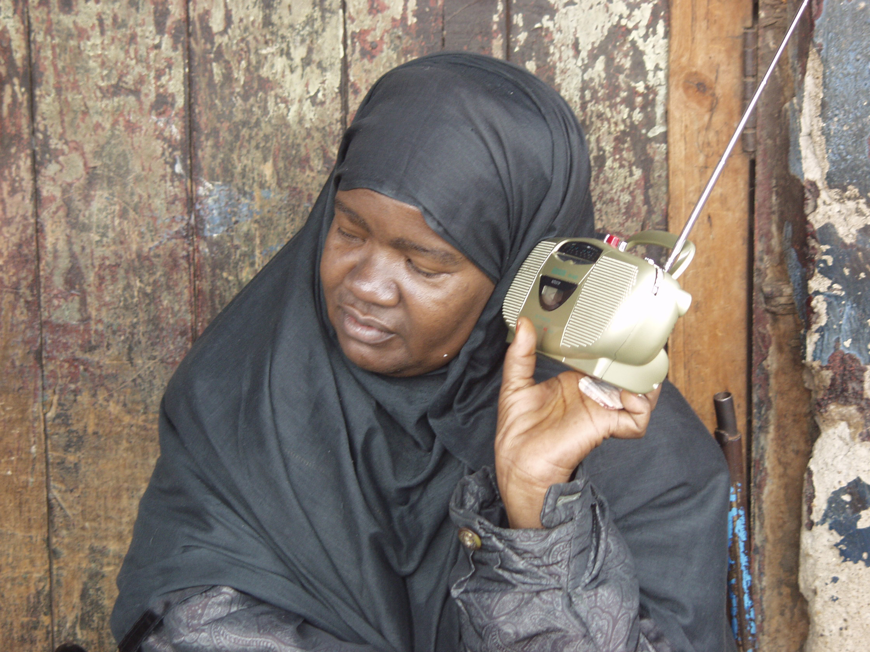
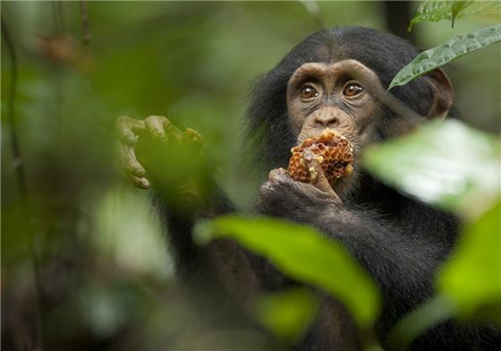
BEHAVIORAL CHANGE COMMUNICATION
Power Point 4

Slide 2
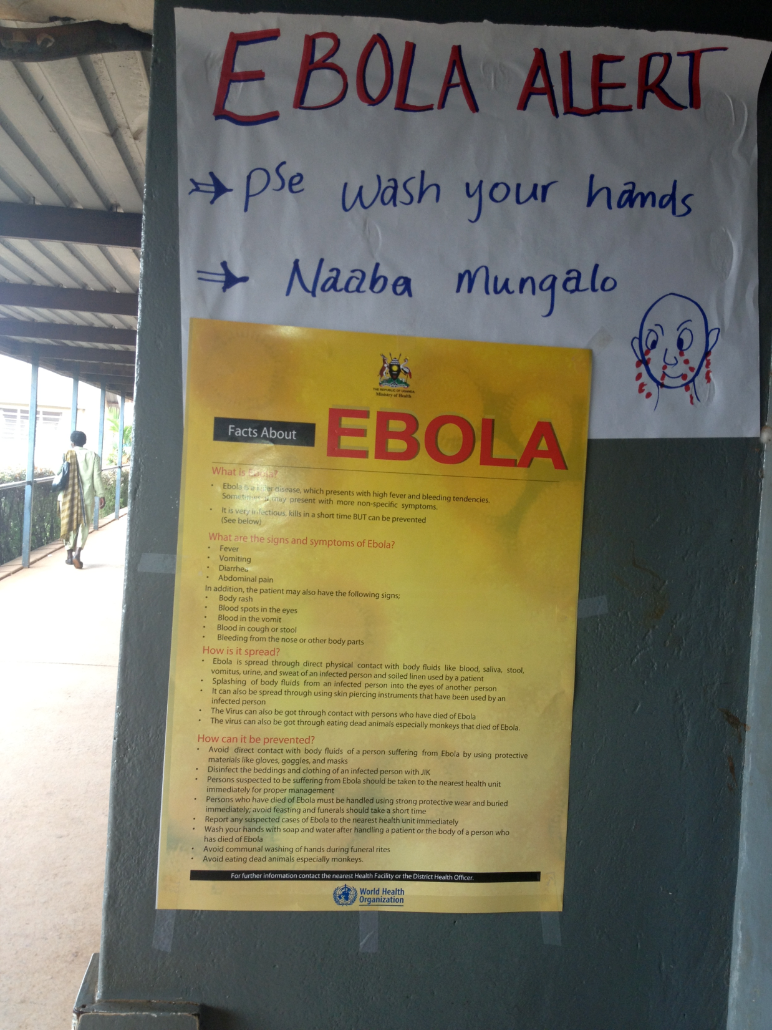

Slide 3
Building a Communications Plan
KNOW YOUR AUDIENCE
Identify a deficit or need that is detrimental to society or the environment.
Educate the community about the need and a solution.
Motivate the community to support change.
Provide knowledge and tools to make the change possible over time.
Notes:
A sound Communications Strategy identifies a deficit detrimental to society, educates the individual and community about the need for change and the solutions available and then provides the knowledge and tools to make change possible over time.
Social marketing can be used to complement other behavior change strategies. (Next slide) These include:

Slide 4
Communications Program Design
When designing a communications program, develop and identify:
  Theory of Change (rationale)
    Resources
    Activities
    Outputs
    Outcomes
    Indicators
Notes:
Formative research:
CONCEPTUALIZE:
Formative Research:
- Define the problem you are trying to solve
Identify community partners to work with
Find strategic partners and evaluate their capacity
Define the target audience(s) for your campaign.
Adapt a general Theory of Change to your specific circumstances.
Impact research:
Create preliminary objectives based on formative research
Define the baseline conditions for your target audience along your ToC using survey or other impact methods.
2. Plan Actions and Monitoring
Monitoring Research
- Establish a plan for how you will monitor

Slide 5
Theory of Change
A set of beliefs of how change happens
Invites questions to ensure greatest likelihood of creating positive change
States your assumptions about what will result from your designed program
Ensures goals are attainable
Focuses on change you want to see rather than activities
To ensure alignment at all levels of program design
Notes:
The backbone of monitoring and evaluation in peacebuilding is thinking about theories of change. Every peacebuilding initiative has a theory of change that is a set of assumptions about how change really happens in a given context

Slide 6
“If… Then…”
Resources
Activities
Outputs
Outcomes
You need certain resources to be able to run your program
IF you have access to those resources, THEN you can accomplish your activities.
IF you can accomplish these activities, THEN you will have delivered the services you planned
IF you have delivered the services as planned, THEN there will be benefits for those your program serves.

Slide 7
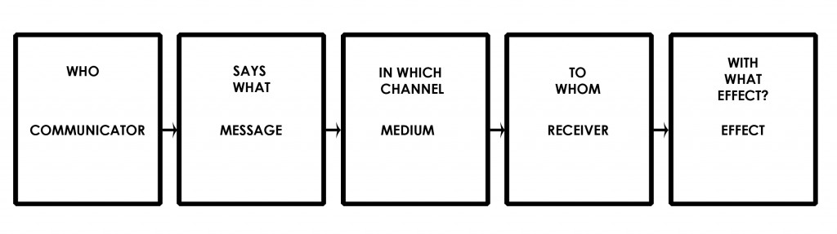
Communications ToC

Slide 8
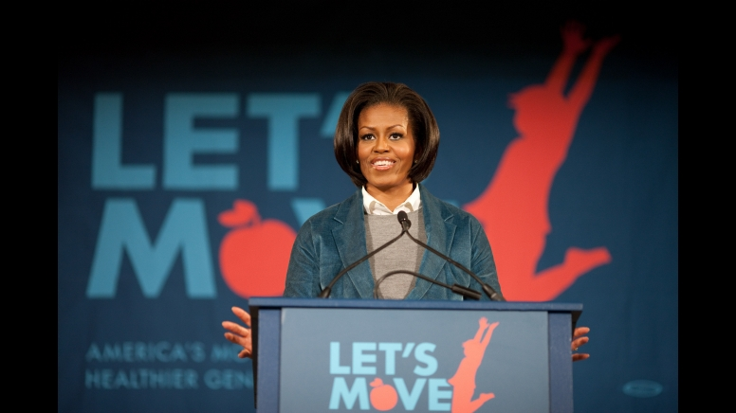

Example: “Let’s Move!”
Almost 1/3 of children are overweight.
Today (versus 30 years ago), we eat 31% more calories.
8-18 year olds spend an average of 7.5 hours using entertainment media.
Only 1/3 of high school students get the recommended amount of daily physical activity

Slide 9

Theory of Change: Let’s Move! Campaign
Problem Statement:
Almost 1/3 of children in the United States are overweight.
Goal:
Reduce the child obesity rate to 5% by 2030

Slide 10

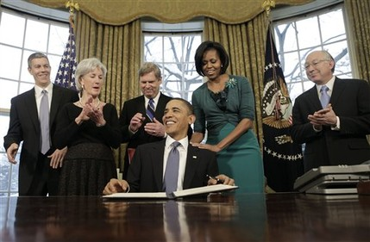

Let’s Move!: Resources
What sort of resources are needed to launch an effective campaign?
Mrs Obama had funding, a presidential task force, communications experts, a few years, and production abilities.

Slide 11
Let’s Move!: Activities
Launched a Task Force on Childhood Obesity
Initiated institutional collaboration to improve nutrition in schools, hospitals and military families
Arranged school visits
Mobilized community organizations
Created television, print and outdoor public service announcements.
Developed campaign-wide recognizable branding

Slide 12

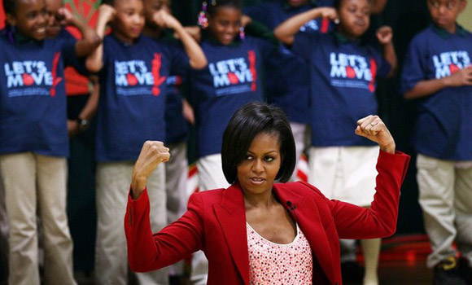
Let’s Move!: Outputs
Public Service Announcements (print and television)
Website with Factsheets and Columns by the First Lady
School Events
Promotion on mainstream media (SNL, Sesame Street)

Slide 13
The evolution of mom dancing
You tube

Slide 14
Communications ToC: Let’s Move!
Can you identify each of the following in the Evolution of Mom Dancing video?
Late Night Talk Show
Mothers engage their kids in activity
Michelle Obama
Move!
Mothers

Slide 15
Let’s Move!: Outcomes
Improved awareness of nutrition
Partnerships with athletic organizations, celebrities, and community groups that spread the Let’s Move! message
5,000+ schools now meeting high standards for nutrition and fitness
Through partnership with the Olympic Committee, in 2012, 1.7 million children had access to low-cost athletics
Institutional policy changes

Slide 16
Types of Communication
Let’s Move! used:
Social Media
Web
Television
Print
Mainstream Media/Celebrities
Community Outreach
What types of communication do you see being most effective in your line of work?

Slide 17
Communications ToC-One Health

Slide 18
7 Powerful Tips
Clear Purpose/Cause/Problem
Know your audience
Demonstrate better behavior (VISION)
Frame and message clearly
Celebrate success
Good spokespeople
Do what works

Slide 19
1. ANALYSIS AND PURPOSE
ANALYZE the problem. Then, have a clear PURPOSE (work/solution).
If your communication strategy
has no purpose,
it is a waste of time
Notes:
Grabber
Problem/Benefit
Your work/solution

Slide 20
2. KNOW YOUR AUDIENCE!
If you don’t know who your audience is or what they care about, you can’t reach them effectively.

Slide 21
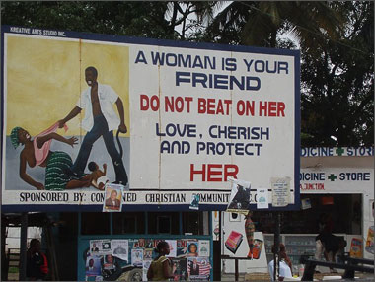
Billboard in Liberia

Slide 22

Literacy:
Total pop: 60.8%
Male: 64.8%
Female: 56.8%
Now what do you see?
Notes:
Adult literacy rate in Liberia 61%

Slide 23
Now what do you see?
Notes:
Adult literacy rate in Liberia 61%

Slide 24
3. VISION
Communicate with a vision of what your way looks like. Offer a solution to the problem

Slide 25
4. MESSAGE WELL
When messaging, always have a clear goal or “ask”

Slide 26
5.CELEBRATE SUCCESS, NOT FAILURE!
Don’t only stress the problem and the challenges, but show what is working and CAN work…
Use Love, NOT Loss

Slide 27
6. GOOD SPOKESPEOPLE
It isn’t just what is being said, but who is saying it…

Slide 28

PROTECTING SHARKS

Slide 29
7. DO WHAT WORKS!
If what you are doing isn’t working, STOP!

Slide 30
Staff Exercise: Designing a Campaign
YOUR TURN to design a communications strategy
  What are your theories of change and types of change? Include resources, activities, outputs & outcomes, key partners
  Suggest a set of six indicators
  (please include qualitative and quantitative)
  Means of verification?

Slide 31

Questions and reflections…

