Slide 1

The Personal Leadership Journey: Developing Competencies
PPP No. 4

Slide 2
Is it true?
You can't teach an old dog new tricks
Getting people to change their habits or acquire new skills is impossible. Puppies are teachable, but older dogs are less apt to be able to be trained.
An octogenarian who has read the morning newspaper for decades is unlikely to be willing, much less eager, to switch to the online edition
http://idioms.thefreedictionary.com/You+can't+teach+an+old+dog+new+tricks (retrieved: 9/21/15)

Slide 3
Is it true?
Chasser le naturel, il revient au galop
You can’t change bad habits, they always come back faster.

Slide 4
Knowledge – Attitude – Skills – Habits
(KASH)
Knowledge: learning new things
Attitude: choosing mind set
Skills: acquiring new tricks, ways of doing
Habits: changing behaviors

Slide 5
KASH determines your ability to develop new levels of competence!
Knowledge
Attitudes
Skills
Habits

Slide 6
Why do we need to learn
One Health competencies?
The world is facing new health challenges stemming from emerging diseases (75% from wildlife).
One Health approach has been recognized as the way to handle emerging disease challenges.
Past experiences have shown that multidisciplinary collaboration is not easy to achieve.

Slide 7
We are here to learn
One Health Cornerstone Competencies
Self Awareness
Visionary & Strategic
Team working & Teambuilding
Communication
Change Management

Slide 8
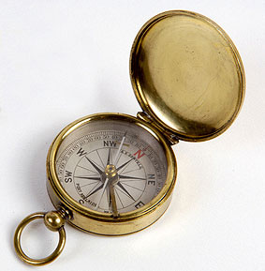
Self awareness
N
W
E
S
The True North Principle
Discovering and actualizing your Authentic OH leadership Style

Slide 9
How easy is it for us to change personally?

Slide 10

Change in knowledge
and skills
Thinking Brain
Change in attitude
and habit
Emotional Brain

Slide 11
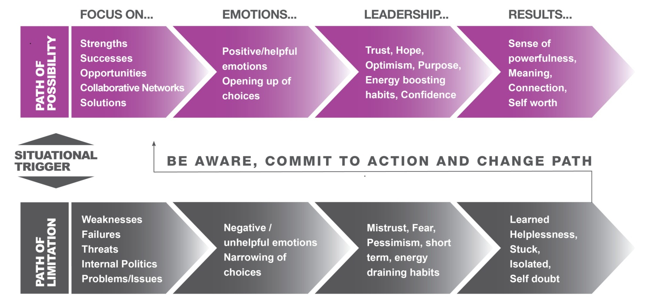
CHOOSING YOUR MINDSET

Slide 12
Performance = Potential – Interference
Performance
Actions
Feeling
Emotions
Thinking
Cognitions

Slide 13
With some difficulty!
Habits are hard, but not impossible to change.
Brain plasticity
Paying attention to what we are “thinking and feeling” and practising new thinking and behaviours over time establishes new habits.

Slide 14
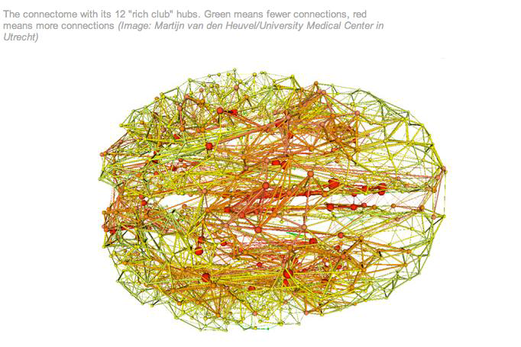
Habits are a result of our current neural circuitry
http://www.newscientist.com/article/dn21117-the-rich-club-that-rules-your-brain.html

Slide 15
Limiting inner dialogue and self beliefs: Performance Inhibiting Thinking
I hate meetings, make me feel
tense and uncomfortable. I am
tense, no eye contact race through
my points, poor impact
Performance
Actions
Feeling
Emotions
Thinking
Cognitions
I’m hopeless at this,
just get it over
with as quickly
as possible. I don’t like people
thinking I am “blowing my own
trumpet.
People are
judging me.
I will look stupid
If I can’t answer
their questions
I feel really tense and
quite fearful.. heart beat
raised, tense , can’t think
clearly

Slide 16
Developing Positive Inner Dialogue:
Performance Enhancing Thinking
I prepare for the meeting and communicate the
key points in a relaxed and confident manner, I
highlight the key successes of the team and I am
comfortable highlighting some areas for concern.
Performance
Actions
Feeling
Emotions
Thinking
Cognitions
I’ve got the skills and know what to do
I’ve prepared well . I am comfortable if some people do not like me for talking about our successes and
on balance believe that the team want to hear
how things are going
and enjoy the opportunity
of getting together and
hearing my reports.
If I can’t answer the
Questions, I can always
clarify the issue after
the meeting.
I feel quite confident and a
bit more relaxed. I can think
much more clearly.

Slide 17
Five key steps to habit change
(Daniel Goleman: Focus - the hidden driver of excellence)
Familiarize yourself with the self-defeating habit. Get so you can recognize the routine as it starts, or begins to take over. This might be by noticing its typical thoughts or feelings, or how you start to act.
Be mindful. Monitor your behavior – thoughts, feelings, actions – from a neutral, “witness” awareness.
Remember the alternatives – think of a better way to handle the situation.
Choose something better – e.g., what you say or do that would be helpful instead of self-defeating.
Do this at every naturally occurring opportunity. (Repetition is key!!)
Notes:
1) Familiarize yourself with the self-defeating habit. Get so you can recognize the routine as it starts, or begins to take over. This might be by noticing its typical thoughts or feelings, or how you start to act. You can also follow Paul Ekman's simple suggestion: keep a journal of your triggers.
2) Be mindful. Monitor your behavior –thoughts, feelings, actions – from a neutral, “witness” awareness.
3) Remember the alternatives – think of a better way to handle the situation.
4) Choose something better – e.g., what you say or do that would be helpful instead of self-defeating.
5) Do this at every naturally occurring opportunity.

Slide 18
Part 2

Slide 19
The Four Cornerstone Competencies for One Health
Self Awareness
Visionary & Strategic
Team working & Teambuilding
Communication
Change Management

Slide 20
What's Your Development Plan?
Exercise (handout: copy of One Health Core Competencies)
1. Take 5 minutes to review the core competencies and identify: What are my strengths and potential areas for development?
2. Discuss in small groups. (10 minutes)
3. Report in plenary session in a table format. (5 minutes per group)

Slide 21
What's Your Development Plan?
Exercise (handout)
What's Your Story? – Individual/Group Activity
“Experience may be the best teacher – but it is not necessarily always a kind or clear teacher…” - Winston Churchill
Take 10 minutes and answer the questions on your handout. Then…
In your group, let each participant share their story. (5 minutes each).

Slide 22
Thank you

