Slide 1
Behavior change
Attribution theory
PowerPoint 7

Slide 2
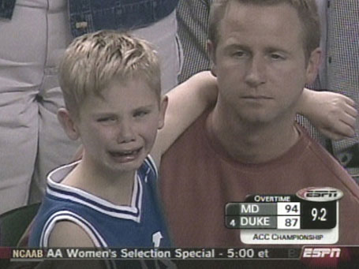
Attribution Theories
What do we think explains behavior?
Understanding “why?”
Complexity
Intentionality
Notes:
Layered on top of people’s values, attitudes, beliefs and internal and external motivations are how they interpret situations.
People in general tend to ask “why?” when they confront important events that are negative or unexpected (Hastie, 1984, Weiner, 1985)
And to make sense of our social world, we try to understand the causes of other people’s behavior.
If you ask people to explain why their fellow human beings behave as they do – why they succeed or fail, laugh or cry, work or play, or help or hurt others - and you’ll see that they come up with complex explanations often focused on whether the behavior is intentional or unintentional (Malle et al., 2000)

Slide 3
What do we think explains behavior?
Personal attribution: internal
characteristics of an actor, such as ability, personality, mood, or effort
Situational attribution: factors external to an actor, such as the task, other people, or luck.

Slide 4
Notes:
Imagine a car cuts you off while you’re driving – what do you think? (they’re a jerk)
Imagine you cut someone else off when you’re driving – what do you say to yourself? (Oh, I had no idea!)

Slide 5
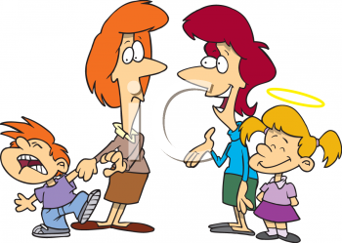
Fundamental Attribution Error
We tend to rely on situational explanations for our daily actions and personal attributions for others’ actions

Slide 6
What influences behavior?
Internal motives (personal values)
External motives (rewards, punishments)
Interactionist perspective (both)
Notes:
Behavior is a function of the interaction between the person and the environment.
Both internal and external factors affect behavior.
Internal motives (intrinsic values)
External motives (rewards and punishments)
Interactionist perspective: An emphasis on how both an individual’s personality and environmental characteristics influence behavior.
6

Slide 7
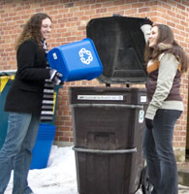
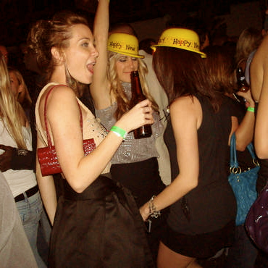
Notes:
Same person might recycle when it’s convenient but not when it’s not
7

Slide 8
Fostering Sustainable Behavior
An Introduction to Community-Based Social Marketing
Notes:
So human behavior is very complex – it’s shaped by our values, beliefs and attitudes, internal and external motivators, our environment and even how we perceive the motivations of the people around us.
Now we’re going to talk about some of the common methods being used by well-meaning groups that are trying to change the behavior of the masses. We’ll talk about why they don’t work and what can we done instead.
-----
“If the very individuals who design and deliver programs to foster sustainable behaviour do not consistently engage in actions that support sustainability what can we expect of the general public who are often far less motivated and knowledgeable.” Finally, I would encourage you to note that behaviour change is the cornerstone of sustainability. Whether we are working to promote energy or water efficiency, modal transportation changes, watershed protection, or the conservation of species, changing human behaviour is central to our task.

Slide 9
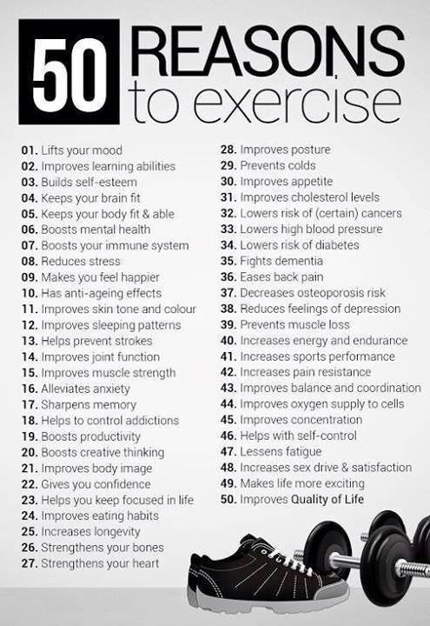
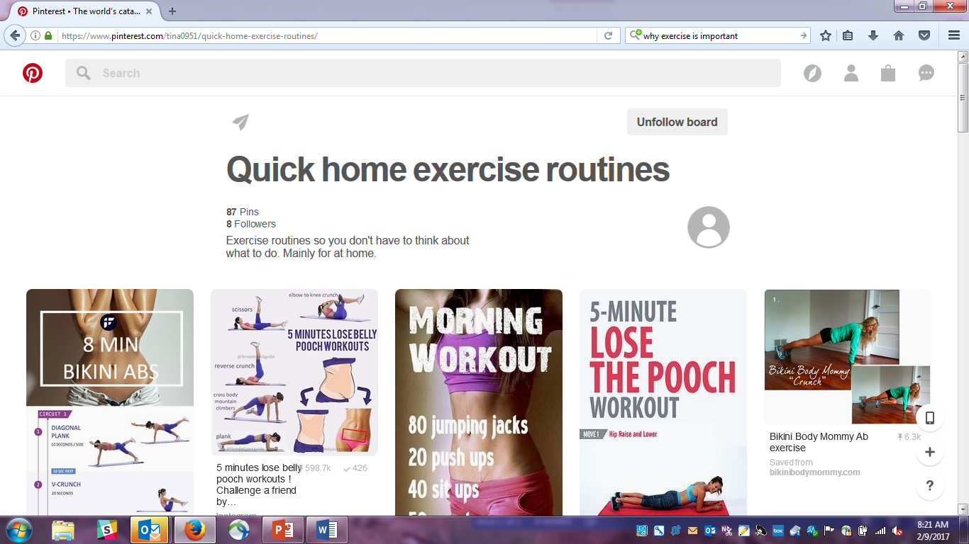
Notes:
Let’s talk about a behavior that probably most people know if important: exercise.
I like to exercise. I like to hike and do yoga. Sometimes at the same time.
[click]
I know why it’s important to exercise
[click]
I know how to exercise – I have a pinterest board dedicated to things I can do at home

Slide 10
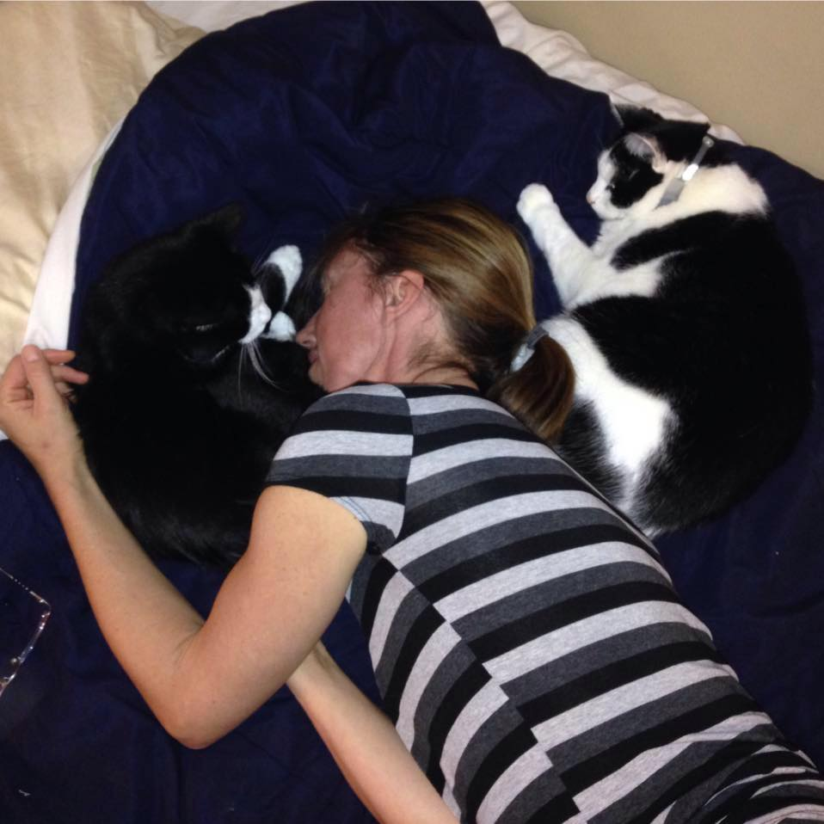
Notes:
But during the winter I often look like this.
Why?

Slide 11
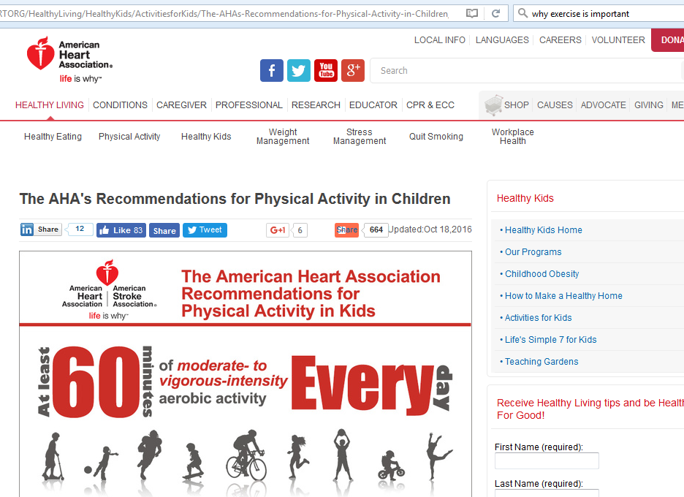
Notes:
Folks who care about health do their best to make sure I know why and how to exercise. They have websites and newsletters and all sorts of information available.
It is a typical information intensive campaign – this is the most common method of trying to create behavior change. We’re going to talk a little bit about what they are so we can understand why they don’t tend to work. Why I’m still laying in bed instead of out exercising.

Slide 12
Information-Intensive
Radio
Television
Internet
Newsprint
Notes:
Information intensive programs rely solely on the distribution of information through radio, television, the internet, or newsprint as their way of promoting changes in behaviour.

Slide 13
Information-Intensive
Attitude-Behaviour
Economic Self-Interest
Notes:
Information intensive programs tend to be based on one of two models of behaviour change: The attitude-behaviour change approach or the economic self-interest approach.

Slide 14
Attitude-Behaviour
Attitudes = Behaviour
Little Connection
Notes:
The attitude-behaviour change approach is based on the assumption that if we want to change behaviour we want to begin with changing attitudes and knowledge so that are target audience is more knowledgeable regarding the actions they can take and why these actions are important. Unfortunately, there is frequently little connection between the attitudes that someone holds, the level of knowledge they have, and the behaviours they engage in.
See Chapter 1 in FSB pages 3-5 for further information on this model.

Slide 15
Attitude-Behavior
Energy Efficiency Workshop
Attitudes and Knowledge
Evaluation
1 of 40 Lowered HHW
2 of 40 Installed Wrap
8 of 40 Installed Showerhead
Notes:
In Doug MacKenzie Mohr’s book he describes the following situation. Scott Geller organized a three-hour energy-efficiency workshop in which the attendees responded to an advertisement in the local newspaper. This experience is far longer than we normally get to spend with our target audience, and that they were highly motivated to make their homes energy efficient. Geller measured their energy efficiency attitudes and knowledge before the workshop and afterward.
The attendees attitudes and knowledge had shifted substantially as a result of participating in the workshop. As a consequence, the attitude-behaviour change model would predict that their behaviour should as well. However, when an evaluation was done, only one person had lowered their temperature on their hot water heater, two had put blankets around their hot water heaters (but they had done this before the workshop!), and eight had installed low flow showerheads. The number of households who had installed low-flow showerheads is more impressive as it is nearly 25% of participants.
This sounds impressive until you find out that everyone was given low-flow showerheads, but only eight installed them.
this study sets the “outside boundary” conditions of what we could most hope for -- that is, you are able to spend three hours with the target audience and they are highly motivated.

Slide 16
Economic Self-Interest
Systematically Evaluate
Act in Self-Interest
Enlightenment = Change
Notes:
The other prevalent model of behaviour change that lies behind information intensive approaches is The “Economic Self-Interest” approach. This approach is used extensively by utilities (water, gas and electric) and is based on the premise that people systematically evaluate their choices and then act in their economic self-interest. Based on this approach all we need to do is emphasize that actions are in someone’s financial best interest (e.g., installing a programmable thermostat) and once our target audience understands that they will change their behaviour. If only life were so simple!

Slide 17
Economic Self-Interest
Residential Cons. Service
Gas & Electric Utilities
Audits, Loans, Contractors
Evaluation
6% Requested Audit
50% Acted, Savings 2-3%
30% Waiting List Control
Notes:
From FSB page 6: “An act passed by the United States Congress brought into being the Residential Conservation Service (RCS). The RCS mandated that major gas and electric utilities in the United States provide homeowners with audits in order to enhance energy efficiency. In addition, homeowners had access to interest-free or low-cost loans and a listing of local contractors and suppliers. In total, 5.6% of eligible households requested that an RCS assessor evaluate their home.
Of those who had their home evaluated, 50% took steps to enhance the energy efficiency of their dwelling, compared to 30% for non-participants (the non-participants were households who were on the waiting list to have their homes assessed). What types of actions were taken? In general, the actions were inexpensive and did not involve a contractor. Frequent energy-efficiency actions included caulking, weather-stripping, installing programmable thermostats, turning down the hot water thermostat, and installing a water heater blanket. These actions reduced energy use per household between 2% and 3%.16 Given that millions of dollars were spent on the RCS, and that it is possible to reduce residential energy use often by more than 20%, an initiative that produces annual savings of 2-3% can only be seen as a failure.”
Note the control group:
Whenever we deliver programs in which people self-select themselves to participate there is the possibility that the results we are seeing are due to their motivation rather than our program (e.g., we are subsidizing people to do things that they were going to do anyway). In the case of the RCS, several utilities included “waiting list controls” which include those individuals who are waiting for an audit to be delivered, but have to wait a significant amount of time for the audit to occur. Waiting list controls allow us to estimate how much of what we are observing is due to the program we are delivering versus pre-existing motivation. When the households on the waiting lists were examined they found that 30% of them engaged in the same actions as those who had participated in the audits, indicating that much of the changes observed in the RCS program was due to pre-existing motivation rather than the audit itself.

Slide 18
Why Prevalent?
Underestimate
Difficulty
Expediency
Ineffective Models
Relative Ease
Lack of Evaluations
Notes:
Why do they believe information intensive programs exist despite a lack of evidence that they work effectively?
we are going to wrong people (communication firms) and getting the wrong advice and, as a consequence, we are underestimating the challenges of changing behaviour. Who should we be turning to for assistance? Behavioral scientists and social marketers.
[For the last bullet point I would emphasize that] we are traditionally measuring outputs rather than outcomes. That is, we are measuring the number of brochures that we have distributed rather than whether we have actually changed behavior, resource use, or resource quality (outcomes).

