Slide 1
Behavior change
Community-Based Social Marketing

Slide 2
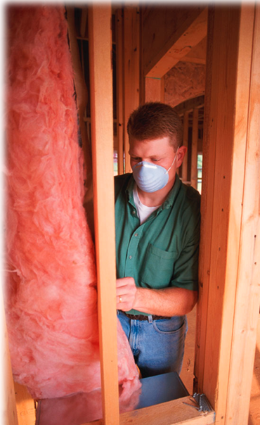
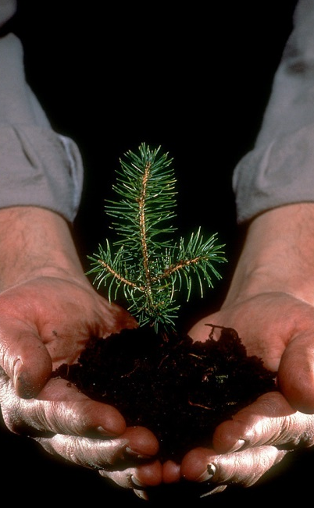
Community-Based Social Marketing
Notes:
An alternative: community-based social marketing (CBSM). CBSM unites knowledge from psychology with the field of social marketing. It emphasizes understanding the barriers that exist within a community to the behavioural changes that are being advocated. Further, it stresses the importance of the “social” aspects of the behaviours we adopt, such as interpersonal communication, social diffusion and social norms.

Slide 3
Community-Based Social Marketing
Uncover
Barriers
&
Benefits
Implement
Broadly
&
Evaluate
Develop
Strategy
Pilot
Strategy
Select
Behaviours
Notes:
CBSM consists of 5 steps, that when done thoughtfully can lead to effective behavior change.
[See pages 8-9 of FSB for an overview of CBSM.]

Slide 4
Community-Based Social Marketing
2
3
5
4
Select
Behaviors
Notes:
The first step is to select the behavior. This seems simple but most people actually will skip straight to step 3 – and select a strategy first (e.g. install shower timers).
Why might we want to step back and spend some more time thinking about exactly what behavior we want to change?
[See pages 12-19 of FSB for information on selecting behaviours]

Slide 5
Selecting Behaviors
What is most important?
Notes:
The selection of behaviors begins by determining which sectors have the greatest impact on your area of interest. Once you have determined which sector(s) to target, analyze how your issue is affected by the different behaviors within that sector.

Slide 6
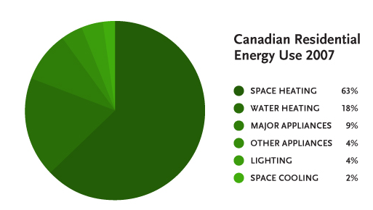
Selecting Behaviors
What is most important?
Notes:
Within the broad category there are usually more defined categories

Slide 7
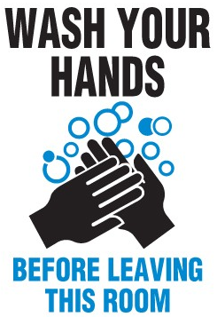
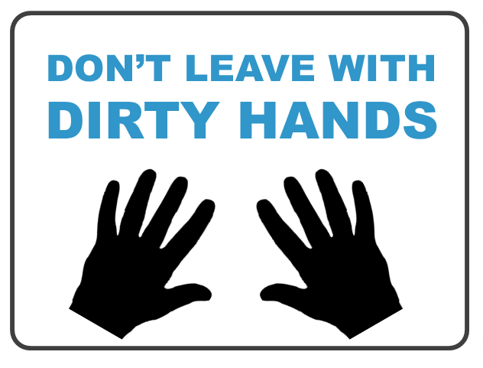
Evaluating Behaviors
Behavior should be non-divisible
Behavior should be end-state
Behavior should be framed as a positive
Brainstorm!
JOIN
THE
GYM
Exercise at the gym 5x/week
Notes:
Here are some additional tips for selecting behaviors.
First, you want to choose behaviors that are non-divisible. A divisible behavior is one that can be further broken down into smaller actions. For example – something like “live a healthier lifestyle” is a DIVISIBLE behavior. The reason why this behavior is divisible is because it can be broken down further into a series of smaller actions or behaviors – things like getting 8 hours of sleep each night or eating 5 servings of fruit and vegetables each day.
When trying to bring about change, we want to target behaviors that are NON-DIVISIBLE, or can’t be broken down into any smaller sub-actions. The reason for this, which we will discuss on the next slide, is that each of these sub-actions have their own associated barriers.
A behavior should also be end-state, and what end state means is that the behavior itself produces the desired outcome. So what do you think about this behavior: Joining the gym. Does joining the gym directly produce the outcome of helping you get in shape?
Joining the gym isn’t end state because you don’t reap any health benefits from simply having a gym membership. You get the desired health outcome from actually GOING to the gym. So a Behavior like “go to the gym 5 times/week is END STATE.
And finally, a behavior should be framed as a positive. In other words, the behavior you select should be what you WANT people to do, not what you don’t want them to do. Looking at these two examples – which one is framed as a positive, and thus the one we want to choose? Correct – we want the behavior to be wash your hands before leaving.
Then create a list

Slide 8
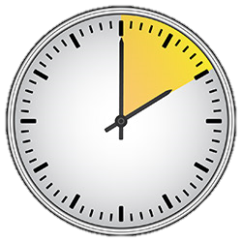
Exercise 1: Selecting Behaviors
What problem do you want to solve?
What behavior change is needed?
Whose behavior needs to change?
Stages of Change Model
PROGRESS
Precontemplation
Contemplation
Preparation
Action
RELAPSE
Maintenance
Notes:
TIME CHECK: 10 AM
First step to creating CBSM campaign:
(We’re not going to do this now but this is how you would start)
CLICK Select behavior – ask 3 questions
CLICK What problem do you want to solve? What is it that’s going on now that needs to stop?
Can’t just tell people what NOT to do… need to ID
CLICK What behavior change is needed? The behavior that we WANT people to engage in.
CLICK Look at our Audience - Whose behavior needs to change? (look at both your primary audience, and the secondary audience, people who have particular influence over your primary audience’s behavior)
CLICK The Stages of Change model can be really helpful to guide us when thinking about audience. Takes us through 5 steps of behavior change.
Precontemplation – problem present, may not be recognized, no intention of change
Contemplation – individual recognizes problem, is seriously thinking about changing
Preparation – recognize problem, intention to change behavior within the immediate future - a month or so
Action – behavior has been changed for less than 6 months
Maintenance – keep new behavior for more than 6 months
People may move up and down these steps before a behavior becomes permanent.
Get into groups based on your case study – identify answers to these questions and brainstorm a list of potential behaviors. For each behavior determine who the audience would be.
10-15 min

Slide 9
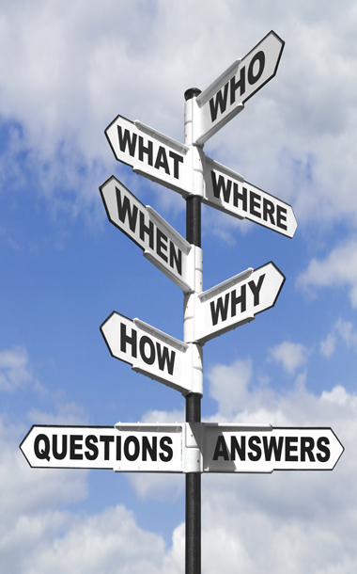
Selecting Behaviors
Impact
Probability
Level of penetration
Notes:
To narrow down your list to one behavior determine
How impactful is the behavior?
How probable is it that my target audience will engage in the behavior?
What level of penetration has the behavior already obtained with my target audience?

Slide 10
Selecting Behaviors
Rigorous
Technical Review (Impact)
Review Cases (Probability)
Inspections (Penetration)
Less Rigorous
Survey Experts (Impact)
Survey Audience (Probability)
Survey Audience
(Penetration)

Slide 11
Exercise 2: Evaluating Behaviors
Based on your case study
Non-divisible
End-state
How can you determine impact, probability and penetration?
No strategies
Notes:
Get into groups by case study
Look over your list of behaviors to make sure they’re non-divisible and end-state. Discuss how you might determine their impact, probability and penetration and (for this exercise) pick one.
Finish by 10:30

Slide 12
Community-Based Social Marketing
3
4
5
Uncover
Barriers
&
Benefits
Select
Behaviours

Slide 13
Uncovering Barriers & Benefits
Literature
Search
Observations
Focus Groups
Surveys
Notes:
There are four main methods of uncovering barriers and benefits: a literature search, observations, focus groups and surveys (see chapter 3 for more detail on each of these).
Each of these methods have inherent strengths and weaknesses. For example, focus groups provide you with rich detailed information about barriers and benefits, but are limited in generalizability. As a consequence, we want to pair together different methods so that the weaknesses of one are compensated by the strengths of another (e.g., surveys have better generalizability).

Slide 14
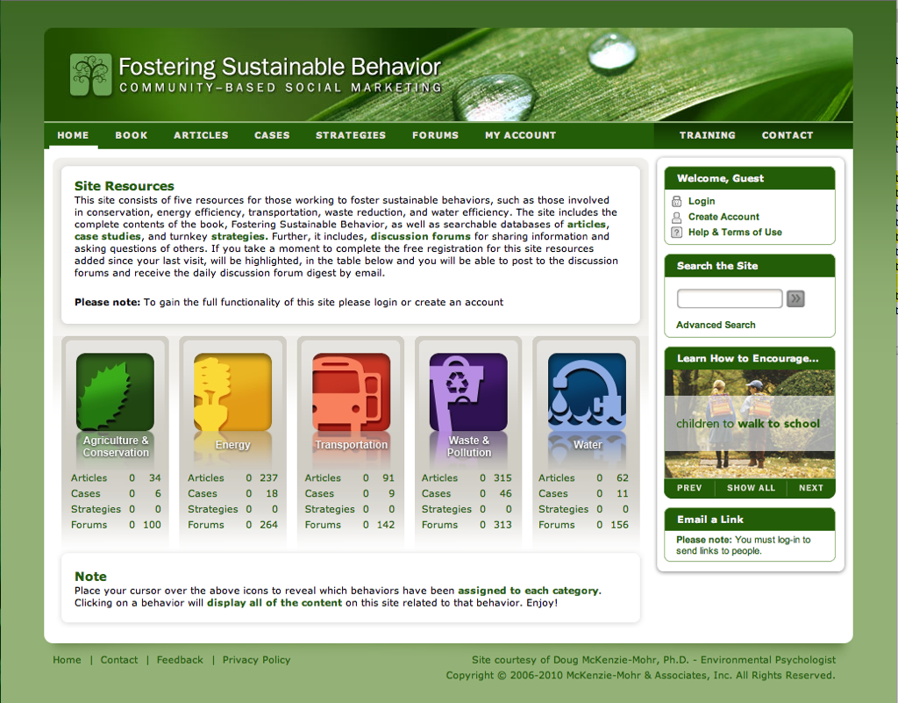
Notes:
The Fostering Sustainable Behavior site, and the associated digest, can be used to conduct a literature search, ask questions of other environmental program planners and to uncover examples of successful programs.

Slide 15
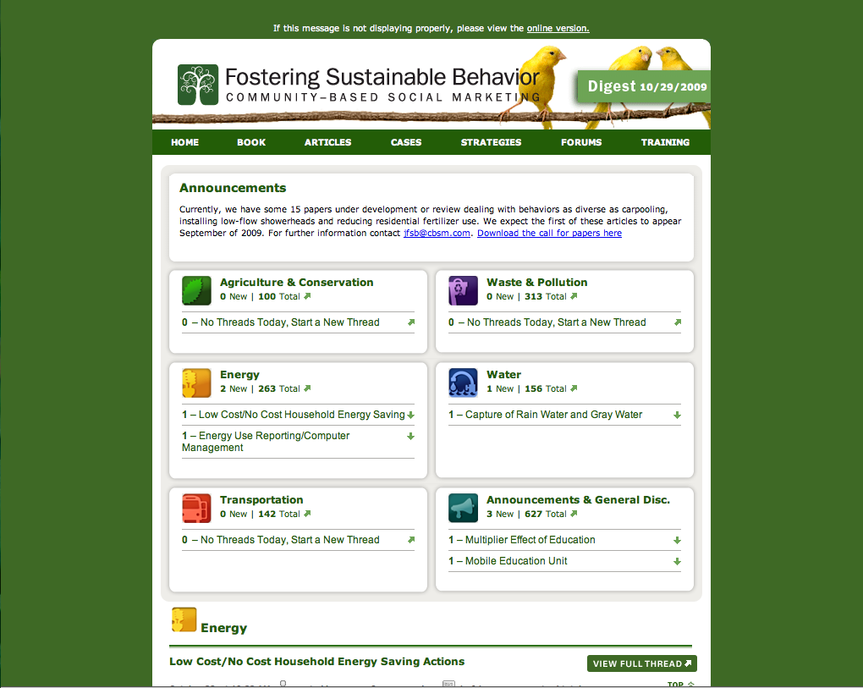

Slide 16
Identifying Barriers & Benefits
Don’t assume you know what they are!
Develop strategies that decrease barriers and increase benefits
Benefits
Barriers
Notes:
Once selected behaviors, move on to step 2 – ID barriers and benefits.
It’s really easy to assume that we know what drives people or what they would see as barriers and benefits, but we can’t really uncover actual barriers or benefits unless we actually investigate. This is an absolutely crucial step because if we design strategies to address the wrong sets barriers & benefits, our programs won’t be effective and we wont’ see the desired results.
Can identify barriers and benefits through observations, group discussions (AKA focus groups), or surveys
Going back to transportation – for someone who drives, what might be some of the barriers to switching to more sustainable alternatives?
insufficient knowledge (don’t know that driving has negative impacts on the environment)
institutional factors (poor infrastructure, no public transportation available where you live)
socio-cultural factors (I know driving is bad, but most people I know drive, so it’s socially acceptable)
motivation (I value environment, but also my time – I drive because it takes less time in many cases → value of time>value of environment)
emotional involvement (when I see the direct consequences of my actions, like pollution, I’m more apt to change) → in your office, focus on protecting the bird outside your window/making your office a healthy place to work, not on saving the polar bears
locus of control (if I feel like stopping driving won’t fix anything, I’m less likely to change) → in your office, focus on what you can do, not what you can’t. Why key to ID what behavior change is needed.
What might some of the benefits be?
Cheaper, save money, less stressful, etc.
Ideal programs or initiatives are those that both decrease barriers while increasing benefits.

Slide 17
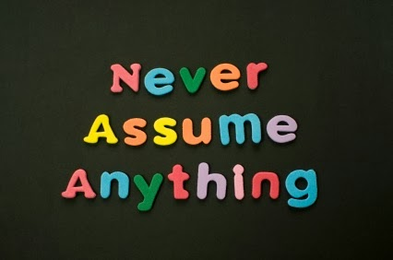

Slide 18
Exercise 3: Barriers & Benefits
Based on your case study
What barriers do you think your audience will have to your behavior?
What benefits (to them) might they experience?
Notes:
Get into groups by case study and do some initial discussion of how you might uncover barriers and benefits to your chosen behavior.
Remember that the benefits must be to the individual (not the world in general or some greater good).
For example for recycling the benefits might be feeling good about yourself (vs. helping the planet)
10:35-10:45

Slide 19
Community-Based Social Marketing
4
5
Uncover
Barriers
&
Benefits
Select
Behaviours
Develop
Strategy
Notes:
TIME CHECK: should be 10:45/11

Slide 20
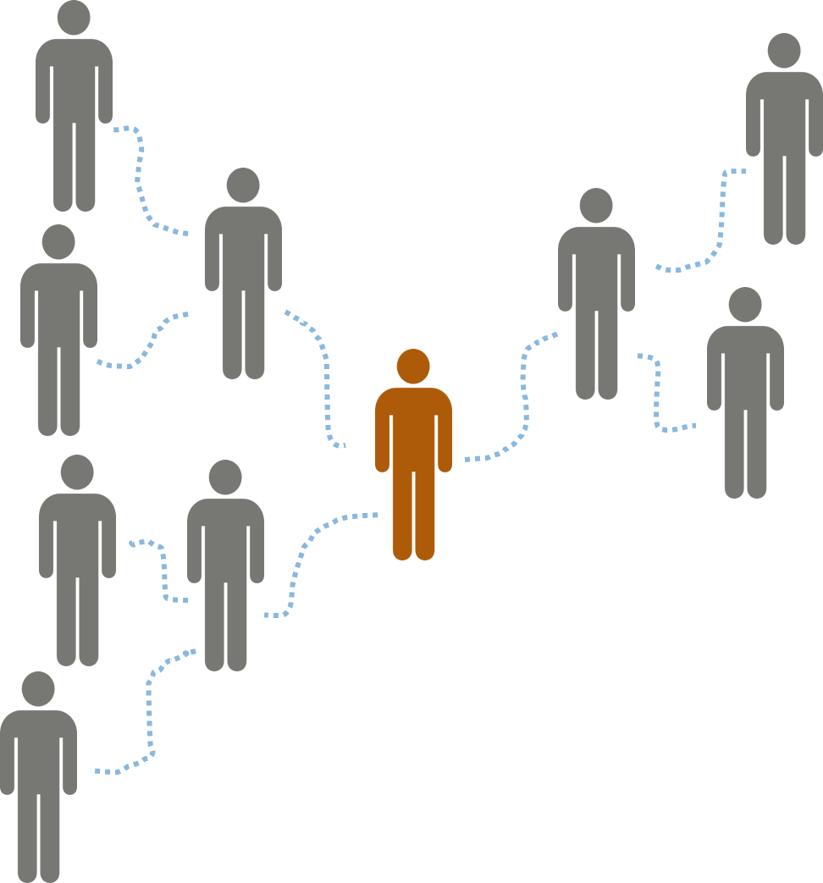
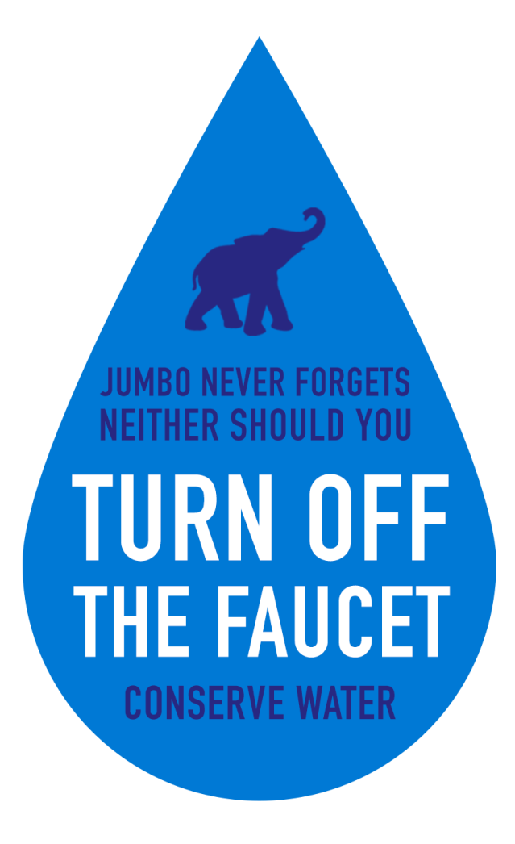
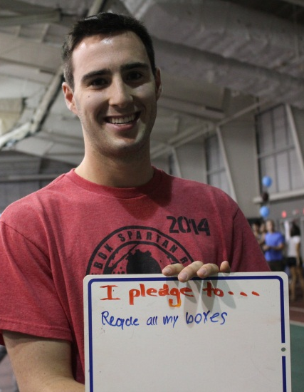
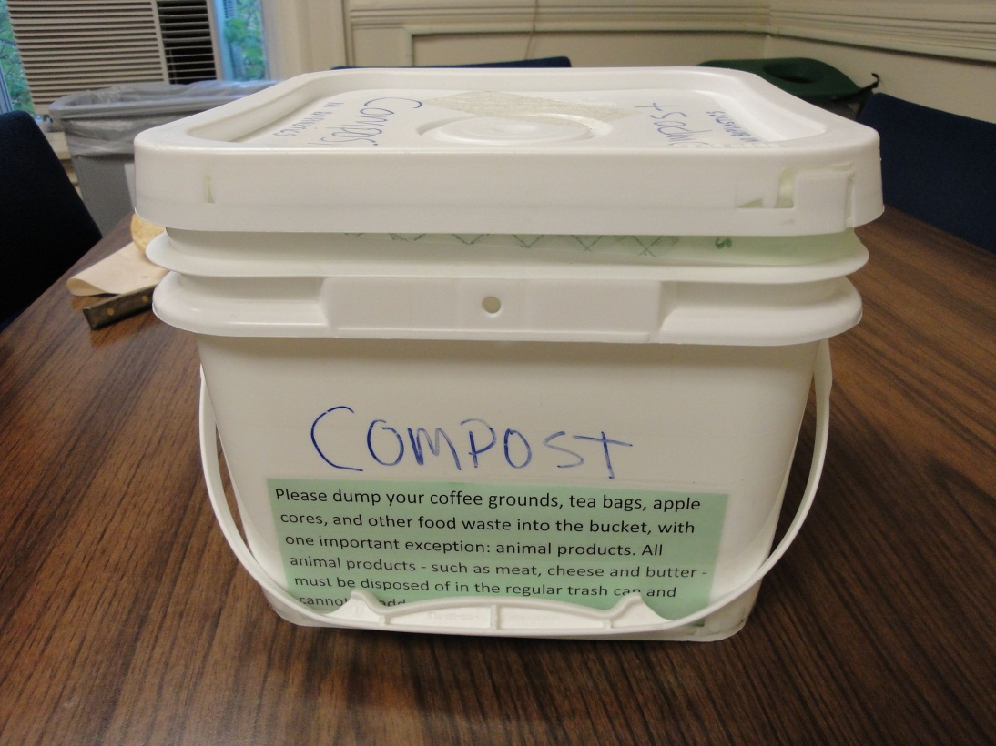
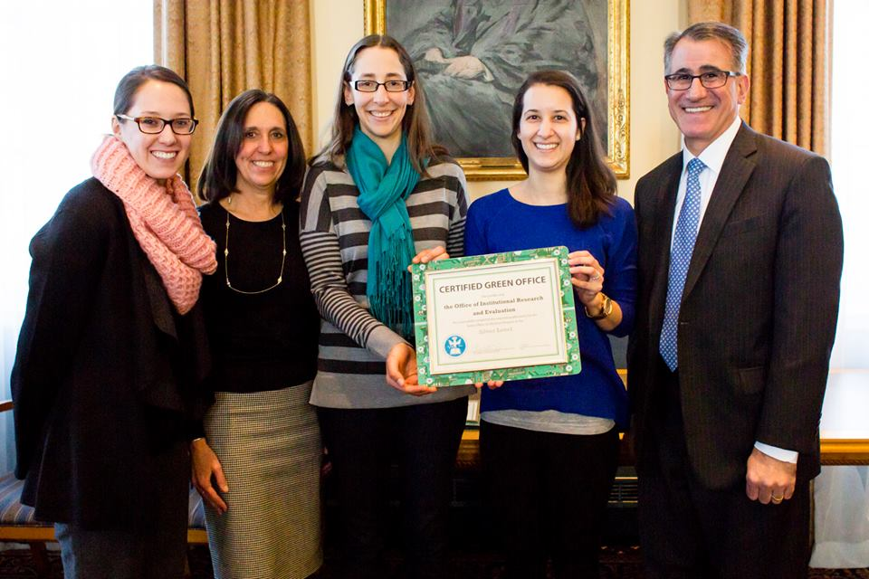
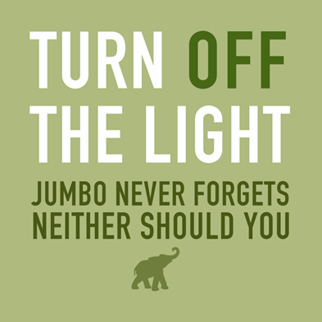
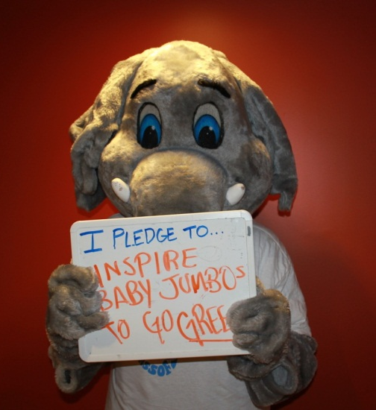
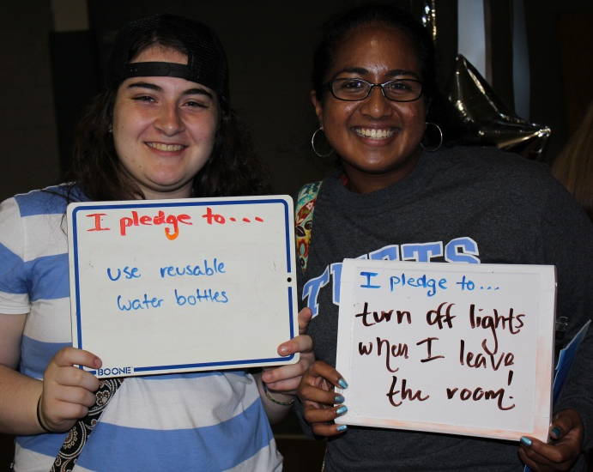
Develop Strategy
Convenience
Commitments
Voluntary
Written
Public
Social Diffusion
Prompts
Incentives
Notes:
Once you’ve identified the desired behavior and its barriers/benefits, you can develop appropriate strategies to help decrease barriers and increase benefits. There are many different tools or strategies we can consider to do this.
Convenience – Pretty intuitive that people are more likely to engage in an action if it’s convenient. So whenever possible, we should make our chosen action the default so it’s easy (e.g. default double sided printing)
Commitments – e.g. Pledges, are great change catalysts because people are more likely to follow up on something if they’ve made their intentions known, and are more likely to commit to something larger if they’ve already committed to something small
To be most effective, they must be voluntary, written, and public (print in newspaper, post online, etc.). People like to be self-consistent, but if they feel like they’ve been coerced or its not genuinely their choice, they are less likely to feel like it’s a commitment that they made.
Social Diffusion – people change behaviors based on what their friends, and people they have personal relationships and direct interaction with, do. Personal conversations and direct face-to-face interactions play the pivotal role in helping a behavior become widely adopted or diffused across a population. (one of your friends recommends that you try a product or activity)
Prompts – reminders or signs that help people remember to take an appropriate behavior (light switch stickers, etc.), they must be placed where the decision to act takes place (e.g. light switch prompt on or directly next to light switch) – prompts can be integral in helping people develop sustainable habits and routines, which are key in maintaining long-term change. Important to note that prompts don’t change motivation – they just help us remember to do things we’re already on board with (so they should be used for actions that someone’s already inclined to take, but just can’t remember to do).
Incentives – Giving people the extra push they might need to undertake an action. In order for long-lasting behavior change, should be small so that people driven by recognition/self-motivation, not the prize itself. This is like signing up for a charity race in order to motivate yourself to start running – you might win, but really, it’s just an incentive. As you can see from this example incentives don’t even necessarily have to be monetary or something material, either – can be recognitions or awards.

Slide 21
Social Norms
Descriptive (what people do)
Injunctive (what people approve/disapprove of)
38%
Help save the environment by reusing your towels.
36%
Join with our efforts to protect the environment and reuse your towels.
48%
75% of guests who have stayed in this room reuse their towels. Join your fellow guests in helping to save the environment.
Notes:
Social Norms – Does anyone know what social norms are? They’re general rules of conduct that reflect standards of social approval/disapproval - what’s socially acceptable
Most people claim that they aren’t persuaded by what others do. Do you think research supports or refutes that claim?
Experiments refute that claim and demonstrate that people are, in fact, influenced by what others do, or what’s the socially acceptable thing to do.
Thus, normative messaging can be very effective.
Descriptive norms – describe what people do
Injunctive norms – describe what people approve or disapprove of
Need a combination of norms for the most effect (you want to indicate that acting sustainably is what everyone does and that acting unsustainably is not acceptable or approved of)
Example of how normative messaging works:
Hotel did an experiment to try and get people to reuse towels, put 3 different messages on cards
Environmental protection: Help save the environment by reusing your towels.
Cooperation: Join with our efforts to protect the environment and reuse your towels.
Norm: 75% of guests who are asked to participate in a new resource savings program reuse their towels. Join your fellow guests in helping to save the environment.
Which do you think was the most effective in getting people to reuse their towels?
So the first and second messages that focused respectively on protecting the environment and cooperation both got just above 1/3 of guests to participate
The 3rd message, however, that employed descriptive norms, increased participation to nearly 50%
Here’s another example of a poster that my colleague just made to promote the Tufts Clean Air Challenge in September. As you can see, she has effectively use normative messaging to help influence commuting behaviors.

Slide 22
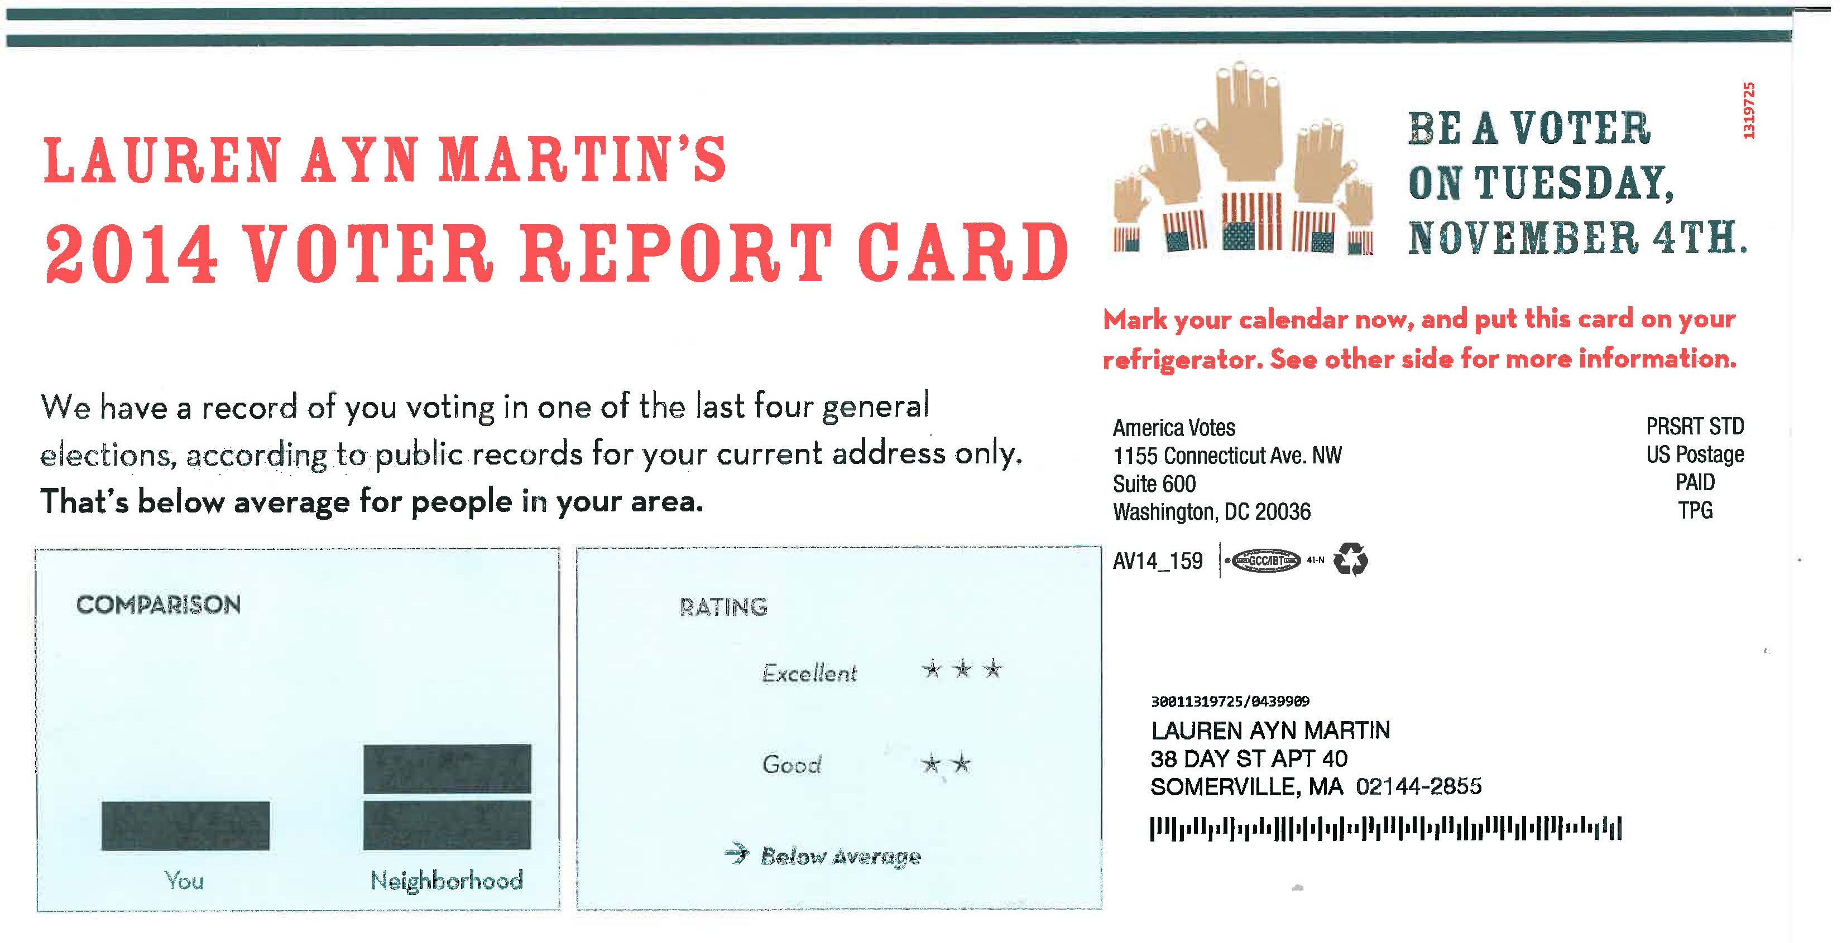
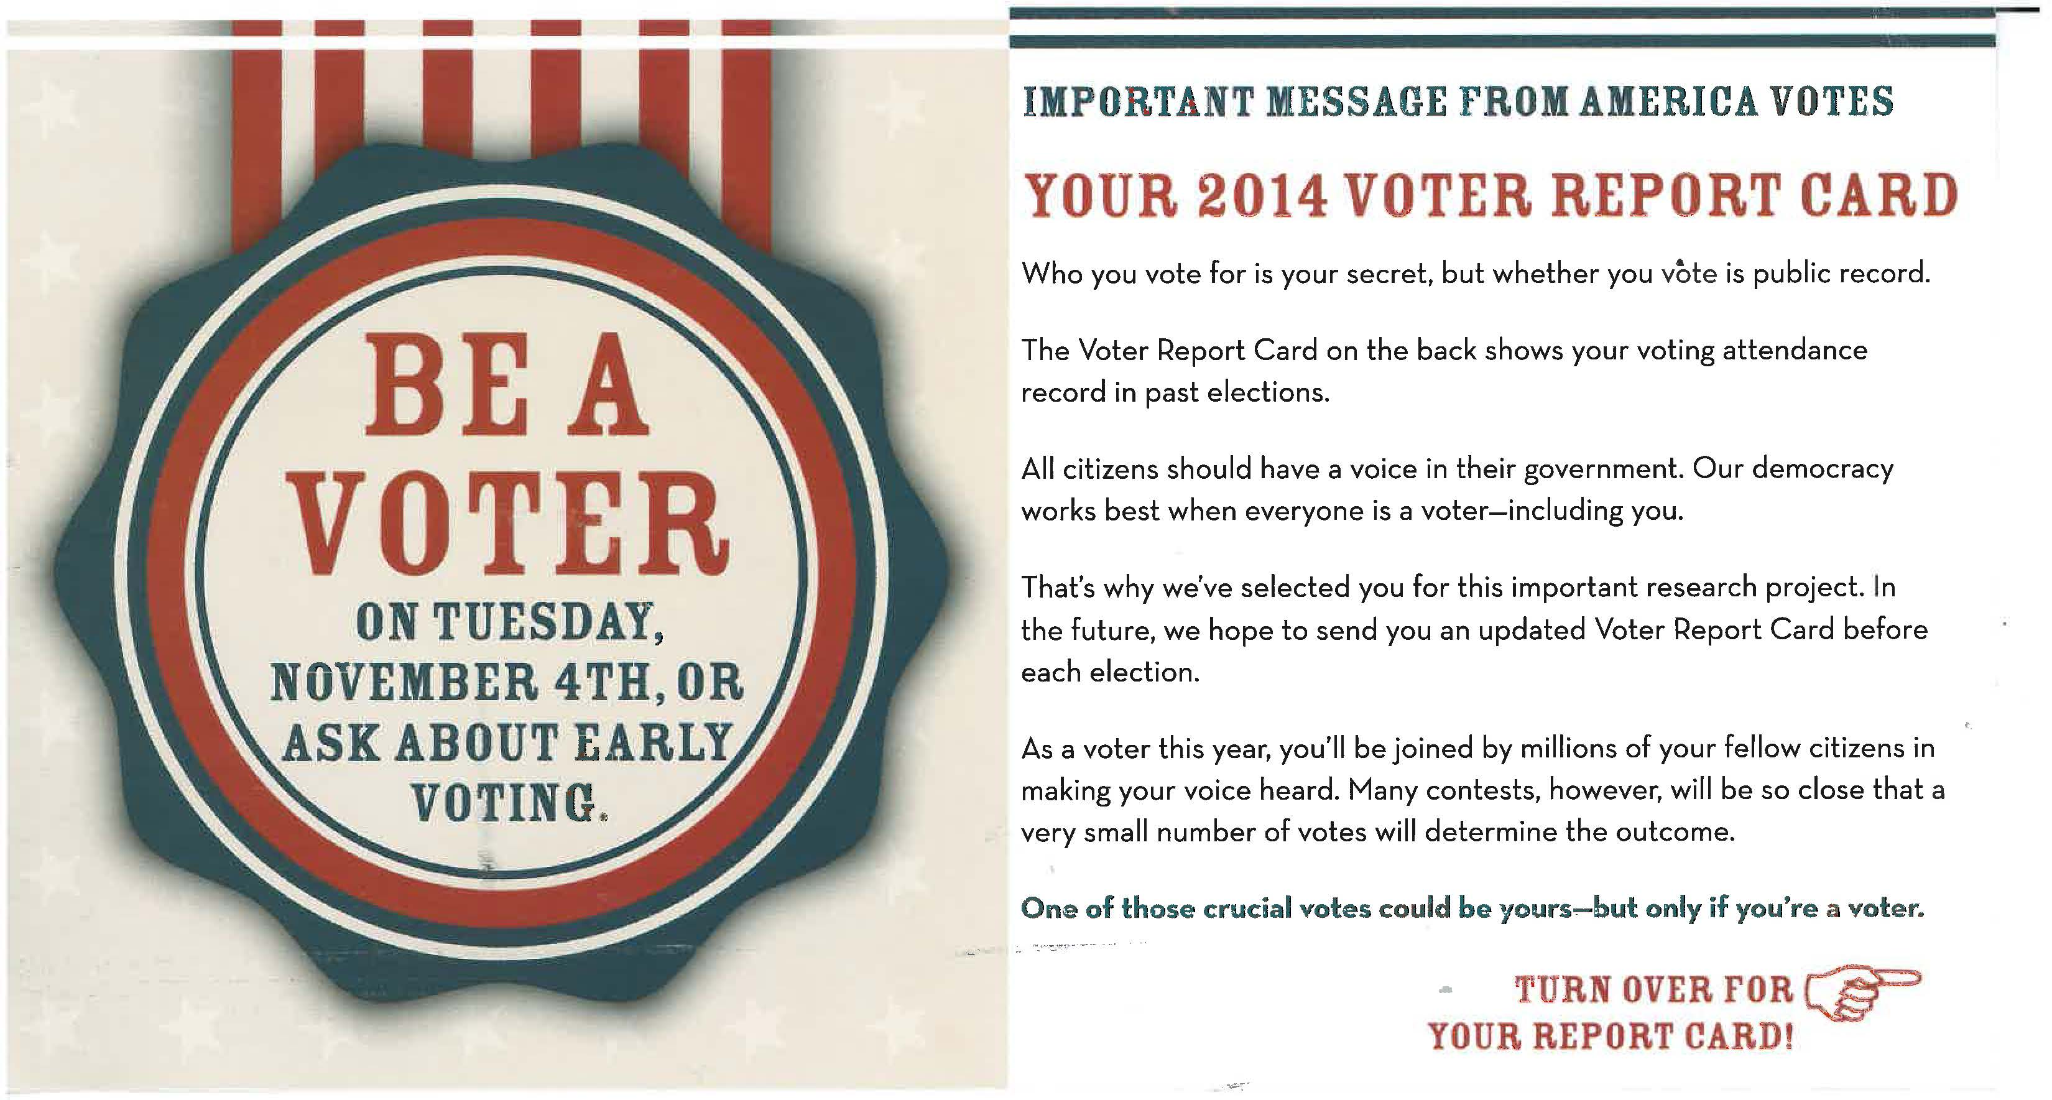
Notes:
Social norming by comparing to the rest of neighborhood.
Also asks you to use it as a prompt to remember to vote.

Slide 23
Picking the Right Strategies
BARRIERS | TOOLS
Lack of Motivation
Forget to Act
Lack of Social Pressure
Lack of Knowledge
Structural Barriers
Commitments Norms Incentives
Prompts
Norms
Social Diffusion
Convenience
Notes:
Helpful chart that lays out the various tools and strategies we discussed along with the corresponding barriers they can help overcome.

Slide 24
Tips for Developing Strategies
Overcoming resistance
Reactance →
Skepticism →
Inertia →
Reduce scarcity
Liking principle
Frame your message attractively
stories
change comparison
disrupt and reframe
Notes:
Additional factors and considerations to be mindful of when developing strategies
First has to do with creating strategies that address resistance to change, using a framework called Alpha and Omega strategies.
Alpha strategies deal with resistance by overwhelming it. When a person is ambivalent, the Alpha approach is to overpower the resistance with rhetoric (describing the benefits) or incentives (adding benefits). The problem is that Alpha Strategies, even when they are successful in persuading, don’t actually diminish the underlying concerns and apprehensions that a customer had, and doesn’t necessarily create a situation that’s conducive to long-term change because doesn’t get at underlying issues
Omega strategies, on the other hand, deal with resistance to change directly by finding ways to reduce or remove it to reveal benefits. Resistance comes in 3 main forms, and we can use different tactics or strategies to deal with each.
Reactance – Resistance to persuasion (people don’t like feeling like someone is forcing them to change) – Depersonalize the Interaction e.g. by using a story/anecdote to make the request less personal, message will still get through
Skeptical of message – Can Provide Guarantees, Reframe (e.g. so it’s not about climate change), Change Comparison (instead of "we are currently at 2% and should be at 48%" say, "Yale's goal is 50%, ours should be 48%")
Inertia – people set in ways & reluctant to change – disrupt and reframe. Disrupt and Reframe to get attention and interrupt the mental ‘refusal script’. (ex: For example, “typically there will be a collection location in less than 46,297 inches from your house – that’s less than a quarter mile. It’s convenient.” The large number (46,297) disrupts their stream of consciousness because it’s so unusual. The statement that “it’s convenient” reframes the change as convenient.)
Ties in to concept I mentioned earlier that we want to both decrease barriers AND increase benefits, not just one or the other. Can’t just focus on benefits (like alpha strategies) without addressing the barriers or resistance.
Reduce scarcity – be cognizant that people don’t like to have freedoms removed, which is why people often resist change – If we want to take something away (or increase its scarcity), we want to provide an alternative that is more prevalent, readily available or accessible.
If want to move people away from one option (e.g. paper cups), first give people a readily available alternative (e.g. reusable mugs). Thus help reduce the barrier to change and you’re using a positive message - focusing on what people SHOULD do – as opposed to what people shouldn’t do.
Liking principle – People are more apt to commit to something if they like the person who’s asking. Be a friendly messenger in your office
Good communication makes all the difference
Frame your message attractively using captivating, compelling information that is relatable and credible.
Avoid threatening messages (can cause reluctance to change and/or helplessness) and make sure to pair messages with concrete actions that encourage people to undertake the desired behavior
Make message visible and easy to remember and use a variety of communications vehicles
E.g. prompts and clear/specific information, provide personal or office-wide goals, hold events to foster communication

Slide 25
Exercise 4: Develop Strategy
Specific Behaviour | Barriers | Benefits
Encourage
Discourage
Notes:
Too often environmental program planners focus solely on the behavior they wish to encourage without giving adequate thought to the opposing behavior. By also addressing the behavior to be discouraged, we can make the desired action more attractive in contrast.
Example of biking vs. driving in Holland
See page 42 of FSB
DONE by 11:30 AM

Slide 26
Community-Based Social Marketing
5
Uncover
Barriers
&
Benefits
Select
Behaviours
Develop
Strategy
Pilot
Strategy

Slide 27
Piloting
Random Selection
Random Assignment
Measurement
Behavior Change
Resource Use
Resource Quality
Notes:
Note that random selection and random assignment are hallmarks of effective pilots. Random selection refers to obtaining your pilot participants in such a way that they are representative of the larger community to which you will eventually deliver your program. In contrast, random assignment refers to placing your participants in your control or strategy group(s) based simply on chance. Random assignment allows you to assert that it was your program rather than preexisting differences between your groups that is responsible for a successful pilot. See page 141 of FSB.

Slide 28
Pilot Strategy
Group
Pretest
Program
Posttest
Follow-up
Time
Notes:
This is the most common way of evaluating a program, but it is not definitive as we can’t be sure that it was our program rather than some other event in the community that caused the changes we observed. In general, we should avoid using this design.

Slide 29
Pilot Strategy
Strategy
Pretest
Program
Posttest
Follow-up
Control
Pretest
Posttest
Follow-up
Time
Notes:
The addition of a control group makes this a much more effective pilot. The control allows you to ascertain if observed differences between the pretest and posttest are occurring because of something other than your program. Note that if changes are observed in your control group, they need to be subtracted from the results in the strategy group. See page 138 FSB.

Slide 30
Community-Based Social Marketing
Uncover
Barriers
&
Benefits
Implement
Broadly
&
Evaluate
Select
Behaviours
Develop
Strategy
Pilot
Strategy

