Slide 1
Introduction to Risk Communication PowerPoint No. 8
Notes:
… TO COMPLEX/WICKED PROBLEMS/GRAND CHALLENGES/COMPLEX ISSUES

Slide 2
Learning Objectives
Introduce risk communication
Introduce risk communication best practices
Practice key message development
Practice risk communication skills through examples

Slide 3
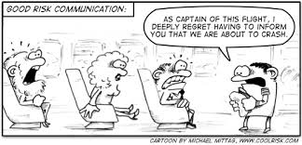
.
Risk communication is an open, two-way exchange of information and opinion about risk that leads to better understanding and better risk management decisions by all involved.
Notes:
Involved egs. (egs. public health officials, clinicians, patients, scientists).
Often involves multiple messages about the nature of risk or expressing concerns, opinions, or reactions to risk messages or to legal and institutional arrangements for risk management

Slide 4
What is a Crisis/Disaster Situation?
An external situation which presents a threat to a person or his/her relatives.
It may interrupt the functional, cognitive and historic continuity among individuals, families, groups and the community.

Slide 5
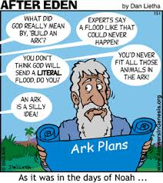
Crisis
Crisis situations are volatile
Poor or misleading communication about the event can worsen the public’s fears and increase panic.

Slide 6
A truck dumps cattle carcasses in Athi River

Slide 7
A truck dumps cattle carcasses

Slide 8
Risk analysis paradigm
Everything we do involves risk
Zero risk is unachievable
Options exist for managing every risk

Slide 9
Risk Analysis Paradigm
1. Risk Assessment:
Hazards are identified
Risks are determined
2. Risk Management:
Options are identified
Best option chosen and implemented
Risk Communication:
Open exchange of information resulting in better decisions about risk and its management
Risk Assessment
Risk Management
Risk Communication

Slide 10
Conflicting perceptions about risk
Health Professional / Veterinarian / Scientist
Risk = Probability x Magnitude
How likely to happen?
How bad if it happens?
Policy Makers / Decision Makers / Public
Risk = Hazard + Outrage

Slide 11
Our human reaction
Risk = Hazard + Outrage
Hazard = something that can go wrong
Outrage = source of fear & / insecurity
Peter Sandman http://www.psandman.com

Slide 12
Two Key Issues
Instill Confidence
Prevent panic!
Calm and make the public feel comfortable and self assured
Provide information to Public
Educate public in advance, if possible
Provide necessary information
Do Not Confuse Them!

Slide 13
4 types of risk communications!
Calm down!!
Outrage
Management
We’ll get through this together.
Crisis
Communication
High
Outrage
Public
Relations
Watch out Precaution
Advocacy
Low
High
Danger (Hazard)
Peter Sandman
http://www.psandman.com/
Notes:
Discuss 4 quadrants

Slide 14
Summary
Risk communication & risk analysis paradigm
Our perception of risk is a combination of facts (objective) and emotion (subjective)
Appreciate the disconnect between science and public perceptions of risk

Slide 15
Applied Question #1 Think, Pair, Share
Moldy maize meal has been put into animal feed.
This can cause Aflatoxicosis, a fungal intoxication that will damage the liver.
Once the animal shows clinical signs such as poor appetite and jaundice, treatment may not help.
Who are the most important audiences to communicate this danger / risk to?
What communication methods will you use?

Slide 16
RISK COMMUNICATION
Goal:
Informed support
Resistance
High Stress Changes the Rules

Slide 17
High Stress Changes the Rules of Communication
People want to know that you care before they care about what you know.
People have difficulty hearing, understanding and remembering information.
People understand information at four grades below their education level.

Slide 18
High Stress Changes the Rules
Mental noise reduces the ability to process communication on average 80%.

Slide 19
Goals of Risk Communication
Decrease outrage!
Take into account emotional response to event
Empower audiences to make informed decisions
Discourage negative behavior
Encourage constructive responses to risk or danger
Trust - one of the most important factors in determining the effectiveness of risk communication
Notes:
Needed? If so, where Scientists are trained to provide all the known information about a particular risk. For a risk communicator the goal is to take the information, digest it, translate it into understandable language and tailor specific messages to each audience.

Slide 20
Older Risk Communication
Information flow in one direction, or the “we tell them” approach.
Contemporary Risk Communication
Risk communication is multi-directional and actively involves audience as partners.

Slide 21
Risk Communication Best Practices (1)
Remember communication is two way street
Listen to your audience and seek understanding
Communicate with empathy and concern
Don’t assume
Be aware of cultural and language differences

Slide 22
Risk Communication Best Practices (2)
Use appropriate terminology
Accept uncertainty
Use key messages
Provide resources for more information
Foster partnerships
Remain accessible

Slide 23
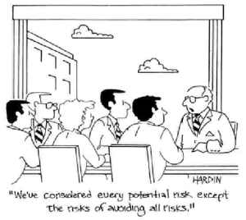
Myths!
Communicating risk is more likely to harm people versus calm them.
Notes:
PANIC!!

Slide 24
Myths!
Communicating risk is more likely to harm people versus calm them
Notes:
PANIC!!

Slide 25
Myths!
Communication is less important than education – if people knew the true risks they would accept them.
Notes:
PANIC!!

Slide 26
Myths!
Communication is less important than education – if people knew the true risks they would accept them
Notes:
PANIC!!

Slide 27
Myths!
Issues arising in crisis are too difficult for the public to understand, so it is better to say nothing or just tell them what to do.
Notes:
PANIC!!

Slide 28
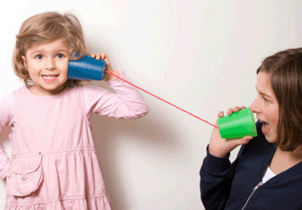
Myths!
Issues arising in crisis are too difficult for the public to understand, so it is better to say nothing or just tell them what to do
Notes:
PANIC!!

Slide 29
Myths!
Risk communication is someone else’s job / problem.
Notes:
PANIC!!

Slide 30
Myths!
Risk communication is someone else’s job / problem
Notes:
PANIC!!

Slide 31
Summary
Risk communication is an open, two-way exchange of information and opinion about risk which leads to better understanding and better risk management decisions.
Using risk communication best practices can help manage risks better.

Slide 32
Applied Question #1 Think, Pair, Share
You are spokesperson for the National Anthrax Taskforce leading government response to an outbreak in wildlife in a national park.
Following the initial press release about the outbreak you are misquoted in international media - misinformation which may cause undue concern or alarm (outrage!).
As a spokesperson, how should you address inconsistent messages about the outbreak?
Notes:
Two examples of miss-information
Anthrax spread by hippos cannibalizing each other. Note: Hippos are herbivores!
Fish caught near dead hippos spreads anthrax to people.

Slide 33
Reducing Outrage
Do not wait until all the answers are in!
Communicate:
What you know
What you don’t know
What you are doing to address the situation

Slide 34
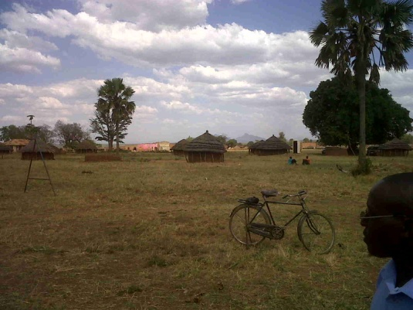
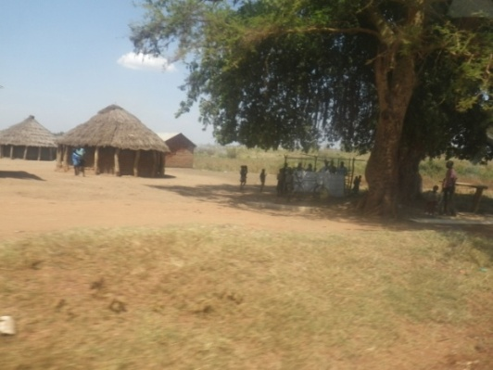
Case Example ‘Strange disease’ in Northern Uganda
Nov 2010 – Mid Dec 2010
97 cases and 31 deaths reported

Slide 35
What we know
First cases reported on 10 Nov 2010
Symptoms
Severe headache
Dizziness / General Body Weakness
Fever
Abdominal Pain
Diarrhea (with and without blood)
Vomiting (with and without blood)
Bleeding from nose
Fatal if not treated

Slide 36
What we know
Samples sent for laboratory testing negative for;
Ebola
Marburg
Clostridium perfringens
Others
Males more affected than females
Epi association with Waragi consumption

Slide 37
What we know
Outbreak resolving in Abim and Agago – new cases in Kitgum
Use of PPE prevents infection
Tx with IV antibiotics (cipro / ceftrixone) and supportive care
Without treatment quickly fatal

Slide 38
What we DON’T know…
What is causing this disease
How the disease is spread
How many cases / deaths there will be
Why men are affected more than women
When the disease will be contained and eliminated

Slide 39
What is being done
District and national emergency taskforce(s) convened.
Uganda MoH leading and coordinating investigation.
Isolation wards set-up to treat cases.
Surveillance to identify and treat additional cases.
Intergovernmental and non-governmental support for investigation and response efforts.
Human medical, public health, animal health and environmental health experts working together.

Slide 40
Summary: What is known, unknown and what is being done
Deadly disease outbreak
Antibiotic treatment saves lives
Associated with alcohol consumption (Waragi)
Primarily affects men
Unknowns
What is causing this disease
Where the disease came from
How long until disease contained / eliminated
Response
Contain outbreak
Identify cause
Eliminate disease → Return to normal
Notes:
KEY MESSAGES – Summary slide
Incorporate messages from technical, risk communication

Slide 41
Goal: Acknowledge hazard, validate concern, give individuals ways to respond
Outrage
Management
Crisis/
Emergency Communication
High
Outrage
Public
Relations
Precaution
Advocacy
Low
Danger (Hazard)
High

Slide 42
Give people useful actions
Must do…
Seek immediate treatment if sick
Report suspect cases to health authorities
Stay in treatment until discharged by doctor
Follow government regulations (National, District and Local)
Should do…
Wash hands regularly
Avoid close contact with sick people
Avoid contact with and meat from sick or dead animals
Early reporting to health centre increases chance of survival
Avoid local alcohol (Waragi)
Could do…
Keep informed / educate yourself & others
Notes:
Insert event specific data…
Examples
Must do…
Report suspected human or animal infections
Follow government regulations
Case isolation, travel restrictions, Animal quarantines, animal movement restrictions, animal & livestock vaccination guidelines
Should do…
Protect yourself, your family and your animals
Follow government recommendations
Could do…
Keep informed / educate yourself & others about the facts
Assist others directly affected by outbreak

Slide 43
Message Mapping
Helps develop key messages about risk
First adopted following the 2001 anthrax attacks in the United States
Developed by Vincent Covello at Columbia University
Notes:
What we have here is a failure to communicate” due to lack of clear communications goals

Slide 44
“Mental Noise”
When people are stressed, fearful or upset, they have difficulty:
hearing information
understanding information
remembering information
Notes:
People in hi state of conerrn their ability to process info effectively and efficiently is severely impaired this emotional response creates “mental noise”

Slide 45
Message basics
Know your audience.
Keep messages short and focused (single sentences & headlines).
Save the background information for later.
Give action recommendations in positive terms (“do” rather than “don’t do”).
Notes:
FMD for the farmer vs the veterinarian, Tb for the patient’s family vs the ER docs

Slide 46
Message Basics
Prioritize messages
First and last
Must do, should do, could do
Use visuals (graphics, demos)
Use non-technical language
Use common figures of speech
Don’t overwhelm with numbers / probabilities
Notes:
Use simple, non-technical language (no jargon).

Slide 47
Message Mapping – Key Questions
What are the most important things:
you would like your audience to know?
your audience would like to know?
your audience is most likely to get wrong unless they are emphasized?
Notes:
NOTE: your audience’s need are MORE important than what YOU want them to know!
47

Slide 48
A Basic Message Map

Slide 49
Applied Question #3 Small group exercise
‘Strange disease’ / hemorrhagic fever outbreak in remote town
As a One Health leader, how can you communicate appropriate risk messages?
Identify one audience, one to two communication vehicles and develop 3 key points (messages),

Slide 50
Thank you

