Slide 1
Gender, one health and infectious disease management
Case study development-
powerpoint no. 10

Slide 2
Case Study Development

Slide 3
Watch Video – Fatal infestations
Use this video as a case study and identify the key themes.

Slide 4
Themes
Disease ecology and epidemiology
Human animal and environmental dynamics
Multi-disciplinary collaboration
Emergency preparedness and response
Social-political dimensions
Policy implications

Slide 5
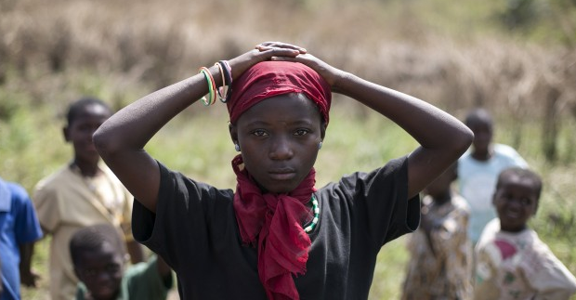
Can you tell a story about this image?

Slide 6
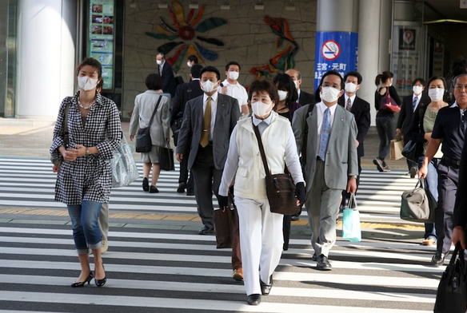

Slide 7
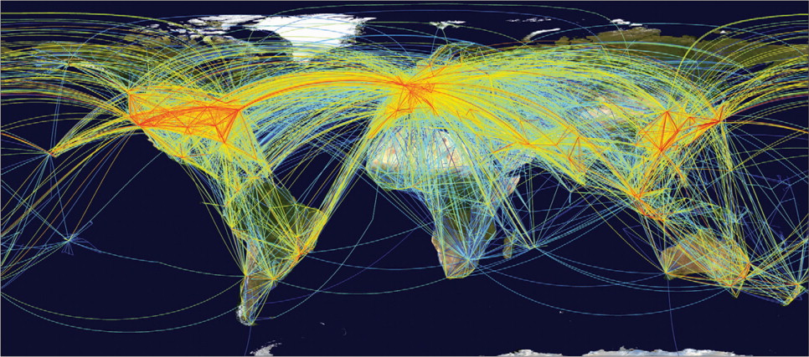

Slide 8
What is a case?
A case study is a puzzle that has to be solved.
A case should have a problem that the readers need to solve
The case should have enough information in it that readers can understand what is in it, think about it, analyze and be able to come up with proposed solutions.
A good case is more than just a description.

Slide 9
Case study Development
The purpose of a case study is to provide a more thorough analysis of a situation or "case" which might reveal interesting information about that classification of things.
The key is to take your large problem and bring it down to the level of the individual or single unit.

Slide 10
Basic steps in case writing
Research
Analysis
Actual writing

Slide 11
Steps to writing a case study
Determine what your case study will be about.
Develop learning objectives for the case.
Choose a case site. Think of a location, an organization, company, or individuals who are dealing with that problem.
Think through open ended questions that will provide you with information about what is working in that situation, how the situation developed and which parties are involved.

Slide 12
Research
Library and internet research, what has been written before, important background info.
Interview people who know the place or the situation.
Avoid `yes’ or `no’ questions.

Slide 13
Analysis Phase
Put all the information in one place.
Assign sections of material to different people.
Each person figures out what is really important.
Environment and orangutan
Try to formulate case problem in a few sentences to start with.
This will help you figure out if you need more information.

Slide 14
Case writing
Describe the problem or case question you want the reader to solve.
Organize the sections of your case
Introduction to the problem
Background on the case: place/ person/ theme/ community/ disease
What you know about the problem, how it developed, what solutions came up
Suggested solutions: may or may be not
Conclusion: Must leave it open for readers to come up with their own conclusions.

Slide 15
Write the case study
- Introduction to the problem:
- Background on the case: Information about your case study site, where or who it is. - The next several sections should be about the problem as it pertains to the case. Describe for the reader what you learned about the problem at this site, how it developed, what solutions have already been proposed and/or tried, and feelings and thoughts of those working or visiting there. - The concluding paragraph should wrap it up with possible solutions, without solving the case per se. It might make some final references to the stakeholders and their thoughts about possible solutions, while leaving it open to the reader to come up with a different answer.

Slide 16
Case study analytical questions
Formulate some questions that you will want whoever is reading the case to answer for every section that will direct them.
Basically your assessment questions
Add important references that will be useful for your readers/learners.
Have some answers to these questions.

