Slide 1
Gender, ONE HEALTH and infectious disease management
Introduction to basic gender terms
Powerpoint No1

Slide 2
At the beginning
Think as far back as possible and write down your first experience of realizing you were different from members of the opposite sex / were expected to act differently/were treated differently
A story about an experience that made you aware of the difference between men and women.

Slide 3
RECORD
How old were you?
Who was involved?
Where did the incident take place?
What was the incident?
How did you feel?
How did other aspects of your identity (race, religion, nationality, social status, ethnicity) come into play?

Slide 4
SESSION 1
What is sex and Gender?

Slide 5
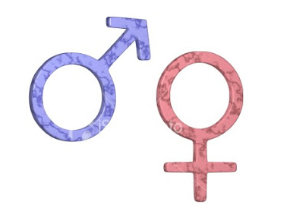
Sex and gender
Sex refers to the biological and physiological factors that define males and females.
Gender refers to the socially constructed roles, behaviors, activities, and attributes that a given society considers appropriate for males and females. Gender differences include both socio-cultural factors as well as male-female differences in access and control over resources.
In many countries, gender influences access to economic resources. The lack of access to economic resources is sometimes a barrier to prompt and effective health care for women.

Slide 6
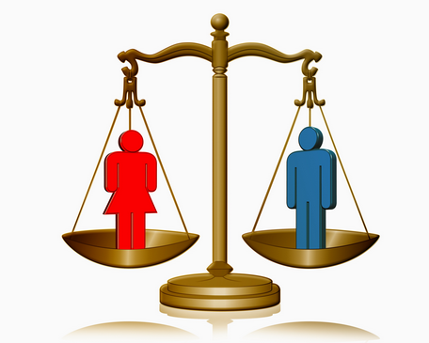
Gender EQUALITY
Equal treatment of men and women in laws and policies.
Equal access to resources and services within families, communities and societies at large.

Slide 7
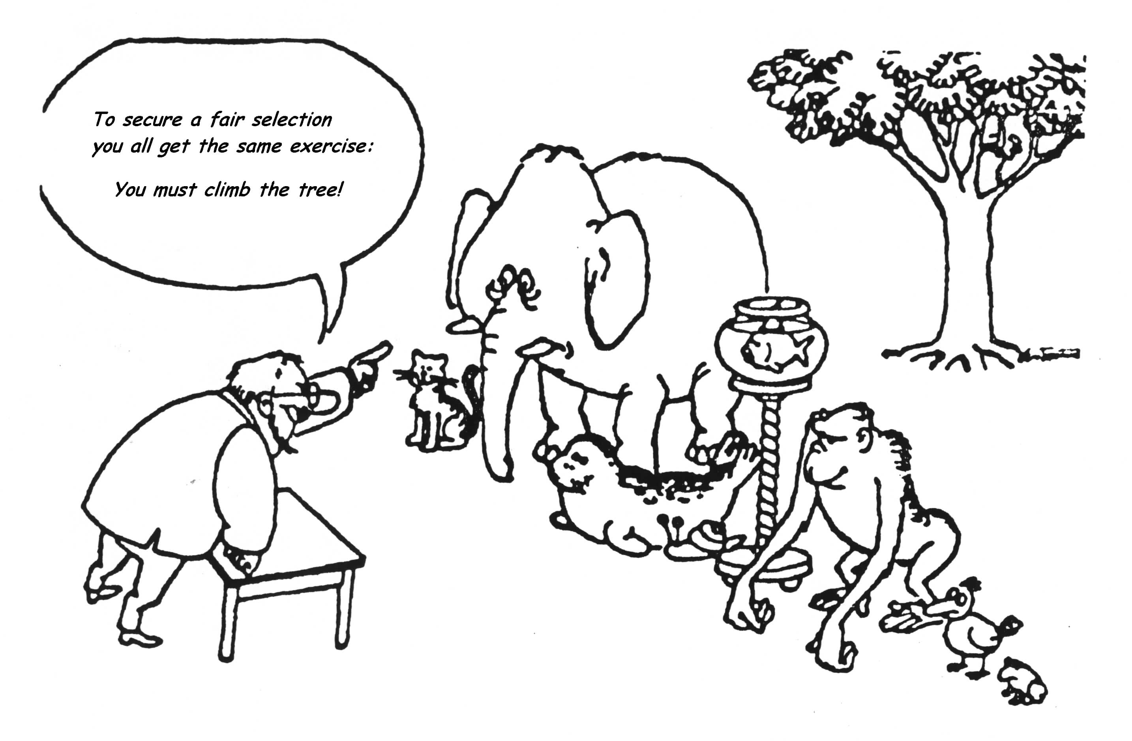
Equal opportunities?
Notes:
7

Slide 8
Gender equity
Fairness and justice in the distribution of benefits and responsibilities between men and women.
Often requires women specific programs to end inequities.
Reproductive roles acknowledged as work.

Slide 9
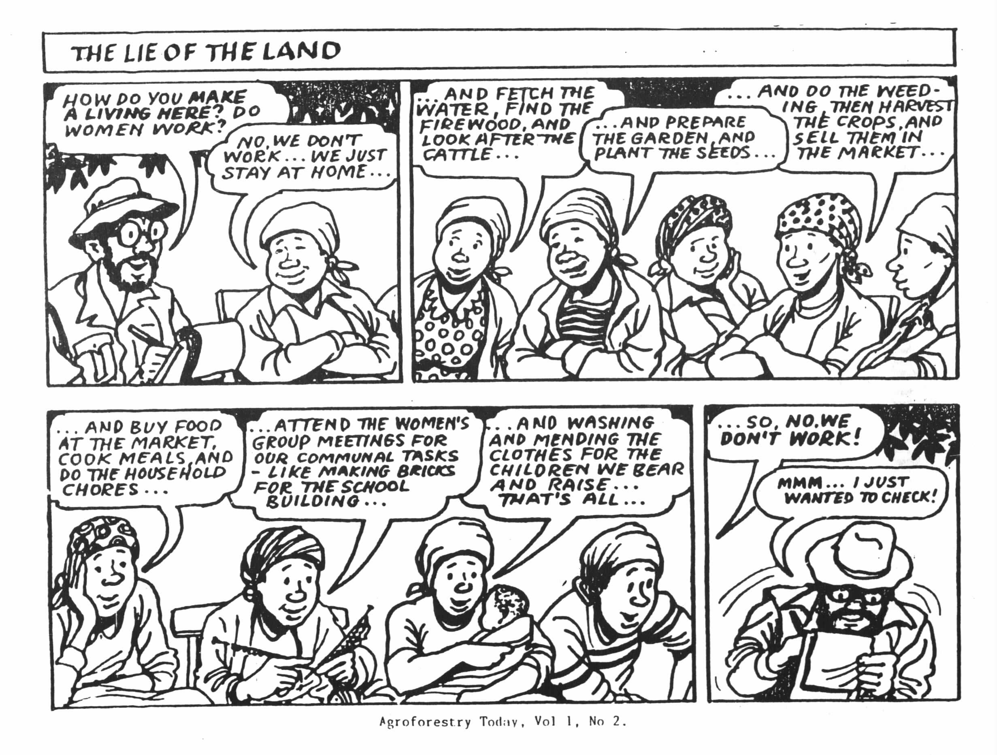

Slide 10
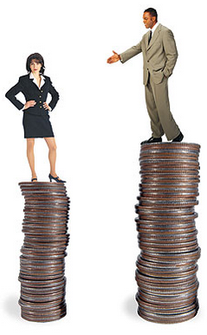
Gender discrimination
Refers to any distinction, exclusion or restriction made on the basis of socially constructed gender roles and norms that prevent someone from enjoying full human rights.

Slide 11
Close out
Gender roles are learnt.
Socialization into gender roles begins early in life.
Learning to be different in terms of appearance and dress, activity and pastimes, behavior, emotions, responsibilities, intellectual pursuits.
Gender roles are not unchangeable - they can be unlearnt.

Slide 12
Society
Role of family, other social institutions and women themselves - women play as significant a role on socializing girls and boys (the girl with unshaved legs at the hair salon).
Society generally values women less than men (First Lady -Michelle Obama and fashion).
It is difficult to put pressure on the family to change - private sphere - absolute power to male heads of households.
Gender based inequality is often written in laws and policies (Kenya – polygamy law).
Men are also constrained by construction of masculinity.
Fighting gender inequality is about challenging an ideology - an ideology that is perpetuated by both men and women - and vests great power.

Slide 13
Creating a 24 hr calendar

Slide 14
24 hour CalendAr
Daily activity clock for household with sick child and community with Ebola outbreak
Brainstorm activities involved in caring for sick child
Record responses on flip chart
Create 24 hour calendar for family with sick child (Ebola community)
Create 24 hour calendar for normal family (no disease - normal daily activities)
Include sleeping and leisure time

Slide 15
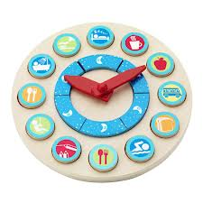
Create a 24-hour activity clock
Record the different activities that men, boys, women, and girls do over a 24-hour period.
Time | Adult Men | Boys | Adult Women | Girls
05:30 am | Waking up getting ready to go to work | Sleeping | Giving the sick child medicine and tea | On the phone with her friends
06:00 | Preparing bath and breakfast tea | Sleeping | Preparing bath and breakfast tea

Slide 16
What do you think?
What are the main activities?
What are the similarities and differences in the activities performed by men and women?
How do you think each activity impacts:
Differences in exposure to the illness?
Difference in contact with people outside the home?

Slide 17
What do you think?
What were areas of agreement/disagreement among your team as you created the activity clock?
Surprises
What do the differences among the activities performed by men, boys, women and girls mean to you as someone involved in managing disease?
Why do these differences exist and why are they maintained?

Slide 18
Observations from 24 hr time line
Women and men have different responsibilities.
Women work a longer day than men.
Women’s days are often fragmented as they go along while men’s days are more likely to be characterized by blocks of time allocated to separate activities.
Men seem to get longer rest hours than women
Men travel farther distances to work.
Women undertake productive work close to home.

Slide 19
reflections
Do you feel women’s roles are less valued than men? If yesb- why? If not, why not?
Do you feel that men are becoming marginalized? If yes why? If no, why not?

Slide 21
Consequences of gender roles

Slide 22
Women are flowers of the world

Slide 23
Men are the elephant’s front legs and women are its hind legs

Slide 24
Discussion of incidence
Division of labor: chores girls do/compared to boys - Affected by culture, economic status, education
Dress codes
Physical segregation of boys and girls
The kind of games girls and boys play
Emotional responses
Intellectual responses - Japan

Slide 25
Did any of you challenge that? Or do you know others who challenged it and what happened?
If not, why not?
To which institution/system did the people who introduced you to or reinforce gender norms belong to?
Did anyone you know get labelled when they challenged a norm/ or even get thrown out of the social structure/ostracized/ treated violently?
This aggression may be amplified by race, ethnicity, national status.
Depending on where you are seeking remedy ,may be very different or impossible.

Slide 26
Laws and policies
Gender norms have often been formalized in law and policy.
Laws of inheritance often favor males.
Marriage and divorce laws in many countries
Resource ownership
For a long time, domestic violence was considered in the personal sphere

Slide 27
Institutions of gender socialization
Behind the institutions that introduce and reinforce gender norms are a range of social institutions:
the family, religious institutions, communities, schools, the media, and the state
List the three you think play the most role?
Family, media, religion

Slide 28
Gender roles
Women considered “caring”.
Care for sick - most likely to become infected.
Women spend a great deal of their time in the caring activities which involve feeding, cleaning, washing, preparing food.
As a consequence, often women and young girls are less likely to be involved in political, educational, and professional activities.
Because they are less educated and informed, their knowledge about the disease is often less than what men have.

Slide 29
Institutional gender policies
Three categories of gender policies:
Gender- blind
Gender-aware
Gender-neutral
Gender-specific practical
Gender-redistributive: strategic
Notes:
29

Slide 30
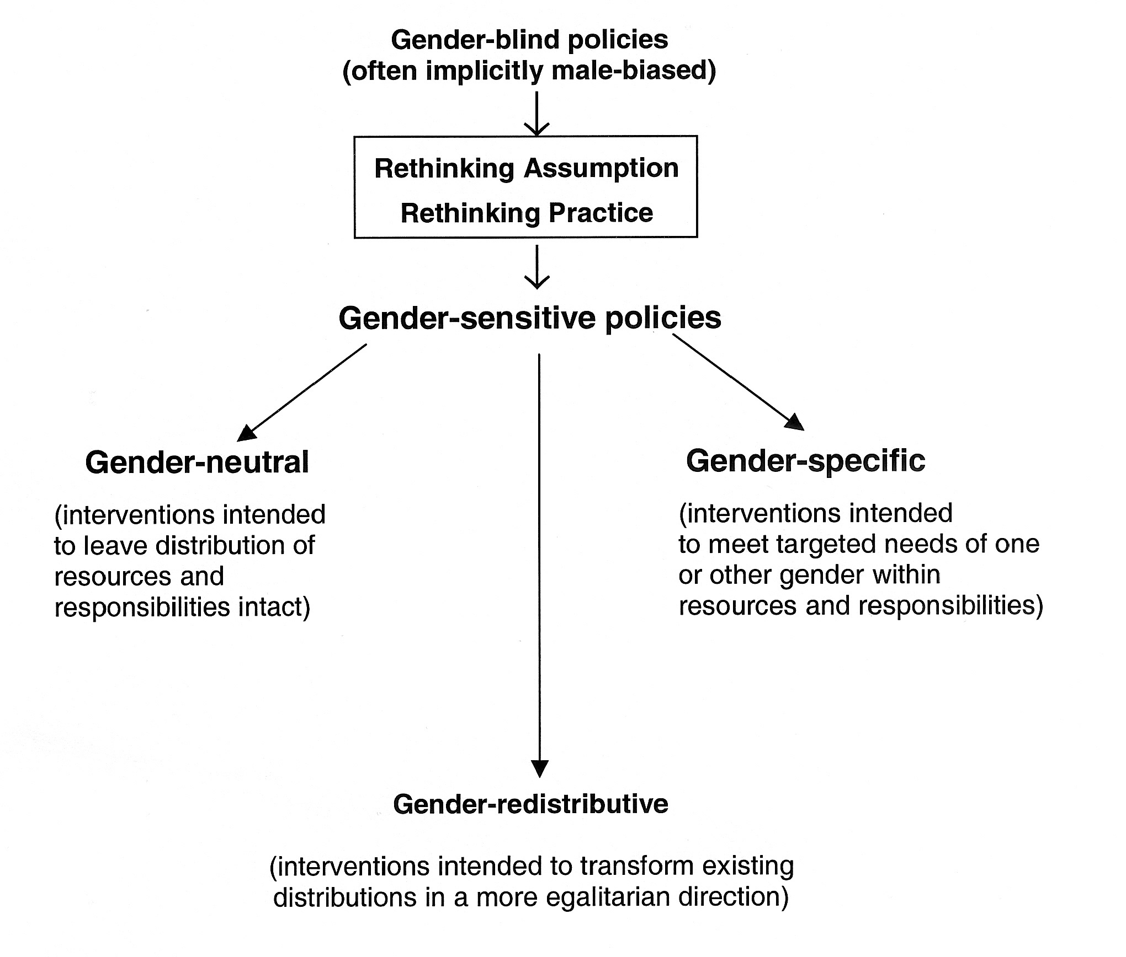
Notes:
o till now we have develpoped a tool to knockdown the expression of the three NMEEs together in the parasites, and seen that knocking down these NMEEs ex vivo debilitate worm’s ability to cleave ATP. Now we wanted to ask the question what happens to the worms if their ability cleave ATP is debiiated in the host ..
30

Slide 31
Gender friendly Innovations
Innovation in production practices
Innovation in delivery system
Innovation in infrastructure
Insurance
Land dev. / water cons. exercises
Agriculture techniques
Marketing
Activism for infrastructure access and use
Collective farming
Service delivery leading to women’s empowement
Allied livelihood options
Notes:
o till now we have develpoped a tool to knockdown the expression of the three NMEEs together in the parasites, and seen that knocking down these NMEEs ex vivo debilitate worm’s ability to cleave ATP. Now we wanted to ask the question what happens to the worms if their ability cleave ATP is debiiated in the host ..
31

Slide 32
Understanding reasons for differences and Impacts of these differences in roles men and women play
Root: Why are there gender role differences? Culture, stereotypes, religion, legal system, political system
Trunk: What are the gender role differences seen? When we did the calendar
Branches: What creates and maintains those differences? e.g. policies, institutions, legislation
Leaves: Consequences: disease , food insecurity, poverty, lack of access to resources like education

Slide 34
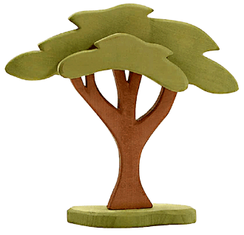
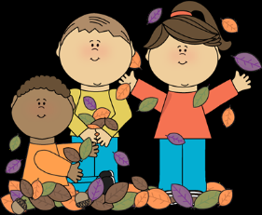
GENDER ROLES
Source: mycutegraphics.com

Slide 35
GENDER ROLES
Roots – Causes

Slide 36
GENDER ROLES
Trunk – Gender Roles
Roots – Causes

Slide 37
GENDER ROLES
Branches – Create and Maintain
Trunk – Gender Roles
Roots – Causes

Slide 38
GENDER ROLES
Leaves - Consequences
Branches – Create and Maintain
Trunk – Gender Roles
Roots – Causes

Slide 39
Women in the workplace in this country
Women in politics

Slide 40
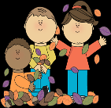
Discovery activity
Draw your tree describing:
Why there are role differences between men and women (ROOTS)
The different roles men and women play (TRUNK)
What institutions, legislation policies create and maintain gender differences (BRANCHES)
The consequences of institutionalized gender differences (LEAVES)
Source: mycutegraphics.com

Slide 41
What do you think?
Which part of the tree would you target for long-term, systemic intervention in order to manage disease sustainably?
What would you do?

