Slide 1
Gender one health and infectious disease management
One health and the drivers of disease emergence
Power point no2

Slide 2
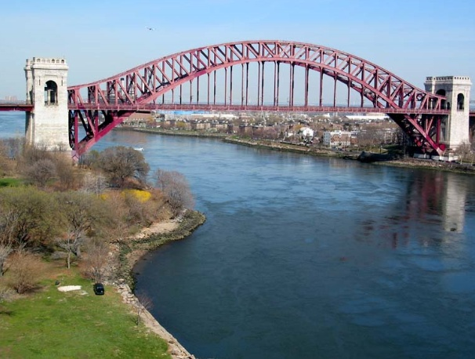
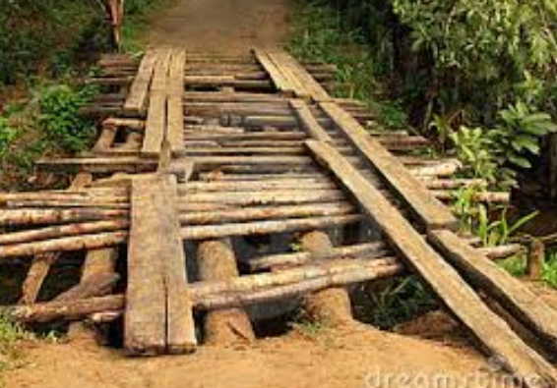
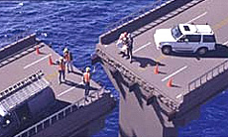
Building bridges
People understand bridges — they get you where you’re going, erase divides and create connections.

Slide 3
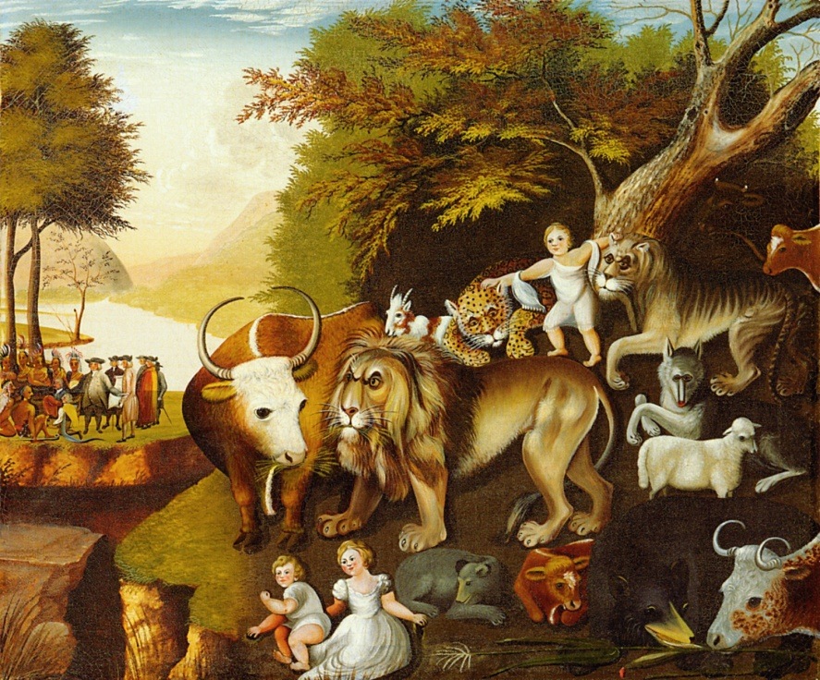
We need an integrated approach?

Slide 4
Emerging infectious diseases
Jones, et al Global trends in emerging infectious diseases
  On the rise – 335 (1940-2004)
  60.3% are zoonotic
    71.8% from wildlife
Wolfe et al. Origins of major human infectious diseases
  New evidence on origins of human malaria

Slide 5
Emerging Diseases
Not just humans….
Avian Influenza H5N1
  475 humans :How many birds ?
BSE & Chronic Wasting Disease
Tuberculosis in wildlife reservoirs
Chytridiomycosis in amphibians
Morbillivirus in marine mammals
White-Nose Syndrome in bats

Slide 6
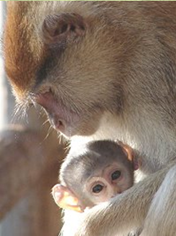
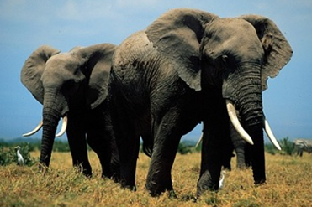
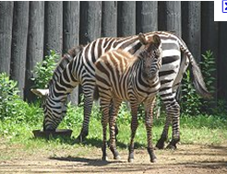
Shrinking habitats

Slide 7
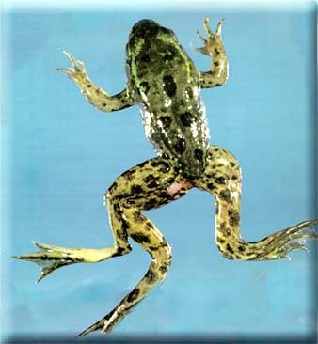
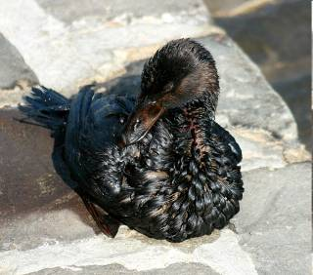
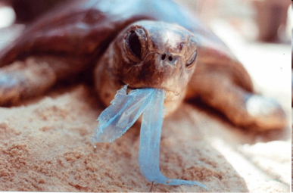
Pollution

Slide 8
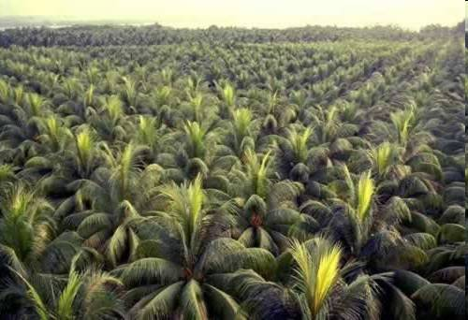
Loss of biodiversity

Slide 9

Climate change: changes in environment and Land use

Slide 10
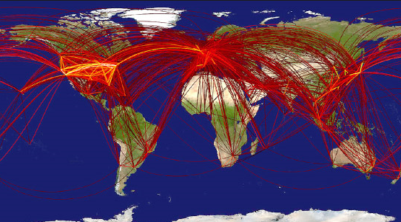
Globalization and travel

Slide 11
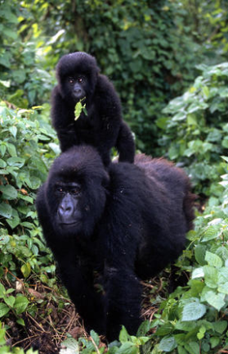
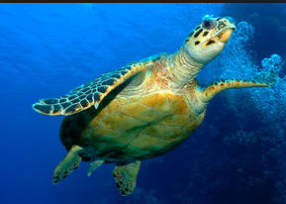
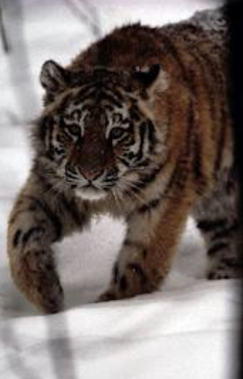
Global trade of wildlife

Slide 12
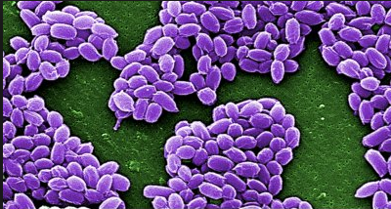
Bio-Terrorism as part of the threat

Slide 13
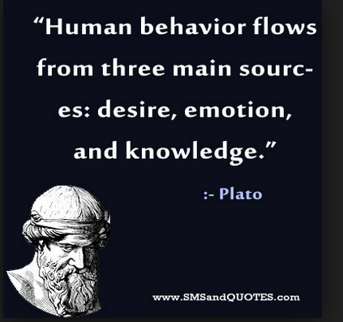
Human behavior
Sexually transmitted diseases
increased three fold when minimum
age for teenagers having sex dropped.
The development of complacent
attitudes and lack of basic knowledge
about risks have led to re-emergence of
Syphilis in the UK.
Sharing of blood contaminated
needles by drug users has led to
spread of hepatitis B and C.
Increased popularity of body piercings and tattoos provides an opportunity for the spread of blood borne viruses.

Slide 14
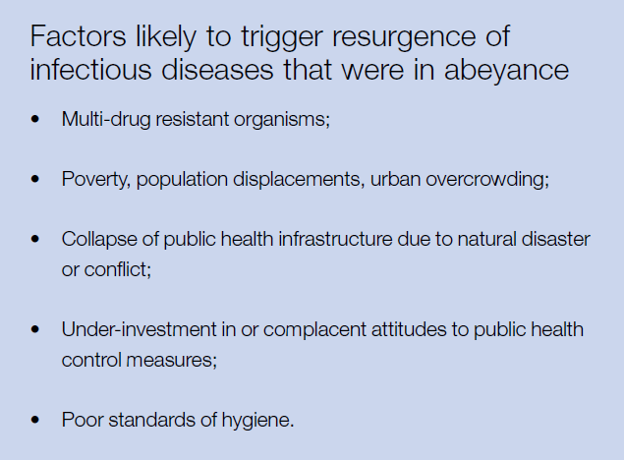

Slide 15
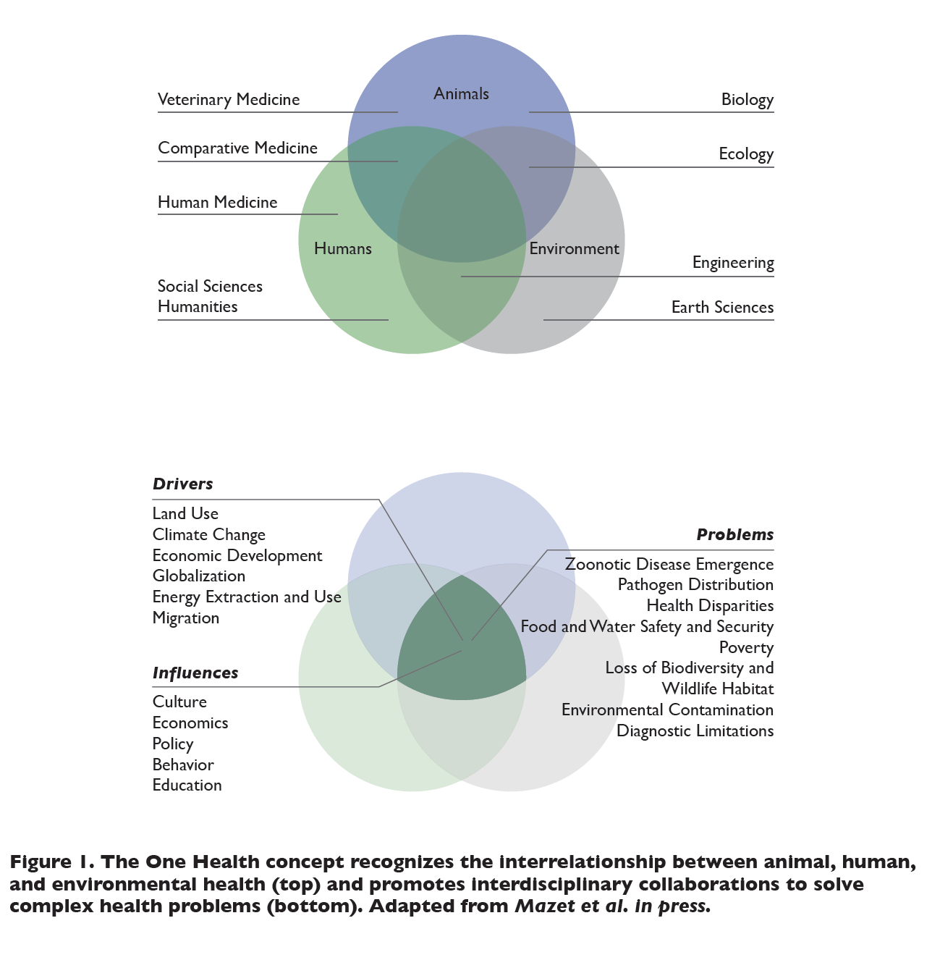

Slide 16

Why?
Prevent and respond to disease outbreaks
Reduce risk of infectious diseases outbreak
Recognize and identify zoonoses
ONE world: ONE health

Slide 17
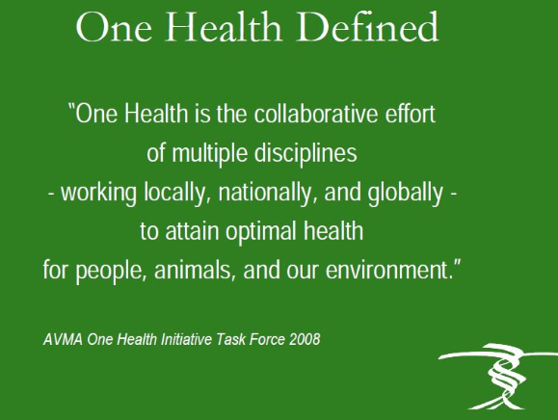

Slide 18
One Health
An interdisciplinary strategy to address health from an integrated perspective rather than a discipline-based fragmented perspective ….
Is not a discipline, it is an approach

Slide 19
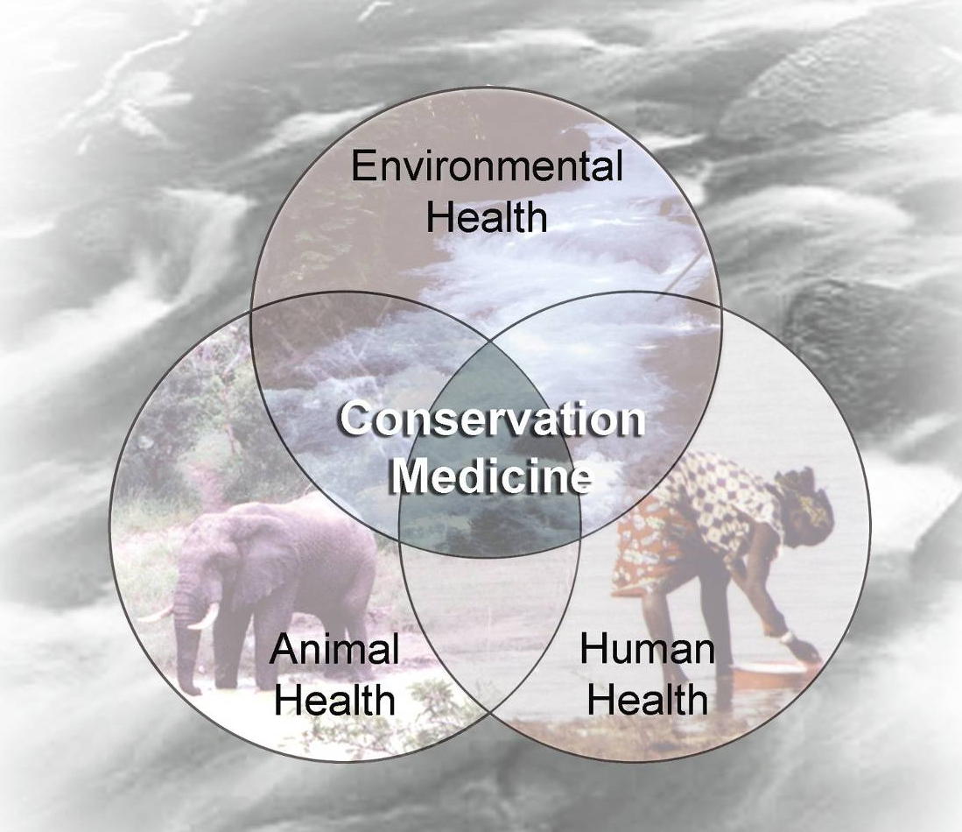
One Health

Slide 20
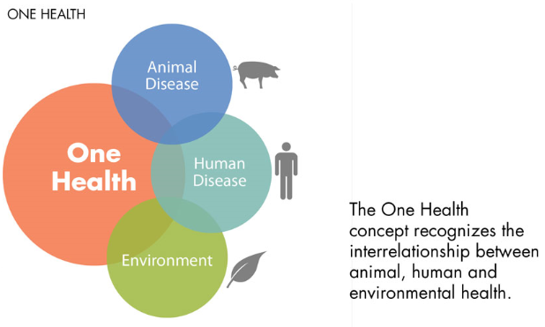

Slide 21
One health
Human, livestock or wildlife health cannot be discussed in isolation anymore.
Public health depends on a clean environment: Hippocrates
Objective of OH approach is to create stronger, more efficient, integrated health systems with input from multiple stakeholders in addressing global health issues

Slide 22
Scope of one health
Combating existing and emerging diseases and zoonosis, biomedical research and clinical medicine, conservation medicine, diagnosis, surveillance, control, response and recovery directed at natural and or intentional threats that are chemical , toxicological or radiological in nature, ethics, entomology, food safety and security, global food and water systems, global trade and commerce, health of the environment and environmental conservation, implications of climate change, infectious disease ecology and integrated systems for disease detection, land use production systems and practice, mental and occupational health, public health, awareness and communication, support of biodiversity, wildlife promotion and conservation.

Slide 23
Animal science, human health, and environmental science are at the core of One Health
Drivers of One Health include…
Land Use
Economic Development
Globalization
Energy Use
Migration
Influences of One Health include…
Culture
Economics
Policy
Behavior
Education
Workforce Development
Vector born disease and entomology
Occupational health
Disease surveillance
Food safety & security
Education
Zoonotic
disease management
Water
sanitation & hygiene
Human health
Animal health
Biotechnology
Urbanization
A number of fields are involved within and beyond health…
Comparative medicine
Social science
Ecology
Engineering
Earth science
Private sector
Politics
Many more…
Environmental
health
Clean energy
solutions
Climate change
How we enter One Health
Research
Biosecurity
Policy
Sustainable Agriculture
Anti-microbial resistance
Community
Areas of focus within One health
Who is involved
Notes:
Hellen to present
One Health is about collaboration, not creating a new silo
This is only a sampling of issues within One Health that are commonly funded or otherwise experts say are in need of investment and focus from One Health
Question for today is how do we foster collaboration together?

Slide 24
There is a need for interdisciplinary training as only about 50% of human clinicians surveyed interacted with an animal or environmental professional
In your daily work, how often have you interacted with experts in veterinary medicine and ecological science?
Based on what you know today, how important do you think One Health is to your work?
Sources: UGHE One Health clinician survey at IMB. N = 15
Notes:
Sidney
Medical professionals rarely interact with vets or environmental scientists
However, they think OH is important to their work

Slide 25

One Health
What do we DO with this recognition?.....
What is it?
Recognition that
human health,
animal health and
ecosystem health
are inextricably linked

Slide 26
Principles of one health
Use of holistic systems approach in the management of health challenges:
-Multidisciplinary and/or inter-sectoral collaboration
-Sharing of resources: technical, information, structural, human, etc.
- Promotion of transparent communication and sharing of information between stakeholders
- Cooperation between the public and private sectors
- Unified and cooperative capacity building within the health sector.

Slide 27

Major challenges
Transform systems and professions to respond more efficiently and sustainably to disease prevention and control requirements?
Work with industries currently active in locations where animal-human-environment interface is a daily reality
Enable disciplines to work together

Slide 28
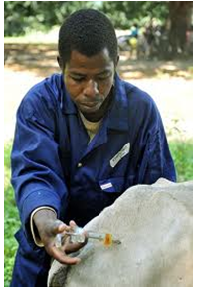

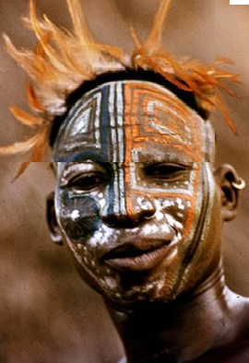
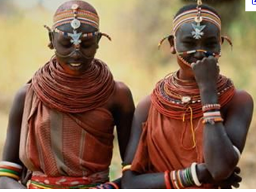
Barriers
History
Professional biases
Policies
Jurisdiction
Resources
Culture
Inertia:
-organizational
-Surveillance skills

Slide 29
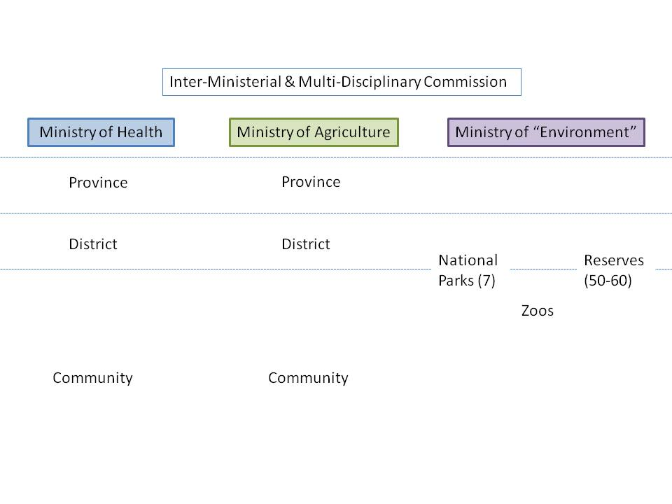
Thanks to H5N1
Management silos
One way flow of information
Limited feedback
Limited lateral flow
Notes:
“environment”

Slide 30
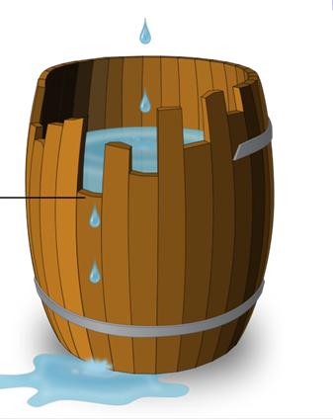
Unequal human resource capacity …
… lack of front line responders from all health professions

Slide 31
Leveling interdisciplinary understanding
Understanding limitations of own discipline
Developing a common language
Identifying gaps in past approaches to the problem

Slide 32
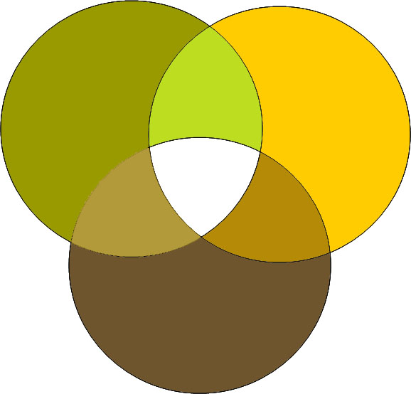

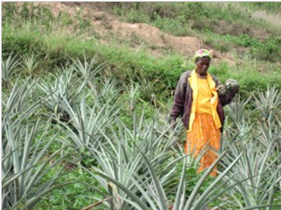

We don’t all have the same priorities…

Slide 33

The Stone Soup Fable
The whole is bigger than the sum of the part

Slide 34

Each One Health professional is well-trained for their roles, mandated and appropriately equipped
Professions have improved skills to work collaboratively with each other
Health systems benefit from One Health efficiencies

Slide 35


