Slide 1
Gender one health and infectious diseases
One health core competencies
powerpoint no. 3

Slide 2
Review of the One Health Core Competency Work to Date
OHCEA
SEAOHUN
Global
Some Information provided by Professor Ray Hyatt
School of Public Health, Tufts University.

Slide 3
SEAOHUN wordle

Slide 4
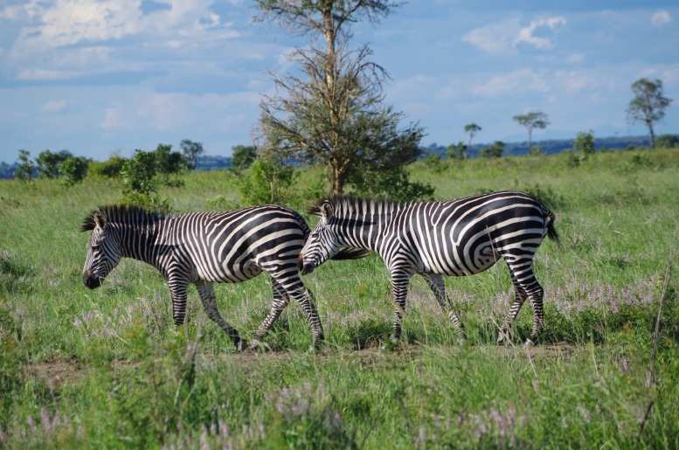
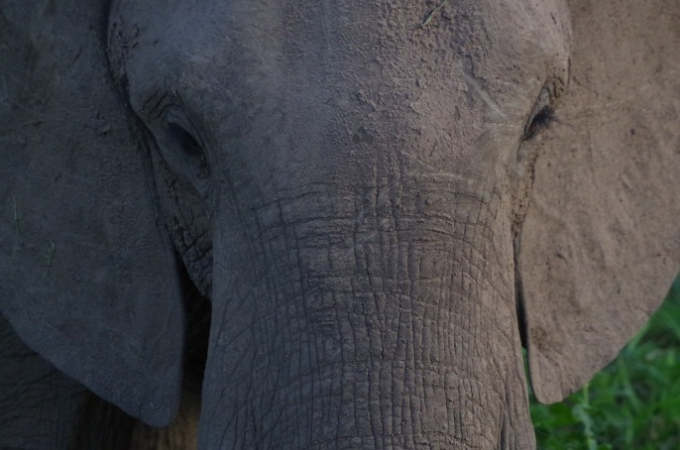
Notes:
Kilosa demonstration site wordle

Slide 5
How we Define Competencies
Knowledge, skills, and behaviors that can be measured, whether for a worker or for a learner; Core Competencies are essential for the success of an organization (e.g. an academic or government institution)
For this project, competencies were identified locally using a participatory approach, based on institutional and national need
One Health Core Competencies versus Discipline-Specific Professional Competencies (core within a discipline)

Slide 6
What are the OHCC used for?
The Core Competencies are used to work closely with universities and governments in the region to map and identify current gaps in curricula, to discuss opportunities to fill those gaps and to develop acceptable strategies to produce the future OH leaders in our communities.
The goal is to prepare individuals with the skills to effectively and efficiently work together to protect human, animal and environmental health.

Slide 7
Example: Tufts University: MPH domains and core competencies: Describe in conceptual terms what a Tufts MPH graduate can do.
Competency Domains
Core Subject Competencies
Epidemiology and Biostatistics
Health Policy
Health Organization and Systems Management
Social & Behavioral Sciences
Environmental and Occupational Health Sciences and Policy
Biology
Cross-cutting Competencies
Planning and Evaluation
Professionalism and Ethics
Public Health Practice
Communication
Diversity
Leadership and Advocacy

Slide 8
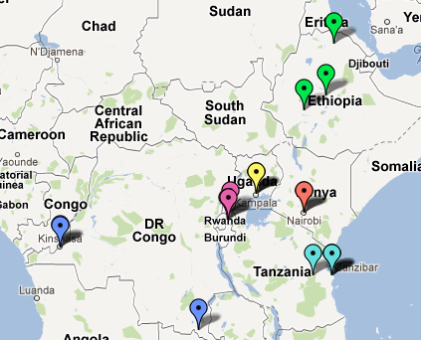
OHCEA Participating Institutions
Jimma University, Health and Medical
Mekelle University, Veterinary Medicine
Ethiopian Health and Nutrition Research Institute
Makerere University
Ministry of Health (UG)
Ministry of Agriculture (UG)
Nat. University Rwanda, Public Health
Umatura Polytech, Veterinary Medicine
Rwanda Animal Resources Development Authority
Ministry of Health (RW)
University of Nairobi
University of Kinshasa School of Public Health
Moi University
University de Lumbashi
Zoonotic Disease Unit (KY)
Ministry of Higher Education (DRC)
Muhimbili University
Ministry of Agriculture (DRC)
Sokoine University
Ministry of Livestock and Fisheries (TZ)
Ministry of Health and Social Welfare
Notes:
OHCEA network and its participating institutions

Slide 9
RESPOND OHCC Results to Date
GLOBAL | SEAOHUN | OHCEA
Management | Management | Management
Communication and Informatics | Communication and Informatics | Communication
Culture and Beliefs | Culture and Beliefs | Gender, Culture and Belief
Leadership | Leadership | Leadership
Collaboration and Partnership | Collaboration and Partnership | Collaboration and Partnership
Values and Ethics | Values and Ethics | Values and Ethics
Systems Thinking | Systems Thinking | Systems Thinking
 |  | Policy and Advocacy
 |  | Research
Notes:
Global competencies compared to South East Asia and Africa

Slide 10
OHCEA Regional OHCC Domains and Definitions – Tanzania, September 2012
Domain | Definition
Management | The process of planning, designing, implementing, organizing, monitoring, and evaluating One Health programs in order to maximize the effectiveness of OH action and desired health outcomes.
Communication | Acquisition, synthesis, and exchange of information across sectors, disciplines, and stakeholders to enhance and promote a common understanding of OH action.
Values and Ethics | The demonstration of integrity, honesty, trust, fairness, adaptability, and respect in OH action in diverse contexts.
Leadership | Initiate a shared vision; create, inspire, and motivate teams across sectors; execute a role; and manage OH actions.
Collaboration and Partnership | Identify, foster, and sustain equitable relationships with stakeholders while advancing OH actions.
Notes:
These are the competencies identified by OHCEA as key.

Slide 11
OHCEA Regional OHCC Domains and Definitions – Tanzania, September 2012
Domain | Definition
Systems Thinking | Comprehensive approach that recognizes and appreciates how the dynamic interactions and interdependencies among entities within an ecosystem affect the functioning of the system.
Gender, Culture, and Belief | The diverse social norms, values, roles, and practices among individuals and within communities and agencies.
Policy and Advocacy | Legal frameworks and other legitimate factors supporting and promoting implementation of OH approaches.
Research | Systematic investigation through multidisciplinary and intersectoral approaches to generate, validate, disseminate, and use OH knowledge.
Notes:
These are the competencies identified by OHCEA as key

