Slide 1
Gender ONE HEALTH and infectious disease management
Epidemiology and gender gaps
powerpoint 4A

Slide 2
Why gender?
Need for greater global health security
Challenge presented by the emergence of new epidemic-prone infectious diseases
Important role of gender for understanding and controlling the transmission of infectious diseases
Reducing the threat of emerging diseases.

Slide 3
Ebola outbreak in West Africa

Slide 4
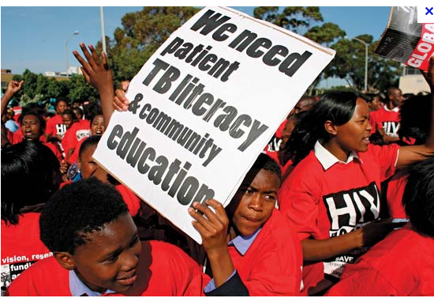
Tuberculosis
Accessibility to training in Ethiopia
DANIDA-access to clean water
Brucellosis

Slide 5
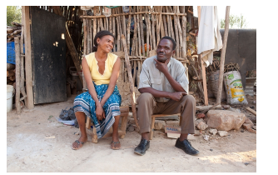
HIV and Anti-Retrovirals
.
In countries with limited resources, women are generally less
immune-depressed than men at the start of antiretroviral treatment (ARV).
The gap is decisive for explaining the differential in immune reconstitution
or mortality between men and women undergoing ARV treatment in favor
of women.

Slide 6
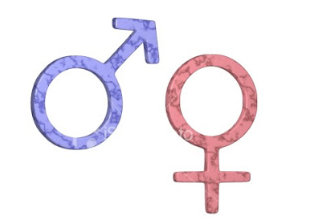
definitions
Sex refers to the biological and physiological factors that define males and females.
Gender refers to the socially constructed roles, behaviors, activities, and attributes that a given society considers appropriate for males and females. Gender differences include both socio-cultural factors as well as male-female differences in access and control over resources.
In many countries, gender influences access to economic resources and the lack of access to economic resources is sometimes a barrier to prompt and effective health care for women.

Slide 7
General belief
Little attention on sex, gender and infectious diseases
Infectious diseases affect both male and female equally
Focus public health attention during an outbreak control and treatment
Leave it to the social scientists to address the “social issues”
Notes:
On the contrary, it will demonstrate that understanding
the interaction between gender roles and infectious disease can lead to important insights
into transmission patterns and to strategies for outbreak prevention and control, thereby
reducing disease transmission and increasing cooperation with public health interventions
and the uptake of health promotion and protection measures.

Slide 8
Framework
Outlines the pathways by which a person’s sex and gender affect:
incidence, duration, severity, and mortality from emerging infectious diseases:
directly through:
effects on vulnerability of men and women to infectious diseases
exposures to infectious pathogens
responses to illness
Indirectly through effects on disease prevention and control programmes.

Slide 9
Three areas
Gender influences the risk of acquiring infections during health care encounters
Gender roles and access to resources affect exposure to animals and the risk of acquiring diseases from animals
Implications of sex and gender for surveillance

Slide 10
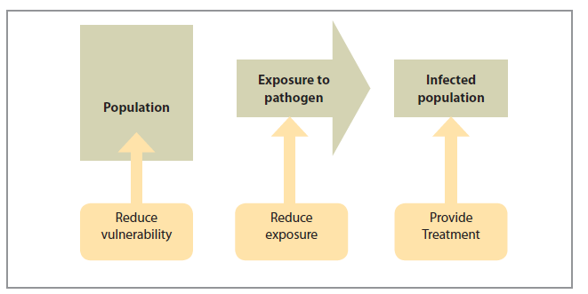
Transmission model
Notes:
The transmission model begins with a population into which an infectious pathogen
is introduced. For an outbreak to occur, some individuals must be exposed to the
pathogen and a proportion of exposed individuals must become ill ( Figure 1). Health
interventions can take place at any time before, during, and after an outbreak. In general,
these interventions aim to:
• reduce the vulnerability (and increase resistance) of people to the effects of
infectious pathogens;
• reduce exposure to infectious pathogens; and
• treat people who become infected.

Slide 11
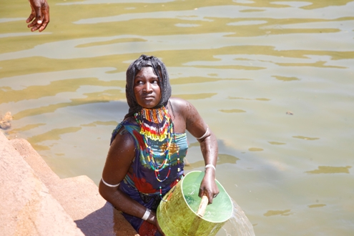
How gender differences influence emerging infectious diseases
Vulnerability
Exposure
Response to infection
Public health interventions
Gender differences vary from country to country
Gender differences also vary within countries according to a host of socio-economic variables

Slide 12
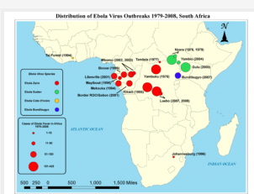
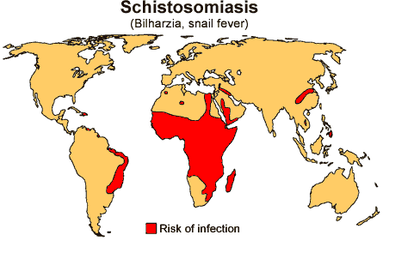
Vulnerability to infectious diseases
First contact
Ebola, TB, anthrax
Gender related norms
Value of males against females
Vaccination rates
Risk factors: pastoralist communities and cholera outbreak
Gender roles and responsibilities
Schistosomiasis
Guinea worm

Slide 13
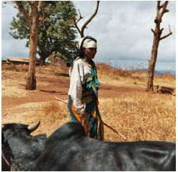
Exposure to Pathogens
Occupational exposure
Hunters, gatherers, preparing meals
Outdoor activities and rabies in Ethiopia
Raw milk and TB among the Somali community
Caring for sick/dead family members
Child care and care takers
Exposure in health care setting
Exposure to livestock
Slaughter and marketing

Slide 14
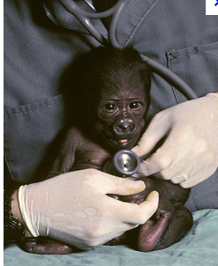
Response to infections
Prompt treatment
Role of culture
Access to information
Access to resources
Use of informal health services
Cheaper health care
TB treatment in Ethiopia
Adherence to treatment
MDR TB
Time constraints

Slide 15
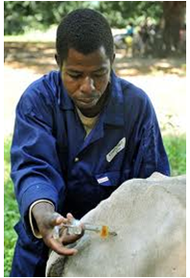
Effectiveness of Health Interventions
The gendered structure of societies
Interventions need to take gender/culture into consideration
Vector control activities: malaria
Gender sensitive communication
Risk communication during outbreaks
Women not as active in public sphere
Ebola outbreak
Avian influenza extension workers
Interventions in animal health

Slide 16
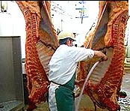
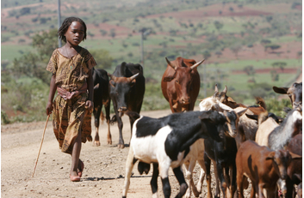
Gender and diseases of zoonotic origin
75% of all emerging pathogens
More than half of all human pathogens
Gender division of labor
Care and marketing
Extension services focus more on larger enterprises than backyard farms
Reduces access to information, medical veterinary services
Not actual owners of farms: Avian
influenza

Slide 17
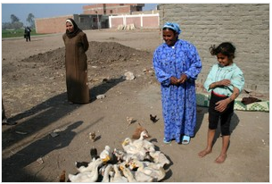
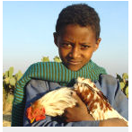
Avian influenza
Small poultry farms run by women were excluded from extension
Excluded from compensation
Risk of exposure was very high
Little or no biosecurity
If there is no compensation, people sell their birds

Slide 18
Gender and disease surveillance
Need for disaggregated data by sex
Assumption that sex and gender not crucial
Need for data on pregnancy status
Gender biases in surveillance data
undercount the relative importance of symptoms that can only affect one sex
TB diagnosis cough/sputum
Tuberculin test negative for women
Gender issues in analysis

Slide 19
Conclusions
Gender differences in behaviors, activities, and access to resources and decision-making affect disease transmission and outcome.
There is an urgent need to disaggregate data by age and sex.
Gaps in knowledge still exist but should not detract from the fact that much is already known about the importance of including a gender perspective.
Multidisciplinary approach.

Slide 20
Merci

