Slide 1
Gender and OH Policy and Advocacy
PowerPoint No. 5

Slide 2
What Is Gender?
Culturally or socially shaped group of attributes and behavior given to a female or male human being in a given ethnic, tribe or religious setting.
Gender is a social-cultural construct.

Slide 3
Gender is……..
The opportunities, roles, responsibilities, relationships and personal identities a particular society prescribes as proper for men and women.
These attributes are socially constructed and learned both individually and collectively.

Slide 4
Gender analysis
We live in societies that are permeated by gender differences and gender inequalities.
There is no country in which the outcomes of public policy are equal for men and women.
Dimensions of these inequalities are often so deeply embedded that they are difficult to perceive.

Slide 5
Gender analysis
Reveals these differences, and the fact that in such a social context any gender interventions that profess to be gender-neutral will in fact reflect and probably reinforce the imbalances that exist.
Required to bring these inequalities to the surface and to the attention of people who can make a difference, so that their decisions are taken in a manner that is sensitive to and reflects the outcome of gender analysis.

Slide 6
Gender equality and gender equity can be addressed by using various approaches, including legislation, organizational processes and information gathering.

Slide 7
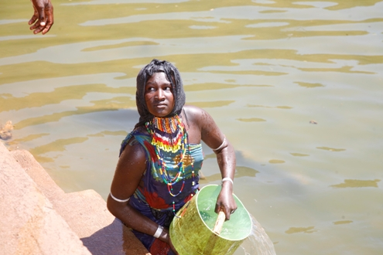
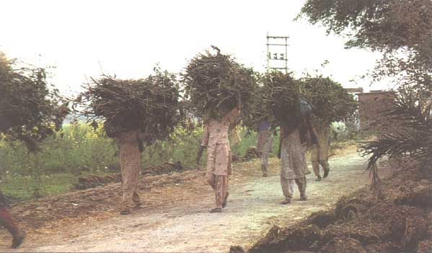
How Gender Differences Influence Emerging Infectious Diseases
Vulnerability
Exposure
Response to infection
Public health interventions
Gender differences vary from country to country
Gender differences also vary within countries according to a host of socio-economic variables

Slide 8
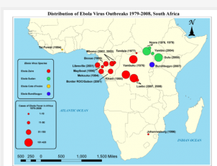
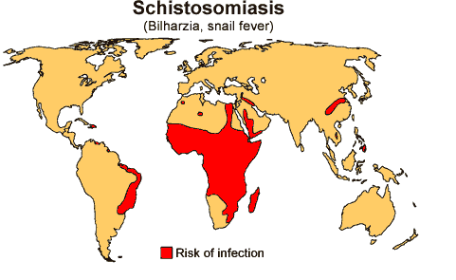
Vulnerability to Infectious Diseases
First contact
Ebola, TB, anthrax
Gender related norms
Value of males against females
Vaccination rates
Risk factors: pastoralist communities and cholera outbreak
Gender roles and responsibilities
Schistosomiasis
Guinea worm

Slide 9
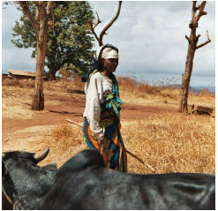
Exposure to Pathogens
Occupational exposure
Hunters, gatherers, preparing meals
Outdoor activities and rabies in Ethiopia
Raw milk and TB among the Somali community
Caring for sick/dead family members
Child care and care takers
Exposure in health care setting
Exposure to livestock
Slaughter and marketing

Slide 10
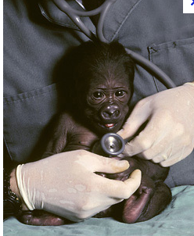
Response to Infections
Prompt treatment
Role of culture
Access to information
Access to resources
Use of informal health services
Cheaper health care
TB treatment in Ethiopia
Adherence to treatment
MDR TB
Time constraints

Slide 11
One Health policy may exacerbate gender inequalities when it fails to address the needs of either men or women, and that health systems must address gender equity.
Gender and OH policy and advocacy is important in order to reduce the health gap between men and women and to improve efficiency.

Slide 12
Policy Approaches to Gender Equality in OH
A range of strategies have been used in various countries to address gender equity.
Regulatory approaches
Organizational approaches
Informational approaches.
It is important to note that these approaches might need to be combined to address gender equity goals effectively.

Slide 13
Regulatory Approaches
Include legislation designed to counter discrimination, protect human rights and protect patient rights, and laws that require public-sector authorities to address and counter gender inequalities.

Slide 14
Organizational Approaches
Include gender mainstreaming, gender-related budgeting, gender impact assessments, health-outcome targets and gender tools that facilitate the assessment of evidence relating to gender differences.
These approaches use various tools to identify gender equity issues explicitly in fiscal decision-making, in the drawing up and implementation of policy and in policy outcomes.

Slide 15
Informational Approaches
Focus on the need for good information, which is central to effective health stewardship. These include the use of gender sensitive health indicators and gender equity indices.

