Slide 1
GENDER ONE HEALTH AND INFECTIOUS DISEASES
LEARNING AND APPLYING GENDER ANALYSIS TOOLS
PowerPoint No. 5

Slide 2
WHAT IS GENDER ANALYSIS ?

Slide 3
GENDER ANALYSIS
We live in societies that are permeated by gender differences and gender inequalities.
There is no country in which the outcomes of public policy are equal for men and women.
Dimensions of these inequalities are often so deeply embedded that they are difficult to perceive.

Slide 4
GENDER ANALYSIS
Reveals these differences, and the fact that in such a social context any gender interventions that profess to be gender-neutral will in fact reflect and probably reinforce the imbalances that exist.
Required to bring these inequalities to the surface and to the attention of people who can make a difference, so that their decisions are taken in a manner that is sensitive to and reflects the outcome of gender analysis.

Slide 5
WHAT IS GENDER ANALYSIS
Systematic gathering and examination of information on gender differences and social relations in order to identify, understand and redress inequities based on gender.
Gender analysis is a valuable descriptive and diagnostic tool for anyone wishing to become a transformative agent or development planner.

Slide 6
PURPOSE
To reveal the connections between gender relations and the development problem to be solved -infectious disease preparedness prevention and control.
To “surface” the fact that gender relations are likely to have an impact on the solution to the problem.
To indicate exactly what that impact is likely to be, and alternative courses of action.

Slide 7
GENDER ANALYSIS
An intrinsic dimension of policy analysis.
Identifies specifically how public policy affects women and men differently.
Demonstrates that policy and implementation cannot be gender neutral in gendered societies.
Is supported by specific analytic tools.

Slide 8
A GOOD GENDER ANALYSIS SHOULD PROVIDE:
Gender awareness - understanding of gender relations and their implications for development policy and implementation.
Analysis of the division of labor - activities, access and control.
A review of men and women’s priorities-restraining and driving forces.
Recommendations to address practical and strategic needs.
Productive and unpaid/reproductive work.

Slide 9
GENDER ANALYSIS TOOLS

Slide 11
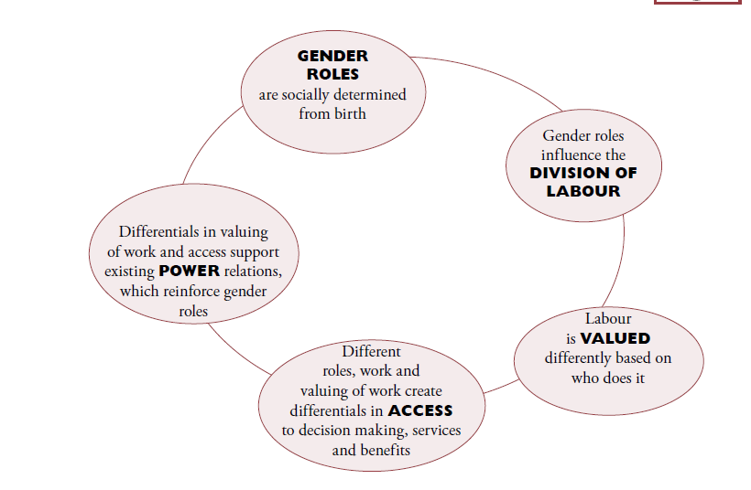
Key components of gender analysis

Slide 12
GENDER ANALYSIS CONCEPTS
Sex and gender
Gender division of labor (triple role)
Productive work
Reproductive work
Community work / political work
Differential access to and control over resources and benefits
Strategical and practical needs
Position and condition
Notes:
Gender relations are concerned with how power is distributed between the sexes. They create and reproduce systemic differences in men’s and women’s position in a given society. They define the ways in which responsibilities and claims are allocated and the way in which each are given a value
The term “gender relations” also refers to the relationships between people and their broader community, if these relationships vary with the sex of the people concerned. For example, the relationship between members of a village community and their local government entity is a gender relationship if men and women experience different benefits and controls from it.

Slide 13
GENDER ROLES
Productive work: This is work that produces goods and services for exchange in the market place (for income). Both men and women contribute to family income with various forms of productive work, although men predominate in productive work, especially at the higher echelons of remuneration.
Reproductive work/unpaid work: This work involves all the tasks associated with supporting and servicing the current and future workforce – those who undertake or will undertake productive work. It includes child-bearing and nurture, but is not limited to these tasks. Socially reproductive activities include childcare, food preparation, care for the sick, and socialization of the young, attention to ritual and cultural activities through which the society’s work ethic is transmitted, and the community sharing and support which is essential to the survival of economic stress.
Community managing role: Activities undertaken primarily by women at the community level, as an extension of their reproductive role, to ensure the provision and maintenance of scarce resources of collective consumption, such as water, health care and education. This is voluntary unpaid work, undertaken in "free" time.
Community politics role: Activities undertaken primarily by men at the community level, organizing at the formal political level, often within the framework of national politics. This is usually paid work, either directly or indirectly, through status and power.
Notes:
The fact that reproductive work is the essential basis of productive work is the principal argument for the economic importance of reproductive work, even though most of it is unpaid, and therefore unrecorded in national accounts. Women and girls are mainly responsible for this work which is usually unpaid.

Slide 14
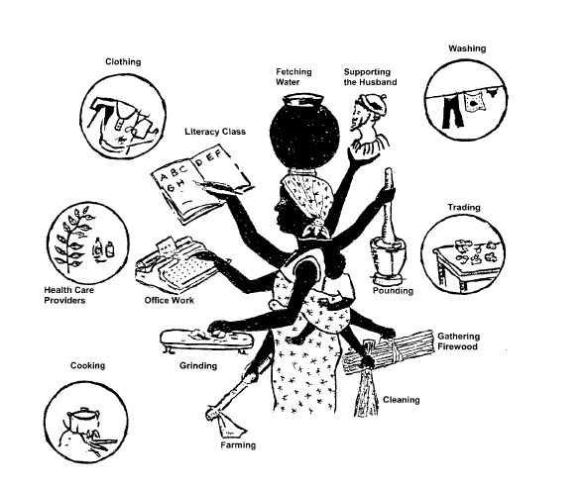

Slide 15
DIFFERENTIAL ACCESS TO AND CONTROL OVER RESOURCES AND BENEFITS
Access: Gives a person the use of a resource e. g. land to grow crops.
Control: Allows a person to make decisions about who uses the resource or to dispose of the resource e.g. sell land.
Economic/Productive/Resources: (Land, credit, cash income, employment)
Political Resources: (Education, political representation, leadership)
Time: (A critical resource, which increasingly acquires a monetary value).

Slide 16
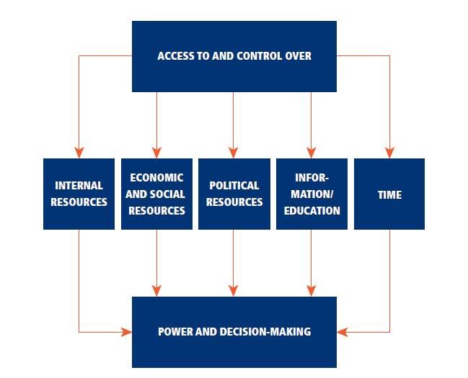

Slide 17
PRACTICAL AND STRATEGIC NEEDS
Practical gender needs: Women and men can easily identify these needs as they often relate to living conditions. Women may identify safe water, food, health care, cash income, as immediate interests/needs that they must meet. Meeting women’s practical gender needs is essential in order to improve living conditions, but in itself it will not change the prevailing disadvantaged (subordinate) position of women. It may in fact reinforce the gender division of labor.
Strategic gender interests/needs: Strategic gender interests/needs are those that women themselves identify as due to their subordinate position to men in their society. They relate to issues of power and control, and to exploitation under the sexual division of labor.

Slide 19
The resources may be:
Physical resource – forest, wildlife and wetland.
Social services – hospitals, schools, places of worship, transport
Economic resources like cattle, agricultural gardens
Human resources – health workers, teachers, household as a unit
It is key to identify who in the community has access to these resources and who controls them

Slide 21
GENDER ANALYSIS CONCEPTS
Practical needs & and strategic gender Interests
Condition and position: In addition to the specific conditions which women share with men, differential access means women’s position in relation to men must also be assessed when interventions are planned and implemented.
Transforming gender relations
Transformatory potential
Empowerment: Women’s empowerment means developing their ability to collectively and individually take control over their own lives, identify their needs, set their own agendas and demand support from their communities and the state to see that their interests are responded to.
Notes:
Women’s empowerment means developing their ability to collectively and individually take control over their own lives, identify their needs, set their own agendas and demand support from their communities and the state to see that their interests are responded to. In most cases the empowerment of women requires transformation of the division of labour and of society

Slide 22
USAID 5 DOMAINS OF ANALYSIS
Laws, Policies, Regulations and Institutional Practices: Are men and women treated equally in legislation, and by official policies and institutions in the country? How could this impact your project or activity?
Access to and Control over Assets and Resources (including income, employment, and assets such as land): Who has access to which resources? Do men and women have equal access to the resources needed to participate in this project?
Gender Roles, Responsibilities and Time Use: Who does what? How do gender roles and responsibilities impact the likelihood that men and women will participate in this project and in development activities in general?
Cultural Norms and Beliefs: What beliefs and perceptions shape gender identities and norms? Do gender stereotypes function as a facilitator or barrier to men’s or women’s engagement in this activity?
Patterns of Power and Decision-making: Will women have control over and benefit from assets they may accrue as a result of participating in the project?

Slide 23
GENDER ANALYSIS TOOLS
Gender Analysis Matrix
Social network analysis
Access and control over resources
Communication profile
SWOT analysis
Gender continuum

Slide 24
GENDER ANALYSIS MATRIX
The Gender Analysis Matrix is an analytical tool that uses participatory methodology to facilitate the definition and analysis of gender issues by the communities that are affected by them.
Using the Gender Analysis Matrix will provide a unique articulation of issues as well as develop gender analysis capacity from the grassroots level up.
Community based technique: Community itself can identify and challenge their assumptions about gender roles in a constructive manner.
Includes men, women and community as categories.

Slide 25
SWOT ANALYSIS
Strengths | Weaknesses
Opportunities | Threats

Slide 26
SEX-DISAGGREGATED DATA AND INDICATORS
All activities developed and implemented should include gender and cultural awareness and gender and cultural relevant issues. Monitoring and evaluation of these activities needs to take into consideration the development of quantitative and qualitative indicators to monitor the impact and progress of the project in relation to the inclusion of gender and cultural aspects.

Slide 27
ACTIVITY 1 – TRIPLE ROLE
In your selected setting, complete the handouts identifying the productive, reproductive, community and political role carried out by men and women and discuss the vulnerability, exposure and response to disease outbreak as it affects men and women, the household and entire communities.

Slide 28
ACTIVITY 2 – COMMUNITY RESOURCE MAPPING, ACCESS, CONTROL AND BENEFIT OVER RESOURCES
In the same group, in the same community, with the same disease
Fill up the table on access, control and benefit over resources
Develop a map of your community

Slide 29
ACTIVITY 3 – VULNERABILITY TO RISK MAPPING
Read the document about risks related to Ebola.
Map out the risks faced by different community members (women, men, children, medical personnel).
Identify/ map out signs of those risks in the community.
Add resources that can be used to mitigate those risks to the maps in different colors.
Identify practical needs and strategic needs.

Slide 30
SOCIAL NETWORK ANALYSIS (SNA)

Slide 31
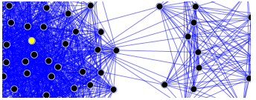
Social network analysis: Mapping tool to help people understand
visualize, discuss, and improve situations in which many
different actors and places influence outcomes.
Also used to better understand the implications
of the position of individual actors and areas in a social structure.

Slide 32
ACTIVITY 4 – SOCIAL NETWORK ANALYSIS – COMMUNICATION ANALYSIS
Based on the community you are working in, have participants fill out the communication matrix for their community.

Slide 33
SOCIAL NETWORK ANALYSIS
Social network analysis [SNA] is the mapping and measuring of relationships and flows between people, groups, places, organizations, computers, URLs, and other connected information/knowledge entities.
The SNA will specifically focus on participants mapping and identifying what they consider are places of significance in a community for different stakeholders.
The nodes in the network are the people, places, things, organizations and groups while the links show relationships or flows between the nodes.
SNA provides both a visual and a mathematical analysis of human/stakeholder relationships.

Slide 34
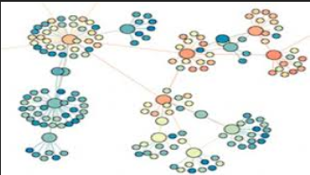
Bridge
Centrality
Density/size of circle
Cliques/places
Who are the most important nodes?
Is there a hidden community structure?
How does this structure affect decision-making, policy and cultural issues?

Slide 35
These measures give us insight into the various roles and groupings in a network
Who are the connectors, leaders, bridges, isolates?
Where are the clusters and who is in them?
Who is in the core of the network, and who is on the periphery?

Slide 36
GENDER COMMUNICATION PROFILE

Slide 37
GENDER COMMUNICATION PROFILE
Provides information on how women and men access and share information.
It can be community driven – having community members do it themselves.
Think specifically in terms of an outbreak like Ebola.
Who is providing information and how are they providing it? Key players
Add any communication methods that you think are missing.

Slide 38
COMMUNICATION ANALYSIS MATRIX

Slide 39
ACTIVITY 5 - SOCIAL NETWORK ANALYSIS AND COMMUNICATION ANALYSIS IN AN EBOLA OUTBREAK
Based on the community, you are working in, fill out the communication matrix for your community and develop a social network analysis.

Slide 40
GENDER CONTINUUM

Slide 41
GENDER CONTINUUM
Ignores:
the set of economic, social, and political roles, responsibilities, rights, entitlements and obligations associated with being female and male.
dynamics between and among men and women.
Gender Blind
Gender Aware
Examines and addresses these gender considerations and adopts an approach along the continuum.
Exploitative
Accommodating
Transformative
Fosters critical examination of gender norms* and dynamics.
Strengthens or creates systems* that support gender equality.
Strengthens or creates equitable gender norms and dynamics.
Changes inequitable gender norms and dynamics
Reinforces or takes advantage of gender inequalities and stereotypes.
Works around existing gender differences and inequalities.
Goal:
Gender Equality for
better development outcomes
*Norms encompass attitudes and practices
*Systems consist of a set of interacting structures, practices, beliefs and relations that define what it means to be male or female
Notes:
Discuss continuum tool
AFTER GAME: Discuss where projects fall along the continuum. How to improve?

Slide 42
GENDER CONTINUUM EXAMPLES
Gender Exploitative Programming
“What kind of mother would not feed her baby correctly”
Others?
Gender Accommodating Programming
Community-based distribution of best practices for infant and young child nutrition for women
Others?
Gender Transformative Programming
Engaging mothers-in-law, women and men in information regarding breastfeeding best practices through interventions that unpack gender and cultural norms.
Others?

Slide 43
ACTIVITY 6 - GENDER CONTINUUM
Engage in the case studies
Are the cases gender blind/ gender aware?
Exploitative
Accommodating
Transformative
Begin to think of ways to make them transformative
What specific gender transformative action can you come up with?
Fill up the table

Slide 44
GENDER ANALYSIS MATRIX

Slide 45
GENDER ANALYSIS MATRIX
The Gender Analysis Matrix is based on the following principles:
All requisite knowledge for gender analysis exists among the people whose lives are the subject of the analysis.
Gender analysis does not require the technical expertise of those outside the community being analyzed, except as facilitators.
Gender analysis cannot be transformative unless the analysis is done by the people being analyzed.

Slide 46
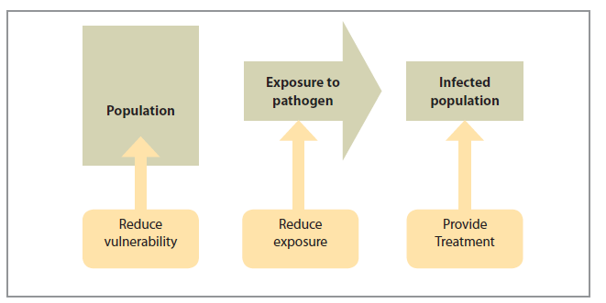
TRANSMISSION MODEL
Notes:
The transmission model begins with a population into which an infectious pathogen
is introduced. For an outbreak to occur, some individuals must be exposed to the
pathogen and a proportion of exposed individuals must become ill ( Figure 1). Health
interventions can take place at any time before, during, and after an outbreak. In general,
these interventions aim to:
• reduce the vulnerability (and increase resistance) of people to the effects of
infectious pathogens;
• reduce exposure to infectious pathogens; and
• treat people who become infected.

Slide 47
HOW GENDER DIFFERENCES INFLUENCE EMERGING INFECTIOUS DISEASES
Vulnerability
Exposure
Response to infection
Public health interventions
Gender differences vary from country to country
Gender differences also vary within countries according to a host of socio-economic variables

Slide 48
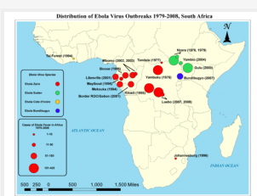
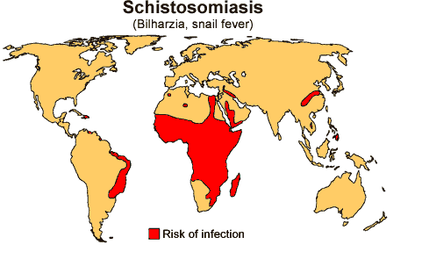
VULNERABILITY TO INFECTIOUS DISEASES
First contact
Ebola, TB, anthrax
Gender-related norms
Value of males against females
Vaccination rates
Risk factors: pastoralist communities and cholera outbreak
Gender roles and responsibilities
Schistosomiasis
Guinea worm

Slide 49
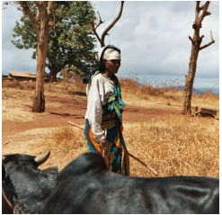
EXPOSURE TO PATHOGENS
Occupational exposure:
Hunters, gatherers, preparing meals
Outdoor activities and rabies in Ethiopia
Raw milk and TB among the Somali community
Caring for sick/dead family members
Child care and care takers
Exposure in health care setting
Exposure to livestock
Slaughter and marketing

Slide 50
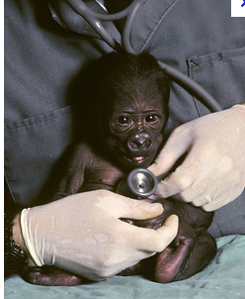
RESPONSE TO INFECTIONS
Prompt treatment
Role of culture
Access to information
Access to resources
Use of informal health services
Cheaper health care
TB treatment in Ethiopia
Adherence to treatment
MDR TB
Time constraints

Slide 51
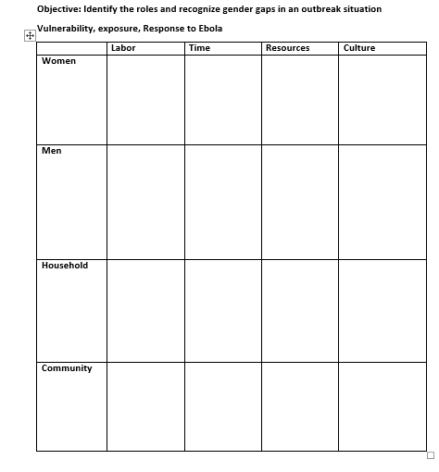

Slide 52
SOCIAL NETWORK MAP
Individuals create influence network maps using materials from a physical toolkit.
Actor names, places, organizations are written on it and distributed on a large sheet of paper.
Lines are drawn to link the actors and reveal how they are connected or not connected, and “influence towers” are built to reflect the relative power of each actor (the higher the influence tower, the greater the influence).
Size of the circle is important.

Slide 53
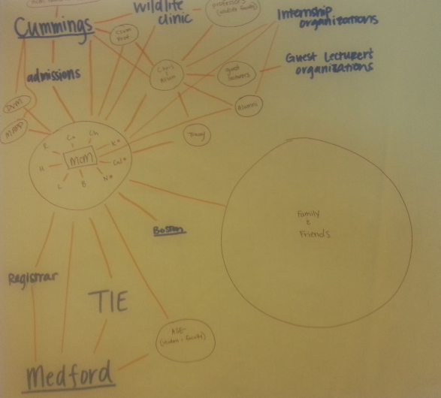

Slide 54
WALK THROUGH
Group 1 will identify similarities in groups.
Group 2 will identify differences in groups.
Group 3 will think of why there are differences.
Group 4: How do the differences affect access to and control over resources for men and women?

Slide 55
MONITORING AND EVALUATION USING GENDER TOOLS

Slide 56
FROM PLANNING TO POST IMPLEMENTATION REVIEW
Analysis tool must be useful / provide gender sensitive information / address gender relations and issues.
The norm is to not do it sub-consciously
Conscious effort
Mapping for media
Mapping for health care workers
Communication profile
Can use tools for other things

Slide 57
VULNERABILITY TO RISK MAPPING
Essential to identify who the most vulnerable in an infectious disease outbreak is and why.
Which capacities need to be strengthened and what relief and services are needed?
Vulnerabilities and capacities of people evolve over time and determine people’s abilities to cope and recover from disaster.

Slide 58
VULNERABILITY MAPPING
Map out the risks faced by their teams: (Lack of health care, few health care workers, lack of resources to purchase medication, reduced education, lack of information, cultural norms, stereotyping, consumption of bush meat, hunting)
Identify – Map out signs of those at risk in the community.
Add resources that can be used to mitigate those risks in different colors.

Slide 59
LAWS AND POLICIES
Gender norms have often been formalized in law and policy.
Laws of inheritance often favor males.
Marriage and divorce laws in many countries
Resource ownership
For a long time, domestic violence was considered in the personal sphere.

Slide 60
INSTITUTIONS OF GENDER SOCIALIZATION
Behind the institutions that introduce and reinforce gender norms are a range of social institutions:
- The family, religious institutions, communities, schools, the media, and the state
What three do you think play the most role?
- Family, media, religion

Slide 61
GENDER STATISTICS ARE DEFINED BY THE SUM OF THE FOLLOWING CHARACTERISTICS
Data are collected and presented by sex as a primary and overall classification
Data reflect gender issues: roles, laws, division of labor, access and control over resources, benefits, power and decision-making
Data are based on concepts and definitions that adequately reflect the diversity of women and men and capture all aspects of their lives.
Data collection methods take into account stereotypes and social and cultural factors that may induce gender bias in the data.

Slide 62
GENDER STATISTIC/GENDER SENSITIVE INDICATORS
For example, “a gender statistic could be “60% of women in country X are literate, as opposed to 30% five years ago.
A gender-sensitive indicator could be “60% of women in country X are literate, as compared to 82% of men, and compared to 30% and 52% respectively five years ago”.

Slide 63
GENDER INDICATORS
Sex-disaggregated statistics: gives the straightforward numbers of males and females in a given population, and
Gender statistics: can reveal the relationships between women and men that underlie the numbers.
Gender-sensitive indicators provide direct evidence of the status of women and men in relation to each other, relative to some agreed normative standard or explicit reference group.

Slide 64
GENDER STATISTICS VERSUS SEX-DISAGGREGATED DATA
Gender statistics are more than data disaggregated by sex. The characteristics listed above are useful in differentiating between sex-disaggregated statistics (the first requirement in the list above) and gender statistics (which incorporate all four requirements). Sex-disaggregated statistics are simply data collected and tabulated separately for women and men.

Slide 65
GENDER SENSITIVE INDICATORS
Indicators that track gender-related changes over time. Their value lies in measuring whether gender equality/equity is achieved through a number of ways:
Example: Women in engineering; track increase in number of women registered in engineering programs over the past 5 years compared to men.
Track why increase and what was done: gender awareness training done among faculty every year
Policy change at university to ensure equal opportunities for both men and female registration
Improvement in the gender content of the curriculum in high schools and colleges

Slide 66
CONTINUED -
Gender indicators take into account that gender roles exist and point to changes in the status and roles of women and men over time.
They help illustrate the ways a project affects gender roles and confirms or disregards gender discrimination.
Gender indicators should be drawn from identifying gender issues within a specific context of a project or activity.
Many indicators that look into gender such as measuring gender empowerment, human and development index, and gender development indices are useful tools in tracking gender equality/ equity.
KEY QUESTION: “Is it life-changing?”

Slide 67
CONTINUED -
All activities developed and implemented should include gender awareness and gender relevant issues.
Monitoring and evaluation of these activities needs to take into consideration the development of quantitative and qualitative indicators to monitor the impact and progress of the project in relation to the inclusion of gender aspects.

Slide 68
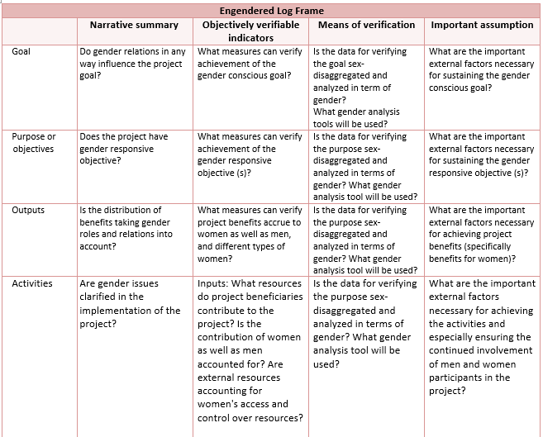

Slide 69
OHW OBJECTIVES
Define OHW needs: Support African One Health University Networks to participate with government, academia, and other key partners in defining One Health workforce needs.
Pre-service and in service training: Support networks to assist government ministries to train the current and future OH workforce.
Faculty development: Support developed country universities under OHW in strengthening faculty capacities for OH teaching, research, and community outreach for the African and South East Asian University Networks.
Organizational development: Positioning the One Health Networks as long-term sustainable leaders in One Health.

Slide 70
ASSIGNMENT
Develop a logical framework and some indicators for a project you are working on that specifically includes gender tools and analysis.

Slide 71
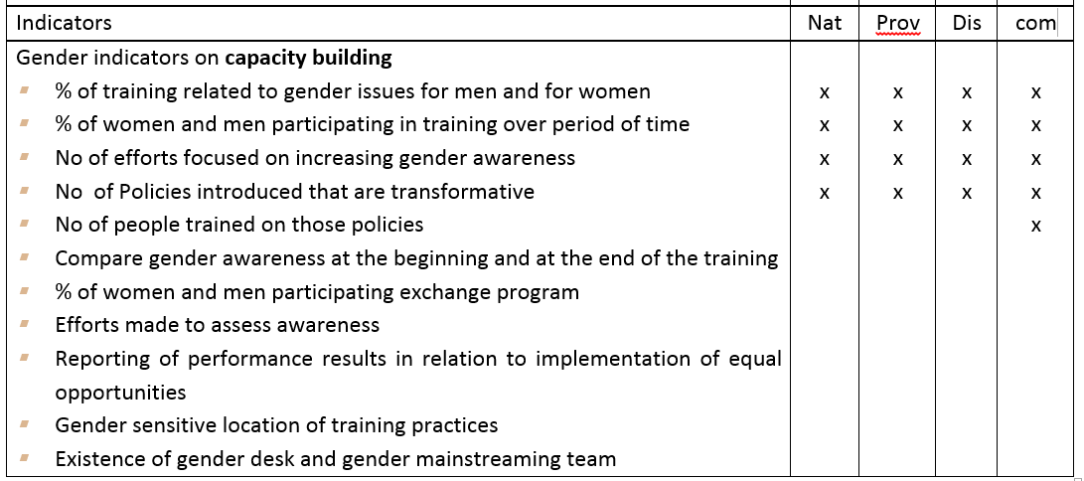

Slide 73
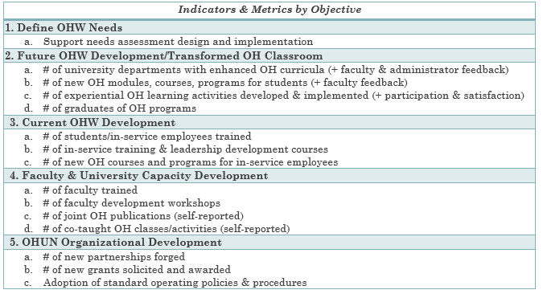

Slide 74
ACTIVITY 6: MONITORING AND EVALUATION USING GENDER TOOLS
Using the gender tools, develop interventions related to your assigned RESPOND activity (e.g., response, surveillance, prevention, control) to address an Ebola outbreak for the village community you have been working on.
Complete the implementation table and give reason for your options of intervention.

