Slide 1
Gender, ONE HEALTH and infectious disease management
Introduction to advocacy- did you know?
PowerPoint No.8A

Slide 2
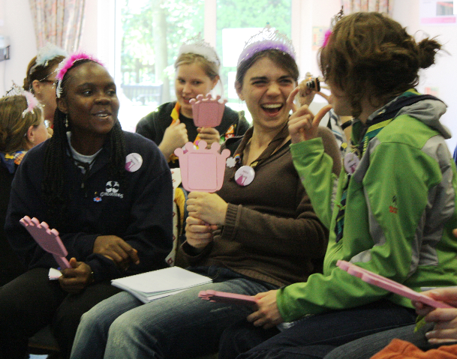
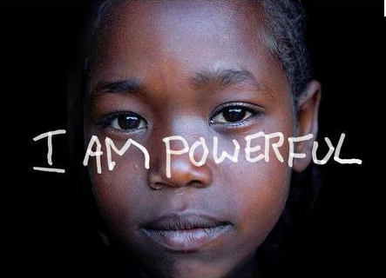
Did you know?
Taking action on gender equity

Slide 3
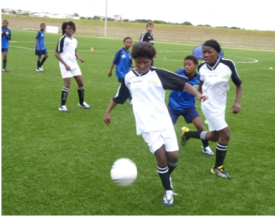
Did you know?
Achieving gender equality continues to be one of the biggest challenges facing societies today.

Slide 4
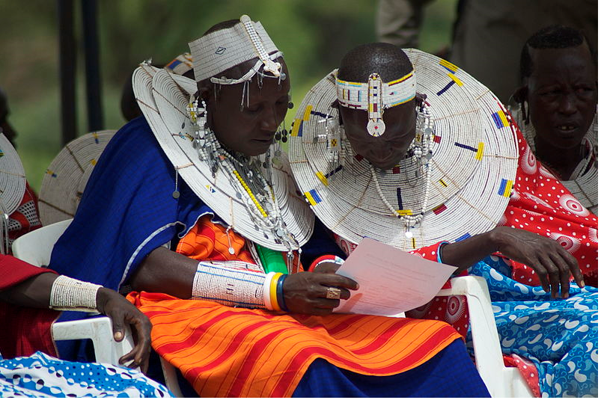
That:
Many barriers preventing equal participation of young women remain.

Slide 5
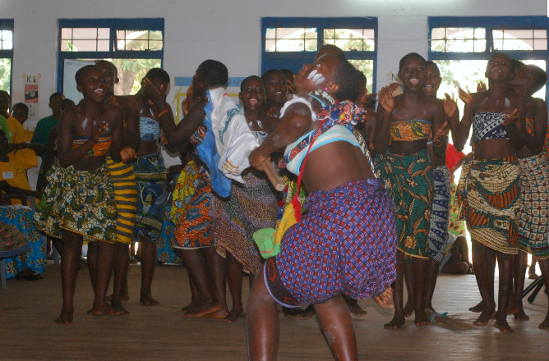
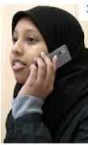
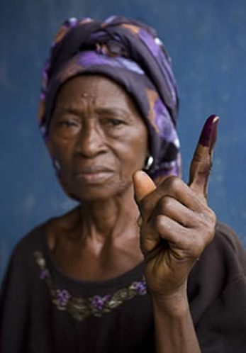
That
History, culture
tradition or political and
economic circumstances
are some of them

Slide 6
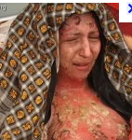
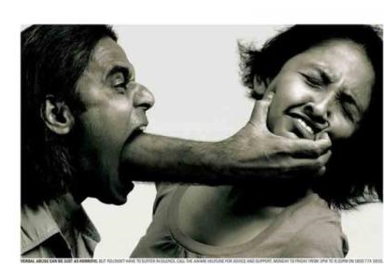
Did you know?
Girls and young women continue to face disadvantage, inequality, exploitation and violence.

Slide 7
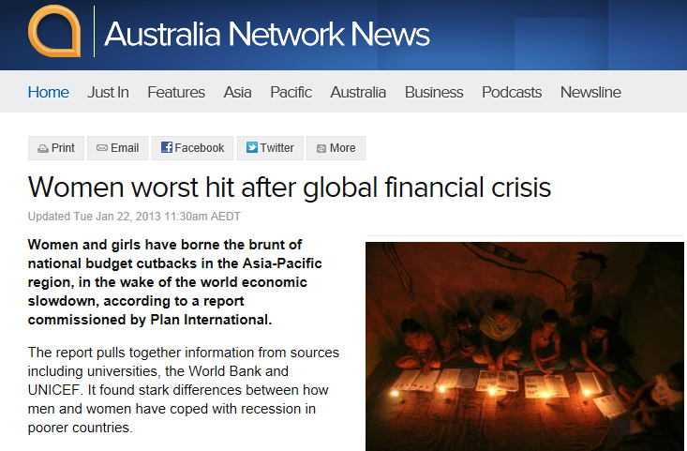
Did you know?
The current economic crisis, while affecting all young people has had a double impact on young women both as recipients and employees of public services.

Slide 8
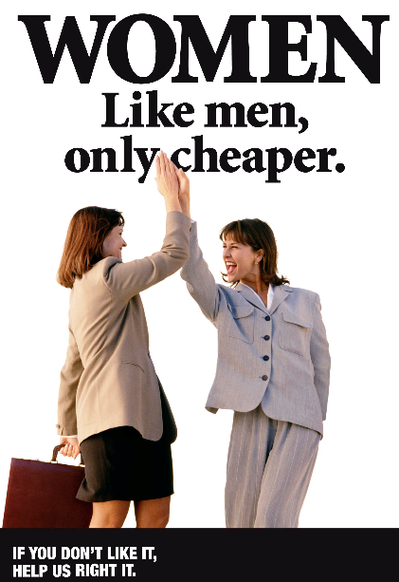
Did you know ?
Although they are half the population and 60% of university graduates, women are severely under-represented at every level of decision-making across sectors.

Slide 9
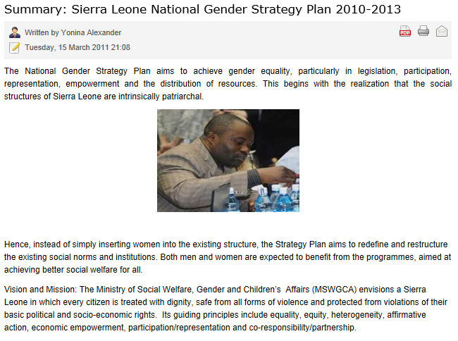
Did you know?
Only when you understand the current situation can you begin to develop a plan or strategy.

Slide 10
That:
Only by developing a clear picture can you define priorities, develop objectives and select the most effective methods and tools.

Slide 11
Help make gender equity a reality
Help make gender equity a reality
Help make gender equity a reality
Help make gender equity a reality
Help make gender equity a reality
Help make gender equity a reality
Help make gender equity a reality
Help make gender equity a reality
Help make gender equity a reality
Help make gender equity a reality
Help make gender equity a reality

Slide 12
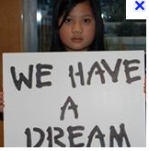
TOO!

Slide 13
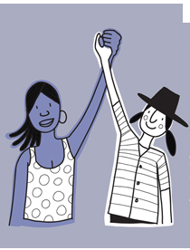
NOW YOU KNOW !!!!!

Slide 14
Day one evaluation How Did Today’s class go?

