Slide 1
Gender, one health and infectious disease management
Risk communication: message mapping
Powerpoint No.8B

Slide 3
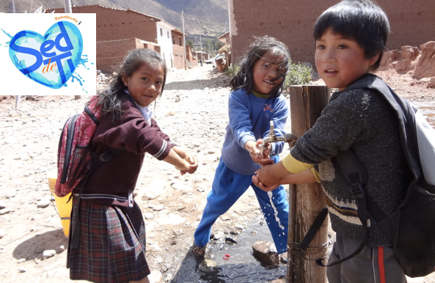

Slide 4
Message Mapping
A message map is a multi-layer template used to develop key messages about risk.
Developed by Vincent Covello, Director of the Center for Risk Communication at Columbia University.
Used as a public health risk management tool, it was first adopted following the 2001 anthrax attacks in the United States.
( information obtained from Mac Farnham, USAID risk communication training , Kinshasa, DRC 2011)
Notes:
What we have here is a failure to communicate” due to lack of clear communications goals

Slide 5
“Mental Noise”
When people are stressed or upset, they have difficulty:
hearing information.
understanding information.
remembering information.
Notes:
People in hi state of concern their ability to process info effectively and efficiently is severely impaired this emotional response creates “mental noise”

Slide 6
Message Mapping – Key Questions
What are the most important things you would like your audience to know?
What are the most important things your audience would like to know?
What are the most important things your audience is most likely to get wrong unless they are emphasized?
Notes:
6

Slide 7
Message basics
Know your target audience.
Keep messages short and focused (single sentences & headlines).
Save the background information for later.
Give action recommendations in positive terms (“do” rather than “don’t do”).
Notes:
FMD for the farmer vs the veterinarian, Tb for the patient’s family vs the ER docs

Slide 8
Message Basics
Prioritize messages
First and last
Must, should, could
Use visuals (graphics, demos)
Use non-technical language
Use common figures of speech
Don’t overwhelm with numbers / probabilities
Notes:
Use simple, non-technical language (no jargon).

Slide 14
LETS MOVE
Evolution of mom dancing( Jimmy Fallon and Michelle Obama)

Slide 19
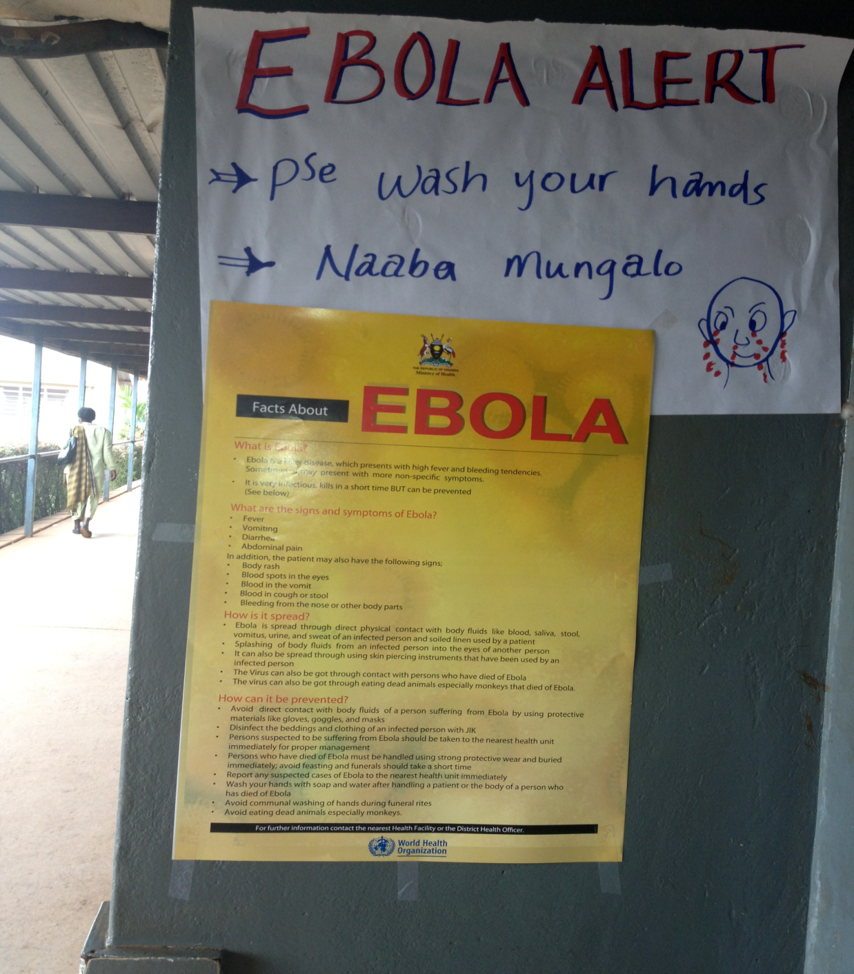

Slide 20
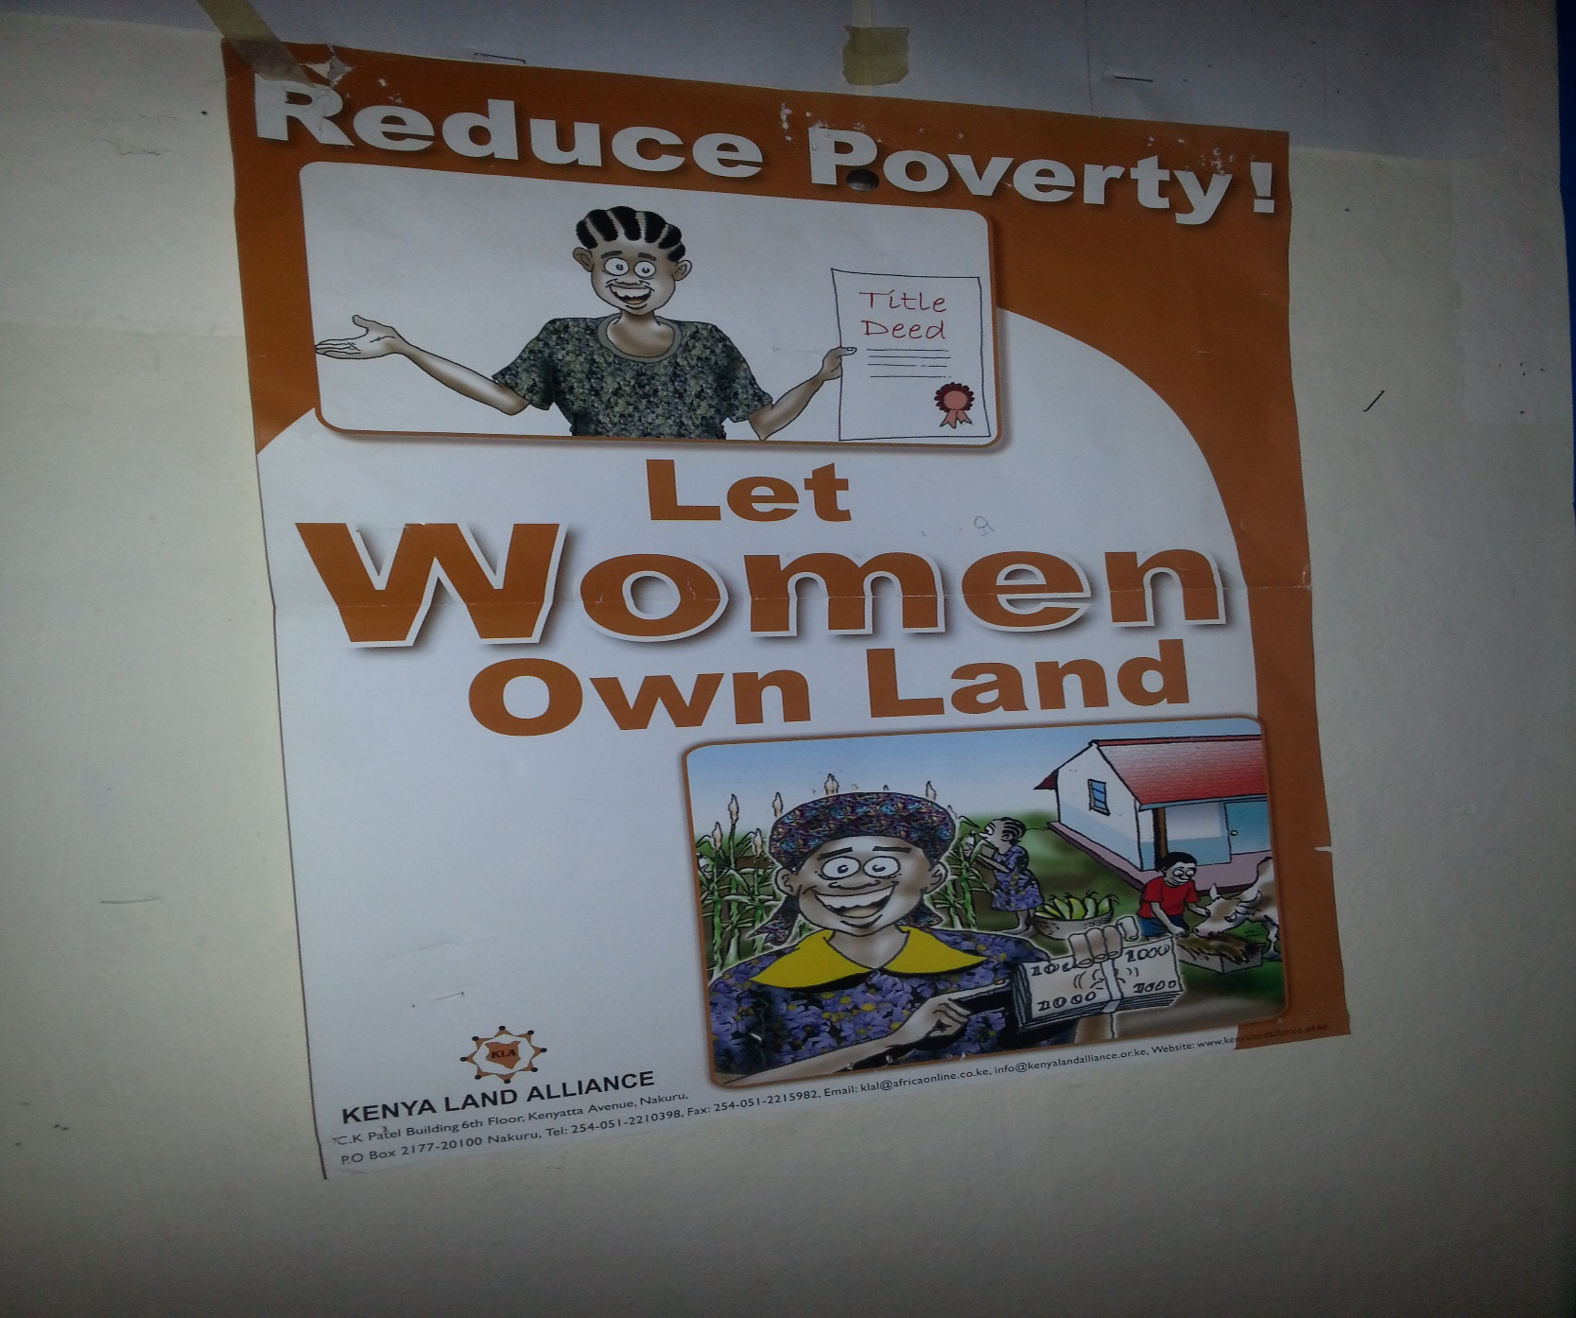

Slide 21
Question# 1
Makerere University is supporting a rabies vaccination campaign in Hoima district.
What communication vehicles (methods) would you use to promote the campaign in a gender sensitive manner?

Slide 22
Question# 2
There are reports of abortions in cattle around Nyagatare village.
There are also reports of sick people throughout with malaria-like symptoms, there is concern that this maybe an outbreak of brucellosis.
As a representative of the Veterinary Department, what would be some target audiences to share and exchange information with regarding a potential outbreak and how would you ensure that you are being gender sensitive?

Slide 23
Question #3
The number of TB patients in your village has doubled over the past couple of months, especially among children. It is suspected that this is due to drinking unboiled milk.
You have just received word that there is a big organization willing to fund a project to control this endemic diseases.
Prepare a two minute message that you can present to the donor that shows the need to target and or include women in the project (5 minutes to prepare this).
Remember to develop 3 key points (messages)

Slide 24
Question #4
You have just received word that there is a big organization willing to provide resources to control this infectious disease.
Prepare a two minute message that you can present to the donor that shows the need to target and or include women in the project.
Remember to develop 3 key points (messages)

Slide 25
Question #5
Prepare a poster communicating pertinent information targeting traders.
Prepare a poster communicating pertinent information targeting community members.

