Slide 1
Gender, one health and infectious disease management
Risk communication and elevator pitches
powerpoint NO. 9

Slide 2

Learning Objectives
Introduce risk communication
Introduce risk communication best practices
Practice key message development
Practice risk communication skills through examples

Slide 3
What is Communication?

Slide 4
What is risk communication?

Slide 5
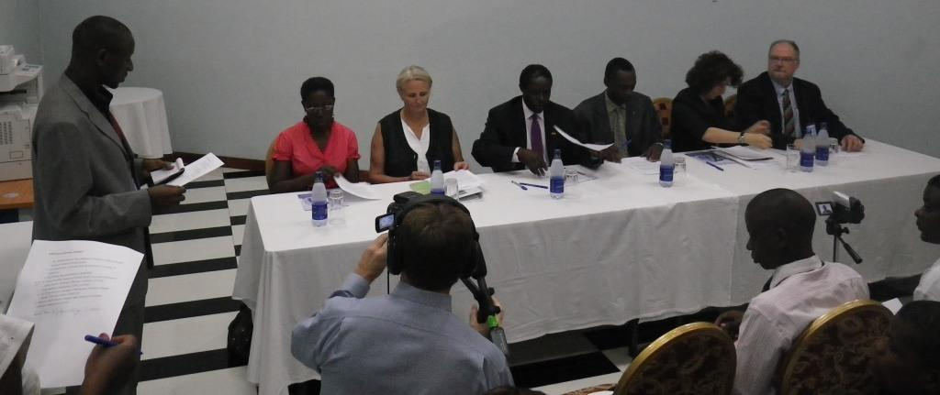
.
Risk communication is an open, two-way exchange of information and opinion about risk that leads to better understanding and better risk management decisions by all involved.
Notes:
Involved egs. (egs. public health officials, clinicians, patients, scientists).
Often involves multiple messages about the nature of risk or expressing concerns, opinions, or reactions to risk messages or to legal and institutional arrangements for risk management

Slide 6
Risk analysis paradigm
  Everything we do involves risk
  Zero risk is unachievable
  Options exist for managing every risk

Slide 7
Risk Analysis Paradigm
1. Risk Assessment:
Hazards are identified
Risks are determined
2. Risk Management:
Options are identified
Best option chosen and implemented
Risk Communication:
Open exchange of information resulting in better decisions about risk and its management
Risk Assessment
Risk Management
Risk Communication

Slide 8
4 types of risk communications!
Outrage
Management
Crisis
Communication
High
Outrage
Public
Relations
Precaution
Advocacy
Low
High
Peter Sandman
http://www.psandman.com/
Danger (Hazard)
Notes:
Discuss 4 quadrants

Slide 9
Summary
Risk communication & risk analysis paradigm
Our perception of risk is a combination of facts (objective) and emotion (subjective).
Appreciate the disconnect between science and public perceptions of risk.

Slide 10
Applied Question #1
Think, Pair, Share
Moldy maize meal has been put into animal feed.
This can cause Aflatoxicosis, a fungal intoxication that will damage the liver.
Once the animal shows clinical signs such as poor appetite and jaundice, treatment may not help.
Who are the most important audiences to communicate this danger / risk to?
What communication methods will you use?

Slide 11
Goals of Risk Communication
Decrease outrage!
Take into account emotional response to event.
Empower audiences to make informed decisions.
Discourage negative behavior.
Encourage constructive responses to risk or danger.
Trust - one of the most important factors in determining the effectiveness of risk communication
Notes:
Needed? If so, whereScientists are trained to provide all the known information about a particular risk. For a risk communicator the goal is to take the information, digest it, translate it into understandable language and tailor specific messages to each audience.

Slide 12

Older Risk Communication
Information flow in one direction, or the “we tell them” approach.
Contemporary Risk Communication
Risk communication is multi-directional and actively involves audience as partners.

Slide 13
Risk Communication
Best Practices (1)
Remember communication is a two way street.
Listen to your audience and seek understanding.
Communicate with empathy and concern.
Don’t assume.
Be aware of cultural and language differences.

Slide 14
Risk Communication
Best Practices (2)
Use appropriate terminology
Accept uncertainty
Use key messages
Provide resources for more information
Foster partnerships
Remain accessible

Slide 15

Myths!
Communicating risk is more likely to harm people than calm them.
Notes:
PANIC!!

Slide 16
Myths!
Communicating risk is more likely to harm people than calm them.
Notes:
PANIC!!

Slide 17
Myths!
Communication is less important than education – if people knew the true risks they would accept them.
Notes:
PANIC!!

Slide 18
Myths!
Communication is less important than education – if people knew the true risks they would accept them.
Notes:
PANIC!!

Slide 19
Myths!
Issues arising in crisis are too difficult for the public to understand, so it is better to say nothing or just tell them what to do.
Notes:
PANIC!!

Slide 20
Myths!
Issues arising in crisis are too difficult for the public to understand, so it is better to say nothing or just tell them what to do.
Notes:
PANIC!!

Slide 21
Myths!
Risk communication is someone else’s job / problem.
Notes:
PANIC!!

Slide 22
Myths!
Risk communication is someone else’s job / problem.
Notes:
PANIC!!

Slide 23
Summary
Risk communication is an open, two-way exchange of information and opinion about risk which leads to better understanding and better risk management decisions.
Using risk communication best practices can help manage risks better.

Slide 24
Applied Question #1
Think, Pair, Share
You are spokesperson for the National Rift Valley Fever Taskforce leading government response to an outbreak in wildlife in a national park.
Following the initial press release about the outbreak you are miss-quoted in international media - miss-information which may cause undue concern or alarm (outrage!).
As a spokesperson, how should you address inconsistent messages about the outbreak?
Notes:
Two examples of miss-information
Anthrax spread by hippos cannibalizing each other. Note: Hippos are herbivores!
Fish caught near dead hippos spreads anthrax to people.

Slide 25
Reducing Outrage
Do not wait until all the answers are in!
Communicate
  what you know.
  what you don’t know.
  what you are doing to address the situation.

Slide 26

Goal: Acknowledge hazard, validate concern, give individuals ways to respond
Outrage
Management
Crisis/
Emergency Communication
High
Outrage
Public
Relations
Precaution
Advocacy
Low
Danger (Hazard)
High

Slide 27
Polishing your “elevator pitch”
For use when you only have a minute or two with a key stakeholder!

Slide 28

What does “elevator pitch” mean?
The expression refers to those short communication opportunities that emerge unexpectedly, such as when you find yourself on an elevator with someone you want to influence!

Slide 29
Keys to a good ‘elevator pitch’
Keep it short (the fewer words the better).
Make it catchy (to capture their attention).
Use memorable phrases.
Focus on 3 key messages.
Wrap it up with a punch line!

Slide 30
Example
“Thank you Mr/Mrs/Doctor xxx, your support inspired us to do more to help our country.
The training you supported significantly improved our ability to respond to new diseases.
Ten more teams of medical doctors, nurses, veterinarians and wildlife specialist now stand ready to react as soon as a deadly disease occurs.
Please keep pushing us so we can get even better!”

Slide 31
.
Risk communication is an open, two-way exchange of information and opinion about risk that leads to better understanding and better risk management decisions by all involved.
Notes:
Involved egs. (egs. public health officials, clinicians, patients, scientists).
Often involves multiple messages about the nature of risk or expressing concerns, opinions, or reactions to risk messages or to legal and institutional arrangements for risk management

Slide 32
