Slide 1
Ebola Outbreak 2014-2015
Sierra Leone Case Example
Social, Cultural and Gender Components

Slide 2
Outbreak Numbers:
Countries with Widespread Transmission
Country | Suspected Cases | Confirmed Cases | Total Dead | Fatality Rate
Guinea | 3081 | 2693 | 2032 | 75.5%
Liberia | 8931 | 3147 | 3858 | **43.2%
Sierra Leone | 10987 | 8155 | 3363 | 41.2%
Total | 22999 | 13955 | 9253 | 66.3%
** calculated from suspected cases

Slide 3
https://www.youtube.com/watch?v=N8eWFivR9-c

Slide 4
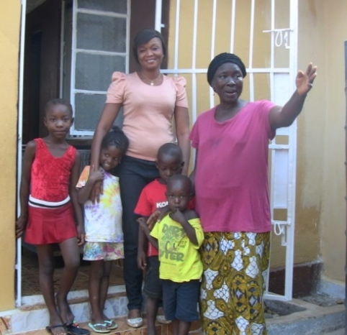
Risk of Exposure/Transmission
Gender, and associated roles, can translate to differences in disease risk
Men and hunting
Women and caretaking
Cross-border traders
http://www.nature.com/news/ebola-an-eyewitness-account-from-sierra-leone-1.16463
Notes:
As we have discussed in the past, risk of Ebola infection can be dependent on gender, specifically, Ebola is biased towards women. In this current outbreak, women make up 55-60% of the deceased. This is largely due to the jobs that each gender fill.
As hunters, men are often the first targets of infection because of their exposure to wild animals infected with Ebola. As caretakers, women contract the virus from men. Women are also the traditional nurses and laundry workers in hospitals, putting them at higher risk for exposure.
Outside of the caretaking sphere, women also play a major role as traders across borders, facilitating the spread of Ebola as well as being more exposed to outbreaks in other areas. Additionally, the closing of borders due to this outbreak severely affects their trade and livelihoods.
Finally, women also traditionally prepare funerals.
In this current outbreak, women make up 55 to 60% of the deceased. In liberia, women made up 75% of those infected or dead and in the 1979 outbreak, women have made up 69% of those affected by Ebola.
This is largely because women fill caregiving roles
While men are often the bush hunters and so are often the first targets of infection, women are the targets for secondary infections.
Women are the traditional nurses and laundry workers in hospitals, putting them at higher risk for exposure. Pregnant women are also at higher risk of exposure due their increased contact with health professions. “2 of the 3 largest outbreaks of Ebola involved transmission of the virus in maternity settings”
Outside of the caretaking sphere, women also play a major role as traders across borders, facilitating the spread of Ebola as well as being more exposed to outbreaks in other areas. Additionally, the closing of borders due to this outbreak severely affects their trade and livelihoods.
Finally, women also traditionally prepare funerals, which Hannah will discuss in more detail.

Slide 5
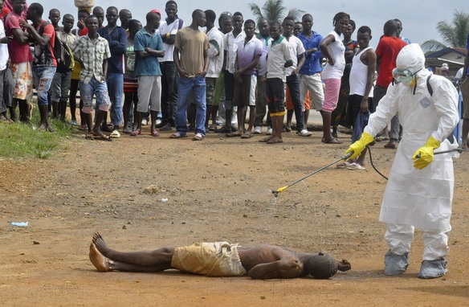
Risk of Exposure/Transmission
Social/Cultural Activity
Funerals
Burials
Taxi occupancy banned to only 3
http://politomix.com/the-gateway-pundit/571851/dead-ebola-patients-resurrect-before-funeral-in-liberia/
Notes:
Guinea: Red Cross workers have been stoned and harassed during funerals
Liberia: Once 7-8 people used to cram into taxis- even goats were along for the ride. Now a ban on more than 3 people per taxi has been set.
Burials: traditional SL burials involve touching, washing, and kissing the body
This presents a problem since people are being advised not to contact bodies; yet tradition is tough to break
WHO suggests that the virus can remain alive and virulent for 3 days in blood, saliva, urine, and tears of an infected individual
Example of modifications since outbreak: taxis that once held 7-8 passengers have been reduced to carrying three

Slide 6
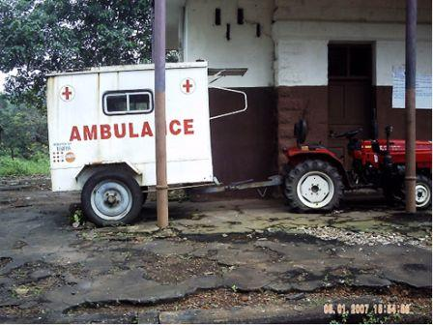
Infrastructure and Communication
Access to villages and health care
Supplies & training
Communication limitations
http://africayoungvoices.com/wp-content/uploads/2011/09/Ambulance-used-in-Kongbora.jpg
Notes:
Access to villages & health care
The country’s infrastructure has been destroyed, and development has been delayed, largely due to a decade-long civil war. It is ranked 177 out of 187 on the UNDP Human Development Index as of 2013.
97% of transport and movement is by road, yet only 10% of the roads are paved. There is also a massive disparity between urban and rural networks. This limits local and regional communication and access. Little maintenance to paved roads let alone unpaved roads - this can greatly increase travel time (huge problem when medical treatment is needed) and often prevents travel altogether. Sometimes walking is the safest and most reliable method of transportation.
Limited development in the energy sector - less than 10% of Sierra Leone’s population has access to electricity; again there is a huge disparity between urban and rural areas. This in turn affects the communication capacity of individuals and communities, and the stability and quality of healthcare that can be provided.
Supplies & training
Funding for supplies is limited in rural areas; often supplies given are not sufficient for the environment - can lead to temporary fixes. Due to limited travel access, often the training of locals/key individuals on the scene is delayed or non-existent. Influences reaction-time and containment measures that are necessary in an outbreak scenario with Ebola or another emerging infectious disease (EID).
Communication limitations
Language barriers exist; even those native to the country may struggle due to varying village dialects and tongues. For example in many affected villages there is no word for “virus” - how do you explain an infectious disease when the concept of one is often limited at best? Had to use the word for maggot (tumbu) to try to convey the message, which while better than nothing, can also lead to confusion in understanding transmission of Ebola.
Lines of communication are often limited to word of mouth in rural areas; for example while visiting a village that had been quarantined, health care workers learned about a case of Ebola in a nearby village; only learned this through a conversation with an individual they had quarantined for monitoring purposes - this was a week after the death in the neighboring village.

Slide 7
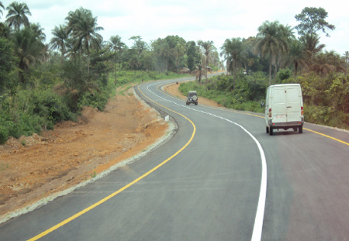
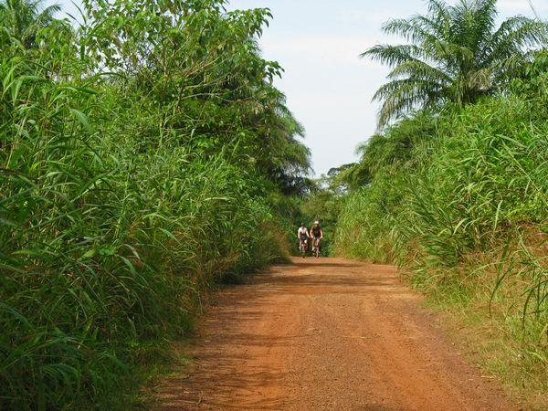
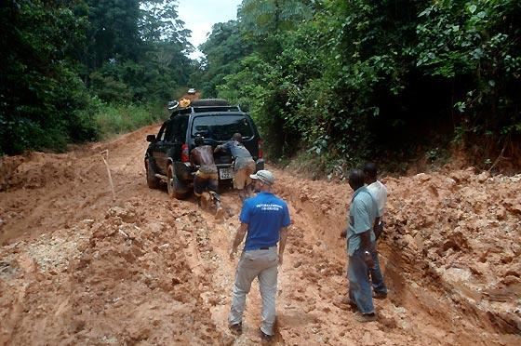
Roads in Sierra Leone
http://news.sl/drwebsite/exec/view.cgi?archive=6&num=15532
http://blog.cartercenter.org/2012/11/12/election-observers-aim-to-illuminate-the-process-in-sierra-leone/
http://www.ibike.org/bikeafrica/sierra-leone/essay/05-Makali.htm
Notes:
Picture 1: highway in Sierra Leone; example of 10% paved roads
Picture 2: most commonly seen road in Sierra Leone
Picture 3: problems facing travelers on these dirt roads due to weather events; example is of what is commonly encountered during rainy season.

Slide 8
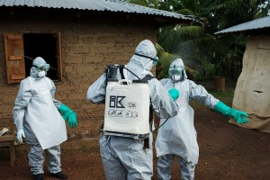
Public Perception and Attitudes
-Ebola “curse”
-Mistrust of officials
-Misconceptions of health care workers
http://www.thisissierraleone.com/in-focus-sierra-leone-doctors-and-nurses-risk-everything-to-fight-ebola-in-west-africa/
Notes:
Community members are not willing to accept Ebola as a disease-- do not report illness to officials or seek treatment
It is a common misconception to think that health care officials are spraying Ebola into schools when they are actually sanitizing.
Some people see this as a ploy for donations
Health Care Workers-- stigma, not trusted by community, even if they are part of it
Thoughts: Despite their brave efforts and unwavering commitment, these nurses are also subjected to the stigma and fear that have characterized the epidemic since it first arrived in the country. “We are known as the ‘Ebola nurses’. No one wants to come close to us,” Sister Nancy says. “The nurses in the general ward won’t talk to us. Even our families are scared they will catch the virus from us.”
Friends and neighbours suggested that the man might have Ebola, but his wife refused to allow her husband to be taken to the hospital. Instead, she called an herbalist, a traditional healer who told the family that the man had been shot by a witch gun — a spiritual weapon that rains calamity on the victim.

Slide 9
Community Aftermath - Survivors
Social stigma:
14% would not welcome back a neighbor
31% would not buy vegetables from a shopkeeper
46% admitted to some form of bias
Notes:
The misconceptions have translated into local prejudices against survivors. In a november survey by UNICEF in Sierra Leone, they found that 14% of respondents would not welcome back a neighbor that had survived infection, 31% would not buy vegetables from a shopkeeper that had beaten Ebola, and 46% of respondents admitted to some form of bias against survivors. But these are large improvements from the survey conducted in august when 94% of respondents held negative attitudes.
The stigmatization against survivors makes employment options scarce. Survivors often work as social workers in the fight against Ebola or are favored to watch over children because they are thought to be immune. However, no research has shown exactly how long they are immune to reinfection.
Those who overcome an infection often lose the majority of their family to the virus. Between the lack of employment and consequent lack of income and the loss of family, survivors are facing high emotional distress. The local government and other organizations are attempting to mitigate this by providing conferences that discusses protecting their communities, how their bodies defeated the disease, and provide psychosocial support as well as “release packages” that include things like mattresses, which are often destroyed during the course of infection.
Despite these negative attitudes, survivors often choose to work as social workers (such as nurses, caregivers, counsellors, organizers,and outreach workers)

Slide 10
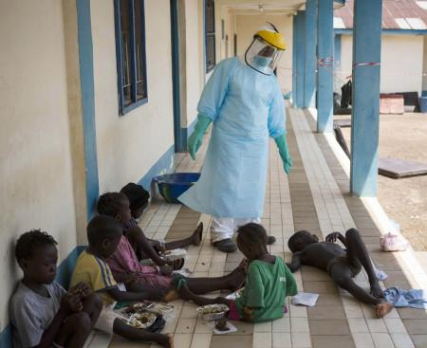
Community Aftermath - Children
School delays
Orphans
Over 16,600
children affected
Ostracization
http://www.huffingtonpost.com/2014/11/11/ebola-children-adults_n_6135102.html
Notes:
Children have also been highly impacted by the Ebola outbreak. Public schools have been closed since august and will not reopen until March 30th for SL. More importantly, over 16,600 children (in Guinea, Liberia, and Sierra Leone)have lost one or both parents or caregivers to the virus. In SL specifically, 3600 children have lost both parents. Like with other survivors, children survivors are ostracized and shunned, as we saw in the video at the beginning. However, Manual Fontain, UNICEF’s Regional Director for West and Central Africa has commented that as these “initial fears and misconceptions about Ebola” are overcome, “families have been showing incredible support, providing care and protection for children whose parents have died.” As a result, less than 3% of orphans have had to be placed outside family or community care. However, it is important to note that this relocation also affects their schooling. Not to mention that the lack in income will affect their future attendance at school.
Public schools in Guinea (19 Jan. 2015), Liberia (16 Feb. 2015), and Sierra Leone (30 March 2015) remain closed, depriving at least 5 million children of months of school education

Slide 11
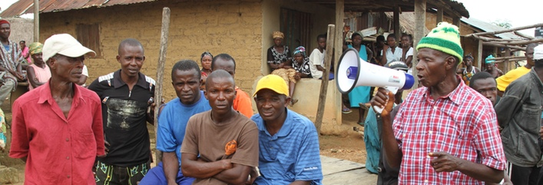
Future Hope
“We cannot do it on our own, which is why it is critical to engage with community leaders, be they traditional healers or religious leaders.”
http://www.redcross.org/news/article/Red-Cross-Engages-Traditional-Healers-to-Raise-Ebola-Awareness
Notes:
The Red Cross taps into Sierra Leone’s cultural system of medicinal healers and witchcraft doctors. By educating these respected community members in the dangers and health threats of the contagious virus, important medical messages are spread and learned.
Fallah James has changed his practices by abstaining from contact with any patient, whether or not presenting signs of Ebola. He is one of nearly 200 traditional healers in SLand is helping to combat the negative stigma associated with the disease.
Because he is of the Muslim faith, he is restricted from eating monkey or ape meat. However, he has cut all bushmeat out of his and his family’s diet. No antelope, deer, squirrel, porcupine. Most of his protein now comes from fish.
When dealing with deadly diseases in cultures that vary widely, those in the field must account for cultural and social factors that may be overlooked for education and eventual eradication of disease. Honing into the society and cultural framework is essential for understanding etiology of disease.

Slide 12
Discussion
What was surprising or new to you in this presentation?
If an Ebola outbreak reached your community, how would your family change?
How do gender roles differ within the communities discussed?
What are the social dynamics associated with Ebola? Can you think of other issues that may arise because of the virus?

