Slide 1
POH 100:Introduction to Pandemics and One Health
Notes:
The facilitator requires to lay good foundation for the whole course,.
Key here is to make it interactive.
One should ask students to;
Read the history of infectious diseases from such names as John Snow, Ignaz Semmelweis, John Lister and Robert Koch.
Students should then demonstrate ability to search for information in the library.
The other component are the terms pandemics, epidemics and outbreaks
The final and most important is have students read the history of ONE Health, the need for One Health and the current concept of One Health
Students are encouraged to read on drivers of pandemics, barriers to One Health

Slide 2
Purpose
This topic introduces learners to basic aspects and components of pandemics and One Health

Slide 3
Objectives
This topic enables learning about:
Concepts in pandemics and One Health
Fundamentals of the One Health Approach
Drivers of pandemics
Barriers to One Health

Slide 4
Expected Learning Outcomes
By the end of this topic learners should be able to:
Define concepts in pandemics and One Health
Outline historical perspectives of pandemics
Discuss drivers of pandemics
Describe barriers to One Health

Slide 5
Historical milestones of infectious diseases I
1846 Ignaz Semmelweiss demonstrated the importance of handwashing using antiseptics in the prevention of puerperal sepsis
1854:John Snows classic investigation of the Broad Street cholera epidemic
1860’s, John Lister proved the importance of aseptic technique and disinfection in reducing the incidence of infections following surgery.
Notes:
Students should present for up to 15 minutes what they read about John Snow, Ignaz Semmelweis, John Lister and Robert Koch.

Slide 6
Historical milestones II
1890 Robert Koch theorized that certain diseases were caused by particular pathogens
Henle-Koch postulates on the relationship between disease and bacteria
These early investigators were among the first to advance the “germ theory” of disease by recognizing that some infectious diseases were contagious – i.e. transmitted by contact, while others were communicable – transmitted indirectly by water or insects

Slide 7
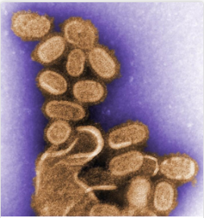
Spanish Flu 1918
The 1918 H1N1 flu pandemic, sometimes referred to as the “Spanish flu,” killed an estimated 50 million people worldwide, including ~675,000 people in the US
The pandemic lowered average life expectancy in the US by more than 12 years
Why was the 1918 virus so deadly?
Where did the virus originate from?
What can the public health community learn from 1918 virus to better prepare for and defend against future pandemics?
C. Goldsmaith - Public Health Image Library #11098.
https://www.cdc.gov/flu/pandemic-resources/reconstruction-1918-virus.html

Slide 8
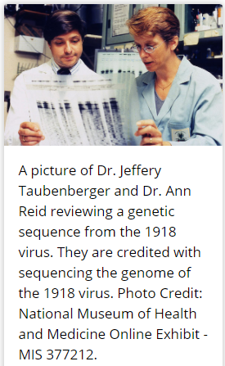
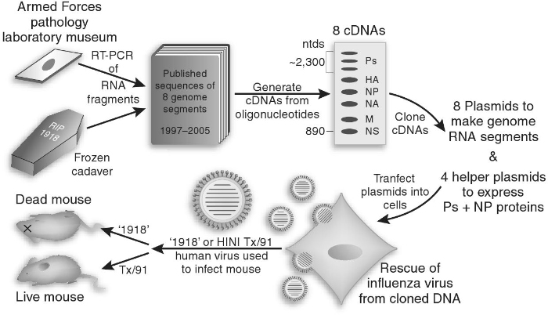
Spanish Flu 1918
Resurrected viruses (1918 flu)
Tumpey T, Science 07 Oct 2005: Vol. 310, Issue 5745, pp. 77-80

Slide 9
Epidemic
These are outbreaks of infections that are in excess of the normal “endemic” incidence of a particular type of infection. There are 2 types of epidemics
- A Common Source Outbreak is represented by a sharp curve. It is a point source outbreak with a single site or agent (e.g., food) causing infection. Eliminate the source and eliminate the epidemic (i.e., removing the handle during the Broad Street Pump epidemic)
- A Propagated Epidemic is when secondary cases are involved such as chicken pox affecting a large community
Notes:
Participants are asked to define terms Epidemic, Outbreak and Pandemic

Slide 10
Pathogen and Infection
A Pathogen is any microorganism capable of causing disease in a susceptible host
Pathogens are often described as primary(capable of causing disease in normal hosts) or opportunists(primarily causing disease in immunocompromised individuals).
Some microorganisms are highly pathogenic, e.g. Shigella spp. and a relatively small number are capable of causing disease while others, e.g. Staphylococcus epidermidis require special settings or a relatively high bacterial inoculum

Slide 11
Infection
Infection refers to the ability of microorganisms to invade tissue and find conditions that are suitable for growth and replication.

Slide 12
Intoxication and carrier
Intoxication: Some pathogens can cause disease by the elaboration of a toxin. This can occur in the absence of viable bacteria e.g. food poisoning.
Carrier: An individual with asymptomatic colonization or infection who is capable of transmitting infection to others. They may or may not be ill themselves (e.g., hepatitis C). Historically, “Typhoid Mary” a cook was responsible for several outbreaks of Salmonella typhi infections in the Northeast of the United States
http://www.history1900s.about.com/homework/history1900s/library/weekly/aa062900a.htm.

Slide 13
Virulence and latency
From the Latin virulentus (full of poison)
-Refers to the ability of an organism to cause disease.
-This is often dependent on the possession of factors such as surface adhesins that enable the microorganism to colonize host tissue
-Latency: The pathogen remains viable but is dormant within the host. It however remains capable of causing disease at a later date (e.g., Mycobacterium tuberculosis or Herpes viruses).
Notes:
The facilitator should discuss this slide on virulence and latency

Slide 14
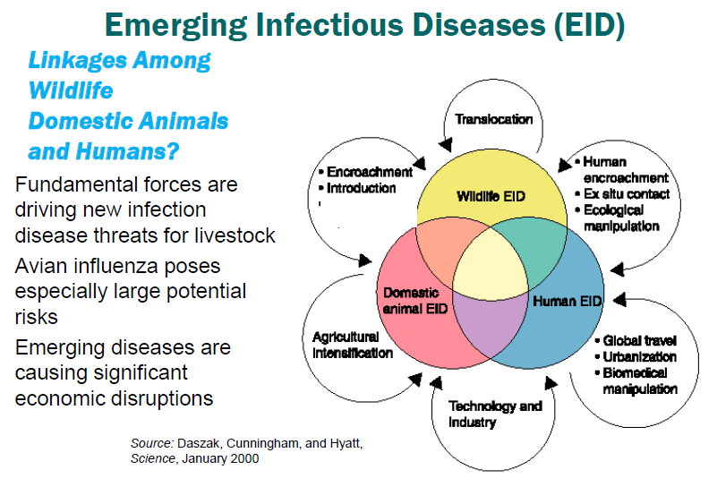
Notes:
The facilitator should ask participants to identify emerging infectious diseases and factors likely to trigger emerging infectious diseases

Slide 15
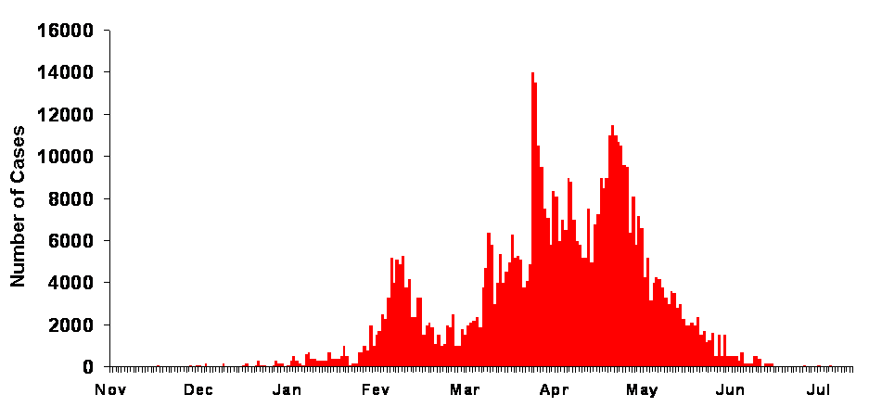

Drivers of Pandemic Risk
Pandemic Global spread
Global travel and trade
Globalization
Global travel: people, animals, vectors
Global trade: animal and their products
Epidemic Amplification
Amplification
Urbanization
Population density
Agricultural Intensification
Technology And Industry
Vector distribution and densities
Transmission in health care centers
Successful A2H, V2H & H2H transmission,
Human to human
transmission
Amplification
Outbreak Emergence
Emergence
Human encroachment
Exploitation
Translocation
Climate variability
Vector density and distribution
Ecological Pressure
Human
ecosystem
environment
interface

Slide 16
Drivers of Pandemics
Human population movements/displacements, including travel, tourism, mass gatherings and migration.
Animal-dependent drivers arise from livestock via the farming industry, movement and/or trade of livestock, pets and wildlife, and food production imports and exports.
Environmental drivers include climate change, urban planning and land use, pollution, and biodiversity promoting activities such reforestation, recreation of wetlands, and rewilding.
Social factors such as inequality, political instability as well as loopholes or breakdowns in human-driven control processes (e.g. disease surveillance) also constitute drivers for disease threats.
Cultural factors dictate beliefs about vaccine efficacy, access to antibiotics, or developments in human health delivery (e.g. web/app doctors), which alter potential disease risks.

Slide 17
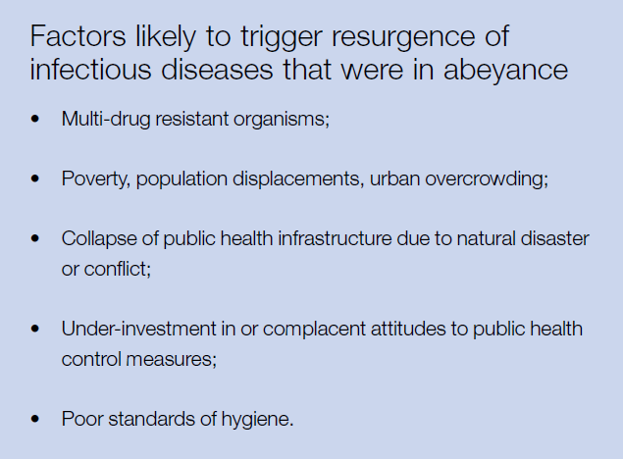

Slide 18
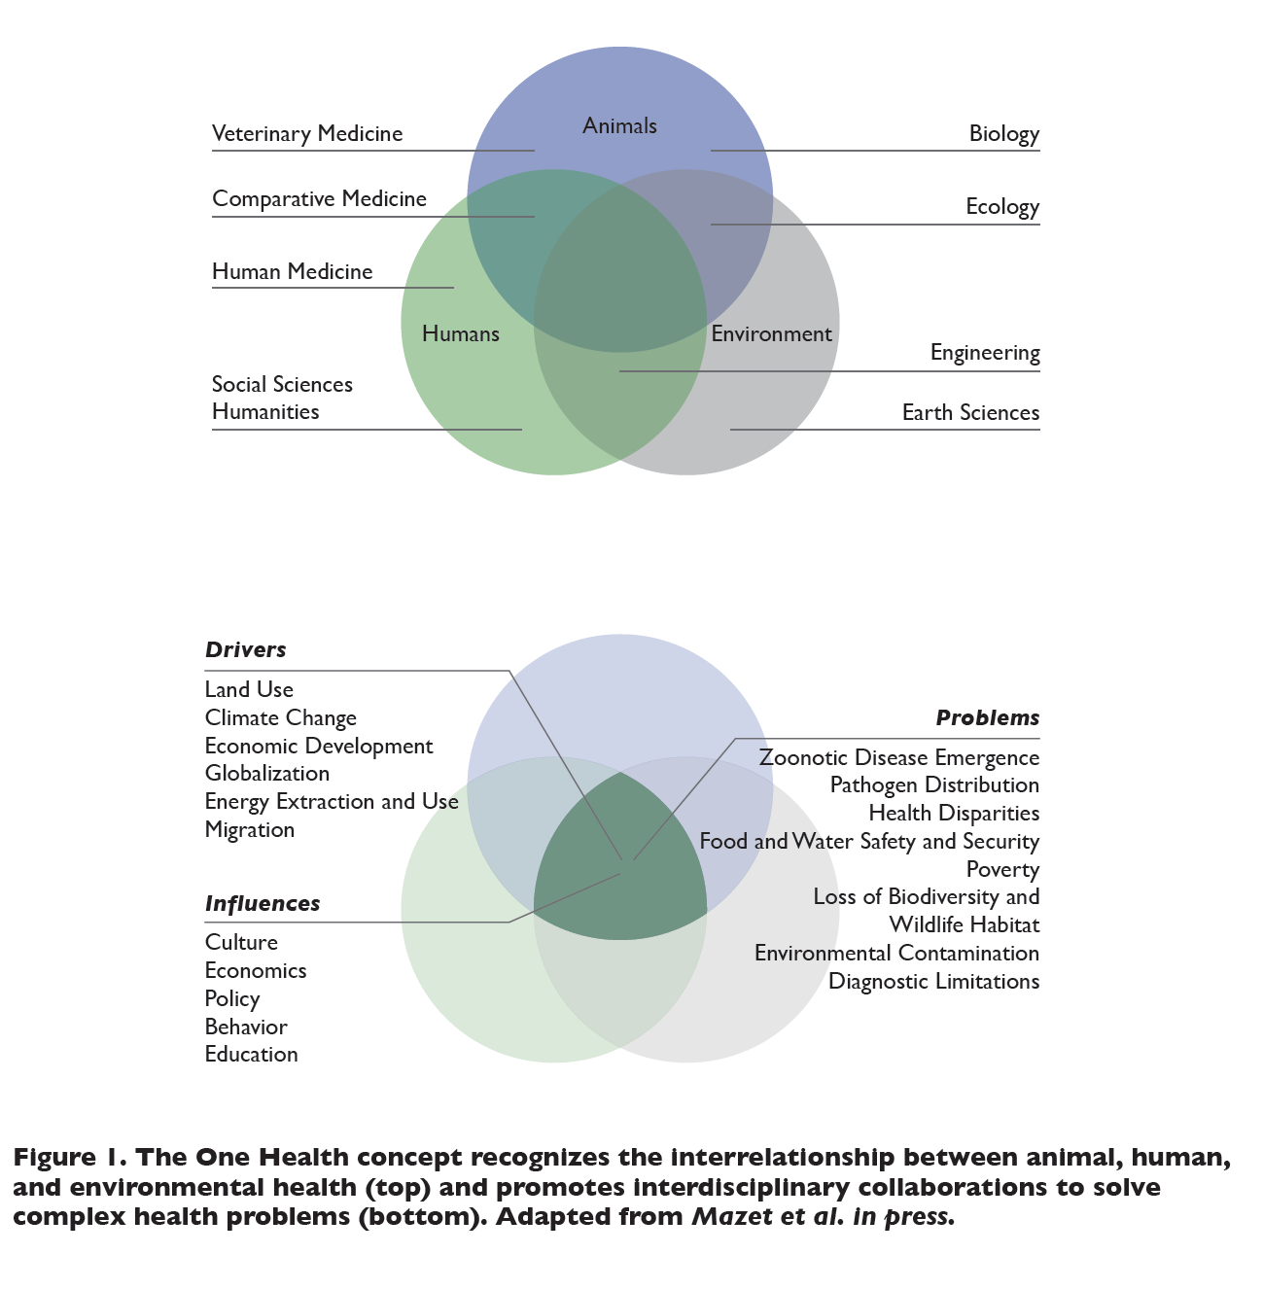
Notes:
The facilitator should take some time on this slide to explain the concept of One Health, not just human, animal, environment health, but that all other sectors are involved

Slide 19
Animal science, human health, and environmental science are at the core of One Health
Drivers of One Health include…
Land Use
Economic Development
Globalization
Energy Use
Migration
Influences of One Health include…
Culture
Economics
Policy
Behavior
Education
Workforce Development
Vector born disease and entomology
Occupational health
Disease surveillance
Food safety & security
Education
Zoonotic
disease management
Water
sanitation & hygiene
Human health
Animal health
Biotechnology
Urbanization
A number of fields are involved within and beyond health…
Comparative medicine
Social science
Ecology
Engineering
Earth science
Private sector
Politics
Many more…
Environmental
health
Clean energy
solutions
Climate change
How we enter One Health
Research
Biosecurity
Policy
Sustainable Agriculture
Anti-microbial resistance
Community
Areas of focus within One health
Who is involved
Notes:
One Health is about collaboration, not creating a new silo
This is only a sampling of issues within One Health that are commonly funded or otherwise experts say are in need of investment and focus from One Health
Question for today is how do we foster collaboration together?

Slide 20
One Health Approach I
One Health is an approach that emerged from collaboration between the human health and veterinarian/food sciences sector and has developed to gradually include additional branches of science, notably the environmental sciences and social sciences.
WHO describes One Health as ‘An approach to designing and implementing programmes, policies, legislation and research in which multiple sectors communicate and work together to achieve better public health outcomes’.
The One health approach is an integrative effort of multiple disciplines working locally, nationally, and globally to achieve optimal health for people, animals, and the environment

Slide 21
One Health Approach II
The One Health approach to global health security recommends a holistic view of the interface between human, animal and ecosystem health domains.
It promotes an international, interdisciplinary, intersectoral perspective to disease emergence and control.
The One Health approach can be used in designing and implementing programmes, policies, legislation and research where multiple sectors collaborate to achieve better public health outcomes.
Notes:
This assignment should have been given before the class on what One health is, sectors involved in One Health, drivers of pandemics, barriers to One Health

Slide 22
History of One Health
Vicq d’Azyr an 18th century physician linked human and animal epidemics to climatic and geographical conditions through the study of rinderpest
19th century, the first modern veterinary educational institutions were established
In the modern era, the epidemiologist William Foege, who played a major role in eradicating smallpox, said “You can’t tell the story of human health separate from animal health or environmental health” [4]
1975, WHO, the Office International des Epizoonotics, and FAO collaboratively defined the concept of veterinary public health, which was an important facilitator of the international response to avian influenza in 2003
One Health, which started with comparative medicine and then went through the paradigm of One Medicine before including environmental health, calls for a horizontal approach across interdisciplinary institutions and requires a contextual approach to ecosystems

Slide 23
Why One Health?
Increasing antimicrobial resistance (AMR) and emerging zoonotic pathogens, including avian influenza, Ebola virus, and Zika virus have threatened global health
These novel public health threats are urgent issues, because 61% of infectious organisms affecting humans are zoonotic
There is need to address health issues using as many sectors and disciplines
Cost-effectiveness of early detection of health threats in animals, thus reducing the impact on human lives

Slide 24
Sectors involved in One health
Veterinarian services
Wildlife (e.g. entomologists)
Transport
Trade
Human medicine
Media and communication
Biosecurity
Pharmaceutical
Law enforcement, police, border control
Environment (geological survey, land planning/development)
Civil society (volunteers, citizen scientists)
Risk management (insurance industries)

Slide 25
Principles of One health
Use of holistic systems approach in the management of health challenges
Multidisciplinary and/or inter-sectoral collaboration
Sharing of resources: technical, information, structural, human, etc.
Promotion of transparent communication and sharing of information between stakeholders
Cooperation between the public and private sectors
Unified and cooperative capacity building within the health sector

Slide 26
Barriers to One Health I
Communication/coordination :
-Without effective communication channels across sectors, the potential for response is limited
-Communication mechanisms and frameworks should therefore be established during non-emergency periods, and always with a focus on One Health aspects
Surveillance and early warning systems across sectors.
A mechanism for joint situational awareness is urgently needed, as is a platform to share early signals with a low threshold of interaction.
Identification of an appropriate system is necessary so that all sectors (e.g. public health and animal health) are alerted with impending threats.

Slide 27
Barriers to One Health II
-Roles, responsibilities, and contact points, while clear for some sectors, are unclear for others (environmental)
-Data/sample sharing: National and regional sharing of biological samples between agencies is problematic and reflects
-Lack of in-country capacity and coordination between sectors. There is need for a joint database for data sharing and development of protocols and frameworks for sample sharing
-Capacity building: Local human resources who cover risk assessment, laboratory skills, diagnostics, vaccine purchases
-Reference laboratories: For sites where capacities are low or unavailable, a reference laboratory network is essential

Slide 28
Barriers to One Health III
Risk perception. The level of acceptable risk differs between public health (precautionary) and animal health (less stringent). There is a need for improved communication and agreement on the level of acceptable risk
Recognition of cultural tendencies. Different countries may employ different strategies to tackle infectious diseases (e.g. influenza vaccination of the public in Scandinavia). Acknowledgement of these cultural tendencies and open discussions across borders should be encouraged
Overlap of prediction modelling. Lack of collaboration in the area of prediction modelling for risk assessment across different sectors (i.e. meteorological sector)

Slide 29
Barriers to One Health IV
Financial responsibility and funding challenges arise at all levels, and can be exacerbated by industry influence or animal rights issues (i.e. if animal vaccinations are needed for human health, who funds it?)
Intellectual property issues for technology or vaccine development requires examination and clarification.
Career constraints in the academic system can affect collaboration activities. Scientific staff is not necessarily rewarded for publishing in cross-disciplinary journals or collaborating across sectors;
Leadership issues impact interpretation and consistency to act upon early signals

Slide 30
Core References
Ibrahim, S. (2020). The pandemic century: A history of global contagion from the Spanish flu to COVID-19. Malaysian Orthopaedic Journal, 14(3), 209.
Kock, R. (2020). Introduction to One Health: An Interdisciplinary Approach to Planetary Health.
World Health Organization. One Health [internet]. Geneva: WHO; 2018 [accessed 5 May 2018]. Available from: http://www.who.int/features/qa/one-health/en/
Semenza JC, Lindgren E, Balkanyi L, Espinosa L, Almqvist MS, Penttinen P, et al. Determinants and drivers of infectious disease threat events in Europe. Emerg Infect Dis. 2016; 22(4):581-589.

Slide 31



Review of The Pandemic Preparedness with One Health approach (PPOH) short course is by the East African Community (EAC) Secretariat in cooperation with universities of the six EAC Partner States. It is facilitated by the German Government and implemented by the Deutsche Gesellschaft für Internationale Zusammenarbeit GIZ GmbH through the Global Programme Pandemic Prevention and Response, One Health (GP PPOH)

