Slide 1
POH 103: NATURE AND OCCURRENCE OF PANDEMICS

Slide 2
PURPOSE
This topic introduces learners to causation, spread and control of pandemics

Slide 3
OBJECTIVES
This topic enables learning about:
Concepts and nature of pandemics
Disease causation and transmission
Interrelationship between host, agent, and environment
Principles of control of pandemics

Slide 4
Expected Learning Outcomes
At the end of this topic, the learner should be able to:
Describe concepts and nature of pandemics
Explain disease causation and transmission
Analyze the interrelationship between host, agent, and environment and
Discuss principles of control of pandemics

Slide 5
Introduction to Infectious Diseases
Infectious diseases are disorders that are caused by organisms, usually microscopic in size, such as bacteria, viruses, fungi, or parasites that are passed, directly or indirectly, from one person to another. Humans can also become infected following exposure to an infected animal that harbors a pathogenic organism that is capable of infecting humans.

Slide 6
Infectious Diseases - Definitions
Disease – a pathological condition of body parts or tissues characterized by an identifiable group of signs and symptoms.
Infectious disease – disease caused by an infectious agent such as a bacterium, virus, protozoan, or fungus that can be passed on to others.
Infection – occurs when an infectious agent enters the body and begins to reproduce; may or may not lead to disease.
Pathogen – an infectious agent that causes disease.
Host – an organism infected by another organism.
Virulence – the relative ability of an agent to cause rapid and severe disease in a host.

Slide 7
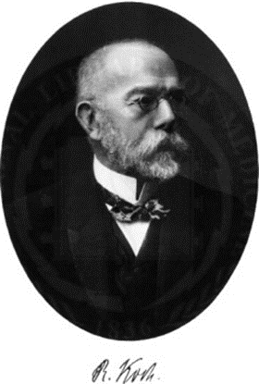
Koch’s Postulates
Koch developed four criteria to demonstrate that a specific disease is caused by a particular agent.
The specific agent must be associated with every case of the disease.
The agent must be isolated from a diseased host and grown in culture.
When the culture-grown agent is introduced into a healthy susceptible host, the agent must cause the same disease.
The same agent must again be isolated from the infected experimental host.

Slide 8
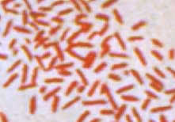
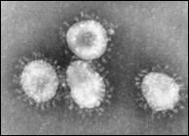
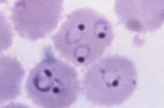
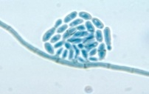
Infectious Disease Agents
Most infectious agents that cause disease are microscopic in size and thus, are called microbes or microorganisms.
Different groups of agents that cause disease are:
-Bacteria
-Viruses
-Protozoa (Protists)
-Fungi
-Helminths (Animals)
Courtesy of CDC
Notes:
Infectious Disease Agents
Most disease-causing organisms, or pathogens, are too small to be seen without a microscope. Some (e.g., most viruses) are even too small to be visible under a light microscope and must be viewed with the more powerful electron microscope. Because of their microscopic size, these minute organisms often are referred to as microbes or microorganisms. The study of these organisms is called microbiology, and scientists who study these organisms are microbiologists. Not all microbes cause disease; many are beneficial and even essential. Bacteria, in the digestive system, for example are important partners in digestion. Microbes that cause disease are sometimes informally referred to as “germs” or “bugs”.
The five main groups of pathogens are bacteria, viruses, protozoa, fungi, and helminths. Bacteria are simple, single-celled organisms that lack an organized nucleus or membrane enclosed organelles. They often have a cell wall (prokaryotes), and their cells usually are rod-shaped or spherical. Commonly known diseases caused by bacteria are diarrheal diseases, pneumonia, strep throat, tuberculosis, and anthrax.
Viruses are particles of nucleic acid (DNA or RNA) surrounded by a protective coat that replicate within specific host cells and can spread from cell to cell. Infectious diseases caused by viruses include the flu, the common cold, AIDS, chickenpox, and hepatitis.
Protozoa are single-celled, motile, eukaryotic organisms, found in the Kingdom Protista, that can be human parasites. A protozoan known as Plasmodium (over 170 species), causes malaria, an infectious disease that is one of the world’s top killers.
Fungi are made of eukaryotic cells (organized nucleus and membrane enclosed organelles). All fungi, with the exception of the yeast group, are multi-cellular organisms that absorb nutrients from the environment. Fungi can cause athlete’s foot, sinusitis, skin diseases, and vaginal infections.
Helminths (worms and flukes) are invertebrate animals, some of which are parasitic. Wuchereia bancrofti is transmitted to humans by way of the mosquito. The mature adults pass into lymphatic glands, obstructing lymphatic drainage and resulting in a disfiguring condition, known as elephantiasis.
References
Alberts, B., Johnson, A., Lewis, J., Raff, M., Roberts, K., & Walter, P. (2002). Molecular Bbology of the cell, (4th ed.). New York: Garland Publishing, Inc. Black, J. G. (2005). Microbiology (6th ed.). John Wiley & Sons, Inc.
National Institute for Allergy and Infectious Diseases. (2006). Microbes in sickness and in health. Retrieved 9-20-2006 from http://www.niaid.nih.gov/publications/microbes.htm
Image References
Ajello, L. Yeast-type fungus that causes a skin disease (ID # 4314). CDC. Retrieved 11-29-2006 from http://phil.cdc.gov/phil/home.asp
CDC. Rod-shaped bacteria. Retrieved 9-18-2006 from http://phil.cdc.gov/phil/home.asp
Glenn, S. Malaria parasite inside a red blood cell. CDC. Retrieved 11-29-2006 from http://phil.cdc.gov/phil/home.asp
Melvin, M. (1979). Scolex of Taenia solium (ID #1515). CDC. Retrieved 11-29-2006 from http://phil.cdc.gov/phil/home.asp
Murphy, F. (1975). SARS-related virus (ID # 4814). CDC. Retrieved 11-29-2006 from http://phil.cdc.gov/phil/home.asp

Slide 9
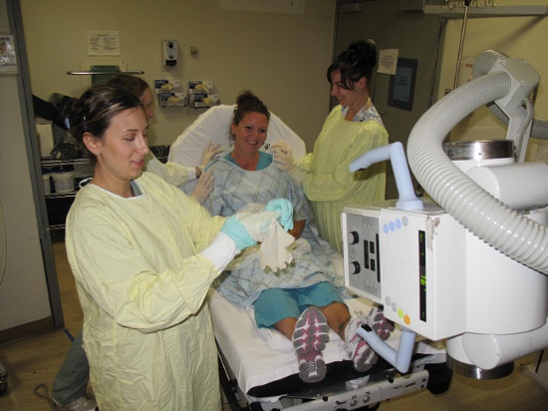
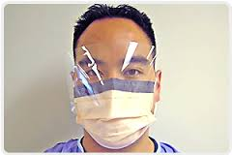
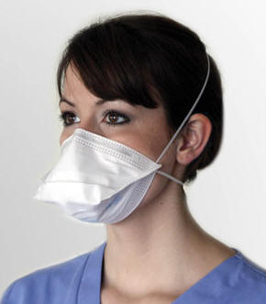
Three Basic Routes of Transmission
Contact
- Direct
- Indirect
Droplet
-Larger; don’t travel long distances, not infective over time
-Spatial separation (≥ 3 feet)
Airborne
-Smaller; infective over time and distance

Slide 10
Rationale
Transmission of infectious agents requires three elements:
A source (or reservoir) of infectious agents
A susceptible host with a portal of entry receptive to the agent
3. A mode of transmission for the agent

Slide 11
The Chain of Infection
Infectious Agent
Bacteria
Virus
Fungi
Reservoir
People
Environment
Equipment & Water
Portal of Exit
Excretion, secretions, skin, and droplets
Means of Transmission
Direct/Indirect Contact
Inhalation
Airborne
Portal of Entry
Mucous Membranes
Respiratory & GI Tract
Broken Skin
Susceptible Host
Patient
Staff
Visitor

Slide 12
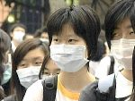
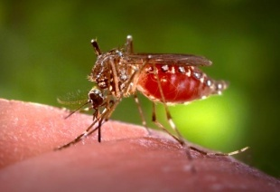
Transmission of Infectious Diseases
Agents that cause infectious diseases can be transmitted in many ways.
Through the air
Through contaminated food or water
Through body fluids
By direct contact with contaminated objects
By animal vectors such as insects, birds, bats, etc.
Courtesy of VOA
Chinese students wearing masks during a SARS outbreak
Courtesy of CDC
Aedes aegypti mosquito
Known to transmit Dengue fever
Notes:
Transmission of Infectious Diseases
There are many ways that infectious diseases can spread. Pathogens usually have specific routes by which they are transmitted, and these routes may depend on the type of cells and tissue that a particular agent targets. For example, because cold viruses infect the respiratory tract, they are dispersed into the air via coughing and sneezing. Once in the air, the viruses can infect another person who is unlucky enough to inhale air containing the virus particles.
Agents vary greatly in their stability in the environment. Some viruses may survive for only a few minutes outside of a host, while some spore-forming bacteria are extremely durable and may survive in a dormant state for a decade or more.
As noted, some diseases, such as colds, the flu and tuberculosis, spread through the air when an infected person coughs or sneezes. Another route or transmission is through ingestion of contaminated food or water. Water- and food-borne illnesses can be caused by bacteria, viruses, or protozoa. This risk of contracting these illnesses is greatest with impure and untreated water and undercooked or improperly stored foods. Infectious diseases can also be transmitted through body fluids, such as blood, semen, and saliva. For example, HIV easily can be passed through contact with blood and semen, however, even though the virus has been found in saliva, there are no documented cases where HIV has been transmitted by contact with saliva. Similarly, there are no known cases of transmission of HIV by mosquitoes. Additionally, infectious agents can be passed through blood and blood products during medical procedures, such as blood transfusions. Many hemophiliacs receiving blood products were unwittingly infected with HIV before the responsible agent was identified and blood donations were screened. Other people can be infected as a result of sharing contaminated needles.
Touching contaminated objects commonly leads to infection, especially among pre-school children. Fecal to oral transmission is a major path for diarrheal diseases, such as rotavirus and Norwalk virus, that are widespread in daycare centers. It is also possible to become infected with some agents by touching surfaces such as doorknobs and telephones, especially those located in public places. Pigs and birds, in particular, are known to harbor viruses that can mutate and spread to humans upon contact. Finally, pathogens can be transmitted through insect vectors, such as mosquitoes. Mosquitoes are responsible for the spread of malaria, yellow fever, and West Nile virus, among other diseases. Ticks, which spread Lyme’s disease, are another common vector.
References
Black, J. G. (2005). Microbiology (6th ed.). John Wiley & Sons, Inc.
National Institute for Allergy and Infectious Diseases. (2006). Microbes in sickness and in health. Retrieved 9-20-2006 from http://www.niaid.nih.gov/publications/microbes.htm
Image References
Chinese students wearing masks during the SARS epidemic. Courtesy: VOA
Gathany, J. (2006). Feeding female mosquito (ID# 9182). CDC. Retrieved 11-29-2006 from http://phil.cdc.gov/phil/home.asp

Slide 13
Transmission Based Precautions
Contact Precautions
Hand Hygiene
Droplet Precautions
Hand Hygiene
Gown
Gloves
Airborne Precautions
Hand Hygiene
Mask
PAPR/N-95 Respirator mask
Negative pressure room

Slide 14
Breaking the Chain of Infection
Infectious Agent
Bacteria
Virus
Fungi
Reservoir
People
Environment
Equipment & Water
Portal of Exit
Excretion, secretions, skin, and droplets
Means of Transmission
Direct & Indirect Contact
Inhalation
Airborne
Portal of Entry
Mucous Membranes
Respiratory & GI Tract
Broken Skin
Susceptible Host
Patient
Staff
Visitor
Rapid identification, diagnosis, and treatment
Recognition of high risk patients Treatment of underlying disease Immunizations
Education
Environmental Hygiene Disinfection and Sterilization
Hand Hygiene,
Personal Hygiene
Transmission Based Precautions Aseptic Technique Wound/catheter care
Hand Hygiene
Control of Excretions & secretions
Proper attire
Hand Hygiene
Transmission based precautions Environmental Hygiene
Notes:
Excretion; the body excretes waste products – i.e., stool, urine, sweat
Secretion; substance expelled by a cell, gland, or organ – i.e., blood, breast milk, pus

Slide 15
Phases of Infectious Disease
Incubation period – time between infection and the appearance of signs and symptoms.
Prodromal phase – mild, nonspecific symptoms that signal onset of some diseases.
Clinical phase – a person experiences typical signs and symptoms of disease.
Decline phase - subsidence of symptoms.
Recovery phase – symptoms have disappeared, tissues heal, and the body regains strength.
Notes:
Phases of Infectious Disease
Diseases caused by infectious agents usually run a standard course that is associated with different signs and symptoms. Before we describe these different phases of infectious diseases, we must first define the terms, “signs” and “symptoms.” Signs of an infectious disease are characteristics of a disease that can be observed by examining a patient. They include things such as fever, coughing, rash, vomiting, and diarrhea. Symptoms, on the other hand, can be felt only by the patient. They include pain, headache, and nausea.
The time period from when a person first becomes infected until signs and symptoms become apparent is called the incubation period. During this phase, the person is not aware that he or she is infected, but he or she may already be contagious (capable of passing the agent on to others). The length of the incubation period is typical for a specific agent but can vary, depending on how virulent the agent is, the dose of infectious agent entering the body, and the route of infection (i.e., where the agent enters the body relative to the tissue it infects).
In the prodromal phase, a person experiences mild, nonspecific symptoms. During this time, the agent is continuing to multiply and the person is contagious. This phase is absent in some diseases, which cause a person to feel ill suddenly, without any warning.
The clinical phase (also called the invasive phase or acute phase) is the period in which typical disease signs and symptoms are evident. During this phase, there comes a time when symptoms reach their greatest intensity. Called the “acme,” this is the height of the battle between the pathogen that is invading and destroying tissue and the efforts of the body’s immune system to contain and obliterate the invader. Fever is usually a component of this phase, during which the patient is most contagious. Once the acme is reached, the number of infectious agents begins to drop and the signs and symptoms start to decrease. This is the decline phase, during which the body’s activities gradually return to normal, the tissues heal, and the individual no longer experiences any symptoms. The recovery phase also is known as the convalescent phase. With some diseases, such as chickenpox, a person can still be contagious during recovery until the lesions are healed.
From the pathogen’s perspective, it is advantageous to induce the signs and symptoms of disease, such as coughing, sneezing, vomiting, and diarrhea, because these are ways that the infectious agent can be released from one host and spread to another. And although we do not enjoy feeling ill, these signs and symptoms are beneficial to us, in that they make us more likely to stay in bed and conserve energy to fight the pathogen and minimize the chance of spreading the disease to others.
Reference
Black, J. G. (2005). Microbiology (6th ed.). John Wiley & Sons, Inc.

Slide 16
Classification of Infectious Disease
Duration
Acute – develops and runs its course quickly.
Chronic – develops more slowly and is usually less severe, but may persist for a long, indefinite period of time.
Latent – characterized by periods of no symptoms between outbreaks of illness.
By location
Local – confined to a specific area of the body.
Systemic – a generalized illness that infects most of the body with pathogens distributed widely in tissues.
By timing
Primary – initial infection in a previously healthy person.
Secondary – infection that occurs in a person weakened by a primary infection.
Notes:
Types of Infectious Disease
Infectious diseases are classified by their duration and their location within the body, among other characteristics. “Acute,” “chronic,” and “latent” are terms used to describe the duration of a disease, how quickly the symptoms develop, and how long they last. The common cold is an acute disease; tuberculosis is a chronic disease; and herpes infections can produce latent infections with recurring attacks interspersed by periods with no symptoms (e.g. cold sores).
“Local” and “systemic” refer to the location of a disease within the body. Pathogens that spread from a more localized site, enter the bloodstream and are carried to other tissues can produce a systemic infection.
“Primary” and “secondary” characterize the order of infection. A primary infection, usually an acute infection, occurs first in a previously healthy person. Sometimes, when a person is suffering from a primary infection and his or her immune system has been weakened by battling the primary infection, the person can succumb to a secondary infection caused by another agent. Thus, a person who has caught a cold due to a virus may then become ill with an ear infection caused by a bacterium because his/her immune system is incapable of fighting off another agent in its weakened state.
Reference
Black, J. G. (2005). Microbiology (6th ed.). John Wiley & Sons, Inc.

Slide 17
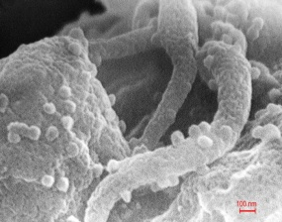
How Infectious Agents Cause Disease
Production of poisons, such as toxins and enzymes, that destroy cells and tissues.
Direct invasion and destruction of host cells.
Triggering responses from the host’s immune system leading to disease signs and symptoms.
Courtesy of CDC
Human Immunodeficiency Virus. HIV-1 virions can be seen on surface of lymphocytes.
Notes:
How Infectious Agents Cause Disease
Many microbes produce toxins or enzymes that damage host tissue. Bacteria produce two groups of toxins: endotoxins and exotoxins. Endotoxins are part of the cell wall of some types of bacteria and are released into host tissues when the bacteria divide or die. Exotoxins are secreted by bacteria into host tissues; they are sufficient to make a person ill even in the absence of the bacterial organisms.
There are seven different types of the exotoxin produced by the organism that causes botulism (Clostridium botulinum). Types A, B, E, and F cause a severe type of food poisoning, producing one of the most poisonous substances known to mankind. Types C, D, and E cause illness in mammals, birds, and fish. Botox, a pharmaceutical, is a purified and diluted A neurotoxin used for clinical and cosmetic purposes (e.g., to remove wrinkles by paralyzing forehead muscles for several months). Viruses must invade a cell directly in order to reproduce and in the process disrupt normal host cell functions. In many cases, the assembly and release of new virus particles causes the cell to lyse or rupture, releasing the new virus particles which can go on to infect more cells. Fungi and protozoa also can release toxins and enzymes that destroy host tissues. Some protozoa, such as the parasite that causes malaria, directly invade host cells.
Many signs and symptoms of disease are brought on by the host’s immune system in response to pathogen invasion. Fever, for example, is an attempt by your body to kill invading microbes that are sensitive to changes in temperature. Sneezing, coughing, vomiting, and diarrhea all are efforts by the body to rid itself of pathogens.
Reference
Black, J. G. (2005). Microbiology (6th ed.). John Wiley & Sons, Inc.
Image Reference
Goldsmith, C., Feoriino, P., Palmer, E. L., & McManus, W. R. (1989). HIV particles on the surface of a blood cell (ID # 8244). CDC. Retrieved 11-29-2006 from http://phil.cdc.gov/phil/home.asp

Slide 18
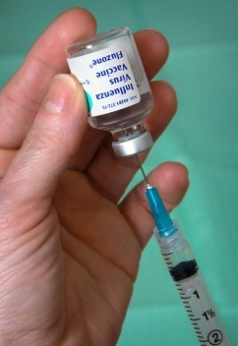
Reducing the Spread of Infectious Diseases
Vaccines
Antimicrobial drugs
Good personal hygiene and sanitation
Quarantine
Notes:
Reducing the Spread of Infectious Diseases
The most effective method of stemming the spread of infectious disease is through vaccination. Vaccines consist of weakened or killed microbes, or just components of a pathogen, and stimulate the body’s natural defenses—the immune system—to combat infections. Vaccination has eliminated smallpox, nearly eradicated poliovirus from much of the world, and drastically reduced the incidence of childhood infections, such as measles, mumps, and whooping cough, at least in the developed world. Influenza vaccines are available to reduce the occurrence of seasonal flu, although the shot must be given yearly due to the extreme variance of the influenza virus from season to season. Vaccines for other infectious diseases, especially HIV, still are being sought.
Antibiotics are effective for many types of bacterial infections (although they are entirely useless against viruses). But increasingly, bacteria are becoming resistant to the arsenal of antibiotics at our disposal. Very few drugs work well against viruses (anti-viral drugs for influenza and HIV were discussed in the previous two slides). Anti-fungal drugs exist, but their use is limited.
There are no vaccines against protozoan parasites, and other medications against them are becoming ineffective. Therefore, protection from insect vectors such as mosquitoes and control of mosquito populations are crucial strategies in containing the spread of insect-borne diseases, such as malaria. Good sanitation, water purification, hand washing, and proper cooking and storage of foods all help to reduce the prevalence of infectious disease. In cases of highly contagious, often fatal diseases, quarantine is employed as a means of preventing the spread of disease through a community. However, regardless of the disease, it is wise to limit contact with other individuals when ill.
Reference
Hahn, D. B., Payne, W. A., & Mauer, E. B. (2005). Focus on health (7th ed.). New York: McGraw Hill.
National Institute for Allergy and Infectious Diseases. (2006). Microbes in sickness and in health. Retrieved 9-20-2006 from http://www.niaid.nih.gov/publications/microbes.htm
Image Reference
Gathany, J. (2003). Influenza virus vaccine, (ID# 5404). CDC. Retrieved 8-14-2006 from http://phil.cdc.gov/phil/quicksearch.asp

Slide 19
Emerging Infectious Diseases
Emerging diseases are those that have recently appeared within a population, or whose incidence or geographic range is increasing rapidly.
Diseases can emerge or re-emerge due to:
-Appearance of a previously unknown agent.
-Evolution of a new infectious agent.
-Spread of an infectious agent to a new host.
-Spread of an infectious agent to new locations.
-Acquisition of resistance to anti-microbial drugs.
-Deliberate introduction into a population.
Notes:
Emerging Infectious Diseases
Although we have developed the technology to control many infectious diseases, new diseases continue to arise and spread. Emerging infectious diseases can be caused by both “new” and “old” pathogens. Diseases that recently appeared in a population, or whose range of hosts or geographic locations are rapidly expanding or threatening to expand in the near future are referred to as “emerging diseases.” Diseases whose incidence had significantly declined in the past, but have again reappeared are known as “re-emerging diseases.” Examples of emerging diseases are HIV, influenza, SARS, and Ebola. Tuberculosis is a disease that is re-emerging. “Old” pathogens are considered emerging if they are spreading to new species or new geographic locations.
Diseases sometimes emerge due to natural processes, such as the evolution of the infectious agent over time, but many emerging diseases result from human activities. These include population growth, migration from rural areas to cities, international air travel, blood transfusions, poverty, wars, and destructive ecological changes caused by economic development and land use.
Many emerging diseases arise when infectious agents in animals are passed to humans (referred to as zoonoses). This is occurring more and more as the human population grows and spreads into new geographical regions, resulting in increased contact with wild animal. It is not difficult to imagine a scenario in which a hunter in a remote area of Africa becomes infected with a “new” infectious agent and then travels to a village, where he infects other locals, one of whom boards a plane and infects his fellow passengers, who then travel to other parts of the world before any infection is detected. In this way, a disease could emerge quite rapidly.
For an emerging disease to become established, at least two events must occur: (1) the infectious agent must be introduced into a vulnerable population; and (2) the agent must have the ability to spread readily from person to person, cause disease, and sustain itself within the population. Both of these events have occurred with HIV. To date, only the first has happened with avian flu.
Even diseases previously thought to have been under control can sometimes make a comeback. This can occur when an agent becomes resistant to the drugs, such as antibiotics, used to treat the disease. An infectious agent can mutate so that these drugs are no longer useful in combating the disease. Drug resistance is on the rise, in large part due to overuse and misuse of antibiotics and other drugs. Tuberculosis, for example, is becoming highly antibiotic-resistant. Malaria, too is becoming increasingly drug-resistant.
A frightening possibility is the emergence of an infectious disease due to its deliberate introduction into human or agricultural populations for terrorist purposes. Since the terrorist attacks of September 11, 2001, and the subsequent mailing of anthrax-laced letters, this threat is being taken very seriously. Agents considered most dangerous include those which cause anthrax, botulism, plague, and smallpox. Other potential agents classified as risks, albeit lower level ones, include West Nile virus, Salmonella, SARS, influenza, yellow fever, and drug-resistant tuberculosis.
References
National Institute of Allergy and Infectious Diseases. (1999). Understanding emerging and re-emerging infectious diseases. NIH Curriculum Supplements Series. Retrieved 9-18-2006 from http://www.niaid.nih.gov/publications/curriculum.htm
Baylor College of Medicine. (2006). Infectious diseases. Department of Molecular Virology and Microbiology. Retrieved 9-18-2006 from http://www.bcm.edu/molvir/eidbt/eidbt-mvm-pbt.htm
Baylor College of Medicine. (2006). Infectious diseases. Department of Molecular Virology and Microbiology. Retrieved 9-18-2006 from http://www.bcm.edu/molvir/eidbt/eidbt-mvm-eid.htm

Slide 20
Review of The Pandemic Preparedness with One Health approach (PPOH) short course is by the East African Community (EAC) Secretariat in cooperation with universities of the six EAC Partner States. It is facilitated by the German Government and implemented by the Deutsche Gesellschaft für Internationale Zusammenarbeit GIZ GmbH through the Global Programme Pandemic Prevention and Response, One Health (GP PPOH)

