Slide 1
POH 105: POLICY, LEADERSHIP AND GOVERNANCE IN PANDEMICS
Notes:
Introduce code and title of the course

Slide 2
Purpose
This topic introduces learners to policy, leadership and governance mechanisms in pandemic preparedness and response.
Notes:
Explain to student the purpose of the course

Slide 3
Objectives
This topic enables learning about:
Basic concepts in leadership, management, and governance
Stakeholder roles in pandemic prevention, preparedness, and response
Legal and regulatory frameworks important in the management of pandemics
Ethical guidelines in pandemic response

Slide 4
Expected Learning Outcomes
At the end of this course the learner should be able to:
Define basic concepts in Leadership, management and governance
Analyze stakeholder roles in pandemic prevention, preparedness and response
Discuss legal and regulatory frameworks important in the management of pandemics
Describe ethical guidelines and challenges in pandemic response

Slide 5
KEY CONCEPTS
Define the following and share with the rest:
Questions for Discussion
Hazard
Conflict
Vulnerability
Disaster
Pandemic
Shock
Which major global disaster can you recall and what were its impacts?
How could these impacts have been minimized/reduced?
What has been our experience with disasters at the national level?

Slide 6
Key concepts and principles of the One Health Approach
The One Health approach is a worldwide strategy for expanding interdisciplinary and Multisectoral collaborations and communications in all aspects of health care for humans, animals and the environment.
The synergism achieved will advance health care for the 21st century and beyond by accelerating biomedical research discoveries, enhancing public health efficacy, expeditiously expanding the scientific knowledge base, and improving medical education and clinical care . http://www.onehealthinitiative.com/about.php
Notes:
Explain the concept of One Health emphasizing meaning, origin and various organizations involved
Introduce the next slide by linking the need for those organizations to have guiding policies, regulations, frameworks etc.

Slide 7
One Health Core Competencies
Leadership
Management and Governance
Communication and informatics
Culture, Beliefs and Gender
Values and ethics
Collaboration and partnerships
Roles and Responsibilities; and
Systems thinking
Policy and Advocacy
Research

Slide 8
Policy, Leadership and Governance

Slide 9
What is Policy?
A set of decisions which are oriented towards a long-term economic and/or social purpose or to a particular problem in a broad subject field. Such decisions by governments are often embodied in legislation and usually apply to a country as a whole rather than to one part of it (pan-territorial).

Slide 10
Public Policy
Decisions taken by political leaders and the civil service to achieve specific goals affecting the general public or a section of it”.
Examples of Public Policies
http://repository.eac.int/bitstream/handle/11671/339/EAC%20Communication%20Policy%20and%20Strategy.pdf?sequence=1&isAllowed=y
http://repository.eac.int/bitstream/handle/11671/538/EAC%20Climate%20Change%20Policy_April%202011.pdf?sequence=1&isAllowed=y

Slide 11
The Global Policy Context
The social impacts of disasters reinforce inequalities and keep the poorest people poor
Evidence consistently shows that investing in DRM saves lives and money in the long run
Disaster risk is increasingly of global concern and its impact
and actions in one region can have an impact on risks
in another, and vice versa.

Slide 12
Overview of relevant global sector: policies, regulations, agreements and frameworks
Notes:
Introduce and discuss the IHR in an effort to provide overview of global sector policies, regulations, agreements and framework

Slide 13
The Sendai Framework for Disaster Risk Reduction 2015–2030
The Sendai Framework for Disaster Risk Reduction 2015–2030 -15years
adopted at the Third United Nations World Conference on Disaster Risk Reduction in Sendai, Miyagi, Japan.
Building on the Hyogo Framework for Action
The Goal is; To prevent new and reduce existing disaster risk through the implementation of integrated and inclusive measures
that prevent and reduce hazard exposure and
vulnerability to disaster, increase preparedness
for response and recovery and thus strengthen
resilience.

Slide 14
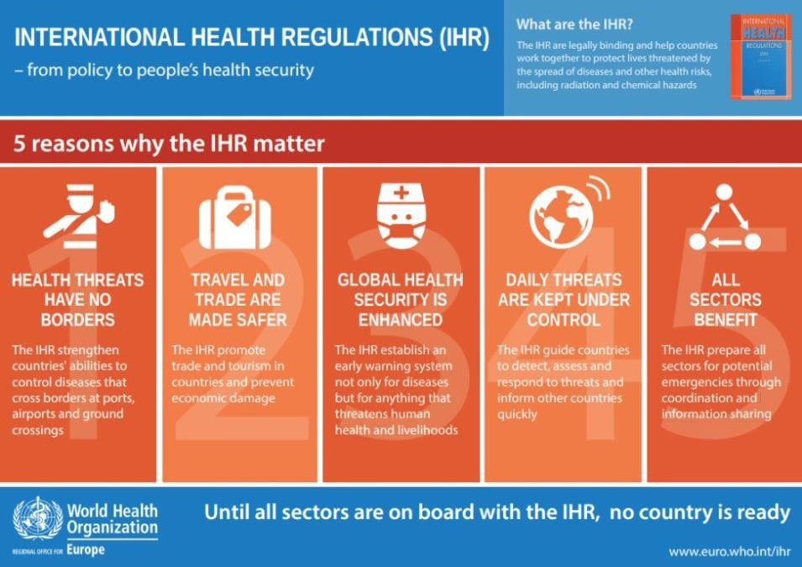
International Health Regulations (IHR)
Global health security
framework to:
Prevent
Protect against
Provide a public
health response
…for ALL public
health threats
A legally-binding global health security framework
agreed to by 196 States Parties, including all World Health Organization (WHO) Member States.

Slide 15
Joint External Assessment (JEE)
Voluntary collaborative process to assess a country’s IHR capacities
Offers opportunity for the identification of the most urgent needs within the health security system of a country and to prioritize interventions for enhanced preparedness, detection and response

Slide 16
Joint External Evaluation
19 technical areas arranged according to core elements:
Prevent
Detect
Respond
Other IHR Hazards and PoE
48 indicators
Source: WHO

Slide 17
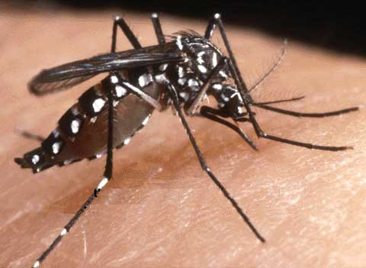
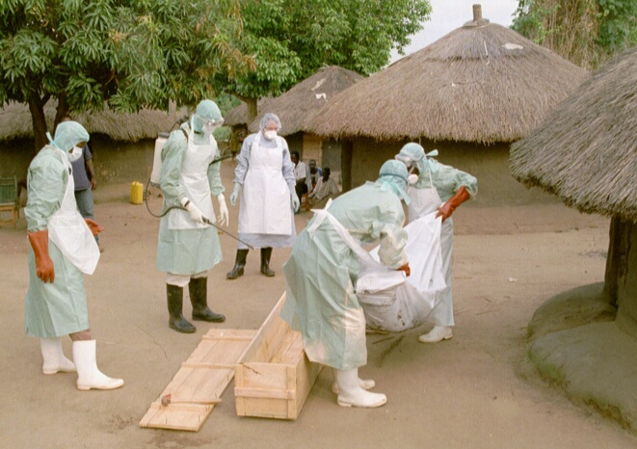
Core Capacity Requirements
:
Countries must have capacities “to detect, report and respond” to risks in general, and to those at international ports, airports and land crossings.
Annex 1A: core capacity requirements for surveillance and response
Annex 1B: core capacity requirements for designated airports, ports and ground crossing
Capacity levels: local community, intermediate public health response and national level
Notes:
Discuss what it takes for countries to address the pandemics together. Focus more on core capacity required as stipulated in IHR

Slide 18
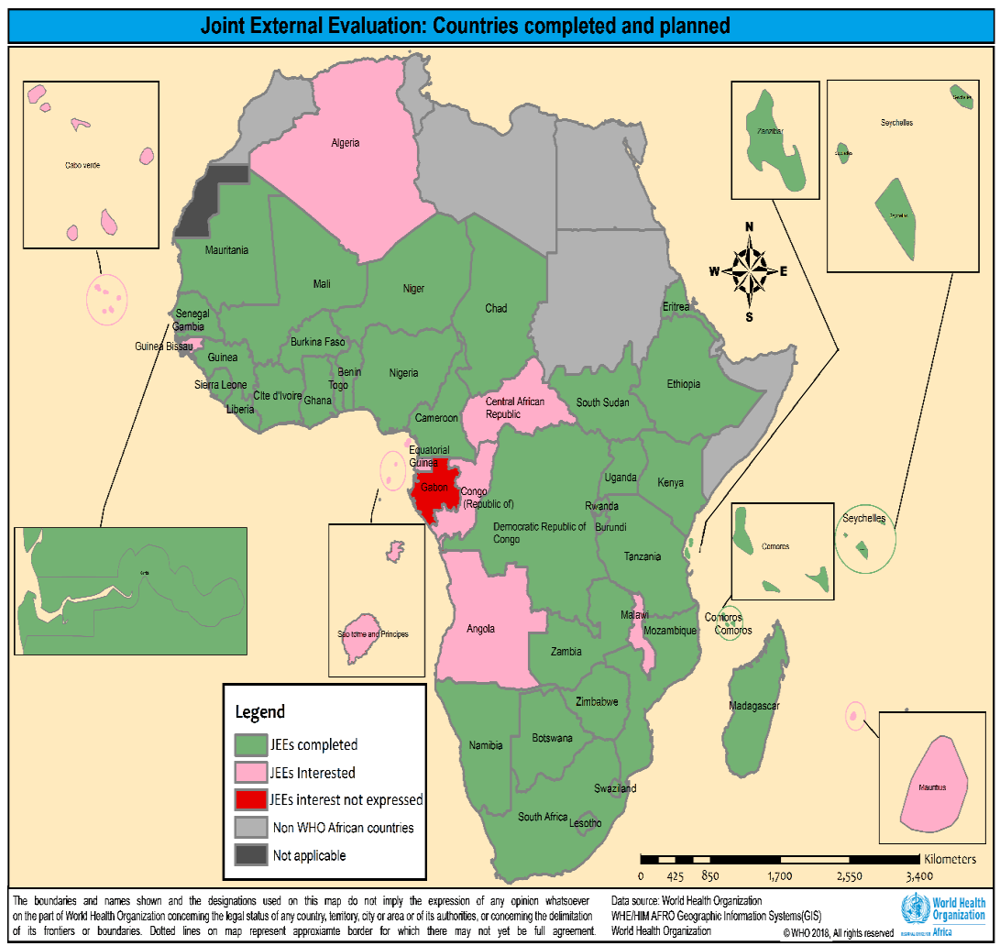
JEE Scoring system
1 = No capacity-RED
2 = Limited Capacity-YELLOW
3 = Developed Capacity-YELLOW
4 = Demonstrated Capacity-GREEN
5 = Sustainable Capacity-GREEN
JEEs have been conducted in 36 (76%) countries between February 2016 and July 2018

Slide 19
PVS tool – Veterinary Services
The tool is used to assess the performance of the Veterinary services with a view of improving the services and hence contributing to improved Health.
https://www.oie.int/fileadmin/Home/eng/Support_to_OIE_Members/docs/pdf/2019_PVS_Tool_FINAL.pdf

Slide 20
FAO/OIE/WHO TRIPARTITE
Health threats at the human-animal-ecosystem (HAEI) interface pose risks to public health, animal health and global health security.
Transmitted through contact between humans, animals, food, water, and contaminated environments can not effectively be addressed by one health sector alone. Thus, continuous communication and collaboration among all sectors responsible for health are required.
WHO works in close collaboration with FAO and the World Organisation for Animal Health (OIE) to promote cross-sectoral collaboration to address risks from zoonoses and other public health threats existing and emerging at the human-animal-ecosystems interface, and provide guidance on how to reduce these risks.
The FAO-OIE-WHO Collaboration: a tripartite concept note https://www.who.int/foodsafety/areas_work/zoonose/concept-note/en/

Slide 21
Continental Level (AU)
Africa Centres for Disease Control and Prevention Strategy at a Glance (2017-2021)
file:///C:/Users/Hp/AppData/Local/Temp/Africa-CDC-Strategy-EN.pdf
Africa Joint Continental Strategy for COVID-19 Outbreak
https://africacdc.org/download/africa-joint-continental-strategy-for-covid-19-outbreak/

Slide 22
EAC Contingency Plan
The East African Community have the instruments to respond to disasters and Disease Outbreaks
The EAC Regional Contingency Plan for Epidemics due to Communicable Diseases, Conditions and other events of Public Health Concern 2018 – 2023
file:///C:/Users/Hp/AppData/Local/Temp/The%20EAC%20Regional%20contingency%20plan%20for%20epidemics%20-%20FINAL%20EDITING%2005062019%20(002).pdf

Slide 23
Policy, Leadership and Governance (Leadership)
Notes:
Introduce code and title of the course

Slide 24
Outline - Leadership
Define Leaderships and leader
Good leadership qualities
Common types of leadership
Leadership and One Health approach
Leadership in Management of Diseases – Pandemics
Distinguish between a leader and a manager

Slide 25
Leadership
Leadership is Influence
Leadership is defined as the process of influencing people and providing an environment to achieve team or organizational objectives
Leadership is interpersonal influence, exercised in a situation, and directed, through the communication process, toward the attainment of a specified goal or goals. ( Tannenbaum,Weschler & Massarik)
Leadership: stems from social influence ,
not authority or power

Slide 26
Who is a leader?
Vision + Follower ship + Influence= Leadership
A person who has a vision , a drive and commitment to achieve the vision and the skills to make it happen
A leader is one who knows the way, goes the way and shows the way

Slide 27
Good Leadership Qualities
Leadership qualities that every good leader should strive for, They include:
Honesty
Delegate
Communication
Confidence
Commitment
Positive attitude
Creativity
Inspire
Empathy
Accountability
Enthusiastic
Focus and drive
Responsible

Slide 28
Common Leadership Styles
1. Coach
2. Visionary
3. Servant
4. Autocratic
5. Laissez-faire or hands-off
6. Democratic
7. Pacesetter
8. Transformational
9. Transactional
10. Bureaucratic

Slide 29
Leadership and One Health
Leadership is one of the core competencies of One Health
Leadership helps to achieve the One Health:
Shared Vision
Strategic and Critical Thinking
Decision Making
Collaborative Solutions
Team Commitment
Note: One health approach requires stakeholder engagement

Slide 30
Response and Management of Pandemic Requires:
Strong Leadership
Community engagement
To reduce spread
Save Lives
Driven by the principles of:
Cooperation and Partnerships
Coordination,
Collaboration and
Communication

Slide 31
Difference Between a Leader and Manager
Leader
Manager
Innovates
Develop
Inspire
Long term
Ask what and why
Originate
Challenge status
Do right things
Administer
Maintain
Control
Short term
Ask how and when
Initiate
Accept the status
Do things right
“People ask the difference between a leader and a boss. The leader leads, and the boss drives.” -Theodore Roosevelt

Slide 33
Policy, Leadership and Governance (Management and Governance)
Notes:
Introduce code and title of the course

Slide 34
Outline
Definition of Management and Governance
Principles of Management and Governance
Conflicts
Partnerships
Collaboration and Partnerships
Stakeholders

Slide 35
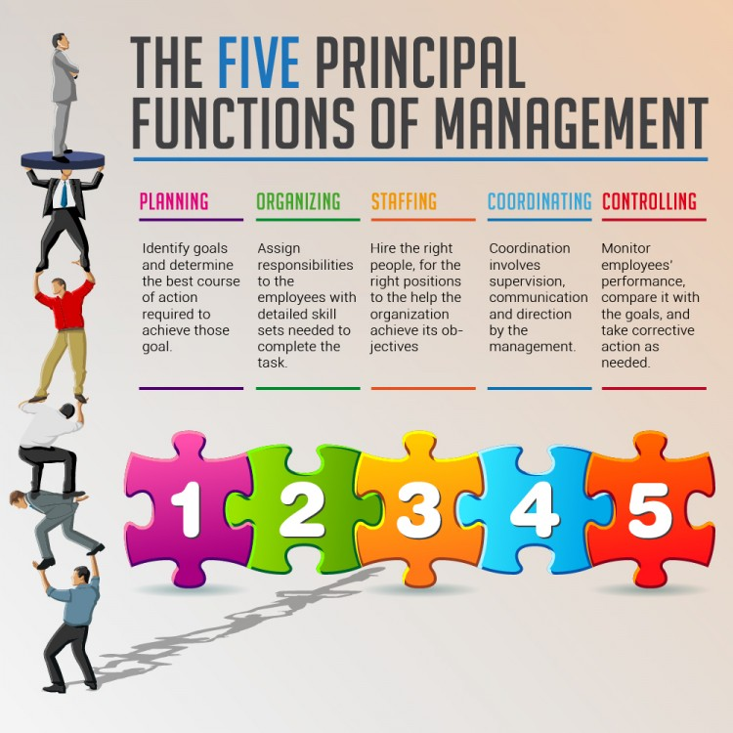
Management and Governance Concept
Management
Refers to the art and science of coordination of all resources through the process of planning, organizing, staffing, directing and controlling in order to attain stated goal or objectives”.
Notes:
Introduce concept of management and related five functions

Slide 36
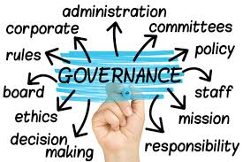
Management and Governance Concept Cont…
Governance:
Refers to the process of decision making which involves establishment of guiding policies and continuous monitoring of their implementation by the members of the governing body of an organization.
Notes:
Introduce the concept of governance and key issues

Slide 37
Principles of Management
Division of labor: job specialization
Authority and responsibility: formal and informal
Unity of command: existence of “only one” boss
Line of authority: a clear chain of command from top to bottom
Unity of direction: a single plan of action to guide the organization
Centralization: degree to which authority is situated
Equity: justice and fairness to all employees
Order: the arrangement of employees
Initiative: fostering of creativity and innovation among employees
Discipline: obedient and respectful employees
Remuneration: an equitable uniform and motivated payment system
Stability of tenure: tenure of employment
Subordination of individual interest to the common interest: the organization’s interests are superior to individual interests
Notes:
Discuss the 13 principles of management

Slide 38
Principles of Governance
Good
vs
Bad governance
Notes:
Provide the difference between good and bad governance
Discuss the key principles of good governance

Slide 39
Conflict Management in Health Emergencies
What is a conflict
A state of incompatibility of ideas between two or more parties or individuals
Types of Conflict
Inter-personal and intra-personal
Inter-group and intra-group
Competitive and disruptive
Conflict Management
Conflict management is the practice of identifying and handling conflict in a sensible, fair and efficient manner
Notes:
Discuss the conflict management in health emergencies emphasizing more on: meaning, Types and management process

Slide 40
Steps To Resolve Conflicts
Assure privacy
Empathize than sympathize
Listen actively
Maintain equity
Focus on issue, not on personality
Avoid blame
Identify key theme
Re-state key theme frequently
Encourage feedback
Identify alternate solutions
Give your positive feedback
Agree on an action plan
Notes:
Ask students the sources of conflict
Discuss various ways and steps to resolve conflicts

Slide 41
Partnerships in Health Emergencies
What is partnership
Is a collaborative relationship between entities to work toward shared objectives through a mutually agreed division of labor
Why partnership
Collective thinking
Access to resources
Costs sharing
Risk minimization/ diversification
Time saving
Widening scope of operation
Bridging gaps ( scientific/ business/ social )
There is added value in working with other organizations.
Notes:
Introduce the concept of partnership: focus on meaning and reasons/motives behind partnership

Slide 42
Partnerships in Health Emergencies
Public Health Emergency Operations Centre (EOC)
Refers to a physical location or virtual space in which designated public health emergency management personnel assemble to coordinate operational information and resources for strategic management of public health events and emergencies.
Notes:
In line with the previous slide, introduce the need to have coordination point
Discuss the Public Health Emergency Operations Centre (EOC)

Slide 43
Basics of Partnership Development
Need for partnership
Clarity of leadership
Clarity of understanding
Different cultures/practices
Clear purpose
High commitment levels
Trust
Clear working arrangements
Performance management systems
Learning/exchanges of good practices
Notes:
Discuss basics of partnership development

Slide 44
Collaborations and Coordination in Health Emergencies
Barriers
Limited vision/failure to inspire one partner manipulates or dominates, or partners compete for the lead
Lack of clear purpose and inconsistent level of understanding purpose
Lack of understanding roles/responsibilities
Lack of support from partner organizations with ultimate decision-making power
Differences of philosophies and manners of working
Notes:
Introduce the concept of collaborations
Discuss the barriers that may arise and what can be done to minimize or avoid them

Slide 45
Collaborations and Coordination in Health Emergencies II
Barriers
Lack of commitment; unwilling participants
Unequal and/or unacceptable balance of power and control
Key interests and/or people missing from the partnership
Hidden agendas
Failure to communicate
Lack of evaluation or monitoring systems
Failure to learn
Financial and time commitments outweigh potential benefits
Too little time for effective consultation
Notes:
Introduce the concept of collaborations
Discuss the barriers that may arise and what can be done to minimize or avoid them

Slide 46
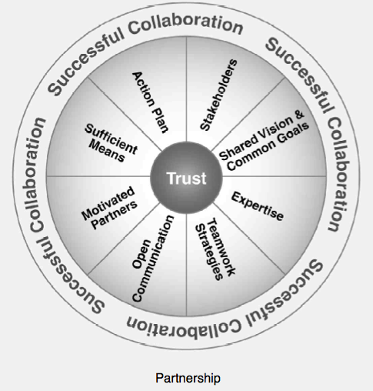
Elements of a Successful Collaboration
Stakeholders with a vested interest in the collaboration
Shared vision and common goals for the collaboration
Expertise is required
Teamwork strategies
Open communication
Sufficient means to implement and sustain the collaborative effort
A detailed action plan
Trusting relationships among and between the partners
Notes:
Explain the need for a successful collaboration
Discuss with students elements of successful collaboration
Provide a source for more details on this area - Collaboration Toolkit pdf

Slide 47
Stakeholders
A stakeholder
“A stakeholder in an organization is any group or individual who can affect or is affected by the achievement of the organization’s objectives”. (Freedman, 1984, p. 4)
“Individuals and organizations who are involved in or may be affected by project activities” (Freedman, 1984 , p. 170)
Notes:
Introduce a concept of stakeholder

Slide 48
Stakeholder Identification Approaches
Brainstorming
Entire group – free form
Nominal group technique
Focus groups
Reviewing documents
Lessons learned
Charters, WBS
Standards/Regulation
Procurements
Interviews
Questionnaires and surveys
Experts
Delphi approach
Profile analysis meetings
Roles, interests, stakeholder position
Others??
Notes:
Discuss various approaches to enable identification of stakeholders

Slide 49
Stakeholder Analysis
Meaning
A tool and technique for organizational planning - to ensure stakeholder needs are analyzed and can be met
Steps
Identify all stakeholders and their key information - stakeholder register
Classify the stakeholders into groups by analyzing their impact and support
Assess how the stakeholders might respond in various circumstances
Notes:
Introduce stakeholders analysis
Discuss various steps to be followed in stakeholders analysis

Slide 50
Stakeholder Analysis – Cont.
Expertise
Contribution
Legitimacy
Willingness
Willingness to engage
Value
Influence
Necessity of Involvement

Slide 51
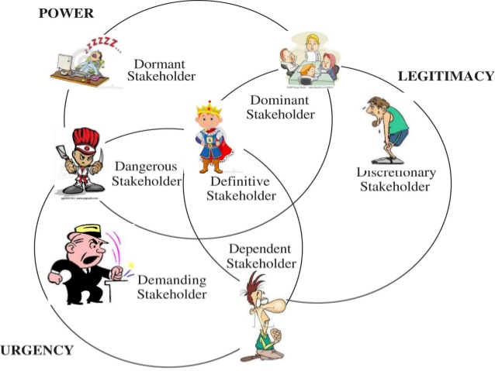
Stakeholder Mapping and Prioritization: Salience Model
www.slideshare.net
Notes:
Discuss mapping and prioritization of stakeholders, focusing more on salience model

Slide 52
Stakeholder Engagement Planning
Engagement plan
Is detailed strategy for effective stakeholder engagement on the program?
Includes stakeholder engagement guidelines
Provides insight as to how component stakeholders are engaged
Defines metrics to measure performance of stakeholder engagement activities
Satisfy how all program stakeholders will be engaged during the program
Engagement level
Unaware = Unaware of the portfolio, program, or project and potential impacts
Resistant = Aware but resistant to change
Neutral = Aware but not supportive or resistant
Supportive = Aware and supports change
Leading – Actively engaged in supporting the change
The Standard for Program Management, p. 49
Notes:
Discuss the importance and process of stakeholder engagement
Discuss in details the engagement plan
Discuss various levels of stakeholer engagement

Slide 53
Case Scenario
Ebola Virus Alert is just issued in your country, as an expert in your area:
What will you do?
Where will you report to?
Who are the stakeholders to be involved?
How will be the role of each of the stakeholders?
What policies and regulations will you consider?
How will you manage the situation?

Slide 54
Assignment
Why is COVID -19 Pandemic touted be a test of leadership, governance and commitment in Africa?

Slide 55
References
World Health Organization. Joint external evaluation tool: International Health Regulations (2005). Geneva: World Health Organization; 2016. Available from: http://www.who.int/ihr/publications/WHO_HSE_GCR_2016_2/en/.
Berk, ML, Gaylin, DS and Schur, CL. Exploring the Public’s Views on the Health Care System: A National Survey on the Issues and Options. Health Affairs. 2006; w596-606.
Gostin, LO and Powers, M. What Does Social Justice Require for the Public’s Health? Public Health Ethics and Policy Imperatives. Health Affairs. 2006; 25(4): 1053-1060.
Roberts MJ, Reich MR. Ethical analysis in public health. Lancet. 2002; 359: 1055–9.
Kass NE. An ethics framework for public health. Am J Public Health. 2001; 91: 1776–82.
Ning Ning, Zheng Kang, Mingli Jiao, Yanhua Hao, Lijun Gao, Hong Sun and Qunhong Wu (2014) Factors affecting emergency preparedness competency of public health inspectors: a cross-sectional study in northeastern China. BMJ Open. 4(1): e003832. doi: 10.1136/bmjopen-2013-003832
Allen Y. Lai, MD1 (2012) Organizational Collaborative Capacity in Fighting Pandemic Crises: A Literature Review From the Public Management Perspective. Asia-Pacific Journal of Public Health 24(1) 7–20. DOI: 10.1177/1010539511429592

Slide 56
Review of The Pandemic Preparedness with One Health approach (PPOH) short course is by the East African Community (EAC) Secretariat in cooperation with universities of the six EAC Partner States. It is facilitated by the German Government and implemented by the Deutsche Gesellschaft für Internationale Zusammenarbeit GIZ GmbH through the Global Programme Pandemic Prevention and Response, One Health (GP PPOH)

