Slide 1
POH 106: Pandemic Preparedness Planning

Slide 2
Purpose
This topic seeks to equip the participant with knowledge and skills on how to prepare for effective response to pandemics using a One Health approach

Slide 3
Expected Learning Outcomes
1. Explain terms and concepts used in preparedness planning
2. Develop a framework for pandemic preparedness
3. Design emergency and pandemic preparedness plans
4. Analyze strategies for pandemic preparedness

Slide 4
Basic Concepts
Preparedness - measures taken to set for and reduce the effects of pandemics/disasters. That is, to predict and, where possible, prevent pandemics, mitigate their impact on vulnerable populations, and respond effectively as well as cope with their consequences.
Surveillance - Systematic collection and analysis of health data in order to be able to detect changes in disease patterns
Planning - process of thinking about the activities required to achieve a desired goal. It is the first and foremost activity to achieve desired results.

Slide 5
Defining Pandemic Preparedness
Pandemic preparedness is a continuous and integrated process resulting from a wide range of risk reduction activities and resources rather than from a distinct sectoral activity by itself.
It requires the contributions of many different areas—ranging from training and logistics, to health care, recovery, livelihood to institutional development.

Slide 6
Why Pandemic Preparedness Planning?
It provides a platform to design effective, realistic and coordinated planning, reduces duplication of efforts and increase the overall effectiveness of National societies, households and community members preparedness and response efforts in a cost effective manner.

Slide 7
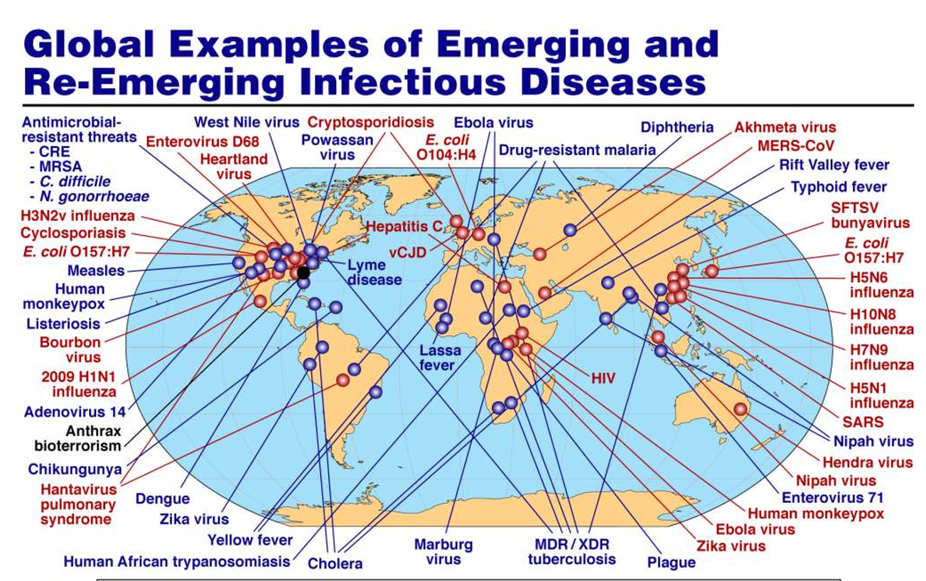
Notes:
To be used to demonstrate the risks of infectious diseases at the global level

Slide 8
Notes:
To be used to demonstrate the recent incidences of infectious diseases

Slide 9
Why Pandemic Preparedness Planning? Cont…
Pandemic preparedness activities embedded with risk reduction measures can prevent pandemic situations and also result in saving maximum lives and livelihoods during any pandemic situation, enabling the affected population to get back to normalcy within a short time period.

Slide 10
Why Pandemic Preparedness Planning? Cont…
Pandemics, whether mild, moderate or severe, affect a large proportion of the population and require a multisectoral response over several months or even years. For this reason, countries develop plans describing their strategies for responding to a pandemic supported by operational plans at national and subnational levels.

Slide 11
Why Pandemic Preparedness Planning? Cont…
Preparing for pandemics is a continuous process of planning, exercising, revising and translating into action national and subnational pandemic preparedness and response plans.
A pandemic plan is thus a living document which is reviewed at intervals and revised if there is a change in global guidance or evidence-base; lessons learned from a pandemic, an exercise, or other relevant outbreak; or changes to national or international legislation related to communicable disease prevention and control

Slide 13
Sendai Framework for Disaster Risk Reduction
Priorities for Action
Priority 1: Understanding disaster risk
Priority 2: Strengthening disaster risk governance to manage disaster risk
Priority 3: Investing in disaster risk reduction for resilience
Priority 4: Enhancing disaster preparedness for effective response and to ‘Build Back Better” in recovery, rehabilitation and reconstruction

Slide 14
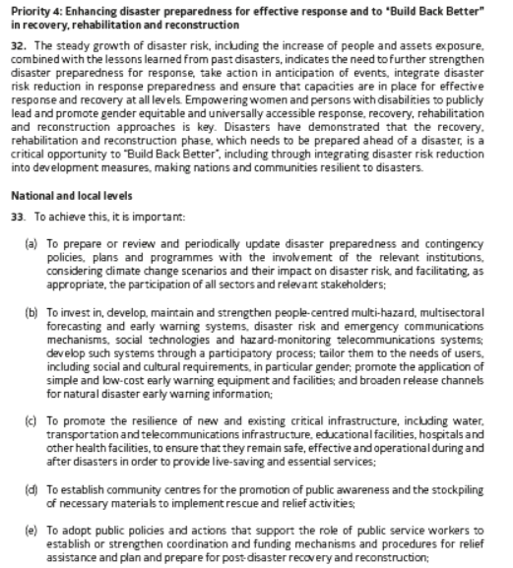

Slide 15
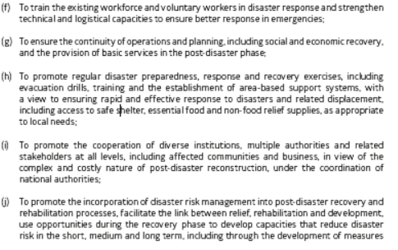

Slide 16
Disaster Management Cycle

Slide 17
Principles for Effective Preparedness Planning
Pandemic preparedness, response and evaluation should be built on generic preparedness platforms, structures, mechanisms and plans for crisis and emergency management.
Pandemic preparedness should aim to strengthen existing systems rather than developing new ones, in particular components of national prevention and control programmes.
New systems that will be implemented during a pandemic should be tested during the inter-pandemic period.
Adequate resources must be allocated for all aspects of pandemic preparedness and response.

Slide 18
Principles for Effective Preparedness Planning Cont…
The planning process, implementing what is planned, testing and revising the plan in order for key stakeholders to familiarize themselves with the issues at hand, may be even more important than the pandemic plan itself.
Pandemic response requires that business continuity plans and surge capacity plans be developed for the health sector and all other sectors that could be affected by a pandemic to ensure sustained capacity during a pandemic

Slide 19
Principles for Effective Preparedness Planning Cont…
The response to a pandemic must be evidence-based where this is available and commensurate with the threat, in accordance with the IHR.
Planning should be based on pandemics of differing severity while the response is based on the actual situation determined by national and global risk assessments.

Slide 20
Core Elements of Pandemic Preparedness Plans
Communications strategy
Outlining the responsibilities of the stakeholders & public
Surveillance
Drugs and Pandemic vaccines
Reorganization of health services and redeployment of health service staff
Essential supplies.
Coordination
Information management
Trainings and mock drills
Emergency operations plans
Surveillance system that can detect an impending/outbreak
Ability to get laboratory confirmation
Maintain reserve stock of supplies and equipment
Early warning systems

Slide 21
Notes:
Illustrate comprehensively the vitality of various components of multi-dimensional approach to pandemic preparedness

Slide 22
Early Warning Signals
Clustering of cases or deaths
Increases in cases or deaths
Single case of disease of epidemic potential
Acute febrile illness of an unknown etiology
Shifting in age distribution of cases
High vector density
Natural disasters
Notes:
Discuss the possible indicators for potential outbreaks

Slide 23
Surveillance Systems in Epidemics
Health workers
Can health workers (HWs) recognize an epidemic?
Do HWs know the case definitions?
Do HWs know how to report?
Do HWs know what to report?
In endemic areas, is the weekly number of cases being followed?
Notes:
Discuss the various aspects of preparedness, surveillance systems, for emergency staff and relevant stakeholders

Slide 24
Surveillance Systems in Epidemics
Investigation team
Have members been identified?
Have members been trained or briefed on their duties?
Has funding for investigations been found?
Have supplies been provided for?
Notes:
Highlight on the aspects for consideration during preparedness and surveillance for investigation teams

Slide 25
Ability to Get Laboratory Confirmation
Are staff trained to collect specimens?
Are supplies for collection and transport available?
Have laboratories been identified?
Have funds been allocated?
Notes:
Explain the aspects of preparedness for laboratory logistics

Slide 26
Train staff
Determine staff responsibilities.
Decide who needs to be trained.
Decide what they need to learn to do.
Make a training plan
What training is needed
before an epidemic?
after an epidemic begins?
Conduct training
Notes:
Explain the modalities of training before and during an outbreak/epidemic

Slide 27
Maintain Reserve Stock of Supplies
Is there a reserve stock of supplies?
Where is it located?
How much is there?
Do relevant officials know how to request more supplies?
Is there a stock of materials needed for laboratory confirmation?
Has funding been found for the reserves?
Notes:
Discuss checklist for addressing stock piles in outbreaks and pandemics

Slide 28
Emergency Operations Plan Staff and Logistics
Have specific responsibilities been decided?
Is there a plan for re-assigning staff during an epidemic?
Is there a plan for enlisting additional personnel (e.g. nursing students)?
Is there a plan to recruit and train volunteers to help?
Is there a plan for setting up temporary treatment centers?
Have logistics needs been identified?
Has funding for staff costs and logistics been allocated?
Notes:
Discuss the modalities for planning and logistics for relevant staff during pandemics

Slide 29
Financial planning
Have costs related to preparation for an epidemic been identified?
Have costs related to investigation and confirmation been identified?
Have costs related to response been identified?
Has a source of funding been found for each expense?
Notes:
Discuss the financial parameters to be captured in preparedness planning

Slide 30
Evaluate Pandemic Preparedness
Has the level of preparedness been evaluated? Following a Pandemic or simulation
If so, were the results of the evaluation acted on?
Are regular, periodic evaluations scheduled?
Notes:
Explain the role of evaluations for pandemic preparedness

Slide 31
References
WHO: Increasing community engagement for Ebola on-air in Sierra Leone – YouTube
Jean, T Jamison., Hellen, Gellband., Susan Horton., PrabhatJha, Ramanan, Lakmimayan., Charles N. Nugeut. Disease Control Priorities: Improving Health and Reducing Poverty. 3rd Edition, Volume; 2018.
Katz R. Essentials of Public Health Preparedness. Jones & Bartlett Learning; 2013
Landesman, L and Weisfuse, I. Case Studies in Public Health Preparedness and Response to Disasters. Jones & Bartlett Learning; 2014
Harvey, V. Fineberg. (2014). Pandemic Preparedness and Response-Lessons from the N1H1 Influenza of 2009.The New England Journal of Medicine; 370:1335-1342.
Other reference materials
National Incident Management System (NIMS). IS 800: http://www.training.fema.gov?EMIWeb/IS/is800.asp
National Response Plan (NRP). IS 700: http://www.training.fema.gov?EMIWeb/IS/is700.asp
Comprehensive Preparedness Guide 101; A Guide for All-Hazard Emergency Operations Planning: http://www.fema.gov/about/divisions/cpg.shtm
CDC. Public Health Preparedness: Strengthening CDC’s Emergency Response. A CDC Report on Terrorism Preparedness and Emergency Response (TPER) - Funded Activities. January 2009: http://emergency.cdc.gov/publications/jan09phprep/index.aspus
Wisconsin Pandemic Flu Plan:http://pandemic.wisconsin.gov/docview.asp?docid=13654&locid=106
World Health Organization Epidemic and Pandemic Alert and Response (EPR) web page: http://www.who.int/csr/en/
Notes:
Guide the learners to refer to these literatures and websites among others for additional information

Slide 32
Assignment: Country X PPP
Preliminaries-plan title, issuing authority, plan revision, scope
Background
Hazard vulnerability assessment(surveillance)
Objectives & logical framework
Coordination
Financing the plan
Monitoring implementation of the plan

Slide 33
Review of The Pandemic Preparedness with One Health approach (PPOH) short course is by the East African Community (EAC) Secretariat in cooperation with universities of the six EAC Partner States. It is facilitated by the German Government and implemented by the Deutsche Gesellschaft für Internationale Zusammenarbeit GIZ GmbH through the Global Programme Pandemic Prevention and Response, One Health (GP PPOH)

