Slide 1
POH 107: DETECTION, IDENTIFICATION AND MONITORING OF PANDEMICS

Slide 2
Purpose
This course will introduce learners to the basic principles of detection, identification and monitoring of pandemics and introduce the basic elements of outbreak investigation.

Slide 3
Objectives
This topic enables learning about:
Concepts and principles of disease surveillance
Steps required in surveillance and outbreak investigation
Collection, analysis and interpretation of surveillance data and dissemination of information
Designing and evaluating a disease surveillance system

Slide 4
Expected Learning Outcomes
At the end of this course the learner should be able to:
Describe concepts and principles of disease surveillance
Outline steps required in surveillance and outbreak investigation
Collect, analyze, interpret data and disseminate surveillance information
Design and evaluate a surveillance system

Slide 5
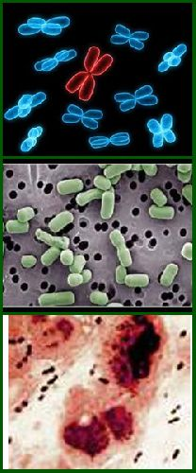
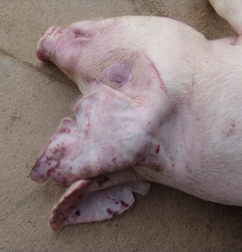
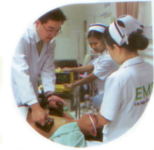
Epidemiological Triad
Host
Agent
Environment
Gordis, L. (2004). Epidemiology. Philadelphia: Elsevier Saunders.

Slide 6
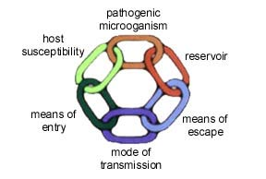
Chain of infection

Slide 7
Managing Infectious Diseases
Requires knowledge of:
Infectious organisms (“agent”)
Modes of disease transmission
Risk
Management concepts

Slide 8
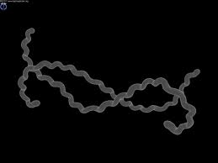
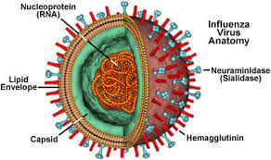
Infectious Organisms
Bacteria
Viruses
Parasites
Fungi
Prions
Leptospira interrogans
en.wikipedia.org
en.wikipedia.org
Notes:
Cover the main categories of infectious organisms and ask participants if they can think of a couple of examples of diseases caused by each.
A few examples are below, if needed for discussion:
Bacteria: leptospira interrogans (pictured), Yersinia pestis (causes plague), Borrelia burgdorferi (Lyme disease), E. coli, Salmonella, Campylobacter (all food borne)
Viruses: avian influenza (pictured), SARS, Ebola, Dengue, Japanese encephalitis, Nipah, Hendra
Parasites: malaria (protozoan), roundworms, hookworms, tapeworms (helminths), cryptosporidium (protozoan)
Fungi: candida albicans, Aspergillus, Histoplasmosis, Cryptococcus, Pneumocystis
Prions: bovine spongiform encephalopathy (mad cow disease), Creutzfeld-Jakob disease, kuru

Slide 9
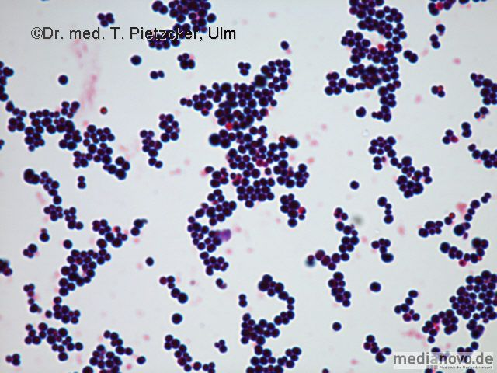
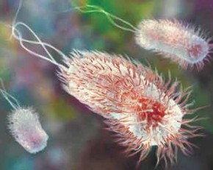
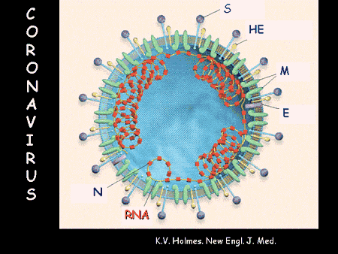
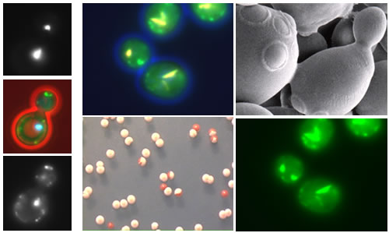
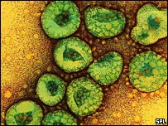
Infectious Agents
Clostridium botulinum
Enterohaemorrhagic E. coli O104

Slide 10
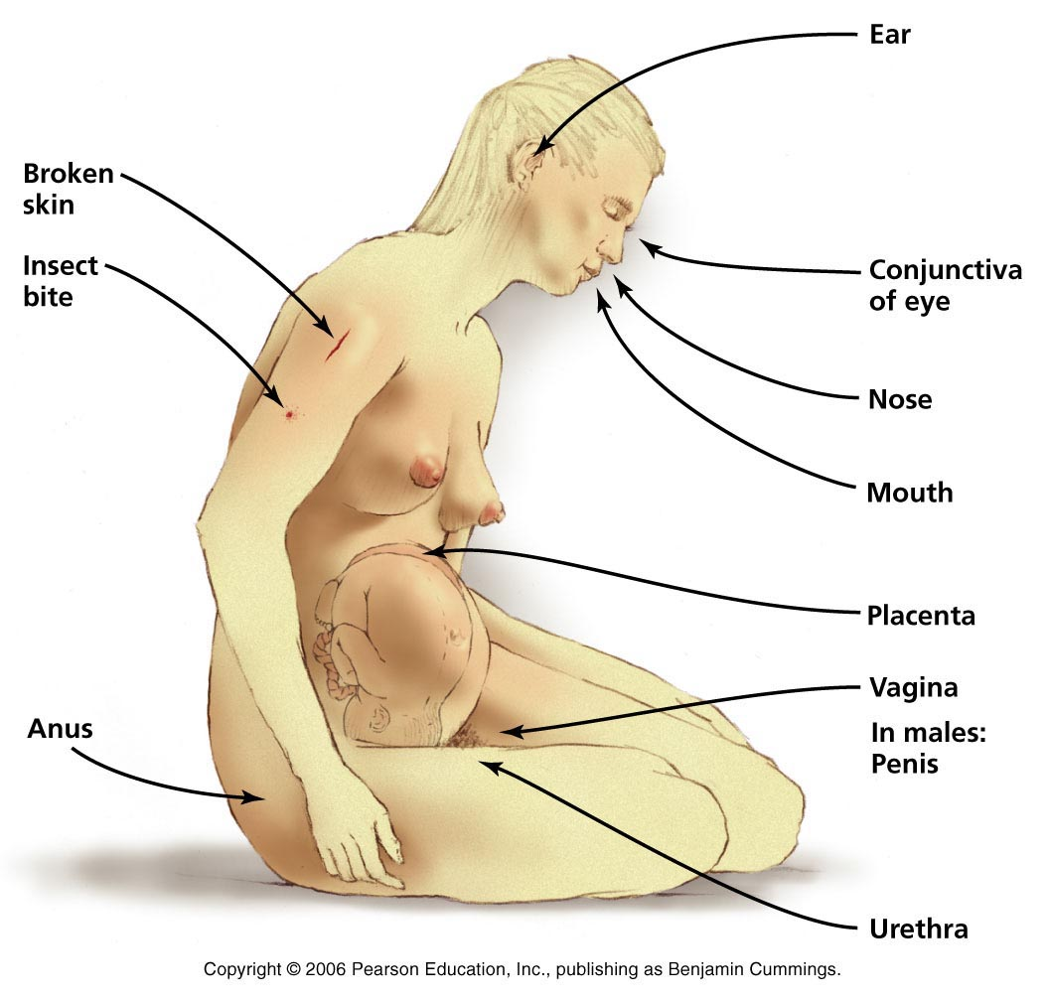
Portal of Entry

Slide 11
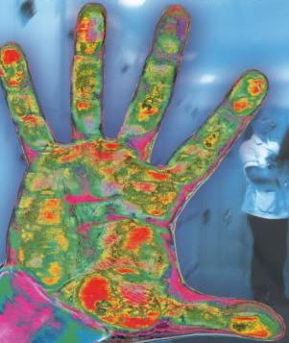
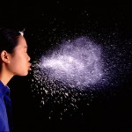
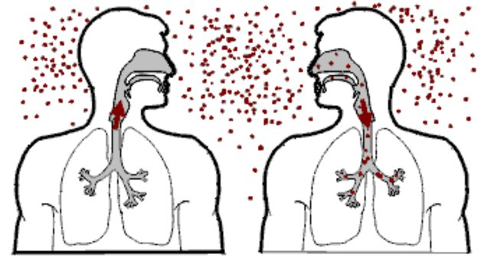
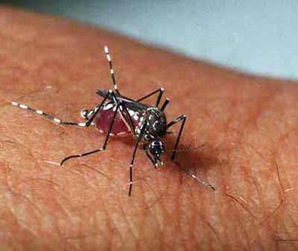
Modes of Disease Transmission
Contact
Direct
Indirect
Airborne
Droplet
Airborne
Vector Borne
Vehicle
* Aerosolized particles
* Aerosolized Particles from coughing or sneezing <5 microns in size containing influenza virus can be inhaled at alveolar level of lungs
Notes:
Transmission – route by which an infectious organism infects a new host
Method of transmission will influence management plan strategies
Transmission routes:
Direct contact with infected animal or human or their secretions
Indirect contact with a contaminated surface, fomite, or other object
Contact with or consumption of contaminated food or water
Biological vector - bite of an insect such as rats, ticks, mosquitoes, or flies
Ask participants for an example of a disease spread by each transmission route. One example of each is below.
Note that some diseases can be spread by more than one transmission category - see if participants can think of one.
Direct contact - influenza (contact with respiratory secretions of individual - breathing in particles from coughing or sneezing) - influenza could also be spread by fomites
Contaminated surface or fomite - Salmonella on contaminated food prep surface - can also be food consumption
Consumption of food or water - cholera
Biological vector - dengue

Slide 12
Direct Contact Transmission
Direct contact with infected individual person or animals, or their secretions
Infectious organisms can enter via:
Respiratory tract - inhaled particles from sneezing and coughing
Mucous membranes - eyes, nose, reproductive, digestive tracts
Skin - cuts, wounds, open sore, injury can facilitate entry
Ingestion - swallowing

Slide 13
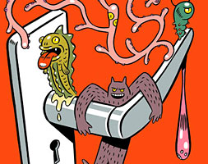
Contact with Fomite
Fomite: an inanimate object contaminated with an infectious organism
Organisms can survive on surfaces
Does not require direct contact between individuals
Examples of fomites:
Doorknobs
Computer keyboard
Bedding or towels
Needles, forceps, scissors,
other medical equipment
Food preparation equipment and
serving vessels
healthline.com
Notes:
After defining what a fomite is, prompt participants to give examples of fomites that may be involved in disease transfer before listing examples.

Slide 14
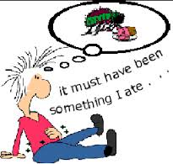
Contaminated Food and Water
Food and water can become contaminated and transmit diseases when consumed
Contaminated food or water possible in:
Restaurants
Central water supply
Water storage containers
Often cause gastroenteritis
Diarrhea, vomiting, nausea
E. coli, Salmonella, Campylobacter
Cholera, Hepatitis A
Intestinal parasites
en.wikipedia.org

Slide 15
Reservoir Hosts and Transmission
Reservoir hosts with infectious agents can transmit the organism, but may not develop disease
Hosts provide a reservoir for the organism in the environment
Management difficult if host population is large or difficult to control
Host may be required for stage(s) of an organism’s development or transmission cycle before capable of infecting another host or vector

Slide 16
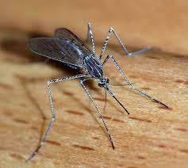
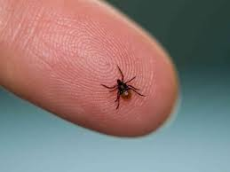
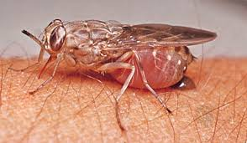
Biological Vectors - Arthropods
Vector borne diseases are common worldwide
Insect provides a necessary part of disease transmission process (e.g., biting during blood meal)
Considering vector(s) key to management plans
www.list25.com
www.tse-tse.com
www.cdc.gov

Slide 17
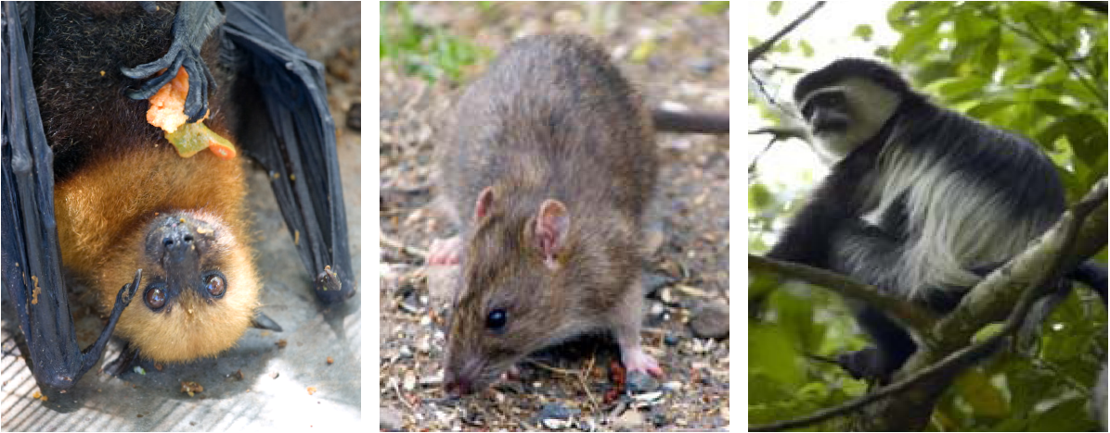
Biological Vectors - Animals

Slide 18
Risk Factors and Infectious Diseases
Consider risk factors when forming a management plan
Risk factors affect whether an individual will contract a disease
Consider intrinsic and extrinsic risk factors
Consider high-risk behaviors/occupations
Knowledge about risk factors useful when developing public awareness materials

Slide 19
Intrinsic Risk Factors
Intrinsic factors are those related to the host itself (human or animal):
Genetics
May cause susceptibility to a disease
Host have correct receptors? (important for many viruses)
Immune system - robust response can reduce severity
Underlying diseases (HIV/AIDS, cancer - immunodeficiency associated with increased severity of disease, death)
Age (infants, children, elderly generally more susceptible to severe illness)
Nutrition (malnutrition, or being under - or overweight can increase susceptibility to disease)

Slide 20
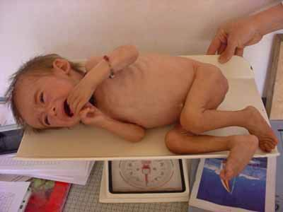
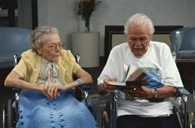
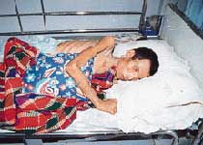
Susceptible Hosts
Notes:
Infants, the elderly, and immuno-compromised

Slide 21
Extrinsic Risk Factors I
Extrinsic factors are not directly host - related
Reservoir or infectious hosts:
Does an individual have exposure to infected hosts?
What are the reservoir hosts?
Exposure risks
Contaminated food and water
Contaminated surfaces
Socioeconomic status

Slide 22
Extrinsic Risk Factors II
Specific temporal risks:
Occupational exposures
Environmental exposures
Natural disasters:
Floods
Drought
Climate change

Slide 23
Questions To Guide Management Plan
What is the infectious organism (agent)?
What are the characteristics of that organism?
Which host species develop disease?
What are the reservoir hosts?
How is the disease transmitted from one host to another?
Who gets the disease?
What are the most important risk factors for disease?

Slide 24
Deciding on a Plan
Determine what interventions are available
Vaccination
Treatment
Control of vectors and reservoir hosts
Monitoring of food and water supply
Safe food and water handling and preparation
Cleaning of contaminated surfaces or fomites
Animal husbandry practices
Control of contact with reservoir hosts
Public education - safe practices related to the disease

Slide 25
Evaluating the Plan
Once possible intervention strategies determined, consider best for the situation and context
Where in the concept map do each of the possible interventions fit?
What is the positive impact of each intervention?
Cost-benefit? Want to maximize
Are there negative consequences of the interventions?
Who is affected?
How to minimize negative impacts?
Always consider downstream effects of disease management decisions

Slide 26
Infectious Disease Risk Factors in an Outbreak Scenario; Case of Rabies
Infectious Disease Management

Slide 27
Rabies
How is rabies transmitted to humans?
What are the symptoms and outcome of rabies infection in humans?
Which animal species can be infected with rabies?
Which animal species transmit rabies to humans?
What risk factors increase the risk of rabies infection to domestic animals? To humans?
Vaccine available for animals? Important?
Vaccine in humans (post-exposure prophylaxis)?

Slide 28
Rabies video, Nepal
Hydrophobia in advanced Rabies, Nepal /www.youtube.com/watch?v=bd6Vv0C64wU

Slide 29
Rabies Case Scenario
How serious is the rabies outbreak?
What are the most significant risk factors in the rabies outbreak?
Who is responsible for monitoring risk factors?
What is a major concern in a rabies outbreak situation?
What would you do to mitigate risk factors for rabies during an outbreak?
What is your group’s plan of action?

Slide 30
Preventive Strategies
Primary prevention
Secondary prevention
Tertiary prevention

Slide 31
Primary Prevention of Infectious Disease
Seek to prevent new cases of infection from occurring by interrupting the transmission of pathogens to susceptible human hosts, or increasing their resistance to infection
Vaccination

Slide 32
Vaccination
Directly, by increasing the immunity of individuals vaccinated against the pathogen targeted by vaccine
Indirectly, by decreasing potential exposure to a pathogen, by reducing the proportion of susceptible individuals capable of transmitting the infection in the population

Slide 33
Secondary Prevention of Infectious Disease
Detect new cases of infectious disease at the earliest possible stage and intervene in ways that prevent or reduce the risk of infection spreading further in the population.
Some examples of how secondary prevention can be put into practice are described below.
Early treatment
Education and health-related behavior modification
Screening program

Slide 34
Tertiary Prevention of Infectious Disease
Prevent the worst outcomes of a disease in an individual already diagnosed (e.g., rehabilitation)
Although this may greatly improve the quality of life for that person, it has at most a limited impact on the spread of infectious disease
Extremely expensive, compared to prevention of disease

Slide 35
Avian influenza
The danger of Avian Influenza www.youtube.com/watch?v=8RApk1t9XDo

Slide 36
A Risk Based Approach to Avian Flu Control in Developing Countries
A risk based approach to Avian flu control in developing countries www.youtube.com/watch?v=R9Un5fD5Rlk

Slide 37
Small Group Assignments
For your assigned scenario, discuss potential risk factors, host, agent, environment, mode of transmission, and management of assigned zoonotic diseases
Create a zoonotic disease public awareness plan
Present this information through a conceptual model or map that visualizes this information
Considering using an open source mapping software such as visual understanding environment (vue)

Slide 38
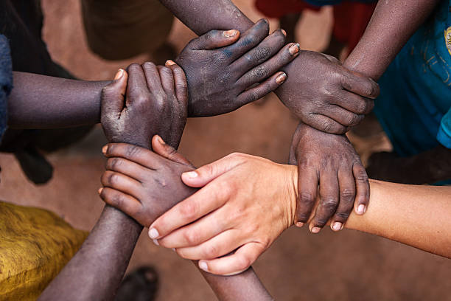
If you want to go fast, go alone.
If you want to go far, go together
African proverb

Slide 39
Exposure Assessment
Identifies potentially affected population
Determines exposure/transmission pathways
Estimate dose of exposure
Estimate exposure factors such as contact rates and the frequency and duration of exposure
Estimate physiological parameters such as inhalation and ingestion rates, absorption rates, body weight, and life expectancy
Notes:
Exposure assessment is a step in the risk assessment process. Fundamentally you need to identify your sources (where/when/what), the pathways of transmission, and your receptors. When thinking about the exposure assessment - you should consider whether the conditions allow for transmission. How could be people be exposed? Are there vectors? Are they proliferating? You also want to consider the risk factors in your community - such as: does the population have immunity? Is the community vaccinated? Is the community healthy? Are they adequately fed?

Slide 40
Notes:
In the exposure assessment, you often create a conceptual model of your routes of exposure so that you understand both transmission and exposure pathways. Although the above graphic describes how a conceptual model should be developed for a model where contaminants are involved, the same principles can be applied for a pathogen. Think of the pathogen as a contaminant. The pathways are the exposure/transmission pathways. The receptors are your populations and subpopulations.

Slide 41
Routes of Exposure
Ingestion Dermal Inhalation
Notes:
Oral, dermal, inhalation routes of exposure

Slide 42
Risk Factors
Notes:
Other factors to consider in how a pathogen could affect a community are the community’s risk factors. Other risk factors include the nutrition, the quality of housing, water quality, sanitation, vaccination, and exposure to disease vectors

Slide 43
Subpopulations of Potential Concern
Notes:
Subpopulations like the elderly, the chronically, pregnant women, babies and children can be more or less susceptible to certain pathogens

Slide 44
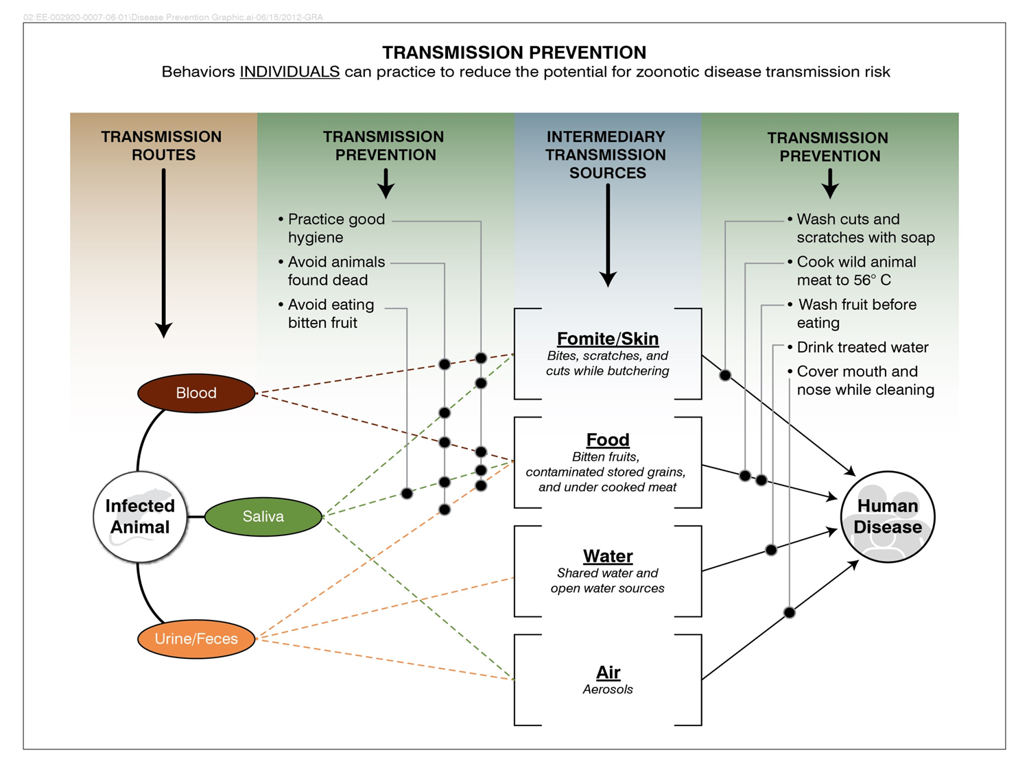
Notes:
This is an example of a conceptual model of transmission from an infected animal to people through multiple different transmission pathways. How would you refine a model like this to include the populations that could be exposed and the susceptible subpopulations? If the pathogen was rabies, what would be the routes of exposure? Who would be the susceptible populations? For a pathogen such as Nipah virus, what would be your source? What would be the exposure pathways? Do you have intermediary transmission sources? Who have been the populations at risk?

Slide 45
All substances are poisons;
There is none which is not a poison.
The right dose differentiates
a poison and a remedy.
Paracelsus
(1493-1541)
Notes:
Keep this in mind especially when you are thinking doses. People have died from drinking too much water.

Slide 46
Infectious Disease Risk Analysis Factors
Agent or
Disease
Route(s) of transmission
Methods of exposure or contact
Result of contact
Population
dynamics
Pathogenicity
Potential for spread
Agent class
Air - borne
Direct contact
Vector - borne
Cross contamination
Infectivity (ID50)
Reservoir
Virulence (LD50)
Environmental factors contributing to agent survivability
Exposure dose
(Amount X Time X Route)
Host susceptibility
Notes:
This diagram summarizes some of the factors that should be considered when conducting an infectious disease risk analysis

Slide 47
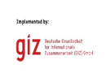
Review of The Pandemic Preparedness with One Health approach (PPOH) short course is by the East African Community (EAC) Secretariat in cooperation with universities of the six EAC Partner States. It is facilitated by the German Government and implemented by the Deutsche Gesellschaft für Internationale Zusammenarbeit GIZ GmbH through the Global Programme Pandemic Prevention and Response, One Health (GP PPOH)

