Slide 1
POH 108: RISK AND CRISIS COMMUNICATION IN PANDEMICS A: Principles, Approaches and Tools of Risk Communication

Slide 2
Purpose
This topic introduces learners to basic terms, principles, and approaches to effective risk and crisis communication in pandemics.

Slide 3
Objectives
This topic enables learning about:
Terminologies in risk and crisis communication
Principles and purpose of risk and crisis communication
Approaches to effective risk and crisis communication
Risk communication components and SOPs

Slide 4
Expected Learning Outcomes
At the end of this course, learners are expected to:
Define terminologies in risk and crisis communication
Describe principles and purpose of risk and crisis communication
Explain the approaches to effective risk and crisis communication
Describe Risk communication components and SOPs

Slide 5
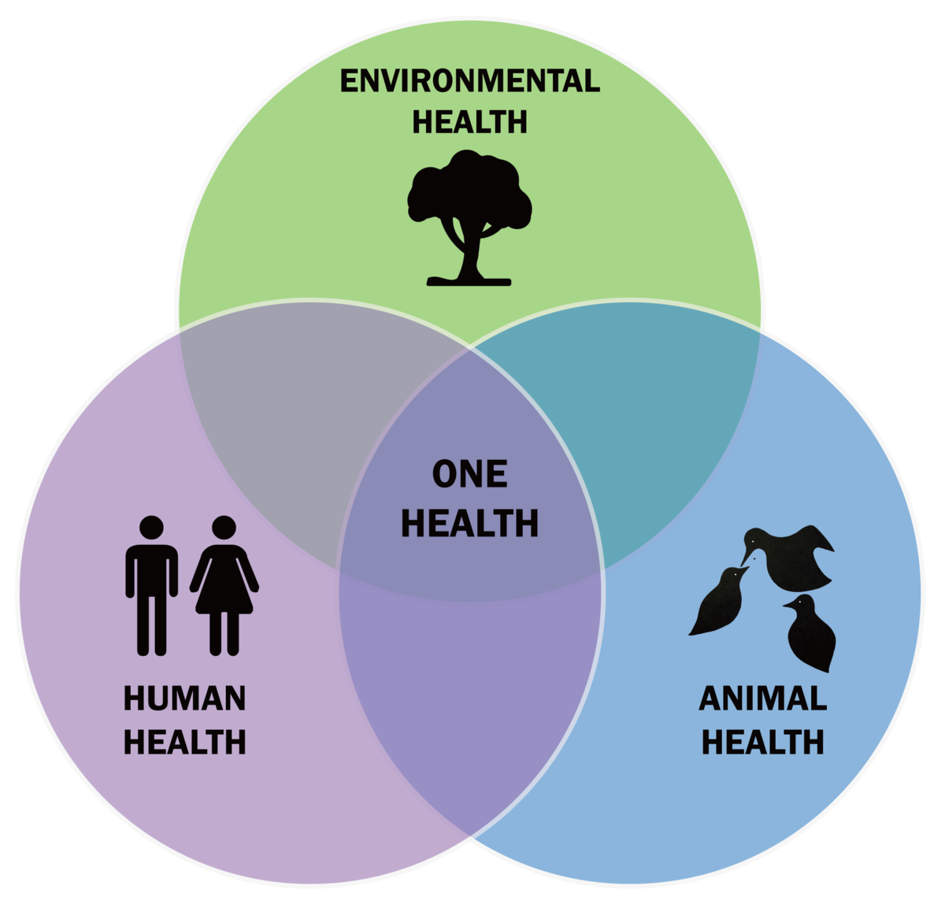
Definition of Terms
Communication
Risk
Risk Communication
Crisis
Crisis communication
Hazard
One Health
Risk assessment

Slide 6
Communication
Means of sending or receiving information, such as telephone lines or computers
Exchanging of information by speaking, writing, or using some other medium

Slide 7
Risk and Risk Communication
Risk
A probability or threat of damage, injury, liability, loss, or any other negative occurrence that is caused by external or internal vulnerabilities, and that may be avoided through pre-emptive action.
A situation involving exposure to danger.
Risk communication
Refers to the exchange of real-time information, advice and opinions between experts and people facing threats to their health, economic or social well-being.
The ultimate purpose of risk communication is to enable people at risk to take informed decisions to protect themselves and their loved ones.

Slide 8
Crisis and Crisis Communication
Crisis
A time of intense difficulty or danger.
The turning point of a disease when an important change takes place, indicating either recovery or death.
Crisis communication
Crisis communication is the real-time exchange of information, advice, and opinions during an emergency event
The exchange of real-time information, advice and opinions between experts and people facing threats to their health, economic or social well-being.
The ultimate purpose of risk communication is to enable people at risk to take informed decisions to protect themselves and their loved ones.”

Slide 9
Crisis Communication
From a corporate angle; In contrast, the goal of crisis communications is typically to keep the brand, or the investors safer.
“Crisis communication is designed to protect and defend an individual, company, or organization facing a public challenge on its own merit or to its reputation.”
Crisis communication typically dictates what you do after your public awareness and risk communications programs have failed.

Slide 10
Topic Outline:
Principles of Risk and Crisis Communication
Building trust from your audience
Being factual and accurate
Independence
Responsibility
Timeliness
Clarity
Inclusiveness

Slide 11
Timeliness
Risk and crisis communications materials and activities shall be developed and delivered at a time when information is needed and relevant.
Risk communications efforts are ongoing and thus require sustained attention, established structures, and sufficient funding to maintain timeliness and accuracy.

Slide 12
Factual and Accurate
Risk and crisis communications shall always be accurate and factual
This enhances credibility of your organization

Slide 13
Clarity
Risk and crisis communications shall be delivered in plain language, using short sentences and avoiding jargon. Where information is technical in nature, supporting explanatory information will be provided.
Materials associated with risk will be developed and provided in different languages and alternative formats (e.g. illustrations for low-literacy populations) as needed to support awareness and community engagement.

Slide 14
Independence, Responsibility, Inclusiveness
Independence: Risk communications shall be trustworthy and
reliable, independent from vested interests.
Responsibility: Information shared through risk and crisis communications initiatives shall be responsible, acknowledging and respecting privacy and security concerns.
Inclusiveness: Risk and crisis communications initiatives shall seek to engage with the broadest sections of affected communities, including high-risk and vulnerable populations.

Slide 15
Risk Communication Approaches
Communication process approach,
National research council's approach,
Mental models approach,
Situational Crisis communication theory approach,
Convergence communication approach,
Three‐challenge approach,
Social constructionist approach, and
Hazard plus outrage approach

Slide 16
Lasswell Communication Model

Slide 17
Communication Process Approach
COMMUNICATOR
Component: the sender, formulates and spreads a message. Analysis: management and audit analysis, helps the sender to have the power to communicate.
MESSAGE
Component: the content of the message the sender spreads. Analysis: The content analysis relates to the aim of the message and/or the secondary intent.
MEDIUM
Component: the media used to convey and spread the message. Analysis: The media analysis shows which medium is best used to convey a message to the receivers as effectively as possible.
RECEIVER
Component: the receiver(s), such as a target group or an individual. With mass communication, there’s an audience. Analysis: The target analysis shows who the message is meant for and how they are best reached and/or influenced.
EFFECT
Component: The effect is the result the message leads to. The so-called triangle of success ‘knowledge, attitude, behaviour’ is often used to describe the desired effect. Analysis: The effect analysis starts beforehand, so the messages can be aimed at and fitted to the target audience.
Notes:
It is also called a ‘linear model of communication’, ‘uni-directional process’ or ‘action model, because it describes a one-way process within communication.

Slide 18
Lasswell’s Communication Model

Slide 19
Mental Models Approach
One well-established two-way framework for developing risk communication is the mental models approach to risk communication (MMARC).
The MMARC is based on the idea that people's views of a concept are based on a complex web of information, drawn from personal experience and external sources.
Mental models are personal, internal representations of external reality that people use to interact with the world around them. They are constructed by individuals based on their unique life experiences, perceptions, and understandings of the world.

Slide 20
Mental Models Approach
Test effectiveness of communication content
Conduct randomized controlled trial to test effect of
communication on recipients’ understanding,
decision and behavior
4
Identify what people already know
And how they make their decisions (Lay decision model)
Conduct semi-structured interviews to identify beliefs
Conduct follow up surveys to examine prevalence of interviewees’ beliefs
3
2
Design Communication content
Compare lay decision model with expert decision model
Address common gaps and misconceptions
Iteratively test communications for adequacy and understanding and accuracy
1
Identify what people need to know to make informed decisions (Expert decision model)
Conduct literature review
Convene expert panel

Slide 21
Situational Crisis Communication Theory Approach (SCCT)
The Situational Crisis Communication Theory (SCCT) identifies response strategies that organizations can use to handle a crisis. It's based on who was responsible for causing the crisis as well as how significant the threat is to the business's reputation.
The model argues that five factors influence an organizations' communication during a crisis: crisis origin, crisis type, infrastructure, message strategy, and message form.

Slide 22
Types of Crises
Victim Crisis: occurs when the organization is perceived to be a victim of the situation. A more common example of a victim crisis is natural disasters.
Accidental Crisis: occurs when the organization is at fault for the crisis, but its actions were unintentional. While this may not seem like a pressing issue on the surface, these crises can still cause significant damage to your brand's reputation.
Preventable Crisis: occurs when the organization intentionally takes a risk that leads to a negative outcome or event. A preventable crisis is the worst possible threat to an organization because there is a high reputational threat to the business.

Slide 23
Crisis Response Communication Strategies for SCCT
Rebuilding Strategy: aims to rebuild relationships with stakeholders by redeeming the organization's reputation by taking responsibility for the crisis and offering apologies or compensation to those affected by the outcome.
Diminish Strategy: works to minimize the amount of responsibility placed on the organization, it is achieved by justifying and offering excuses for the company's actions.
Deny Strategy: completely re-assigns the blame away from the organization by confronting the accuser(s) for their invalid accusations, claiming that there is no crisis, or blaming another party for the crisis.
Bolster Strategy: works to position the organization as an asset to its stakeholders by reminding stakeholders of the organization’s former good deeds and praising stakeholders for their dedication and loyalty.

Slide 24
Hazard Plus Outrage Approach “Risk = Hazard + Outrage”
Premised on what to do when people are excessively frightened or angry about a small hazard and you want to calm them down.
Telling people to “Calm down!” is obviously not how this goal is best accomplished. The strategies that actually work turn out to be profoundly counterintuitive: apologizing for your mistakes, giving others credit for your improvements, acknowledging their grievances and concerns, etc.
Factors such as trust, control, voluntariness, dread, and familiarity (now widely called “the outrage factors”) are as important as mortality or morbidity in what we mean by risk.
Reducing outrage is a socially valuable thing to do only if the outrage is misplaced – that is, if the hazard, the technical risk, is genuinely small.

Slide 25
Hazard Plus Outrage Approach Cont…
Four kinds of risk communication will be described
Public relations (and health and safety education): high-hazard, low-outrage situations,
Stakeholder relations (with interested stakeholders) usually medium-hazard, medium-outrage situations.
Outrage Management: low hazard, high-outrage situations
Crisis Communication high-hazard, high-outrage situations This model is adaptable for many public health tracking situations where uncertainty is high, and people are likely to become justifiably alarmed, at least at first, about a serious or potentially serious hazard.
Notes:
Public relations (and health and safety education): your target audience is apathetic, inattentive, uninterested, unaware. For instance, employees ignore safety rules because of familiarity; patients don't follow medical advice; the public doesn't care that a flood is coming.
Stakeholder relations
Outrage Management: The audience is outraged – possibly at you and your agency, or at a corporation – about a hazard you are almost certain is minimal. The most extreme outraged fanatics on the fringe are the most vocal. A larger less angry group is watching closely to see how the controversy evolves. You often have to deal with your own (usually suppressed) outrage or frustration at these people! And the ways to reduce audience outrage feel unattractive when you are angry or under attack: listening; apologizing for bad prior behavior and bad “process”, sharing control over monitoring and managing the hazard; increasing transparency and public involvement; and other outrage reducing techniques. The largest barrier to doing good risk communication in this situation is the seductive tendency to focus on how low the hazard is, as proven by “sound science," instead of diagnosing, bearing, and addressing the audience's outrage.
Crisis Communication high-hazard, high-outrage situations : Your task is to validate and help them bear their fear, harness their concern, recruit their involvement in responding to the problem, and guide their actions. The tendency to over-reassure, to minimize scary news, and to see people as over-reacting may be overwhelming, and will make things worse. Crisis communication techniques and principles to deal with these tendencies can be learned and rehearsed in advance, for huge national disasters and for local clusters of frightened people. Of the twenty-five crisis communication recommendations on the next page, several of the recommendations for coping with the public's emotional responses will be the main focus.

Slide 27
Risk = Outrage + Hazard

Slide 28
Risk Communication Tools
Stakeholders
engagement
Media
engagement
Rumour
management
Health
promotion
Social
mobilization
Community
engagement

Slide 29
Risk and Crisis Communication Planning
Risk communication
Source for credible and accurate information
Identifying your target audience
Develop messages for dissemination
Identify appropriate channels
Identify others stakeholders to support the communication process
Monitor media report and expert report
Seek approval for the communication plan
Risk communication is a continuous process which should be undertaken at all times to inform people, facilitating informed decisions

Slide 30
Crisis Communication Plan
All the above should be done and only when risk communication is overwhelmed that crisis communication kicks in during an emergency/outbreak
Immediately contact the experts to provide factual credible and accurate communication
Update the Emergency Operation Centre ( EOC)
Identify stakeholders to support the crisis management
Contact the media for press conference/briefing
Draft press release and seek endorsement
Identify spokespersons
Hold press conference
Continue monitoring media and expert report
Update from time to time until the crisis is resolved

Slide 31
Quiz and follow up questions
Why is it important to build trust when communicating risk?
What would you consider to effectively engage your stakeholders when communicating a risk?
What are the most fundamental aspects of a communication plan?

Slide 32
References
Communication cycle: Definition, process, models and examples; Prof. John Velentzas, Dr. Georgia Broni; Technological Institute of Western Macedonia Greece
Communicating in a Crisis (2002): U.S. Department of Health and Human Services Substance Abuse and Mental Health Services Administration Rockville, MD
Field guide to designing a health Communication strategy: Population Communication Services Johns Hopkins Bloomberg School of Public Health/Center for Communication Programs

Slide 33
Review of The Pandemic Preparedness with One Health approach (PPOH) short course is by the East African Community (EAC) Secretariat in cooperation with universities of the six EAC Partner States. It is facilitated by the German Government and implemented by the Deutsche Gesellschaft für Internationale Zusammenarbeit GIZ GmbH through the Global Programme Pandemic Prevention and Response, One Health (GP PPOH)

