Slide 1
POH 108: RISK AND CRISIS COMMUNICATION IN PANDEMICS B: Risk Communication Components

Slide 2
Objectives
By the end of this session participants will be able to;
Describe the risk communication components and how they function
Introduced to some priority Standard Operating procedures for risk and crisis communication

Slide 3
Risk Communication Components
Communication
Message
Audience
Method
Timing
Impact
Notes:
Explain and discuss with participants

Slide 4
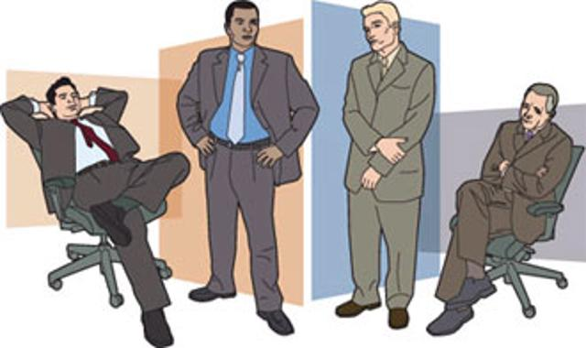
Important Components of Communication
Watch out for your body language
Your stance
How you sit
Facial expressions
Eye contact
Nodding
Gesturing and fidgeting
Notes:
Explain and discuss with participants, using the experience of the participants
Nonverbal communication
Nonverbal Signals: People can communicate information in numerous ways, so pay attention to things like eye contact, gestures, posture, body movements, and tone of voice.
Incongruent or unrelated Behaviors: words that do not match their nonverbal behaviors, e.g. someone might tell you they are happy while frowning and staring at the ground.
Tone of Voice: can convey a wealth of information, ranging from enthusiasm to disinterest to anger.
Eye Contact: hiding something?
Ask Questions: If you are confused about another person's nonverbal signals, don't be afraid to ask questions. A good idea is to repeat back your interpretation of what has been said and ask for clarification
Use Signals to Add Meaning: You can improve your spoken communication by using body language that reinforces and supports what you are saying
Look at Signals as a Whole: take a more holistic approach to what a person is communicating
Consider the Context: consider the situation and the context in which the communication occurs.
Be Aware That Signals Can be Misread: a firm handshake indicates a strong personality while a weak handshake is taken as a lack of fortitude

Slide 5
Key Component
Message
What do you want to say?
Reflects the purpose of the communication
Informing
Influencing
Motivating
Notes:
First, the message. This answers the question “what do you want to say?” It will reflect the purpose of the communication. Do you want people to gain knowledge, change behavior or take a specific action? For example, do you want the public to know that there is no evidence that swine flu is transmitted through cooked pork? Do you want to influence public officials to close schools? Do you want to motivate the general public to stay home if they feel ill? Or perhaps you have more than one purpose. Knowing the purpose of the communication will help you to formulate an appropriate message

Slide 6
Key Component
With whom do you want to communicate?
Internal staff/supervisor
Local public health officials
Clinicians/health practitioners
Ministry of Health
General public
Legislators
Health researchers
Media
Audience
Notes:
Ask the participants how can be audience, collect the information and discuss

Slide 7
Key Component
How will you communicate?
Oral presentation
Meeting
Public forum
Scientific conference
Written document
Memorandum
Reports
Scientific journal articles
Flyer/brochure
Media (newspaper/television/radio)
Press conference
Press release
Method
Notes:
Explain and discuss with participants

Slide 8
Key Component
When will you communicate?
Before
During
After
Timing
Notes:
Explain and discuss with participants

Slide 9
Key Component
What effect did the message have?
Did the message reach the people you wanted it to reach?
Was the message understood?
Did behavior change?
Did recipients take action as directed?
Did health improve?
Impact
Notes:
Explain and discuss with participants

Slide 10
Standard Operating Procedures (SOP)
Notes:
Here starts a new subtopic for this module

Slide 11
Body Language in a Media Interview

Slide 12
SOPs in Communication
An SOP describes activities necessary to complete tasks systematically in accordance with your organizations, regulation, laws of land or just your own standards for doing business.
Risk and crisis communication can employee various SOPs including:
https://www.eac.int/documents/category/risk-and-crisis-communication-sops
SOP on message development
SOP on developing press release
SOP on rumour management
SOP on stakeholders engagement
SOP on social mobilization
SOP on using social media
Notes:
Explain the importance of SOPs
Here, a session can be introduced, to recapitulate the key issues of the session:
One of the options could be to ask the participants about key issues they have learned and what are the implications in practice
This session can take up to 30 minutes

Slide 13
Case Study
An outbreak of Cholera in the city is reported from the main National hospital. The City authorities call on the central government to provide support.
Media reports show inadequacies in the response and this raises concerns from the public through social media platforms.
Exercise: Design a communication strategy to avert the crisis and a simple plan of how you can implement your strategy.

Slide 14
Practice Exercise on Crisis Communication
Issues
Evidence
What to do
Notes:
Use a case scenario, and follow in groups the IEW concept

Slide 15
Press Release Critic Exercise
A new vaccine on COVID 19 has been manufactured in the United Kingdom. The UKAID office announces it will donate 100,000 doses to the Ministry of Health in your country.
Draft a press release on this breakthrough

Slide 16
A Good Press Release

Slide 17
References
1. Gregg, M.B. (Ed.). 2002. Field Epidemiology (2nd ed.). New York: Oxford University Press.
2. World Health Organization. Risk Communication: Frequently Asked Questions. 2017. http://www.who.int/risk-communication/faq/en/
Notes:
More references

Slide 18
Review of The Pandemic Preparedness with One Health approach (PPOH) short course is by the East African Community (EAC) Secretariat in cooperation with universities of the six EAC Partner States. It is facilitated by the German Government and implemented by the Deutsche Gesellschaft für Internationale Zusammenarbeit GIZ GmbH through the Global Programme Pandemic Prevention and Response, One Health (GP PPOH)

