Slide 1
POH 108: RISK AND CRISIS COMMUNICATION IN PANDEMICS C: Effective Crisis Communication

Slide 2
Objectives
By the end of this topic,
participants shall be able to;
Describe effective crisis communication.
Know the process of developing key messages
Evaluate effective crisis communication
Understand the strategies of dealing with the media when managing a crisis

Slide 3
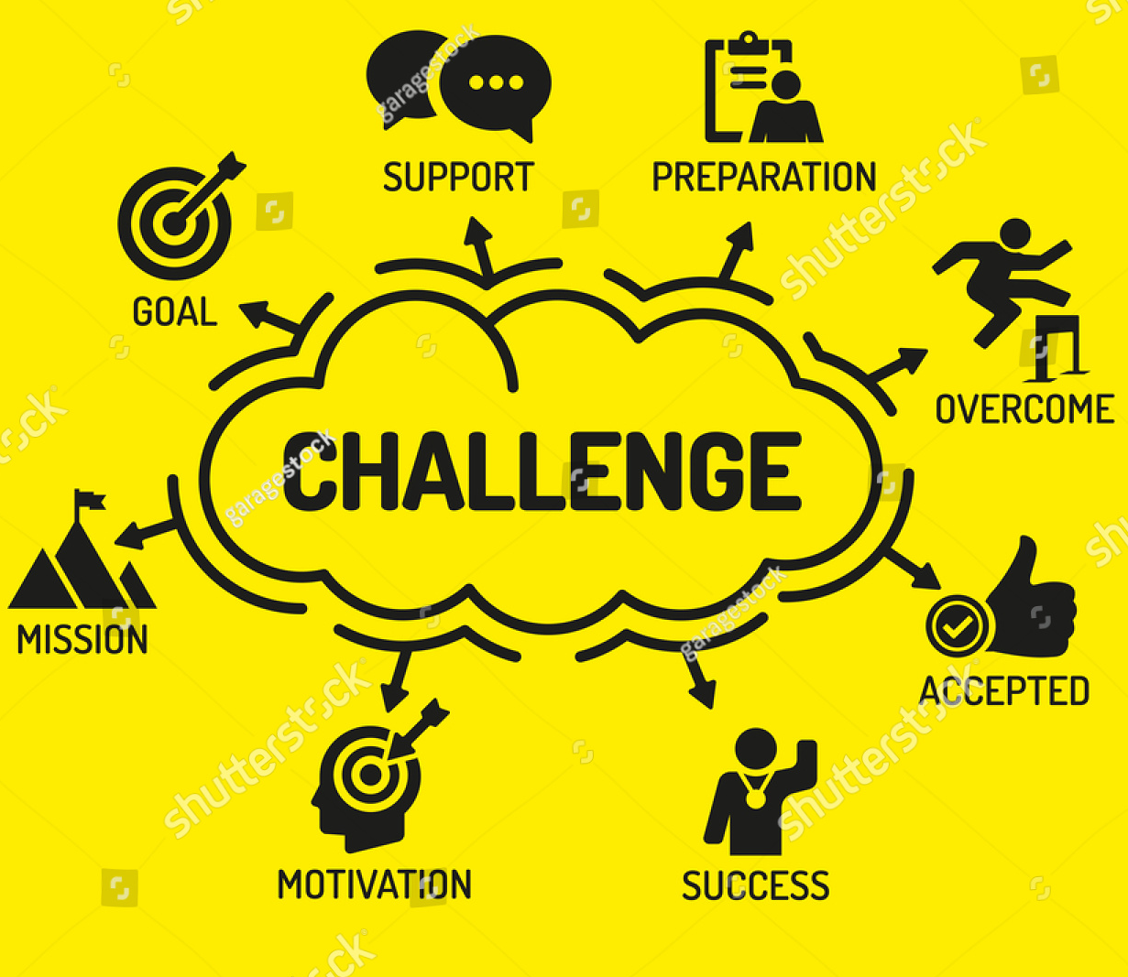
Effective Crisis Communication
Crisis communication can be challenging.
It requires preparation, honesty and responsiveness to be able to provide constant updates to your audience via multiple channels, effectively.
When you overcome the crisis, it is important evaluate your crisis-time performance, and follow up with your audience.
Notes:
Explain and discuss with participants

Slide 4
Effective Crisis Communication Requirements
Prepare a crisis communication plan.
Put the customer first.
Communicate with the public quickly and accurately.
Take advantage of all communication channels.
Use social media as a crisis communication tool.
Conduct post-crisis evaluation and follow-up communication.

Slide 5
Crisis Communication Plan
The plan should outline
the goals,
crisis management team,
key audiences,
steps to take when crisis emerges,
how to communicate (social media and your published content or official statements)
how to prevent the issues from happening or (in the case of natural crises) at least from hurting your company again.

Slide 6
Put the Customer First.
Crisis usually brings up strong negative emotions.
If your organization makes mistakes, the public may write or make negative comments on social media.
When this happens, don't play the blame game instead offer alternative, supportive and collaborative rather than defensive communication climate using all available tools including social media.

Slide 7
Communicate with the Public Quickly and Accurately
Speed is key, but you can't sacrifice accuracy.
Beware of fake news on social media.
Inaccurate information causes more harm and creates panic in a crisis.
Ensure all information and supporting materials are accurate.
Constantly provide updates to reduce uncertainty, anxiety and rumors.
Designate a spokesperson for you’re the organization.
All of the information you send out via different channels must be honest, open, transparent and consistent

Slide 8
Take Advantage of All Communication Channels.
Communicate with your audience via multiple channels, such as
Email or text messages,
customer service or toll free phone number,
voicemail,
website and social media.
Provide updates not only online, but also via traditional channels.

Slide 9
Use Social Media as a Crisis Communication Tool.
Social media is widely used as a crisis communication tool.
Twitter,
LinkedIn,
Facebook,
Instagram,
Pinterest,
Snapchat and
YouTube,

Slide 10
Conduct Post-crisis Evaluation and Follow-up Communication.
The intensity of a crisis diminishes over time and when it is over evaluate how you handled it.
Questions you could ask yourself and your team:
What strengths did we show during this time?
What weaknesses were exposed?
How are we doing now?
What could we do differently next time we're in crisis?
Evaluating your performance and responses from during the crisis enables you to learn from experience and better prepare for the future.

Slide 11
How will you know if your communication about risk has been successful?
Success means reaching a shared understanding of risk with the relevant target audience.
This can be assessed in terms of how close you have come to fully meeting your objectives about the purpose of the communication.
Absence of outrage is usually the desirable outcome, and, as usual, this attracts little attention or gratitude!
Notes:
Explain and discuss with participants

Slide 12
Effective Crisis Communication
Notes:
Participants are asked to discuss how to design a good message, using stakeholder analysis
Stakeholders that lie in the Manage Closely quadrant can easily make your efforts fail if you don’t manage them properly as they have a lot of power and influence.
Stakeholders in the monitor quadrant will require close monitoring as they have less power and influence.
Stakeholders in the keep informed should be availed with up to date information as they can easily influence your audience
Stakeholders in the keep satisfied quadrant wield a lot of power and should be kept satisfied

Slide 13
Stakeholder Analysis When Evaluating Effective Communication
During the Stakeholder Analysis when managing a crisis you need to:
Document the interests and motivations of stakeholders
Identify the stakeholders that will enable you to succeed avert a crisis
Identify conflicting interests and relationships between stakeholders
Determine the level of participation and the level of involvement required from each stakeholder
Identify stakeholders whose influence evolves during the crisis management
Determine communication media and style best suited for each stakeholder

Slide 14
Effectively communicating will also require;
Message development: define the facts that will lead you to the desired goal, provide supporting information, identify the uultimate and lasting impression your audience will have after hearing or seeing the Message.
Audience segmentation: Identify your primary target audience, identify the influencers of your audience, paint a portrait of your primary audience to enable understand the desires, wants, and hopes of the intended audience.
Socio-cultural sensitivity: is critical in crisis communication and should always be considered when designing messages as they can be shunned.
Channel selection: depends on reach, access, cost, versatility and shelf life
Spokesperson: should be credible, informed, understands the media, stress handler, accessible, a quick thinker.

Slide 15
Worst Phrases during a Crisis Interview

Slide 16
Effective Crisis Communication II
Develop key messages :
WHO says 1) what to 2) whom 3) through which channels 4) with what effects?
Also see 7Cs of communication below
WHO: The “spokesperson”
Key position
Media experience
Responsible, calm and confident
Ability to speak clearly and convincingly
Notes:
Participants are asked to discuss how to design a good message, using stakeholder analysis
Setting such goals and identifying support messages are decisions that should be made prior to the issuing of any public comment and are especially important in a crisis.
A written, verbal, or visual statement containing information about risk; may or may not include advice about risk reduction behavior; a formal risk message is a structured written, audio, or visual packaged developed with the express purpose of presenting information about risk.
Once goals and messages have been established, the challenge becomes one of delivery and ensuring that messages are heard and goals are met.
Raise your points often enough that your audience leaves with a clear understanding of the message you wanted them to hear.

Slide 17
7 Cs of Effective Communication
Command attention.
Cater to the heart and head
Clarify the message
Communicate a benefit.
Create trust.
Convey a Consistent message.
Call for action

Slide 18
Tools For Conveying Key Messages
Print and electronic
Broadcast
Website Newsprint
Social media
Notes:
Ask the participants which tools/methods are available to convey messages, discuss pro’s and con’s
Print media
Is more credible
Has longer shelf life and can be a reference point
Social media:
empowers everybody to share information
Very fast
Can alert you of an imminent crisis
Is quite versatile to various formats
But not everyone who uses it has good intentions and sometimes not factual. May have a short shelf life
Broadcast media
TV remains the most influential media channel
Its reach is high depending on access
Creates more effective messaging
Good tool for crisis management
Websites
Gives freedom for whatever you want to communicate
Control on duration of how long your content can last
Provides for feed back
Provides for links to other information sites
Versatile on formats

Slide 19
Basic Tips For Effective Media Relations
Press desk
Single press person
Update website
Prepare the team, spokesperson
Practice the story
Always get back to the media
Notes:
Explain and discuss with participants
As a matter of ethics, journalists will not allow “news” to be defined for them.
Journalists strive to answer six key questions in their stories: who, when, where, what, how, and why.
What you say may not be what is determined to be news. How you say it may lead to confused and confusing reports and misinterpretations. Whatever you say is likely to be balanced against opinions that are different than yours.
Tips
Be sure of your facts. Have information available in fact sheets specifically prepared for the media’s use.
Be able to cite sources and key statistics
Familiarize yourself with information and opinions that are contrary to your points and positions and be able to answer the questions they raise.
Effective communication comes not in fighting these limitations, but in adapting to them.

Slide 20
Basic Tips for Speaking to the Media
Know the subject
Communicate clearly, concisely
Look the part
Prepare
Dress for the part
Avoid jargon
Don’t speculate
Be composed
Maintain eye contact
Sit upright and still
Stay on your message
Notes:
The APP: anticipate challenges, prepare yourself, practice

Slide 21
Preparing for an Interview in times of Crisis

Slide 22
Develop Key Messages
What: the message
What ‘we’ (authorities) know about the situation
What ‘we’ (e.g. health authorities) are doing about the situation
What ‘you’ (the community) can do about the situation
What: message development
Bring it down to the basics: simplify
Provide recommended actions
Be positive: provide more ‘do’ than ‘don’t’
Don’t lie
Be sympathetic
Notes:
Explain and discuss with participants
Situational analysis and facts on the subject matter is critical.
Be clear on the message you wish to disseminate to enable you achieve your goal
Your message should be in plain language easy to read and understand, no jargon
Messages should be conveyed in a positive format rather than negative e.g.
The messages should be close to people’s hearts to stimulate acceptability
The messages should call for action. Remember the 7Cs

Slide 23
Develop Key Messages
To whom: the ‘audience’
Why do people react to risks - real or perceived - the way they do?
How do we deal with the emotional component of how people respond?
How do we help people to interpret the risk and respond to risk in constructive ways?
How: communication channels
How should the message be communicated ?
Messages should be “STARC”:
Simple
Timely
Accurate
Repeated
Consistent
Notes:
Explain and discuss with participants
Knowing your audience is important for message penetration and acceptability.
You cannot use an example of a pig when communicating to the Islamic community
Using an Old man to appeal to young girls to promote sexual reproductive services

Slide 24
Barriers in Risk Communication
Timing
Place
Disrespect
Traditions
Knowledge barrier
Lack of clarity
Socio-cultural issues
Notes:
Explain and discuss with participants, using the experience of the participants
Be ware of barriers to communication, and if not taken care of your messaging may fail
Use of jargon
Emotional barriers and taboos. ...
Lack of attention, interest, distractions, or irrelevance to the receiver. ...
Differences in perception and viewpoint.
Physical disabilities such as hearing problems or speech difficulties.
Dress code
Language

Slide 25
Give attention to;
Gender
Values
Norms
Practices
Traditions practices diversity
Language diversity
Religion diversity
Beliefs diversity
Notes:
Explain and discuss with participants, using the experience of the participants

Slide 26
Review of The Pandemic Preparedness with One Health approach (PPOH) short course is by the East African Community (EAC) Secretariat in cooperation with universities of the six EAC Partner States. It is facilitated by the German Government and implemented by the Deutsche Gesellschaft für Internationale Zusammenarbeit GIZ GmbH through the Global Programme Pandemic Prevention and Response, One Health (GP PPOH)

