Slide 1
POH 110:
Gender and Ethics in Pandemics

Slide 2
Purpose
This course enables participants to integrate the dynamics of gender in outbreaks, epidemics, pandemic preparedness and response

Slide 3
Objectives
The objectives of this course are to learn:
Various concepts of gender and sex
Gender and disease outbreak and pandemic preparedness
Gender issues in pandemic response
Ethical considerations in pandemic preparedness

Slide 4
Expected Learning Outcomes
By the end of this course participants should be able to
  Explain gender, sex, power relations and gender inequities in society and how they influence pandemics
  Discuss concepts of inequality and inequity with regard to preparedness and response for disease outbreaks
  Justify the case for mainstreaming gender and ethics in pandemics preparedness and response
  Assess the contribution of ethical considerations in pandemics response

Slide 5
Definitions and Concepts
Sex refers to the biological and physiological factors that define males and females.
Gender refers to the socially constructed roles, behaviors, activities, and attributes that a given society considers appropriate for males and females. Gender differences include both socio-cultural factors as well as male-female differences in access and control over resources
Gender differences include both socio-cultural factors as well as male-female differences in access and control over resources.
Gender Stereotypes: existent societal connotations
Notes:
Give examples of socially constructed roles

Slide 6
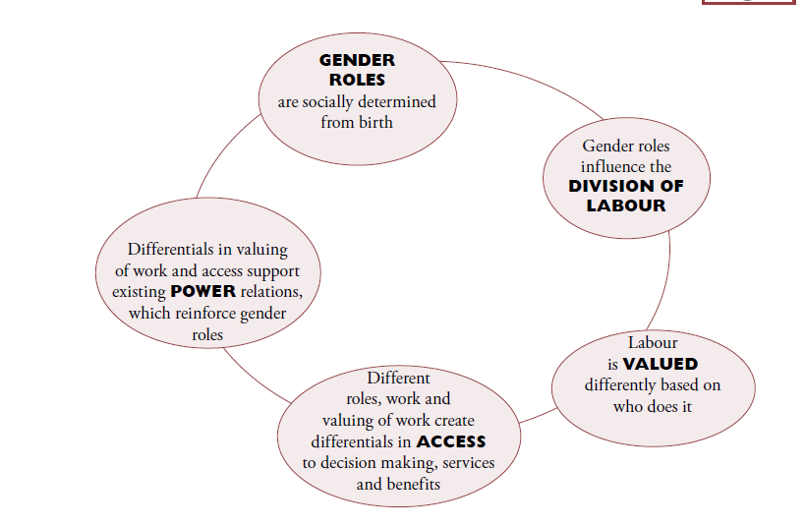
Key Components of Gender Analysis
Notes:
To make everyone understand the meaning of gender as power analysis

Slide 7
GENDER ROLES
Productive work: This is work that produces goods and services for exchange in the market place (for income). Different genders contribute to family income with various forms of productive work, although men predominate in productive work, especially at the higher echelons of remuneration.
Reproductive Work/Unpaid work: This work involves all the tasks associated with supporting and servicing the current and future workforce – those who undertake or will undertake productive work. It includes child-bearing and nurture, but is not limited to these tasks. Socially reproductive activities include childcare, food preparation, care for the sick, and socialization of the young, attention to ritual and cultural activities through which the society’s work ethic is transmitted, and the community sharing and support which is essential to the survival of economic stress.
Community managing role: Activities undertaken primarily by women at the community level, as an extension of their reproductive role, to ensure the provision and maintenance of scarce resources of collective consumption, such as water, health care and education. This is unpaid work, undertaken in "free" time.
Community politics role: Activities undertaken primarily by men at the community level, organizing at the formal political level, often within the framework of national politics. This is usually paid work, either directly or indirectly, through status and power.
Notes:
The fact that reproductive work is the essential basis of productive work is the principal argument for the economic importance of reproductive work, even though most of it is unpaid, and therefore unrecorded in national accounts. Women and girls are mainly responsible for this work which is usually unpaid.

Slide 8
Societal Responsibilities
Role of family, other social institutions and women
Women play as significant a role on socializing children
Society generally values women less than men
It is difficult to put pressure on the family to change traditions and cultural values
Gender based inequality is often written in laws and policies
Men are also constrained by construction of masculinity
Fighting gender inequality is about challenging an ideology
Notes:
Facilitator to provide relevant examples to the issues

Slide 9
Gender and Disease Outbreaks
Women considered “caring therefore tend to care for the sick - most likely to become infected
Women spend a great deal of their time in the caring activities which involve feeding, cleaning, washing, preparing food.
As a consequence, often women and young girls are less likely to be involved in political, educational, and professional activities
Notes:
The facilitator to describe gender roles using examples in health and outbreaks. Talk about the patients and who is most affected, care giver, who is in leadership and makes the decisions

Slide 10
Effects of Gender on Outbreaks
Gender influences the risk of acquiring infections during health care encounters (the role of caregiver mostly exposes women to an increased risks)
Gender roles and access to resources affect exposure to animals and the risk of acquiring diseases from animals
Implications of sex and gender for surveillance (Access to health information and services around the world is always hampered more for women and girls than for men and boys.)
Notes:
Facilitator to ask the class to provide related examples from their social contexts

Slide 11
Gender Issues in Pandemic Response
There is need to consider gender equity issues in the development and implementation of pandemic response plans, given the demonstrated differences in the impacts both of the disease and of control measures on men, women, and non-binary individuals
Most interventions are gender blind but should go a step further in making pandemic preparedness gender transformative.
For example;
  -Integration of gender policies i.e. UN Gender Frameworks and Declarations
  -Include gender awareness and analysis for sensitive issues such as GBV and LBGTQIA
  -Conduct gender inclusive trainings for health workers and first responders
Notes:
The facilitator to share gender policies, create exercises on gender analysis by using a problem tree

Slide 12

Gender Analysis in Infectious Diseases
Why do Gender
Analysis?
Who does what?
Who has what?
Who decides?
How?
Who gains?
Who loses?
It is important to identify the Gender-related practices which increase the probability of men or women getting an infectious disease.
Harmful practices can then be discouraged while helpful ones adopted.

Slide 13
WHO Framework for Sex and Gender and Emerging Infectious Diseases
Skufca, J. and Arima, Y., Western Pacific Surveillance and Response Journal. Source: http://www.wpro.who.int/topics/gender_issues/Takingsexandgenderintoaccount.pdf
Notes:
The WHO framework described is an aid that identifies the effect of Sex and Gender has on the vulnerability of males and females in the society to disease. Gender and Sex will also influence the exposure of the society to pathogens. Lastly the way the individual responds to the resulting illness too is dependent on Sex and Gender.
Therefore as the Response Team plans strategies of interventions or emerging disease policies and programmes, the different needs of men, women, girls, and boys are considered. This is because gender often plays an important role in the capacity and willingness of individuals, households, and communities to protect themselves from infection and obtain treatment when they become ill.
In the figure the tree major components of gender (norms, roles and responsibilities, decision-making and access to resources) are highlighted
Similarly the three major components of sex (anatomy, the immune system, and pregnancy) are given.
The three key elements of the disease transmission model (vulnerability, exposure to pathogens, and response to illness) are shown in the middle circle, which in turn determine determine incidence, duration, and severity of a disease situation.

Slide 14
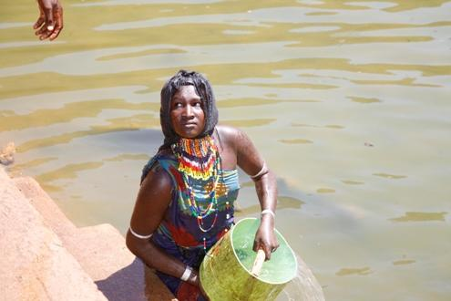
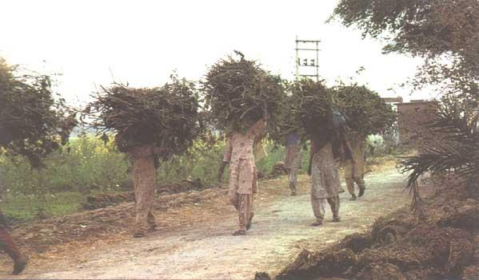
How Gender Differences
Influence Emerging Infectious Diseases
Vulnerability
Exposure
Response to infection
Public health interventions
gender differences vary from country to country
Gender differences also vary within countries according to a host of socio-economic variables

Slide 15
Scenario: Planning Exercise for Participants
Due to the existence of an outbreak of Ebola and Anthrax within the region, describe an appropriate gender related response strategy and responsibilities of the various members of society in your area.
Notes:
Facilitator to front the participants to attempt in a comprehensive manner

Slide 16
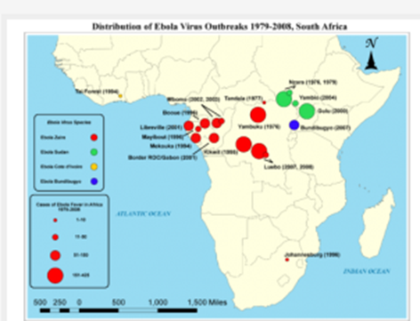
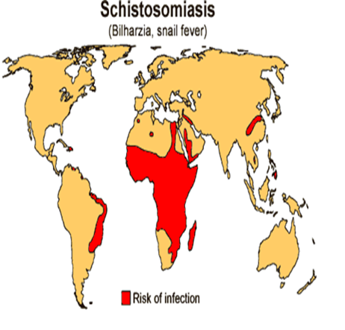
Vulnerability To Infectious Diseases
First contact
  Ebola, TB, anthrax
Gender related norms
  Value of males against females
  Vaccination rates
  Risk factors: pastoralist communities and cholera outbreak
Gender roles and responsibilities
  Schistosomiasis
  Guinea worm

Slide 17
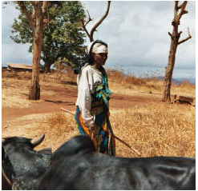
Exposure to Pathogens
Occupational exposure
  Hunters, gatherers, preparing meals
  Outdoor activities and rabies in Ethiopia
  Raw milk and TB among the Somali community
  Caring for sick/dead family members
Child care and care takers
Exposure in health care setting
Exposure to livestock
  Slaughter and marketing

Slide 18
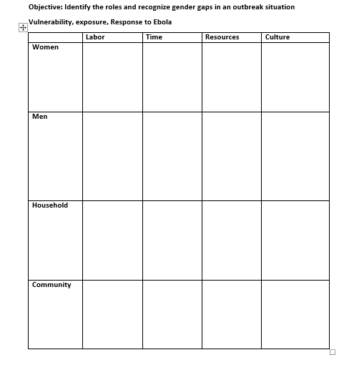

Slide 19
Gender and Ethics
What is ethics?
Systematic rules or principles governing right conduct.
Each practitioner, upon entering a profession, is invested with the responsibility to adhere to the standards of ethical practice and
conduct set by the profession.
Principles of ethics
- Understand Gender equality, gender equity, allocation and resource distribution, morality , vulnerability to disease etc.
Gender bias, discrimination in relation to One Health

Slide 20
Practical and Strategic Needs
Practical gender needs: Women and men can easily identify these needs as they often relate to living conditions. Women may identify safe water, food, health care, cash income, as immediate interests/needs that they must meet. Meeting women’s practical gender needs is essential in order to improve living conditions, but in itself it will not change the prevailing disadvantaged (subordinate) position of women. It may in fact reinforce the gender division of labor.
Strategic gender interests/needs: Strategic gender interests/needs are those that women themselves identify as due to their subordinate position to men in their society. They relate to issues of power and control, and to exploitation under the sexual division of labor.

Slide 21
Gender Analysis Concepts
Practical Needs & and Strategic Gender Interests
Condition and Position: In addition to the specific conditions which women share with men, differential access means women’s position in relation to men must also be assessed when interventions are planned and implemented.
Transforming Gender Relations
Transformatory Potential
Empowerment: Women’s empowerment means developing their ability to collectively and individually take control over their own lives, identify their needs, set their own agendas and demand support from their communities and the state to see that their interests are responded to.
Notes:
Women’s empowerment means developing their ability to collectively and individually take control over their own lives, identify their needs, set their own agendas and demand support from their communities and the state to see that their interests are responded to. In most cases the empowerment of women requires transformation of the division of labour and of society​

Slide 22
Exercise for Participants
In your community, what do you see as the most serious issue facing women? How are the issues facing women different from those facing men?
How do the issues change over a women’s life cycle (e.g. infant, childhood, adolescence, child bearing, nursing, old age)?
What is the impact of these challenges on women’s health?
How do women’s health issues impact men?
Do you know of any ethnic group in Uganda faced with an anthrax outbreak think back in the opening simulation:
Would it be surprising if more women than men got TB? Why?
How do men and women interact differently with domestic animals? With wildlife?
What is the impact of deforestation on women?

Slide 23
Activity 1 – Triple Role
In your selected setting, complete the handouts identifying the productive, reproductive, community and political role carried out by men and women and discuss the vulnerability, exposure and response to disease outbreak as it affects men and women, the household and entire communities

Slide 24
Activity 2 – Vulnerability to Risk Mapping
Read the document about risks related to Ebola
Map out the risks faced by different community members (women, men, children, medical personnel)
Identify/ map out signs of those risks in the community
Add resources that can be used to mitigate those risks to the maps in different colors
Identify practical needs and strategic needs

Slide 25
Gender Communication Profile
Provides information on how women and men access and share information
It can be community driven – having community members do it themselves
Think specifically in terms of an outbreak like Ebola
Who is providing information and how are they providing it- Key players
Add any communication methods that you think are missing

Slide 26
Conclusion
  Confirm the participants understanding of:
  Gender relations, inequities in society and how they influence pandemics
  Concepts of inequality and inequity with regard to preparedness and response for disease outbreaks
  Case for mainstreaming gender in pandemics preparedness and response
  The contribution of ethical considerations in pandemics response

Slide 27
References
www.un.org( UN gender framework)
Caroline Moser, "Gender planning in the third world: Meeting practical and strategic gender needs". World Development. 17 (11): 1799–1825. 1989-11-01. doi:10.1016/0305-750X(89)90201-5. ISSN 0305-750X.
www.asset-scienceinsociety.eu
https://www.who.int/gender-equity-rights/knowledge/9789241500111/en
Porter, Fenella; Sweetman, Caroline (2005). Mainstreaming Gender in Development: A Critical Review. Oxfam. ISBN 9780855985516.

Slide 28


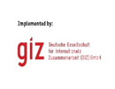
Review of The Pandemic Preparedness with One Health approach (PPOH) short course is by the East African Community (EAC) Secretariat in cooperation with universities of the six EAC Partner States. It is facilitated by the German Government and implemented by the Deutsche Gesellschaft für Internationale Zusammenarbeit GIZ GmbH through the Global Programme Pandemic Prevention and Response, One Health (GP PPOH)

