Slide 1
PPOH 113:
Biotechnology, Biosafety and Biosecurity and Pandemics

Slide 2
Purpose
This topic will enhance the learning of prevention of pandemic threats, protection, and control and provide a global public health response to international spread of diseases.

Slide 3
Objectives
Define Biosafety, Biosecurity , Biotechnology , Bioeconomy and other relevant key terms
Explain dual use research of concern (DURC), providing examples of misuse of pathogens and the components of a bio risk management plan
Describe major global health security or bioterrorism threats and characterize the human, social, economic and political risks they pose to societies
Explain the requirements for packaging, labelling and shipping of different categories of infectious biological samples
Discuss the technologies used in synthetic biology

Slide 4
Expected Learning Outcomes
At the end of this topic, the learner should be able to:
Identify and classify the biological risks and be able to comprehend the scale and impact of accidental release and intentional misuse of biological agents.
Explain the importance of responsible research as well as the necessity of biosafety, and biosecurity measures.
Identify infectious biological samples based on packaging and labelling
Discuss a range of health security threats posed by life science research
Explain the technologies used in synthetic biology

Slide 5
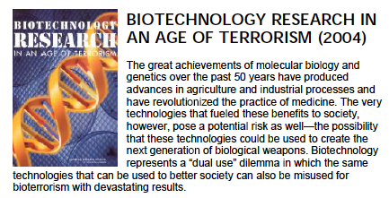
Definitions
Biotechnology
Using scientific methods with organism to produce new products or new forms of organism
Manipulation of genes is called genetic engineering or recombinant DNA technology
Genetic Engineering involves taking one or more genes from in one and either:
-Transferring them to another organism
-Putting them back into the original organism in different combination

Slide 6
Overlap of Biosafety and Biosecurity

Slide 7
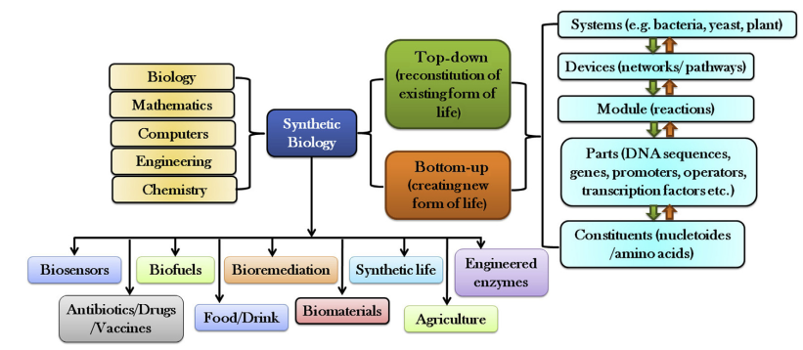
Overview on Synthetic Biology
Synthetic Biology: Solves problems by applying engineering principals to biology
Researchers in this emerging field redesign existing organisms and make new ones
Synthetic biology may provide solutions to problems in areas such as food security, health care, energy and the environment

Slide 8
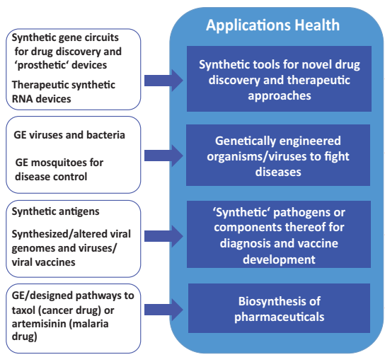
Synthetic Genomic Applications
Synthetic Genomics Applications in Biomedicine and Health

Slide 9
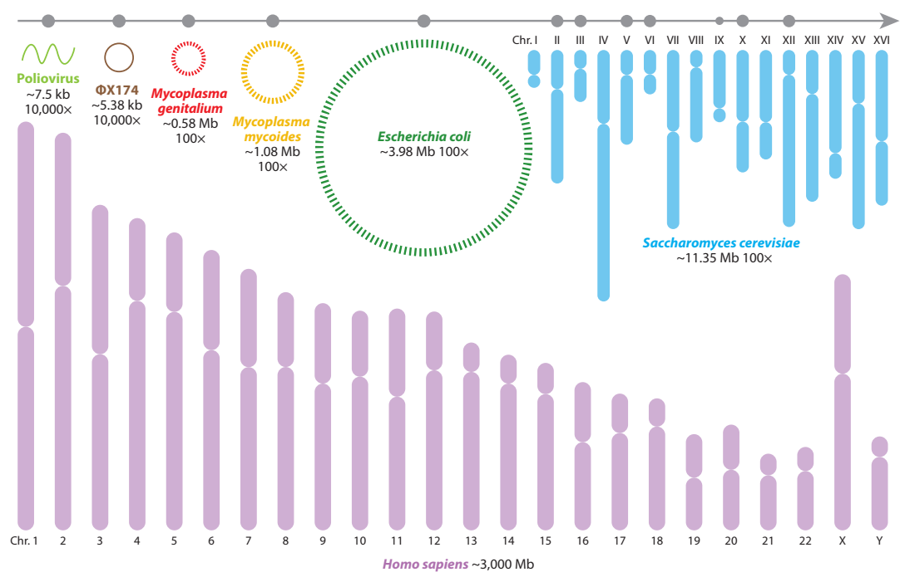
Synthetic Genomes Existing Currently

Slide 10
Synthetic Biology and its Application/Bioeconomy

Slide 11
"Bioeconomy" refers to activities that make use of bio innovations, based on biological sources, materials and processes to generate sustainable economic, social and environmental development.
Allows Countries to respond more directly to global challenges such as the disease burden, food security, competitive industry, climate change and energy requirements.
Provide an engine for future growth
Science-based "biosolutions" can be used to, e.g.
  manufacture high-value protein products - biopharmaceuticals / vaccines;
  produce biofuels;
  improve and adapt crops;
  remedy industrial and municipal waste

Slide 12
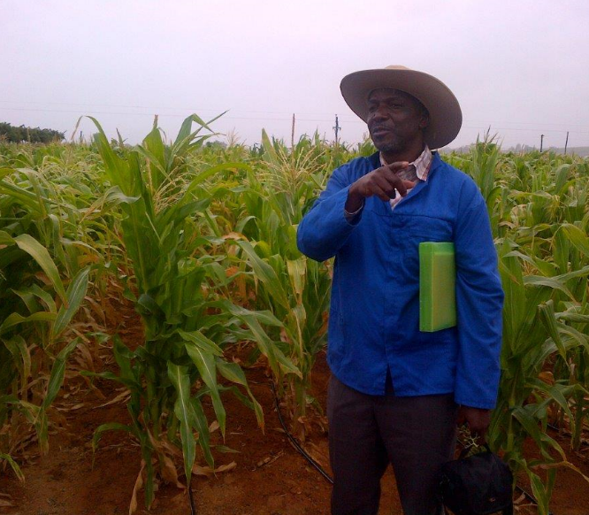

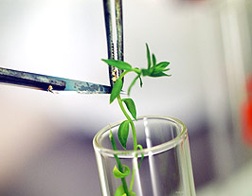
Agricultural Sector
Network of agro-innovation hubs
Strategic projects
  Crop/livestock improvement both for biotic and physical stresses associated with climate change (including indigenous crops)
  Agro processing initiatives
  An integrated food nutrition research programme
  Animal vaccine capabilities
  Energy-crop initiatives
  Biocontrol and bio fertilisers
  Aquaculture
  Soil conservation
  Water resource management

Slide 13
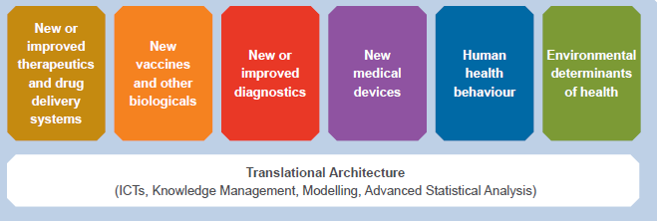
Health
Develop improved drugs to address priority diseases (incl. African Traditional Medicine);
Develop new and improved vaccines and biologics;
Develop improved diagnostics;
Develop improved medical devices;
Strengthen clinical research and development capabilities;
Establish pharmaceutical manufacturing.

Slide 14
Industrial and Environmental Sector
Industrial Applications
Sustainable Environmental Management
Biobased chemicals
Bio-materials
Bioenergy
Water
Waste
Bulk and speciality chemicals
Biocatalysts
Biocontrol products
Additives
Biocomposites
Biopolymers
Biodiesel
Bioethanol
Biobutanol
Biogas
Bioremediation of domestic and industrial wastewater
Bioleaching
Biometallurgy
Biosorption
Enabling technologies
Synthetic and structural biology
Functional genomics

Slide 15
Global Health Security Policy
Discussions about some of the disease outbreaks that have afflicted the region and globally. These will include but not limited to Ebola, Marburg, SARS-COV-2, SARS, AVIAN INLUENZA, Rift valley fever etc.
Lessons learned from Ebola and other infectious disease threats
What are some of the unique challenges facing rural hospitals
Best line of defense – testing and evaluating capacity and capabilities for infectious disease prevention
We will discuss some of the policies that have been put in place to present, detect and respond to these outbreaks for example the GHSA, WOAH-PVS, JEEs. How can they be implemented and how effective these have been?
Issues of dual use research of concern will be discussed

Slide 16
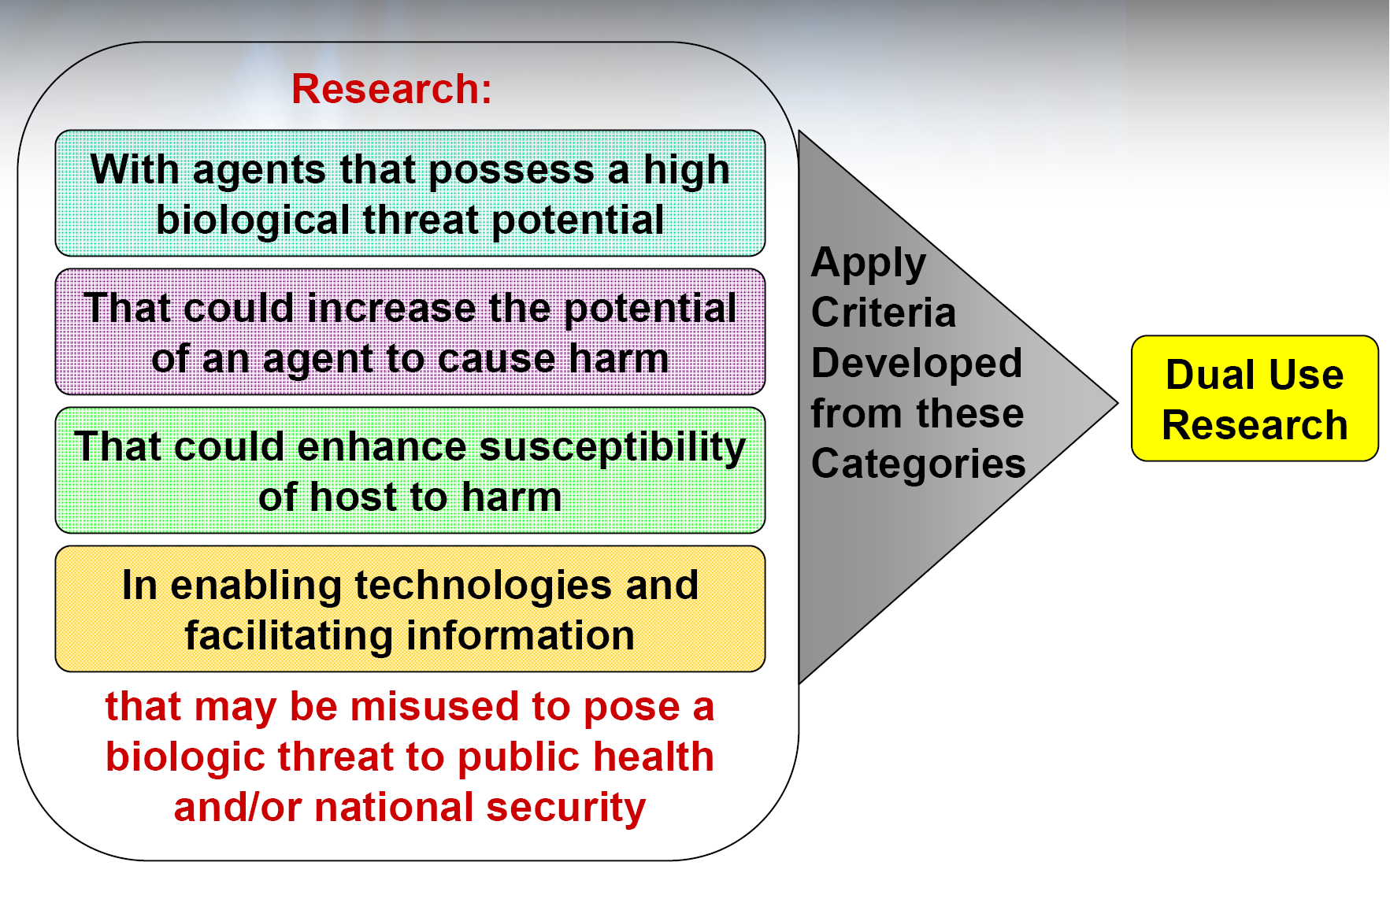
Dual Use and Biosecurity Biosafety and Biotechnology
Emerging concept of dual-use research
Seven categories of Fink
and more

Slide 17
Shipping and Labelling of Infectious Materials (International Regulations)
Transported via
AIR
ROAD
RAIL
SEA
INFECTIOUS MATERIALS
Class 6.2 is subdivided as follows
Infectious substances affecting humans
Infectious substances affecting animals only
Clinical waste
Biological substances
Category A UN 2814 and UN 2900
Category B: UN3373
Clinical waste: UN3291
GMOs: Class 9 of dangerous goods assigned UN3245

Slide 18
Definition
Bio-risk Management
Biorisk is a combination of the probability of occurrence of harm (Hazard) and the severity of that harm (CWA 15793)
Biorisk assessment is the process of evaluating the risks arising from biohazards, considering the adequacy of any existing controls and deciding whether the risks is acceptable (CWA 15793).
Risk Mitigation denotes any activities pursued for the purpose of reducing or eliminating perceived risks
Notes:
Risk Assessment Narrative: Before the pandemic, catholics would shake hands and during the pandemic it was called a risk why?

Slide 19
Why a Risk Assessment?
Changes in lab operations
An incident, accident, laboratory-associated infection,
Any event where a potential for harm is identified,
Non-conformities after safety audits
User feedback
Periodic review
Notes:
changes to biological agents, or new information available on current biological agents,
changes to personnel,
changes to procedures and practices,
changes to laboratory equipment,
changes in international, national or regional regulations or guidelines,
changes to biological agents, or new information available on current biological agents,
changes to personnel,
changes to procedures and practices,
changes to laboratory equipment,
changes in international, national or regional regulations or guidelines,
introduction of new technology,
laboratory relocation or renovation,

Slide 20

Biorisk Assessment Process
What can go wrong?
Agent identification
Biological characteristics of agent
Determine how hazardous the agent is
Define the risk
What harmful consequence does the hazard result into?
Likelihood vs Severity
Identify the Hazard
Characterize the risk
The information gathered here include;
Agent ability to infect and cause disease
Virulence
Availability of prophylactic and treatment measures
Route of transmission
Infective dose
Stability in the environment
Host range
Activities and laboratory environment
Critical for the 3rd Step of a risk assessment
Is the Risk Acceptable?
Consider availability of control measures
Prioritize(Use qualitative two dimensional graph)
Implement mitigation measures
Notes:
Define Hazard Identification: is part of the process used to evaluate if a particular situation, item, activity is may have the potential to cause harm.
Do safety audits and checklists, feedback from users, accidents, job analyses
Types of hazards: physical, environmental, infectious agents, psychological hazards
Risk Evaluation: Is the method of estimating the likelihood and severity of the consequence. It assess whether risks are low, medium and high
Risk Acceptability, that the consequence of the risk can be tolerated.
The acceptability of risk is a subjective value judgment. There are several factors that can influence risk acceptance. These factors include such considerations as the level of available resources to mitigate or control the risks, culture, geographic region, endemicity of the agent or disease in the region, the value of work to the community or to the researcher, the regulatory requirements overseeing the risk, and the public’s general perception, among others. The International Risk Governance Council (IRGC) recommends considering the public concerns as a separate analysis from the technical risk assessment (IRGC, 2005)
Risk Prioritization is the process of identifying which risk you should act upon first basing on the likelihood and severity of a risk

Slide 21
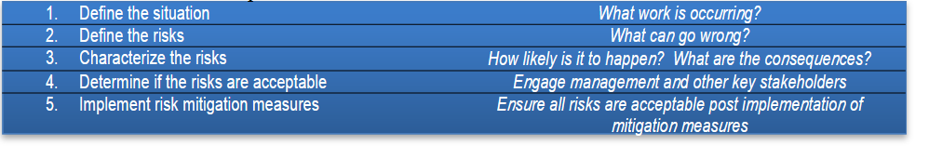
At the most basic level, understanding a particular risk, therefore, involves answering the
following questions
1. What can go wrong?
2. How likely is it?
3. What are the consequences?

Slide 22
Biorisk Mitigation Process
Choose and describe an appropriate risk control measure and mode of risk communication
RISK PRIORITY
Analyze the Risk
Carryout a Risk Assessment
Review the measures & identify the residual risks
Outline the resources required,
Assign implementors and timeline
Notes:
Adopt a PDCA Model for Biorisk Mitigation Process
Reviewing of the risks?
Has the possibility of an exposure/release become less likely to happen? n Have the consequences become less severe? n Have the likelihood and consequences been reduced such that the residual risk is acceptable? n If no, are additional risk control measures available? n Should work proceed, with or without which risk control measures? n Who has the authority to accept the residual risk and approve the work to go ahead? n How should the selected risk control measures and subsequent approval for work to proceed be documented

Slide 23
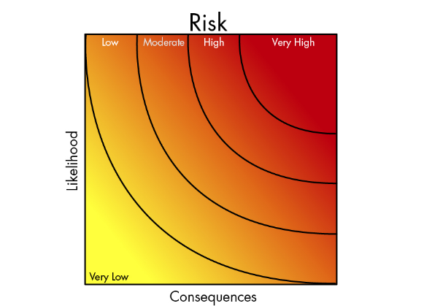

Slide 24
Choosing Risk Control Measures
VERY LOW | These risks are considered acceptable. No further action is necessary other than to ensure that the controls are maintained
LOW | No additional controls are required unless they can be implemented at very low cost (in terms of time, money, and effort). Actions to further reduce these risks are assigned low priority. Arrangements should be made to ensure that the controls are maintained.
MEDIUM | Consideration should be as to whether the risks can be lowered, where applicable, to a tolerable level and preferably to an acceptable level, but the costs of additional risk reduction measures should be taken into account.
HIGH | Substantial efforts should be made to reduce the risk. Risk reduction measures should be implemented urgently within a defined time period.
VERY HIGH | These risk are unacceptable. Substantial improvements in risk control measures are necessary so that the risk is reduced to a tolerable or acceptable level. If it is not possible to reduce the risk, the work should remain prohibited.

Slide 25
Hierarchy of Controls
Most effective (High level) Least effective (Low level) | Elimination: remove the hazard completely from the workplace or activity.
 | Substitution: replace a hazard with a less dangerous one.
 | Redesign: changing a machine or work process to make it safer.
 | Isolation: separate people from the source of the hazard.
 | Administration: putting rules, signage or training in place to make a workplace safer.
 | Personal protective equipment (PPE): protective clothing and equipment.
Notes:
Ergonomic stressors, any force required to complete a task, static walking postures adopted)
Laboratory Biosecurity, The set of measures aimed at the protection, control and accountability for valuable biological materials (VBM, see definition below) and protection of other valuable items (e.g. equipment) within laboratories, in order to prevent their loss, theft, misuse, diversion of, and/or unauthorized access or intentional unauthorized release.
Further, risk assessment is an important responsibility for individuals both within the laboratory and throughout the facility. In an individual laboratory, the best assessors of risk are usually those who work in the laboratory and who are most familiar with the agents and other valuable laboratory materials, as well as the experimental practices and processes. Thus, laboratory biosafety and biosecurity risk assessments should be a shared responsibility between principal investigators, scientists, researchers (or a risk assessment team), and biorisk management advisors.

Slide 26
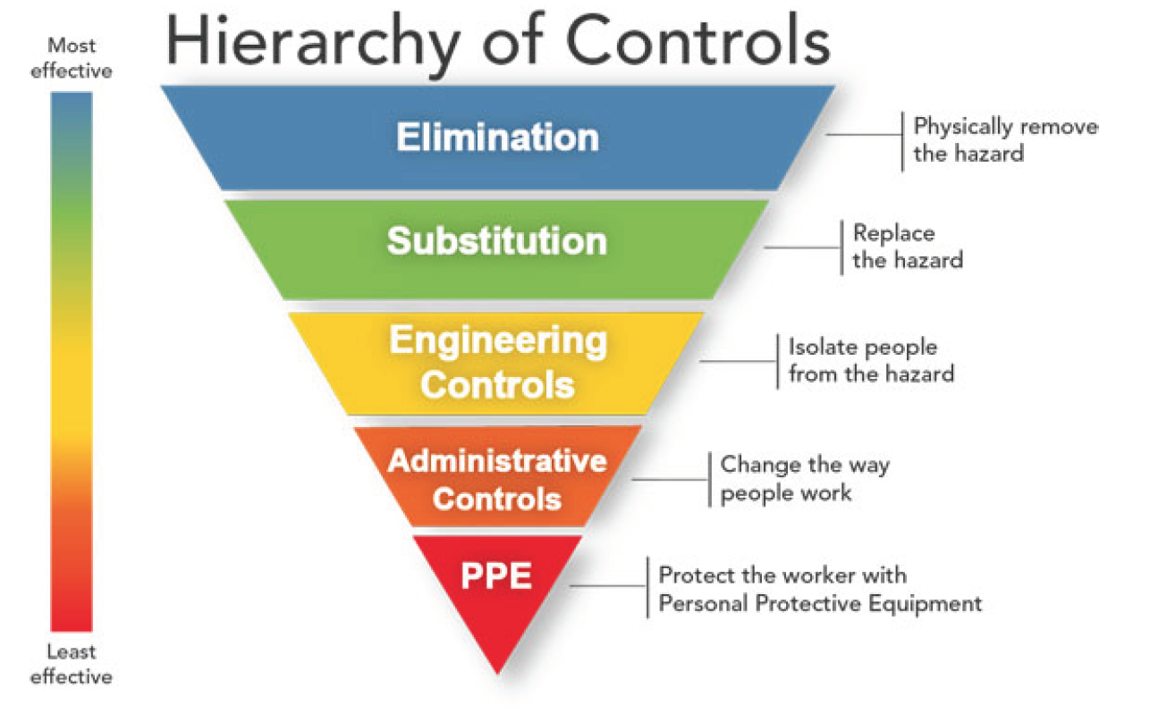
Hierarchy of Controls
26

Slide 27
Biological Weapons Policy and Security
Definitions:
Biological warfare (BW), also known as germ warfare, is the deliberate use of disease-causing biological agents such as protozoa, fungi, bacteria, protists, or viruses, to kill or incapacitate humans, animals, or plants.
Biological weapons (bioweapons) are living organisms or replicating entities (virus) that reproduce or replicate within their host victims.
Categories of organisms used in Biological warfare
Category A and Category B

Slide 28
References and Additional Information
Biosafety and Biosecurity Risk Assessment Technical Guidance Document, https://www.aam.org.ar/descarga-archivos/Laboratory-Biosafety-Biosecurity-Guidance.pdf
Enhancing Biosafety and Biosecurity in the Nation’s Public Health Laboratories,https://www.aphl.org/aboutAPHL/publications/Documents/PHPR-2016-Biosafety%20Report-Jun17.pdf
Guidelines for Biosafety Laboratory Competency, CDC and the association of Public Health Laboratories, 2011, https://www.cdc.gov/mmwr/pdf/other/su6002.pdf
International Organization for Standardization of Medical Service, https://www.iso.org/files/live/sites/isoorg/files/store/en/PUB100343.pdf
Laboratory Biosafety and Biosecurity Policy Guidelines, Ministry of Public Health and Sanitation, https://internationalbiosafety.org/wp-content/uploads/2019/08/Kenya-Biosafety-Guidelines.pdf
WHO Bio-risk management: Laboratory biosecurity guidance, September 2006 http://www.who.int/ihr/biosafety/publications/en/index.html
WHO Laboratory Biosafety Manual - Third Edition http://www.who.int/ihr/biosafety/publications/en/index.html
WHO Laboratory Biosafety Manual Fourth Edition, 2020. https://www.who.int/publications/i/item/9789240011311

Slide 29



Review of The Pandemic Preparedness with One Health approach (PPOH) short course is by the East African Community (EAC) Secretariat in cooperation with universities of the six EAC Partner States. It is facilitated by the German Government and implemented by the Deutsche Gesellschaft für Internationale Zusammenarbeit GIZ GmbH through the Global Programme Pandemic Prevention and Response, One Health (GP PPOH)

